Slide 1
Spira Concepts
Business Intelligence & Custom Reporting
@Inflectra | #InflectraCon

Slide 2
Adam Sandman
Director, Inflectra
Programmer from the age of 10
Working in the IT industry for over 20 years
Adam lives in Washington, DC, USA
@adammarksandman

Slide 3
About Me
Adam Sandman was a programmer from the age of 10 and has been working in the IT industry for the past 20 years.
Currently Adam is Director at Inflectra Corporation, where he is interested in technology, business and innovation.
Adam lives in Washington, DC, USA

Slide 4
Session Objectives
Dive into the features available in Spira for business intelligence and reporting.
We will include an overview of running the built-in graphs and reports before diving deeper into the different types of custom reporting and graphing that are available.
We will provide examples using Entity SQL and the XSLT based report templates.

Slide 5
Agenda
Standard Reports & Graphs
Custom Reports
Templates
Queries
Custom Graphs

Slide 6
Standard Reporting & BI

Slide 7
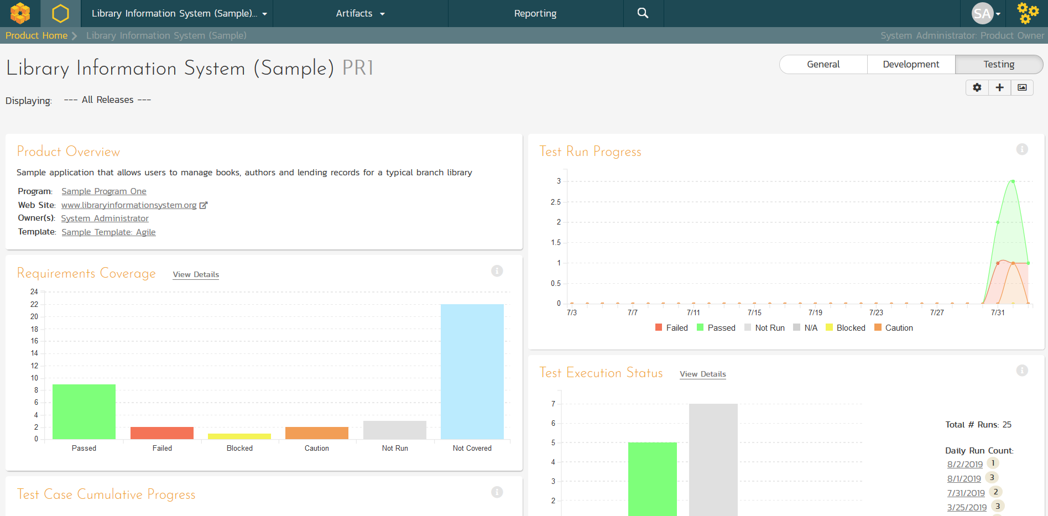
Product Dashboards
Different views & settings

Slide 8
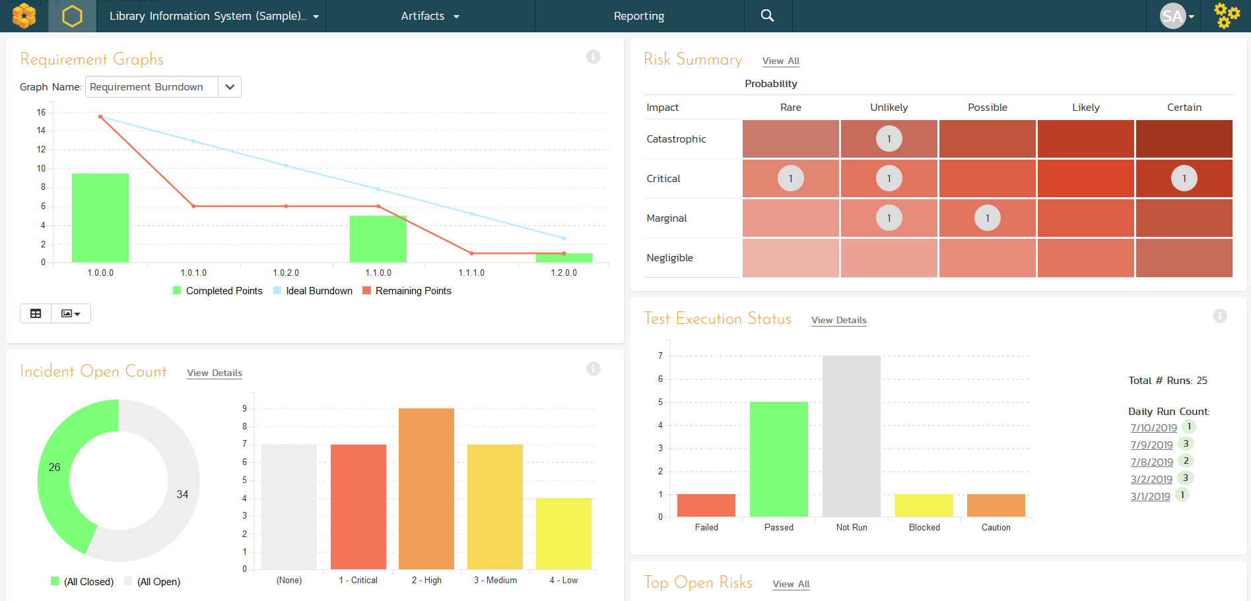
Product Dashboards

Slide 9
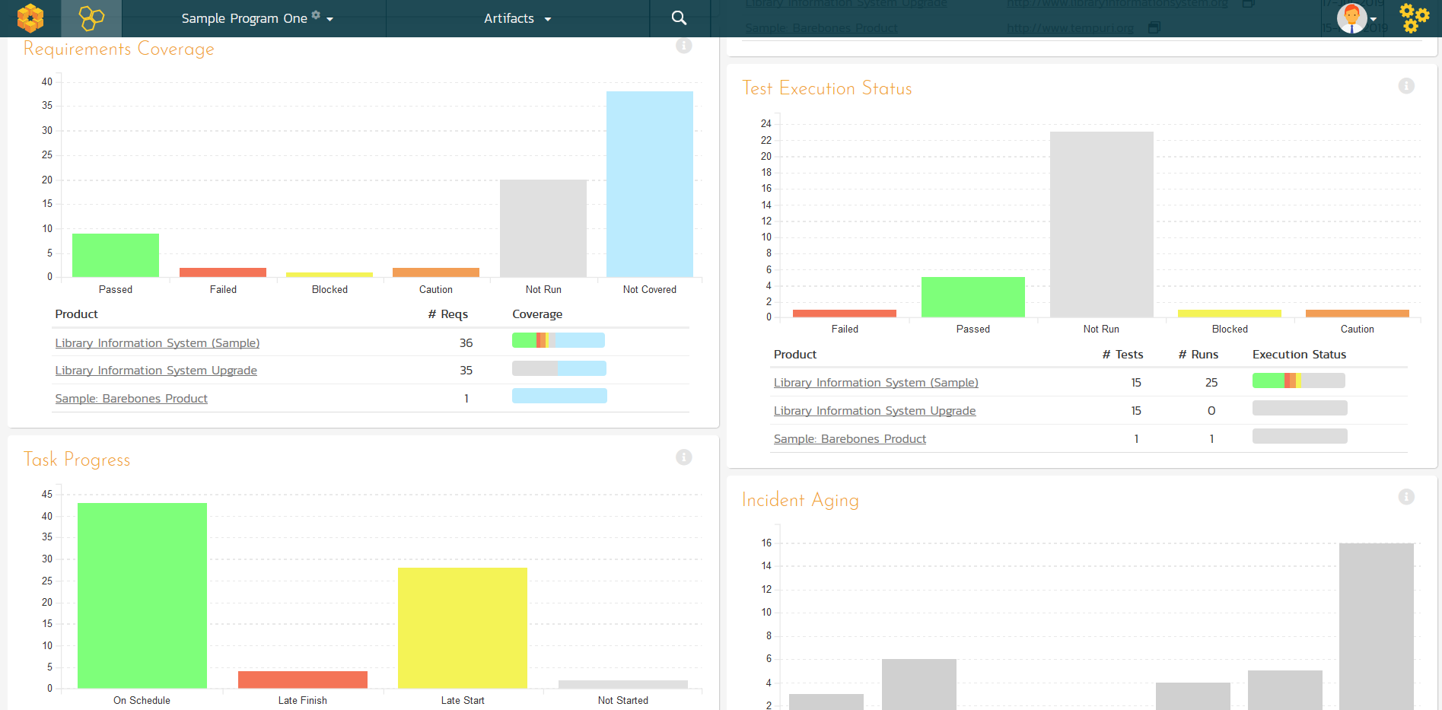
Program Dashboards

Slide 10
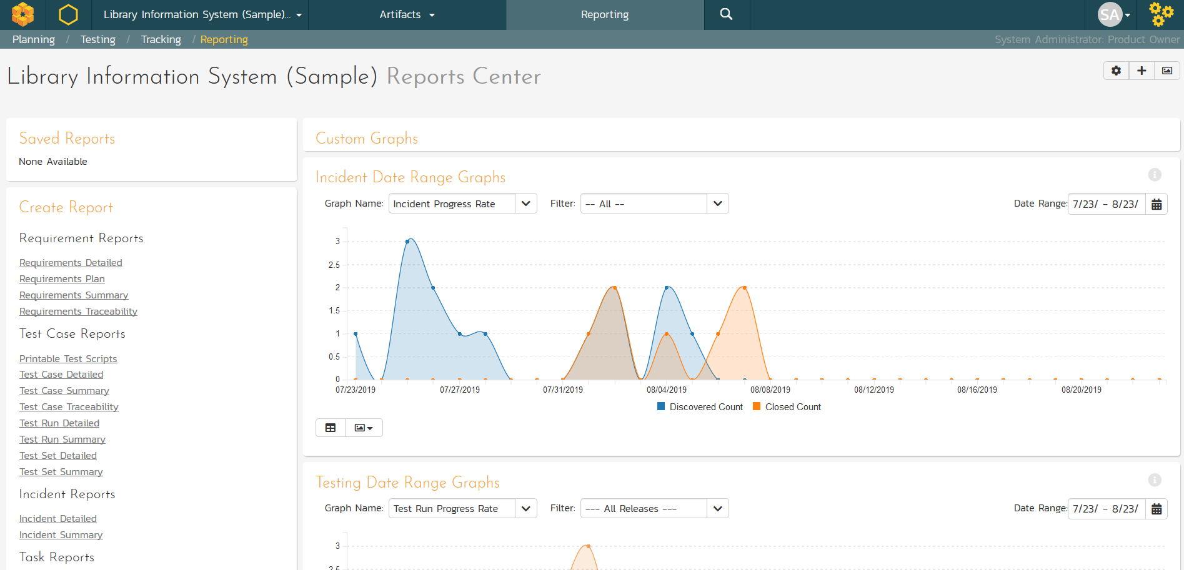
Reporting Center
Graphs

Slide 11
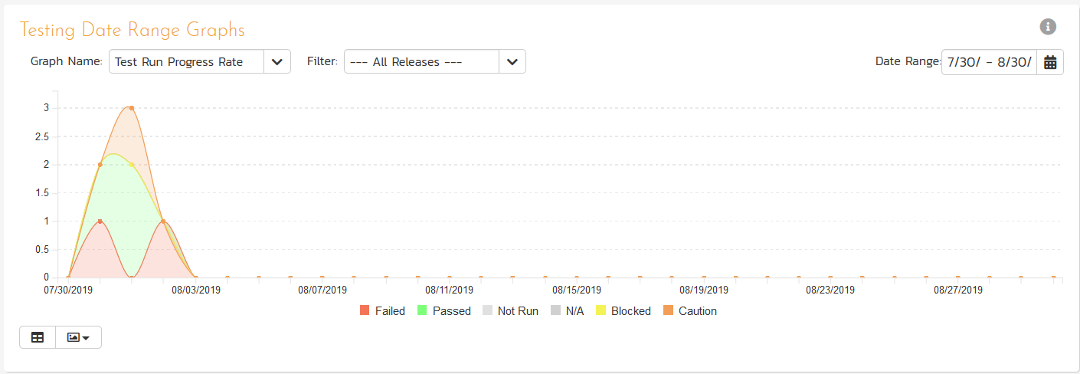
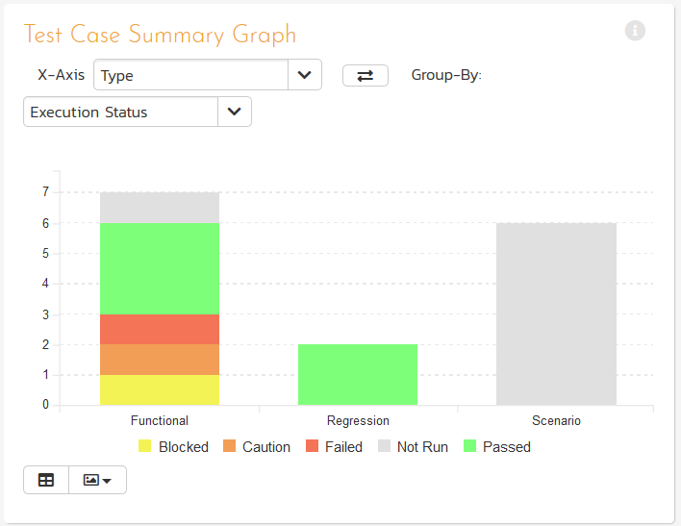
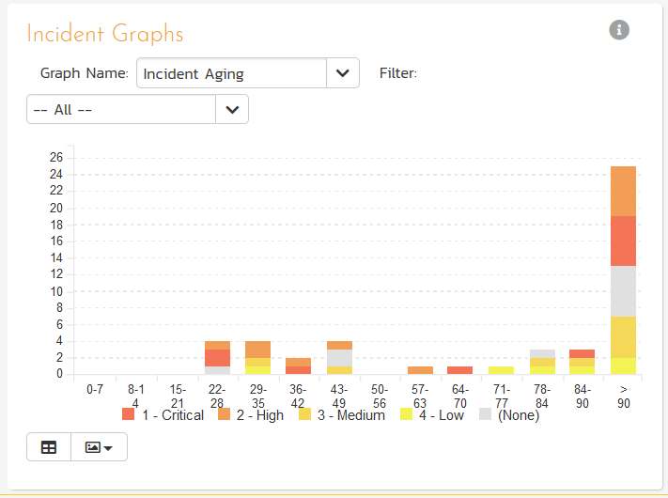
Graph Types
Date Range
Change filters
Display data grid
Export as images
Download as CSV
Snapshot
Summary

Slide 12
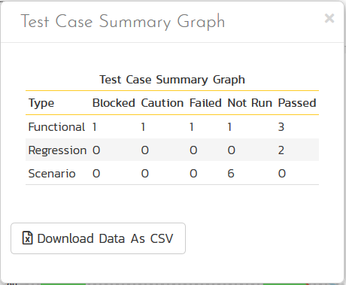
Graph Types
Date Range
Change filters
Display data grid
Export as images
Download as CSV
Snapshot
Summary

Slide 13
Reporting Center
Reports

Slide 14
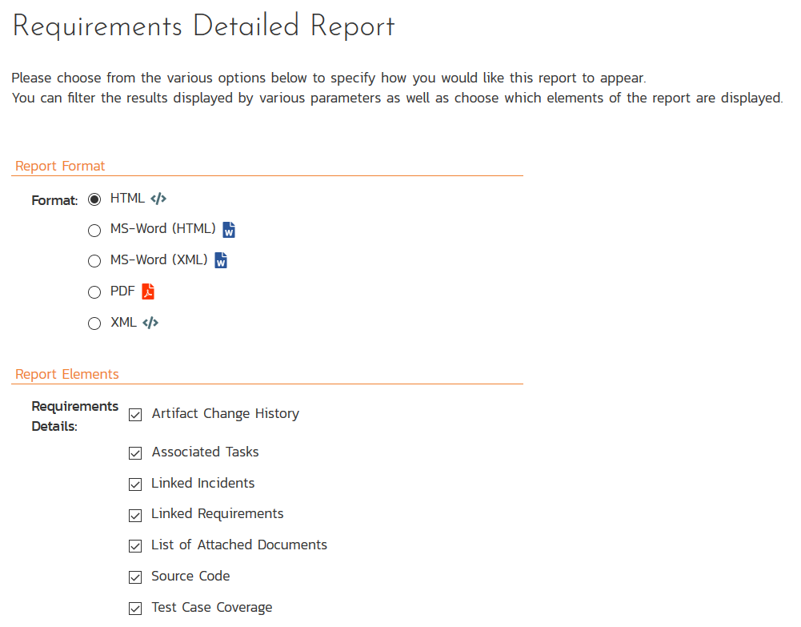
Configuring Report Generation
Formats

Slide 15
Configuring Report Generation
Report Elements

Slide 16
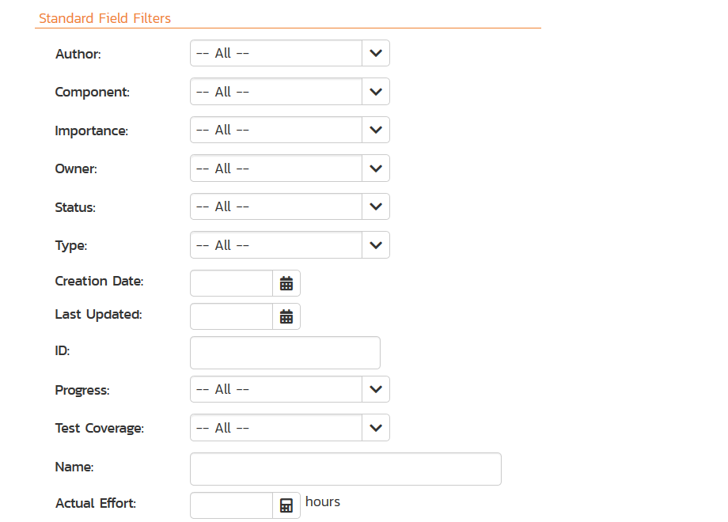
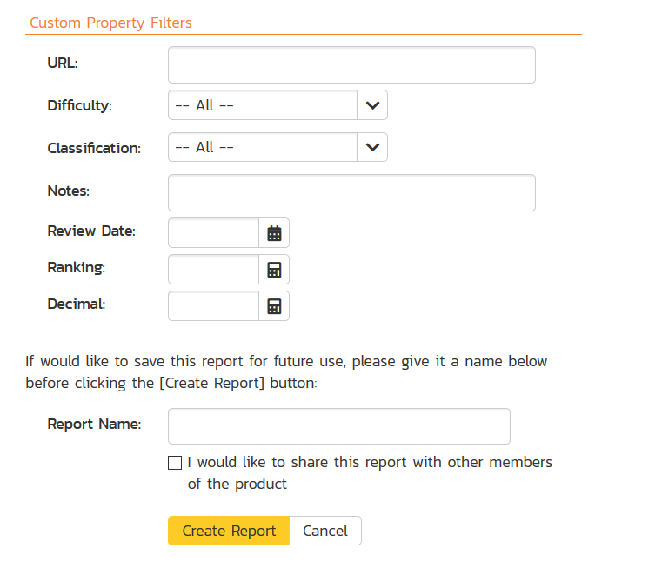
Configuring Report Generation
Save/Share
Report

Slide 17
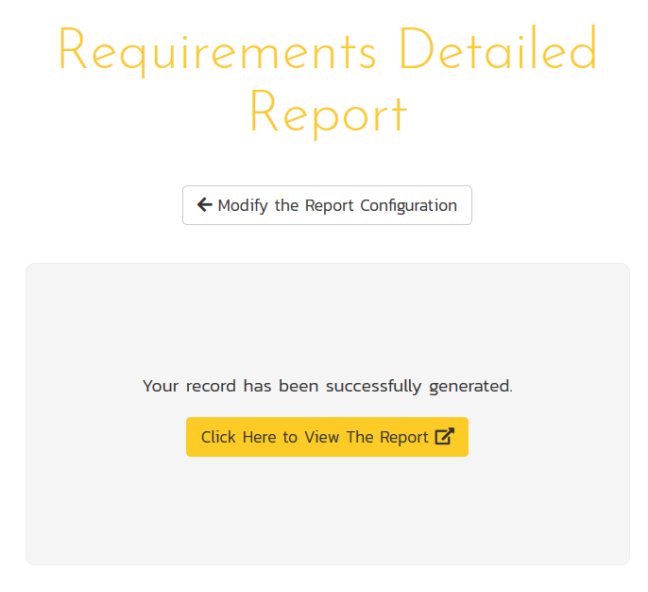
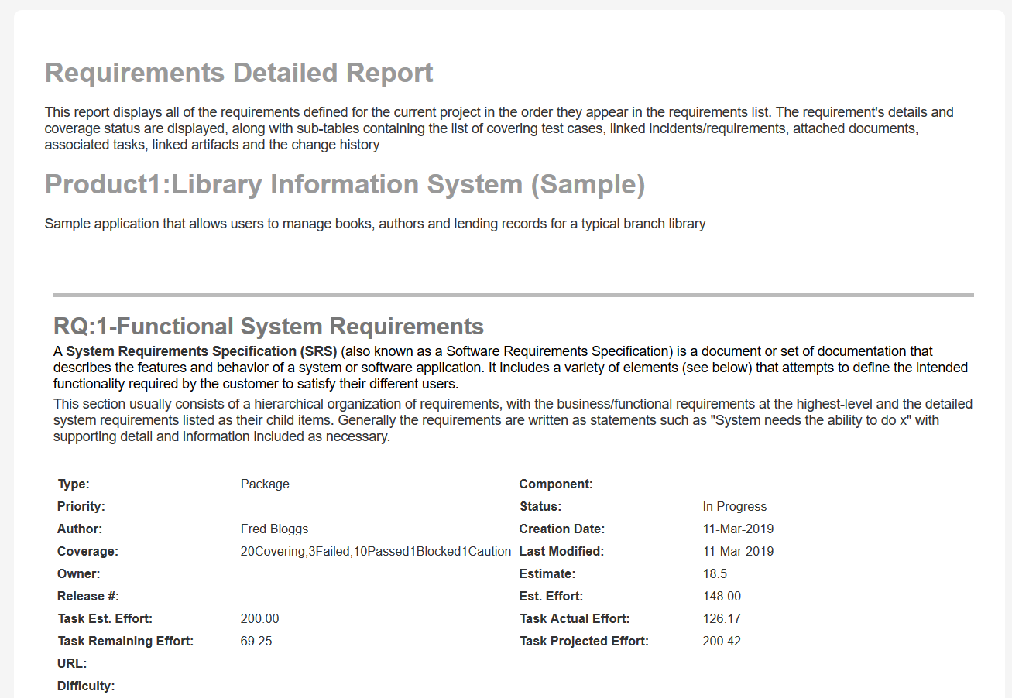
Report Output

Slide 18
Custom Reporting Overview

Slide 19
Reporting Overview
Focus of this talk
Report Data Set
(XML)
Intermediate
Report
Output (HTML)
Final Report Output
(HTML, PDF, Word, Excel, etc.)
SpiraTeam Query Engine
Report Engine
Target Format
Templates
SpiraTeam
Project Data
SpiraTeam
Report Templates

Slide 20
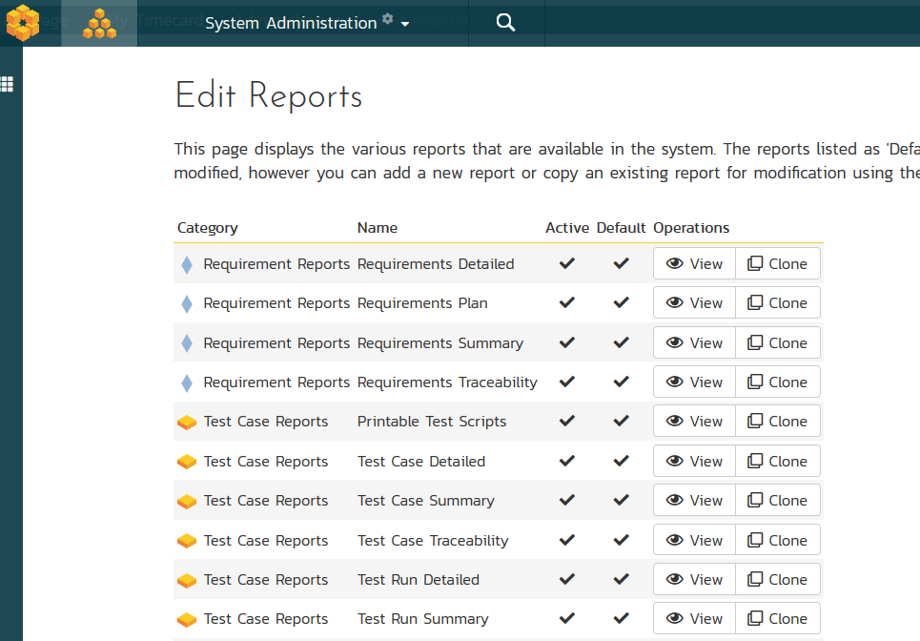
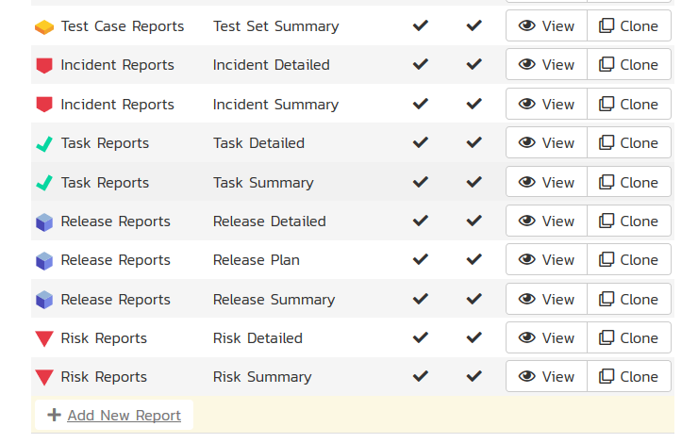
The Basics

Slide 21
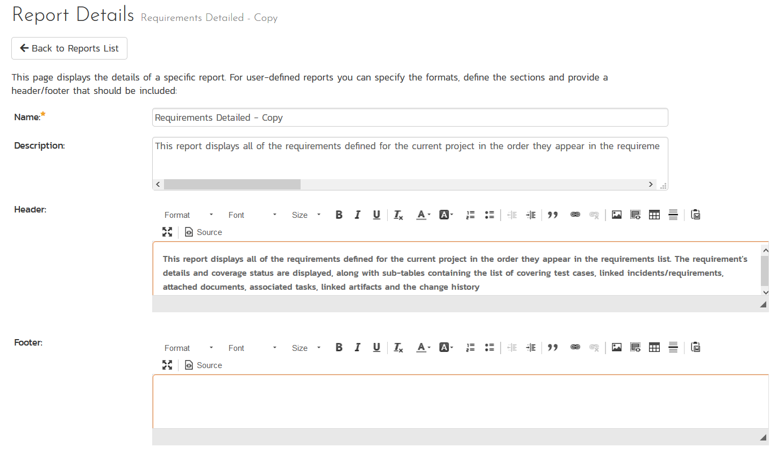
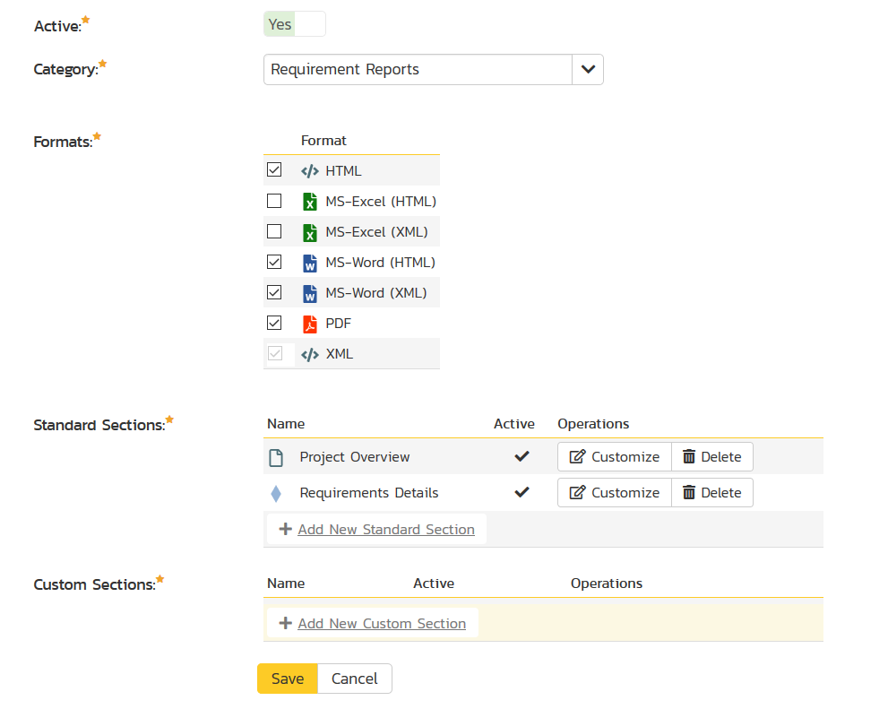
The Basics

Slide 22
Custom Reporting: Using Templates

Slide 23
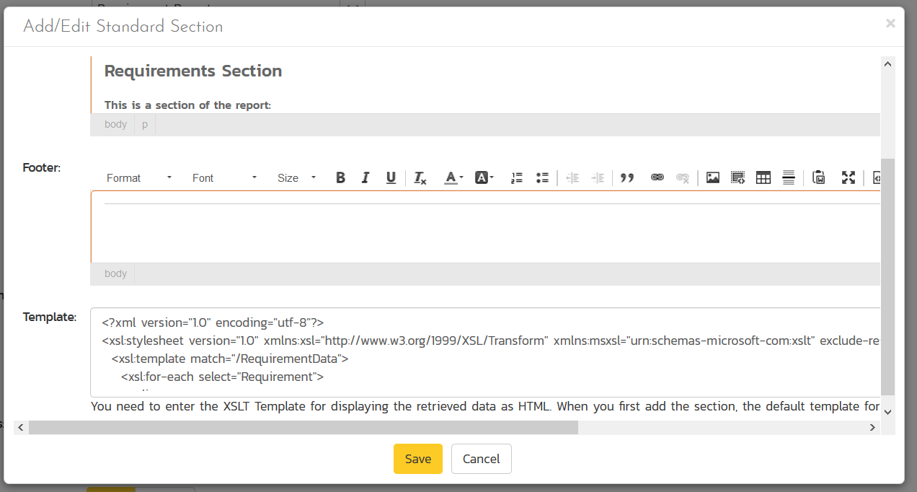
Editing a Section Template

Slide 24
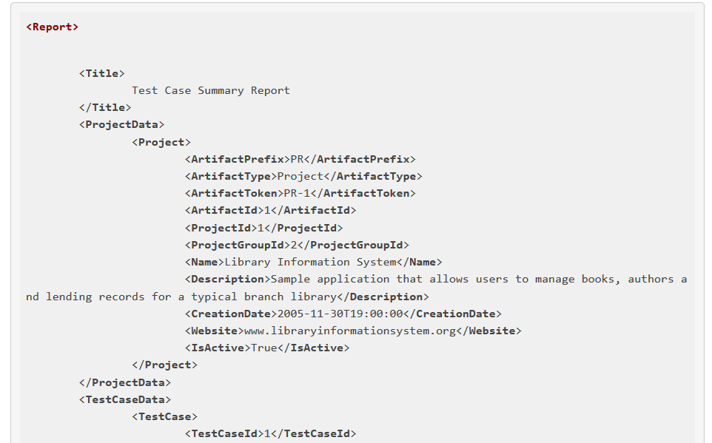
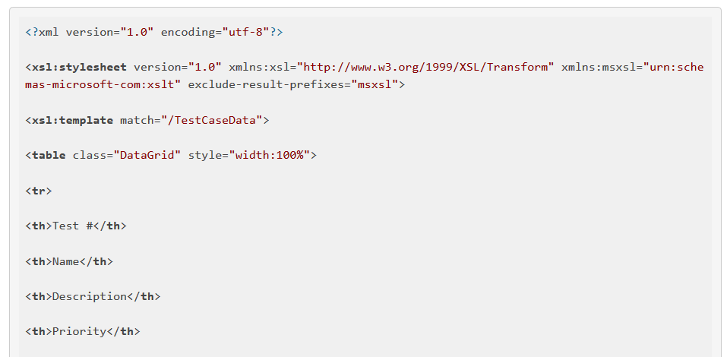
How it Works
Report Data Set
(XML)
Report Template
(XSLT)
Intermediate
Report
Output (HTML)
Final Report Output
(HTML, PDF, Word, Excel, etc.)

Slide 25
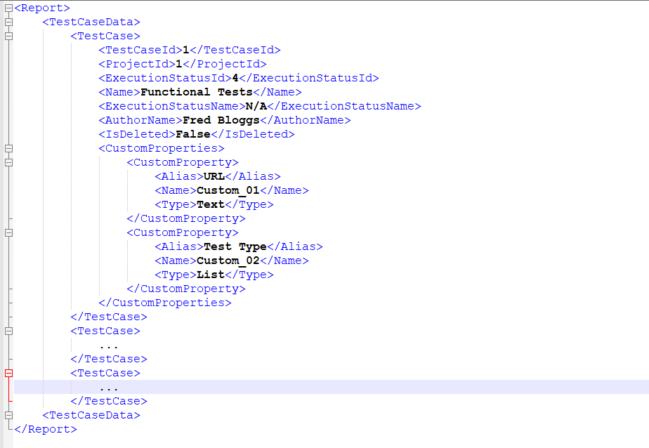
Simplified Example
Report
TestCaseData
TestCase
Attributes
Custom Properties
TestCase
Attributes
Custom Properties
TestCase
Attributes
Custom Properties

Slide 26
Display as Table
<xsl:template match="/TestCaseData">
<table>
<tr><td>ID</td><td>Name</td></tr>
<xsl:for-each select="TestCase">
<tr>
<td><xsl:value-of select="TestCaseId"/></td>
<td><xsl:value-of select="Name"/></td>
</tr> </xsl:for-each>
</table>
</xsl:template>

Slide 27
Display as Table
<xsl:template match="/TestCaseData">
<table>
<tr><td>ID</td><td>Name</td></tr>
<xsl:for-each select="TestCase">
<tr>
<td><xsl:value-of select="TestCaseId"/></td>
<td><xsl:value-of select="Name"/></td>
</tr> </xsl:for-each>
</table>
</xsl:template>
ID | Name
1 | Tests Creating New Book
 | Tests Editing Existing Book

Slide 28
Display as List
<xsl:template match="/TestCaseData">
<ul>
<xsl:for-each select="TestCase">
<li>
<b>TC<xsl:value-of select="TestCaseId"/></b> -
<xsl:value-of select="Name"/>
</li> </xsl:for-each>
</ul>
</xsl:template>

Slide 29
Display as List
<xsl:template match="/TestCaseData">
<ul>
<xsl:for-each select="TestCase">
<li>
<b>TC<xsl:value-of select="TestCaseId"/></b> -
<xsl:value-of select="Name"/>
</li> </xsl:for-each>
</ul>
</xsl:template>
TC1 – Tests Creating New Book
TC2 – Tests Editing Existing Book

Slide 30
Custom Reporting: Using Queries

Slide 31
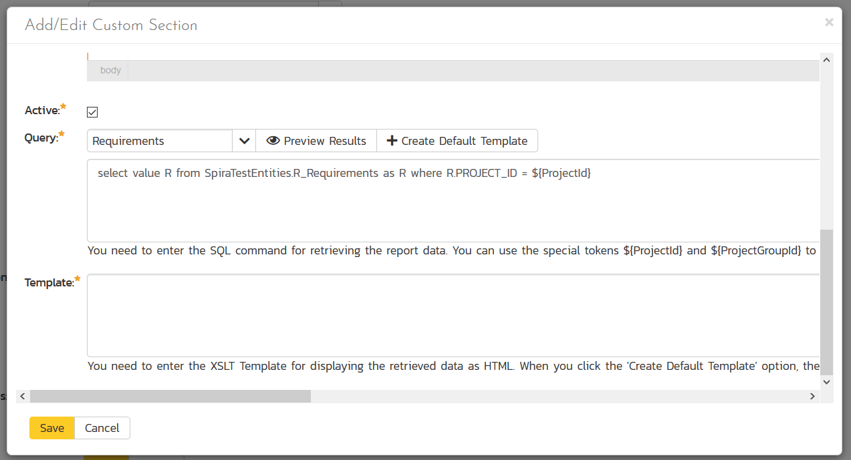
Editing a Custom Section

Slide 32
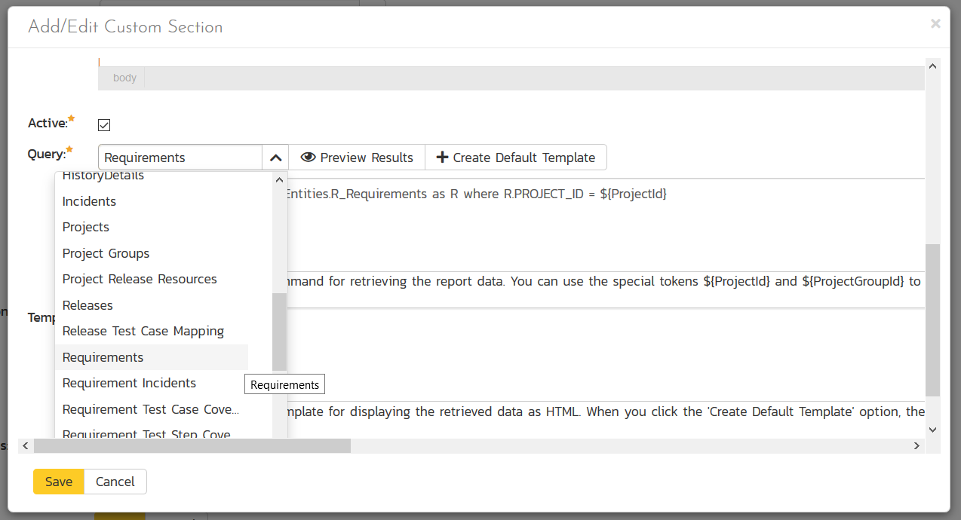
Editing a Custom Section

Slide 33
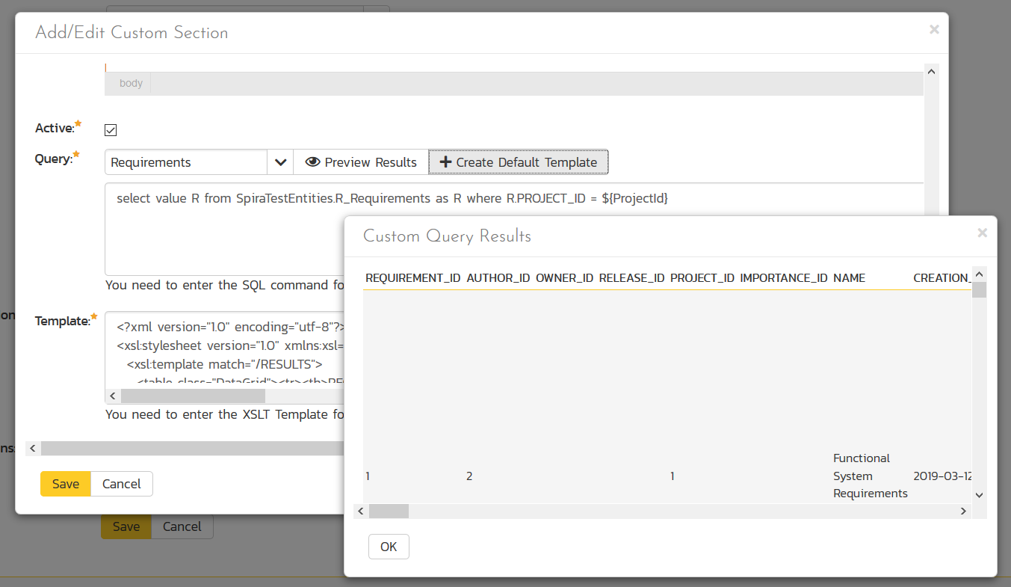
Preview Query and See Data

Slide 34
Entity SQL Language (ESQL)
Similar to database SQL, but object-based:
Reportable objects SpiraTestEntities.R_Requirements
Differences between SQL and Entity SQL:
SELECT * FROM REQUIREMENTS AS R becomes
select value R from SpiraTestEntities.R_Requirements as R
Similarities with database SQL:
You can do JOINs (inner and outer), aggregations (GROUP BY), calculations and sub-queries
https://docs.microsoft.com/en-us/dotnet/framework/data/adonet/ef/language-reference/entity-sql-overview

Slide 35
Spira Extensions to ESQL
There are currently two special parameters you can use in your report queries:
${ProjectId} – the ID of the current product (formerly project)
${ProjectGroupId} – the ID of the current program (formerly project group)
They are often used in WHERE clauses to limit the data to the current product or program
In the future we’re planning on adding similar functionality for Component and Release.

Slide 36
Writing Custom Graphs

Slide 37
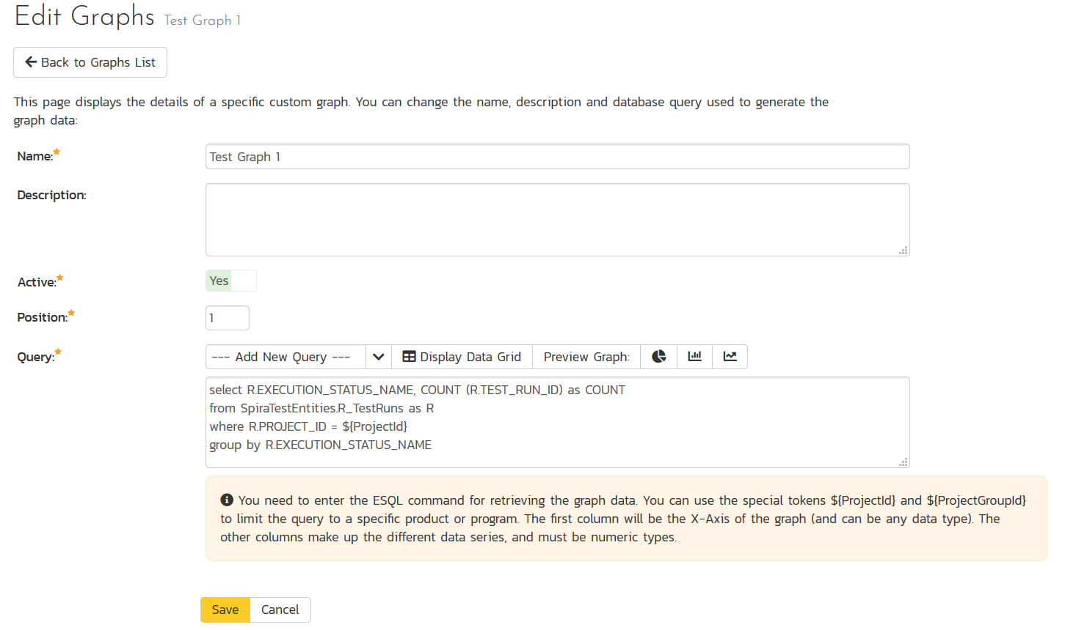
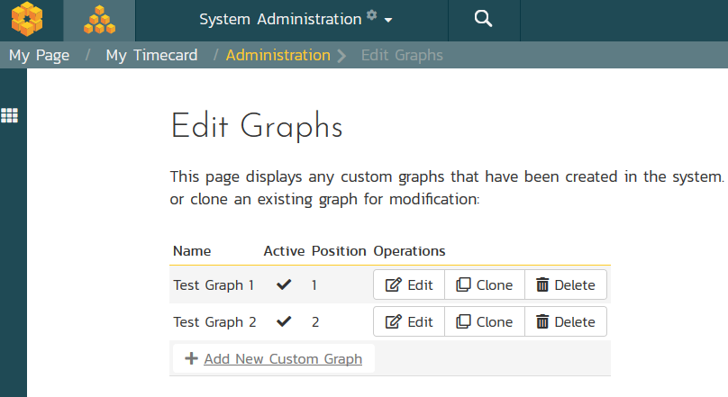
Creating Custom Graphs

Slide 38
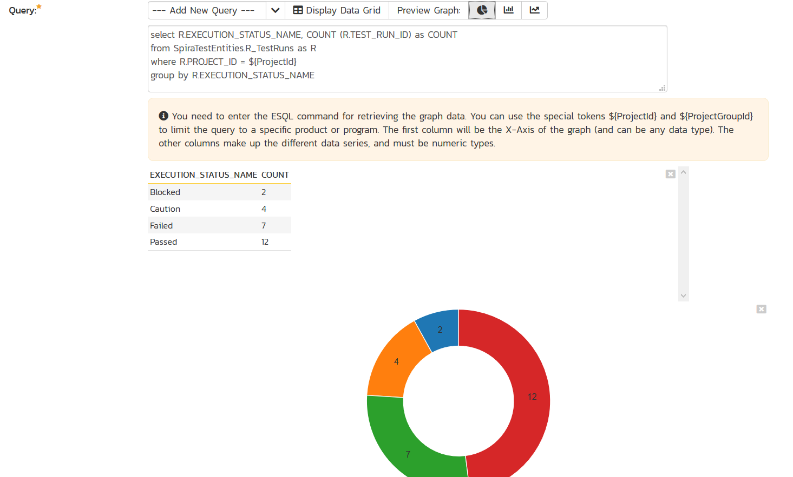
Creating Custom Graphs

Slide 39
Using ESQL for Graphs
You need to have at least two columns
The first one needs to be the axis labels
The others are the data series
Donut (pie) charts can only have a single series, line/bar charts support multiple series
select R.EXECUTION_STATUS_NAME, COUNT (R.TEST_RUN_ID) as COUNT
from SpiraTestEntities.R_TestRuns as R
where R.PROJECT_ID = ${ProjectId}
group by R.EXECUTION_STATUS_NAME

Slide 40
Wrap Up

Slide 41
Key Takeaways
Using the many built-in dashboards, graphs and reports out of the box
How to modify or write your own reports using templates and queries
How to create your own graphs and charts

Slide 42
Questions?

Slide 43
Further Reading
Blog on Writing Custom Reports: https://www.inflectra.com/Ideas/Entry/301.aspx
Forum of User Supplied Custom Reports: https://www.inflectra.com/Support/Forum/spirateam/reports/List.aspx
KB Support Articles on Custom Reports: https://www.inflectra.com/Support/KnowledgeBase/Tag/custom%20reports

