Slide 1
WEBINAR: Becoming Agile In Software Testing: The Government Edition
We will be starting the webinar shortly, please stand by…
All phones will be automatically on mute until the Q&A.
June 12th, 2018 – Adam Sandman

Slide 2
WEBINAR: Becoming Agile In Software Testing: The Government Edition
June 12th, 2018 – Adam Sandman

Slide 3
Agenda
The Agile Manifesto and Testing
Challenges in Government
Methodology
Acquisition Rules
Traceability & IV&V
Managing Testing & Compliance with SpiraTeam
Automating Test Cases with Rapise
Q&A

Slide 5
Why Agile?
And Why Testing is So Important

Slide 6
What Risks Cause Projects to Fail?
Conceptual
Are we building the right thing?
Technical
Will it technically work?
Schedule
Will it be delivered ‘on-time’
Agile Can Help!
Conceptual
Technical
Schedule

Slide 7
Reduce Risks with Agile
Conceptual Risk
Deliver small increments & get feedback
Stakeholders can “see” something tangible, grasp the concept
Technical Risk
Use ‘spike’ solutions to provide out the technical risks early
Change course before too much has been invested
Schedule Risk
Release in small increments, adjust scope vs. dates

Slide 8
Software Testing
All User Stories / Requirements Need to be Tested
Acceptance tests that can be understood by the users
Automated unit tests that run with Continuous Integration
Automated scenario, UI, API, tests where possible
Test-Driven Development
Structural Testing Done Early
Don’t leave performance, security, etc. to the end

Slide 9
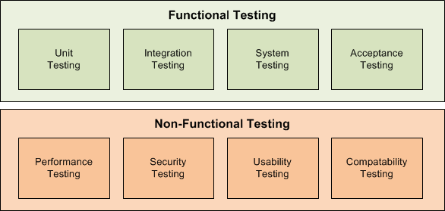
Software Testing
Release Plan
Iteration
Iteration
Scope
Iteration
Plan
Tested,
Integrated
Working
System

Slide 10
Challenges in Government
Unique Considerations when Adopting Agile

Slide 11
The Methodology Challenges
How to make it agile?

Slide 12
Acquisition Rules
“Requirements”
“Development”
“IV&V”
Vendor A
Vendor 1
Vendor X
Vendor B
Vendor 2
Vendor Y
Vendor C

Slide 13
Requirements Traceability & Compliance
Requirements come in many forms
Overarching policy goals
Statutes, laws and regulations
Functional requirements (“user stories”)
Unlike in commercial software, mission systems are required to have traceability from each test step to each requirement.
You need to be agile, with flexibility to “change requirements”, but you have to compliant!

Slide 14
Too Many Tools in Silos
Program Level
Team 1
Team 2
Team 3
Team 4
Team 5
Team 6

Slide 15
The Inflectra Solution
How we can we can help!

Slide 16
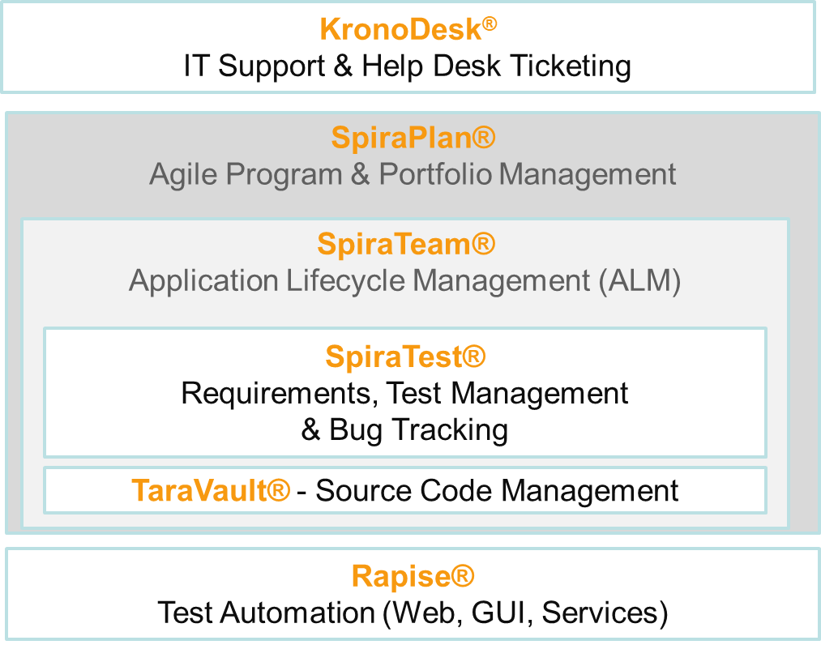
Inflectra Product Suite
Requirements and Test Validation Platform
Test & Process Automation

Slide 17
Integration Options
Developer IDEs
Unit Test Frameworks
Build Servers
Bug-Tracking Tools
Modelling Tools
Functional Testing Tools
Source Code Management
Performance Testing Tools

Slide 18
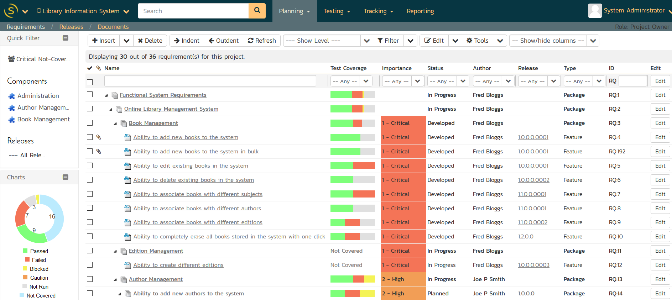
Requirements & Test Validation

Slide 19
Requirements Traceability

Slide 20
Shared Requirements
Ability to define core mandated requirements that are shared between projects as well as project-specific features, use cases, and user stories.

Slide 21
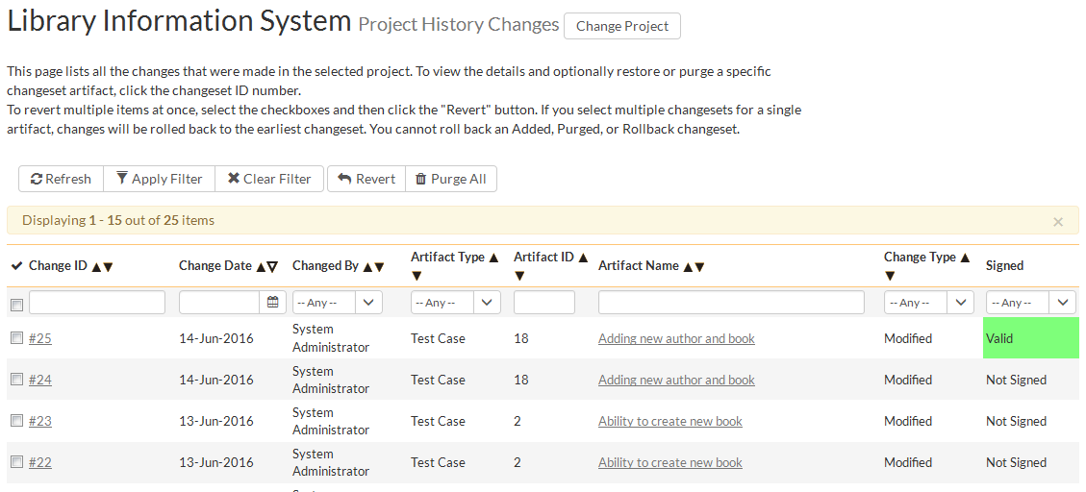
Audit Logging & Trail

Slide 22
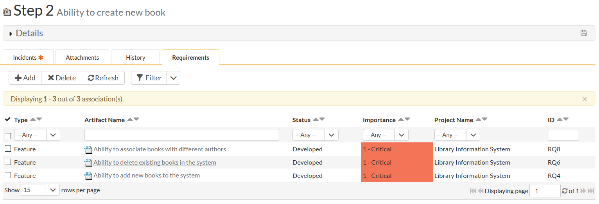
Test Step Level Traceability

Slide 23
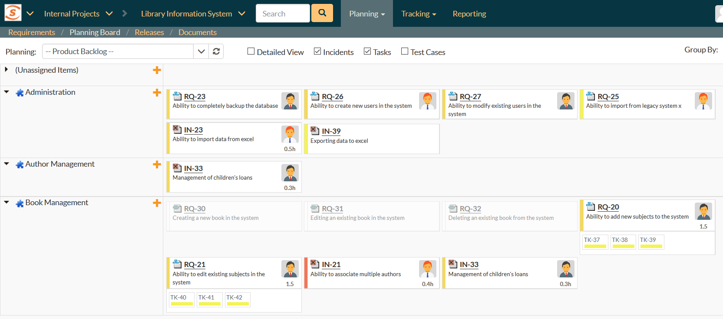
Speed and Agility with Compliance

Slide 24
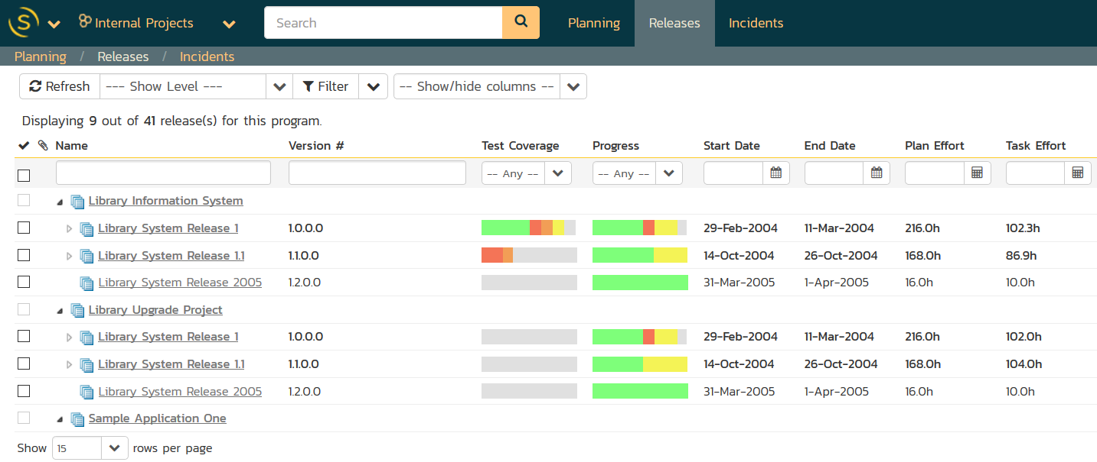
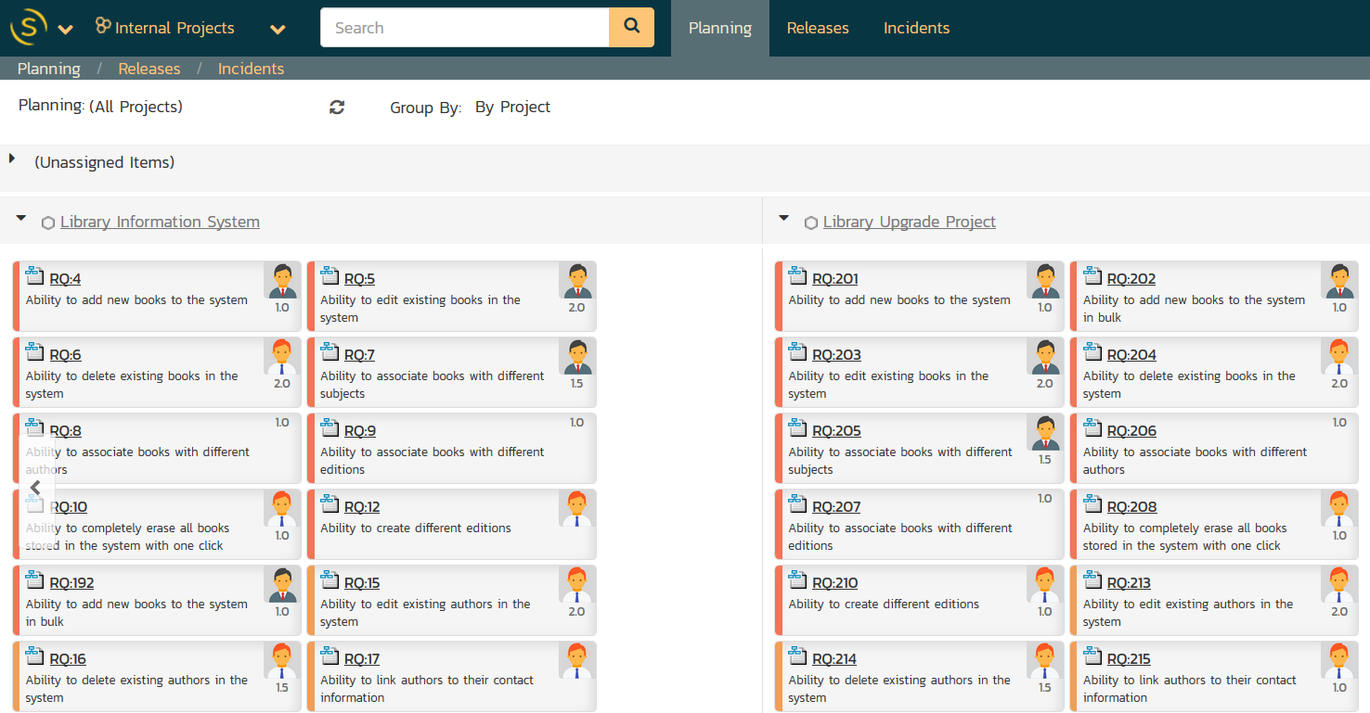
Program Management

Slide 25
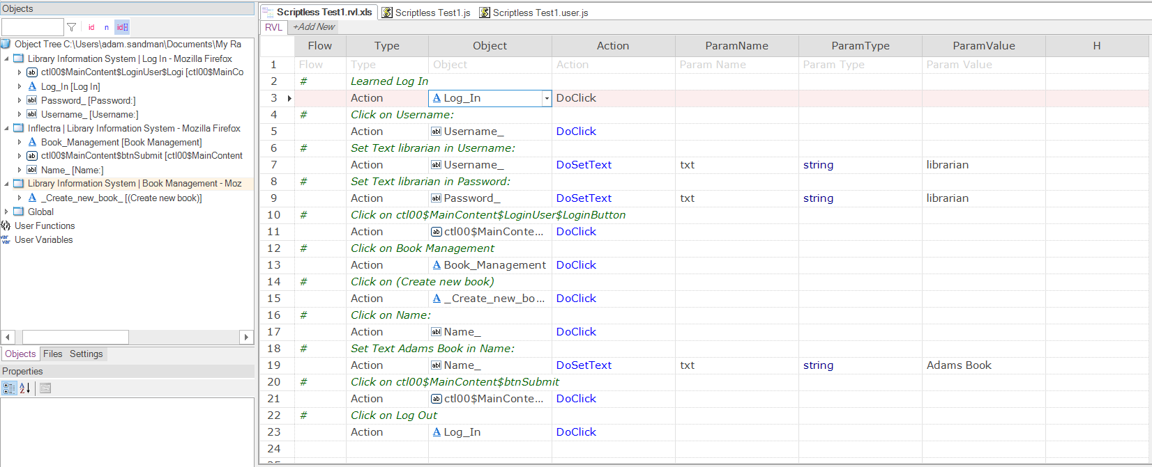
Automated Testing & Validation

Slide 26
Application Demo

Slide 27
Questions?
Please feel free to unmute your line, raise your hand, or simply write your question in the Chat window.

Slide 28
Thanks for Watching
Subscribe to Our Channel for More Videos on Software Testing
http://www.youtube.com/inflectracorporation

