Slide 1

Inflectra User Summit
May 18, 2017

Slide 2
Sophelle Overview
Retail-centric management and technology consultancy
Strategy and implementation
Clients
  Retailers and vertically integrated manufacturers
  Start-up to Fortune 50
  Stores and online
Founded in 1995
50+ retail industry experts
Committed to client success and satisfaction
Sophelle has helped hundreds of retailers on thousands of projects

Slide 3
Sophelle / Inflectra Partnership
Sophelle has been an Inflectra partner since 2009
We have helped Inflectra’s customers with a variety of product related services, including:
    Installation and configuration
    Application hosting
    Training
    Quality Management assessment and optimization
Sophelle has also adopted SpiraTeam as a standard tool for our projects

Slide 4


































Sophelle Has Deep Retail Expertise

Slide 5
Sophelle Projects
Our core business is the selection, implementation and support of retail and digital commerce technology solutions
Our team includes professionals spanning retail business and technology
  Omnichannel Strategy
  Store Systems
  Merchandising and Planning
  eCommerce Technology and Operations
  Digital Marketing
  Application Development and Systems Integration
Nimble Organization
  Sophelle offers the optimal balance between size and agility to provide value fast
Deep Domain Expertise and Holistic Approach
  Sophelle’s understanding of interdependencies across the enterprise enable us to develop strategies that minimize risk
  Flexible Solutions
  Sophelle’s processes are based on best practices, tailored to each client to deliver efficient, effective solutions

Slide 6
Guiding Principle – No Surprises.
Surprises are costly in both their direct and indirect impact.
Sophelle does everything possible to eliminate surprises.
Shared Expectations
Common understanding of project status at all levels
Visibility to true progress against agreed upon milestones
Time to plan for and react to anticipated resource, timeline, and budget issues
  On-time and on-budget commitments
Operational Discipline
  Project Management
  Change Management
  Risk Management
  Quality Management
Complete Transparency
Realistic project planning
Clear, structured and frequent communications
Objectivity and transparency in progress and status reporting
Early identification and escalation of project risks and issues

Slide 7
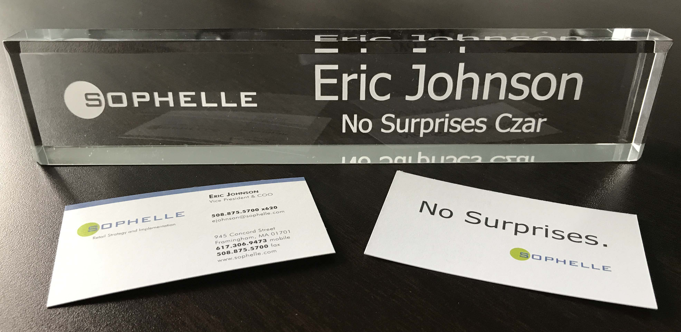
Guiding Principle – No Surprises.

Slide 8
SpiraTeam – No Surprises.
SpiraTeam is a critical component of No Surprises.
Sophelle has adopted SpiraTeam as a standard tool for our projects
  We offer user licenses to all project team members – including Sophelle, client and other third parties for the duration of a project
  At project completion, we offer the SpiraTeam project data to our client, and we have a standard process for transferring to our client’s SpiraTeam instance
Using SpiraTeam helps us with No Surprises.
  Shared Expectations – planning and tracking
  Operational Discipline – requirements, test cases, reporting
  Complete Transparency – defect management and more reporting
Effective communication throughout project allows for delivery not only on-time and on-budget, but also within expected quality metrics

Slide 9
SpiraTeam – No Surprises.
We have integrated SpiraTeam into our project methodology
This includes documentation of
  Processes
  Roles
  Templates and sample documents
  Training materials
Our methodology allows for efficient on-boarding of project resources, and for instructing client team members on implementation processes
For system testing, we have developed libraries of standard test scenarios and test cases
  These can be quickly and effectively customized for a specific client’s operational environment
  Test cases are often used as the basis for client facing training materials
SpiraTeam has helped Sophelle apply discipline and deliver on our guiding principle of No Surprises.

Slide 10

Thank You

