Slide 1
Enterprise Agile Planning Tools MQ
Vendor Briefing

Slide 2
Agenda
Company Overview
Marketing & Positioning
Key Message
Differentiators
Use Cases
Large Scale Agile
Digital Business
Outsourced Development
Regulated Business
Product Development
Future Direction & Vision
Questions

Slide 3
Company Overview

Slide 4
Company Overview
Founded 10 years ago to address the lack of comprehensive tooling across the lifecycle
Initial focus on the QA domain
Broadened to include project management, development, IT service management
Currently 10,000+ customers using our products in over 100 countries
Mix of direct sales and channel partners (70:30)
Maintain both Cloud and On-Premise options
Privately held, no VC funding to date

Slide 5
Product Highlights 2015 / 2016
SpiraTeam 5.0 ®
Enhanced estimation and planning
Support for Kanban and additional agile methodologies
Complete UI overhaul with 100% mobile responsive design
TaraVault™
Enterprise Git & Subversion SCM hosting & integration
Rapise ®
Support for testing mobile devices
Load / performance testing support
API Testing Capabilities – SOAP & REST
Pre-defined support for ERP (Dynamics AX & CRM)

Slide 6
Market Positioning

Slide 7
Issues in the Market
Development is everywhere, hardware and software is being increasingly blurred
Need for system of systems support
PLM/ALM feature sets are becoming integrated
Agile has gone mainstream and enterprise
Large-scale, distributed agile is the norm
Cloud delivery and rapid deployment meets regulation and process.
There is no typical project and customer
Tools need to be flexible to handle different classes of project with ‘just enough process’
Usability and process need to be optimized
Every industry is unique yet the same

Slide 8
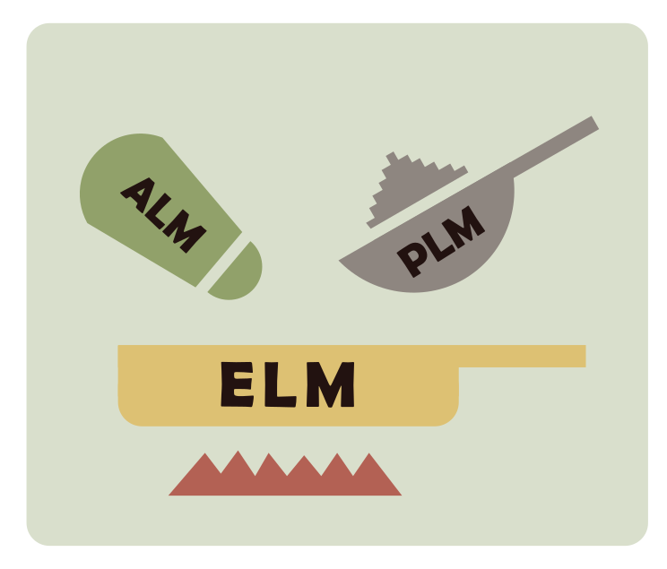
Enterprise Lifecycle Management?
Software is the engine of companies; what we thought of as ALM is now being baked into their operations. The new “ERP”
Software is the product
Information is the inventory
Traditional PLM needs to include software

Slide 9
Go To Market Strategy
Continue to create a strong core Enterprise-grade program and project management solution
Technology and industry agnostic
Mobile-first and deployment agnostic
Integrated into all functions in an organization
Partnerships to extend core product to provide industry-specific solutions as appropriate
Support for different use cases
Address local restrictions and cultural norms
Extend solutions to enable business operations
Project, Product & Program Financials
Human Resource Functions

Slide 10
Product Solution Portfolio
Inflectra solutions cover the following:
Program & Portfolio Management
Project Management
Brainstorming & Idea Discovery
Software Development
IT Operations
Requirements Management
Software Testing & Quality Assurance
Support & Maintenance
Collaboration and Communication

Slide 11
Product Roadmap for 2016 / 2017
SpiraTeam®
Business operations and financials
Program management extensions
Enhanced UI visualizations
Rapise ®
Support for additional ERP products (SAP, etc.)
Scriptless, keyword based testing
Enhanced support for mobile devices
KronoDesk ®
Complete UI overhaul with 100% mobile responsive design
Enhanced workflows, custom reporting & SLA management

Slide 12
Partner Strategy

Slide 13
Partner Strategy
Solution partners provide services (training, consulting) and act as local sales channel.
Technology partners provide complimentary software that augments our core technology platform
Hosting partners provide alternate cloud hosting options to augment our own cloud platform
Industry partners provide unique solutions based on our products to handle specific use cases

Slide 14
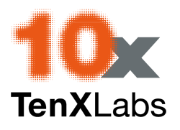
Solution / Service Partners
We have an extensive worldwide partner network that is used to provide global consulting and training services:
North America
South America & Mexico
Asia
Europe
Australia
Middle East & Africa

Slide 15
Technology Partnerships
Inflectra has been pursuing strategic technology partnerships to support our vision
Exgence Artificial Intelligence (AI) technology developed by Univ. of Manchester, UK
Neotys Leader in performance and load testing Seamless integration of SpiraTest & Rapise with NeoLoad platform
Qualitia Leader in scriptless test automation. Extending partnership in 2016/2017

Slide 16
Hosting Partners
In addition to our own cloud service for our products, we have partnered with companies for alternate hosting:
DATIS GmbH German hosting for DACH region, for customers where EU-US privacy shield agreement insufficient.
InfluenceIT & NextDC Australian government and medical certified hosting for sensitive data.
Amazon Web Services (AWS) Global alternate hosting and cloud option for Rapise automation solution.

Slide 17
Industry Partners
Industry partners provide unique solutions based on our products to handle specific use cases:
ValidationMaster by OnShore Tech Extension of SpiraTeam and Rapise platforms to handle unique needs of system validation in regulated life sciences industry.
SmarteSoft Provides medical testing solutions based on Inflectra platform
Core Banking Group Financial Services & Banking Solutions based on SpiraTeam

Slide 18
Use Cases

Slide 19
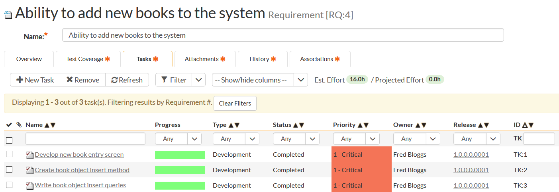
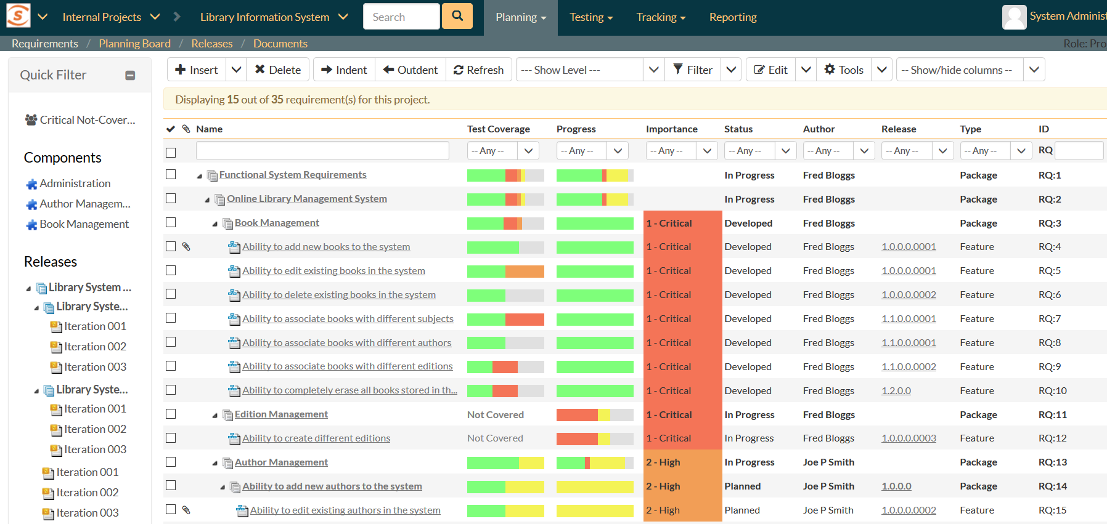
Large Scale Agile (Waterfall Replacement)
Traditional Organization
Transitioning to agile/hybrid
Reporting & Traceability
Process-heavy
Blending iterative approach with upfront activities
Reporting across phases
Customizable processes
Explicit milestones and quality gates
Multi-level releases, phases & iterations
Support for stories, use cases and traditional requirements
Dependent artifacts and cross project visibility & linking

Slide 20
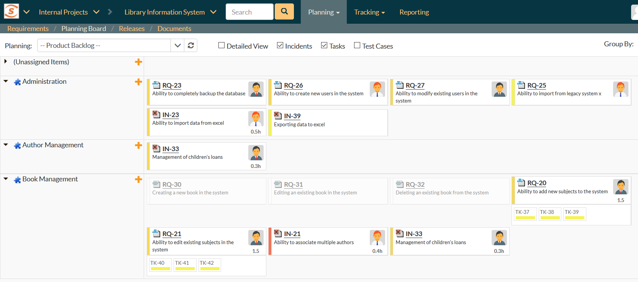
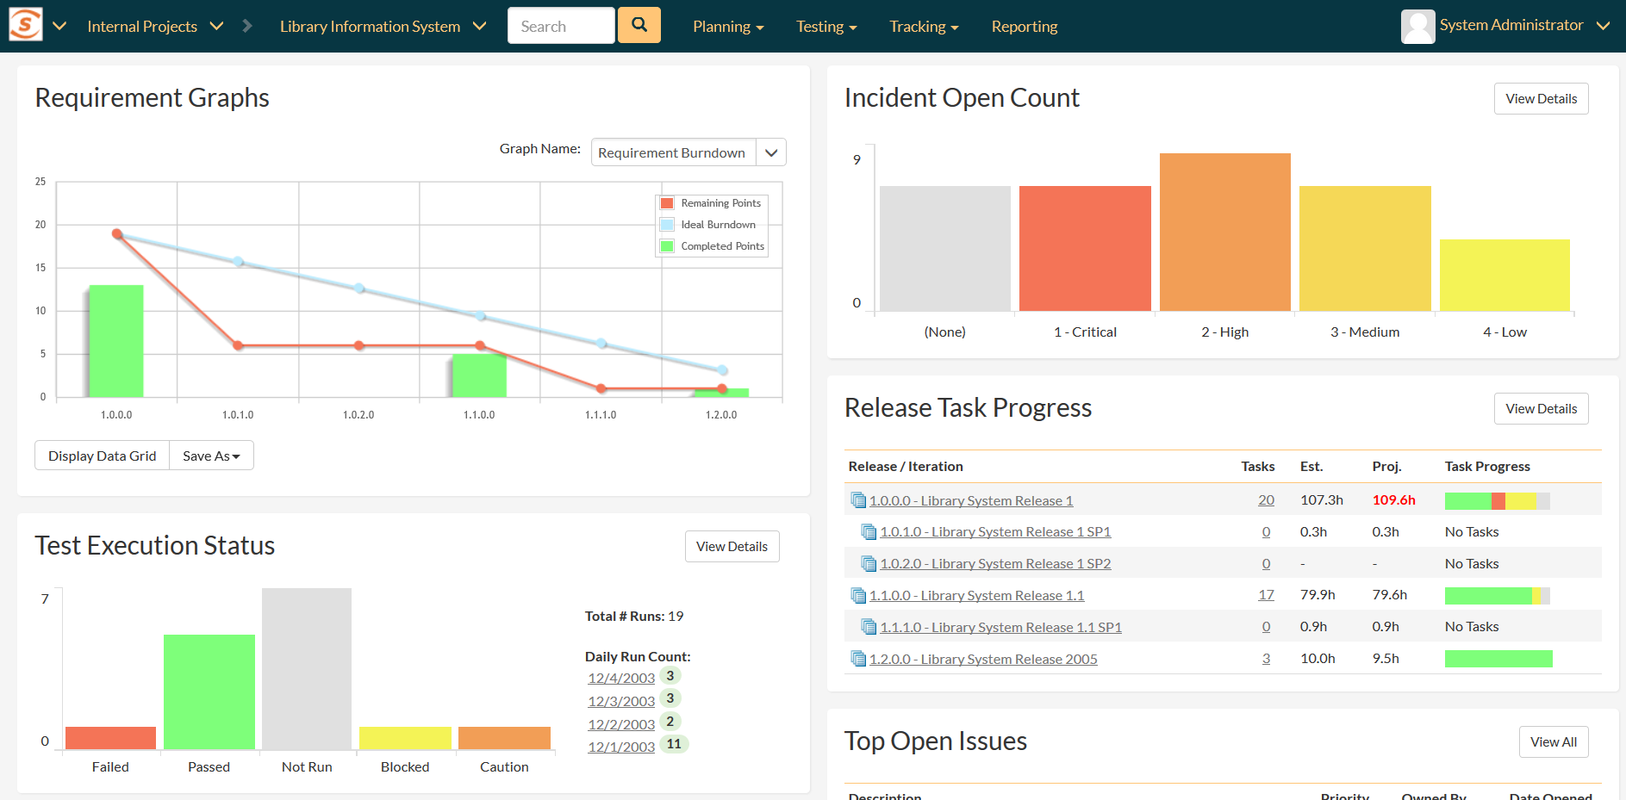
Digital Business (Continuous Delivery)
Using continuous delivery & DevOps principles
Evolutionary agile with MVP
High degree of automation
Evolving requirements
Minimize process “friction”
Integration with other business functions
Time to market, infrastructure “light”
Ability to streamline processes
Integration w/ CI, test automation
REST & SOAP APIs
Data integration architecture
Complete cloud environment

Slide 21
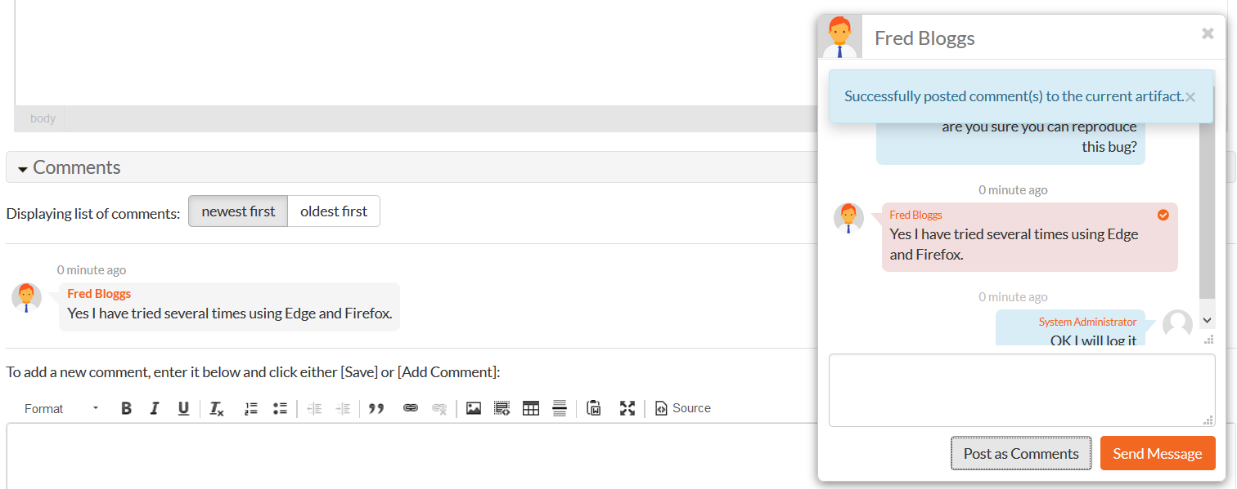
Outsourced Development
Distributed resources
Collaboration & shared goals
Real-time reporting
Complete visibility
Lack of common culture
Miscommunications and mis-aligned expectations
Blocking issues & tasks
Diverse IT environments
Enterprise instant messaging
Global source code hosting
Multi-language, timezones
Cross-project reporting
Scheduling & notifications/alerts

Slide 22
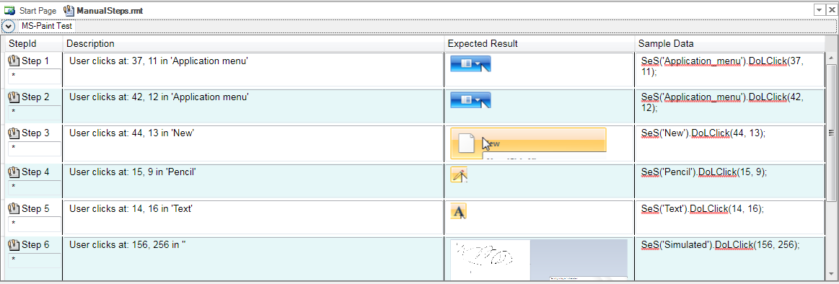
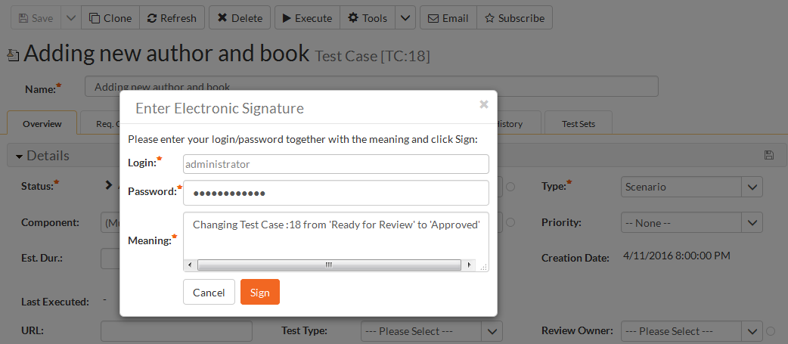
Regulated Business
Processes legally mandated
Change control highly disciplined
Traceability & Reporting
Complete Auditability
Complex, laborious process
Data retained forever
Data integrity legal mandate
Security and privacy rules
End to end traceability
Digital Signatures & workflows
Auditing & change history
Automated regression testing
Flexible hosting/deployment
Validation partner & certification

Slide 23
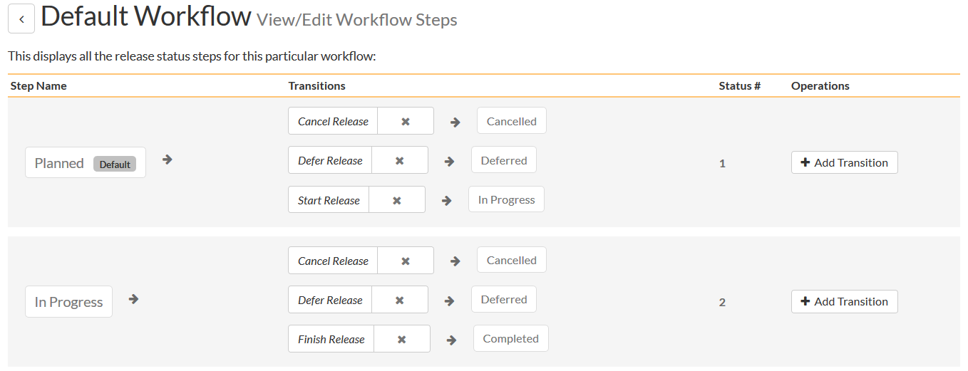
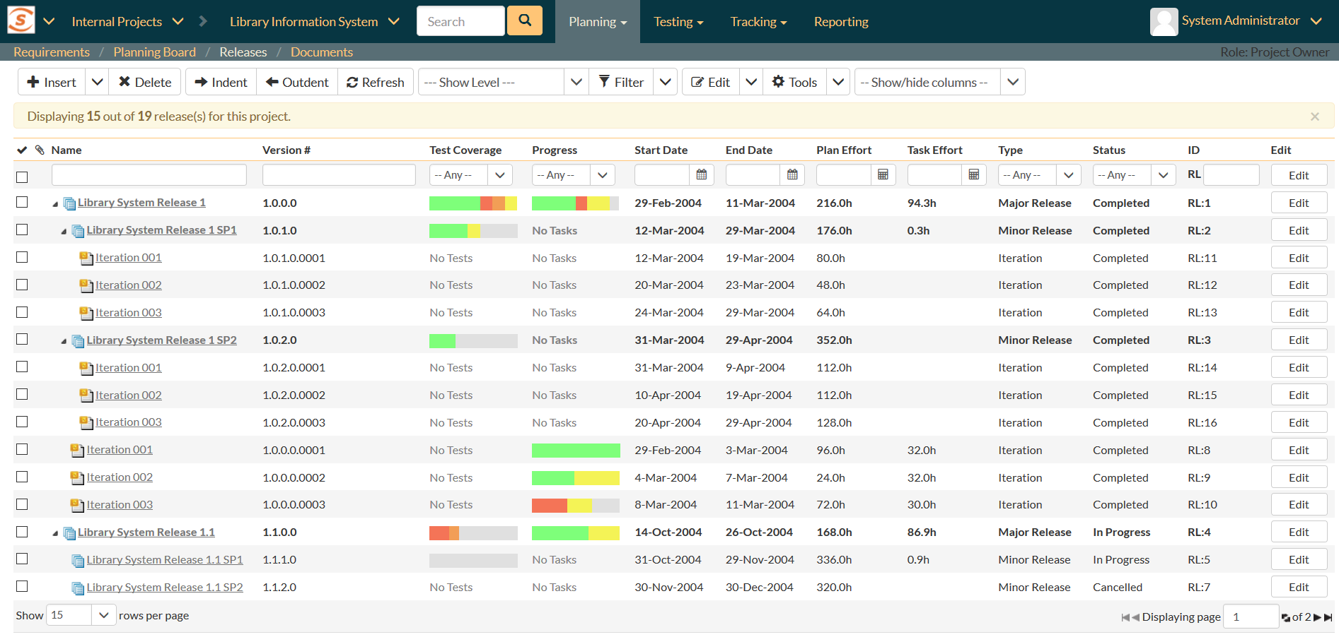
Product Development
Hardware & software components
Coordination across supply chain and lifecycle
System of systems approach
Hierarchy of components, assemblies & parts
Serial-number level tracking
Integration with PLM tools
Cross-project aggregations
Cross-project components
Customizable workflows
Parameterized data
Robust, versioned APIs
Multi-level release scheduling

Slide 24
Questions?

