Slide 1

London User Summit: 2017
Secondary Title

Slide 2
Agenda
1:30 - 1:45 Meet & Greet
1:45 – 2:00 Icebreaker
2:00 - 2:30 Company News
2:30 - 3:30 Spira Showcase
3:30 - 3:45 Coffee Break
3:45 - 4:30 Rapise Showcase [Adam]
4:30 - 4:45 Coffee Break
4:45 – 5:15 KronoDesk Showcase
5:15 - 5:45 Break-out Session/Open Forum Discussion
5:45 – 6:00 Feedback & Wrap Up
6:00 onward - Social Hour

Slide 3
Company News
Secondary Title

Slide 4
The last few months
Big releases across our product line:
  SpiraTeam 5.1
  Rapise 5.0
  KronoDesk 2.0
  Updates to plugins (Excel, Jira)
  Open sourcing a number of plugins
New company strategy to make our tools better, faster
New initiatives (like today) to engage and help our customers beyond traditional support

Slide 5
Where do we want Inflectra to go next?
Accelerate growth (in response to user demand, not VC rounds)
Release updates across our product line on a consistent basis
Develop features faster that make our tools ever easier to use, and ever more powerful (it’s a tightrope)
Stay true to who we are and why we get up in the morning

Slide 6
Background – Who Are We?

Slide 7

In a nutshell…

Slide 8
What does this mean for you?
We are focusing on three groups of people
Each release will balance how we can help each group, so everyone in your teams can get the most out of our products
Testers
Developers
Managers

Slide 9
What specific changes are we making?
Updating our marketing to emphasize the “why”
  Why is Inflectra different
  Why you use our products
Ensuring that we have a cohesive platform and ecosystem that supports our brand
Smaller releases to get new features out faster and respond more quickly to your feedback
Reaching out more proactively to our customers and potential customers
  We’ll discuss this more later…

Slide 10






Branding Changes
In late 2016 we brought in a new head of marketing to better communicate with our users.
We have a new brand and identity that is simpler and more cohesive across our products:

Slide 11
Nurturing the Inflectra Community
Sponsoring Local Meetups
  DC Agile Testing Community
  DC Coding Community
Inflectra User Summits
  Europe – This Week
    London
    Zürich
    Germany
  North America
    Boston, MA – May 18th
    San Francisco, CA – September 28th
  Future
    2018 – Europe-Wide Event?

Slide 12

Getting Social with Inflectra
Website – Blog, Support Forums
Twitter – Latest News & Info
Facebook – News & Industry
LinkedIn – In Depth Coverage
Google+ - Industry & Background
YouTube – Product Videos
Pinterest – Diagrams and Infographics
Instagram – People & Events
Other Places?
  SnapChat? XING? VK ? Dzone?

Slide 13
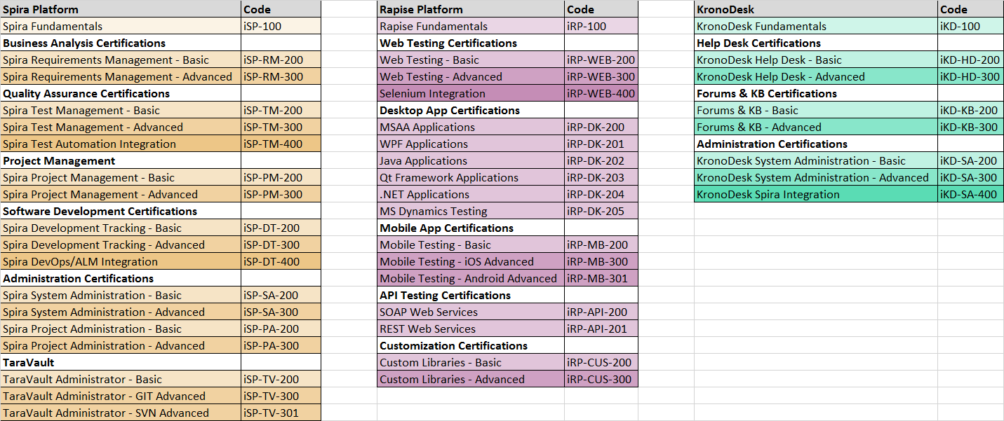
Training Initiatives
Developing curricula and training guides (see above)
Working w/ partners to create online courses using LMS
Free YouTube based videos for self-training

Slide 14
Demo of Velpic LMS Platform

Slide 15
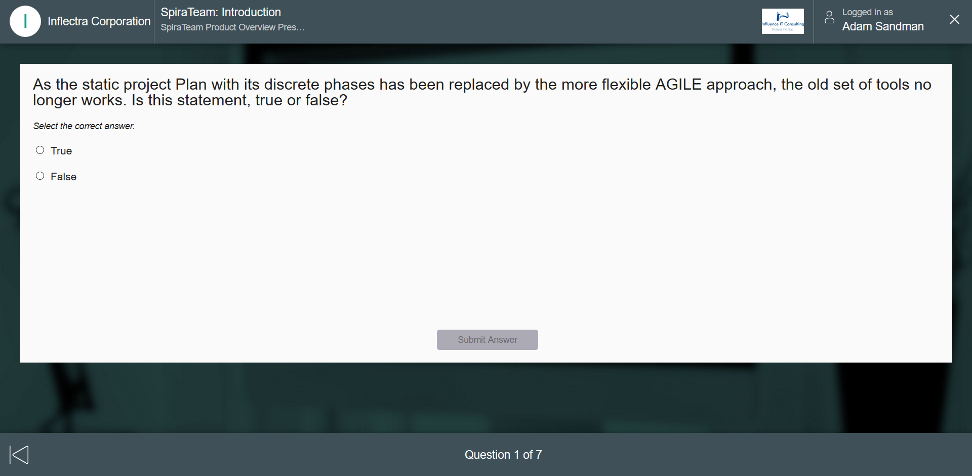
Screenshot of Velpic LMS

Slide 16
Product Showcases

Slide 17
Overview: The Inflectra® Platform
KronoDesk®
IT Support & Help Desk Ticketing
SpiraTeam®
SpiraTest®
Requirements & Test Management
SpiraPlan®
Project Management & Defect Tracking
TaraVault™ - Source Code Hosting
Rapise®
Test Automation Platform (Web, GUI, Services)

Slide 18
Spira Show Case & Roadmap

Slide 19
SpiraTeam 5.2 Showcase
New incident list / detail page [Simon]
  Followers
  UI Updates
  Associations
  Graphs, maybe
Program planning board [Adam]
Testing things [Adam]
  Auto-suspect
  Test set auto-scheduling on build
Scheduled Release - April 7th, 2017

Slide 20
SpiraTeam – Near-Term Roadmap
Version 5.3 – Summer 2017
  Personalized dashboards for developers, testers and managers
  Tasks pages UI redesign to include new layout & fast loading
  Tasks cross-project associations functionality
  Instant Messenger Enhancements
  New charts and graphs added to dashboards & core pages
  High-level program planning milestone-views
Version 5.4 – Autumn 2017
  Test configuration management, with support grid test data
  Enhancements for exploratory and session-based testing
  Cross-project associations for test cases
  Test pages UI redesigns to include new layout and fast loading

Slide 21
SpiraTeam – Versions 6.x – Ideas for 2018
Document workflow functionality with steps, types, transitions and states, with electronic-signature
Support for release notifications and custom property field notifications
Integrated intelligent alerting system with AI diagnostics
Enhanced timecard management with support for hours-per-day level reporting
Support for financial estimations and tracking, and budget forecasting
Support for Earned Value Management reporting
Program Portfolio Management (PPM) Enhancements
Project Tracks and Personnel Groups for enhanced planning
Features for storing and managing freeform documentation
Enhanced code manager and reviewing functionality

Slide 22
Rapise Show Case

Slide 23
Rapise – Version 5.1 – Spring 2017
Specialized support for testing Microsoft web applications
  Office365
  Dynamics365
Rapise Visual Language – scriptless test design
General usability updates to streamline record/playback
Enhances REST API testing validation functionality
Sample frameworks using Rapise with Git or Microsoft TFS
Global File Object to streamline file handling

Slide 24
Rapise Showcase
Overview of Rapise
  Record, Learn & Play
  The SPY tools
Showcase of 5.0 and 5.1
  5.1 - Rapise Visual Language
  5.0 - SOAP and REST
Integration with NeoLoad

Slide 25
Rapise – Future Development Roadmap
Version 5.2 – Mobile & Web Enhancements
  Integration with Kobiton mobile device cloud
  Support for Apple Xcode XCUITest and Appium 1.6 (replaces UIAutomation)
  Support for recording with Microsoft Edge Web on Windows 10
  Support for recording test scripts during mobile testing when sending events
Version 5.3 – Data-Driven
  Data-driven testing, integrated with planned SpiraTeam data-tables
  Support for additional packaged applications based on customer feedback
  Smart-Learn functionality for learning complex compound objects

Slide 26
KronoDesk Show Case

Slide 27
KronoDesk Showcase
What it is and what it does [Adam]
  Why would you need it?
Highlight new version [Simon]
  New User Interface
  Auto-suggest
  KB Insert
Integration with SpiraTeam

Slide 28
KronoDesk – Product Roadmap
Version 2.1 – Summer 2017
  Ability to group external users that belong to one customer organization
  Ability to see all of the tickets in this organization group
  Manage user roles based on external information from CRM systems
  Custom reporting, graphic with multiple visualizations
  Enhancements to the Administration user interface
Version 2.2 – SLA Management
  Auto-escalation when tickets sit at a certain status longer than a configurable period
  Ability to manage different support tiers and escalation levels
  Ability to specify customer-specific SLAs and track actual response times against SLAs

Slide 29
KronoDesk – Product Roadmap
Version 2.3 – Social Integration
  Ability to auto-create users from an external website
  Ability to authenticate a user from an external website
  Ability to choose role based on info from external website
  Integrated real-time chat capability
  Integration with Social Media Accounts
Versions 3.x – Longer Term Features
  Support for ITIL framework processes and procedures
  Ability to have separate KronoDesk instances per domain
  Asset-management capabilities for managing internal IT assets and tracking by user
  Centralized document repository for admins
  Customizable document report writer

Slide 30
Wrap-Up

Slide 31
Wrap Up
Feedback (+s and deltas)
Was this useful?
How can be harness this group going forward
  Local meeting
  Annual user summits
  Other ideas?
  Blogging opportunities
  Other online platforms

