Slide 1
Zürich User Summit: 2017
KV Zürich Business School, Bildungszentrum Sihlpost

Slide 2
Agenda
14:00 - 14:15 Meet & Greet
14:15 – 14:20 Introductions
14:20 - 14:35 Company News
14:35 – 14:55 Intersys Presentation
14:55 – 15:15 PTA Presentation
15:15 - 15:30 Coffee Break
15:30 - 17:00 Spira Showcase
17:00 - 17:15 Coffee Break / Room Change
17:15 - 17:45 Rapise Showcase
17:45 – 18:00 Feedback & Wrap Up

Slide 3
Company News
Secondary Title

Slide 4
The last few months
Big releases across our product line:
SpiraTeam 5.1
Rapise 5.0
KronoDesk 2.0
Updates to plugins (Excel, Jira)
Open sourcing a number of plugins
New company strategy to make our tools better, faster
New initiatives (like today) to engage and help our customers beyond traditional support

Slide 5
Where do we want Inflectra to go next?
Accelerate growth (in response to user demand, not VC rounds)
Release updates across our product line on a consistent basis
Develop features faster that make our tools ever easier to use, and ever more powerful (it’s a tightrope)
Stay true to who we are and why we get up in the morning

Slide 6
What does this mean for you?
We are focusing on three groups of people
Each release will balance how we can help each group, so everyone in your teams can get the most out of our products
Testers
Developers
Managers

Slide 7
Branding Changes
In late 2016 we brought in a new head of marketing to better communicate with our users.
We have a new brand and identity that is simpler and more cohesive across our products:

Slide 8
Nurturing the Inflectra Community
Sponsoring Local Meetups
DC Agile Testing Community
DC Coding Community
Inflectra User Summits
Europe – This Week
London
Zürich
Germany
North America
Boston, MA – May 18th
San Francisco, CA – September 28th
Future
2018 – Europe-Wide Event?

Slide 9
Getting Social with Inflectra
Website – Blog, Support Forums
Twitter – Latest News & Info
Facebook – News & Industry
LinkedIn – In Depth Coverage
Google+ - Industry & Background
YouTube – Product Videos
Pinterest – Diagrams and Infographics
Instagram – People & Events
Other Places?
SnapChat? XING? VK ? Dzone?

Slide 10
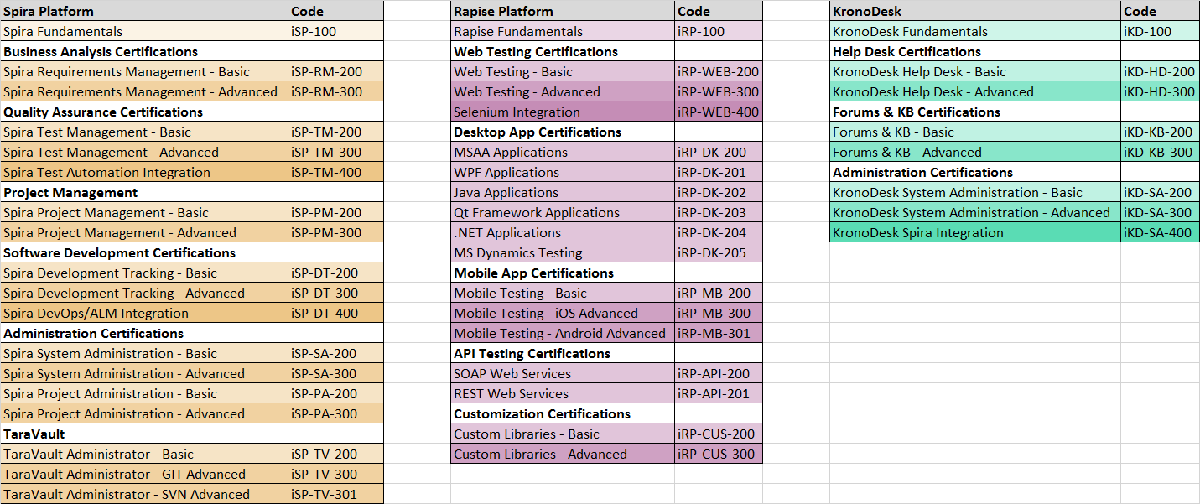
Training Initiatives
Developing curricula and training guides (see above)
Working w/ partners to create online courses using LMS
Free YouTube based videos for self-training

Slide 11
Demo of Velpic LMS Platform

Slide 12
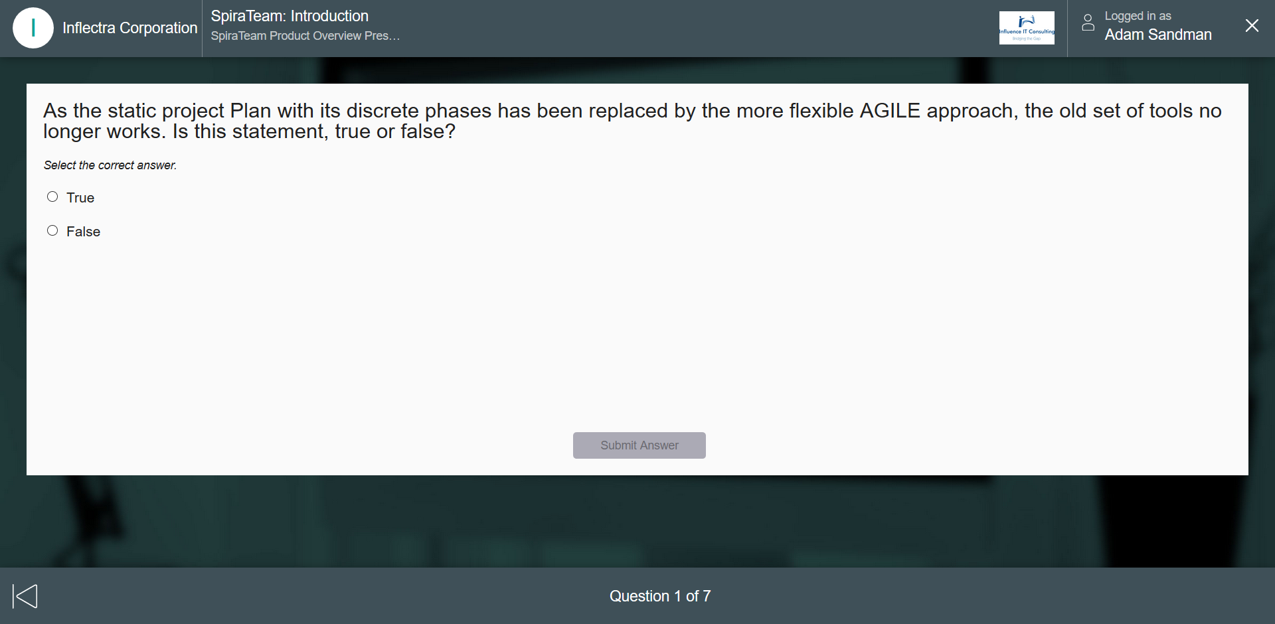
Screenshot of Velpic LMS

Slide 13
Partner Presentation: Intersys

Slide 14
Product Showcases

Slide 15
Overview: The Inflectra® Platform
KronoDesk®
IT Support & Help Desk Ticketing
SpiraTeam®
SpiraTest®
Requirements & Test Management
SpiraPlan®
Project Management & Defect Tracking
TaraVault™ - Source Code Hosting
Rapise®
Test Automation Platform (Web, GUI, Services)

Slide 16
Spira Show Case & Roadmap

Slide 17
SpiraTeam 5.2 Showcase
New incident list / detail page
Followers
UI Updates
Associations
Program planning board
Testing enhancements
Auto-suspect
Test set auto-scheduling on build
Ability to ‘hand-off’ pending test runs
Scheduled Release - April 7th, 2017

Slide 18
SpiraTeam – Near-Term Roadmap
Version 5.3 – Summer 2017
Personalized dashboards for developers, testers and managers
Tasks pages UI redesign to include new layout & fast loading
Tasks cross-project associations functionality
Instant Messenger Enhancements
New charts and graphs added to dashboards & core pages
High-level program planning milestone-views
Version 5.4 – Autumn 2017
Test configuration management, with support grid test data
Enhancements for exploratory and session-based testing
Cross-project associations for test cases
Test pages UI redesigns to include new layout and fast loading

Slide 19
SpiraTeam – Versions 6.x – Ideas for 2018
Document workflow functionality with steps, types, transitions and states, with electronic-signature
Major reporting and graphing enhancements
Integrated intelligent alerting system with AI diagnostics
Enhanced timecard management with support for hours-per-day level reporting
Support for financial estimations and tracking, and budget forecasting
Support for Earned Value Management reporting
Program Portfolio Management (PPM) Enhancements
Project Tracks and Personnel Groups for enhanced planning
Features for storing and managing freeform documentation
Support for custom plugins and widgets in Spira platform

Slide 20
Partner Presentation: PTA

Slide 21
Rapise Show Case

Slide 22
Rapise – Version 5.1 – Spring 2017
Specialized support for testing Microsoft web applications
Office365
Dynamics365
Rapise Visual Language – scriptless test design
General usability updates to streamline record/playback
Enhances REST API testing validation functionality
Sample frameworks using Rapise with Git or Microsoft TFS
Global File Object to streamline file handling

Slide 23
Rapise Showcase
Overview of Rapise
Record, Learn & Play
The SPY tools
Showcase of 5.0 and 5.1
5.1 - Rapise Visual Language
5.0 - SOAP and REST
Integration with NeoLoad

Slide 24
Rapise – Future Development Roadmap
Version 5.2 – Mobile & Web Enhancements
Integration with Kobiton mobile device cloud
Support for Apple Xcode XCUITest and Appium 1.6 (replaces UIAutomation)
Support for recording with Microsoft Edge Web on Windows 10
Support for recording test scripts during mobile testing when sending events
Version 5.3 – Data-Driven
Data-driven testing, integrated with planned SpiraTeam data-tables
Support for additional packaged applications based on customer feedback
Smart-Learn functionality for learning complex compound objects

Slide 25
Wrap-Up

Slide 26
Wrap Up
Feedback (+s and deltas)
Was this useful?
How can be harness this group going forward
Local meeting
Annual user summits
Other ideas?
Blogging opportunities
Other online platforms

