Slide 1

Company Overview
®

Slide 2
Who Are We?

Slide 3
Inflectra Helps You Deliver
Quality Software,
Faster and with
Lower Risk

Slide 4
Inflectra Core Values
Great Products: Build for Our Users Not Investors
  Building great software for customers, not chasing the latest fad.
Great Team: We Just Get it Done
  Treat customers well, solve their problems, no drama or red tape.
Great Workplace: Family and Life Flexibility
  Unlimited vacation, amazing benefits, flex/part time welcomed.
Great Community: Enabling Second Acts
  Expanding opportunities for new/second careers in technology.

Slide 5









Requirements
Management
Quality
Assurance
Risk Management
Software
Development
Project Management
Test
Automation
The Inflectra® Quality Platform
Program
Management
IT Service Management
Process Automation
Exploratory Testing
Integration Services
Agile &
DevOps

Slide 6




































































Our Customers (USA/Canada)
Energy, Industrial & Transport
Financial & Business Services
Media & Telecom
Government & Defense
Healthcare & Bio-Technology

Slide 7


















































Our Customers (Europe)
Energy, Industrial & Transport
Financial & Business Services
Media & Telecom
Government & Defense
Healthcare & Bio-Technology

Slide 8












































Our Customers (Global)
Asia
Middle East
Africa
Australia / NZ
Latin America

Slide 9






























Key Global Partners
North America
South America & Mexico
Asia
Europe
Australia
Middle East & Africa

Slide 10
How Are We Different?

Slide 11
harmony
Notes:
Make great products
Help you work together
Help you deliver your products faster, more easily, with less pain, and less stress
At a grand scale – we’re passionate about making products that you will find transformative to how you work.
We both want to use our tools every day to help you do a whole number of complex things, and at the same time get out of your way so you don’t need to worry about SpiraPlan and can instead focus on helping your own customers

Slide 12
How Do We Foster Harmony?
Across Disciplines
Through Simplicity
Across Ecosystems

Slide 13



Harmony Across the Disciplines
Testers
Developers
Managers
We consider each of these three stakeholders groups when designing our products, so that everyone in teams can get the most out of our products.

Slide 14


Simplicity = Productivity from Day One
Less Time Doing:
More Time Doing:
No plugins, customization or configuration needed day one

Slide 15
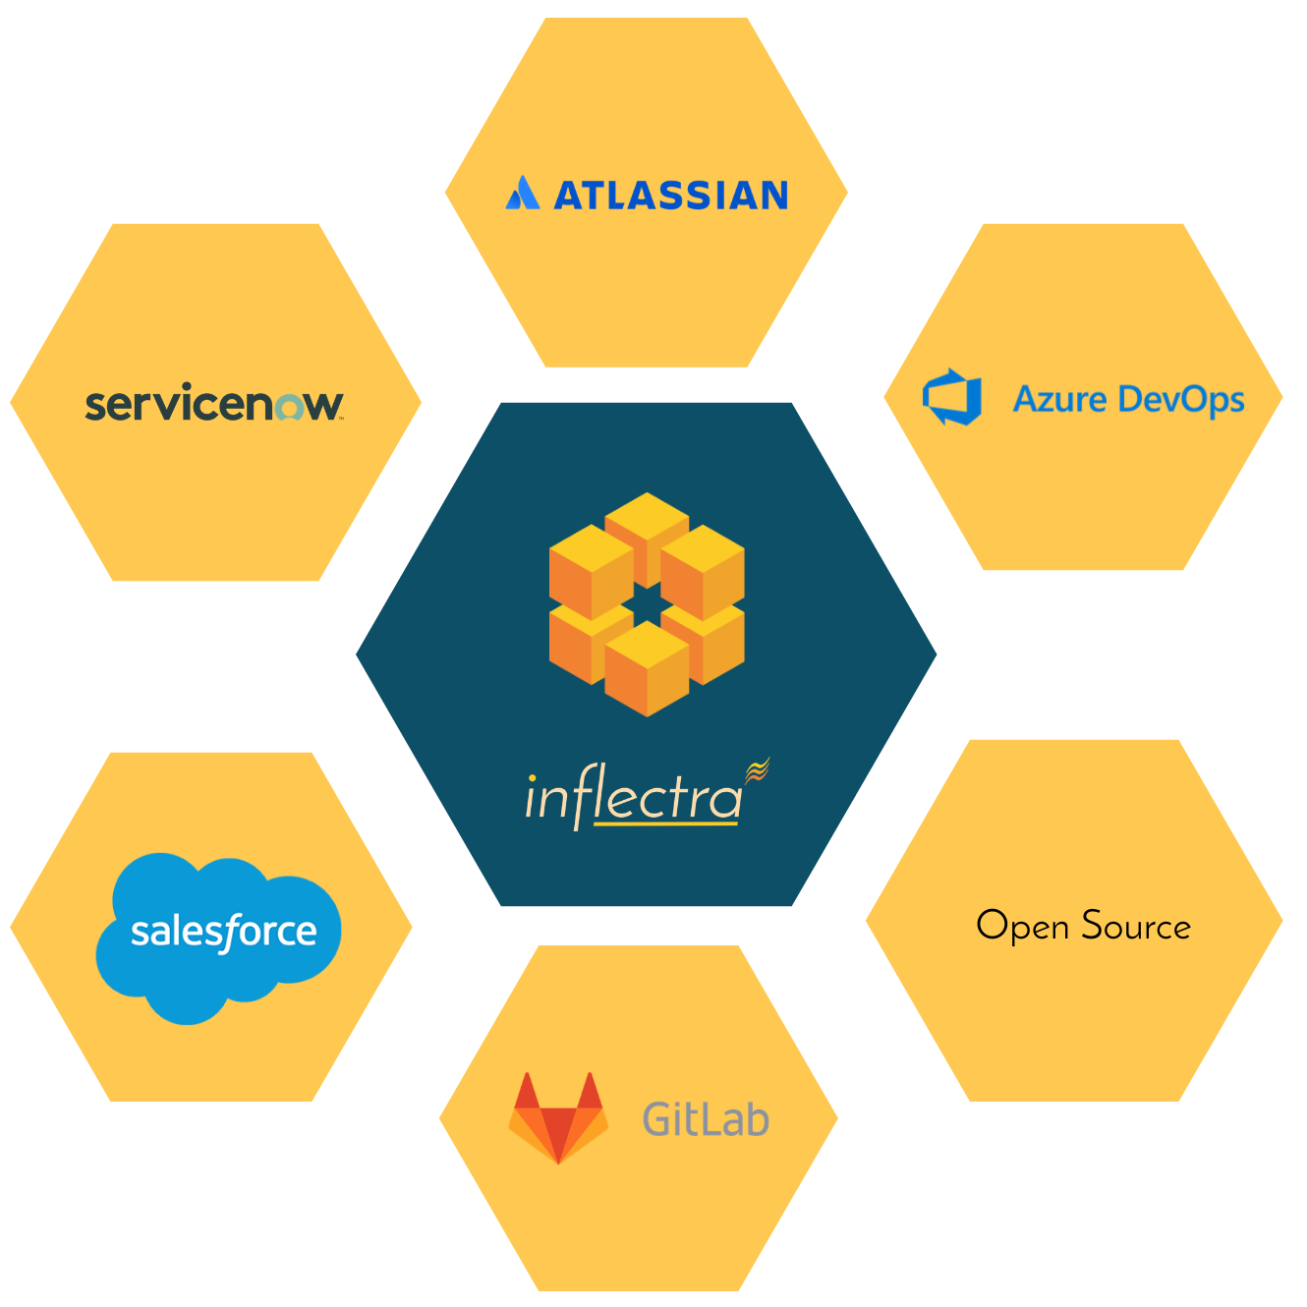
Harmony Across Ecosystems
We recognize that you need to integrate our solutions with other tools and systems
We make this easy and straightforward so you can get working faster & easier

Slide 16
Our Unique Sales Proposition
Reduced
Go-To- Market Time
Innovation Driven
Cost Efficient
Improved Business Process
Short learning curve, easy deployment
Easy and intuitive
SaaS option
Seamless migration/Import
Inflectra’s lightning fast response times & reactivity
Focus on new technologies
Responsive to market & customers needs
Integration with 3rd party tools
No extra modules to purchase
Simple concurrent licensing
Unlimited everything (storage, API calls, Projects, Products)
Single & transparent pricing
Cost vs. equivalent alternatives
One integrated tool, no
add-ons
Fully customizable
For Devs, Testers & Managers
Powerful reporting features
Integration with 3rd party tools

Slide 17
We offer unique features for different industries
While offering simplicity and usability for everyone

Slide 18
Specific Features for Regulated Industries
Auditability and end-to-end traceability
Data Privacy, Security
baked in
Generation of Compliance Documentation
Workflows & Electronic Signatures
Integrated Risk Analysis and Management

Slide 19

Bridging Between Agile and Compliance
Support for Regulated Processes
Modern, Agile Processes
Baselining
Risk Management
Electronic Signatures
Data Privacy
Compliance
Workflow
Requirements Mgt
On-Premise
CI / CD
Scrum
Kanban
Scaled Agile
DevOps
Distributed Teams
Remote Working
Cloud-Based

Slide 20
What Do Our Customers Say?
“
Working with enterprise software in the Finance/Accounting area, I open many support tickets for issues. This time, it's different. I just had to let your team know what a great product Spira is. We mostly need to perform manual tests of key system controls during the SaaS provider's upgrades throughout the year. I'm still learning the product. But, *every single time* I've thought "gee, I bet it doesn't do [fill in blank]," I'm proven wrong. Not only have I not experienced any pain points, but it's almost fun to use such a well-designed product that lets me get to work and get my job done efficiently. So, thank you.
- Michael Aust, Plenty Unlimited Inc.
“
The Customer Service is always quick and efficient to answers questions or issues, which have been few in the 4 years we have been on the product. They continue to develop new features and add to the base product, which is only helping it to grow and stay current with the latest development trends. I love that we have a turn-key solution hosted for us at an affordable price, something no other product we looked at could provide us for the money we had to spend.
- Vanessa Smith, Advent Health
“

Slide 21
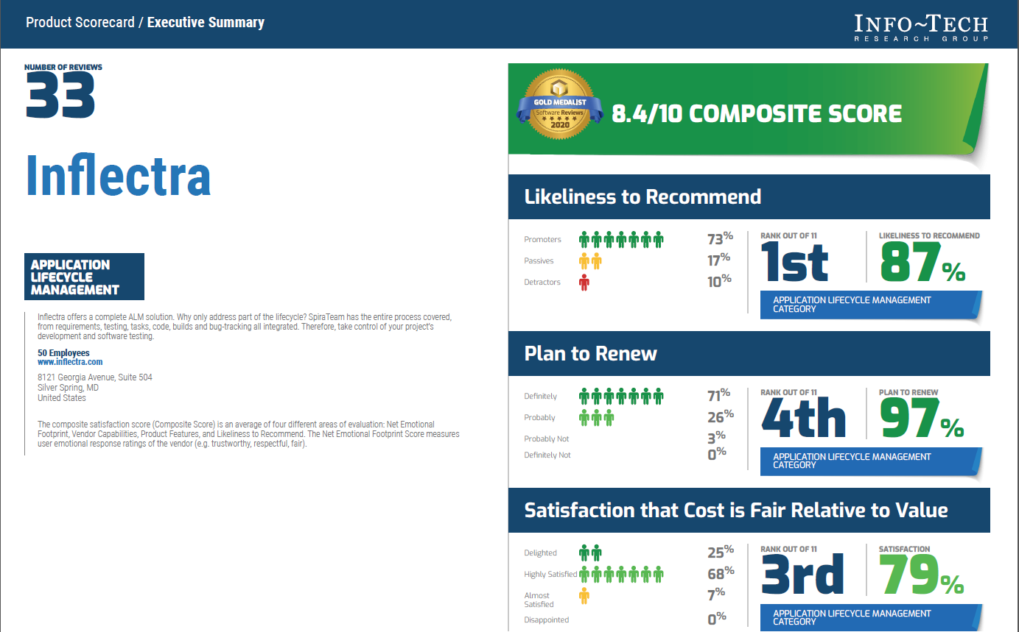
What People Say

Slide 22











Compliance with International Standards
EudraLex
Volume 4
Part I & II
Guidance on Data Integrity

Slide 23
What do we do?

Slide 24

The Inflectra® Platform
KronoDesk®
Customer Service Desk
SpiraCapture™
Exploratory Testing
SpiraPlan®
Agile Program & Portfolio Management for the Enterprise
SpiraTeam®
Agile Lifecycle Management for Teams
SpiraTest®
Test Management for Teams
TaraVault® - Source Code Management
Rapise®
Test Automation (Web, GUI, Mobile, Services)

Slide 25
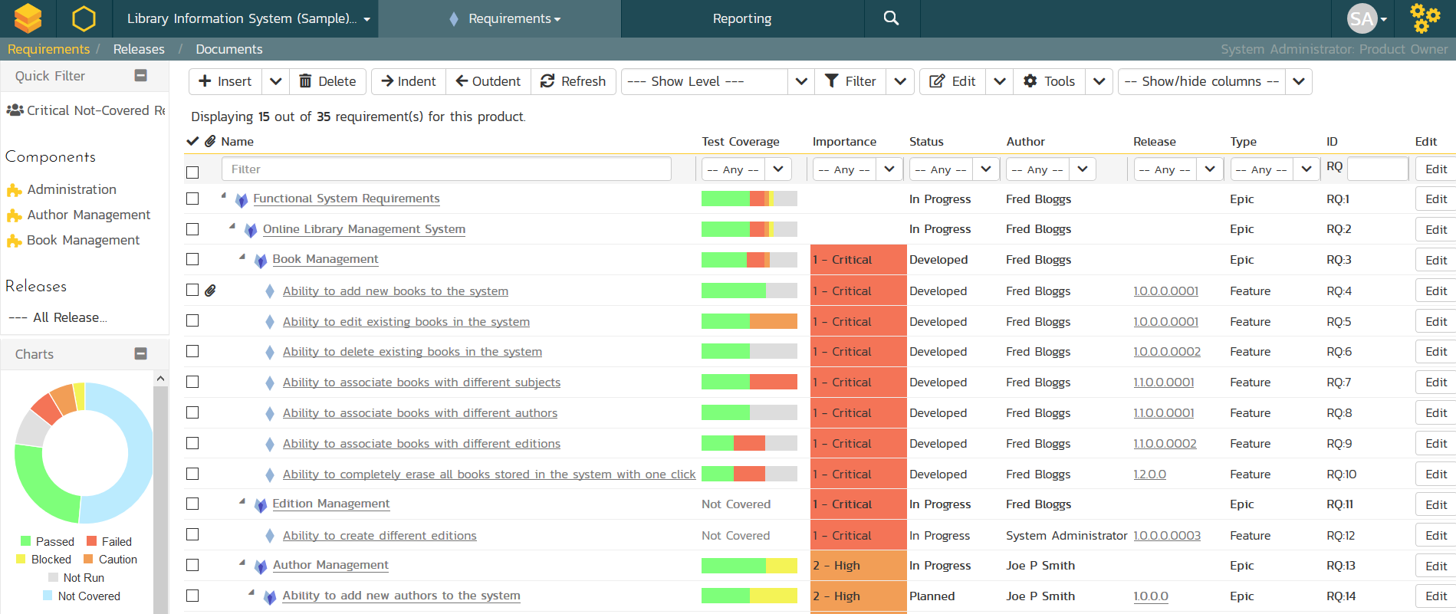
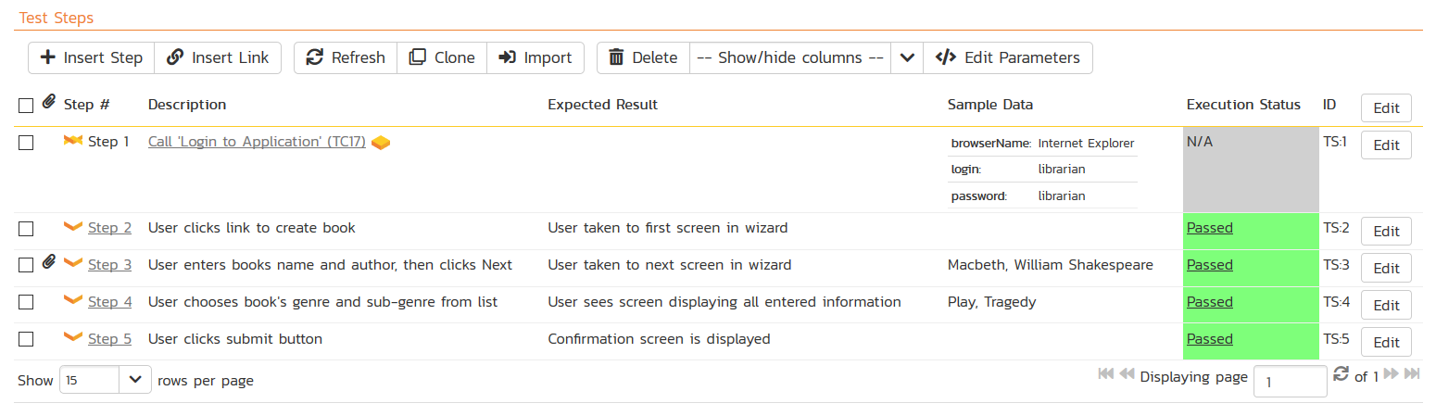
SpiraTest® - Requirements & Test Mgt
Requirements, test and defect management - integrated
End-to-end traceability and real-time reporting

Slide 26
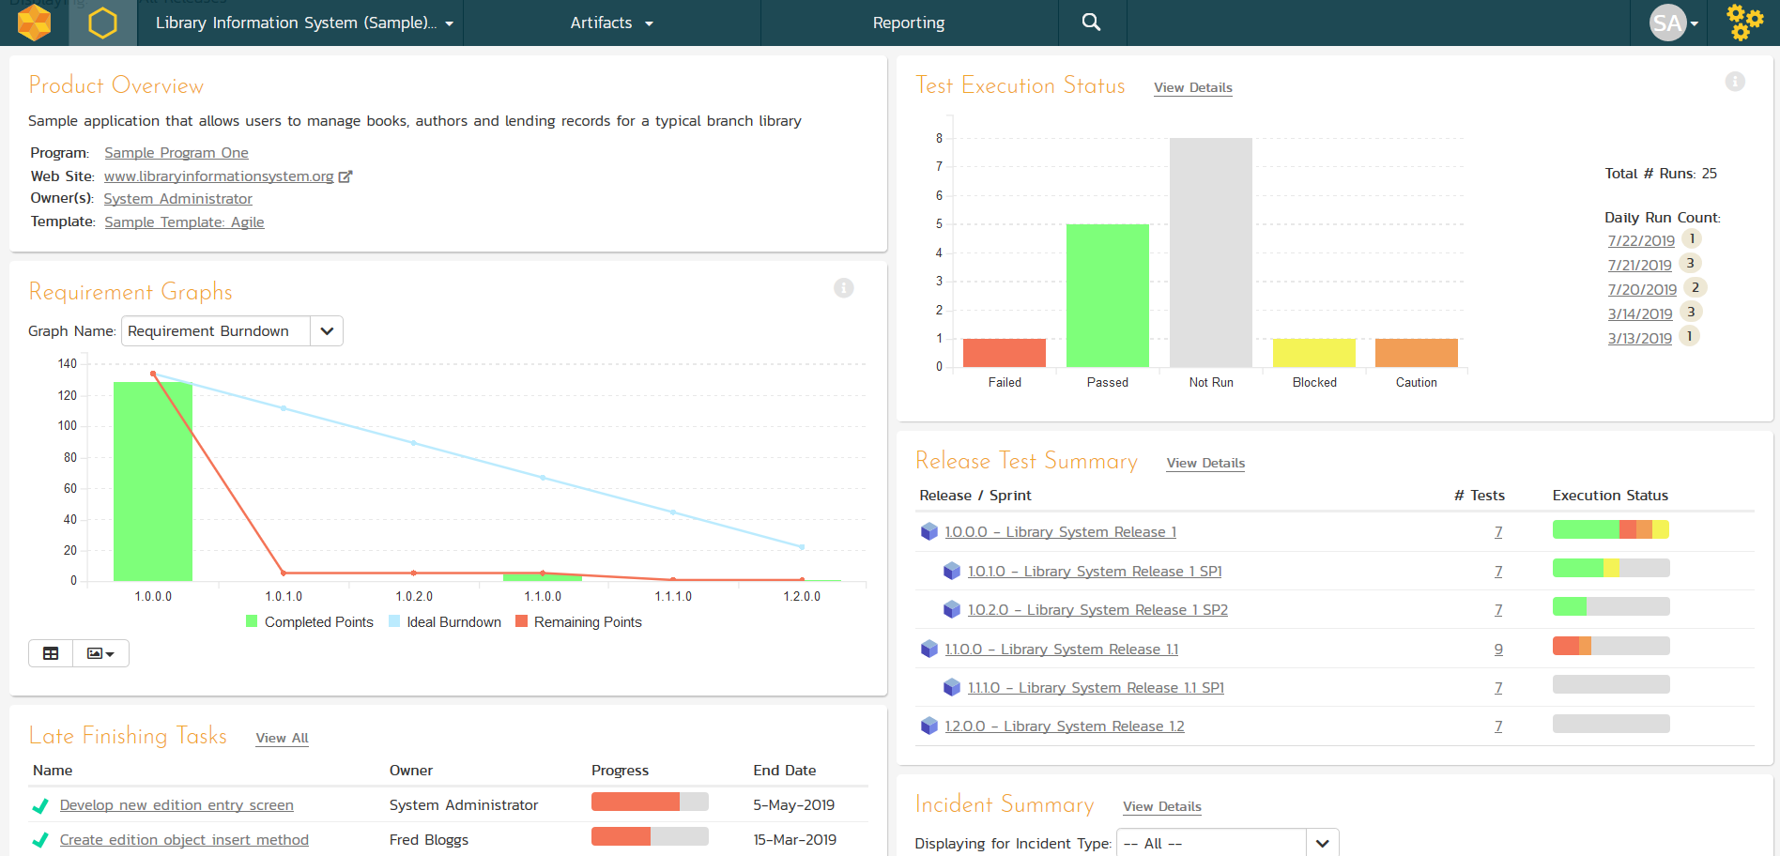
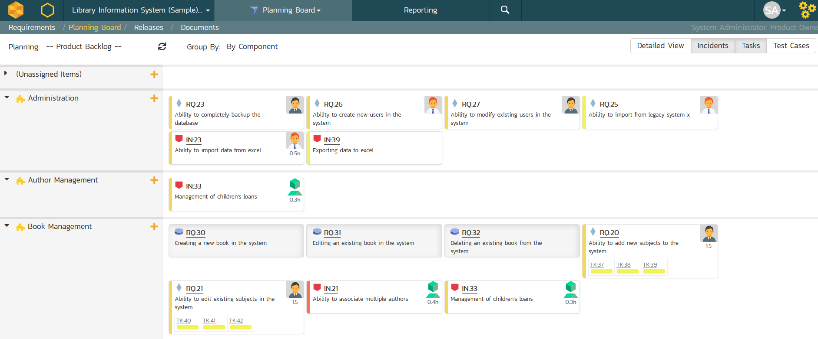
SpiraTeam® - Application Lifecycle Mgt
All of the SpiraTest features, plus agile project management
Supports Scrum, Kanban, waterfall & hybrid projects

Slide 27
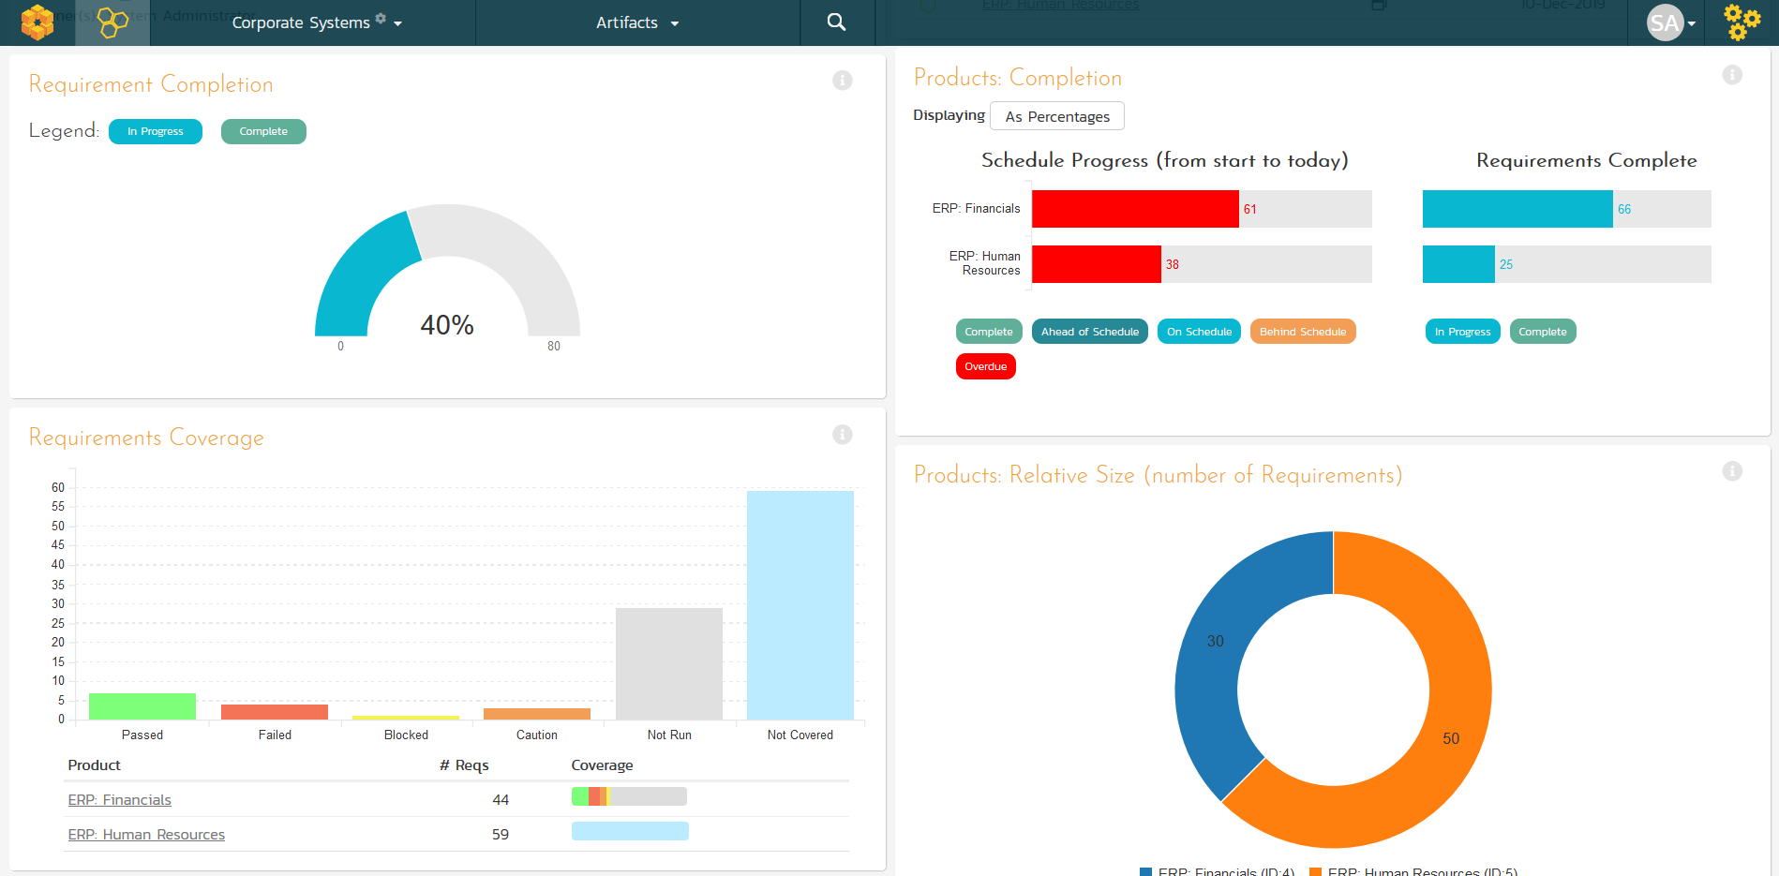
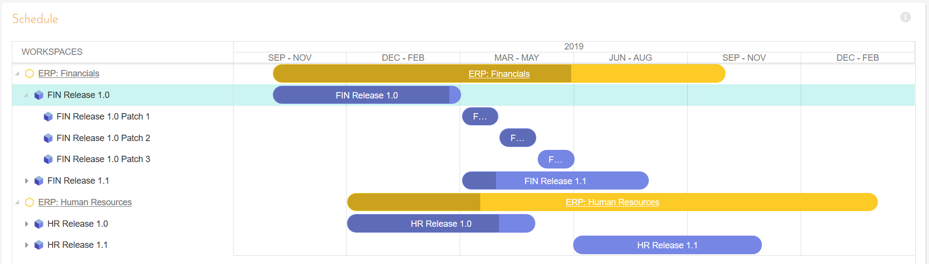
SpiraPlan® - Program & Portfolio Mgt
Extends SpiraTeam with program & portfolio management
Integrated enterprise risk management & tracking

Slide 28
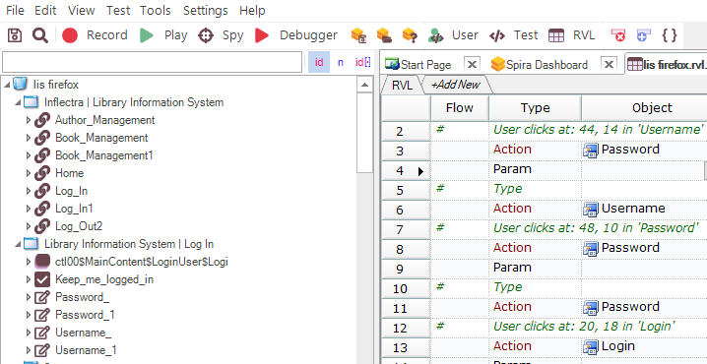
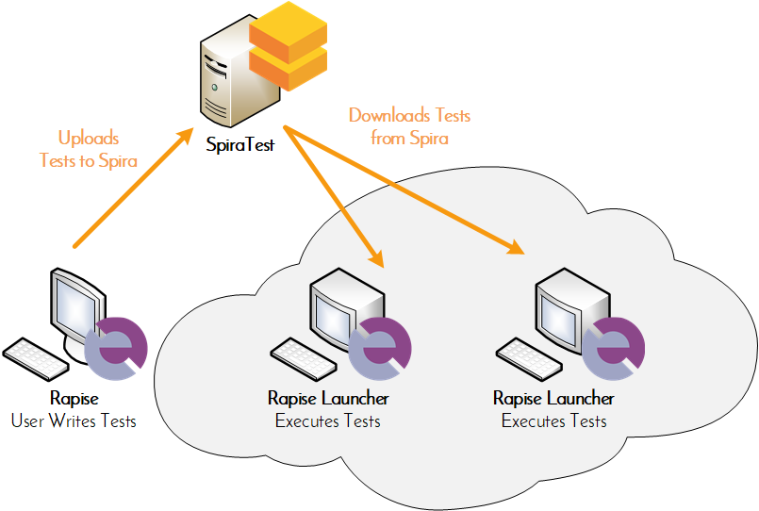
Rapise® - Intelligent Test Automation
Codeless test automation and RPA platform using AI insights
Handles web, mobile, desktop, and APIs in one system

Slide 29
RemoteLaunch® - Automation Integration
Host #1
Windows 2008
IE 8.0
Manual
Tester #1
RemoteLaunch®
Host #2
Windows Vista
Mozilla Firefox
SpiraTeam®
Repository
Manual
Tester #2
RemoteLaunch®
Host #3
Ubuntu Linux
Google Chrome
Manual
Tester #3
RemoteLaunchX®
Integrate automated testing tools with Spira

Slide 30
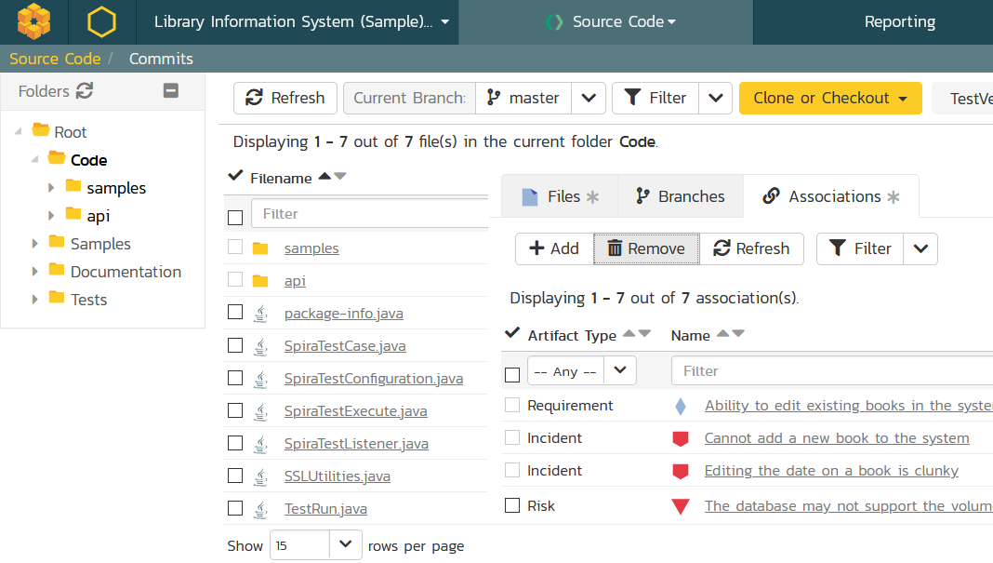
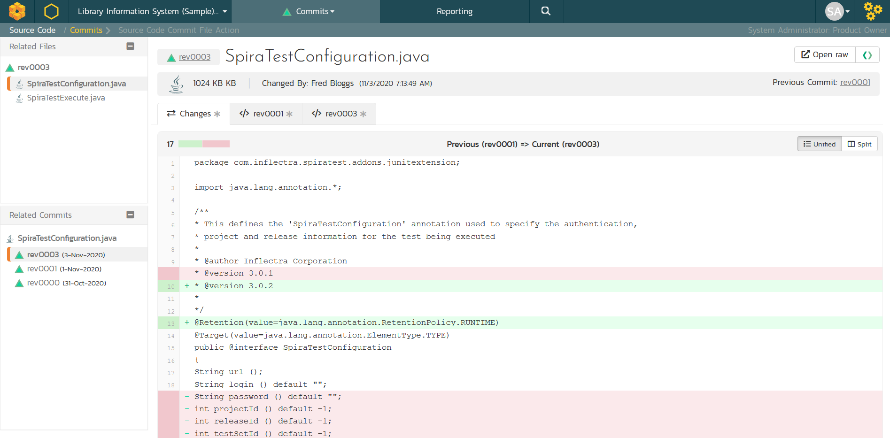
TaraVault® - Source Code Management
Cloud-hosted code repositories (Git & Subversion)
Integrated code viewing and artifact traceability
Support for pull requests and merge workflows

Slide 31
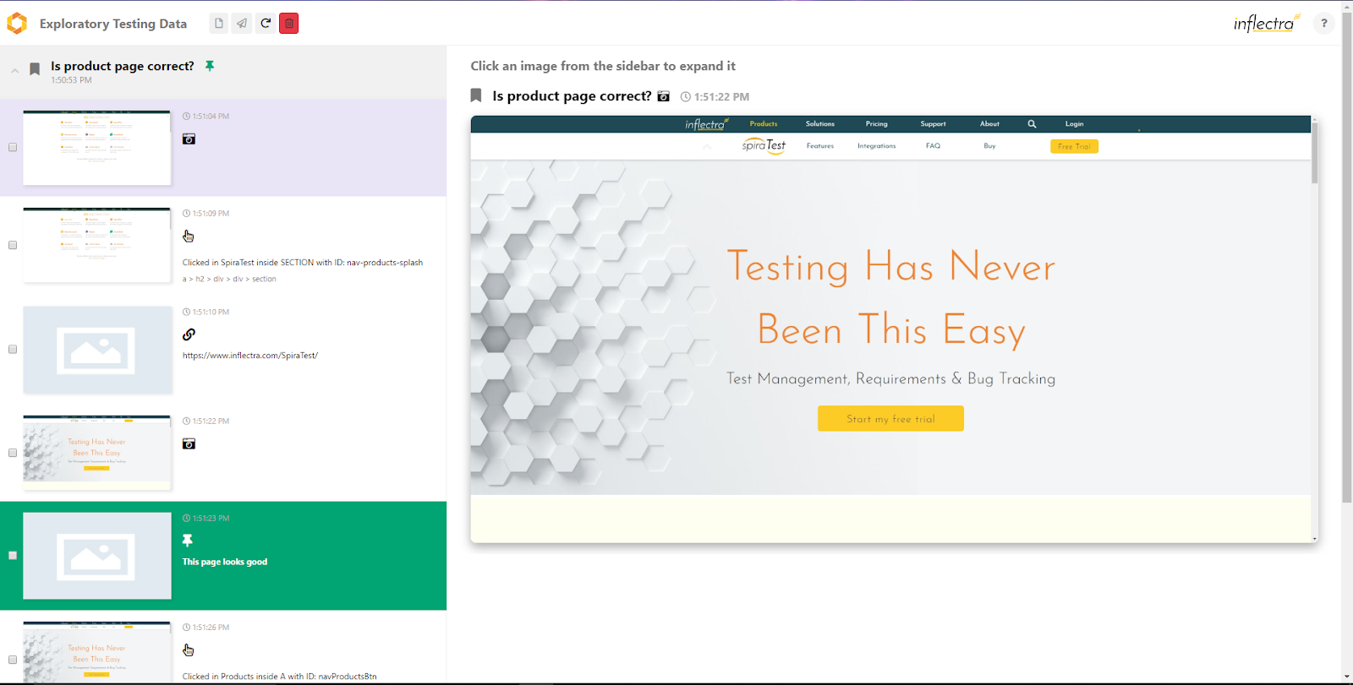
SpiraCapture™ - Exploratory Testing
Chrome extension that captures activity & screenshots
Records and organizes your testing sessions

Slide 32
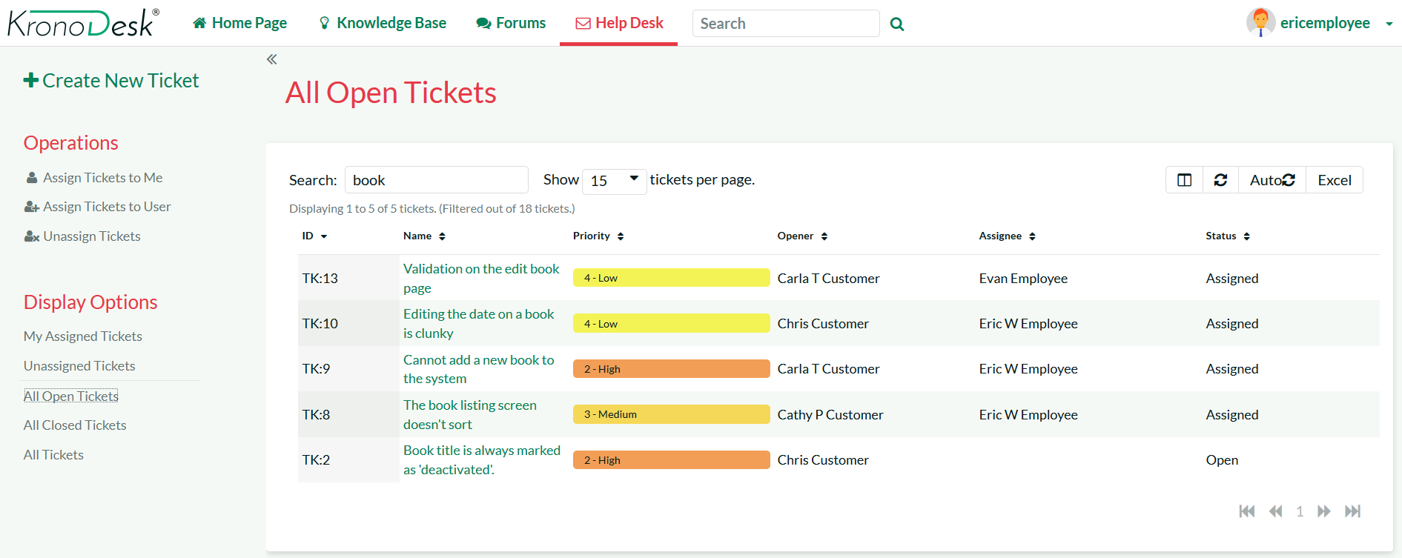
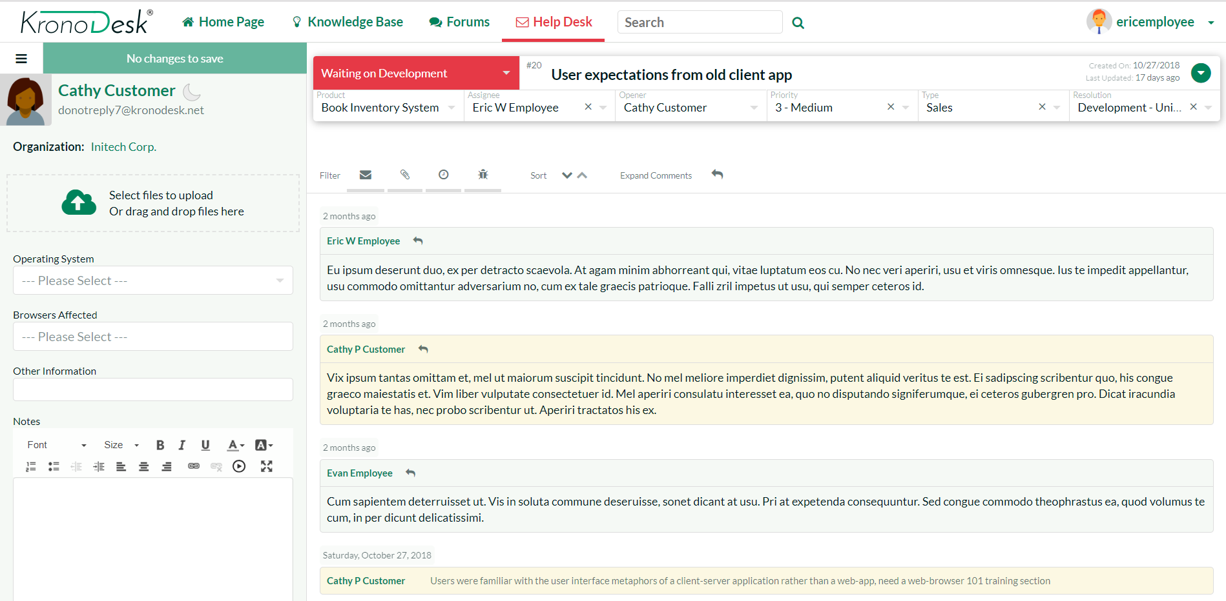
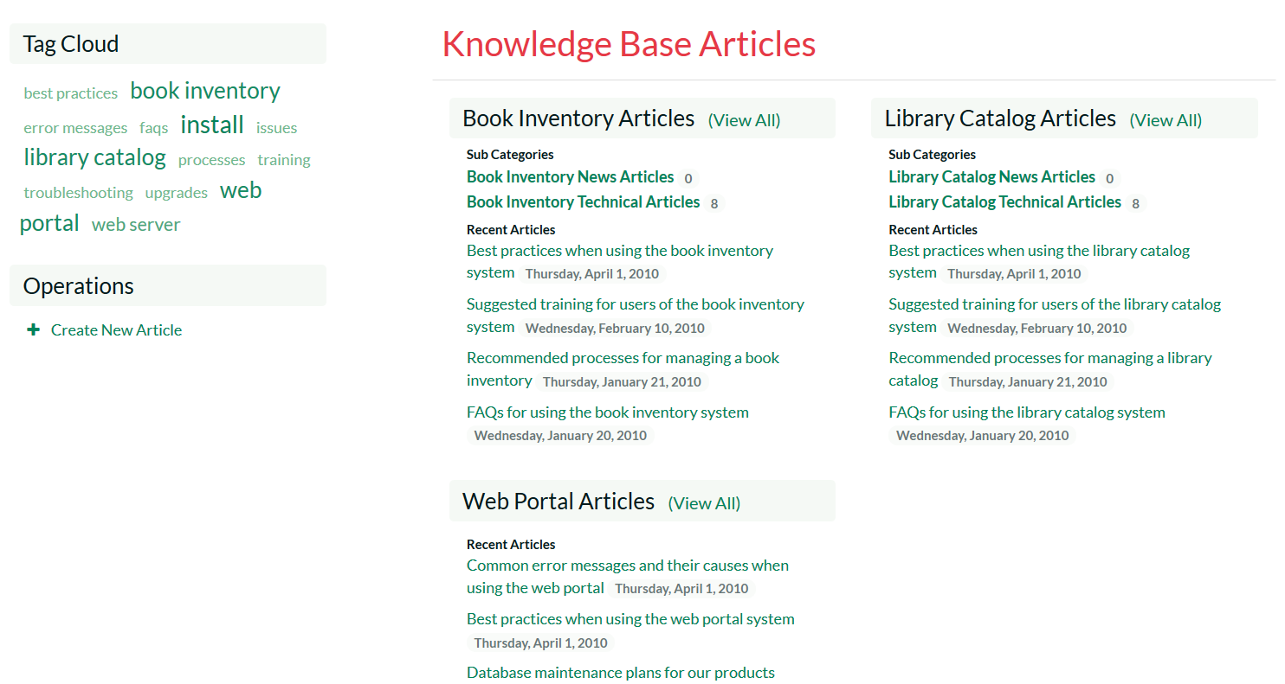
KronoDesk® - Support & Help Desk

Slide 33
Questions?

