Slide 1

COMPANY OVERVIEW
®

Slide 2
Why Inflectra?
WE BELIEVE QUALITY SHOULD BE AT THE CORE, DO YOU?

Slide 3
When A Single Point Of Failure
Is Not An Option
INFLECTRA HELPS YOU DELIVER QUALITY SOFTWARE, FASTER AND WITH LOWER RISK

Slide 4



With Inflectra, Deliver Measurable Quality Fast!
Only 16% of software development projects are completed on time and within budget.
PRODUCT MANAGERS
QUALITY ASSURANCE
SOFTWARE TESTING
52%
of time spent on un-planned “fire-fighting” activities
40%
of software budget spent on Quality Assurance
5%
of companies carry out fully automated testing internally
60%
of businesses lack a plan to enhance their PM process
39%
of software projects fail due to poor requirements gathering
24%
of companies saw ROI uplift from automated testing
39%
of managers that worry about missing launch date
67%
of customers cite “bad experience” with products as their churn reason
35%
of companies use non-testers for software testing
Sources: “Software Survival in 2024”, Beta Breakers; “10 QA Statistics”, Testlio; “Product Management Statistics”, UXCam; “Software Testing Statistics – 2024”, TrueList

Slide 5



Leadership Team
Adam Sandman, Founder & Chief Executive Officer
Founded Inflectra in 2006, with 30+ years of industry experience; responsible for product strategy, technology innovation, and business development
Prior experience as a Director at Sapient Government Services leading their development work with the US Navy, commercial clients, and other government agencies
Masters Degree in Physics from the University of Oxford.
Thea Maisuradze, Chief Revenue Officer
Driving revenue growth and global market expansion through strategic leadership in marketing, business development, and partnerships
Over 20 years of developing and executing communications strategies across business and public sectors, increasing brand awareness and lead generation
Masters of Arts in Law and Diplomacy from The Fletcher School at Tufts University, with expertise in international relations, strategic negotiation, and business diplomacy.
Simon Bor, Chief Technology Officer
Responsible for leading Inflectra’s initiatives and strategic direction for product development, hosting, customer support, IT, and security
Prior experience at the UK Treasury, World Bank, and International Monetary Fund (IMF) overseeing high-profile multi-billion-dollar programs, managing inter-disciplinary teams and providing financial and strategic oversight
Masters Degree with joint honors in Political Science and Medical Science from the University of Cambridge.

Slide 6
How Are We Different?
WE HAVE A FUNDAMENTALLY DIFFERENT APPROACH TO OTHER COMPANIES

Slide 7











Inflectra: Delivering Mission-Critical Software Without Sacrificing Agility or Compliance
FOR REGULATED PROCESSES
INFLECTRA’S CORE PRODUCT SUITE
FOR AGILE PROCESSES
End-to-end requirements traceability
Security & data privacy (cloud & on-premise)
Baselining, audit trails & customizable reporting
Fully integrated risk management
E-signatures, timesheets and customizable workflows
AI-powered & Agile functionality
Scaled agile development support
Framework-agnostic for DevOps
CI/CD
Full functionality for distributed and remote-working teams
SpiraPlan®
SpiraTeam®
SpiraTest®
SpiraApps
DataSync™
SpiraCapture™
Rapise®
KronoDesk®
Testers: Manual, automated, or exploratory testing at full agile speed
Developers: Comprehensive visibility into the development toolchain
Managers: Unified & single source project management for projects of all sizes

Slide 8
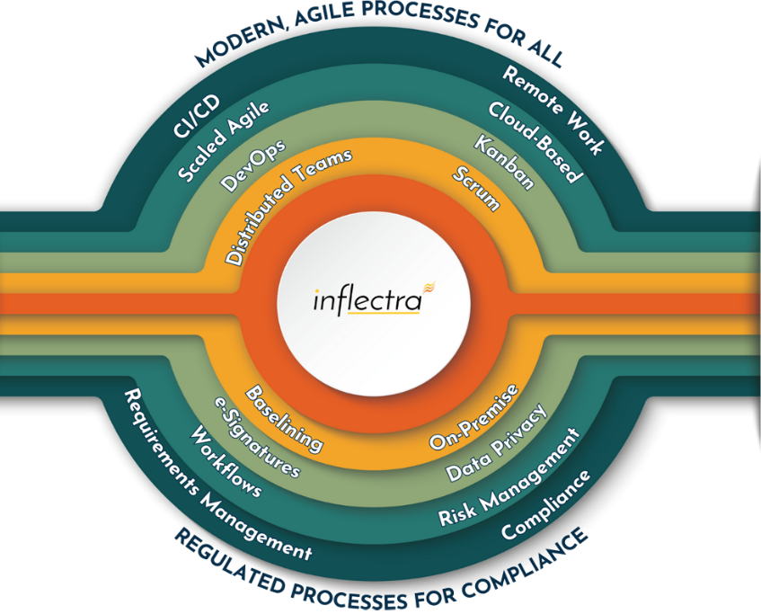
Delivering Value With Quality At Its Core
70%
Lower
Cost
80%
More Coverage
30%
More Efficiency
Ability to consolidate multiple tools across the application lifecycle, creating opportunities to reduce costs and scale down the number of applications in which teams are required to use, maintain, and learn
Achieve more test coverage and deliver high-quality software effortlessly, enabling code-free test automation and accelerated processes in relation to competitors, freeing up time for other essential or mission critical tasks
Streamlines workflows across project and risk management, scaled agile, DevOps, and test automation providing the ability to identify and bridge the gap between areas of inefficiencies

Slide 9
Our Unique Value Proposition
Easy learning curve, fast deployment
Easy and intuitive
Extensive partner support
Seamless migration/Import
Same-day support
Dedicated success manager
Generative AI leader
Customer-driven roadmap
Industry-specific features
InflectraCON thought leadership platform
Peer-to-peer knowledge sharing community
EFFICIENT
INNOVATIVE
Concurrent licensing
No hidden extra costs
Unlimited named users, storage, API calls, projects
Flexible scale-up/down
30-day free trials
Available on AWS Marketplace
ECONOMICAL
EFFECTIVE
Integrated platform
Fully customizable
Built for multiple personas
Powerful reporting features
Integration hub for other tools
SpiraApps tailored to your process and workflow

Slide 10
Our Core Values
Built for Customers not Wall Street
Building great software for customers, not chasing the latest fad. Your feedback and ideas are directly incorporated into the product roadmap.
Supported by Experts
The engineering experts who built the software directly support customers and solve their problems
Family and Life Flexibility
Team enjoy unlimited vacation, flexible hours and other benefits. Low staff turnover benefits customers with knowledgeable support and assistance year after year.
Continuous Community Enablement
Invests in Knowledge Sharing, University Students, Career second acts of employees and sponsorships of various meetups and events that focus on technology quality

Slide 11





A Complete, Out of The Box Solution
Test
Management
3
Requirements Management
Program
Management
Automated
Testing
Risk Management
AI-Powered Functionality

Slide 12
























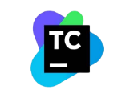




Extensive Integrations & Migrations
80+ INTEGRATIONS
35+ BUILT-IN MIGRATIONS

Slide 13
Industry-Specific Use Cases
WHILE OFFERING FLEXIBILITY AND USABILITY FOR EVERYONE

Slide 14
Features for Regulated Industries
Auditability and end-to-end traceability
Data Privacy, Security
baked in
Generation of Compliance Documentation
Workflows & Electronic Signatures
Integrated Risk Analysis and Management

Slide 15


Healthcare, Life Sciences & Bio-Tech
Electronic signatures for FDA 21 Part 11 compliance
Secure hosting with support for HIPAA BAA agreements
End to end traceability of requirements, tests, and code
Validated platform where you control update cadence
Learn more

Slide 16

Financial Services & Insurance
Secure cloud platform (SOC2) or on-premise deployment
Integrated enterprise risk management
Integration with automated testing and compliance tools
End-to-end traceability and auditability of testing
Helps You Manage Compliance: DORA, SOX, BASEL III
Learn more

Slide 17

Energy, Industrial & Automotive
Testing for public safety with world class test management
Define requirements and test for compliance
Integrate standards and regulations into your test plans
Understand and manage risk of critical systems
Support for Failure Mode & Effects Analysis (FMEA)
Learn more

Slide 18

Defense, Government
& Aerospace
Manage programs and portfolios across platforms
Test step level traceability for mission systems
Automate testing and compliance with RemoteLaunch
Orchestrate System of Systems (SoS) development
Security and privacy with on-premise and AWS GovCloud
Learn more

Slide 19



Security & Compliance
Our cloud platform is SOC2 Type II certified
Our website and payment systems are PCI-DSS certified
Data encrypted in transit and at rest using strong ciphers
Multi-factor authentication (MFA) and Single Sign On (SSO)
Physical infrastructure provided by Amazon Web Services.
Learn more

Slide 20














Compliance with International Standards
Guidance on Data Integrity
EudraLex
Volume 4
Part I & II

Slide 21
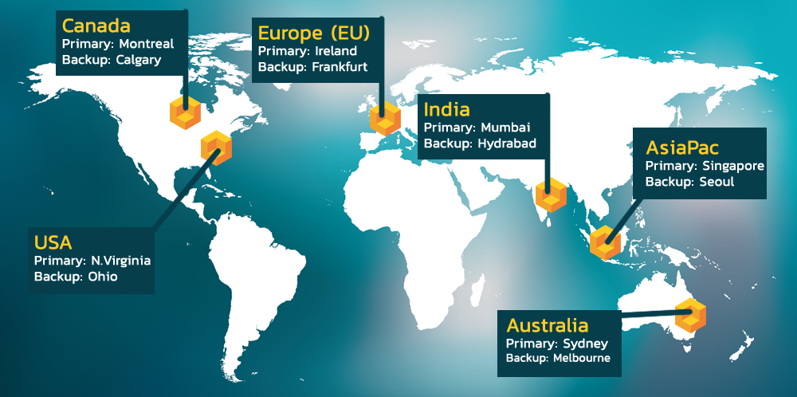
Hosting: Data Privacy and Sovereignty Built In

Slide 22































Representative Customers
Energy, Industrial & Transport
Financial & Business Services
Media & Telecom
Government & Defense
Healthcare & Bio-Technology

Slide 23
What Do We Do?
THE INFLECTRA PLATFORM, PRODUCTS & SERVICES

Slide 24







The Inflectra® Platform
SpiraPlan® - Agile Program & Portfolio Management for the Enterprise
SpiraTeam® - Agile Lifecycle Management for Teams
SpiraTest® - Test Management for Teams
DataSync™ - Seamless
Data Synchronization
SpiraApps™ - Spira
Extensibility Framework
SpiraCapture™- Free
Exploratory Testing
Rapise® - AI-Powered Test Automation
KronoDesk®- Customer Service Desk
RemoteLaunch® - Test Orchestration

Slide 25


Generative AI Capabilities
Spira and Rapise leverage Generative AI to enable autonomous testing, eliminating the need for hand-written automation scripts and driving increased efficiency
SPIRA PLATFORM
RAPISE PLATFORM
AI Overview: Generates downstream artifacts from requirements and user stories
AI Overview: Creates automated test scripts from manual tests, perform autonomous testing
Use Cases: Test cases, test steps, tasks, BDD scenarios, and risks
Use Cases: Generate test data, navigate application, run manual tests as automated, execution analysis.
Future Roadmap: Expand upon types of data created and models supported
Future Roadmap: Additional agentic workflows that further leverage application contextual data.

Slide 26




Spira Platform Snapshot
Capabilities
SpiraTest
SpiraTeam
SpiraPlan
Requirements Management
Test Management & Traceability
Defect & Issue Tracking
Agile Planning Tools
Program & Portfolio Planning

Slide 27











SpiraTest® - Requirements & Test Management
KEY FEATURES & BENEFITS
DIFFERENTIATORS
Centralized management of all factors that impact testing, including requirements, defects, and reporting
1
Modern UI with ease-of-use in mind; quick access to insights and consistent functionality
Easy-to-use, automated bug & issue identification for tracking, prioritization, and resolution of defects before they impact users
2
True “out-of-the-box” platform with a full set of capabilities that can be set up in as little as 10 minutes
Cross-project data storage; simple reporting across projects via pre-built dashboards
3
Streamlined planning, execution, and tracking of testing, including test case management and exploratory testing
Robust set of default workflows for customers in highly regulated industries
4
Extensive and pre-built integration library bolsters in-house capabilities; no need for dedicated admin to manage plug-ins
End-to-end traceability of product releases, tested requirements, and resolved defects, with electronic signature capabilities
5
POPULAR INTEGRATIONS
END USER(S)
95%
40%
30%
Test Managers
QA Managers
Software Testers
Project Managers
Developers
requirements coverage
faster test cycles
cost
reduction
AWS Bedrock

Slide 28










SpiraTeam®- Application Lifecycle Management
KEY FEATURES & BENEFITS
DIFFERENTIATORS
Fully integrated project / requirements management and an extensive integration library to eliminate inefficiencies from overlapping tools
1
Robust data roll-up capabilities across all dimensions – product, component, requirements, release, and team
2
Extensive built-in integration library for easy connections to all solutions with zero limitations
Quality assurance (QA), risk management, and collaboration capabilities to ensure visibility into all aspects of the software development lifecycle
3
Pre-existing niche artifact types to address specific use cases and ensure adherence to best practices
Specialized artifact types, built-in workflows, and advanced dashboards to provide an “out-of-the-box” experience for any team
4
Various project planning views for different roles within the team that can handle both planned and adaptive lifecycles
5
Operates in both cloud and on-premise hosting environments
Complete support of all development methodologies, whether Agile, Waterfall, or hybrid
POPULAR INTEGRATIONS
END USER(S)
Project Managers
QA Managers
Business Analysts
Software Testers
Developers
Chief Information Officer (CIO)
40%
30%
35%
cost
reduction
faster time
to market
better
productivity

Slide 29







SpiraPlan® - Program Management for Scaling Agile
KEY FEATURES & BENEFITS
DIFFERENTIATORS
Enterprise-grade agile planning & execution capabilities enable the user to have a 360-degree view of all projects and programs
1
Truly holistic solution that allows full planning, development, and testing in one solution, eliminating the need to purchase multiple products
2
Focus on “built-in”; with integrations, capabilities, artifacts, and more all included to minimize limitations
Fine-tuned capabilities such as baseline management, configuration management, and version control that are tailored to the complex compliance & quality standards of regulated industries
3
Tailored for highly regulated industries, enabling customers to deliver high quality, mission-critical software without sacrificing speed for compliance
4
OData API for dashboard / report creation with customized queries from common reporting tools (e.g., Excel, PowerBI)
Fully ecosystem-agnostic integrations and various deployment options, designed to fit the needs of any enterprise
5
Operate in both cloud and on-premise hosting environments
Enhanced automation through generative AI, driving efficiencies in creation of project artifacts from requirements and generation of test cases
POPULAR INTEGRATIONS
END USER(S)
Program & Project Managers
Risk Management Professionals
Portfolio Managers
Chief Information Officer (CIO)
30%
40%
30%
faster
delivery
fewer
defects
reduced
risk

Slide 30








Rapise® - Codeless Test Automation
KEY FEATURES & BENEFITS
DIFFERENTIATORS
AI-powered test automation platform for web / mobile / desktop applications, APIs, and enterprise resource planning (ERP) systems
Cross-functional capabilities that allow teams of automation engineers and testers to create highly efficient automated tests in tandem
1
Ability to automate testing for both user interfaces and APIs in both a script-less and JavaScript code environment, driving flexibility in end user type and maximum ROI
Intelligent recording, spy / object manager, self-healing locators, and reusable frameworks and components allow for easy maintenance
2
Extensive set of pre-existing libraries tailored to common applications / platforms such as Salesforce, Microsoft Dynamics & Office, Oracle Forms, ServiceNow, and SAP HANA
Tailored for highly regulated industries, enabling customers to deliver high quality, mission-critical software without sacrificing speed for compliance
3
Translates human-readable test steps into executable scripts using AI-enhanced natural language processing, enabling less technical team members to contribute.
4
Utilizes AI-driven object recognition for dynamic and complex UIs. Automates the maintenance of test scripts through self-healing mechanisms that adapt to changes in application interfaces.
POPULAR APPLICATIONS
END USER(S)
35%
40%
45%
Automation Engineers
Test Leads
QA Engineers
SDETs
Software Testers
faster
testing
productivity boost
better
ROI

Slide 31
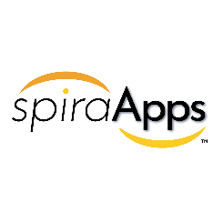


Add-On Products
Extends Spira® Platform (SpiraTest, SpiraTeam, SpiraPlan) with customizable features to meet specific industry needs and compliance requirements.
Offers modular SpiraApps to dynamically adapt workflows, optimize SDLC processes, and maximize ROI.
Integrates with AI solutions like ChatGPT, Azure OpenAI, and AWS Bedrock for automated test generation, risk analysis, and streamlined project management.
Quick installation with support for integrations like GitHub, GitLab, AWS Bedrock, and CircleCI for a unified workflow experience.
Supports third-party development and monetization of SpiraApps, expanding functionality and fostering innovation.
DataSync is a data synchronization tool designed to automate and streamline integrations between Spira and external platforms, ensuring real-time updates and consistent data across systems.
Automatically reflects changes across all connected tools, reducing
manual work and ensuring teams stay aligned.
Adapts to any operational need with cloud, on-premise, and hybrid deployment models, making it ideal for businesses of all sizes and industries.
Comprehensive and developer-friendly, DataSync offers advanced data mapping, multi-instance support, and a centralized dashboard for easy management and troubleshooting.
Ensures data integrity with robust security features and scales effortlessly to handle growing business requirements, including complex hybrid environments.

Slide 32




Add-On Products
Browser-based testing capture tool that enables secure recording of exploratory testing sessions
Automated tracking of clicks & keystrokes on each tab being recorded
Logging of steps for each testing session and notes for specific issues encountered
Delivered as “freemium” product; viewed as additional lever of future product-led growth for the Spira suite
B2B service desk solution for cloud & on-premise installations that integrates tightly with all Spira products to keep product teams informed
Built-in knowledge base, help desk, and forums capabilities with a powerful ticketing system that facilitates communication with the end customer and enables prioritization
Centralization of all customer communications enables a streamlined approach to customer support
Complete configurability allows for adaptability to any customer support workflow
Quick set-up and easy-to-use ticket creation & management, with an existing email integration
Robust and customizable reports for effective visualization of the entire customer support engine with easy KPI tracking (e.g., ticket volume, resolution times, customer satisfaction, etc.)

Slide 33


Add-On Products
Accelerators
Extension of the Spira suite that enables orchestration of automated regression testing (manual & automated)
Open architecture to allow for use in tandem with SpiraTest or other test automation tools, whether commercial (HP Unified Functional Testing, TestComplete) or open source (Selenium, Playright)
Facilitates scheduling, execution, and management of automated test scripts, allowing for full oversight of distributed test labs from a central SpiraTest server
Flexible deployment (cloud, on-premise, hybrid) to suit the needs of all end users
Real-time and detailed reporting delivers a holistic view of manual & automated testing with screenshots, log files, and QA metrics
Primary target users are automation engineers, but also test managers and QA managers
Pre-defined packages of professional services for specific customer objectives
Each package is associated with specific outcomes & deliverables, offered at a fixed price vs. hourly
Provides smaller organizations & teams access to the expertise of Inflectra’s global solution partner network
Offerings are incremental to Inflectra’s existing customer support and other services

Slide 34





Customer Onboarding & Self-Guided Enablement
1
2
3
4
5
Getting Started Videos
Introduces our products and walks you through your first 10 days.
Inflectra Campus
Online Training
Includes free introductory courses followed by paid advanced modules and certificates
Live Webinars
& Q&A
Regular webinars on key product releases, customer roundtables, and other interactive sessions
YouTube
Channel
Recordings of our webinars, advanced product insights and other key Inflectra information
InflectraCon360
Thought leadership content from industry leaders, Inflectra customers and partners
Learn more
Learn more
Learn more
Learn more
Learn more

Slide 35





Technical Support & Customer Success
1
2
3
4
Live Tech Support
Legendary technical support via email, phone, forums. Free standard support with every purchase.
Knowledge Base
A repository of expert-written articles covering product troubleshooting, best practices, and tips & tricks.
Documentation
Quick-start guides, in-depth manuals, and integration instructions for smooth deployment & optimal performance.
Account Managers
Experienced account executives providing strategic guidance from pre-sales consultations through the entire lifecycle.
Premium Support
Combined advanced customer success and tailored technical support delivered by highly skilled professionals.

Slide 36
Stronger with Partners
MEET OUR GLOBAL PARTNERS

Slide 37
























Partnership Ecosystem
SOLUTION PARTNERS
TECHNOLOGY PARTNERS
TIERS
# PARTNERS
AREAS OF FOCUS:
  Artificial Intelligence (AI)
  DevOps & CI/CD
  Test Automation
  Device Management
  Modeling Tools
Platinum
9
Modernization
Agile Transformation
Implementation Services
Training
Load Testing
Gold
10
Silver
31
Blue
69

Slide 38
Inflectra Partnership Program
OUR PARTNER PERSONAS
PARTNER PROGRAM HIGHLIGHTS
1
Our Solution Partners (Affiliates, Resellers, Advisors, Consultants, Trainers) deliver exceptional customer value with Inflectra products.
Dedicated Partner Account Manager
Personalized platform training
On-demand, in-depth, methodology-specific training and certification
Co-marketing opportunities
License discounts and free training licenses
Sales resources including platform comparisons, decks and demo transcripts
Development resources and support access.
2
Our Technology Partners collaborate to:
Integrate advanced solutions
Deliver seamless experiences for shared customers
Optimize Inflectra tools with: Plug-ins, Adapters, Connectors, Technical services
FEATURES FOR PARTNERS
“Together, we empower innovation and elevate joint success serving our customers.”
-Jessica Moore, Alliances, Inflectra
Account Mapping
Partner Portal
Certification Badges

Slide 39
How Our Partners Help Inflectra Customers
1
2
3
4
5
Spira
Accelerators
Spira Accelerators ensure customers receive the exact assistance they need with defined, cost-effective packages expertly implemented by certified partners.
.
Rapise
Accelerators
Rapise Accelerators provide implementation and training services to maximize platform usage and productivity within a defined and affordable scope.
Health Checks
Inflectra partners offer free Health Checks to identify and resolve customers’ potential system issues or pain points to ensure optimal performance and stability.
Implementation, Migration & Transformation
Inflectra partners are uniquely identified, trained and matched to our customers to make sure each engagement is a collaboration addressing the specific needs of each customer.
Training
Inflectra training partners are in-depth experts in our feature-rich platforms with vast experience training teams, individuals, and team trainers to ensure customers have the skills they need to maximize functionality and productivity.

Slide 40






Inflectra AWS Partnership
KEY PARTNERSHIP HIGHLIGHTS
INFLECTRA’S ACHIEVEMENTS
SaaS ISV Partner: Trusted solutions available on AWS Marketplace.
ISV Workload Migration Program: Enabling smooth transitions to AWS for customers using Inflectra’s products, with expert support and resources.
Cloud-Hosted Exclusively on AWS: Secure, scalable, and reliable infrastructure.
DevOps: Leadership in CI/CD and workflow automation.
Life Sciences & Education Software: Industry-specific solutions.
Marketplace Seller Badge: Simplified access and integration.
AWS Qualified Software Provider: Meeting AWS's high standards for security and scalability
AWS Bedrock Generative AI: Access to the latest technologies and services including Bedrock.
WHY INFLECTRA + AWS?
Scalable Innovation: AI-powered SpiraApps leveraging AWS Bedrock for automation.
Industry Compliance: Solutions tailored for regulated industries.
AWS Enterprise Discount Program (EDP)/Private Pricing Agreements (PPA): Inflectra purchases count towards annual AWS spend commitments.

Slide 41
Customer Testimonials
DON’T LISTEN TO US, LISTEN TO OUR HAPPY CUSTOMERS

Slide 42




What Do Our Customers Say?
DONNA B.
DENNIS L.
IT PMO
FUNCTIONAL ANALYST
"SpiraTeam is very easy to use while also providing 100% Requirement Traceability... Teams benefit from being able to track issues not associated with specific tests… Customizable drop-down fields and customizable workflows."
Easy to set up (...the project templates, users, customizable fields). Very good integrations with other tools.. Great customization possibilities for reports… Spira allowed very easy control of Requirements, Test artifacts and traceability reporting, which is vital for e.g. the FDA submissions.
#1 PRODUCT FOR TESTING, DEFECT TRACKING & REQUIREMENTS TRACEABILITY
OUR R&D - MANAGED, AT LAST!

Slide 43
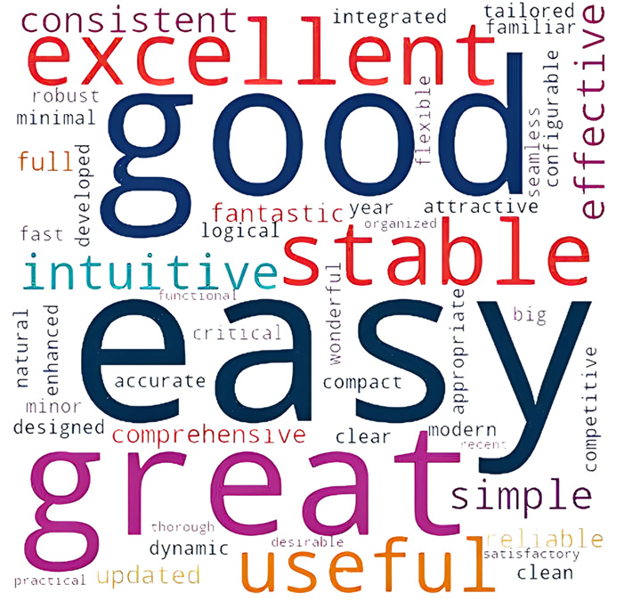
The Inflectra Word cloud
Our customers are at the heart of everything we do. This word cloud represents authentic sentiments from our testimonials, highlighting the values that resonate most—reliability, innovation, and partnership.
Each word reflects real experiences, reinforcing our commitment to delivering unmatched quality and service.
Explore Testimonials

Slide 44
Awards & Recognition
WHAT CUSTOMERS AND TECHNICAL ANALYSTS SAY

Slide 45
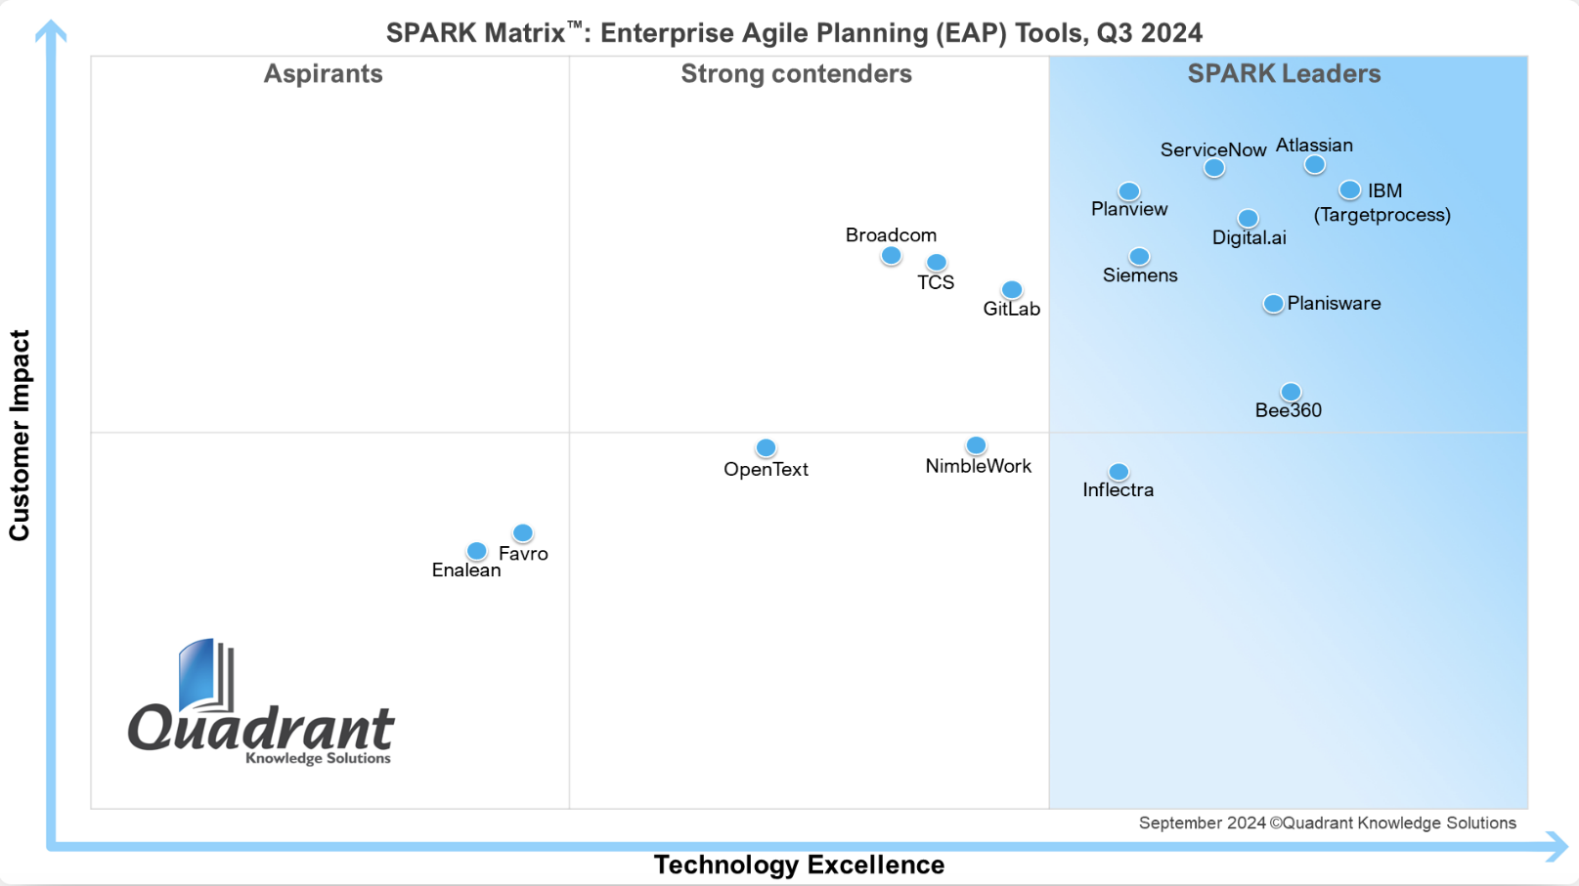
EAP Leader in SPARX 2024 Matrix

Slide 46
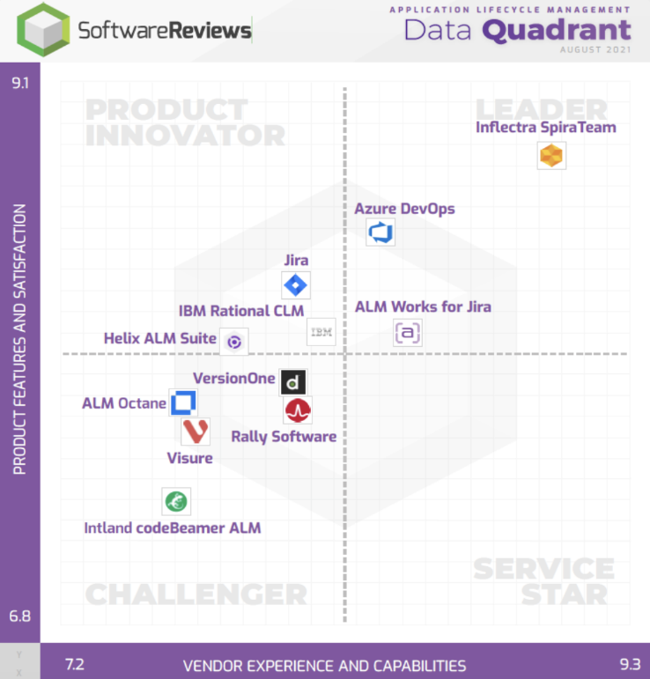
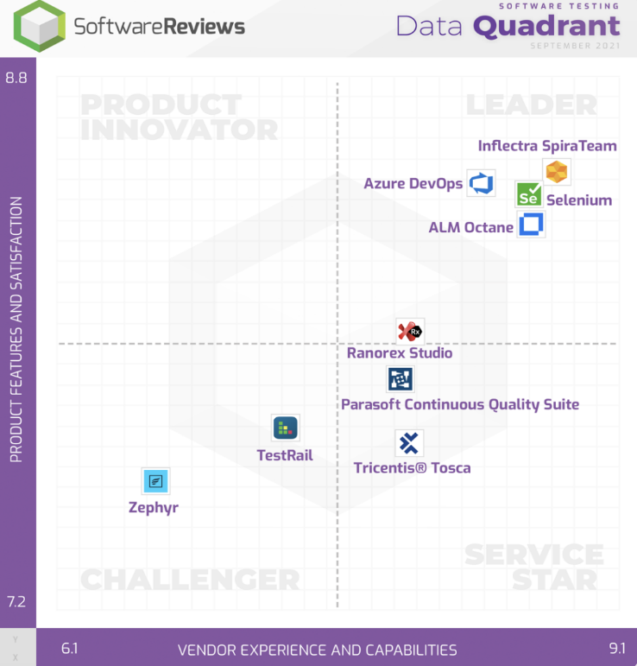
Data Quadrant Leader in Info Tech
APPLICATION LIFECYCLE MANAGEMENT
SOFTWARE TESTING

Slide 47
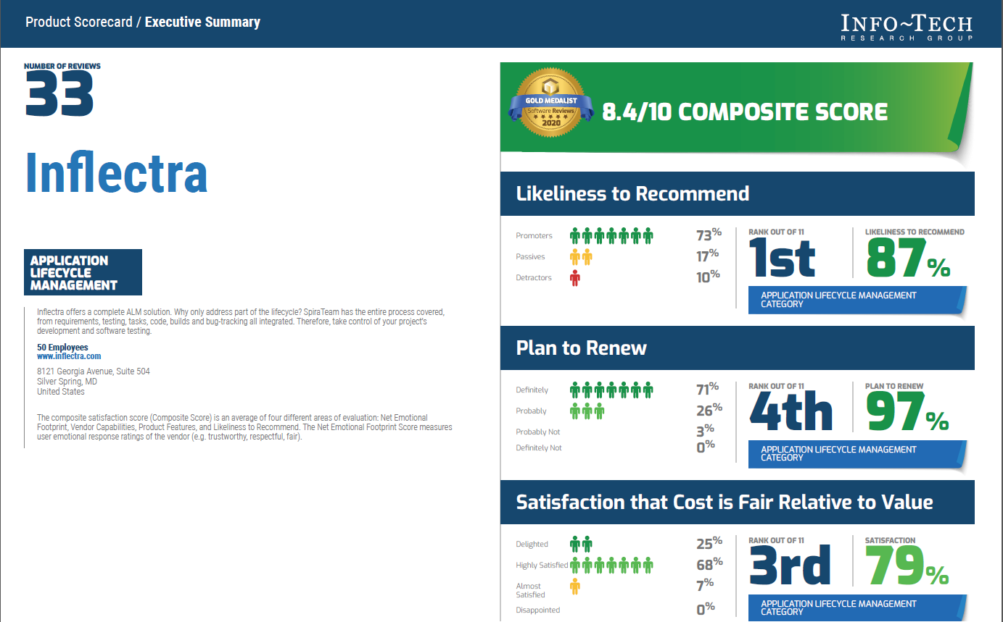
Info Tech Product Scorecard for ALM

Slide 48
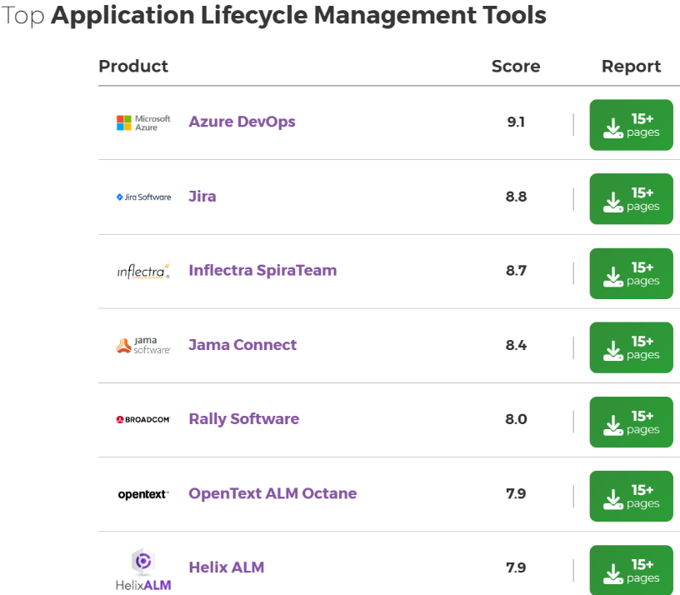
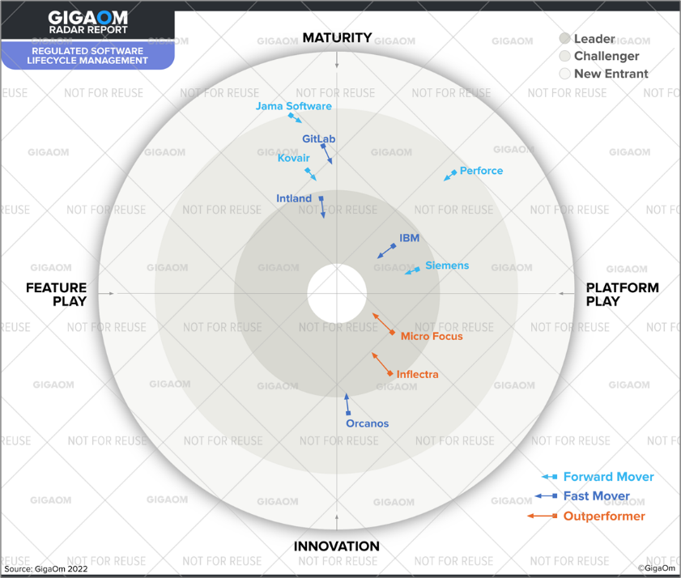
Tech Info & GigaOM: Best for Regulated Industries
“We ranked Inflectra as Leaders in the Platform-Play half. These solutions are comprehensive and support many of the regulated industries, not just one or two.”
- GigaOM RSLM Report
Source: InfoTech

Slide 49
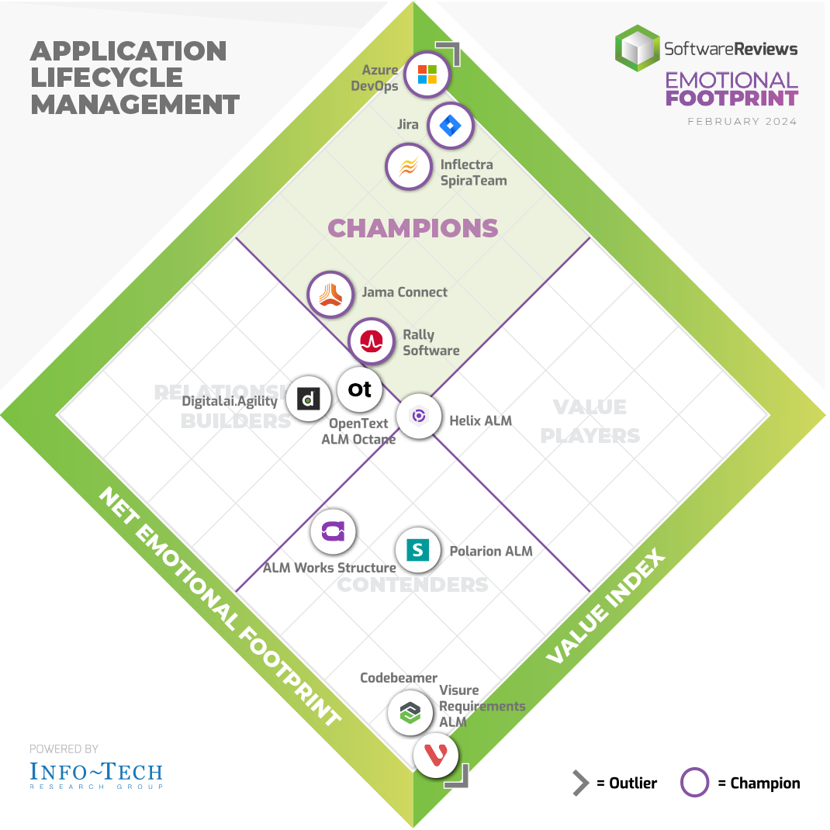
Info Tech Champion in ALM in 2024
Note: Based on 119 customer reviews

Slide 50
Case Studies

Slide 51

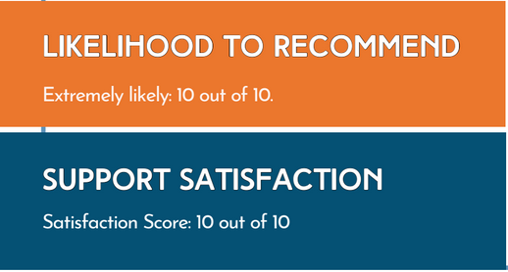
Mastek (IT & Healthcare)
The Challenge
In a highly regulated and competitive market, Mastek needed to enhance their testing processes to achieve comprehensive test coverage, reduce time to market, and efficiently manage multiple projects while maintaining regulatory compliance.
The Solution
Mastek selected Inflectra products due to their favorable pricing, licensing options, and advanced project management and QA functionalities. SpiraTest was implemented to enhance project monitoring, streamline team collaboration, and improve compliance.
Existing Tools in Place
Jira lacked comprehensive test management that could ensure full traceability from requirements to defects. Difficulties in automating test maintenance within Jira's ecosystem, led to greater manual work.
“Inflectra's suite of products has transformed the way we manage our projects and testing processes. With tools like SpiraTest we have achieved unprecedented levels of efficiency, compliance, and quality. The seamless integration and robust features have enabled us to deliver projects faster and with greater accuracy, ensuring our competitive edge in the industry. “-- Kanchan R, Mastek

Slide 52

Leica Biosystems (Life Sciences)
The Challenge
Leica Biosystems was seeking an efficient solution for managing and summarizing test cases for both software and hardware instruments. This included a need for a comprehensive view of tests involving sophisticated sensors for automation.
The Solution
The deployment of Inflectra's SpiraPlan revolutionized Leica Biosystems’ approach to managing medical device development projects, offering a unified platform for diverse project needs. Inflectra's integrated requirements management played a crucial role in keeping all stakeholders aligned.
Key Results and Metrics
Inflectra’s platform enhanced collaboration across Leica Biosystems’ teams in Germany, India, and China. It allowed different departments to effectively share requirements, feedback, and reviews. Finally, it centralized management of requirements, incidents, and tests, improving overall productivity.
“SpiraPlan is an excellent integrated tool for managing both new and ongoing projects. It centralizes all important data, facilitating easy access and consensus among stakeholders.”
- Carey S. V&V Manager, Leica

Slide 53

GME (Manufacturing)
The Challenge
GME Pty Limited faced a significant challenge in managing the lifecycle of their consumer electronics, particularly with
regression testing as products neared their end-of-life phase. Their primary concern was to find an effective solution to streamline their application lifecycle management and test automation.
LIKELIHOOD TO RECOMMEND
Extremely likely: 10 out of 10
SUPPORT SATISFACTION
Satisfaction Score: 10 out of 10
The Solution
GME deployed SpiraTeam to develop a GPS-enabled version of their XRS radio. With SpiraTeam, GME achieved an effective verification and validation for market release. It significantly improved the process of setting up requirements and matching test cases. In addition, it efficiently managed the entire product lifecycle, for electronics approaching their end-of-life.
QUALITY OF OUTCOME
Satisfaction Score: 6 out of 6
Existing Tools in Place
Prior Inflectra's platforms, GME used Excel, which proved inefficient due to excessive setup and maintenance needs.
“The speed at which we could set up the requirements and matching test cases in Inflectra’s system was quite impressive. The Remote test feature was particularly beneficial for automating regression testing.” -- Derek M. PMO & Portfolio Manager

Slide 54

iDirect (Aerospace/Defense)
The Challenge
ST Engineering iDirect sought a robust solution to overcome challenges in maintaining test cases which was becoming increasingly complex and time-consuming as well as enabling efficient project delivery by overcoming the limitations in the existing toolset (Jama).
LIKELIHOOD TO RECOMMEND
Extremely likely: 8 out of 10
SUPPORT SATISFACTION
Satisfaction Score: 9 out of 10
The Solution
SpiraPlan was seamlessly integrated into ST Engineering iDirect’s existing systems. Custom configurations were implemented to cater to their specific needs in satellite communication project management. The implementation enhanced requirements management, compliance, and project governance capabilities.
Key Benefits and Results
A competitive advantage: SpiraPlan’s ability to manage multiple projects and portfolios seamlessly and with end-to-end traceability enhances the projects’ governance capabilities.

Slide 55
Philippine Land Registry (Government)
The Challenge
Land Registration Systems (LARES) faced significant challenges in test management and automation, crucial for the successful digital transformation in land registration. This required a robust and versatile solution that could handle complex data, ensure security, and maintain regulatory compliance.
The Solution
LARES opted for Inflectra's products, SpiraTeam and Rapise, due to their comprehensive feature set, flexible deployment options (both cloud and on-premise), and cost-effective pricing models.
SpiraTeam: Deployed for its advanced SDLC governance
capabilities, facilitating efficient management of the project’s multifaceted IT infrastructure.
Rapise: Chosen for its superior test automation capabilities, which were essential in ensuring the system's reliability and security.
Existing Tools in Place
“Coming from MicroFocus products, Inflectra products really helped us in providing comprehensive support at fraction of the
cost.” -- Jeff M. QA Manager

Slide 56

80% Improvement of Test Coverage
The Challenge
Telstra International faced growing demands for an advanced test automation for its Salesforce platform. The strict security standards, however, required full security review and approval of any automation solution, adding complexity to the selection process.
LIKELIHOOD TO RECOMMEND
Extremely likely: 10 out of 10
SUPPORT SATISFACTION
Satisfaction Score: 8 out of 10
The Solution
SpiraTest and Rapise were deployed to build a comprehensive and reliable regression test suite for Salesforce. Rapise’s flexibility enabled Telstra to automate repetitive and complex tasks within the Salesforce environment, such as regression and daily sanity testing. Furthermore, the team utilized SpiraTest to effectively manage and document their testing processes, ensuring full coverage.
Key Results & Metrics
Test coverage improved by 80%
Regression testing 100% automated
Reduced reliance on manual testing, boosted overall testing efficiency, reducing human error, and improving project agility.
” We have found Rapise to be a great automation tool, enabling us to complete regression and daily sanity testing efficiently. In the future, we plan to update the Rapise scripts to include downstream systems”….. – Nicholas B.

Slide 57

Safran Federal (Defense)
The Challenge
Safran Federal Systems wanted to consolidate its builds and track requirements, while building out an entirely new process. They wanted to enhance agile capabilities and requirements tracking as well as transition from a Microsoft Office-based toolset to a more dynamic QA and project management system.
The Solution
Safran chose Inflectra’s platform for:
Deployment capabilities in both cloud and on-premise environments
Enhanced compliance, traceability, and auditability functionalities
Support for scaled agile methodologies
Advanced project and risk management
Robust requirements management
Cutting-edge test automation and RPA capabilities
Framework agnostic solutions
“Inflectra has proven to be a great partner. Their annual conference, and excellent in-person training have been particularly beneficial. The company is attentive to our specific needs, striving to meet them effectively.”
-- Mark W., Lead Software Engineer

Slide 58

Generali (Insurance)
The Challenge
Generali needed to reduce the number of different tools being used within QA to simplify and streamline their processes. They were seeking a single platform tool on which they could share requirements and incidents between different projects, accommodate both waterfall and agile projects, and maintain integrations to additional software components in their system.
Key Outcomes and KPIs
Allowed real time visibility of test progress and test coverage.
Improved reporting and workflow generation.
Increased understanding of test processes in the company.
Replaced over one dozen tools with a single, easy-to-use solution.
Seamlessly Integrated other tools in Generali’s technology portfolio
The Solution
Generali evaluated numerous tools prior to making a decision. SpiraTeam made the migration from Testlink very easy, as well as the import of legacy documents with the free Microsoft Excel and Word import tool.
Existing Tools in Place
Prior to SpiraTeam, Generali used Bugzilla+Excel for bug tracking, TOSCA+ Testlink for test management, Ranorex + Rational Functional Tester for test automation as well as MS Outlook, Word, Jira, Jenkins, CA’s Service Desk Manager, Clarity/PPM and Workbench.
“SpiraTeam is a complete test management solution with a great price-to-functionality ratio. The quality of the product meets all our expectations”…-- Andreas Eckerle, Head of Test & Quality Management

Slide 59

Oney Bank (Banking & Finance)
The Challenge
Oney wanted a single, integrated platform to manage requirements, create and reference test cases, run
test campaigns, log and track test runs, create tasks and log defects.
Key Outcomes and KPIs
Ability to automatically generate QA metrics for the first time.
One centralized system for standardized QA processes.
Replaced multiple obsolete tools with a single modern solution.
Consolidated testers, developers and designers on one tool.
Increased productivity using native tool
features unavailable with previous solution.
The Solution
Oney Bank conducted thorough market research and determined that only SpiraTest could provide the features and quality they sought in a single tool. SpiraTest also proved to be the best value.
“SpiraTest…is the best tool in terms of quality and value compared to the other competing programs available on the market.. the time, productivity and cost savings are transparent”
-- Benjamin-Michel G., Technical Test Analyst
Existing Tools in Place
Prior to using SpiraTest, Oney employed Microsoft Excel to manage projects, test documentation and defect tracking and Microsoft Word to handle any screenshots.

Slide 60
Ready to Take the Next Step?
Reach out to us at Sales@Inflectra.com to start the conversation.

Slide 61
















































































Our Customers (USA/Canada)
Energy, Industrial & Transport
Financial & Business Services
Media & Telecom
Government & Defense
Healthcare & Bio-Technology

Slide 62




























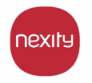





























Our Customers (Europe)
Energy, Industrial & Transport
Financial & Business Services
Media & Telecom
Government & Defense
Healthcare & Bio-Technology

Slide 63














































Our Customers (Global)
Asia
Middle East
Africa
Australia / NZ
Latin America

