Slide 1
Information for Partners
®

Slide 2
Who Are We?

Slide 3
Inflectra Core Values
Great Products: Build for Our Users Not Investors
Building great software for customers, not chasing the latest fad.
Great Team: We Just Get it Done
Treat customers well, solve their problems, no drama or red tape.
Great Workplace: Family and Life Flexibility
Unlimited vacation, amazing benefits, flex/part time welcomed.
Great Community: Enabling Second Acts
Expanding opportunities for new/second careers in technology.

Slide 4
Inflectra, by the numbers
Founded in 2006 to make software creation easier
80,000 users in over 5,000 companies worldwide
We Focus on our customers – not pleasing investors
11 global sales offices and partners across the globe
Delivering frequent releases both cloud and on-premise
Data centers where customers need them most
North America, Europe, India, Asia-Pacific, Australia
Notes:
This has been central to the ethos of the company since it’s beginning.
We’ve been in business for 13 years. We may still be small compared to others in the market, but we believe we truly punch above our weight.
A large part of that is because we focus on developing features for us and our users, not to please short term investors. This may impact our company growth – but it also makes us a sustainable grounded business.
That’s why we are never in maintenance mode. We are always pushing ourselves to improve our products, help our customers wherever they are

Slide 5
Representative Customers
We have ~ 80,000 users in 5,000+ companies worldwide:
Energy & Industrial
Financial & Business Services
Government & Defense
Information Technology
Healthcare & Bio-Technology
Telecommunications
Retail & Consumer Goods
Transportation & Hospitality

Slide 6
How Are We Different?

Slide 7
harmony
Notes:
Make great products
Help you work together
Help you deliver your products faster, more easily, with less pain, and less stress
At a grand scale – we’re passionate about making products that you will find transformative to how you work.
We both want to use our tools every day to help you do a whole number of complex things, and at the same time get out of your way so you don’t need to worry about SpiraPlan and can instead focus on helping your own customers

Slide 8
How Do We Foster Harmony?
Across Disciplines
Through Simplicity
Across Ecosystems

Slide 9
Harmony Across the Disciplines
Testers
Developers
Managers
We consider each of these three stakeholders groups when designing our products, so that everyone in teams can get the most out of our products.

Slide 10
Simplicity = Productivity from Day One
Less Time Doing:
More Time Doing:
No plugins, customization or configuration needed day one

Slide 11
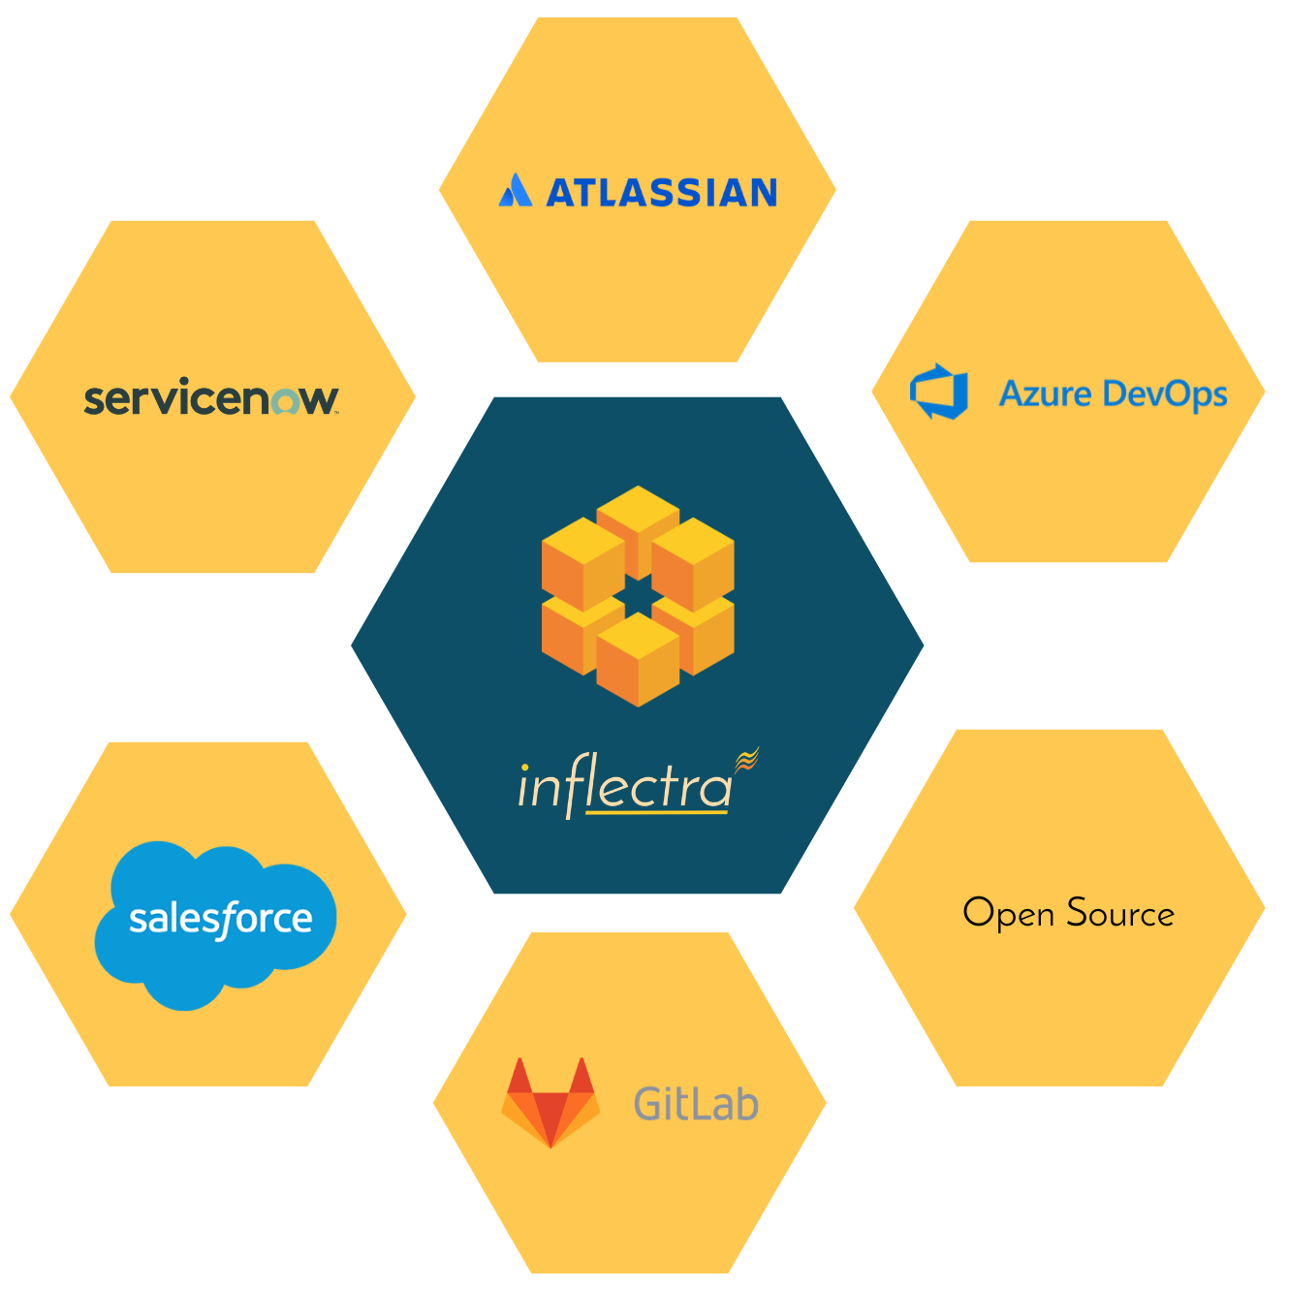
Harmony Across Ecosystems
We recognize that you need to integrate our solutions with other tools and systems
We make this easy and straightforward so you can get working faster & easier

Slide 12
We offer unique features for different industries
While offering simplicity and usability for everyone

Slide 13
Specific Features for Regulated Industries
Auditability and end-to-end traceability
Data Privacy, Security baked in
Generation of Compliance Documentation
Workflows & Electronic Signatures
Integrated Risk Analysis and Management

Slide 14
What Do Our Customers Say?
“
Working with enterprise software in the Finance/Accounting area, I open many support tickets for issues. This time, it's different. I just had to let your team know what a great product Spira is. We mostly need to perform manual tests of key system controls during the SaaS provider's upgrades throughout the year. I'm still learning the product. But, *every single time* I've thought "gee, I bet it doesn't do [fill in blank]," I'm proven wrong. Not only have I not experienced any pain points, but it's almost fun to use such a well-designed product that lets me get to work and get my job done efficiently. So, thank you.
- Michael Aust, Plenty Unlimited Inc.
“
The Customer Service is always quick and efficient to answers questions or issues, which have been few in the 4 years we have been on the product. They continue to develop new features and add to the base product, which is only helping it to grow and stay current with the latest development trends. I love that we have a turn-key solution hosted for us at an affordable price, something no other product we looked at could provide us for the money we had to spend.
- Vanessa Smith, Advent Health
“

Slide 15
What People Say

Slide 16
What do we do?

Slide 17
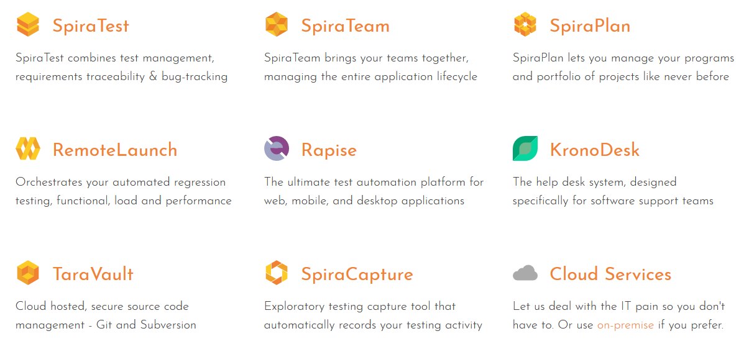
Our Products

Slide 18
How the Inflectra® Suite Fits Together
KronoDesk®
IT Support & Help Desk
SpiraCapture™
Exploratory Testing
SpiraPlan®
Agile Program & Portfolio Management
SpiraTeam®
Application Lifecycle Management (ALM)
SpiraTest®
Requirements, Test Management
& Bug Tracking
TaraVault® - Source Code Management
Rapise®
Test Automation (Web, GUI, Services)

Slide 19
Overview of our products

Slide 20
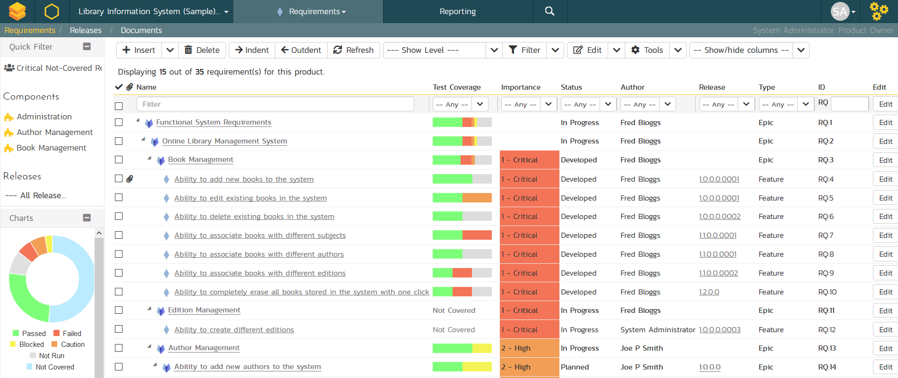
SpiraTest® - Requirements & Test Mgt
Requirements, test and defect management - integrated
End-to-end traceability and real-time reporting

Slide 21
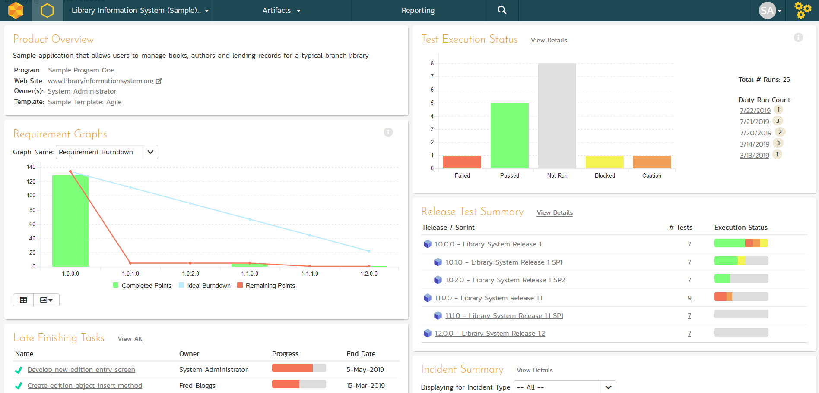
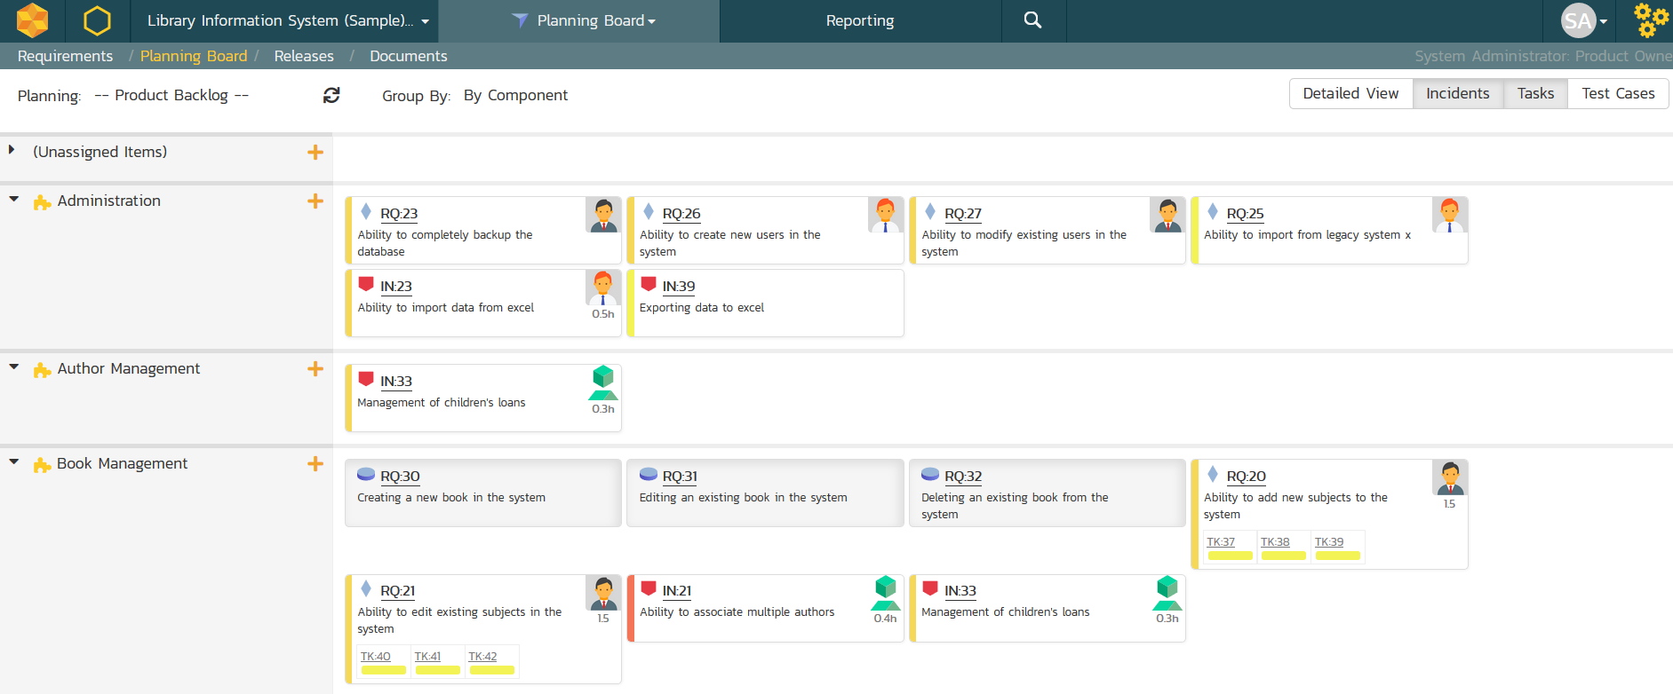
SpiraTeam® - Application Lifecycle Mgt
All of the SpiraTest features, plus agile project management
Supports Scrum, Kanban, waterfall & hybrid projects

Slide 22
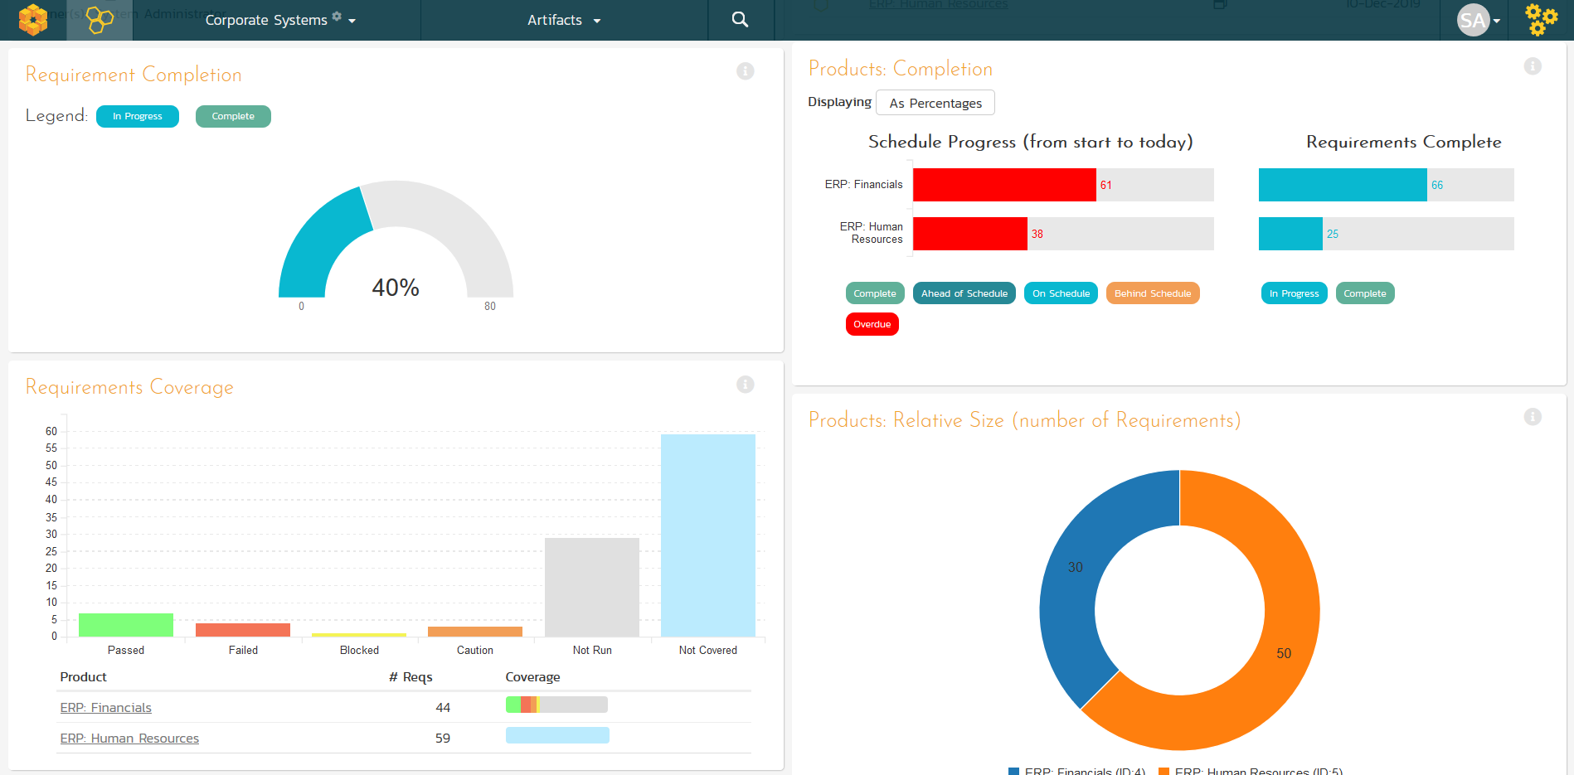
SpiraPlan® - Program & Portfolio Mgt
Extends SpiraTeam with program & portfolio management
Integrated enterprise risk management & tracking

Slide 23
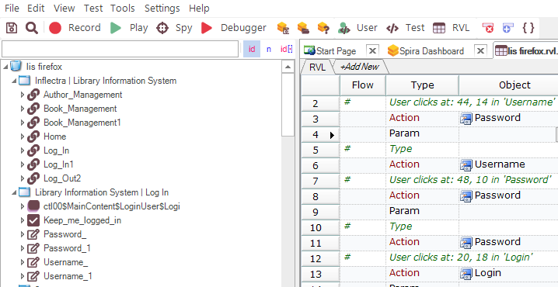
Rapise® - Intelligent Test Automation
Codeless test automation and RPA platform using AI insights
Handles web, mobile, desktop, and APIs in one system

Slide 24
RemoteLaunch® - Automation Integration
Host #1
Windows 2008
IE 8.0
Manual
Tester #1
RemoteLaunch®
Host #2
Windows Vista
Mozilla Firefox
SpiraTeam®
Repository
Manual
Tester #2
RemoteLaunch®
Host #3
Ubuntu Linux
Google Chrome
Manual
Tester #3
RemoteLaunchX®
Integrate automated testing tools with Spira

Slide 25
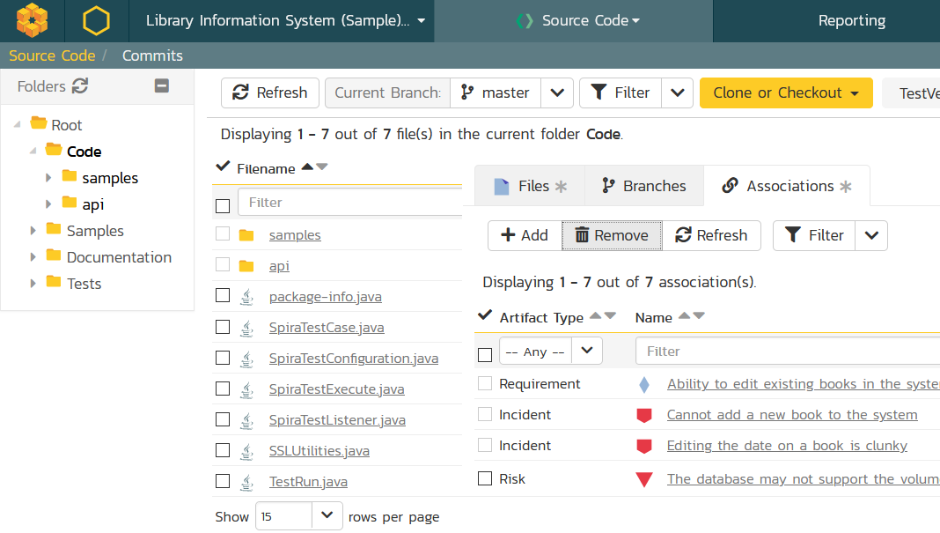
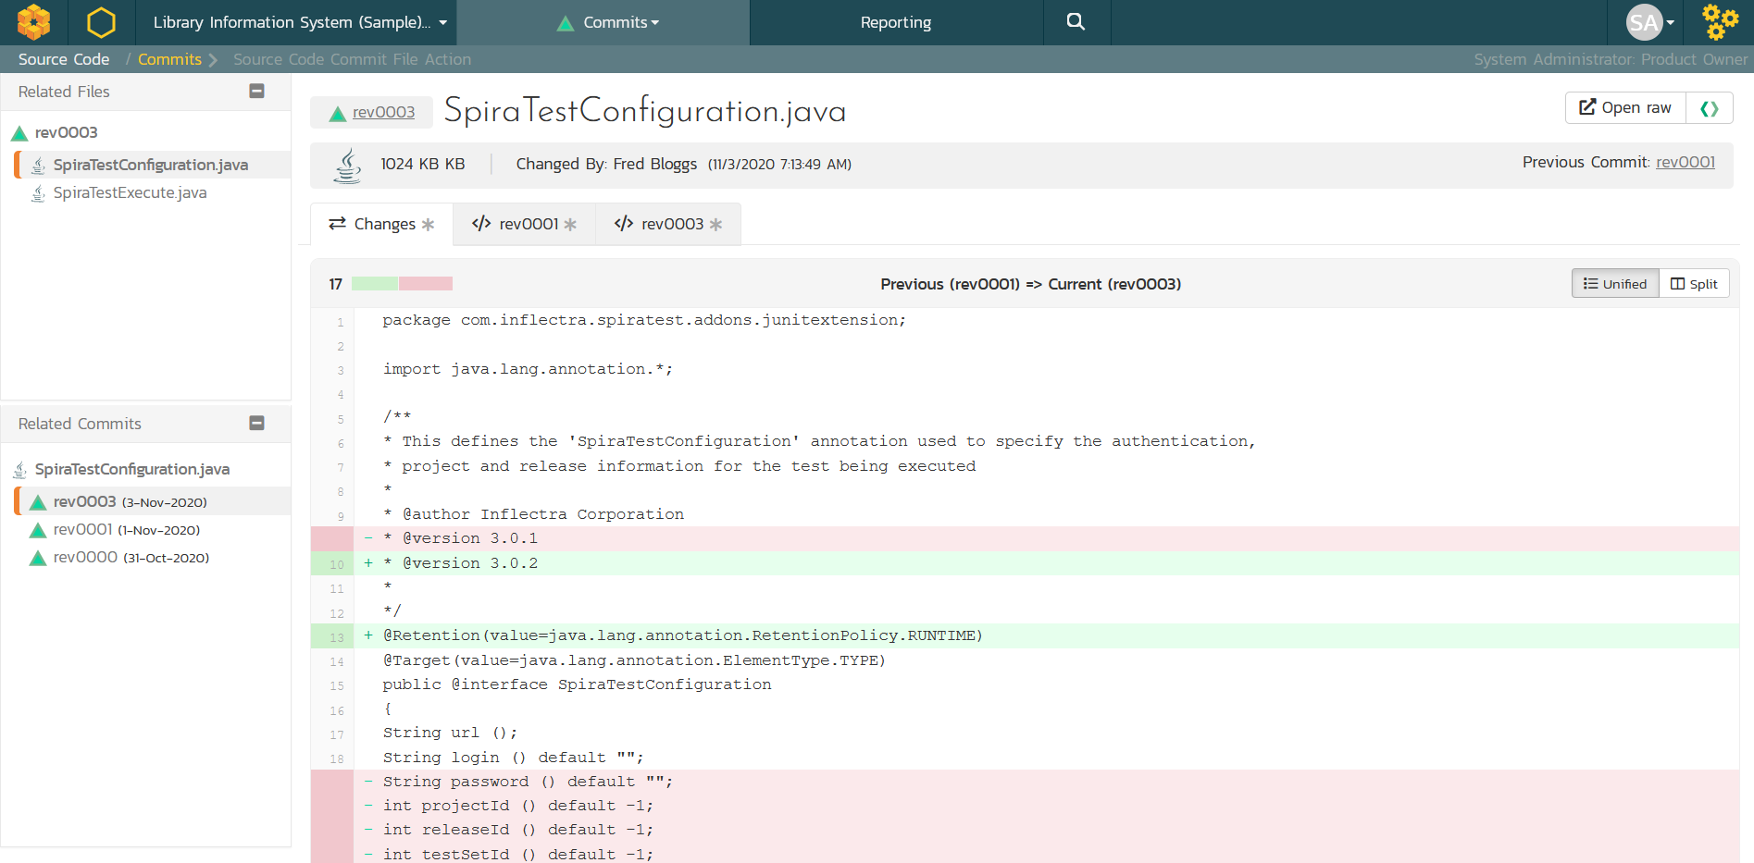
TaraVault® - Source Code Management
Cloud-hosted code repositories (Git & Subversion)
Integrated code viewing and artifact traceability
Support for pull requests and merge workflows

Slide 26
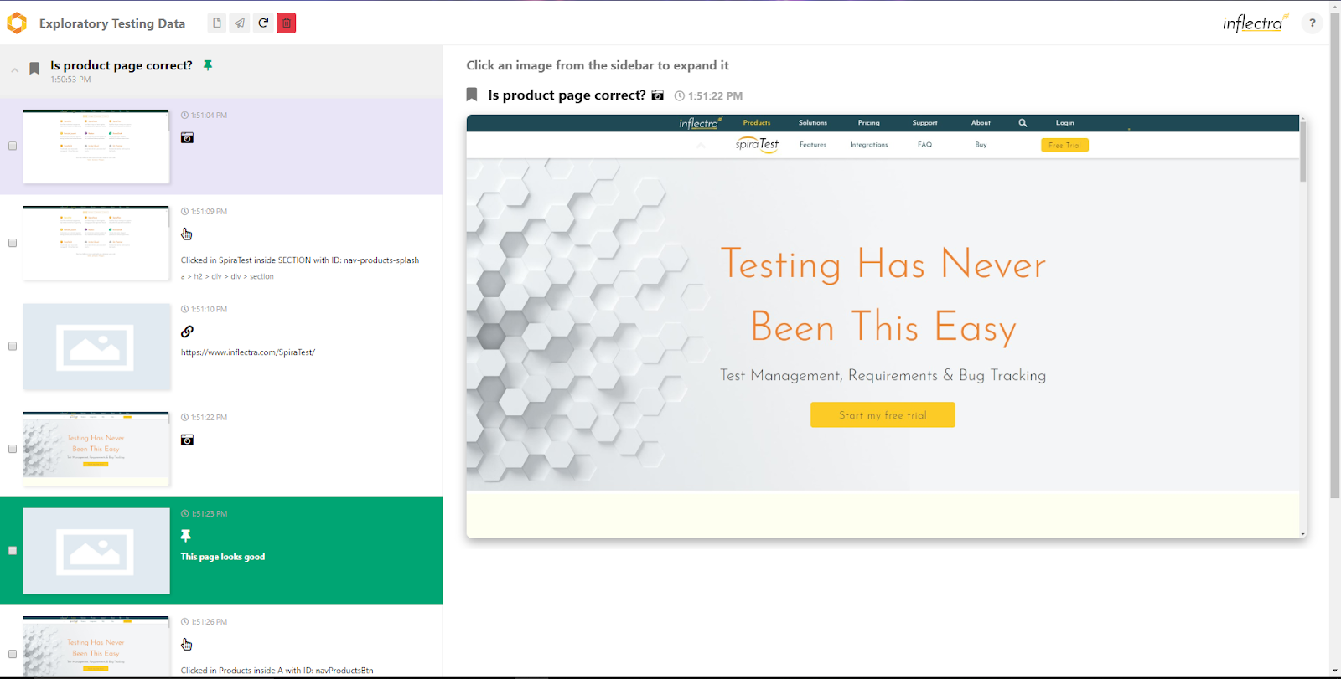
SpiraCapture™ - Exploratory Testing
Chrome extension that captures activity & screenshots
Records and organizes your testing sessions

Slide 27
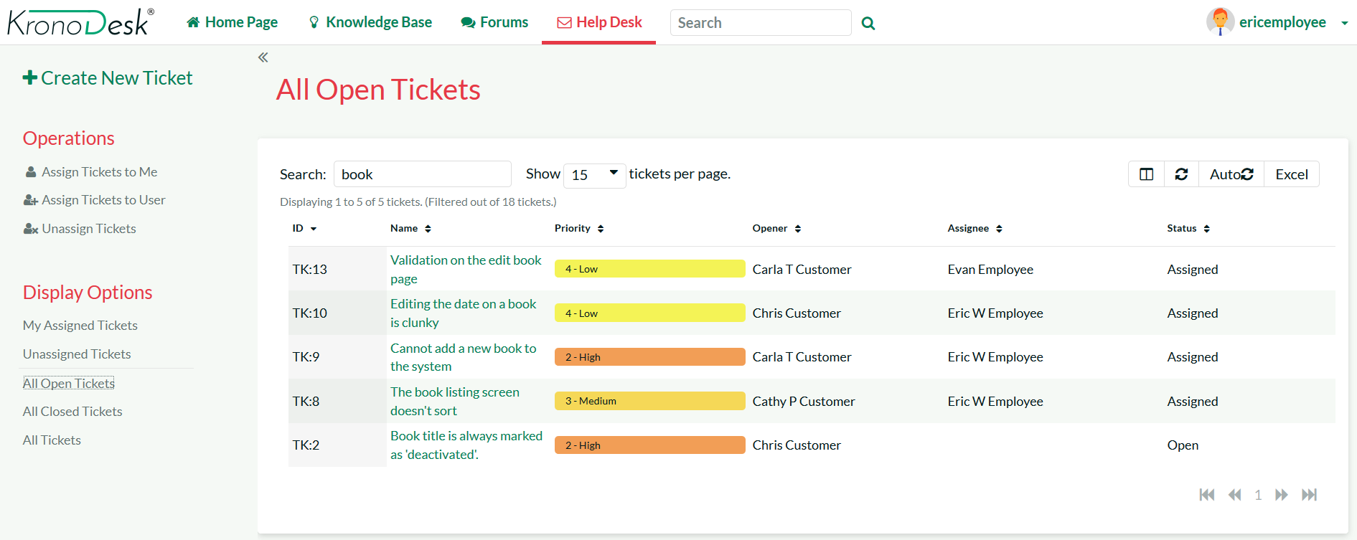
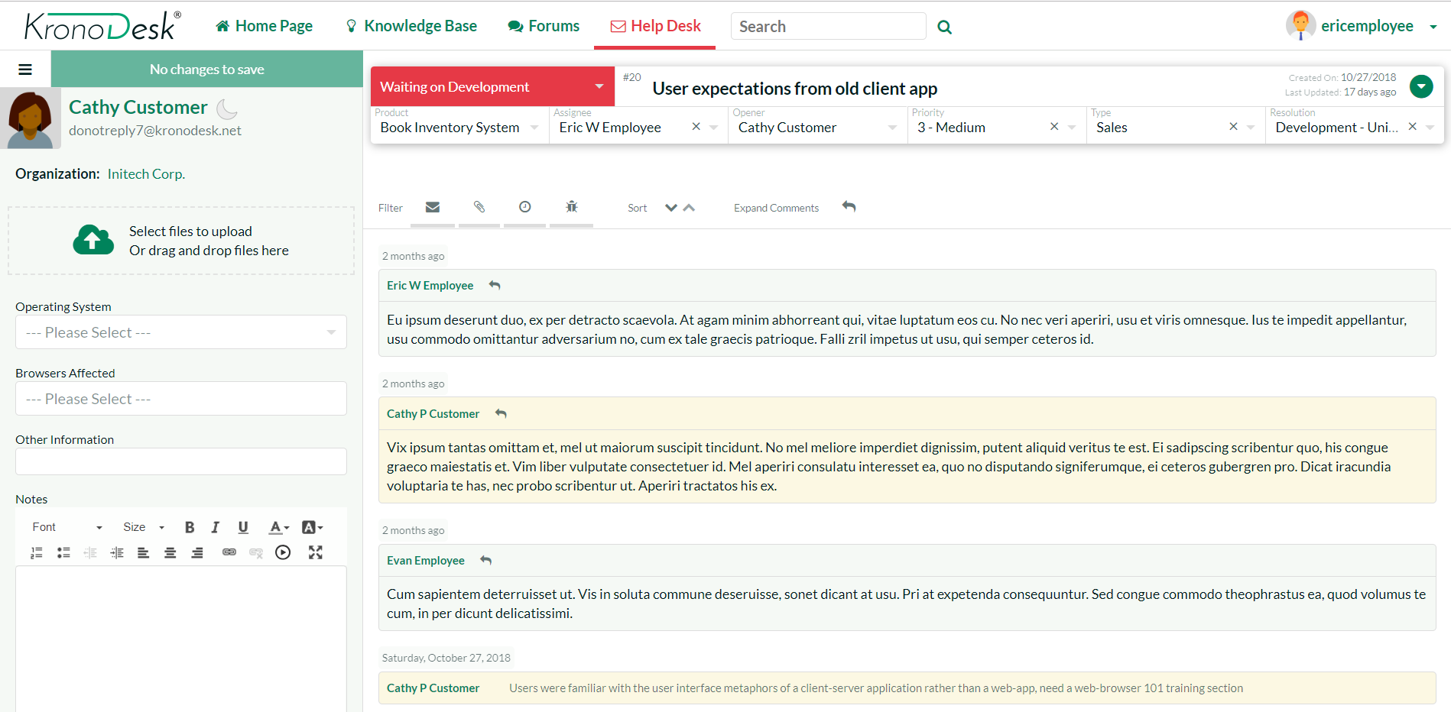
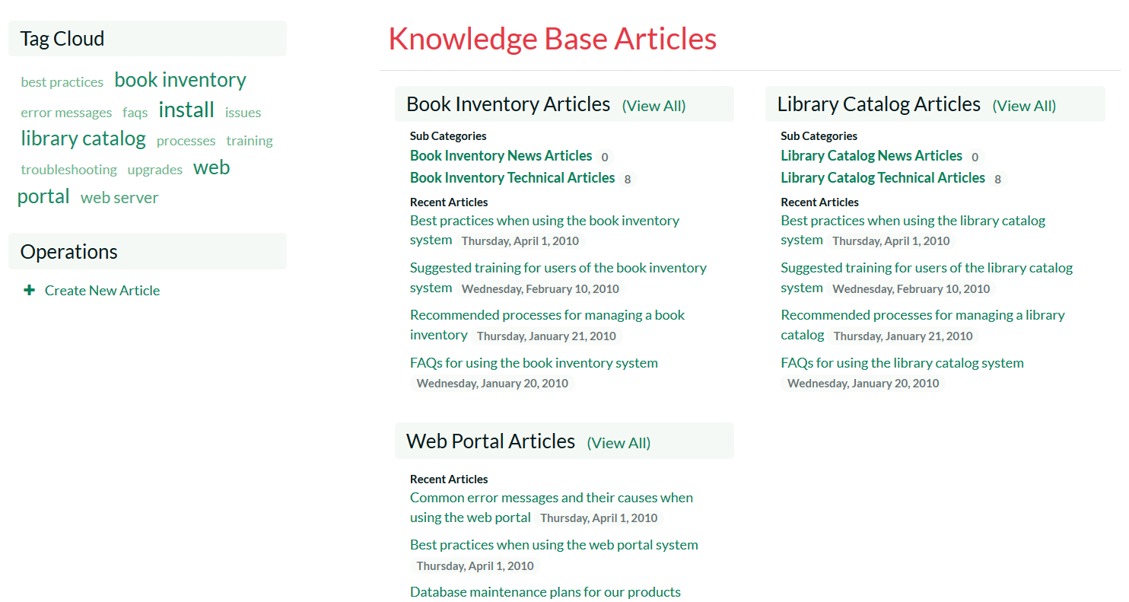
KronoDesk® - Support & Help Desk

Slide 28
Our Partnership Program

Slide 29
Inflectra Partner Network

Slide 30
Our Partnership Program
Solution Partners
These partners are Inflectra affiliates, resellers, advisors, consultants, and trainers who provide and implement customer solutions with Inflectra products. Solution Partners can choose their level of engagement at which they wish to participate.
Technology Partners
These partners work collaboratively with Inflectra to integrate and deliver joint solutions to shared customers. These partners optimize Inflectra solutions with plug-ins, adapters, connectors, and technical services.
Training & Implementation Partners
These partners have extensive knowledge about the Inflectra tool suite and have forged a strong relationship with our company. They are trusted partners with proven capabilities to assist customers with advanced technical solutions.

Slide 31
Solution Partners: Bronze
Benefits
10% discount on tool price for production accounts
Sales support
Joint webinars & co-marketing opportunities
Partner-exclusive events
Inflectra Partner Portal Access

Slide 32
Solution Partners: Silver
Benefits
20% discount on tool price for production accounts
Sales support
Joint webinars & co-marketing opportunities
Partner-exclusive events
Inflectra Partner Portal Access
Certifications & badges
Listed on Inflectra website
Spira & KronoDesk licenses
3 users (for non-production use/for internal training only); Rapise - 1 engine

Slide 33
Solution Partners: Silver
Qualifications
Meet Inflectra sales volume target ($)
List Inflectra on partner website
1 Inflectra-Certified Sales Staff
1 Inflectra-Certified Technical Staff

Slide 34
Solution Partners: Gold
Benefits
25% discount on tool price for production accounts
Sales support
Joint webinars & co-marketing opportunities
Partner-exclusive events
Inflectra Partner Portal access
Certifications & badges
Listed on Inflectra website
Spira & KronoDesk licenses - 3 users (for non-production use/for internal training only); Rapise - 1 engine
Curated leads
Training for sales & tools

Slide 35
Solution Partners: Gold
Qualifications
Meet Inflectra sales volume target ($$)
List Inflectra on partner website
3 Inflectra-Certified Sales Staff
3 Inflectra-Certified Technical Staff
1 Inflectra-Certified Pre-sales/Demo Staff

Slide 36
Solution Partners: Platinum
Benefits
30% discount on tool price for production accounts
Sales support
Joint webinars
Partner-exclusive events
Inflectra Partner Portal access
Certifications & badges
Listed on Inflectra website
Spira & KronoDesk licenses - 3 users (for non-production use/for internal training only); Rapise - 1 engine
Curated leads
Training for sales & tools

Slide 37
Solution Partners: Platinum
Qualifications
Inflectra sales volume target ($$$)
List Inflectra on partner website
5 Inflectra-Certified Sales Staff
5 Inflectra-Certified Technical Staff
2 Inflectra-Certified Pre-sales/Demo Staff

Slide 38
Technology Partners
Benefits
10% partner discount
Joint webinars and co-marketing opportunities
Partner’s marketing collateral at Inflectra-run or sponsored events
Listing on the Inflectra website
Inflectra Partner Portal access

Slide 39
Training & Implementation Partners
Expectations
Offer customers presales consulting
Offer customers implementation and installation services
Offer customers product training
Remain in close and frequent contact with Inflectra to stay informed about the latest software releases, company updates and offerings

Slide 40
Other Features for Inflectra Partners

Slide 41
Badges
Inflectra’s Badge feature seeks to reward the accomplishments and recognize areas of expertise of each partner. It will also allow Inflectra’s customers to find the most appropriate partner by searching the website for partners with badges that best suit customer’s needs.
Some of our badges include:
Spira Academy-Certified Partner
Inflectra-Certified Training Partner
Enterprise-Certified Partner
Industry- and/or geography/region-specific Partner

Slide 42
Partner Portal
Inflectra maintains a robust partner communication, deal management and technical support system through its Partner Portal. A new and improved Inflectra Partner Portal is underway and will allow partners to complete onboarding processes, find educational and sales enablement resources, and consolidate and organize information. It will also include a quote generator and will enable partners to create trials for their users.

Slide 43
Questions?

