Slide 1

Information for Partners
®

Slide 2
Who is Inflectra?

Slide 3



Inflectra by the Numbers
Sales Offices
Hosting Regions
Since
2006
5,000
Companies
Used in 60+ Countries
+80,000 active users

Slide 4








Requirements
Management
Quality
Assurance
Risk Management
Software
Development
Project Management
Test
Automation
Inflectra End to End Capabilities
Program
Management
IT Service Management
Process Automation
Exploratory Testing
Integration Services
Agile &
DevOps

Slide 5
The Inflectra Mission...

Slide 6
harmony
Notes:
Make great products
Help you work together
Help you deliver your products faster, more easily, with less pain, and less stress
At a grand scale – we’re passionate about making products that you will find transformative to how you work.
We both want to use our tools every day to help you do a whole number of complex things, and at the same time get out of your way so you don’t need to worry about SpiraPlan and can instead focus on helping your own customers

Slide 7
Fostering Harmony in our Partnerships
Human API
Global, Yet Local
Your Mission
Open Ecosystem

Slide 8

The Human API
We want to work with our partners across multiple dimensions, just like computers connect using different APIs:
Inflectra
Training
Delivery
Sales
Marketing
Roadmap
Partner

Slide 9
Working Together as a Team
Customer
Support
Inflectra
Implementation
Services
Solution
Partner
Services
Email, Phone,
Help Desk
Small Engagements
< 4 hours
Engagements
Over 4 hours

Slide 10
Global, Yet Local
HQ Alliances Team
Regional Partner Team
Global footprint
Can support you worldwide
Centralized support
Local flexibility
Responsive to local needs
No bureaucracy
No drama

Slide 11
Your Mission Comes First
More Money Spent on Your Services, Less on Our Product
Project Budget Split with Our Competitors
Managed Services | Product Licenses
Project Budget Split with Inflectra
Managed Services | More services | Product Licenses

Slide 12
Inflectra’s Open Ecosystem

Slide 13







































































Open Ecosystem
IDE
CI/CD
Automation
Unit Testing
Bug-Tracking
Detailed Integration List
Import / Conversion
Load Testing

Slide 14
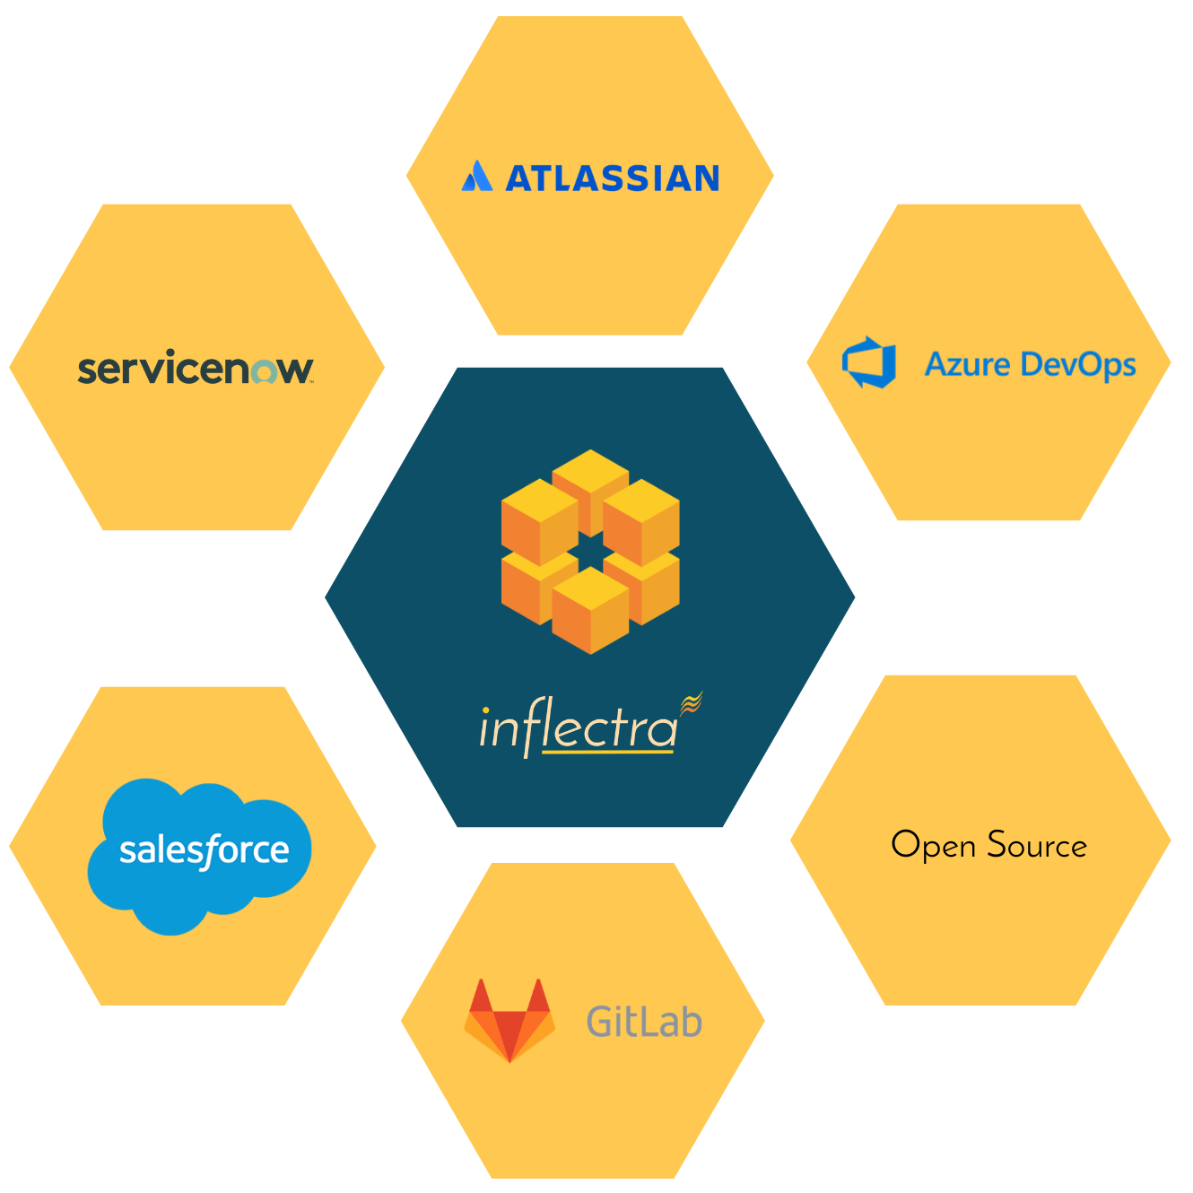
Harmony Across Ecosystems
We recognize that you need to integrate our solutions with other tools and systems
We make this easy and straightforward so you can get working faster & easier

Slide 15
How Are We Different?

Slide 16
Our DNA
Great Products: Build for Our Users Not Wall $treet
  Building great software for customers, not chasing the latest fad.
Great Team: We Just Get it Done
  Treat customers well, solve their problems, no drama or red tape.
Great Workplace: Family and Life Flexibility
  Unlimited vacation, amazing benefits, flex/part time welcomed.
Great Community: Enabling Second Acts
  Expanding opportunities for new/second careers in technology.

Slide 17
Our Unique Sales Proposition
Reduced
Go-To- Market Time
Innovation Driven
Cost Efficient
Improved Business Process
Short learning curve, easy deployment
Easy and intuitive
SaaS option
Seamless migration/Import
Inflectra’s lightning fast response times & reactivity
Focus on new technologies
Responsive to market & customers needs
Integration with 3rd party tools
No extra modules to purchase
Simple concurrent licensing
Unlimited everything (storage, API calls, Projects, Products)
Single & transparent pricing
Cost vs. equivalent alternatives
One integrated tool, no
add-ons
Fully customizable
For Devs, Testers & Managers
Powerful reporting features
Integration with 3rd party tools

Slide 18
Unique Industry Offering
While offering simplicity and usability for everyone

Slide 19
Specific Features for Regulated Industries
Auditability and end-to-end traceability
Data Privacy, Security
baked in
Generation of Compliance Documentation
Workflows & Electronic Signatures
Integrated Risk Analysis and Management

Slide 20

Bridging Between Agile and Compliance
Support for Regulated Processes
Modern, Agile Processes
Baselining
Risk Management
Electronic Signatures
Data Privacy
Compliance
Workflow
Requirements Mgt
On-Premise
CI / CD
Scrum
Kanban
Scaled Agile
DevOps
Distributed Teams
Remote Working
Cloud-Based

Slide 21











Compliance with International Standards
EudraLex
Volume 4
Part I & II
Guidance on Data Integrity

Slide 22
Inflectra’s Secret Sauce

Slide 23
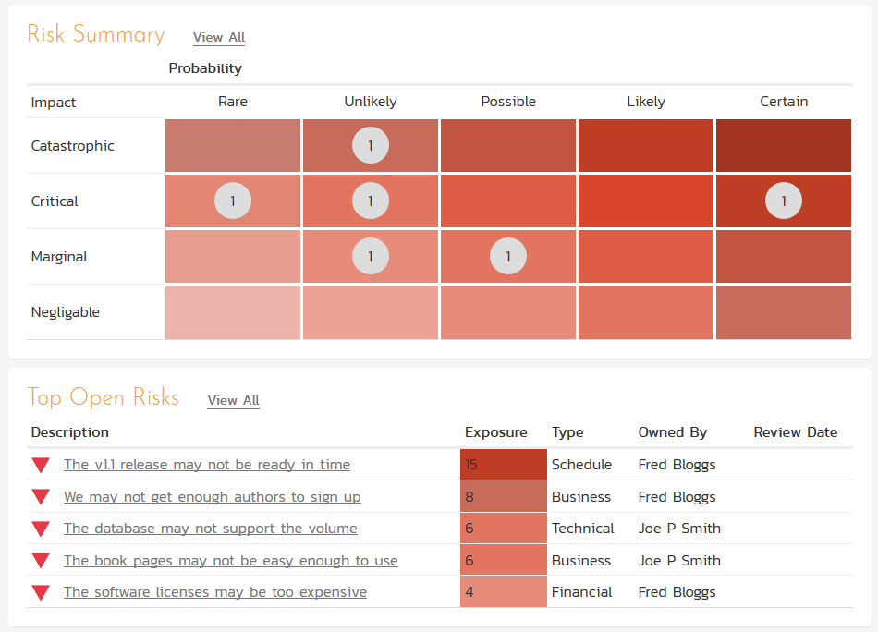
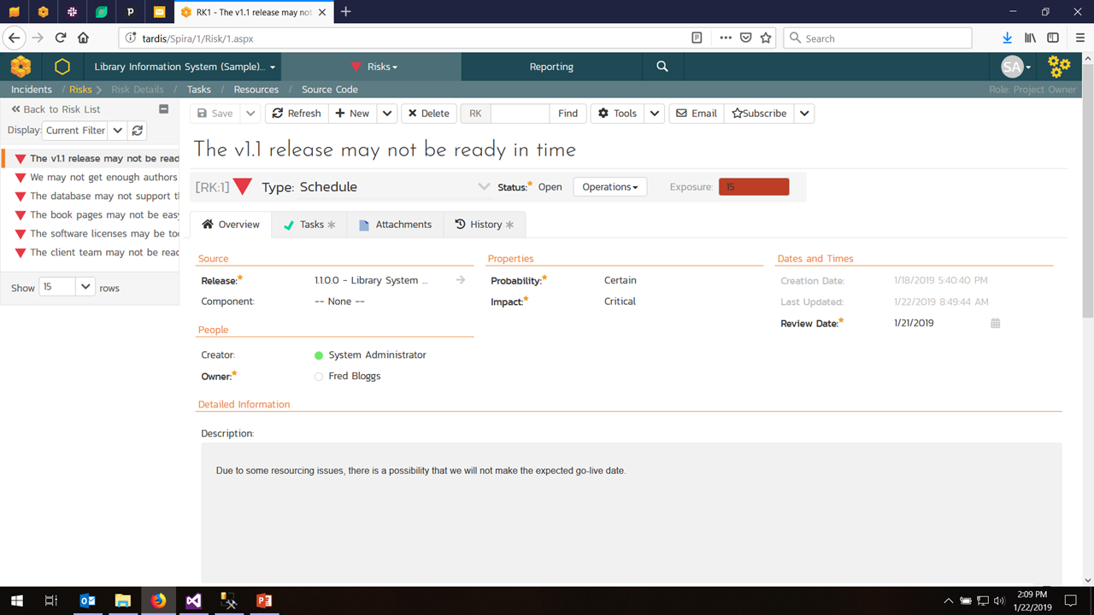
Risk Management

Slide 24
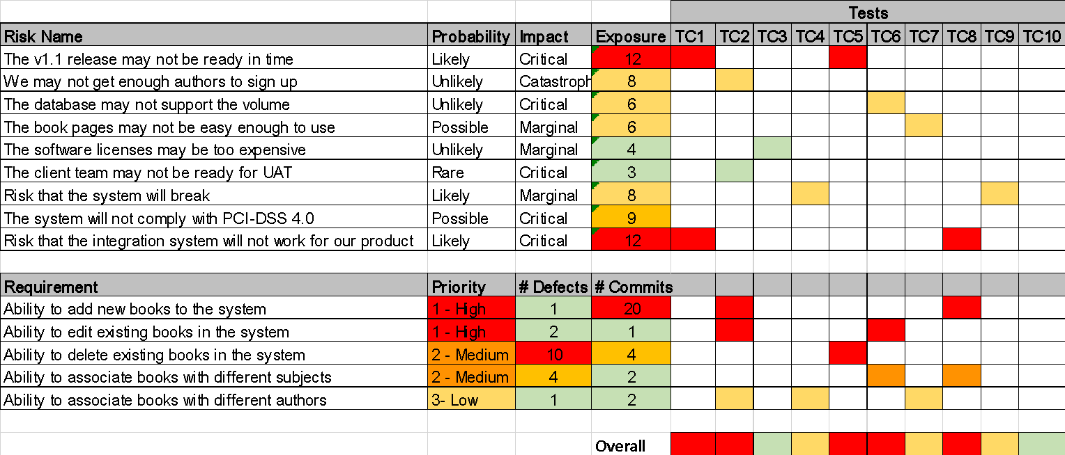
Risk-Based Testing

Slide 25

Software Supply Chain &
Company Strategy & Objectives
Company Strategy & Objectives
Product A
Product B
Product A
Product B
Customer Support & Service Delivery
Customer Support & Service Delivery
Product C
Product D
Product C
Product D
Infrastructure, DevOps, Culture, Values
Infrastructure, DevOps, Culture, Values
Outsourced Supplier
Industry Regulators
Other Suppliers
Company Strategy & Objectives
Product A
Product B
Customer Support & Service Delivery
Data Privacy Authorities
Product C
Product D
Service & Solution Partners
Infrastructure, DevOps, Culture, Values

Slide 26
On Premise + Cloud
Same product, both platforms
Same API
Same user interface
Same integrations and plugins
Handles air-gapped networks
Security, Compliance

Slide 27
Overview of our products

Slide 28

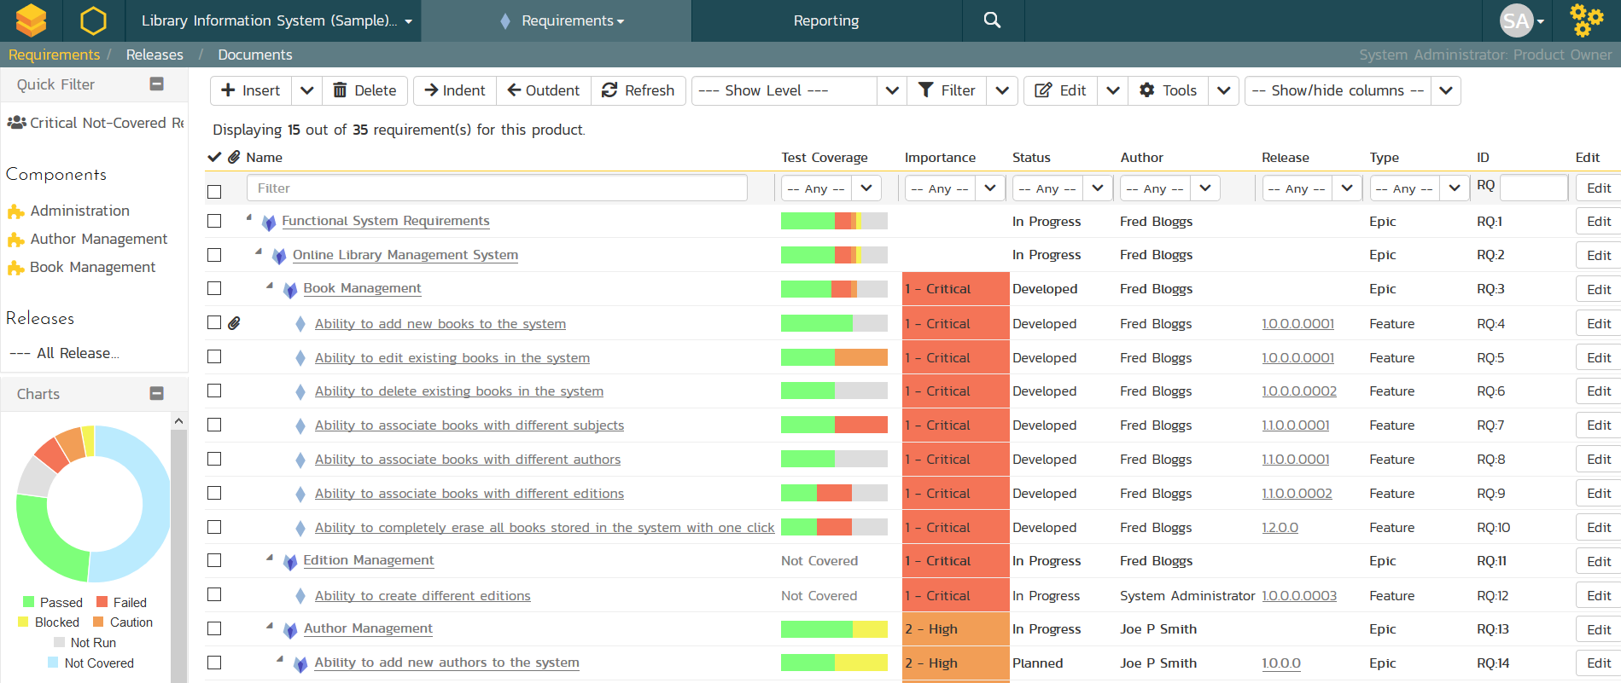
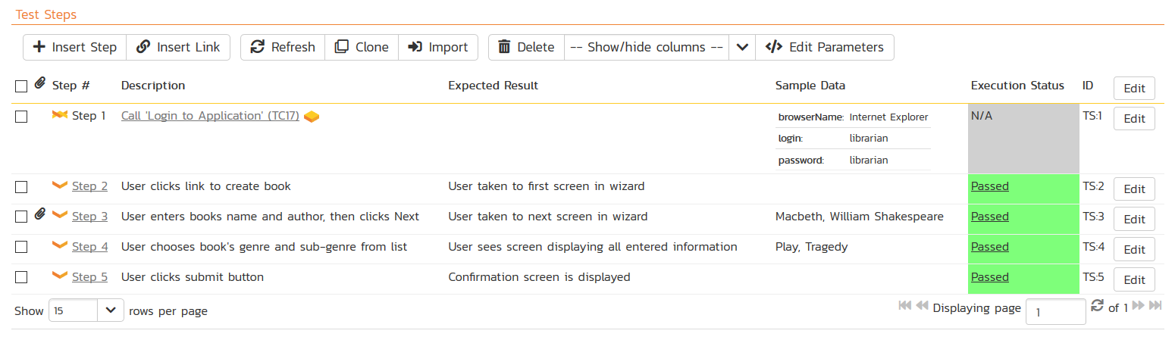
SpiraTest® - Requirements & Test Mgt
Requirements, test and defect management - integrated
End-to-end traceability and real-time reporting

Slide 29
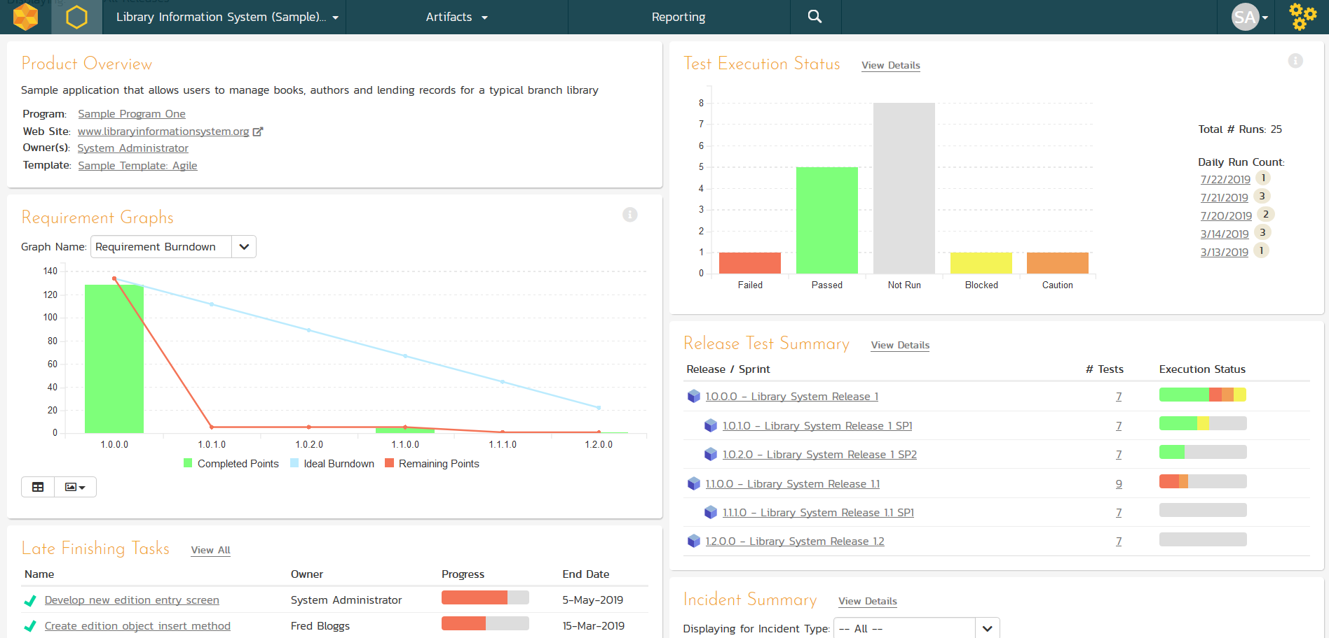
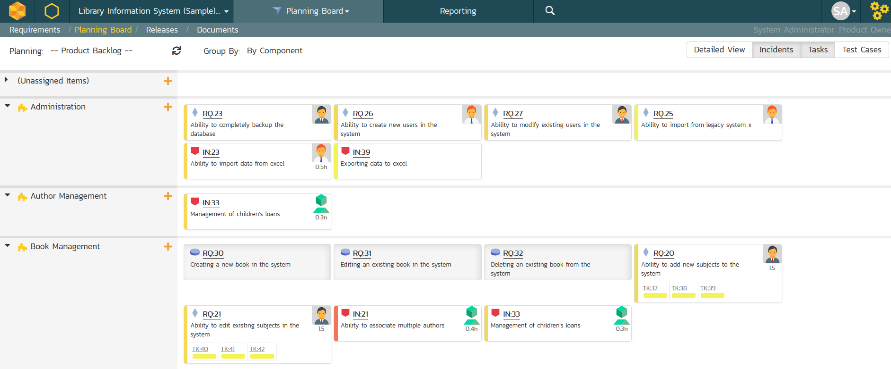
SpiraTeam® - Application Lifecycle Mgt
All of the SpiraTest features, plus agile project management
Supports Scrum, Kanban, waterfall & hybrid projects

Slide 30
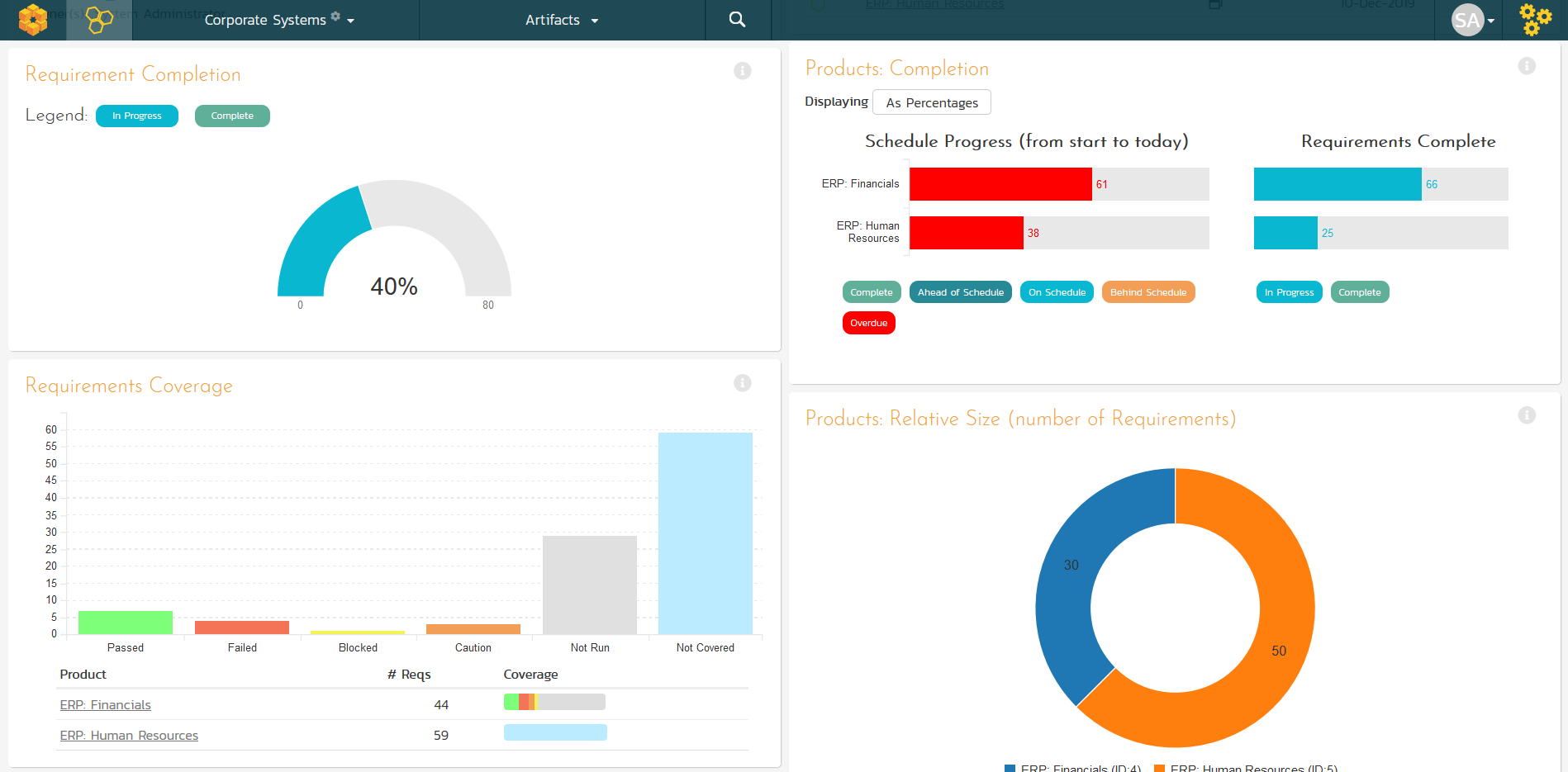
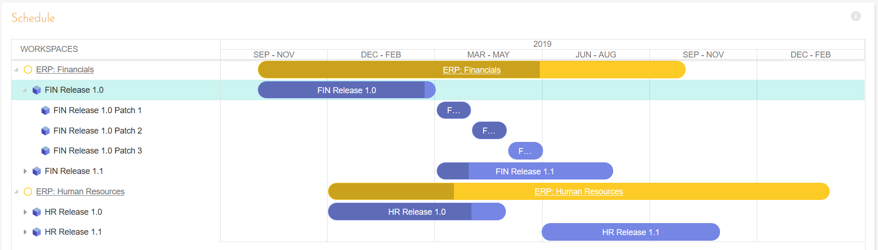
SpiraPlan® - Program & Portfolio Mgt
Extends SpiraTeam with program & portfolio management
Integrated enterprise risk management & tracking

Slide 31

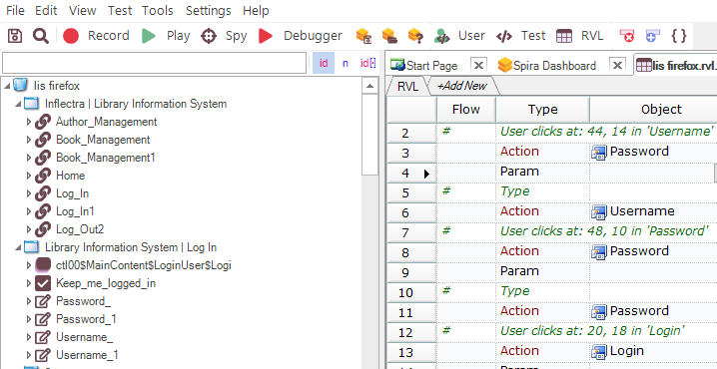
Rapise® - Intelligent Test Automation
Codeless test automation and RPA platform using AI insights
Handles web, mobile, desktop, and APIs in one system

Slide 32


RemoteLaunch® - Automation Integration
Host #1
Windows 2008
IE 8.0
Manual
Tester #1
RemoteLaunch®
Host #2
Windows Vista
Mozilla Firefox
Spira
Repository
Manual
Tester #2
RemoteLaunch®
Host #3
Ubuntu Linux
Google Chrome
Manual
Tester #3
RemoteLaunchX®
Integrate automated testing tools with Spira

Slide 33
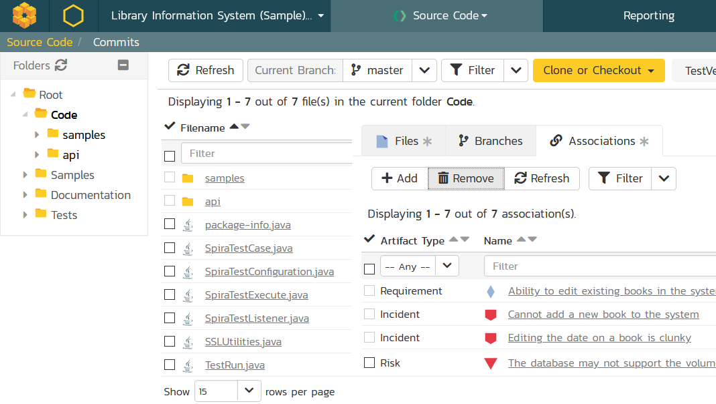
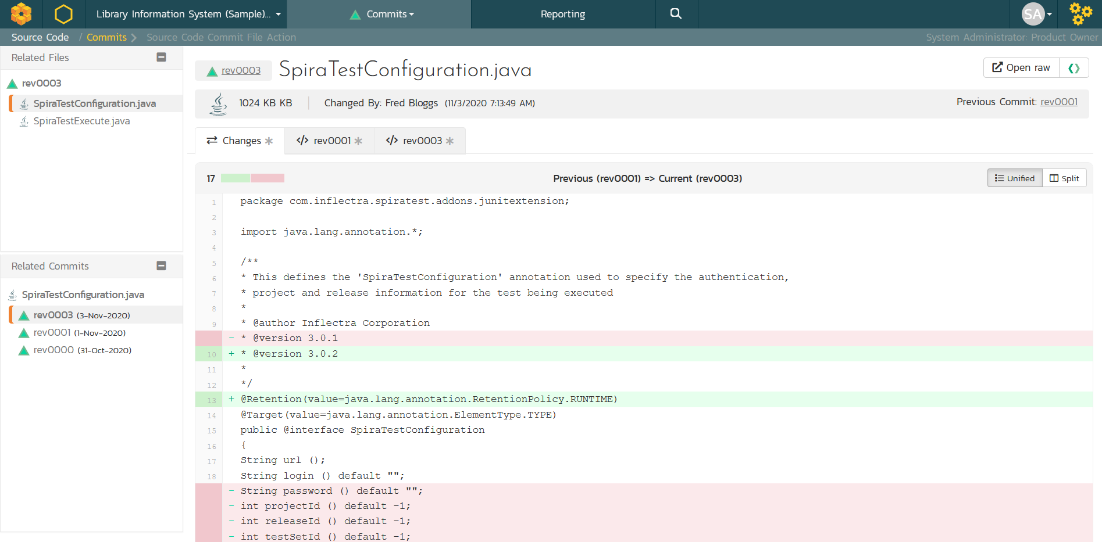
TaraVault® - Source Code Management
Cloud-hosted code repositories (Git & Subversion)
Integrated code viewing and artifact traceability
Support for pull requests and merge workflows

Slide 34

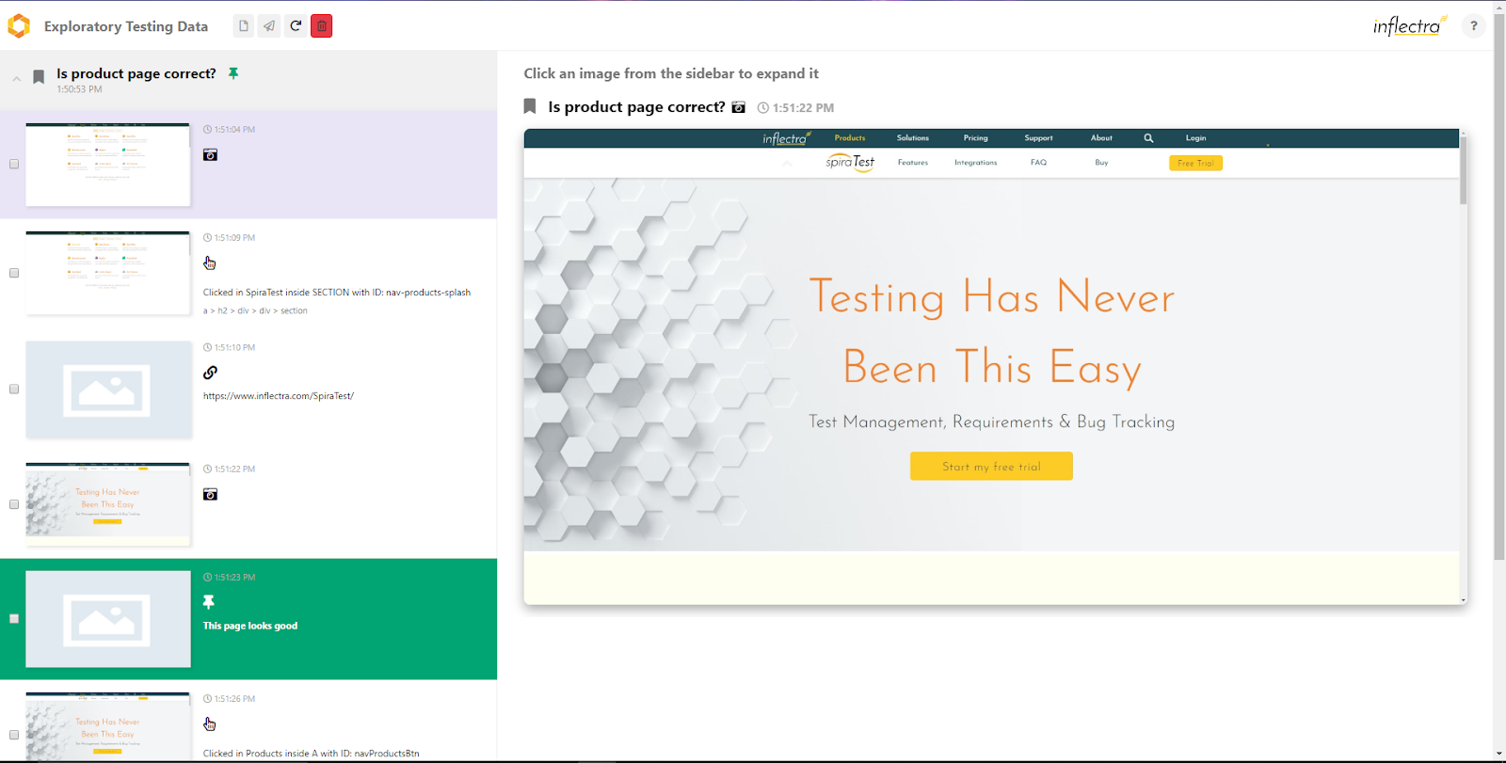
SpiraCapture™ - Exploratory Testing
Chrome extension that captures activity & screenshots
Records and organizes your testing sessions

Slide 35

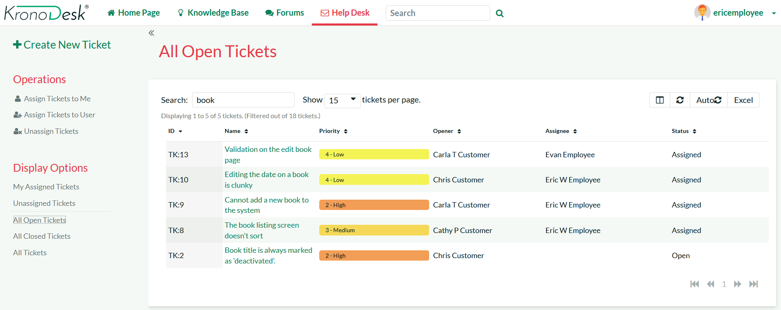
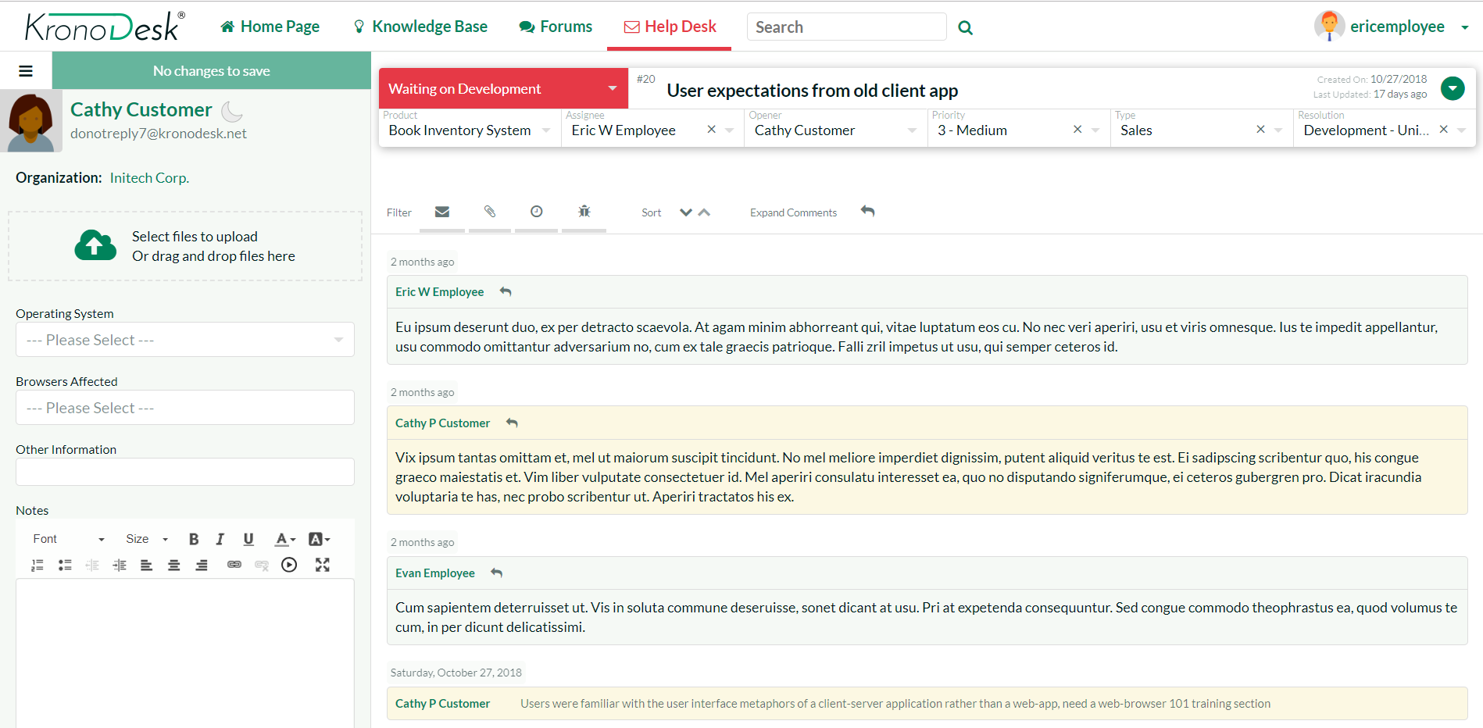
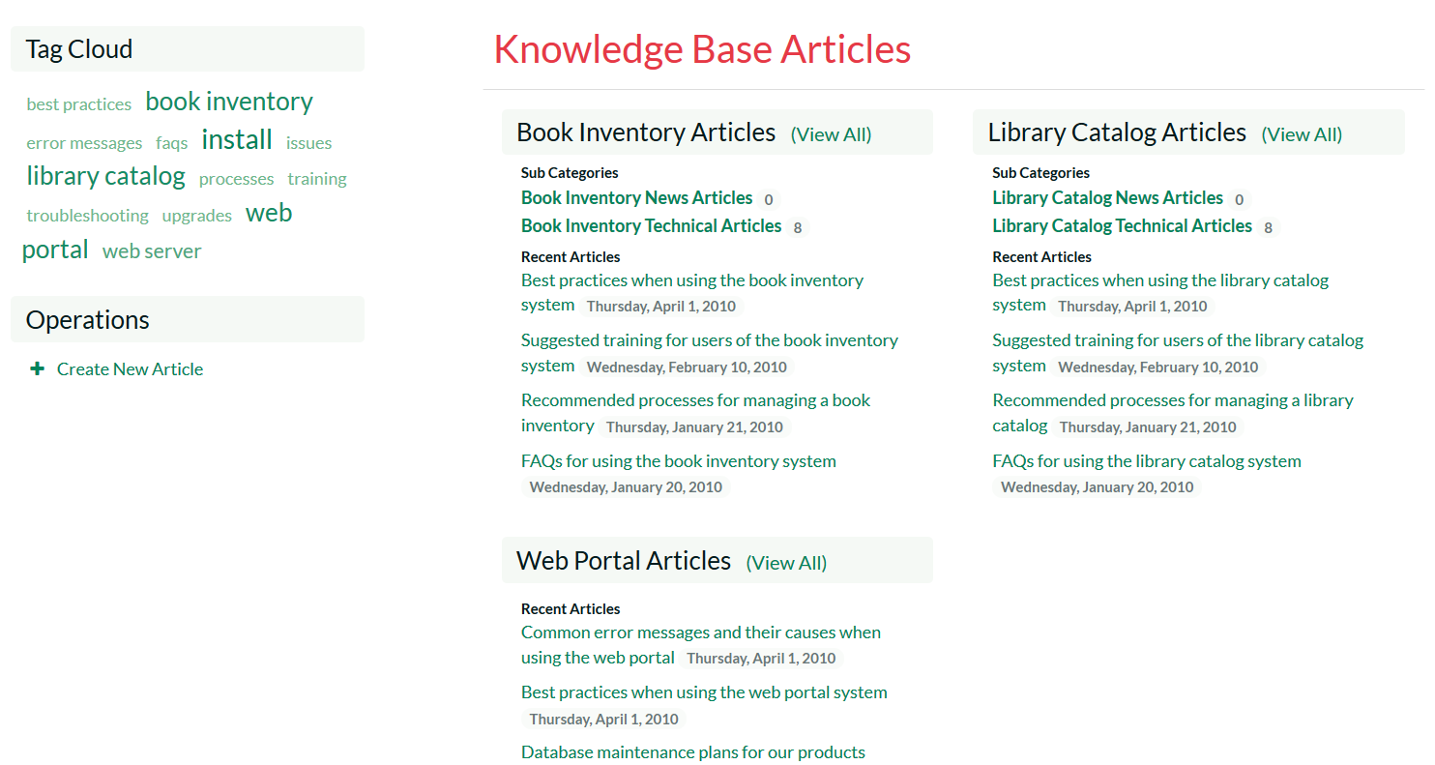
KronoDesk® - Support & Help Desk

Slide 36
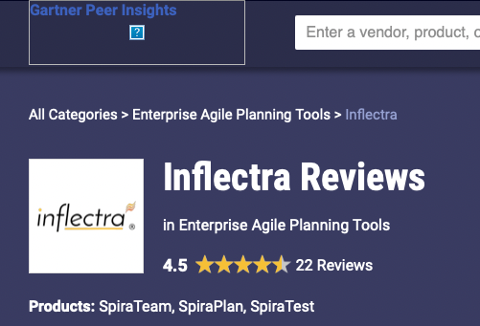


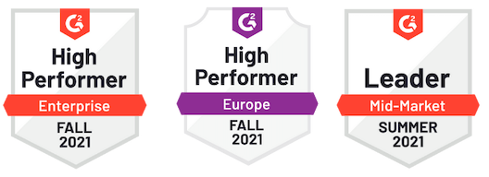
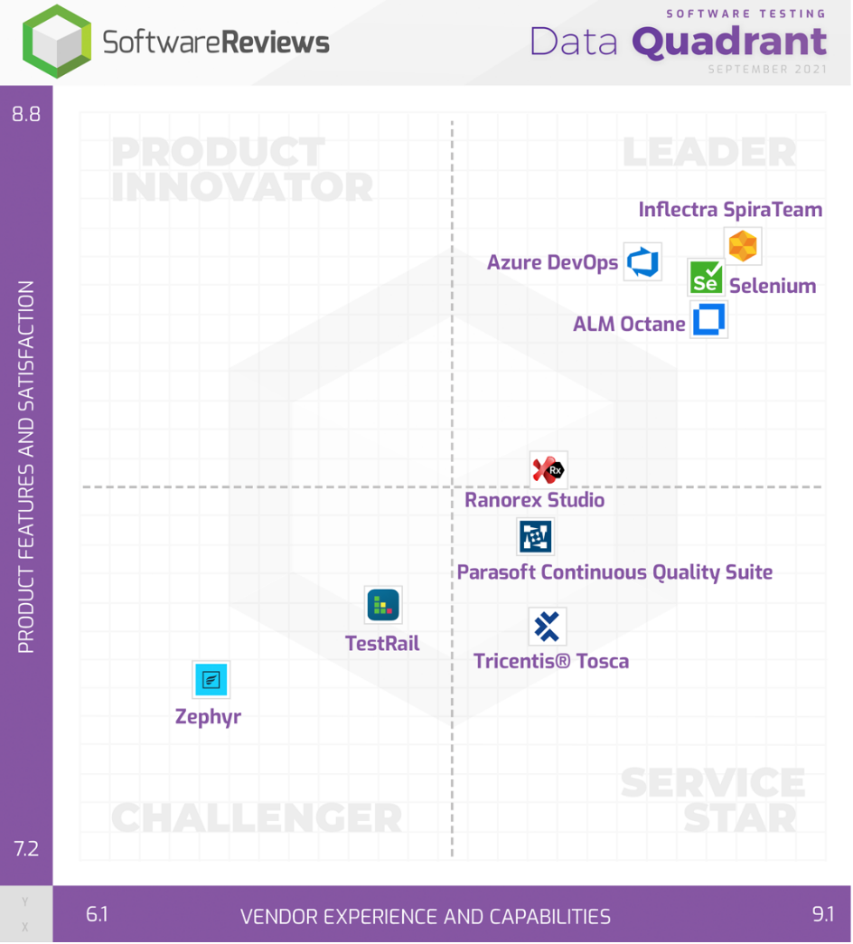
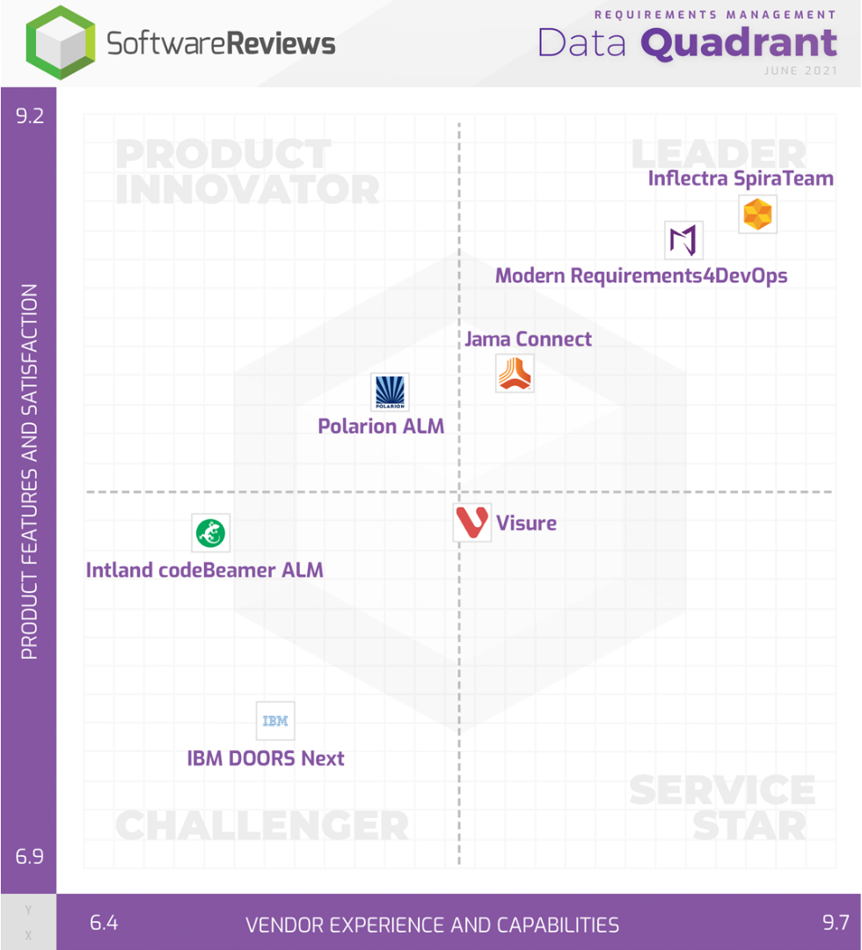
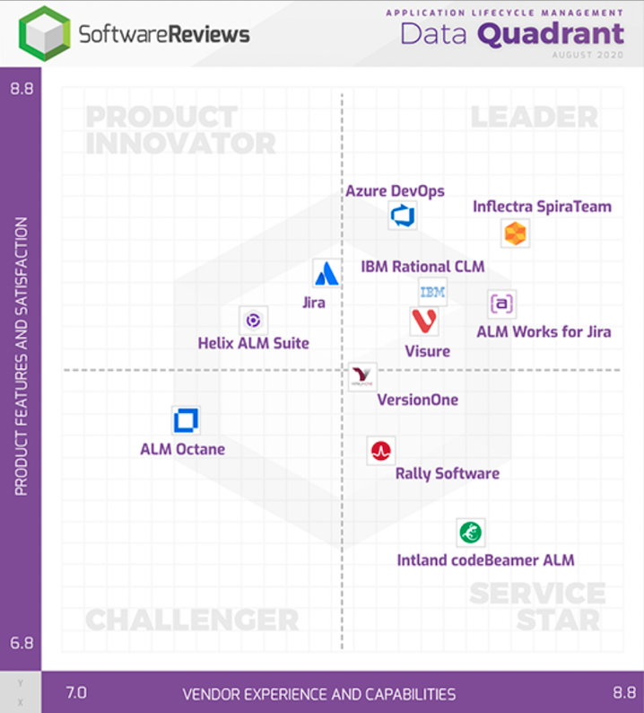
Awards and Recognition

Slide 37
Our Customers

Slide 38



































































Our Customers (USA/Canada)
Energy, Industrial & Transport
Financial & Business Services
Media & Telecom
Government & Defense
Healthcare & Bio-Technology

Slide 39


















































Our Customers (Europe)
Energy, Industrial & Transport
Financial & Business Services
Media & Telecom
Government & Defense
Healthcare & Bio-Technology

Slide 40












































Our Customers (Global)
Asia
Middle East
Africa
Australia / NZ
Latin America

Slide 41
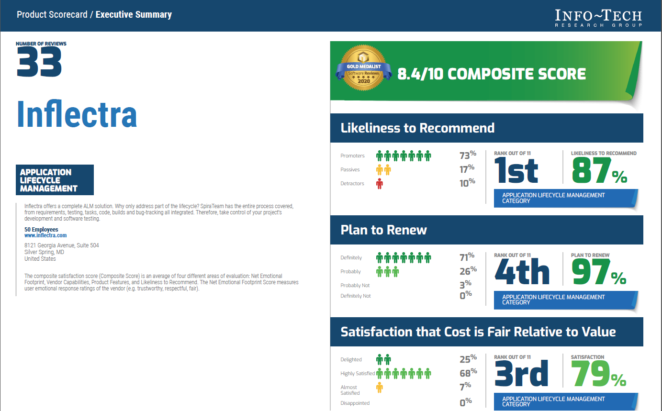

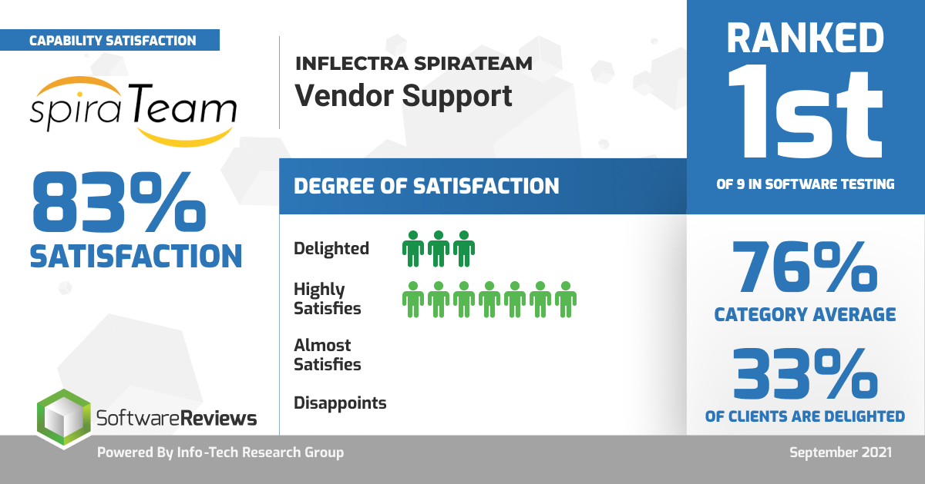
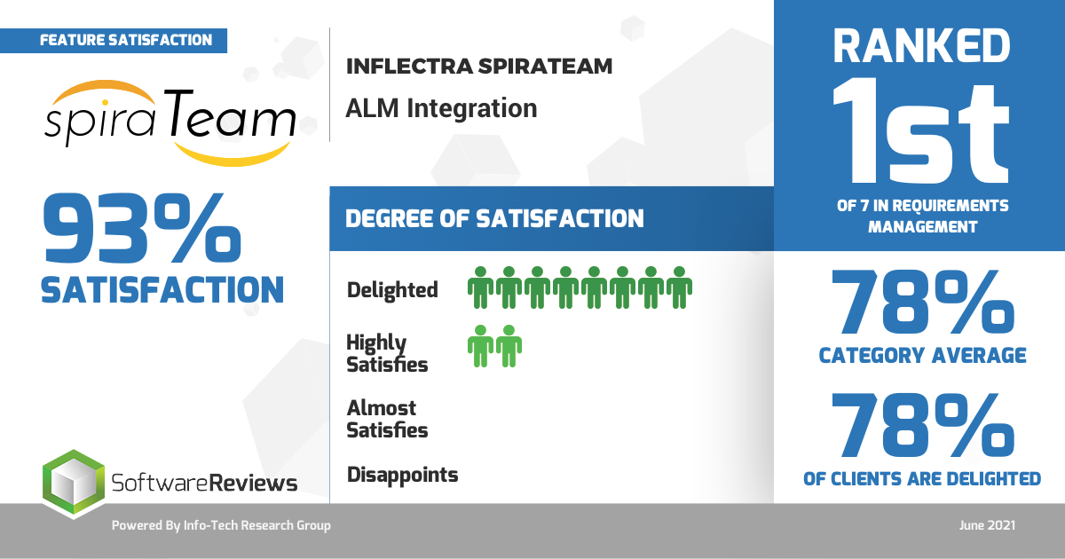
What Our Customers Say

Slide 42

Inflectra Partner
Program

Slide 43
Our Partnership Program
Solution Partners
These partners are Inflectra affiliates, resellers, advisors, consultants, and trainers who provide and implement customer solutions with Inflectra products. Solution Partners can choose their level of engagement at which they wish to participate.
Technology Partners
These partners work collaboratively with Inflectra to integrate and deliver joint solutions to shared customers. These partners optimize Inflectra solutions with plug-ins, adapters, connectors, and technical services.
Training & Implementation Partners
These partners have extensive knowledge about the Inflectra tool suite and have forged a strong relationship with our company. They are trusted partners with proven capabilities to assist customers with advanced technical solutions.

Slide 44
Solution Partners: Bronze
Benefits
  10% discount on tool price for production accounts
  Sales support
  Joint webinars & co-marketing opportunities
  Partner-exclusive events
  Inflectra Partner Portal access
  Training on sales & tools

Slide 45
Solution Partners: Silver
Benefits
  20% discount on tool price for production accounts
  Sales support
  Joint webinars & co-marketing opportunities
  Partner-exclusive events
  Inflectra Partner Portal access
  Training on sales & tools
  Certifications & badges
  Listed on Inflectra website
  Spira & KronoDesk licenses
    3 users (for non-production use/for internal training only); Rapise - 1 engine

Slide 46
Solution Partners: Silver
Qualifications
  Meet Inflectra sales volume target ($)
  List Inflectra on partner website
  1 Inflectra-Certified Sales Staff
  1 Inflectra-Certified Technical Staff

Slide 47
Solution Partners: Gold
Benefits
  25% discount on tool price for production accounts
  Sales support
  Joint webinars & co-marketing opportunities
  Partner-exclusive events
  Inflectra Partner Portal access
  Certifications & badges
  Listed on Inflectra website
  Spira & KronoDesk licenses - 3 users (for non-production use/for internal training only); Rapise - 1 engine
  Curated leads
  Training on sales & tools

Slide 48
Solution Partners: Gold
Qualifications
  Meet Inflectra sales volume target ($$)
  List Inflectra on partner website
  3 Inflectra-Certified Sales Staff
  3 Inflectra-Certified Technical Staff
  1 Inflectra-Certified Pre-sales/Demo Staff

Slide 49
Solution Partners: Platinum
Benefits
  30% discount on tool price for production accounts
  Sales support
  Joint webinars
  Partner-exclusive events
  Inflectra Partner Portal access
  Certifications & badges
  Listed on Inflectra website
  Spira & KronoDesk licenses - 3 users (for non-production use/for internal training only); Rapise - 1 engine
  Curated leads
  Training on sales & tools

Slide 50
Solution Partners: Platinum
Qualifications
  Inflectra sales volume target ($$$)
  List Inflectra on partner website
  5 Inflectra-Certified Sales Staff
  5 Inflectra-Certified Technical Staff
  2 Inflectra-Certified Pre-sales/Demo Staff

Slide 51
Technology Partners
Benefits
  10% partner discount
  Joint webinars and co-marketing opportunities
  Partner’s marketing collateral at Inflectra-run or sponsored events
  Listing on the Inflectra website
  Inflectra Partner Portal access

Slide 52
Training & Implementation Partners
Expectations
  Offer customers presales consulting
  Offer customers implementation and installation services
  Offer customers product training
  Remain in close and frequent contact with Inflectra to stay informed about the latest software releases, company updates and offerings

Slide 53
Other Features for Partners

Slide 54
Badges
Inflectra’s Badge feature seeks to reward the accomplishments and recognize areas of expertise of each partner. It will also allow Inflectra’s customers to find the most appropriate partner by searching the website for partners with badges that best suit customer’s needs.
Some of our badges include:
  Spira Academy-Certified Partner
  Rapise Academy-certified Partner
  Inflectra-certified Training Partner
  Enterprise-certified Partner
  Industry- and/or geography/region-specific Partner

Slide 55
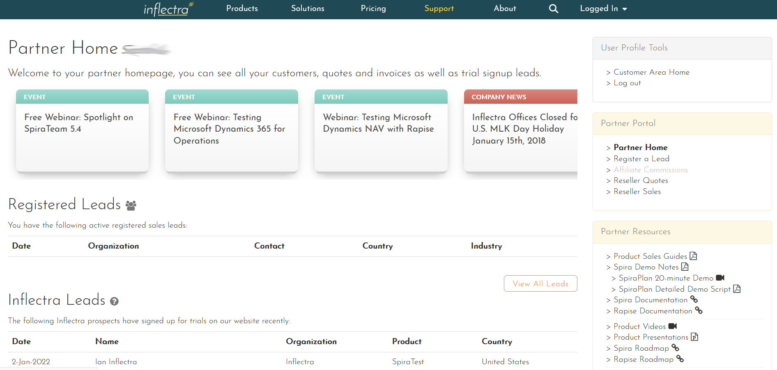
Partner Portal
Inflectra maintains a robust partner communication, deal management and technical support system through its Partner Portal.

Slide 56
Partner Portal
Allows partners to complete onboarding processes, find educational and sales enablement resources, and consolidate and organize information
Inflectra maintains a robust partner communication, deal management and technical support system through its Partner Portal.

Slide 57
Partner Portal
The partner portal lets you register new leads, see Inflectra news, view reseller quotes and manage your customers’ subscriptions.
Inflectra maintains a robust partner communication, deal management and technical support system through its Partner Portal.

