Slide 1

Information for Partners
®

Slide 2
Who is Inflectra?

Slide 3
Inflectra Helps You Deliver Quality Software, Faster and with Lower Risk

Slide 4



Inflectra by the Numbers
Sales Offices
Hosting Regions
Since 2006
5,000 Companies
Used in 60+ Countries
+80,000 active users

Slide 5








Requirements
Management
Quality
Assurance
Risk Management
Software
Development
Project Management
Test
Automation
The Inflectra® Quality Platform
Program
Management
IT Service Management
Process Automation
Exploratory Testing
Integration Services
Agile &
DevOps

Slide 6

The Inflectra® Platform
KronoDesk®
IT Support & Help Desk
SpiraCapture™
Exploratory Testing
SpiraPlan®
Agile Program & Portfolio Management
SpiraTeam®
Application Lifecycle Management (ALM)
SpiraTest®
Requirements, Test Management
& Bug Tracking
TaraVault® - Source Code Management
Rapise®
Test Automation (Web, GUI, Services)

Slide 7
The Inflectra Mission...

Slide 8
harmony
Notes:
Make great products
Help you work together
Help you deliver your products faster, more easily, with less pain, and less stress
At a grand scale – we’re passionate about making products that you will find transformative to how you work.
We both want to use our tools every day to help you do a whole number of complex things, and at the same time get out of your way so you don’t need to worry about SpiraPlan and can instead focus on helping your own customers

Slide 9
Fostering Harmony in our Partnerships
Human API
Global, Yet Local
Your Mission
Open Ecosystem

Slide 10

The Human API
We want to work with our partners across multiple dimensions, just like computers connect using different APIs:
Inflectra
Training
Delivery
Sales
Marketing
Roadmap
Partner

Slide 11
Working Together as a Team
Customer
Support
Inflectra
Implementation
Services
Solution
Partner
Services
Email, Phone,
Help Desk
Small Engagements
< 4 hours
Engagements
Over 4 hours

Slide 12
Global, Yet Local
HQ Alliances Team
Regional Partner Team
Global footprint
Can support you worldwide
Centralized support
Local flexibility
Responsive to local needs
No bureaucracy
No drama

Slide 13
Your Mission Comes First
More Money Spent on Your Services, Less on Our Product
Project Budget Split with Our Competitors
Managed Services | Product Licenses
Project Budget Split with Inflectra
Managed Services | More services | Product Licenses

Slide 14
Inflectra’s Open Ecosystem

Slide 15







































































Open Ecosystem
IDE
CI/CD
Automation
Unit Testing
Bug-Tracking
Detailed Integration List
Import / Conversion
Load Testing

Slide 16
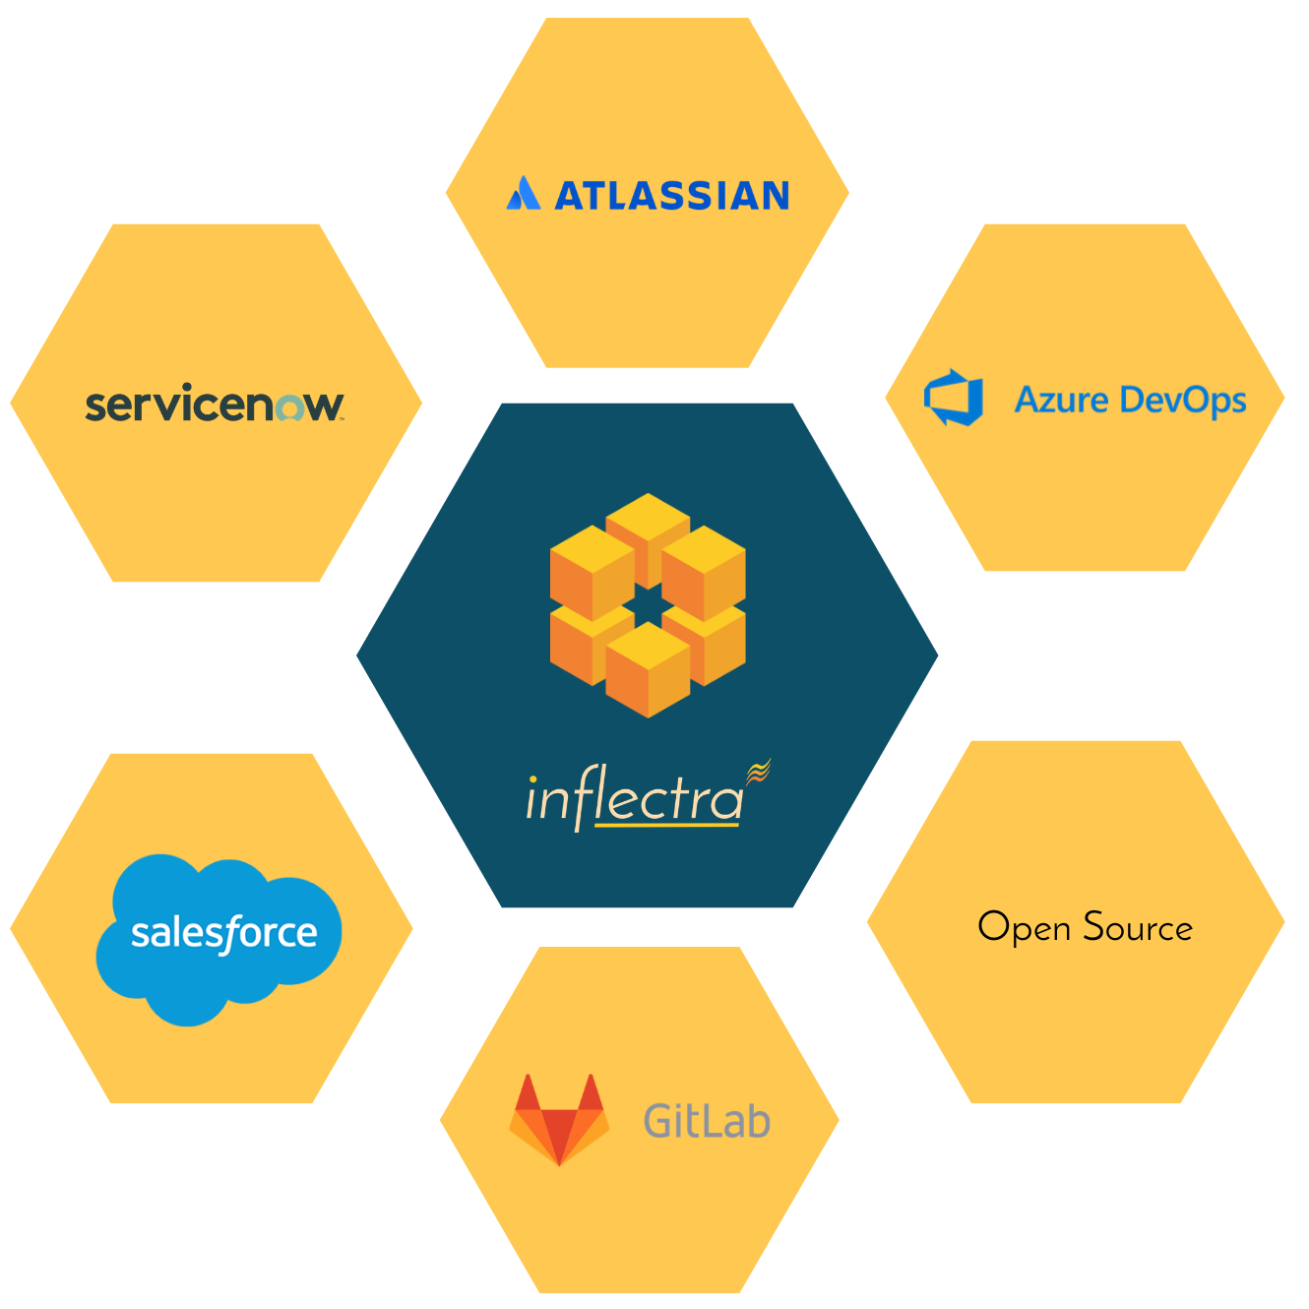
Harmony Across Ecosystems
We recognize that you need to integrate our solutions with other tools and systems
We make this easy and straightforward so you can get working faster & easier

Slide 17
How Are We Different?

Slide 18
Our DNA
Great Products: Build for Our Users Not Wall $treet
Building great software for customers, not chasing the latest fad.
Great Team: We Just Get it Done
Treat customers well, solve their problems, no drama or red tape.
Great Workplace: Family and Life Flexibility
Unlimited vacation, amazing benefits, flex/part time welcomed.
Great Community: Enabling Second Acts
Expanding opportunities for new/second careers in technology.

Slide 19
Our Unique Sales Proposition
Reduced Go-To- Market Time
Innovation Driven
Cost Efficient
Improved Business Process
Short learning curve, easy deployment
Easy and intuitive
SaaS option
Seamless migration/Import
Inflectra’s lightning fast response times & reactivity
Focus on new technologies
Responsive to market & customers needs
Integration with 3rd party tools
No extra modules to purchase
Simple concurrent licensing
Unlimited everything (storage, API calls, Projects, Products)
Single & transparent pricing
Cost vs. equivalent alternatives
One integrated tool, no add-ons
Fully customizable
For Devs, Testers & Managers
Powerful reporting features
Integration with 3rd party tools

Slide 20
Unique Industry Offering
While Offering Simplicity and usability for everyoneusability for everyone

Slide 21
Specific Features for Regulated Industries
Auditability and end-to-end traceability
Data Privacy, Security baked in
Generation of Compliance Documentation
Workflows & Electronic Signatures
Integrated Risk Analysis and Management

Slide 22

Bridging Between Agile and Compliance
Support for Regulated Processes
Modern, Agile Processes
Baselining
Risk Management
Electronic Signatures
Data Privacy
Compliance
Workflow
Requirements Mgt
On-Premise
CI / CD
Scrum
Kanban
Scaled Agile
DevOps
Distributed Teams
Remote Working
Cloud-Based

Slide 23

Healthcare & Life Sciences
Electronic signatures for FDA 21 Part 11 compliance
Secure hosting with support for HIPAA BAA agreements
End to end traceability of requirements, tests, and code
Validated platform where you control update cadence

Slide 24

Financial Services & Insurance
Secure cloud platform (SOC2) or on-premise deployment
Integrated enterprise risk management
Integration with automated testing and compliance tools
End-to-end traceability and auditability of testing

Slide 25

Energy, Industrial, & Automotive
Testing for public safety with world class test management
Define requirements and test for compliance
Integrate standards and regulations into your test plans
Understand and manage risk of critical systems

Slide 26

Defense, Government & Aerospace
Manage programs and portfolios across platforms
Test step level traceability for mission systems
Automate testing and compliance with RemoteLaunch
Security and privacy with on-premise and AWS GovCloud

Slide 27
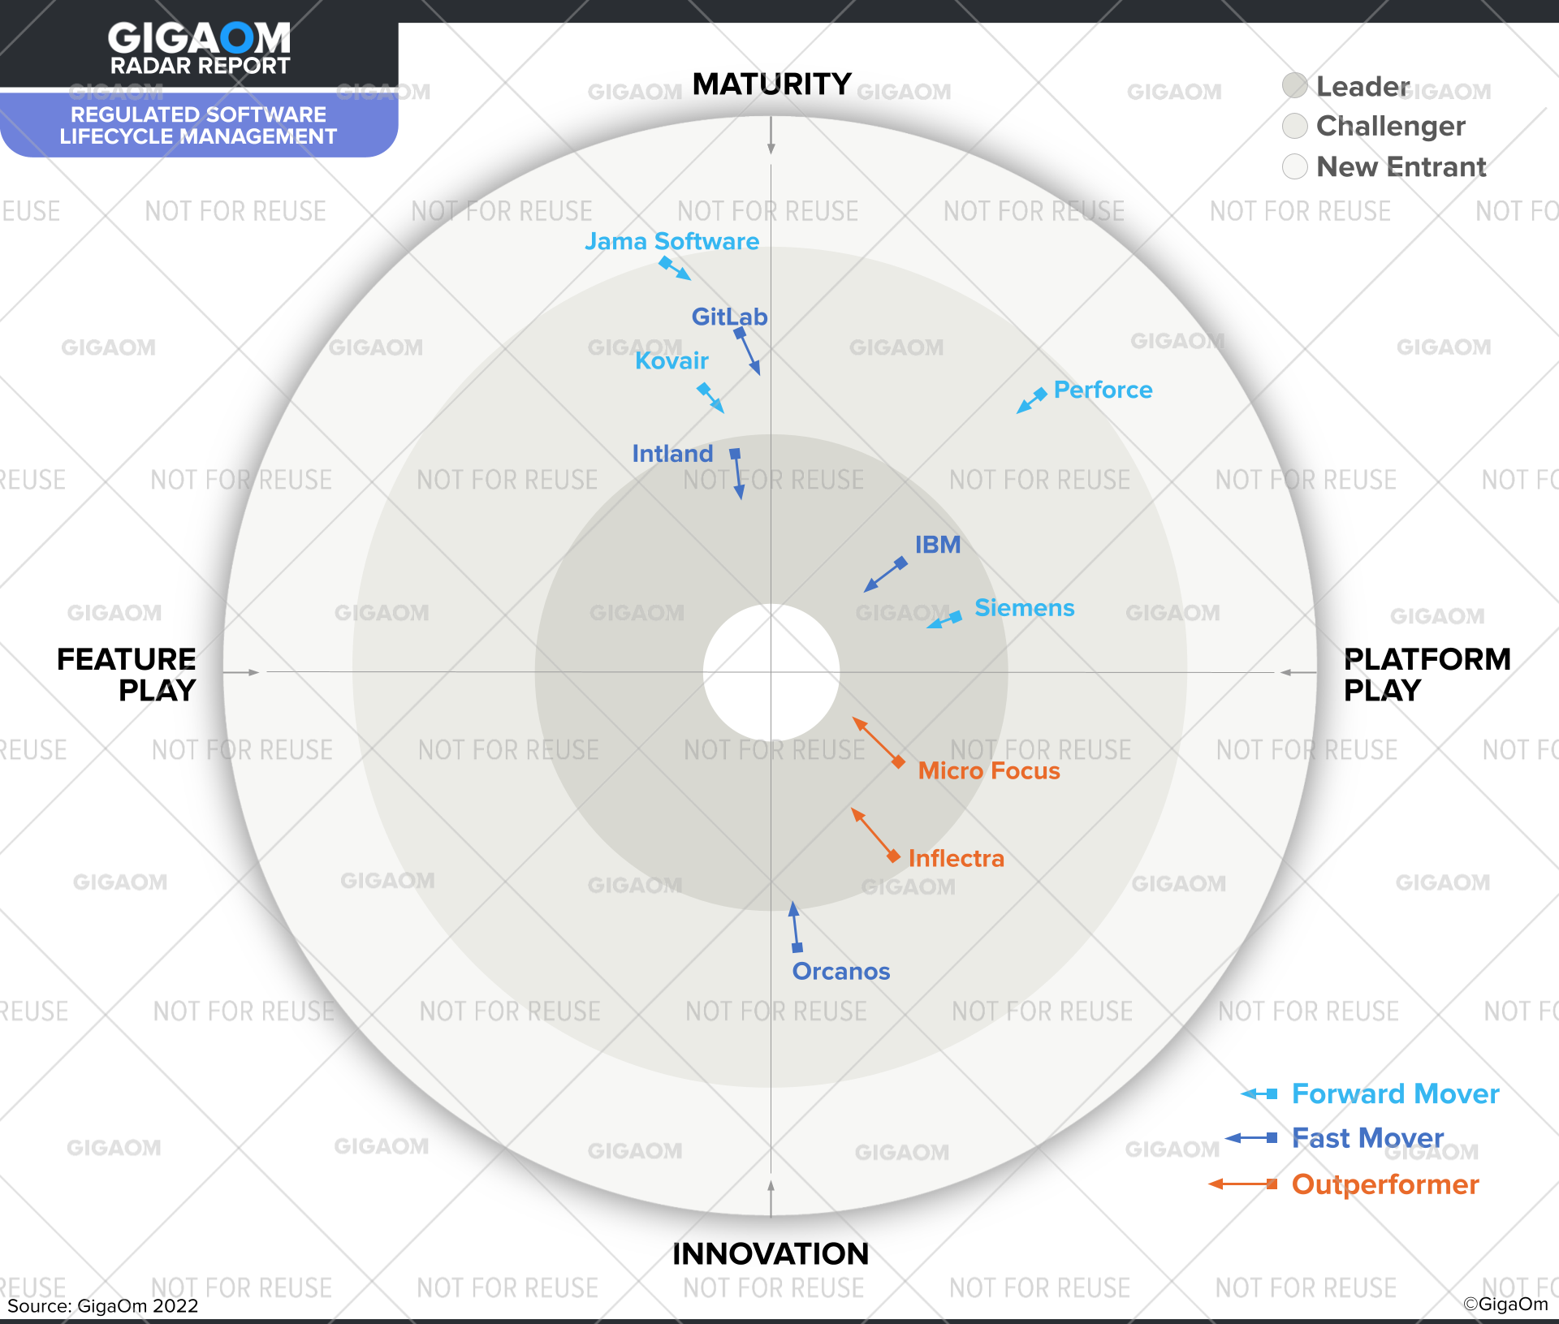
Hot Off The Press
“We ranked Inflectra as Leaders in the Platform-Play half. These solutions are comprehensive and support many of the regulated industries, not just one or two.”
- GigaOM RSLM Report

Slide 28











Compliance with International Standards
EudraLex Volume 4 Part I & II
Guidance on Data Integrity

Slide 29
From Testers to C-Suite
Enable Teams
Lead Projects
Manage Programs
Respond to Customers
Manage Risk
Respect deadlines
Control budget spend
Optimize resource utilization
Avoid quality failure
PM
Test Automation
Load Test
CI/CD
Compare Tests
Exploratory Testing
Managing Teams
QA
Manual Testing
BA
IDE Integration
Continuous Integration
Bug & User Story Tracking
Regression
Agile / Waterfall
Source Code Management

Slide 30
Inflectra’s Secret Sauce

Slide 31
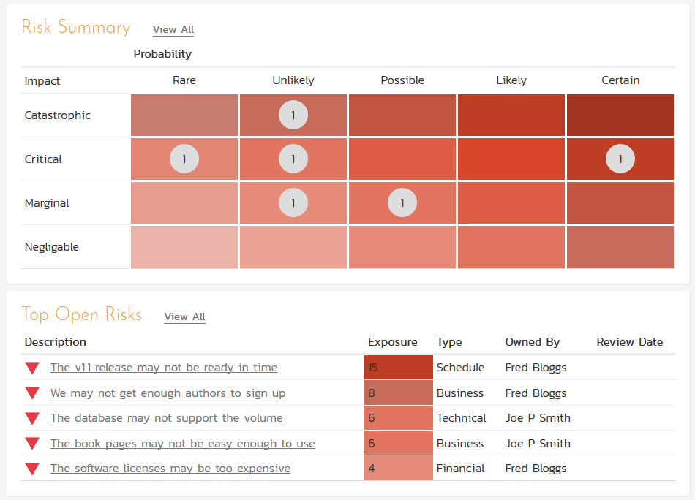
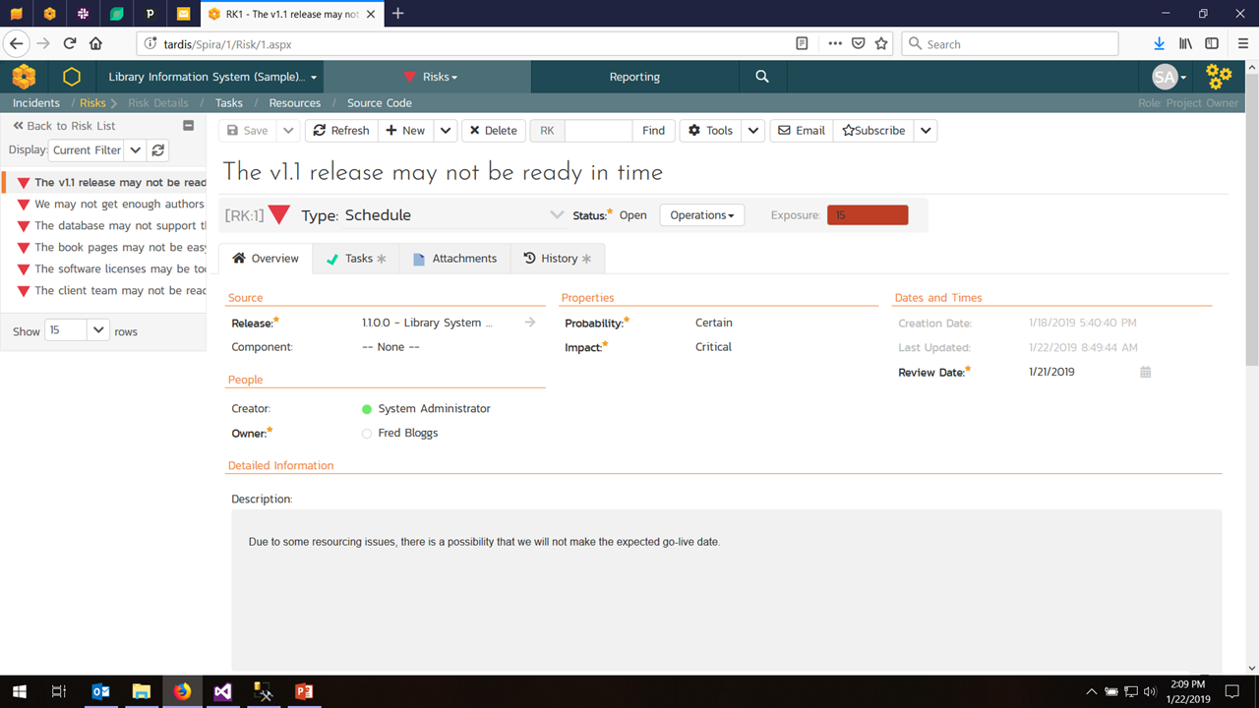
Risk Management

Slide 32
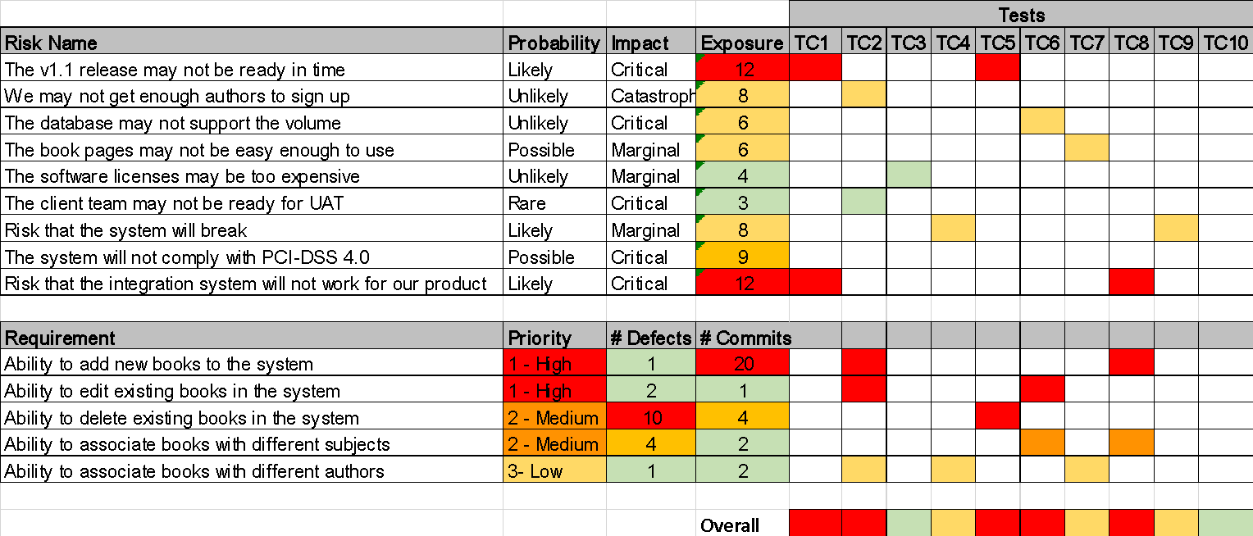
Risk-Based Testing

Slide 33


Distributed Agile
Company Strategy & Objectives
Company Strategy & Objectives
Product A
Product B
Product A
Product B
Customer Support & Service Delivery
Customer Support & Service Delivery
Product C
Product D
Product C
Product D
Infrastructure, DevOps, Culture, Values
Infrastructure, DevOps, Culture, Values
Outsourced Supplier
Industry Regulators
Other Suppliers
Company Strategy & Objectives
Product A
Product B
Customer Support & Service Delivery
Data Privacy Authorities
Product C
Product D
Service & Solution Partners
Infrastructure, DevOps, Culture, Values

Slide 34
On Premise + Cloud
Same product, both platforms
Same API
Same user interface
Same integrations and plugins
Handles air-gapped networks
Security, Compliance

Slide 35
Overview of our products

Slide 36
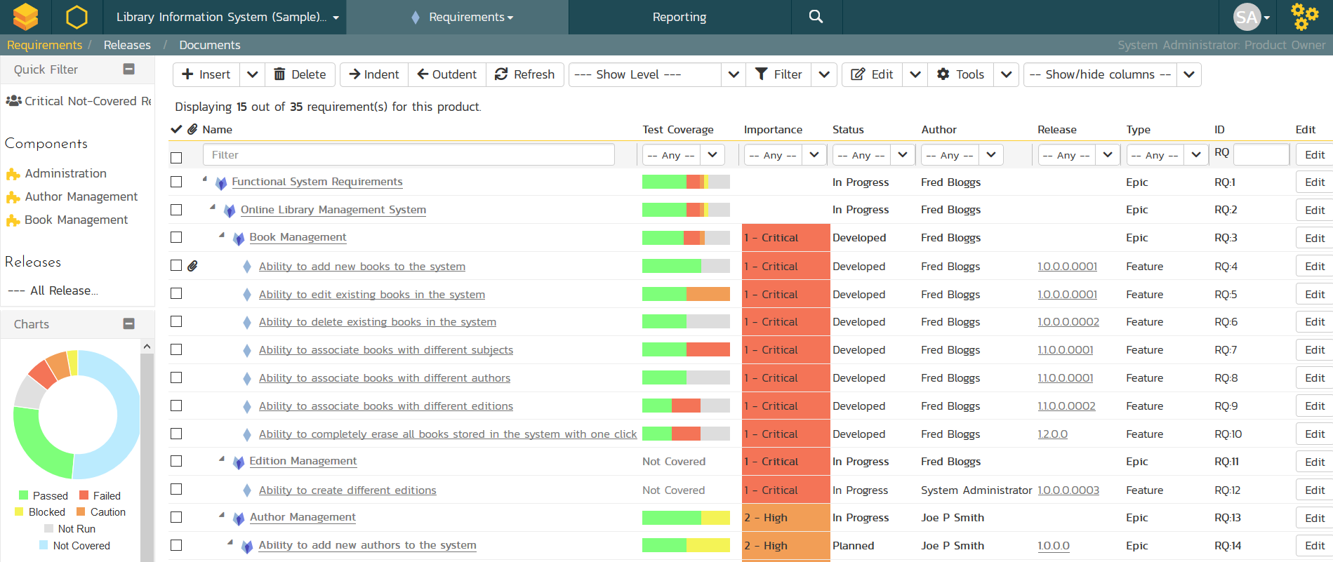
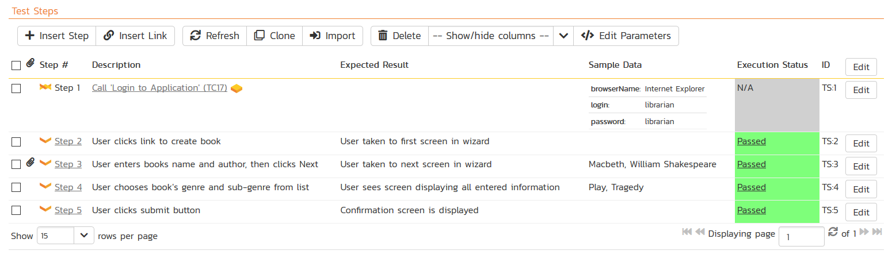
SpiraTest® - Requirements & Test Mgt
Requirements, test and defect management - integrated
End-to-end traceability and real-time reporting

Slide 37

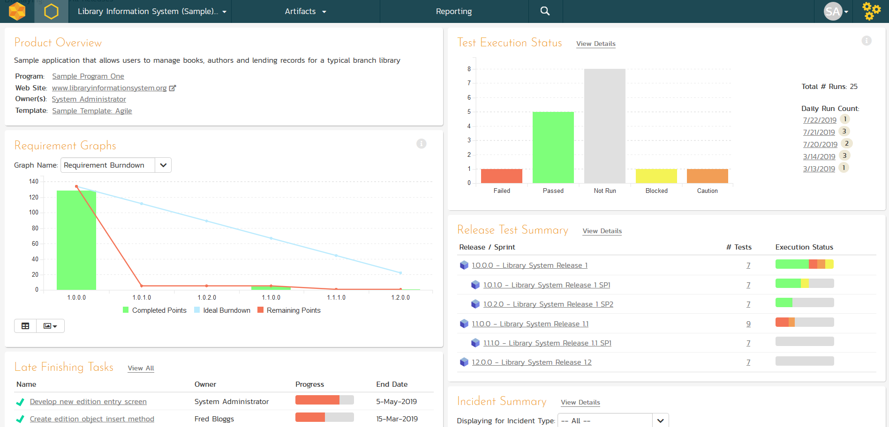
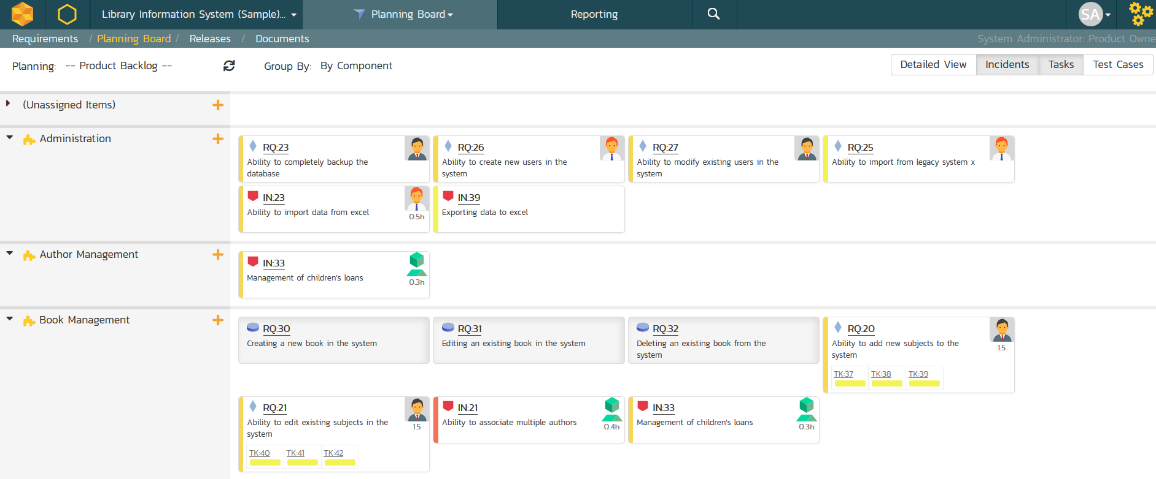
SpiraTeam® - Application Lifecycle Mgt
All of the SpiraTest features, plus agile project management
Supports Scrum, Kanban, waterfall & hybrid projects

Slide 38
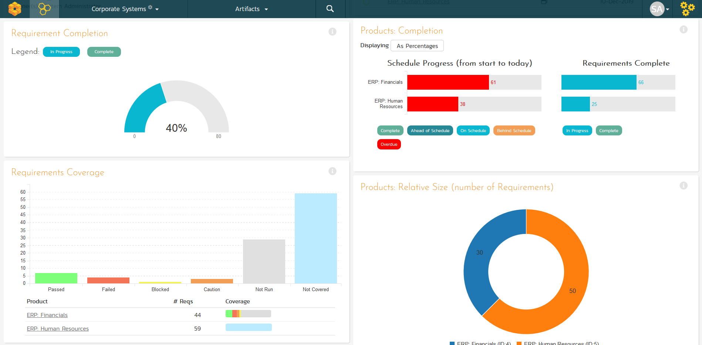
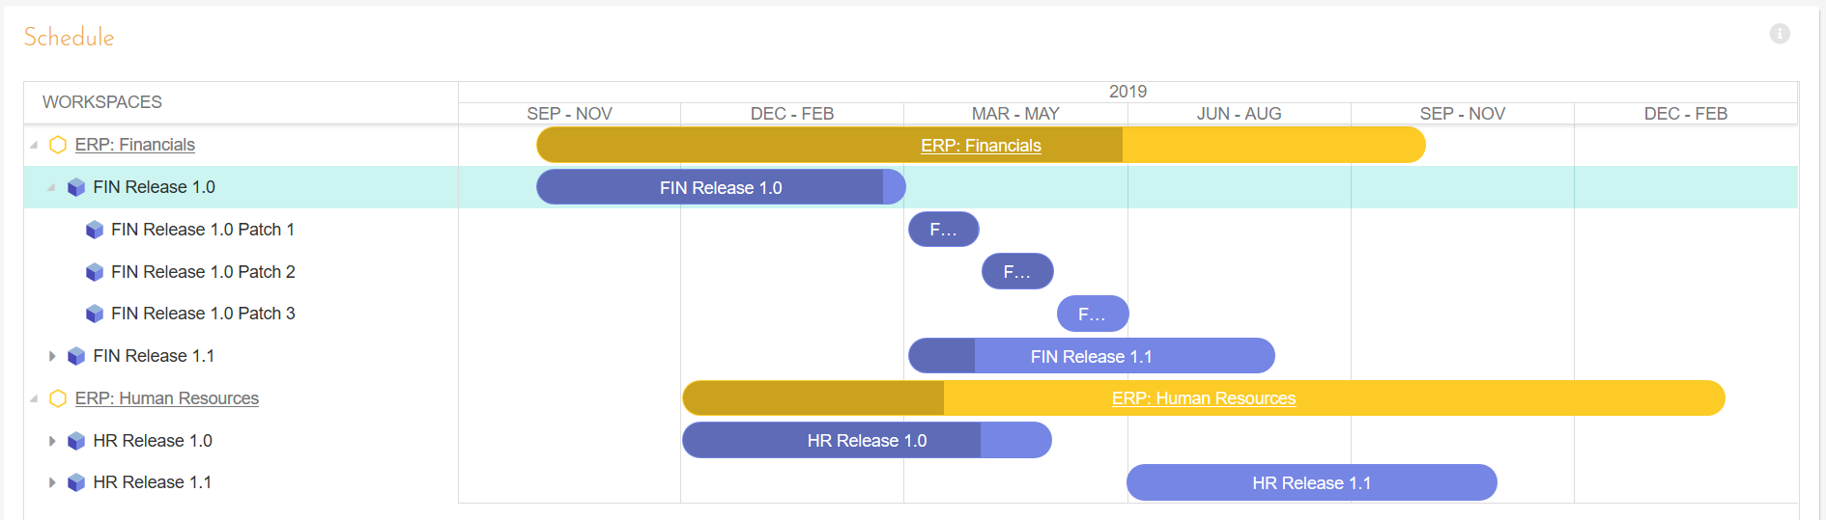
SpiraPlan® - Program & Portfolio Mgt
Extends SpiraTeam with program & portfolio management
Integrated enterprise risk management & tracking

Slide 39
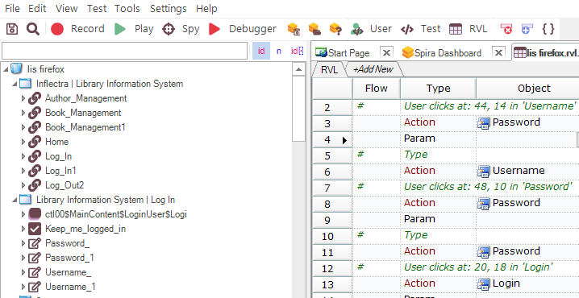
Rapise® - Intelligent Test Automation
Codeless test automation and RPA platform using AI insights
Handles web, mobile, desktop, and APIs in one system

Slide 40


RemoteLaunch® - Automation Integration
Host #1
Windows 2008
IE 8.0
Manual
Tester #1
RemoteLaunch®
Host #2
Windows Vista
Mozilla Firefox
Spira
Repository
Manual
Tester #2
RemoteLaunch®
Host #3
Ubuntu Linux
Google Chrome
Manual
Tester #3
RemoteLaunchX®
Integrate automated testing tools with Spira

Slide 41

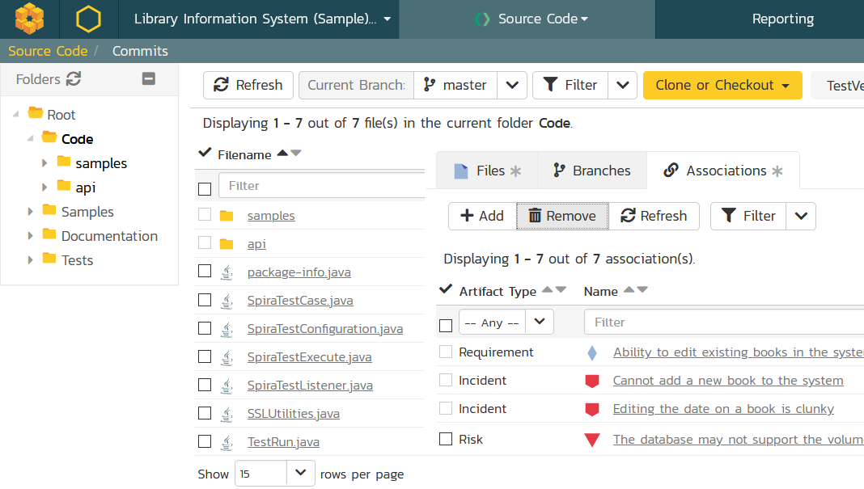
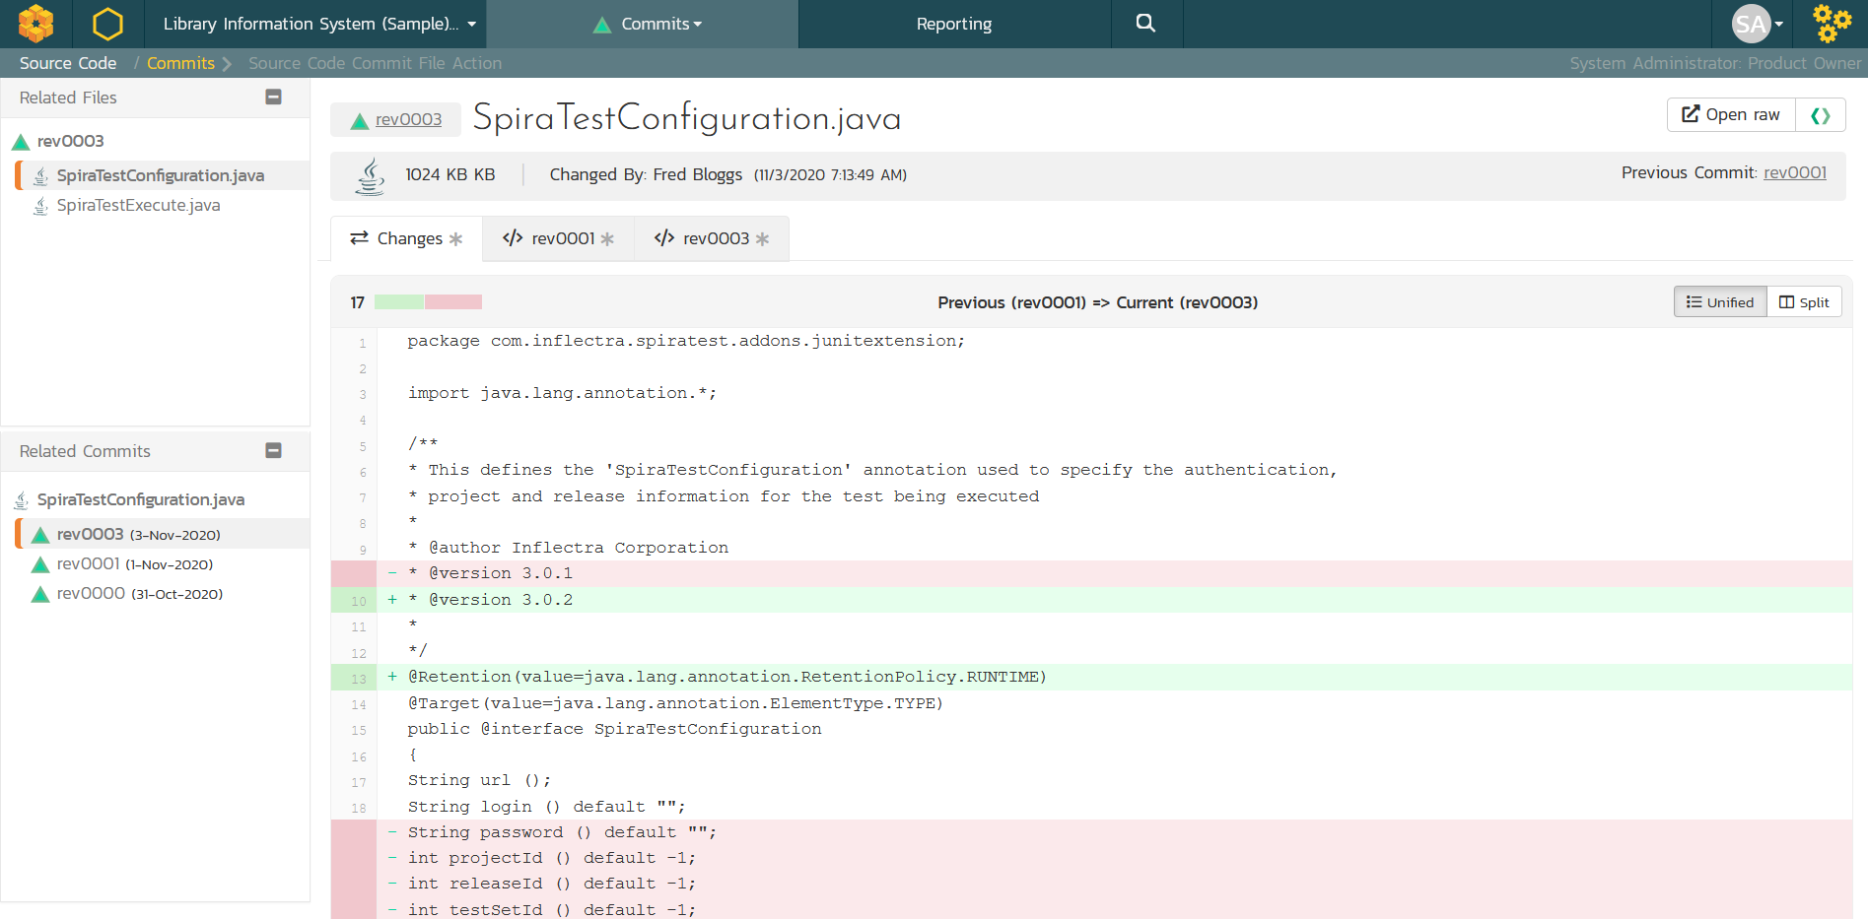
TaraVault® - Source Code Management
Cloud-hosted code repositories (Git & Subversion)
Integrated code viewing and artifact traceability
Support for pull requests and merge workflows

Slide 42
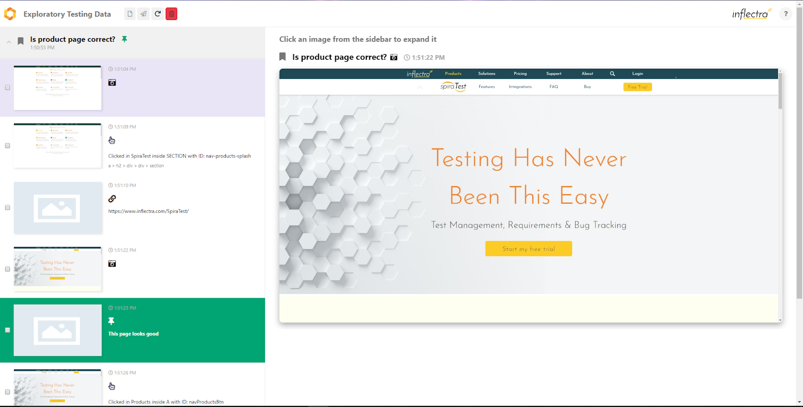
SpiraCapture™ - Exploratory Testing
Chrome extension that captures activity & screenshots
Records and organizes your testing sessions

Slide 43

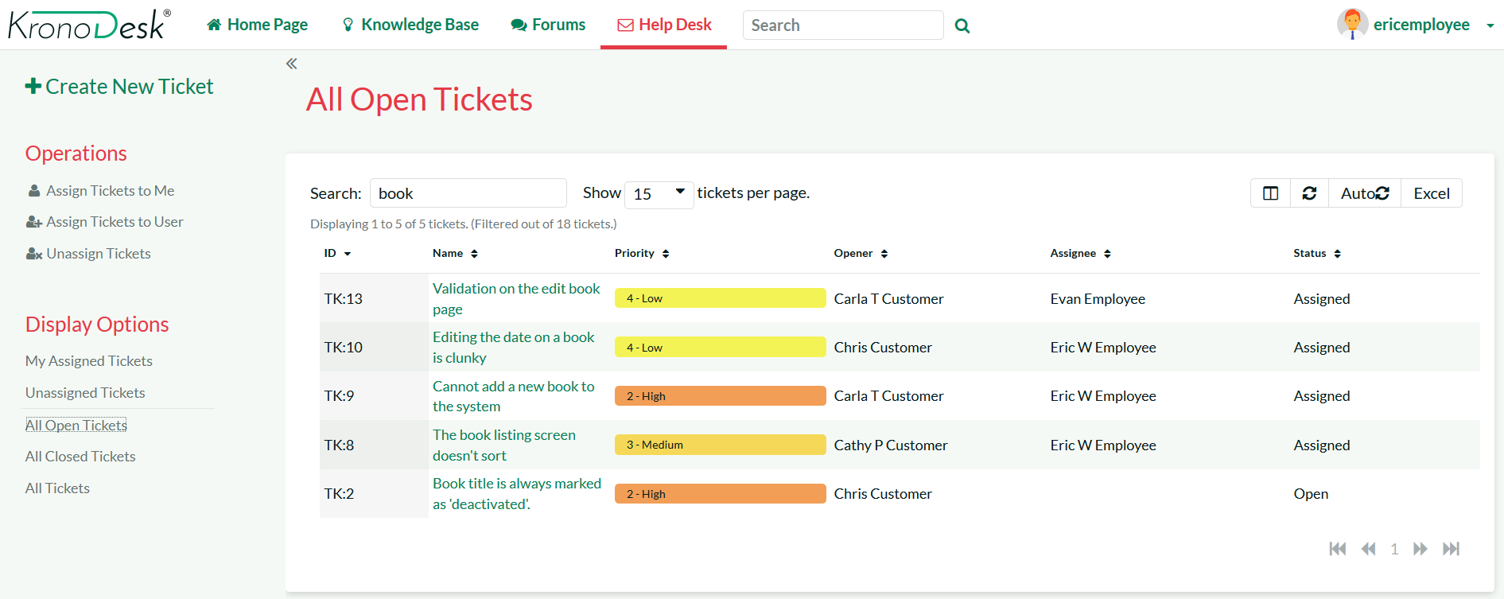
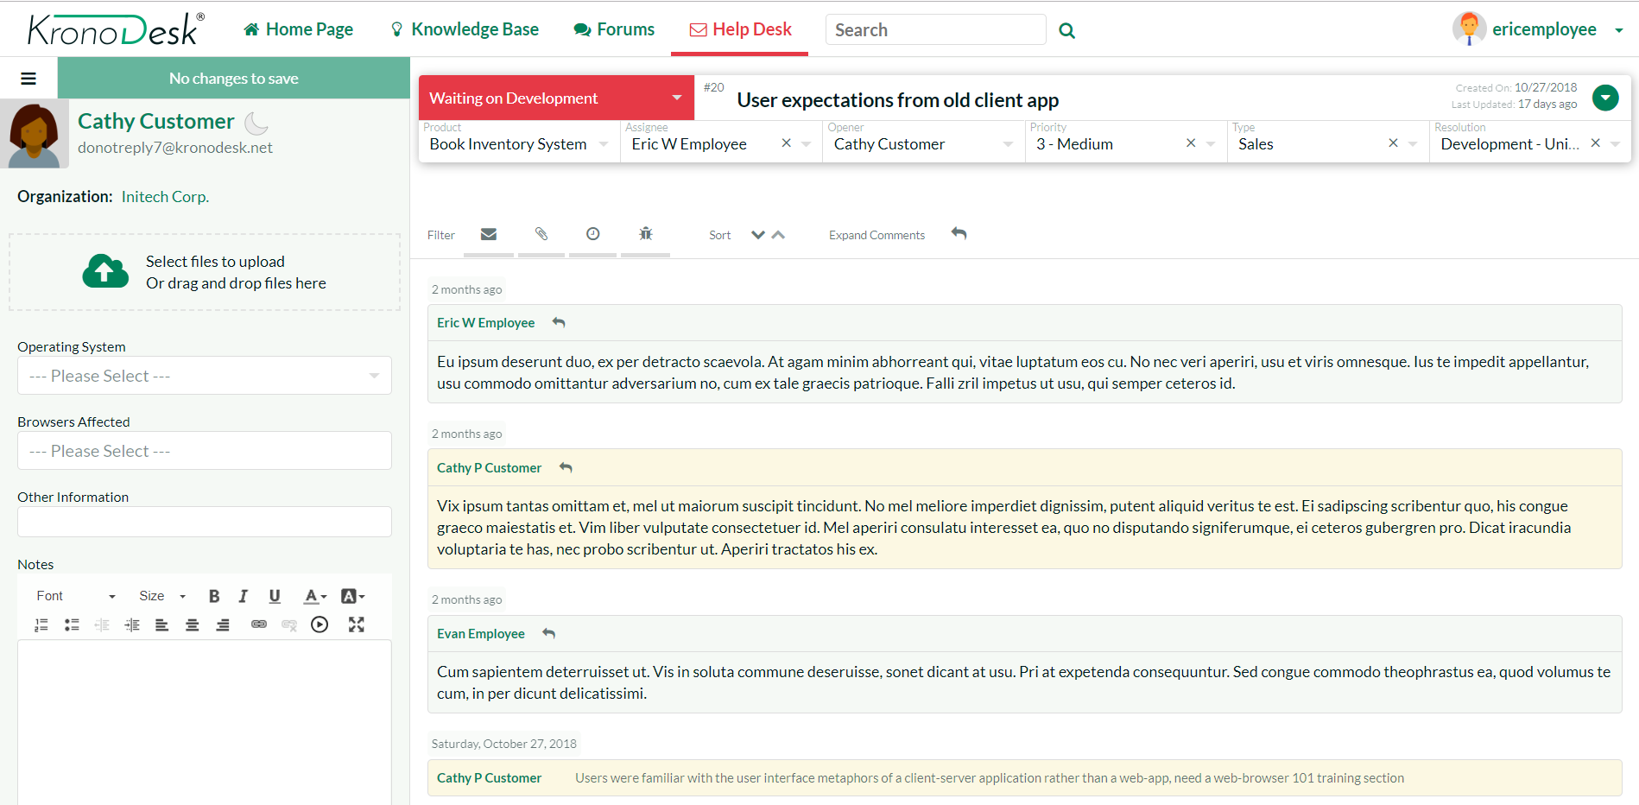
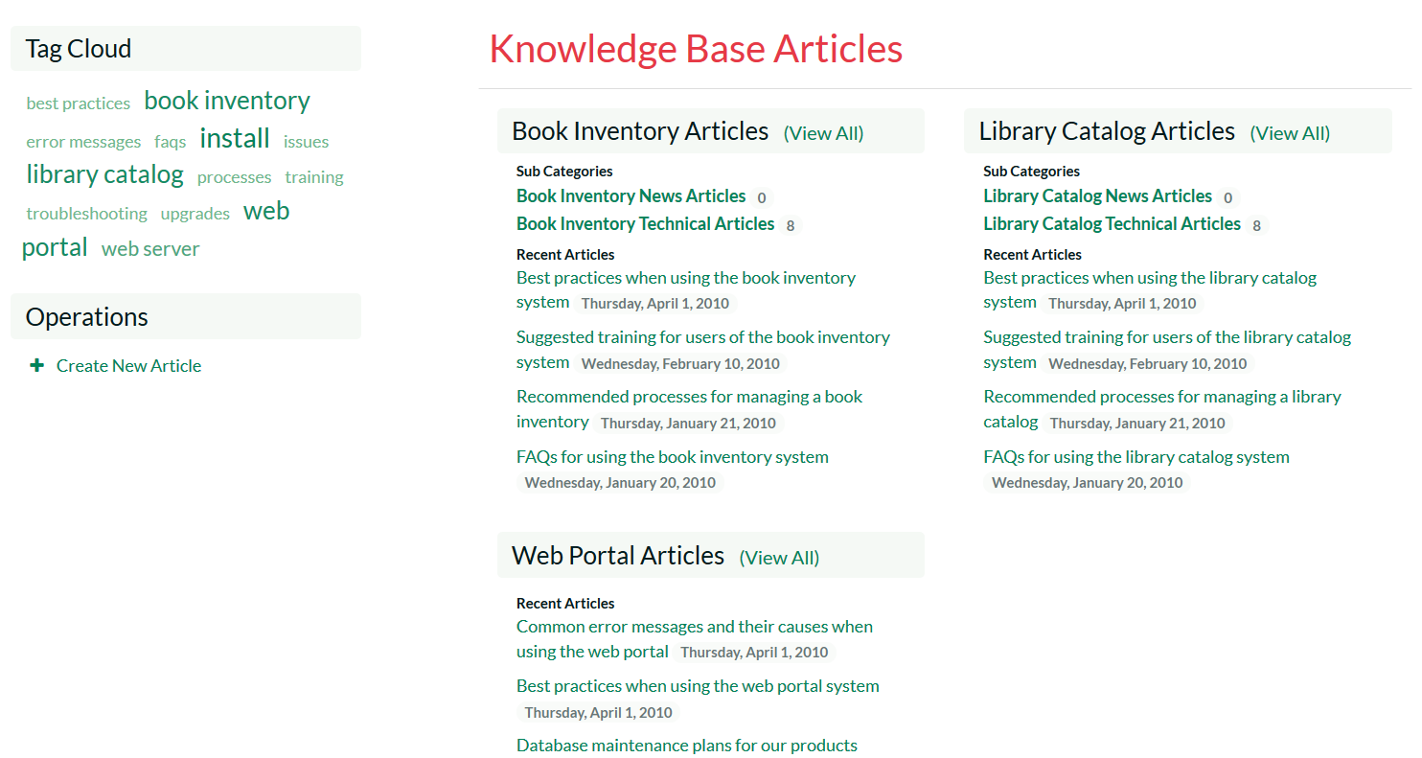
KronoDesk® - Support & Help Desk

Slide 44
Our Customers

Slide 45



































































Our Customers (USA/Canada)
Energy, Industrial & Transport
Financial & Business Services
Media & Telecom
Government & Defense
Healthcare & Bio-Technology

Slide 46


















































Our Customers (Europe)
Energy, Industrial & Transport
Financial & Business Services
Media & Telecom
Government & Defense
Healthcare & Bio-Technology

Slide 47












































Our Customers (Global)
Asia
Middle East
Africa
Australia / NZ
Latin America

Slide 48
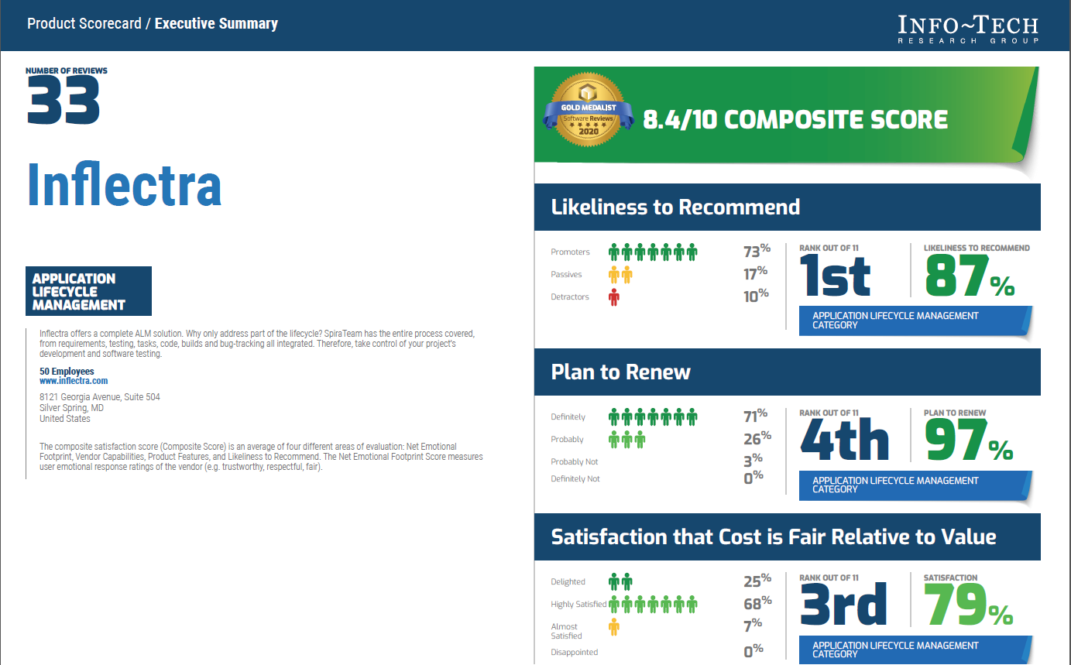
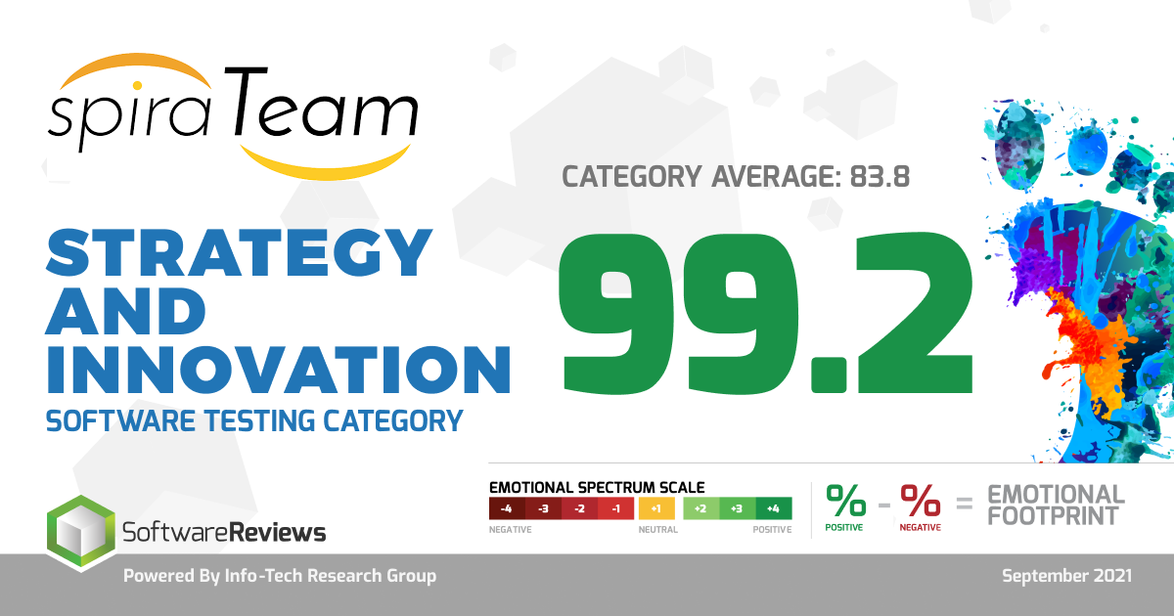
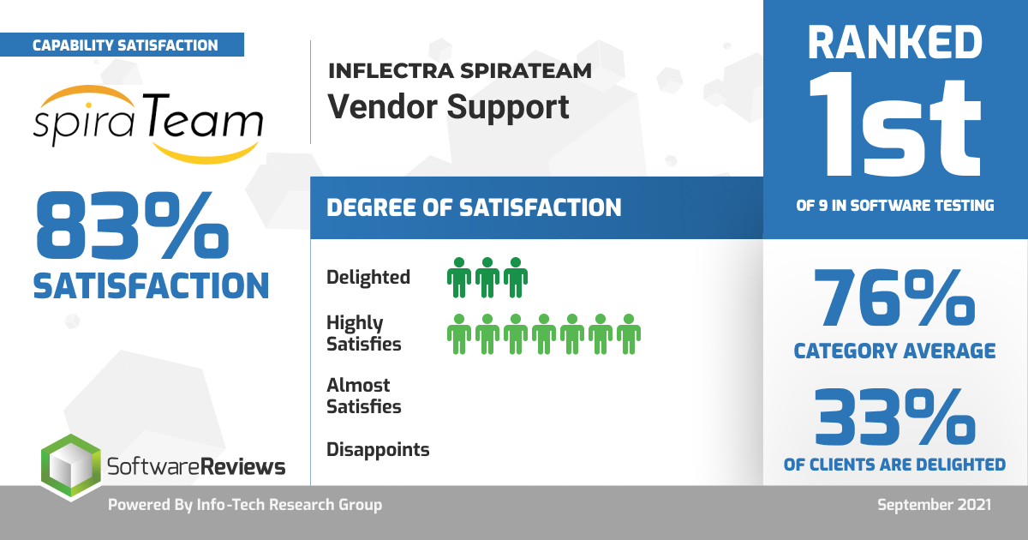
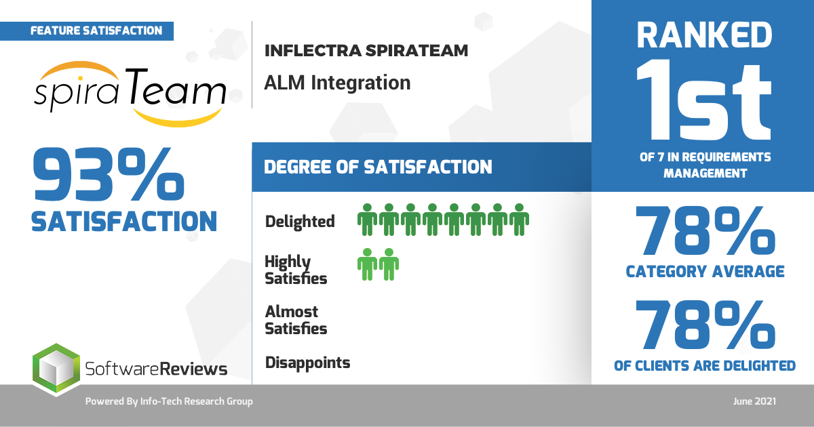
What Our Customers Say

Slide 49
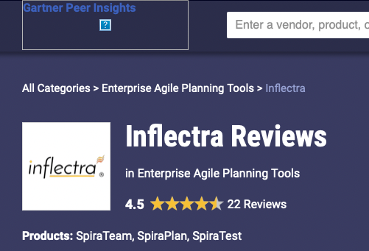

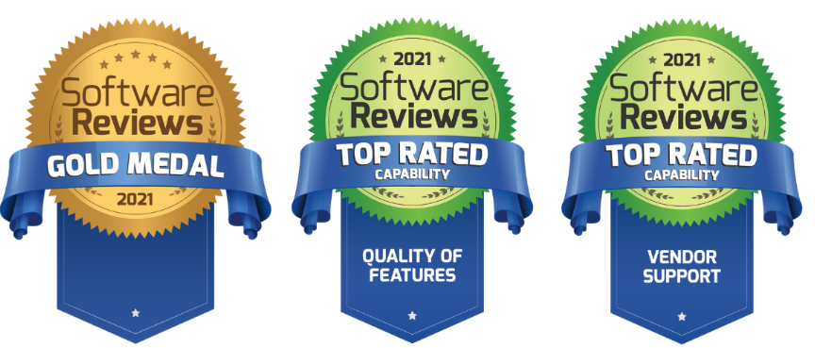
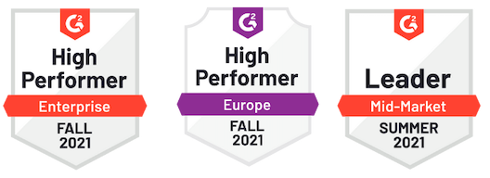
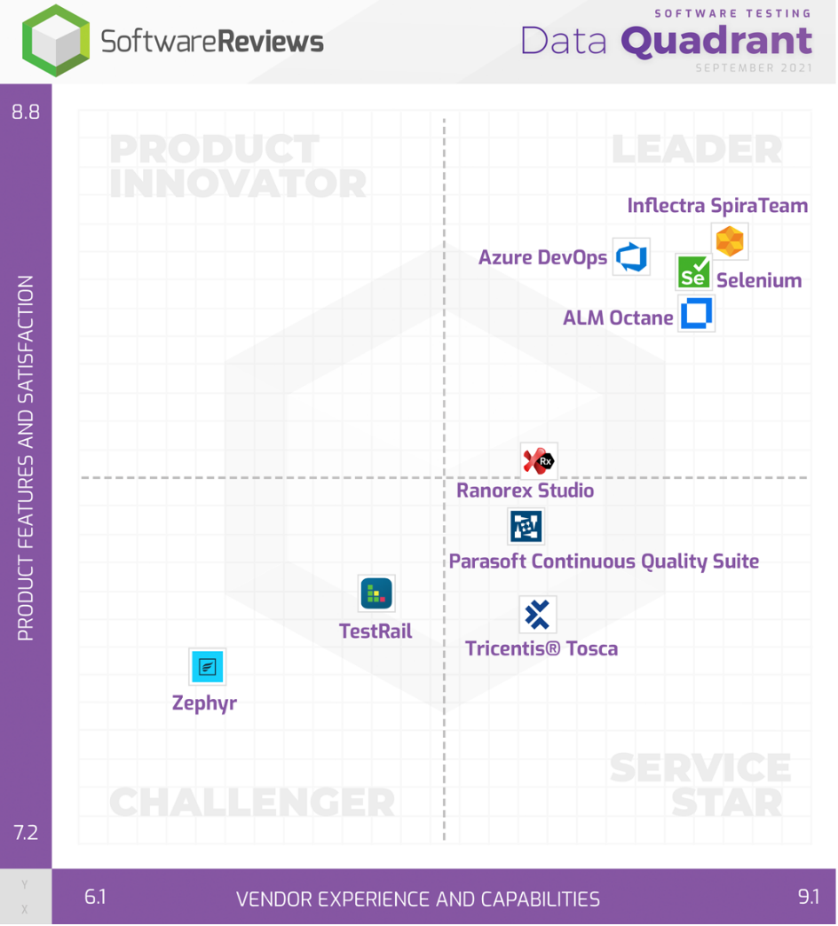
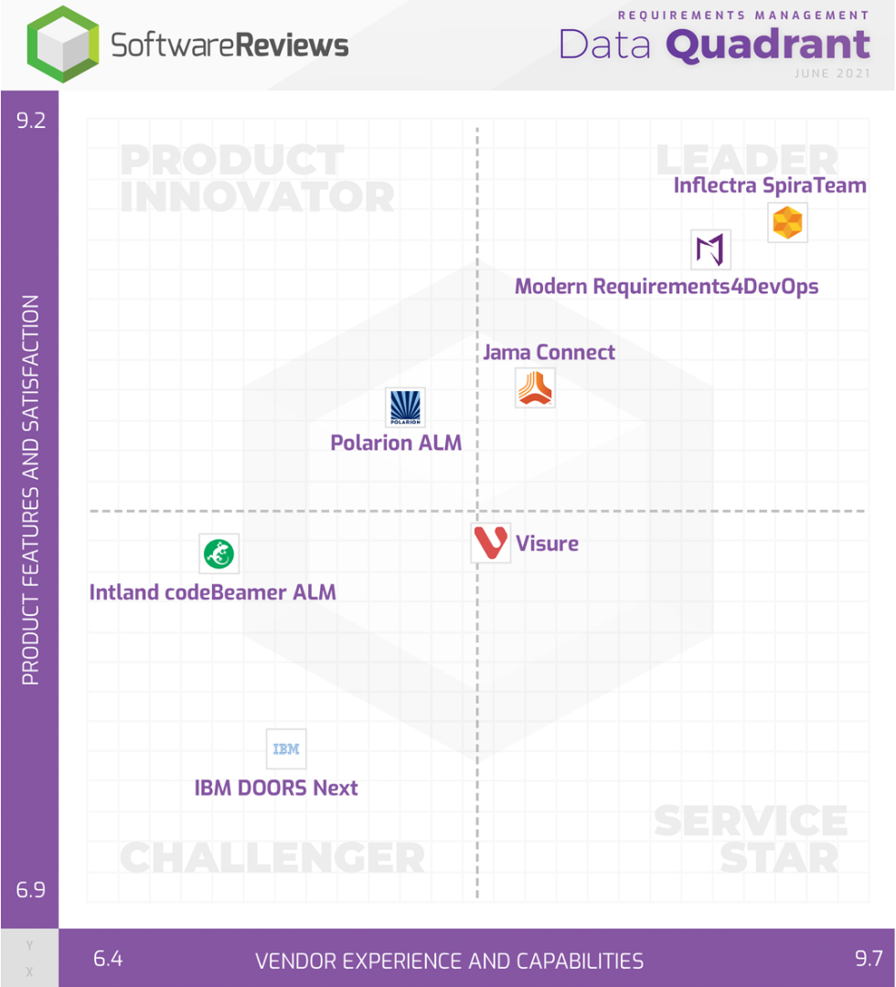
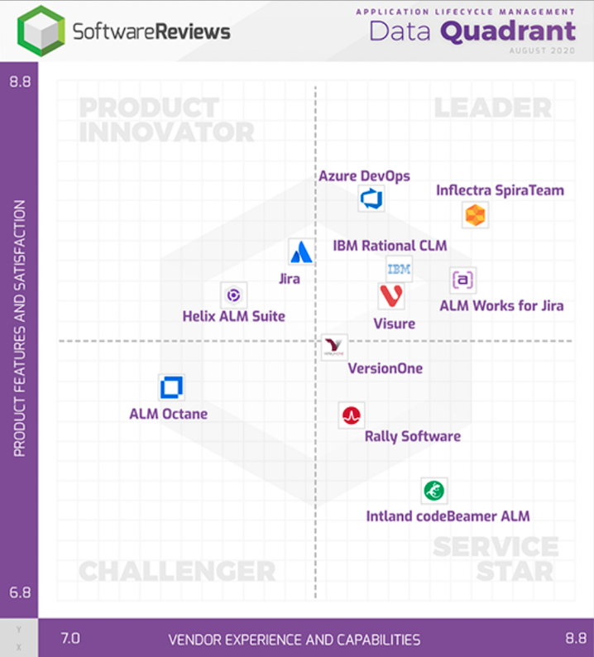
Awards and Recognition

Slide 50

Inflectra Partner Program

Slide 51
Defined Metrics for Success
Point system of engagement
Activities earns points
Targets vary by partner level
Self report activities in the Partner Portal
Sales, Engagement, Continuing Education & Marketing
Notes:
Our new model is based on defined metrics of engagement in four areas:
Each area has a variety of activities,
And each activity has an assigned point value
So there are a variety of ways to achieve points in each category.
Each partner level has a different point target
Activities are reported in the Partner Portal.

Slide 52
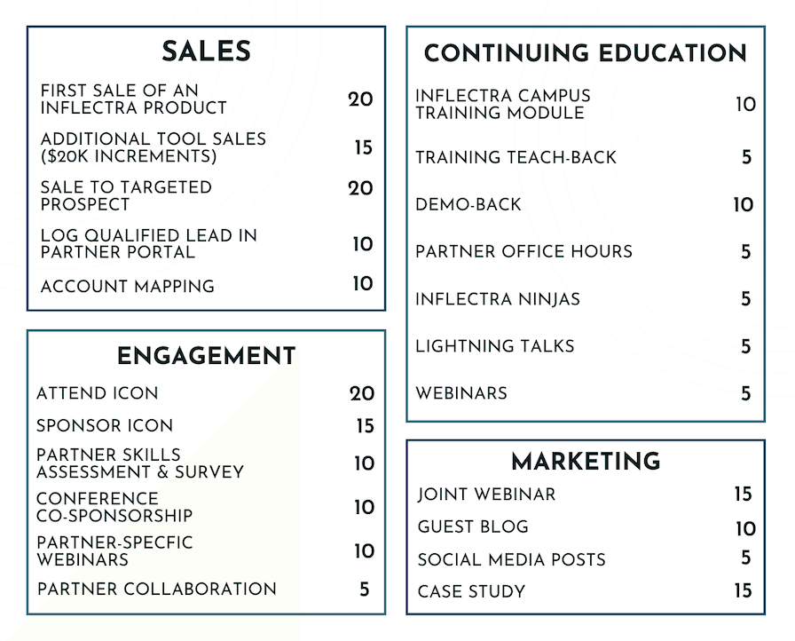
Activities and Point Values
Notes:
Here you can see a breakdown of the activities in each category.
(List some)
As you can see, ICON is on the list, so you’ll get credit for the conference.
We expect this list to expand, and we’re always open to engagements beyond those listed, so please don’t hesitate to offer suggestions or note areas of engagement in which you’ve participated that aren’t on this list.

Slide 53
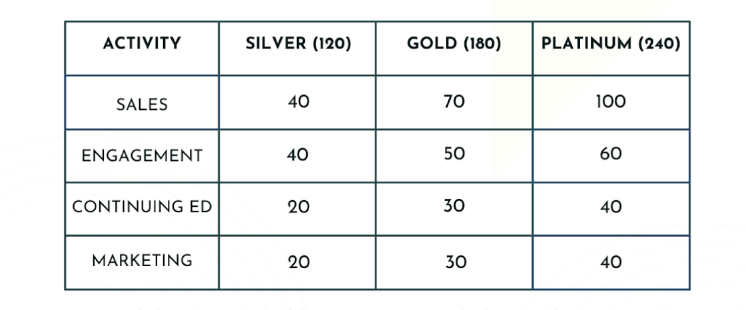
Point Targets by Partner Level
Notes:
Here you can see the point targets per partner level and their breakdown by category.
Talk about categories and targets.

Slide 54
Our Partners Partnership Program
Solution Partners
These partners are Inflectra affiliates, resellers, advisors, consultants, and trainers who provide and implement customer solutions with Inflectra products. Solution Partners can choose their level of engagement at which they wish to participate.
Platinum
Gold
Silver
Technology Partners
These partners work collaboratively with Inflectra to integrate and deliver joint solutions to shared customers. These partners optimize Inflectra solutions with plug-ins, adapters, connectors, and technical services.

Slide 55
Solution Partners: Reseller
Benefits
10% discount on tool price for production accounts
Joint webinars & co-marketing opportunities
Inflectra Partner Portal access

Slide 56
Solution Partners: Silver
Benefits
20% discount on tool price for production accounts
Sales support
Joint webinars & co-marketing opportunities
Partner-exclusive events
Account Mapping
Training on sales & tools
Certifications & badges
Listed on Inflectra website
Spira & KronoDesk licenses
3 users (for non-production use/for internal training only); Rapise - 1 engine

Slide 57
Solution Partners: Silver
Qualifications
Meet Inflectra engagement targets
List Inflectra on partner website
1 Inflectra-Certified Sales Staff
1 Inflectra-Certified Technical Staff

Slide 58
Solution Partners: Gold
Benefits – Everything for Silver Partners, Plus
25% discount on tool price for production accounts
Curated leads
Personalized training on sales & tools
Screen sharing technical assistance
Spira & KronoDesk licenses - 5 users (for non-production use/for internal training only); Rapise - 2 engines

Slide 59
Solution Partners: Gold
Qualifications
Meet Inflectra engagement targets
List Inflectra on partner website
2 Inflectra-Certified Sales Staff
2 Inflectra-Certified Technical Staff
1 Inflectra-Certified Pre-sales/Demo Staff

Slide 60
Solution Partners: Platinum
Benefits – Everything for Gold Partners, Plus
30% discount on tool price for production accounts
Joint PR opportunities
Access to Inflectra Sales Teams
MDF offerings
Spira & KronoDesk licenses - 10 users (for non-production use/for internal training only); Rapise - 2 engines

Slide 61
Solution Partners: Platinum
Qualifications
Meet Inflectra engagement targets
List Inflectra on partner website
5 Inflectra-Certified Sales Staff
5 Inflectra-Certified Technical Staff
2 Inflectra-Certified Pre-sales/Demo Staff

Slide 62
Technology Partners
Benefits
10% partner discount
Joint webinars and co-marketing opportunities
Account Mapping
Partner’s marketing collateral at Inflectra-run or sponsored events
Listing on the Inflectra website
Inflectra Partner Portal access

Slide 63
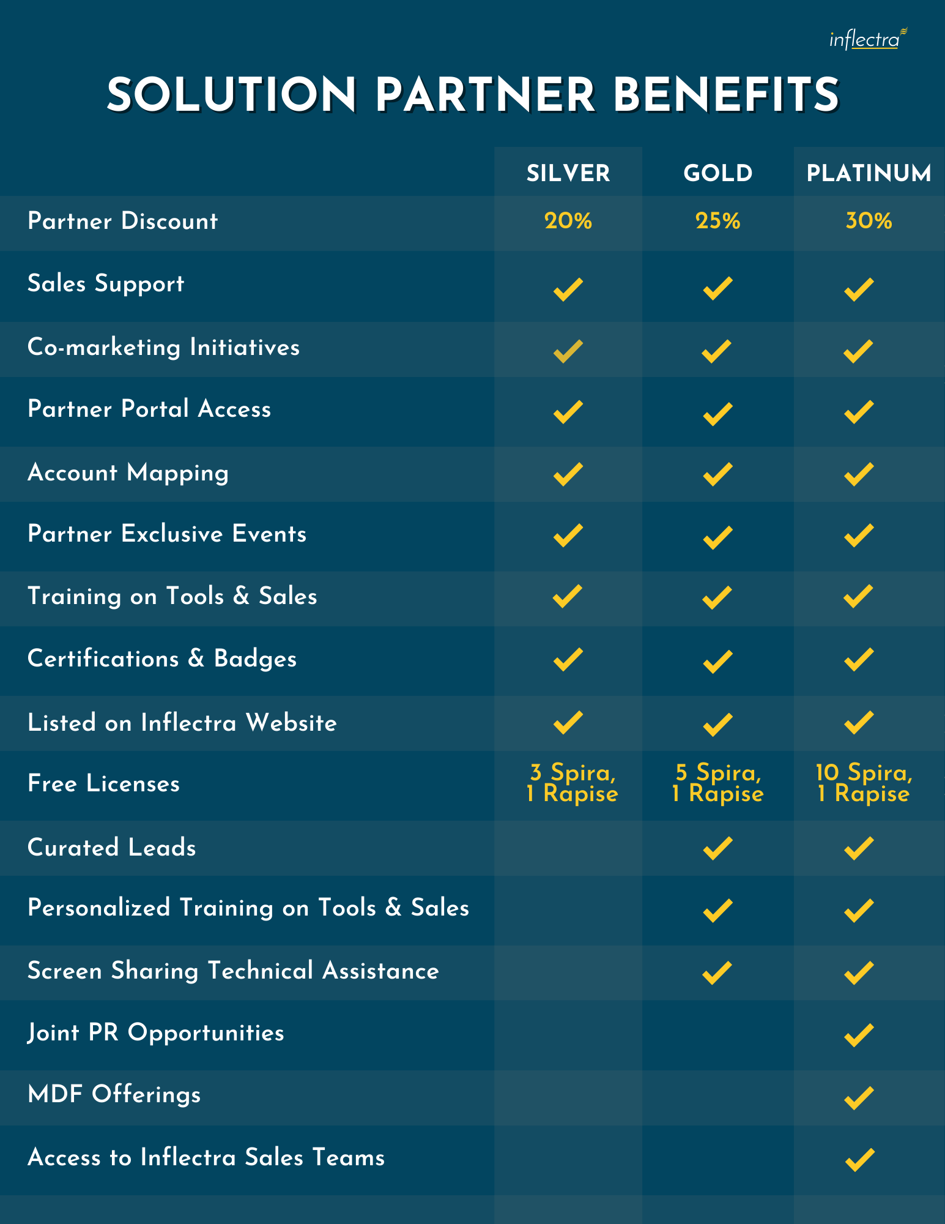
Solution Partner Benefits

Slide 64
Features for Partners

Slide 65

Badges
Badges
Inflectra’s Badge feature seeks to reward the accomplishments and recognize areas of expertise of each partner. It will also allow Inflectra’s customers to find the right partner by searching the website for partners with badges that best suit the customer’s needs.

Slide 66

Reveal – Account Mapping
Instant secure account mapping platform
Connects CRMs to identify account overlaps
Identifies opportunities for wins

Slide 67
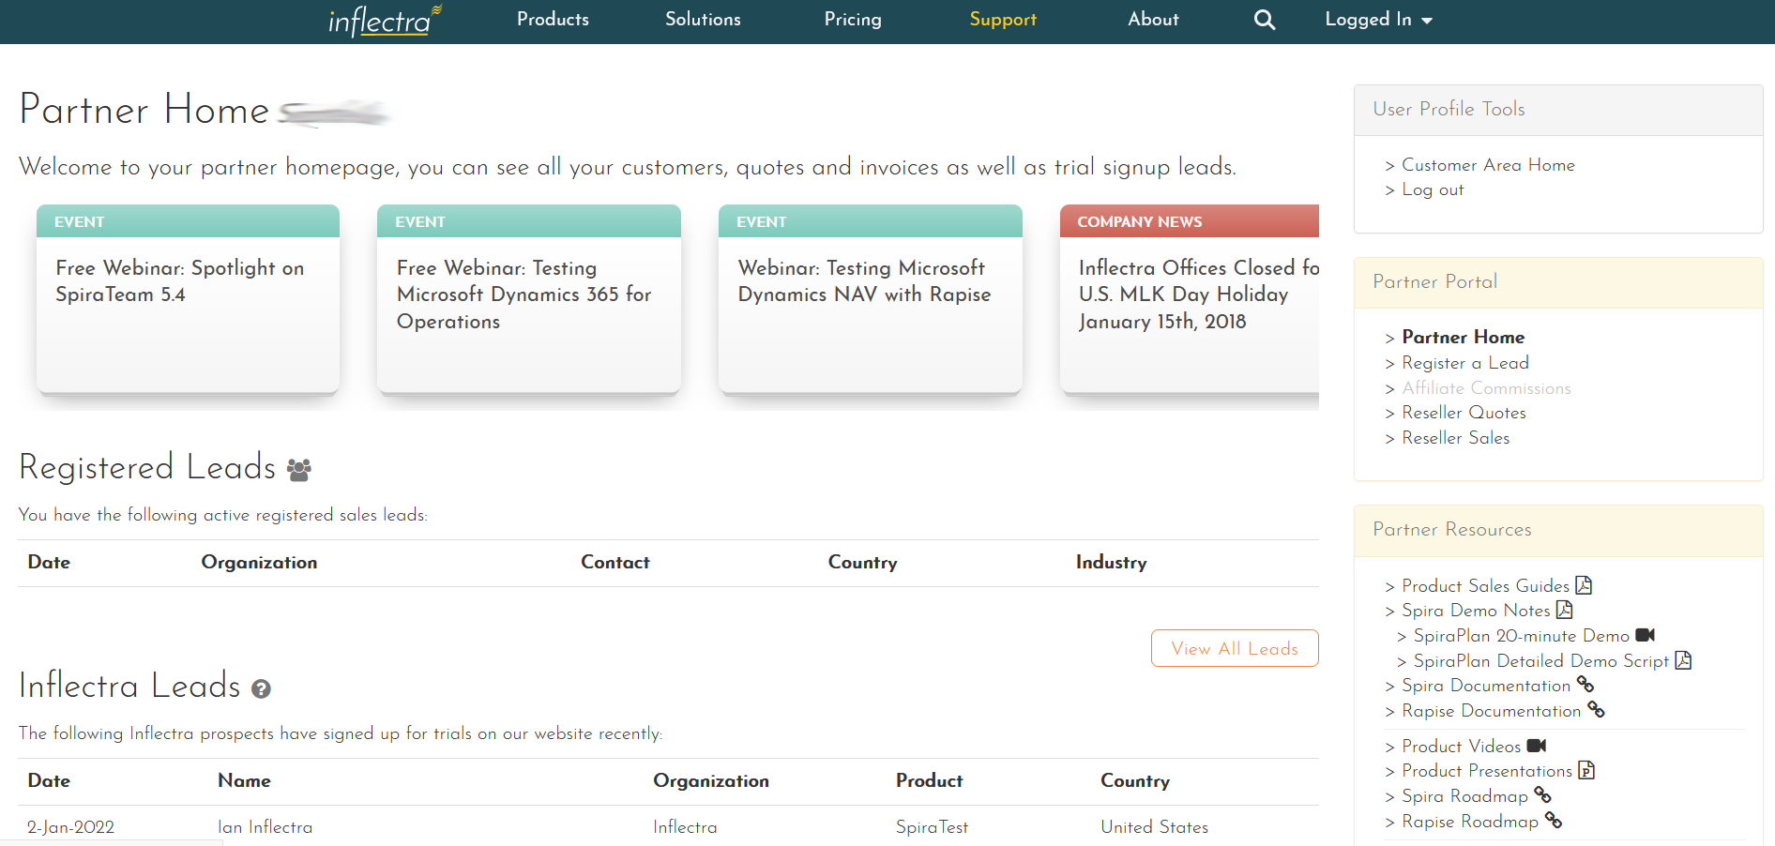
Partner Portal
Inflectra maintains a robust partner communication, deal management and technical support system through its Partner Portal.

Slide 68
Partner Portal
Allows partners to complete onboarding processes, find educational and sales enablement resources, and consolidate and organize information
Inflectra maintains a robust partner communication, deal management and technical support system through its Partner Portal.

Slide 69
Partner Portal
The partner portal lets you register new leads, see Inflectra news, view reseller quotes and manage your customers’ subscriptions.
Inflectra maintains a robust partner communication, deal management and technical support system through its Partner Portal.

Slide 70
Rewards
Additional bespoke training
InflectraCon tickets
Inflectra Swag
Self Selected Treats from the Goody Gifting Program

