Slide 1

Information for Partners
®

Slide 2
Why Inflectra?
WE BELIEVE QUALITY SHOULD BE AT THE CORE, DO YOU?

Slide 3
When A Single Point Of Failure
Is Not An Option
INFLECTRA HELPS YOU DELIVER QUALITY SOFTWARE, FASTER AND WITH LOWER RISK

Slide 4



With Inflectra, Deliver Measurable Quality Fast!
Only 16% of software development projects are completed on time and within budget.
PRODUCT MANAGERS
QUALITY ASSURANCE
SOFTWARE TESTING
52%
of time spent on un-planned “fire-fighting” activities
40%
of software budget spent on Quality Assurance
5%
of companies carry out fully automated testing internally
60%
of businesses lack a plan to enhance their PM process
39%
of software projects fail due to poor requirements gathering
24%
of companies saw ROI uplift from automated testing
39%
of managers that worry about missing launch date
67%
of customers cite “bad experience” with products as their churn reason
35%
of companies use non-testers for software testing
Sources: “Software Survival in 2024”, Beta Breakers; “10 QA Statistics”, Testlio; “Product Management Statistics”, UXCam; “Software Testing Statistics – 2024”, TrueList

Slide 5



Leadership Team
Adam Sandman, Founder & Chief Executive Officer
Founded Inflectra in 2006, with 30+ years of industry experience; responsible for product strategy, technology innovation, and business development
Prior experience as a Director at Sapient Government Services leading their development work with the US Navy, commercial clients, and other government agencies
Masters Degree in Physics from the University of Oxford.
Thea Maisuradze, Chief Revenue Officer
Driving revenue growth and global market expansion through strategic leadership in marketing, business development, and partnerships
Over 20 years of developing and executing communications strategies across business and public sectors, increasing brand awareness and lead generation
Masters of Arts in Law and Diplomacy from The Fletcher School at Tufts University, with expertise in international relations, strategic negotiation, and business diplomacy.
Simon Bor, Chief Technology Officer
Responsible for leading Inflectra’s initiatives and strategic direction for product development, hosting, customer support, IT, and security
Prior experience at the UK Treasury, World Bank, and International Monetary Fund (IMF) overseeing high-profile multi-billion-dollar programs, managing inter-disciplinary teams and providing financial and strategic oversight
Masters Degree with joint honors in Political Science and Medical Science from the University of Cambridge.

Slide 6
How Are We Different?
WE HAVE A FUNDAMENTALLY DIFFERENT APPROACH THAN OTHER COMPANIES

Slide 7











Inflectra: Delivering Mission-Critical Software Without Sacrificing Agility or Compliance
FOR REGULATED PROCESSES
INFLECTRA’S CORE PRODUCT SUITE
FOR AGILE PROCESSES
End-to-end requirements traceability
Security & data privacy (cloud & on-premise)
Baselining, audit trails & customizable reporting
Fully integrated risk management
E-signatures, timesheets and customizable workflows
AI-powered & Agile functionality
Scaled agile development support
Framework-agnostic for DevOps
CI/CD
Full functionality for distributed and remote-working teams
SpiraPlan®
SpiraTeam®
SpiraTest®
SpiraApps
DataSync™
SpiraCapture™
Rapise®
KronoDesk®
Testers: Manual, automated, or exploratory testing at full agile speed
Developers: Comprehensive visibility into the development toolchain
Managers: Unified & single source project management for projects of all sizes

Slide 8
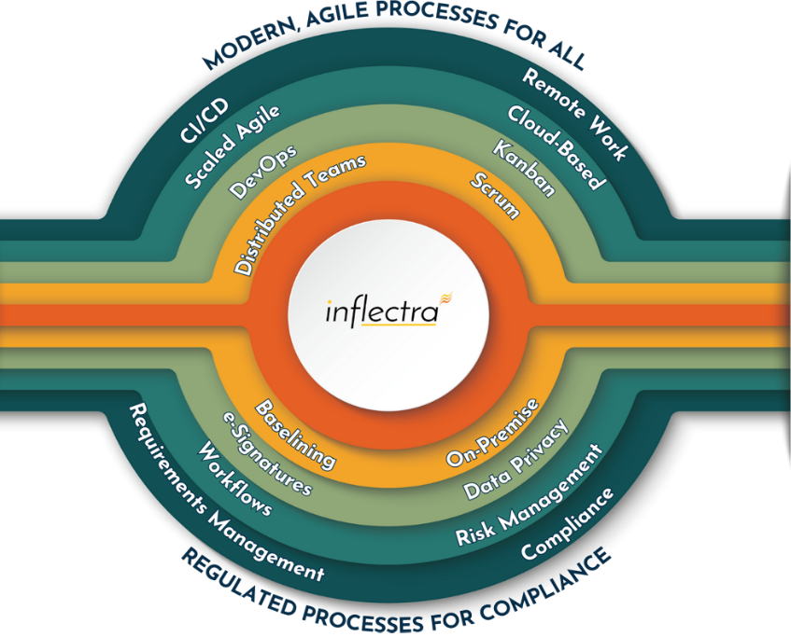
Delivering Value With Quality At Its Core
70%
Lower
Cost
80%
More Coverage
30%
More Efficiency
Ability to consolidate multiple tools across the application lifecycle, creating opportunities to reduce costs and scale down the number of applications in which teams are required to use, maintain, and learn
Achieve more test coverage and deliver high-quality software effortlessly, enabling code-free test automation and accelerated processes in relation to competitors, freeing up time for other essential or mission critical tasks
Streamlines workflows across project and risk management, scaled agile, DevOps, and test automation providing the ability to identify and bridge the gap between areas of inefficiencies

Slide 9
Our Unique Value Proposition
Easy learning curve, fast deployment
Easy and intuitive
Extensive partner support
Seamless migration/Import
Same-day support
Dedicated success manager
Generative AI leader
Customer-driven roadmap
Industry-specific features
InflectraCON thought leadership platform
Peer-to-peer knowledge sharing community
EFFICIENT
INNOVATIVE
Concurrent licensing
No hidden extra costs
Unlimited named users, storage, API calls, projects
Flexible scale-up/down
30-day free trials
Available on AWS Marketplace
ECONOMICAL
EFFECTIVE
Integrated platform
Fully customizable
Built for multiple personas
Powerful reporting features
Integration hub for other tools
SpiraApps tailored to your process and workflow

Slide 10
Our Core Values
Built for Customers not Wall Street
Building great software for customers, not chasing the latest fad. Your feedback and ideas are directly incorporated into the product roadmap.
Supported by Experts
The engineering experts who built the software directly support customers and solve their problems
Family and Life Flexibility
Team enjoy unlimited vacation, flexible hours and other benefits. Low staff turnover benefits customers with knowledgeable support and assistance year after year.
Continuous Community Enablement
Invests in Knowledge Sharing, University Students, Career second acts of employees and sponsorships of various meetups and events that focus on technology quality

Slide 11





A Complete, Out of The Box Solution
Test
Management
3
Requirements Management
Program
Management
Automated
Testing
Risk Management
AI-Powered Functionality

Slide 12
























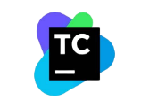




Extensive Integrations & Migrations
80+ INTEGRATIONS
35+ BUILT-IN MIGRATIONS

Slide 13
Industry-Specific Use Cases
WHILE OFFERING FLEXIBILITY AND USABILITY FOR EVERYONE

Slide 14
Features for Regulated Industries
Auditability and end-to-end traceability
Data Privacy, Security
baked in
Generation of Compliance Documentation
Workflows & Electronic Signatures
Integrated Risk Analysis and Management

Slide 15


Healthcare, Life Sciences & Bio-Tech
Electronic signatures for FDA 21 Part 11 compliance
Secure hosting with support for HIPAA BAA agreements
End to end traceability of requirements, tests, and code
Validated platform where you control update cadence
Learn more

Slide 16

Financial Services & Insurance
Secure cloud platform (SOC2) or on-premise deployment
Integrated enterprise risk management
Integration with automated testing and compliance tools
End-to-end traceability and auditability of testing
Helps You Manage Compliance: DORA, SOX, BASEL III
Learn more

Slide 17

Energy, Industrial & Automotive
Testing for public safety with world class test management
Define requirements and test for compliance
Integrate standards and regulations into your test plans
Understand and manage risk of critical systems
Support for Failure Mode & Effects Analysis (FMEA)
Learn more

Slide 18

Defense, Government
& Aerospace
Manage programs and portfolios across platforms
Test step level traceability for mission systems
Automate testing and compliance with RemoteLaunch
Orchestrate System of Systems (SoS) development
Security and privacy with on-premise and AWS GovCloud
Learn more

Slide 19



Security & Compliance
Our cloud platform is SOC2 Type II certified
Our website and payment systems are PCI-DSS certified
Data encrypted in transit and at rest using strong ciphers
Multi-factor authentication (MFA) and Single Sign On (SSO)
Physical infrastructure provided by Amazon Web Services.
Learn more

Slide 20














Compliance with International Standards
Guidance on Data Integrity
EudraLex
Volume 4
Part I & II

Slide 21
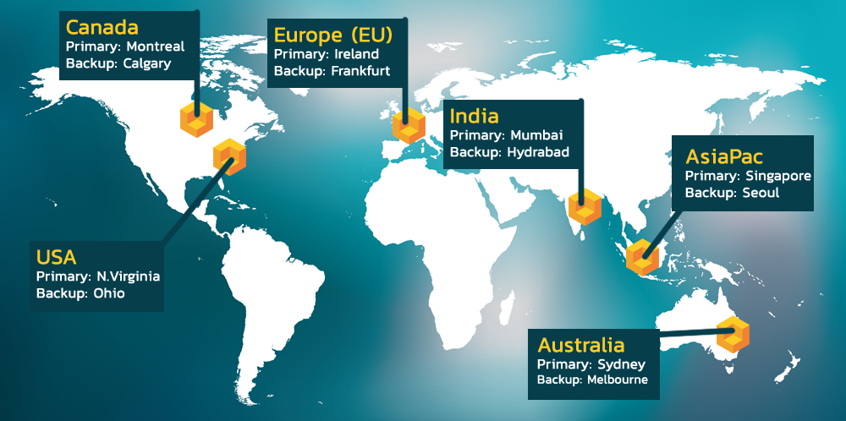
Hosting: Data Privacy and Sovereignty Built In

Slide 22































Representative Customers
Energy, Industrial & Transport
Financial & Business Services
Media & Telecom
Government & Defense
Healthcare & Bio-Technology

Slide 23






Inflectra AWS Partnership
KEY PARTNERSHIP HIGHLIGHTS
INFLECTRA’S ACHIEVEMENTS
SaaS ISV Partner: Trusted solutions available on AWS Marketplace.
ISV Workload Migration Program: Enabling smooth transitions to AWS for customers using Inflectra’s products, with expert support and resources.
Cloud-Hosted Exclusively on AWS: Secure, scalable, and reliable infrastructure.
DevOps: Leadership in CI/CD and workflow automation.
Life Sciences & Education Software: Industry-specific solutions.
Marketplace Seller Badge: Simplified access and integration.
AWS Qualified Software Provider: Meeting AWS's high standards for security and scalability
AWS Bedrock Generative AI: Access to the latest technologies and services including Bedrock.
WHY INFLECTRA + AWS?
Scalable Innovation: AI-powered SpiraApps leveraging AWS Bedrock for automation.
Industry Compliance: Solutions tailored for regulated industries.
AWS Enterprise Discount Program (EDP)/Private Pricing Agreements (PPA): Inflectra purchases count towards annual AWS spend commitments.

Slide 24
What Do We Do?
THE INFLECTRA PLATFORM, PRODUCTS & SERVICES

Slide 25







The Inflectra® Platform
SpiraPlan® - Agile Program & Portfolio Management for the Enterprise
SpiraTeam® - Agile Lifecycle Management for Teams
SpiraTest® - Test Management for Teams
DataSync™ - Seamless
Data Synchronization
SpiraApps™ - Spira
Extensibility Framework
SpiraCapture™- Free
Exploratory Testing
Rapise® - AI-Powered Test Automation
KronoDesk®- Customer Service Desk
RemoteLaunch® - Test Orchestration

Slide 26


Generative AI Capabilities
Spira and Rapise leverage Generative AI to enable autonomous testing, eliminating the need for hand-written automation scripts and driving increased efficiency
SPIRA PLATFORM
RAPISE PLATFORM
AI Overview: Generates downstream artifacts from requirements and user stories
AI Overview: Creates automated test scripts from manual tests, perform autonomous testing
Use Cases: Test cases, test steps, tasks, BDD scenarios, and risks
Use Cases: Generate test data, navigate application, run manual tests as automated, execution analysis
Future Roadmap: Expand upon types of data created and models supported
Future Roadmap: Additional agentic workflows that further leverage application contextual data

Slide 27




Spira Platform Snapshot
Capabilities
SpiraTest
SpiraTeam
SpiraPlan
Requirements Management
Test Management & Traceability
Defect & Issue Tracking
Agile Planning Tools
Program & Portfolio Planning

Slide 28











SpiraTest® - Requirements & Test Management
KEY FEATURES & BENEFITS
DIFFERENTIATORS
Centralized management of all factors that impact testing, including requirements, defects, and reporting
1
Modern UI with ease-of-use in mind; quick access to insights and consistent functionality
Easy-to-use, automated bug & issue identification for tracking, prioritization, and resolution of defects before they impact users
2
True “out-of-the-box” platform with a full set of capabilities that can be set up in as little as 10 minutes
Cross-project data storage; simple reporting across projects via pre-built dashboards
3
Streamlined planning, execution, and tracking of testing, including test case management and exploratory testing
Robust set of default workflows for customers in highly regulated industries
4
Extensive and pre-built integration library bolsters in-house capabilities; no need for dedicated admin to manage plug-ins
End-to-end traceability of product releases, tested requirements, and resolved defects, with electronic signature capabilities
5
POPULAR INTEGRATIONS
END USER(S)
95%
40%
30%
Test Managers
QA Managers
Software Testers
Project Managers
Developers
requirements coverage
faster test cycles
cost
reduction
AWS Bedrock

Slide 29










SpiraTeam®- Application Lifecycle Management
KEY FEATURES & BENEFITS
DIFFERENTIATORS
Fully integrated project / requirements management and an extensive integration library to eliminate inefficiencies from overlapping tools
1
Robust data roll-up capabilities across all dimensions – product, component, requirements, release, and team
2
Extensive built-in integration library for easy connections to all solutions with zero limitations
Quality assurance (QA), risk management, and collaboration capabilities to ensure visibility into all aspects of the software development lifecycle
3
Pre-existing niche artifact types to address specific use cases and ensure adherence to best practices
Specialized artifact types, built-in workflows, and advanced dashboards to provide an “out-of-the-box” experience for any team
4
Various project planning views for different roles within the team that can handle both planned and adaptive lifecycles
5
Operates in both cloud and on-premise hosting environments
Complete support of all development methodologies, whether Agile, Waterfall, or hybrid
POPULAR INTEGRATIONS
END USER(S)
Project Managers
QA Managers
Business Analysts
Software Testers
Developers
Chief Information Officer (CIO)
40%
30%
35%
cost
reduction
faster time
to market
better
productivity

Slide 30







SpiraPlan® - Program Management for Scaling Agile
KEY FEATURES & BENEFITS
DIFFERENTIATORS
Enterprise-grade agile planning & execution capabilities enable the user to have a 360-degree view of all projects and programs
1
Truly holistic solution that allows full planning, development, and testing in one solution, eliminating the need to purchase multiple products
2
Focus on “built-in”; with integrations, capabilities, artifacts, and more all included to minimize limitations
Fine-tuned capabilities such as baseline management, configuration management, and version control that are tailored to the complex compliance & quality standards of regulated industries
3
Tailored for highly regulated industries, enabling customers to deliver high quality, mission-critical software without sacrificing speed for compliance
4
OData API for dashboard / report creation with customized queries from common reporting tools (e.g., Excel, PowerBI)
Fully ecosystem-agnostic integrations and various deployment options, designed to fit the needs of any enterprise
5
Operate in both cloud and on-premise hosting environments
Enhanced automation through generative AI, driving efficiencies in creation of project artifacts from requirements and generation of test cases
POPULAR INTEGRATIONS
END USER(S)
Program & Project Managers
Risk Management Professionals
Portfolio Managers
Chief Information Officer (CIO)
30%
40%
30%
faster
delivery
fewer
defects
reduced
risk

Slide 31








Rapise® - Codeless Test Automation
KEY FEATURES & BENEFITS
DIFFERENTIATORS
AI-powered test automation platform for web / mobile / desktop applications, APIs, and enterprise resource planning (ERP) systems
Cross-functional capabilities that allow teams of automation engineers and testers to create highly efficient automated tests in tandem
1
Ability to automate testing for both user interfaces and APIs in both a script-less and JavaScript code environment, driving flexibility in end user type and maximum ROI
Intelligent recording, spy / object manager, self-healing locators, and reusable frameworks and components allow for easy maintenance
2
Extensive set of pre-existing libraries tailored to common applications / platforms such as Salesforce, Microsoft Dynamics & Office, Oracle Forms, ServiceNow, and SAP HANA
Tailored for highly regulated industries, enabling customers to deliver high quality, mission-critical software without sacrificing speed for compliance
3
Translates human-readable test steps into executable scripts using AI-enhanced natural language processing, enabling less technical team members to contribute.
4
Utilizes AI-driven object recognition for dynamic and complex UIs. Automates the maintenance of test scripts through self-healing mechanisms that adapt to changes in application interfaces.
POPULAR APPLICATIONS
END USER(S)
35%
40%
45%
Automation Engineers
Test Leads
QA Engineers
SDETs
Software Testers
faster
testing
productivity boost
better
ROI

Slide 32



Add-On Products
Extends Spira® Platform (SpiraTest, SpiraTeam, SpiraPlan) with customizable features to meet specific industry needs and compliance requirements.
Offers modular SpiraApps to dynamically adapt workflows, optimize SDLC processes, and maximize ROI.
Integrates with AI solutions like ChatGPT, Azure OpenAI, and AWS Bedrock for automated test generation, risk analysis, and streamlined project management.
Quick installation with support for integrations like GitHub, GitLab, AWS Bedrock, and CircleCI for a unified workflow experience.
Supports third-party development and monetization of SpiraApps, expanding functionality and fostering innovation.
DataSync is a data synchronization tool designed to automate and streamline integrations between Spira and external platforms, ensuring real-time updates and consistent data across systems.
Automatically reflects changes across all connected tools, reducing
manual work and ensuring teams stay aligned.
Adapts to any operational need with cloud, on-premise, and hybrid deployment models, making it ideal for businesses of all sizes and industries.
Comprehensive and developer-friendly, DataSync offers advanced data mapping, multi-instance support, and a centralized dashboard for easy management and troubleshooting.
Ensures data integrity with robust security features and scales effortlessly to handle growing business requirements, including complex hybrid environments.

Slide 33




Add-On Products
Browser-based testing capture tool that enables secure recording of exploratory testing sessions
Automated tracking of clicks & keystrokes on each tab being recorded
Logging of steps for each testing session and notes for specific issues encountered
Delivered as “freemium” product; viewed as additional lever of future product-led growth for the Spira suite
B2B service desk solution for cloud & on-premise installations that integrates tightly with all Spira products to keep product teams informed
Built-in knowledge base, help desk, and forums capabilities with a powerful ticketing system that facilitates communication with the end customer and enables prioritization
Centralization of all customer communications enables a streamlined approach to customer support
Complete configurability allows for adaptability to any customer support workflow
Quick set-up and easy-to-use ticket creation & management, with an existing email integration
Robust and customizable reports for effective visualization of the entire customer support engine with easy KPI tracking (e.g., ticket volume, resolution times, customer satisfaction, etc.)

Slide 34


Add-On Products
Accelerators
Extension of the Spira suite that enables orchestration of automated regression testing (manual & automated)
Open architecture to allow for use in tandem with SpiraTest or other test automation tools, whether commercial (HP Unified Functional Testing, TestComplete) or open source (Selenium, Playright)
Facilitates scheduling, execution, and management of automated test scripts, allowing for full oversight of distributed test labs from a central SpiraTest server
Flexible deployment (cloud, on-premise, hybrid) to suit the needs of all end users
Real-time and detailed reporting delivers a holistic view of manual & automated testing with screenshots, log files, and QA metrics
Primary target users are automation engineers, but also test managers and QA managers
Pre-defined packages of professional services for specific customer objectives
Each package is associated with specific outcomes & deliverables, offered at a fixed price vs. hourly
Provides smaller organizations & teams access to the expertise of Inflectra’s global solution partner network
Offerings are incremental to Inflectra’s existing customer support and other services

Slide 35
Stronger with Partners
JOIN THE INFLECTRA PARTNER PROGRAM

Slide 36
Why Partner With Us?
1
2
Revenue Growth and Market Expansion
Enablement and Competitive Advantage
Recurring Revenue Streams: Generate income through software sales, custom implementations, training, and support services.
Diverse Industry Reach: Serve finance, healthcare, government, and other sectors needing robust test management and Agile solutions.
AWS-Powered Scalability: Offer secure, scalable, and enterprise-ready solutions that integrate seamlessly with cloud and on-premise systems.
Upsell & Cross-Sell Opportunities: Bundle Inflectra solutions with consulting, automation, and managed services to maximize revenue.
Comprehensive Training & Certification: Gain in-depth product knowledge and technical expertise through Inflectra’s partner enablement programs.
Co-Selling & Lead Sharing: Work directly with Inflectra on sales opportunities and benefit from referrals.
Marketing & Branding Support: Access joint marketing initiatives, webinars, and partner promotions to strengthen visibility.
Exclusive Discounts & Early Access: Receive partner-exclusive pricing, beta access to new features, and priority support.

Slide 37
Why Partner With Us?
3
4
Credibility, Flexibility, and Leadership
Commitment to Customer Success
Trusted & Recognized Software Provider: Inflectra is a leader in test management, project management, and automation solutions.
Flexible Deployment Options: Offer customers on-premise, cloud, or hybrid implementations tailored to their needs.
Strong Integration Capabilities: Seamlessly connect Inflectra products with DevOps, Agile, and enterprise IT ecosystems.
Competitive Differentiation: Stand out in the market by providing specialized Inflectra expertise alongside implementation services.
Exceptional Customer Support: Inflectra is known for its fast response times, hands-on assistance, and customer-first approach.
Transparent & Ethical Business Practices: Work with a reliable, values-driven organization committed to partner success.
Continuous Innovation: Leverage Inflectra’s commitment to R&D, ensuring access to cutting-edge technologies and product enhancements.
Long-Term Partnership Growth: Build a sustainable business relationship with a company that values partner input and long-term collaboration.

Slide 38
Inflectra Partner Program at a Glance
Our Partner Types
Partner Program Highlights
Our Solution Partners are Implementors, Value-Added Resellers (VAR’s), System Integrators (SI’s), and Trainers that deliver exceptional customer value with Inflectra products.
Dedicated Partner Account Manager
In-depth Inflectra Platform training
Sales support
Co-marketing opportunities
License discounts and free training licenses
Sales resources including platform comparisons, decks and demo scripts
Development resources and support access.
Curated leads
Our Technology Partners collaborate to integrate advanced solutions and optimize Inflectra tools with plug-ins, adapters, connecters, and technical services in order to deliver a seamless experience for shared customers.
“Together, we empower innovation and elevate joint success serving our customers.”
-Jessica Moore, Alliances, Inflectra

Slide 39
Solution Partners
Empowering Customer Success
Solution Partner Types
Solution Partners are integral to the Inflectra ecosystem, helping businesses deploy, integrate, customize, and maximize the value of our solutions.
Whether you specialize in implementation, training, system integration, or reselling, our Solution Partner Program is built to support your growth while ensuring customer success.
Implementation Partners – Consultants and service providers who deploy, integrate, and optimize Inflectra solutions for seamless adoption.
Value-Added Resellers (VARs) – Resellers who offer customization, training, and support services, adding value beyond product sales.
Training Partners – Experts in structured learning programs, certifications, and hands-on workshops for effective product adoption.
System Integrators (SIs) – Technical specialists who connect Inflectra products with enterprise systems, ensuring smooth interoperability.

Slide 40
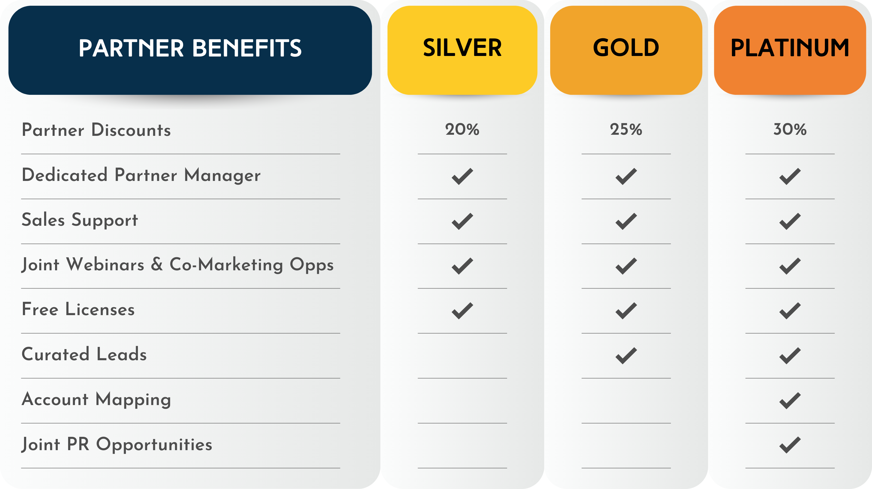
Why Become a Solution Partner?
By joining our partner network, you gain access to exclusive enablement resources, co-marketing opportunities, a tiered growth structure, and the ability to expand your service offerings with Inflectra’s powerful solutions.

Slide 41
Steps to Becoming a Solution Partner
1
2
3
4
5
Connect With Us
Reach out to our partnerships team to discuss your business, goals, and how we can work together. We’ll explore the best fit within our partner ecosystem.
.
Define Your Partnership Path
We’ll align on the right Solution Partner category—whether you’re an Implementation Partner, VAR, Training Partner, or System Integrator—and outline key requirements based on your business model.
Complete Partner Onboarding
Explore your Partner Portal to access key resources and participate in co-marketing activities to promote our partnership. Gain access to Inflectra Campus to complete certifications and training.
Establish Your Partnership Level
Based on your engagement and expertise, you’ll be placed in our tiered partner structure (Silver, Gold, Platinum) and gain access to program benefits.
Start Growing With Inflectra
Leverage sales enablement tools, co-marketing opportunities, and your Partner Portal to drive customer success, generate leads, and expand your business.

Slide 42
Technology Partners
Why Become a Technology Partner?
Areas of Focus
Develop and integrate with Inflectra’s Spira platform, Rapise, and other solutions.
Access Inflectra’s technical documentation, APIs, and developer resources.
Expand into new markets through co-marketing and partner ecosystem exposure.
Gain visibility through joint marketing, webinars, and featured listings.
  Artificial Intelligence (AI)
  DevOps & CI/CD
  Test Automation
  Device Management
  Modeling Tools
  Modernization
  Agile Transformation
  Implementation Services
  Training
  Load Testing
Empowering Customer Success
Technology Partners collaborate with Inflectra to enhance and expand the capabilities of our platform. Through integrations, plug-ins, adapters, and custom SpiraApps, these partners help customers seamlessly connect Inflectra products with their existing technology stack.

Slide 43



More Tools for Your Success
1
2
3
Inflectra Campus Online Training
Expand your knowledge with free, hands—on training through Inflectra Campus, designed to help you stay ahead in the Inflectra ecosystem.
Earn and Showcase Partner Badges
Highlight your expertise, certifications, and industry leadership with Inflectra Partner Badges.
Partner Portal: Your Central Hub
Access sales and enablement materials, log and track leads and referrals, and stay connected with the Inflectra team through the Partner Portal.

Slide 44
Ready to Take the Next Step?
Reach out to us at partnerships@inflectra.com to start the conversation.

