Slide 1
Quick Start Package
Test Automation Quick Start for ERP and CRM Projects

Slide 2
Background

Slide 3
Test Automation Challenges
Embarking of a test automation project can be a daunting task, especially when you are dealing with a large, complex application.
You have to decide:
What tests should be automated
How to teach your testers
(who may be functional experts rather than experienced automation engineers)
How to get started

Slide 4
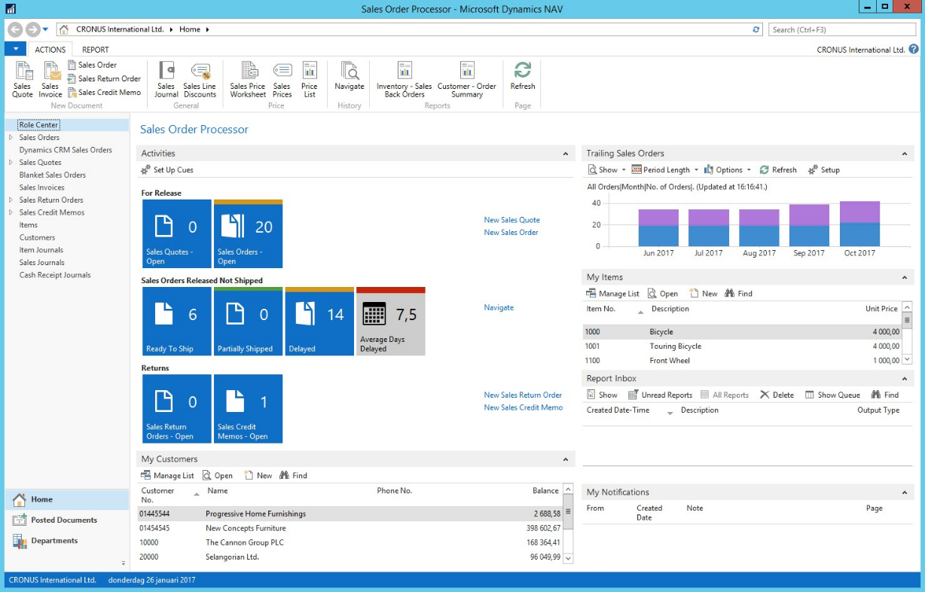
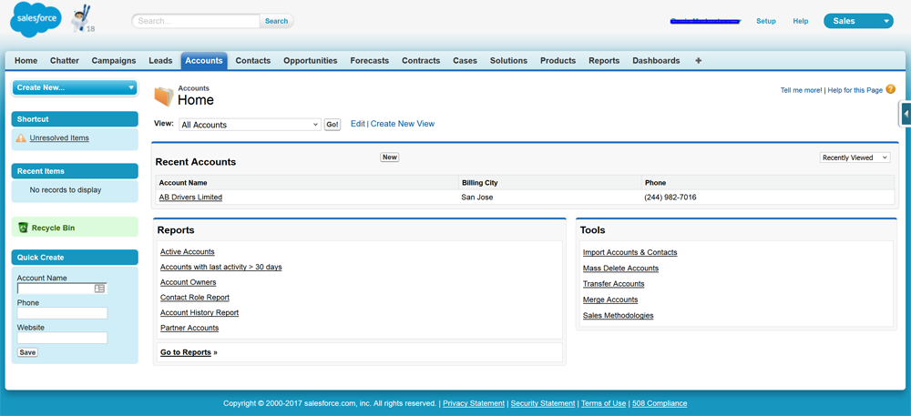
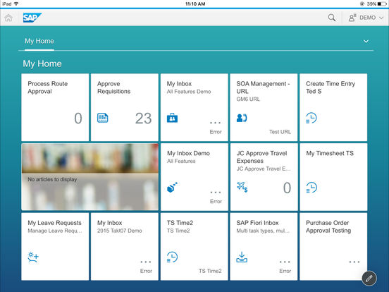
Why Rapise?
Special support for CRM tools such as Salesforce and Dynamics 365
Support for ERP platforms: SAP and Dynamics AX & NAV

Slide 5
Implementation Services

Slide 6
High Level Approach
Week 1
Week 3
Week 5
Phase 1
Installation & Setup
Phase 2
Test Case Review & Scoping
Phase 3
Test Case Implementation
Phase 2 - Training
Support and Assistance

Slide 7
Phase One (1-week)
Kick-off
Review technical requirements
Installation of Rapise
Integration with SpiraTest
Configuration of developer machines
Configuration of RapiseLauncher execution agents
Timeframe
Typically takes 2-6 hours spread over one week

Slide 8
Phase Two (2-4 weeks)
Training of Client testers
12 hours of training for the Rapise test creation users
Would be delivered remotely via. GotoMeeting
Includes the use of practical labs and review of progress by Inflectra Rapise experts.
Review of Test Cases
Team will review test cases to ensure training is aligned
Finalize the list of test cases to be implemented in phase 3
Timeframe
12 hours of work spread over 2-4 weeks depending on schedule

Slide 9
Phase Three (2-4 weeks)
The Inflectra team will automate a critical set for Client
The final lists of tasks will be defined in Phase 2
We typically implement ~ 20 hours worth of test cases
The Inflectra team will focus on implementing test cases that have unique challenges
The Client team can then become self-sufficient and implement the other test cases with the provided assistance and training
Transition should take ~2-6 hours
Initial training will happen before phase 3, additional training in parallel with phase 3, to ensure success.

Slide 10
Support & Assistance (included)
During project, Inflectra team would be available to answer adhoc questions and provide assistance
There is no cost for this, it is included with license purchase
This will be available during the initial 5 weeks after for the remainder of the year after initial purchase
The key will be to have a smooth transition from phase 3 into ongoing support to ensure long-term success
This is why we will focus on the test cases (tasks) that present specific automation challenges, and leave the Client team to focus on the test cases that match those already trained

Slide 11
Extended Training (Optional)
After the initial 5 week phase, Inflectra will have implemented the agreed test cases, completed training and transitioned automation to the client team
This optional item would be to have available 5 hours of GotoMeeting team training time available for use later in the project to be used on an as-needed basis to supplement the support and assistance that comes with the product licenses.

Slide 12
Questions?

