Slide 1
How to Test a Complex ERP Application using a Data-Driven Framework
By Adam Sandman
September 29th, 2017

Slide 2
Agenda
Introduction
Testing Complex Business Applications
Using a Test Automation Framework
The Value of Test Management
Questions

Slide 3
About Me
Adam Sandman was a programmer from the age of 10 and has been working in the IT industry for the past 20 years.
Currently Adam is a Director of Technology at Inflectra Corporation, where he is interested in technology, business and innovation.
Adam lives in Kensington, MD, just outside the Beltway ☺

Slide 4
Objectives
How to create robust automated tests for a complex desktop and web ERP application
The ease of use and flexibility of the Rapise Visual Language (RVL)
The benefits of using an integrated test management system to ensure complete coverage

Slide 5
Before We Start
Who is Already Doing Test Automation?
Who has had to test an ERP System?

Slide 6
Case Study: Microsoft Dynamics

Slide 7
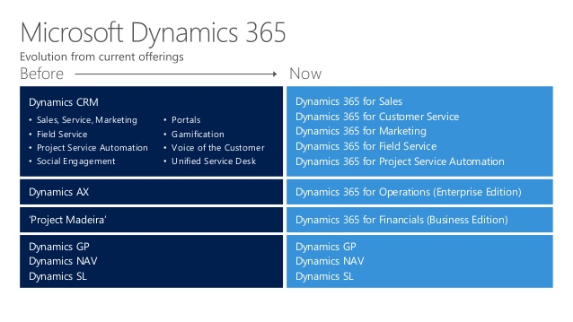
What is Microsoft Dynamics (Official)?
A family of ERP / CRM Applications for Medium-Large Businesses:

Slide 8
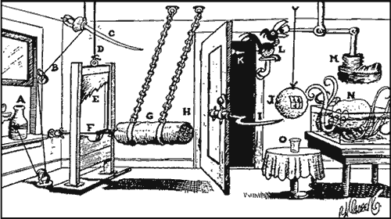
What is Microsoft Dynamics (Unofficial)?
https://turnondynamics.com/microsoft-dynamics-ax-and-its-achilles-heel/

Slide 9
Challenges of Testing Dynamics
Packaged ERP Application, configured by functional users not programmers
Limited ability to do unit testing or non-UI testing
SOAP and REST APIs can be tested independently
Difficult to integrate into a CI process
Different technologies per product
Browsers used for Dynamics 365, CRM
Windows Forms used for Dynamics AX, NAV
Complex UI elements of data
Grids of data
Proprietary menus

Slide 10
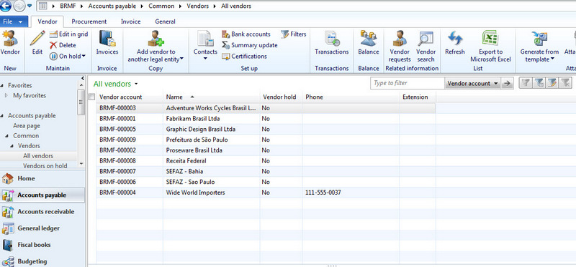
Challenges of Testing Dynamics AX 2012
Cannot use Selenium (not browser based)
Coded UI is available but low-level, lot of effort required
Testers have to deal with grids, treeviews, menus at a very low level
Hard to maintain the CodedUI scripts coded in C#

Slide 11
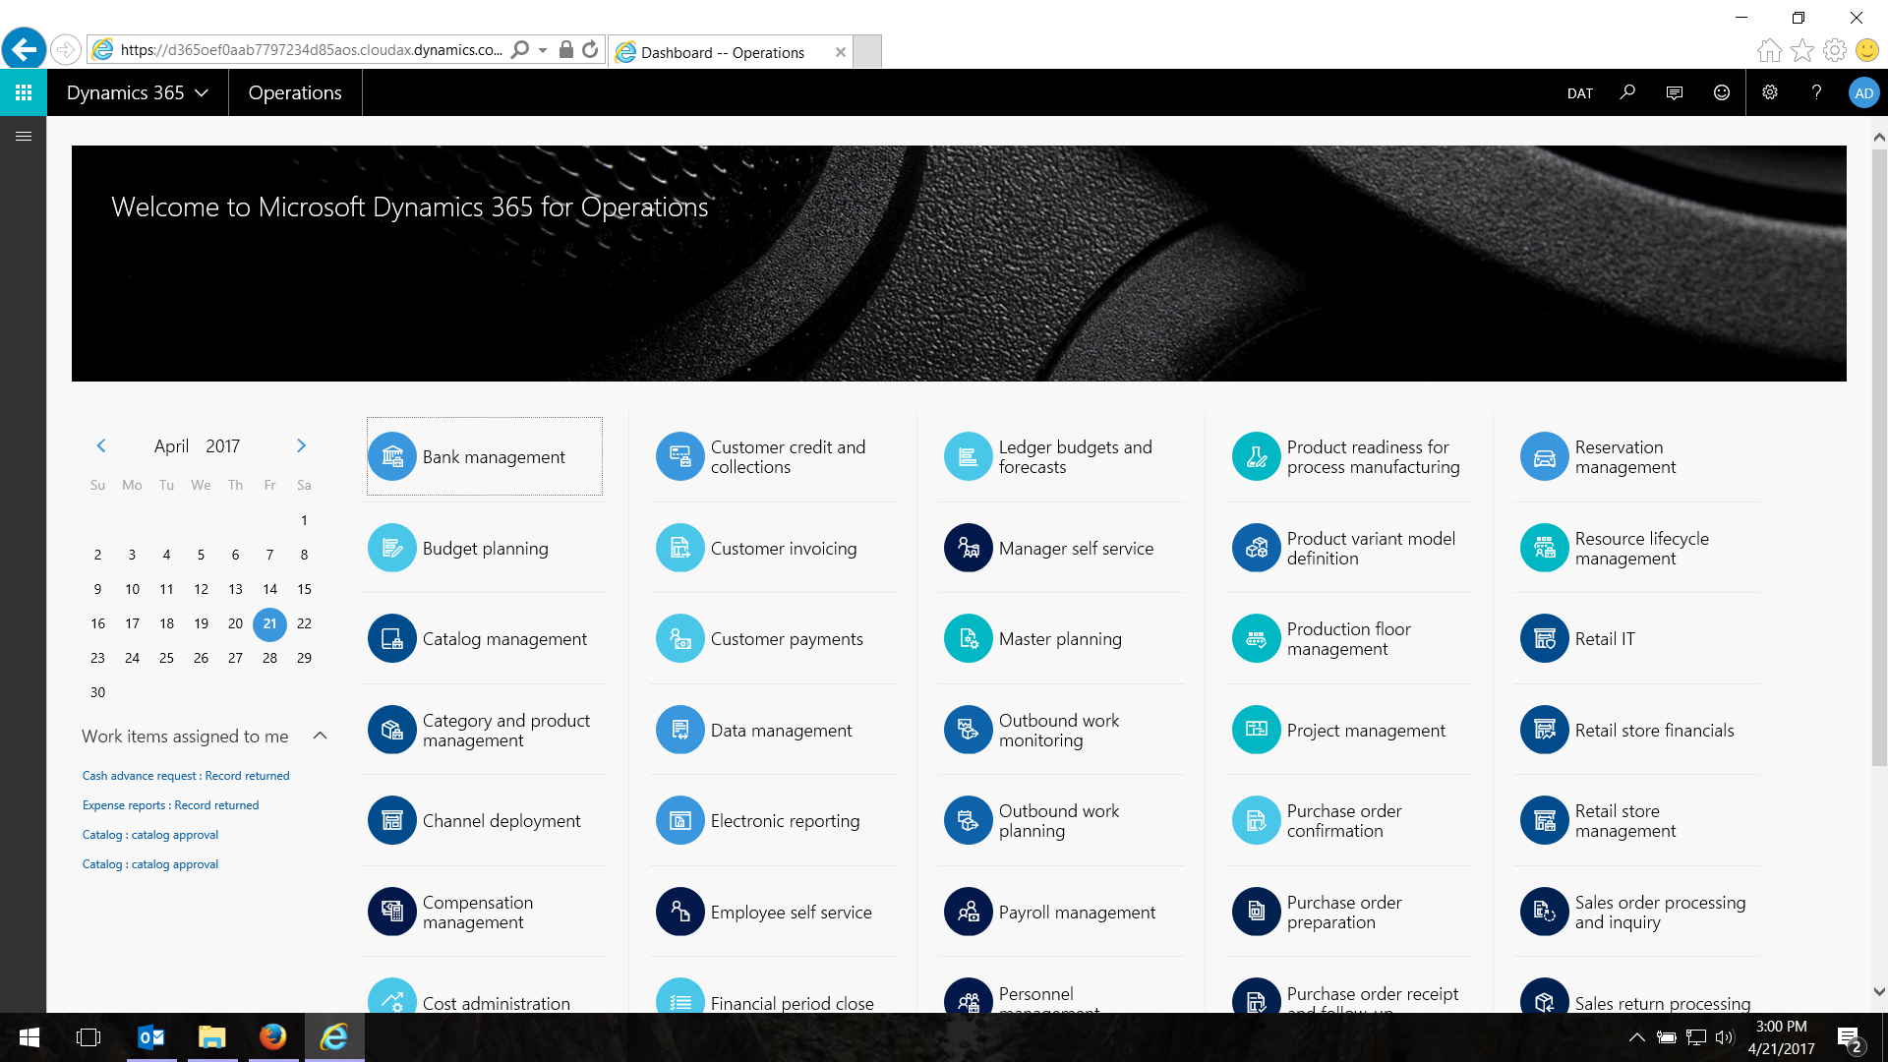
Challenges of Testing Dynamics 365
Selenium possible since browser based
Complex elements (e.g. main menu) hard to automate. Took over a week to create reliable web locators
Grids and other objects complex to interact with once you get beyond the root DOM element
You have popups and other dialogs that need OS click
What happens when you have an obscured item, should it pass/fail?

Slide 12
The Different Testing Roles / Needs

Slide 13
The Functional Expert
ERP = Lots of complex business rules that are designed by accountants, logisticians, warehouse managers:
Functional Knowledge of System
Doesn’t Understand Automation, XPATH, CSS, Frameworks, Libraries

Slide 14
The Test Automation Engineer
Knows how to create automated software tests that are more than just ‘smoke and mirrors’ and will be resilient and reliable.
Knowledge of How to Create Good Tests
Doesn’t know a Purchase Order from a Credit Memo.

Slide 15
Using an Automation Framework

Slide 16
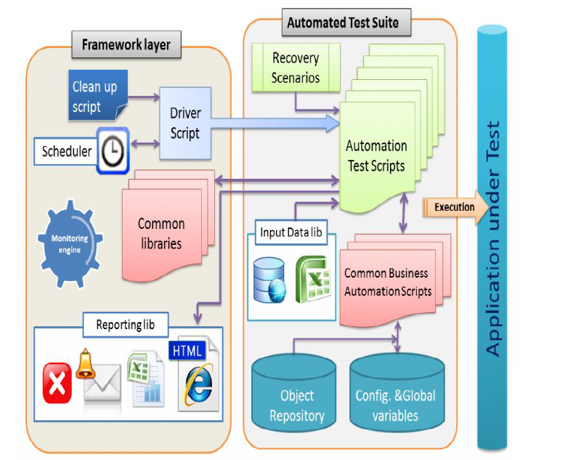
The Landscape of Test Automation
This is where
Selenium
WebDriver
Comes in
(or Appium, MSAA, UIAutomation)
Courtesy of Yoni Flenner – http://yoniflenner.net

Slide 17
Introducing Rapise
Test Automation tool that tests web, mobile, desktop and APIs
Uses JavaScript as its core language
Has Scriptless data-driven framework
Commercial tool but designed to be open and extensible, using Selenium, Appium, …

Slide 18
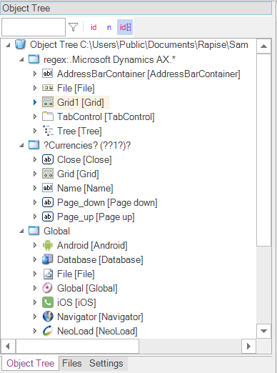
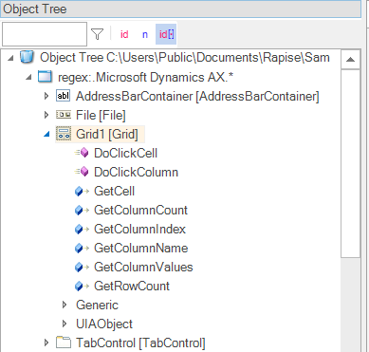
Object Based Recording
Separates the logic for interacting with a UI element from the test script and process flow

Slide 19
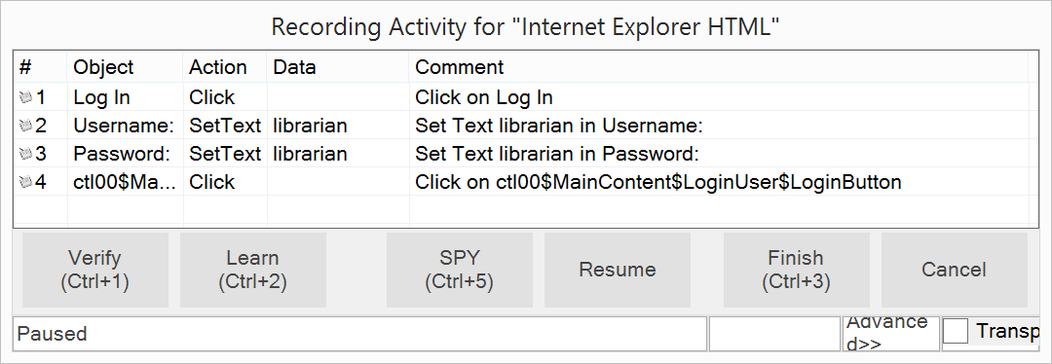
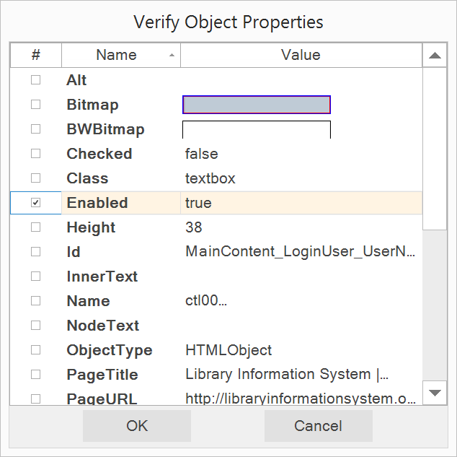
Recording & Learning
Capture User Interactions:
Generate Assertions:

Slide 20
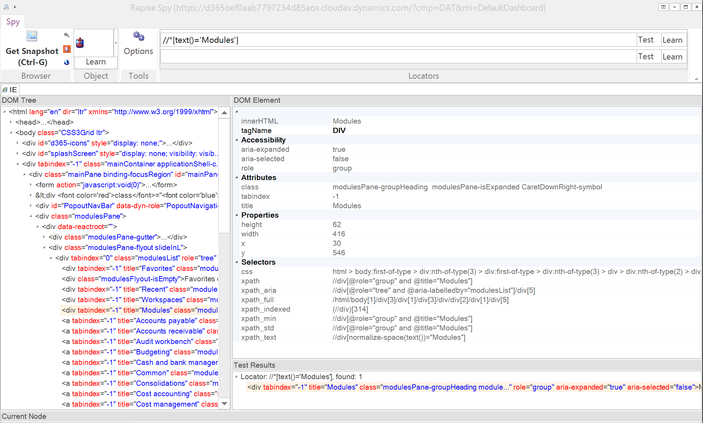
Spy Tools
Web Spy for Browsers
XPATH Generator
Appium Spy for Mobile
Spy Tools for Desktop
Windows, Java, etc.

Slide 21
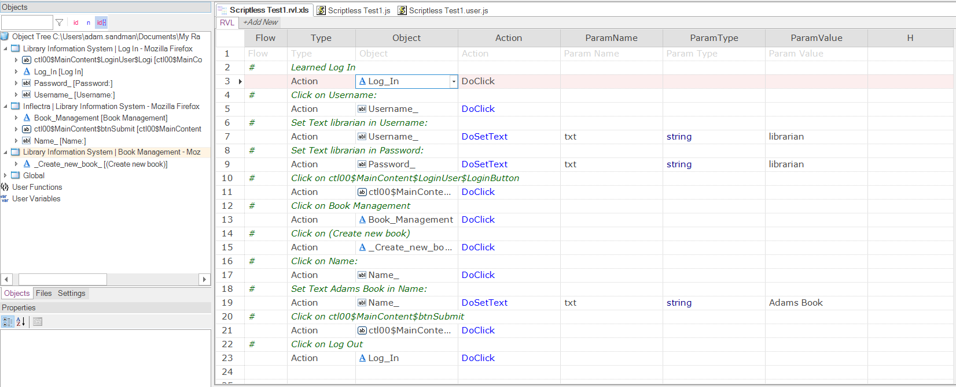
Rapise Visual Language (RVL)
Scriptless table lets functional users compose the test scenarios
The objects can be defined by automation engineers or recorded

Slide 22
Integrating Functional Roles
Creates the test scenarios and can record simple tests
Automation engineer learns objects and writes JS functions/extensions

Slide 23
Rapise Demos
Demonstration of Testing Dynamics AX and 365 using Rapise

Slide 24
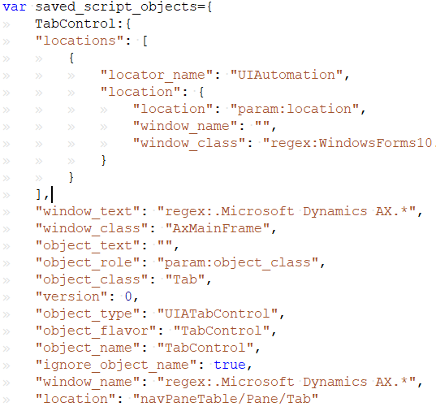
Not a Black Box
==
Choose tools with open formats, that can be extended

Slide 25
The Value of Test Management

Slide 26
Questions?

Slide 27
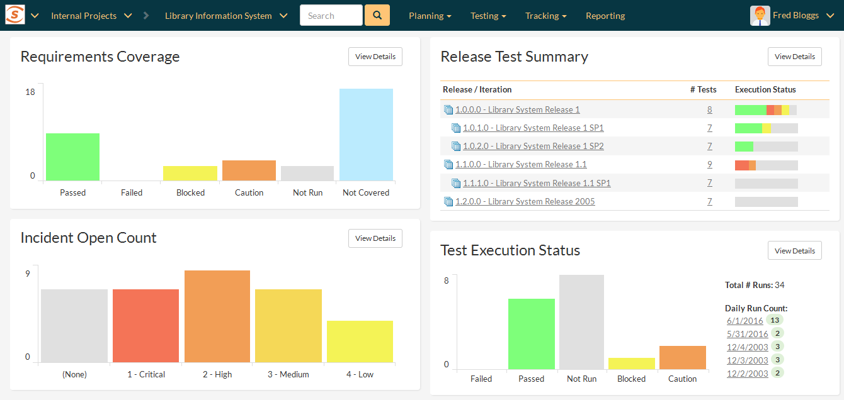
Real Time Monitoring
Modern test management tools include powerful dashboards and reports.

Slide 28
Tie in Test Automation
For ERP applications you can test the UI and APIs
You may be able to test other layers
Integrate them into your test management tool

Slide 29
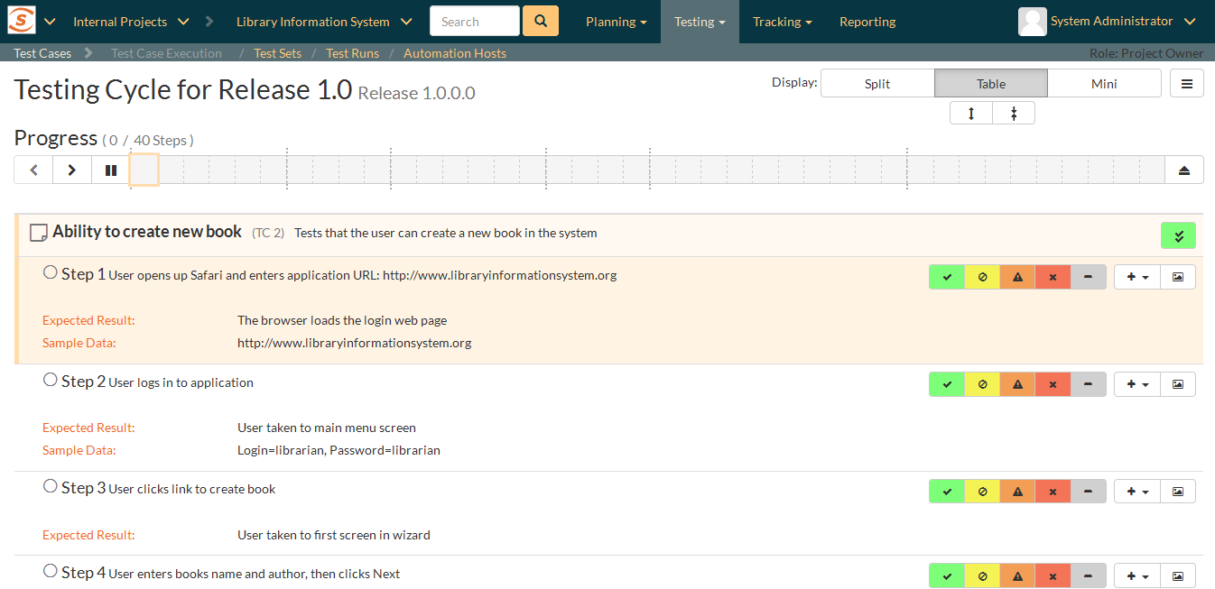
Tie in Manual Testing
There are many good test management tools to choose from. Don’t default to using Excel, Google Sheets
Understand UAT manual testing vs. Exploratory Testing
They are different and should be used appropriately

Slide 30
Some Useful Links
Articles
Tricks & Tips for Testing Dynamics 365 https://www.inflectra.com/Support/KnowledgeBase/KB277.aspx
Tricks & Tips for Testing Dynamics AX https://www.inflectra.com/Support/KnowledgeBase/KB273.aspx
Tricks & Tips for Testing Dynamics NAV https://www.inflectra.com/Support/KnowledgeBase/KB292.aspx
Article about Menu support in Dynamics 365 for Operations https://www.inflectra.com/Ideas/Entry/479.aspx
Article that illustrates Yoni's diagram on slide 16 https://www.inflectra.com/Ideas/Whitepaper/Setting-Up-a-TestOps-Environment-Using-Selenium-WebDriver-and-JavaScript.aspx
Samples on GitHub
Dynamics AX Samples https://github.com/Inflectra/rapise-dynamics-samples
Dynamics 365 for Operations Samples https://github.com/Inflectra/rapise-dynamics365-samples

Slide 31
Questions?

