Slide 1

Inflectra User Summit
San Francisco, CA
Monday, April 16th, 2018

Slide 2
Agenda
Introduction
Company News
Spira 5.x Showcase
Spira 6.0 Roadmap
Rapise & KronoDesk Update
Q&A

Slide 3
Company News

Slide 4
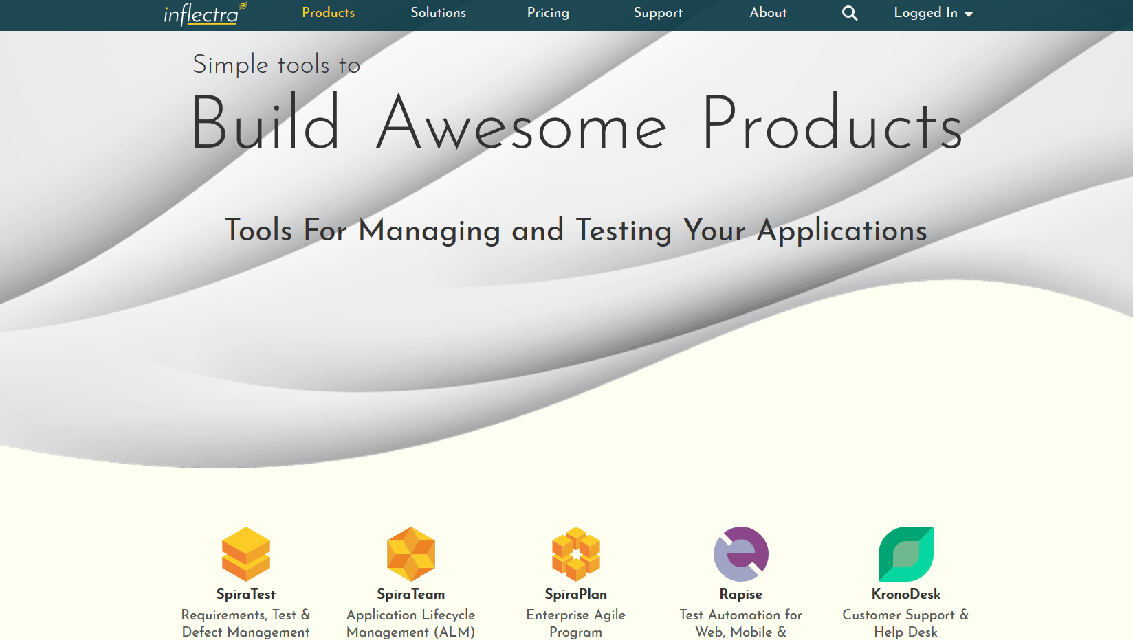
Company Updates – New Website

Slide 5
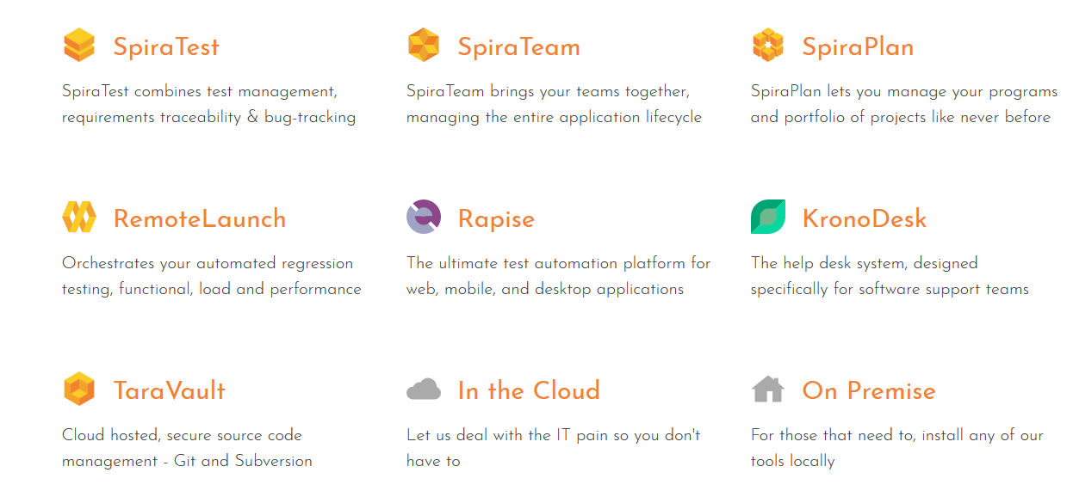
Company Updates – New Product Icons

Slide 6
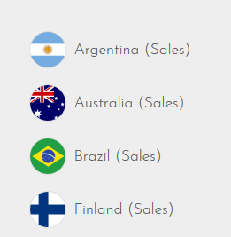
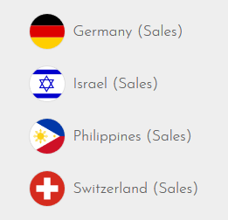
Company Updates - Countries
Sales Offices Opened in the following countries:

Slide 7

Cloud Hosting Options
Inflectra cloud hosting existing options:
  Co-located Inflectra dedicated hardware in Houston, Dallas, TX
Additional Options available in 2018:
  AWS Asia-Pac, Sydney, Australia
  AWS Europe, Ireland
  AWS USA & Canada Options
  AWS GovCloud
Features
  Encrypted EBS Volumes
  Dedicated Databases per customer

Slide 8
The Inflectra® Product Suite
KronoDesk®
IT Support & Help Desk Ticketing
SpiraPlan®
Agile Program & Portfolio Management
SpiraTeam®
Application Lifecycle Management (ALM)
SpiraTest®
Requirements, Test Management
& Bug Tracking
TaraVault® - Source Code Management
Rapise®
Test Automation (Web, GUI, Services)

Slide 9
Product Releases
SpiraTest, SpiraPlan & SpiraTeam
  5.3 – Exploratory and data-driven testing
  5.4 – Program management, Scrum, Kanban task/incident boards
Rapise
  5.4 – Spira Data-Driven Testing & Salesforce classic support
  5.5 - Enhancements for Dynamics and Salesforce Lightning
KronoDesk
  2.1 – Support for user organizations and UI enhancements

Slide 10
Spira 5.x Showcase

Slide 11
Highlights from Spira 5.0 – 5.4
User Interface Changes
Updated Graphing
Exploratory Testing
Test Configurations
Program Management
Scrum Task Boards
Kanban Incident Boards

Slide 12
Spira 6.0 Roadmap

Slide 13
SpiraPlan – The Enterprise Lifecycle Solution
SpiraPlan is the complete solution to manage your projects and programs:
SpiraPlan®
Agile Program & Portfolio Management
SpiraTeam®
Application Lifecycle Management (ALM)
SpiraTest®
Requirements, Test Management
& Bug Tracking
TaraVault® - Source Code Management

Slide 14
SpiraPlan – Enterprise Agile Planning
Enterprise Resource Management
Program & Portfolio Management
Project Management
Brainstorming & Idea Discovery
Software Development
IT Operations
Requirements Management
Software Testing & Quality Assurance
Support & Maintenance
Collaboration and Communication

Slide 15
Published Development Roadmap
Enhanced timecards and time tracking
Project templating / key artifact fields can be customized
Requirements and test case baselining
New features for managing and storing freeform documentation and notes
Project tracks and personnel groups (teams)
Program Portfolio Management (PPM)
Intelligent alerting system
Risk-based testing, planning, and management
Support for financial estimates, tracking, and budget forecasting
Earned Value Management reporting
Portfolio (cross-program) views
Enhanced code manager, including functionality for code reviews
Notifications for releases, and custom properties
Document has full workflow functionality
Continued evolution of the user interface and performance

Slide 16
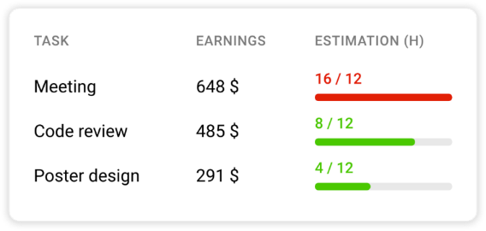
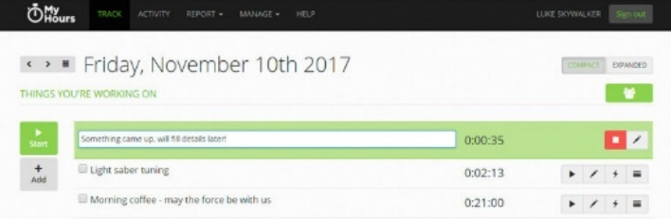
Timecards and Time Tracking
Capture the date of activity, not just the activity
Redesign the timecard (calendar view and entry, more summary data)
Reporting views of timecard data (across teams, projects, sprints)
Could log time live, and enter on artifacts pages too
How to add general time spent against a release?
Tracks against hours available – ie who works what hours on what days in what time zones (links to planning)

Slide 17
Time Based Release Planning
Plan notional releases (allocating roles by %age and time periods)
Allocations could have bill rates, base story points or hours attached
Different view options (calendar, Gantt)
Effort driven or schedule driven planning, with intelligent notifications from system (e.g. delays, need for more staff)
Can work on notional releases without affecting live release
Assess plans against reality (available resources, scheduling)

Slide 18
Project templates could let you…
Edit the types and priorities for requirements, test cases, tasks, and releases (like with incidents)
Have multiple projects created from / share the same template
Use that shared template to manage, in one place, the types and priorities of artifacts (including incidents)
Use that shared template to manage the workflows across all its projects, from one central place
Keep process abstracted from the project data

Slide 19
Project templates raise lots of questions
How should permissions for editing templates differ to those for editing a project?
Should custom fields be managed by the template too? (If templates manage the workflow this would be necessary)
Can you define a default template to use for a program / project group?
Can you enforce a template for all projects in a group?
Should projects still all have their own components?
Should projects be able to have their own custom fields?
Should Spira ship with a range of templates to address different needs?
Can a project be divorced from its template?
How should existing projects, with bespoke incident fields, be handled? Should each create its own template?

Slide 20
Baselining to a Release
Take a snapshot of requirements (and test cases) that tied them to a particular release.
Creating the baseline requires specific permissions
Can switch between baselines by changing release
(future) can visually compare the differences between two baselines
How should baselining tie in with running a test against different releases?

Slide 21
Capturing Unstructured Information
A new interface for capturing, storing, viewing things like: blue sky ideas, team info, new product concepts, pre release checklists
Completely unstructured? can add simple metadata (title, owner, tags)
Also allow structure? ordering and grouping (to create storyboards)
Used to create artifacts? Eg turn an indented list into requirements or releases

Slide 22
Teams and Tracks
Group people by different classifications: eg teams or tracks or guilds, or any other nomenclature.
Tasks, bugs, tests could be assigned to a resource group, rather than individual
Groups could be used for notifications, following artifacts

Slide 23
Managing Programs as a Portfolio
Currently we have projects inside project groups / programs
What about across all programs together (the portfolio level)?
Similar views and reports would aggregate programs and their projects together, to surface key metrics, and management issues across the entire system
Projects become an artifact, custom properties, tags, categories.
  Dates and progress available

Slide 24
Financial Estimates and EVM Management
Use budgets, as well as resources to plan, track, manage projects
Can link time by person to an hourly rate to feed into billing
Should billing and tracking be 100% within SpiraPlan or are there clear enough market leaders we can concentrate on integrating with?
How important is it for SpiraPlan to meet the EVM guidelines?

Slide 25
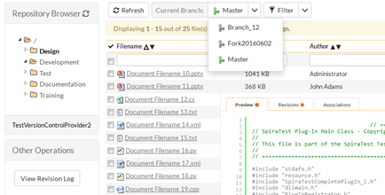
Improved Source Code Tools
Currently, source code is read only
Add line level interactions and
workflow processes to source code
Processes: code reviews and approval, potentially pull requests or branch merging
Line level interactions: comments, responses and questions, as part of a process as above
More powerful file view tools, including comparing two versions of a file live in the browser

Slide 26
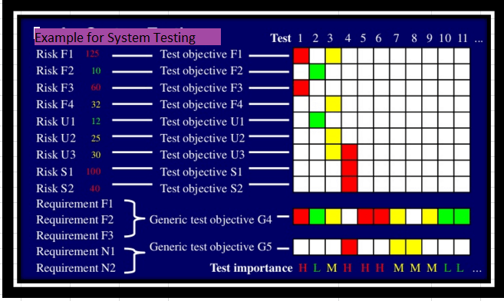
Risk-Based Testing
System will monitor metrics
around requirements
  Complexity, priority,
  task scope
System will review prior
testing activities
  Unstable tests, priority, # defects
System will suggest test plans automatically

Slide 27
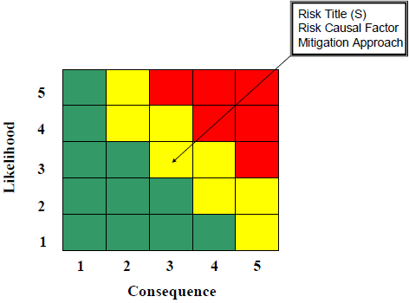
Enterprise Risk Management
Project Level Risk Management
  Track Risk Severity & Probability
Program Level Risk Management
  Assign overall risk status to projects and programs
Associations
  Ability to link Risks to other artifacts, with ‘mitigation’ artifact link type

Slide 28
KronoDesk & Rapise

Slide 29
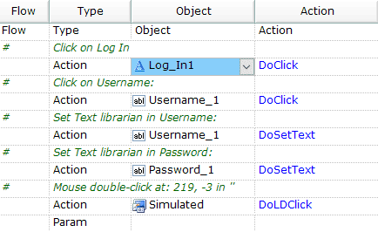
Rapise 6.0+
Focus is on usability and enhancements for testing different applications and technologies:
  ERP Suites (SAP, etc.)
  CRM Suites
  UI Frameworks
What other applications?

Slide 30
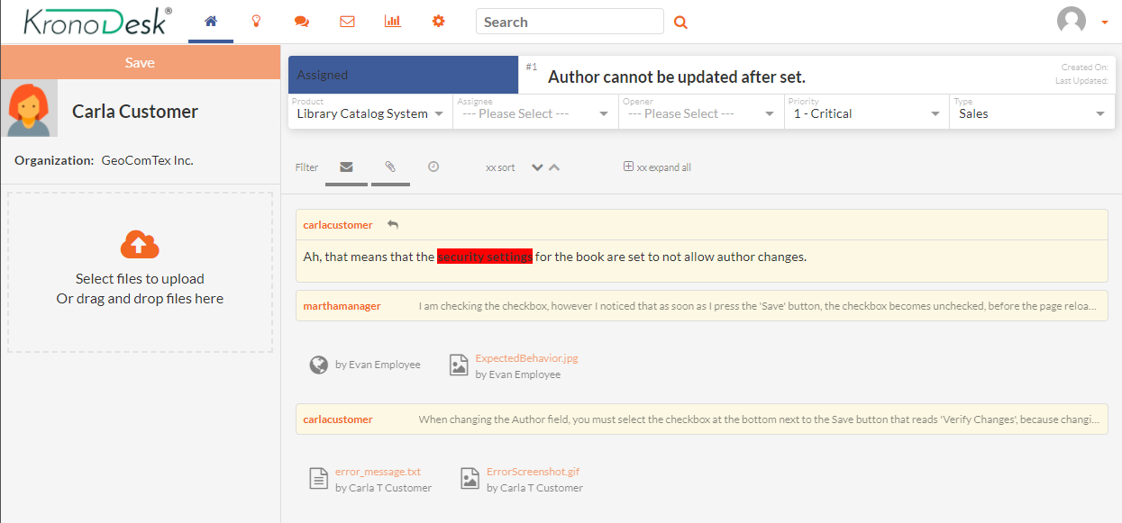
KronoDesk 3.0
Support Groups, SLAs, Escalations & UI Changes:

Slide 31
Questions?

