Slide 1
Welcome to InflectraCon
Notes:
Good morning everyone. We’ve been dreaming about this for a while and it really awesome to say, for the very first time: “Welcome to InflectraCon” – Inflectra’s first global user conference

Slide 2
2 banjos
4 amazing sponsors
6 countries
40 sessions
130 of us
Notes:
We have a great couple of days planned and so excited that we get to meet so many of our users in one place. The plan is to help you learn a lot, but also have fun, and for us all to get to know each other better

Slide 3
Thanks to our sponsors
Notes:
This conference would not be possible without you, but it would also not be possible without our great sponsors. Please take the time to go and chat to them next door to pick their brains, see how they could help you get things done faster and better, and maybe get some swag

Slide 4
Making the most of InflectraCon
3 tracks
Functional: practical, hone your skills
Management: new ideas, discuss bigger picture
Hands-on: 1-on-1 time with experts, bring your questions
How to get help ask anyone in an Inflectra polo shirt
Notes:
This is our first time hosting and running a conference, so we thought let’s keep it simple. Then we decided to fly in speakers from around the world and have three tracks running at once.
Hopefully you all have information about all the sessions and go to whichever session appeals, or just hang out with coffee, or when the hands-on track is open, hang out with Inflectra experts.
We want you to have a great couple of days so if you need help with anything, find someone in an Inflectra polo shirt

Slide 5
What Inflectra is here for
Notes:
OK – introductions out the way, I want to start by talking about what we at Inflectra are here for – what gets us out of bed in the morning

Slide 6
harmony
Notes:
Make great products
Help you work together
Help you deliver your products faster, more easily, with less pain, and less stress
At a grand scale – we’re passionate about making products that you will find transformative to how you work.
We both want to use our tools every day to help you do a whole number of complex things, and at the same time get out of your way so you don’t need to worry about SpiraPlan and can instead focus on helping your own customers

Slide 7
We have been here for 13 years
Focused on our customers – not pleasing investors
Regular new and useful features
11 global sales offices and partners across the globe
Data centers where customers need them most
Notes:
This has been central to the ethos of the company since it’s beginning.
We’ve been in business for 13 years. We may still be small compared to others in the market, but we believe we truly punch above our weight.
A large part of that is because we focus on developing features for us and our users, not to please short term investors. This may impact our company growth – but it also makes us a sustainable grounded business.
That’s why we are never in maintenance mode. We are always pushing ourselves to improve our products, help our customers wherever they are

Slide 8
Who are our users
Notes:
We have a pretty simple of thinking about varied user base

Slide 9
Testers
Developers
Managers
Notes:
At its core there are three groups of users we want to help, and to help work together.
Testers,
Developers
And Managers
All three of these need to work together, and work together well, if we have any hope of delivering great products

Slide 10
Core Spira App
QA tools
Product management
Agile planning
Source code
Programs & portfolios
Risk management
Notes:
You can see our focus on these groups in our flagship application SpiraPlan. We make sure that each group is helped in a balanced way. And over the course of a few releases we aim to roll out features that each group can benefit from

Slide 11
Wider Spira Ecosystem
Test automation: Rapise
Test integration: RemoteLaunch
Integrations: CI/CD, IDEs, unit tests
Source code hosting: TaraVault
Syncing: Jira, Azure, HP, ServiceNow
Helpdesk support: KronoDesk
Notes:
We adopt the same pattern across all the wider Spira ecosystem of products and services
We have integrations, dedicated applications, and addons that meet the needs of each core group

Slide 12
Testers
Notes:
That’s the very high level, but what does this mean in detail for you? What have we or are we about to release that can help you? Let’s talk testers first

Slide 13
Best in class testing tools
Exploratory Testing
Best Rapise ever
Notes:
We have released a number of major features and products to help testers recently – in SpiraTest itself, through external tools, and of course in our test automation tool.
I’m going to touch on each of these in turn – particularly as some of these have come out in the last few days.

Slide 14
Honing our testing chops
Test can link to risks and tasks
Test configurations
Suspect flag on tests
Admins can reassign test runs
Notes:
Testing is the bedrock of our product and we believe it is the best test management tool on the market. That doesn’t stop us from continuing to innovate, refine and add new features.

Slide 15
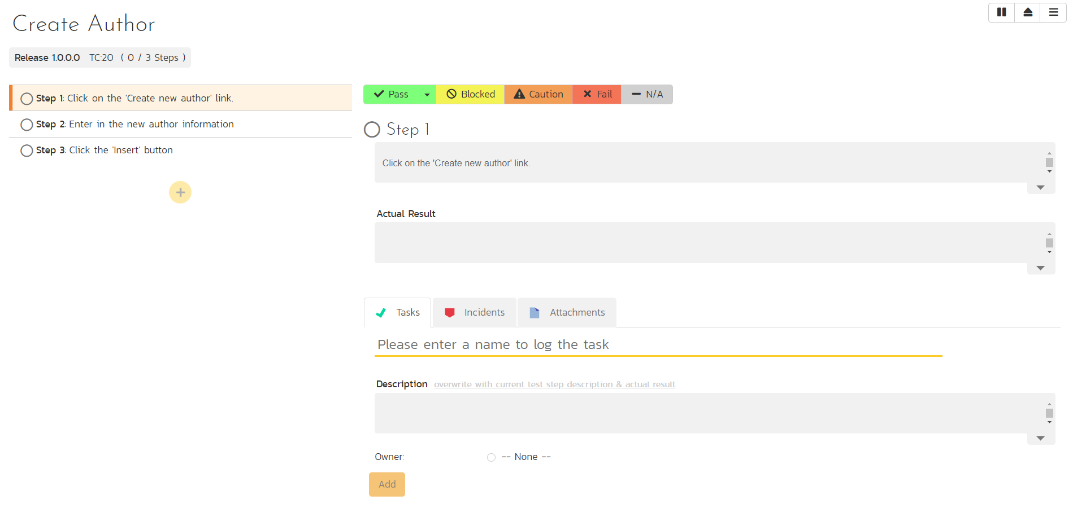
Flexible Exploratory Testing Mode
Notes:
We have embedded exploratory testing into SpiraTest in a powerful way. With a streamlined and adaptive UI testers can build out their test while they are testing

Slide 16
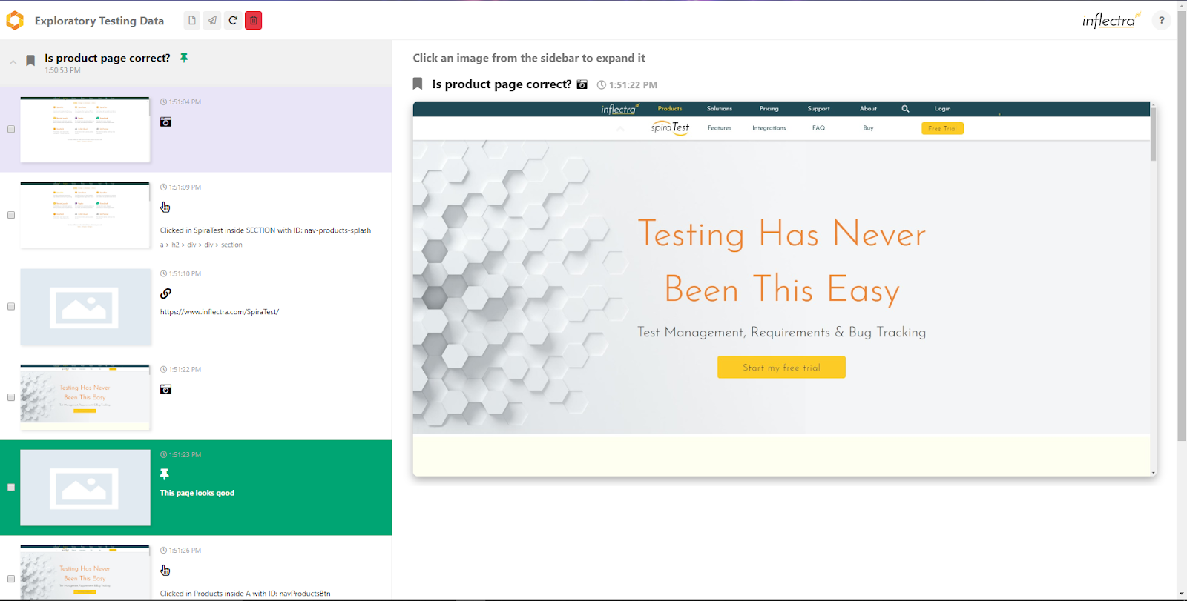
SpiraCapture to log your session
Notes:
We took this to the next level this summer, with the introduction of SpiraCapture – a Chrome plugin. It helps you record everything you do during a test, and then sift through that firehose of information to focus on what you need to capture in Spira. If you haven’t already starting using it, I definitely recommend you do so.

Slide 17
Better looking, easier to use
Notes:
Rapise, our test automation tool, had a huge release this year. While Microsoft is sticking to the ribbon, we had enough and think that the new UI is a lot simpler to use

Slide 18
Improving app support
MS Dynamics
Salesforce
SAP

Slide 19
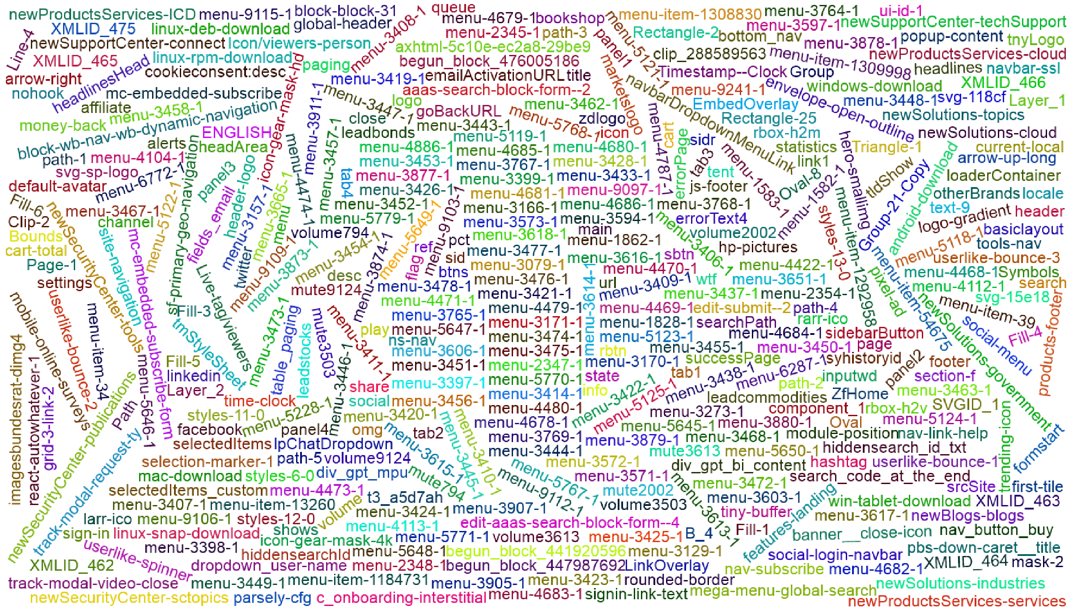
Self healing using machine learning
Notes:
Improves record & play stability Lower maintenance costs Better insights to changes in AUT

Slide 20
Developers
Notes:
Let’s talk next about developers

Slide 21
IDEs
Source Code
DevOps
Notes:
For developers, it is as much how we can get out of the way as how our tools can help. We want to streamline how developers interact with our tools so they can stay in the tools they are already in

Slide 22
IDEs
VS Code
Visual Studio
Eclipse
Jet Brains IDEs

Slide 23
Source Code
TaraVault
Gitlab
Github

Slide 24
DevOps
Azure DevOps
Every major unit test framework
Jenkins

Slide 25
Managers
Notes:
Managers, our third pillar, could always take advantage of our reporting, dashboards, and traceability features. But we knew we could do a lot more to help managers – both senior leaders and those in other roles like BI

Slide 26
Risks
Requirements
Dark mode
Notes:
In 6.0 we added dedicated risk managent to SpiraPlan
In 6.2 we added 4 wholly new and exciting ways to engage with requirements
And today we want to share with you our early thinking about taking all of this to the next level with portfolios

Slide 27
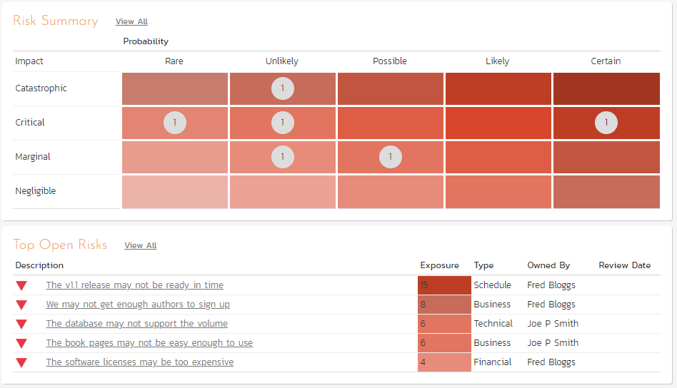
Risk Management
Impacts
Probabilities
Mitigations
Reporting
Fully integrated

Slide 28
Requirements 5 ways
Classic hierarchy
Flat sortable
Kanban board
Document
Mindmap

Slide 29
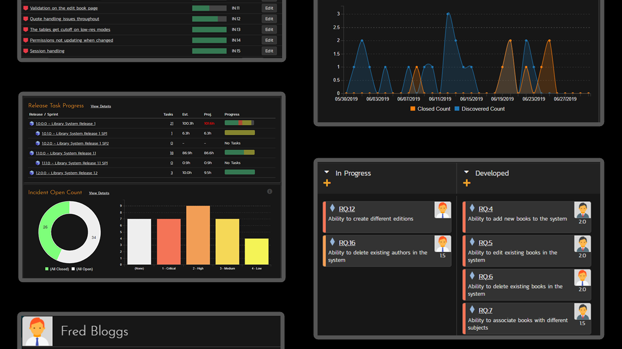
Dark mode (just because)

Slide 30
One more thing…
Notes:
[DO WE NEED THESE SLIDES??]

Slide 31
Portfolio Level Planning

Slide 32
Where next?

Slide 33
Resource planning
Fine grained notifications
Improved SCM
Gannt charts
Teams and tracks
Financial management
Improved instant messenger
Risk-based testing
Enterprise views
Webhook support
Dynamic Test sets
Portfolio artifact pages
Scheduling
AI-powered testing
Baselining
Time tracking
EVM module
Charts and reports
Freeform notes
Simplified integration with third party tools
Managers
Cross-platform
Testers
Developers

Slide 34
harmony
Notes:
Make great products
Help you work together
Help you deliver your products faster, more easily, with less pain, and less stress
At a grand scale – we’re passionate about making products that you will find transformative to how you work.
We both want to use our tools every day to help you do a whole number of complex things, and at the same time get out of your way so you don’t need to worry about SpiraPlan and can instead focus on helping your own customers

Slide 35
Have an amazing InflectraCon!*
*Where should I go next

