Slide 1

Testing 1
Simple Test Cases, Test Sets and Test Runs
@Inflectra | #InflectraCon

Slide 2

Teresa Langston
Engagement Specialist, Inflectra
@tlangston15

Slide 3
Session Objectives
As an introduction to Testing we will review processes for creating and organizing test cases.
We will cover test steps, linked test cases and simple parameters.
Finally, we will demonstrate the creation and execution of a simple test set.

Slide 4





Testing Building Blocks
Test Case
Test Step
Linked Test Step
Test Set
Test Run
Notes:
Spira’s Testing Module is organized with a series of building blocks with thoughtful icons. The first building block or Artifact is a Test Case which is comprised of a list of Test Steps. Test Cases must include at least 1 Test Step to be executed. A Test Step can also be a Linked Test Step
Individual Test Cases can then be added to a Test Set
And once a Test Case or Test Set is executed then it becomes a Test Run.

Slide 5
Test Cases

Slide 6

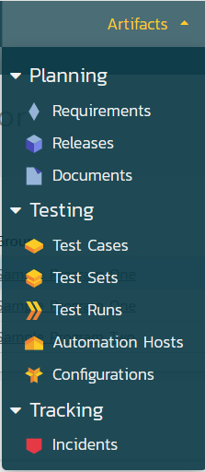
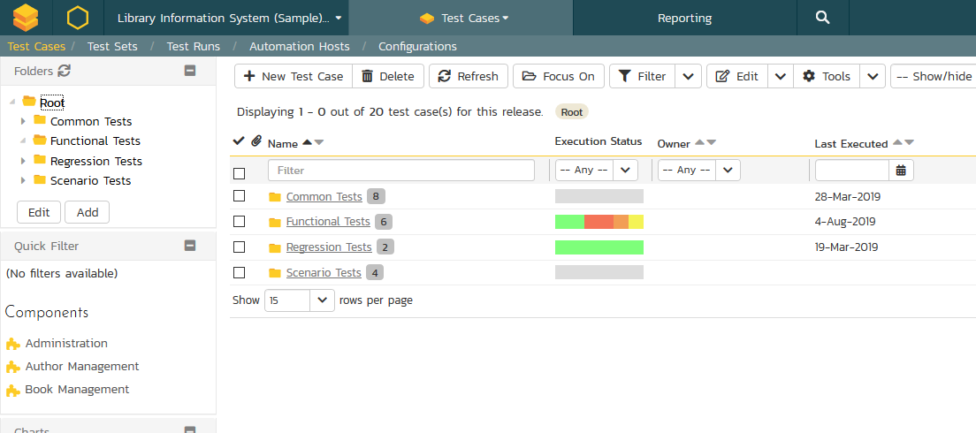
Test Case Organization
Notes:
So you find here a snapshot of the SpiraTest system. The chosen product in the workspace area is Library Information Systems and the Selected Artifact is Test Cases in list view. From here you can see the Test cases are organized in folders. The folders are completely customizable. To add a new folder you can select the Add button and choose the parent folder –None in this case defaults to the Root Folder.

Slide 7
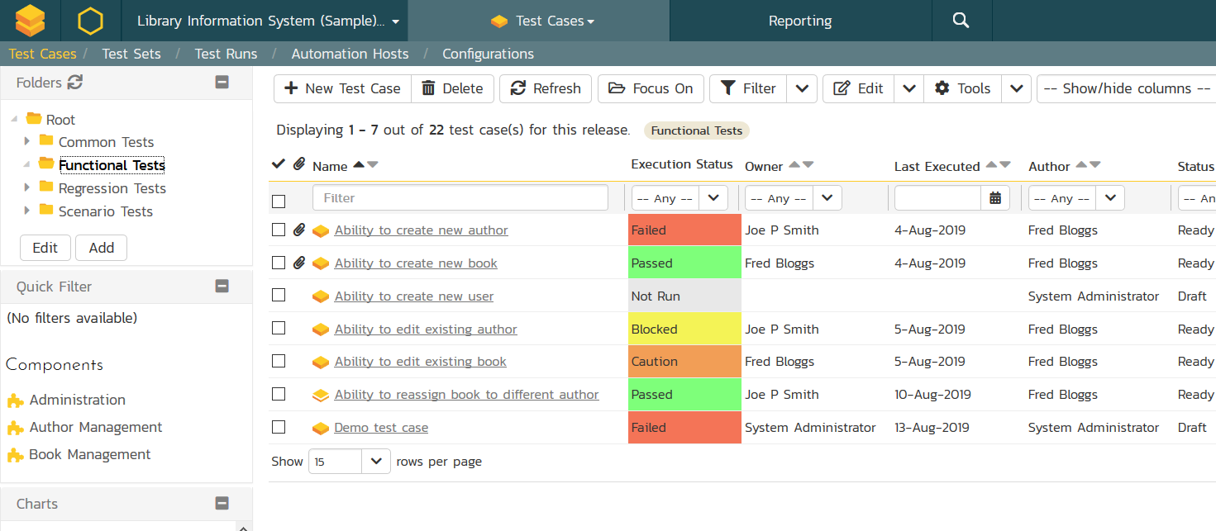
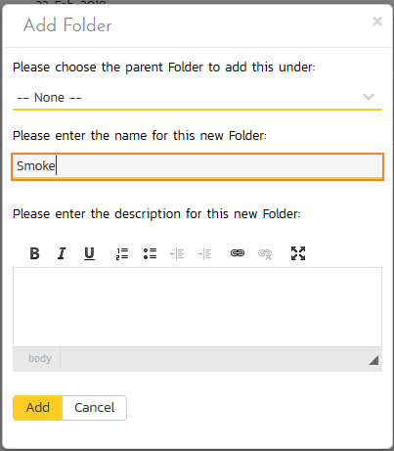
Test Case Organization
Notes:
So you find here a snapshot of the Spira system. The chosen product in the workspace area is Library Information Systems and the Selected Artifact is Test Cases in list view. From here you can see the Test cases are organized in folders. The folders are completely customizable. To add a new folder you can select the Add button and choose the parent folder –None in this case defaults to the Root Folder.

Slide 8
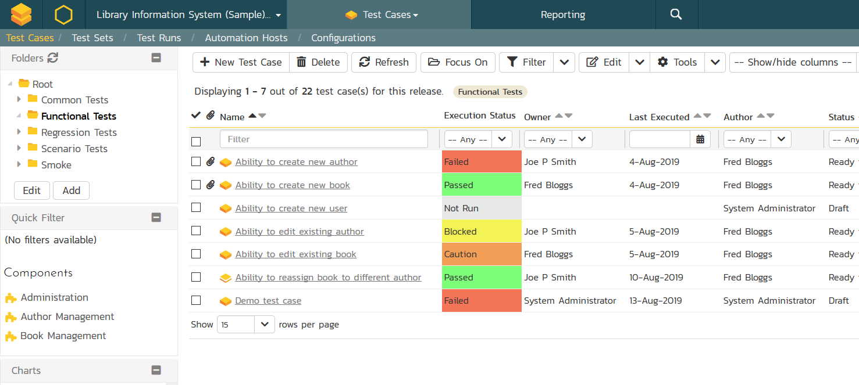
Test Case Organization
Notes:
Here is our new folder.

Slide 9
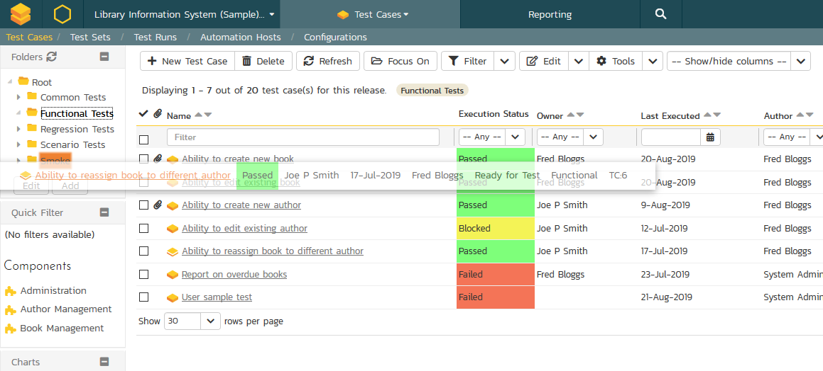
Test Case Organization
Tip:
Easily drop and drag Test Cases into folders.
Notes:
Should you want to move a test case from one folder to the next, you can simply drag and drop from the list view to the folders at the left.

Slide 10
Creating a Test Case
Manual Test: Ability to add new user
Open browser and go to URL
Login to application
Go to the User Management
Add New User Name and Email
Confirm New User is accepted.
Notes:
Let’s identify a simple manual testSo let’s say we would like to create a new test case – if we know where we would like it to be filed you can click on that folder and to reveal the associated list of test cases - in this instance “Functional” – so we click the New Test Case Button.

Slide 11
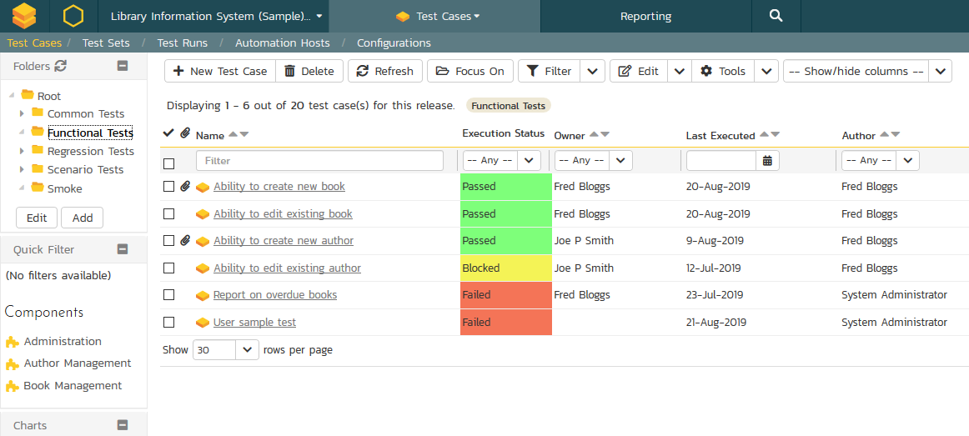
Creating a Test Case
Notes:
So let’s say we would like to create a new test case – if we know where we would like it to be filed you can click on that folder and to reveal the associated list of test cases - in this instance “Functional” – so we click the New Test Case Button.

Slide 12
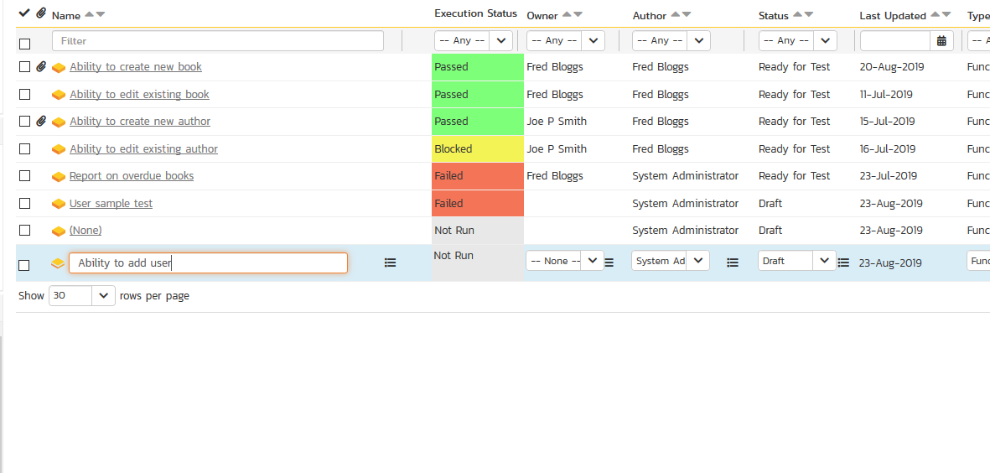

Creating a Test Case
Tip:
When adding more than one Test Case choose Save and New.
Notes:
We give it a name – for our example here we will create a Test Case – Ability to add user. And Save – should we want to add another test case we would select the save and new.

Slide 13
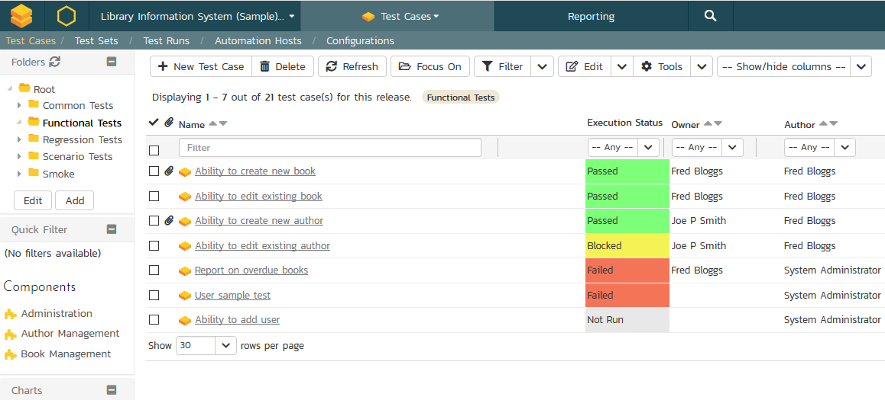
Creating a Test Case
Notes:
Once the case is created – we simply click on it to go to the Test Case Detail Page

Slide 14
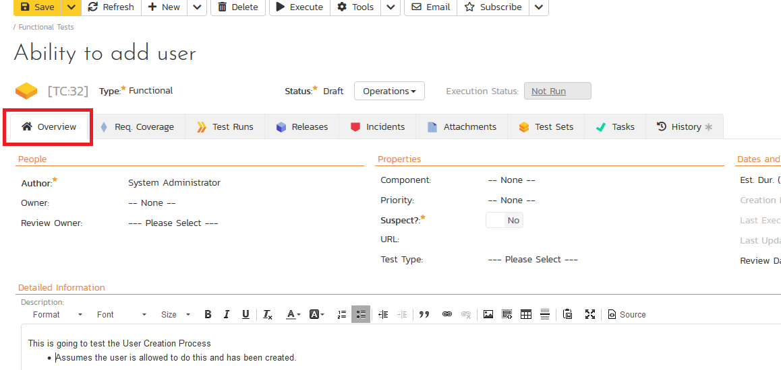
Test Case Detail
Notes:
On the detail page you will see some predefined fields of Test Type and and Status. These are again customizable. Then you will see a series of tabs. In the Overview tab you can easily add a Detailed description in the rich text editor. Then scrolling down you will see the Test Step section.

Slide 15
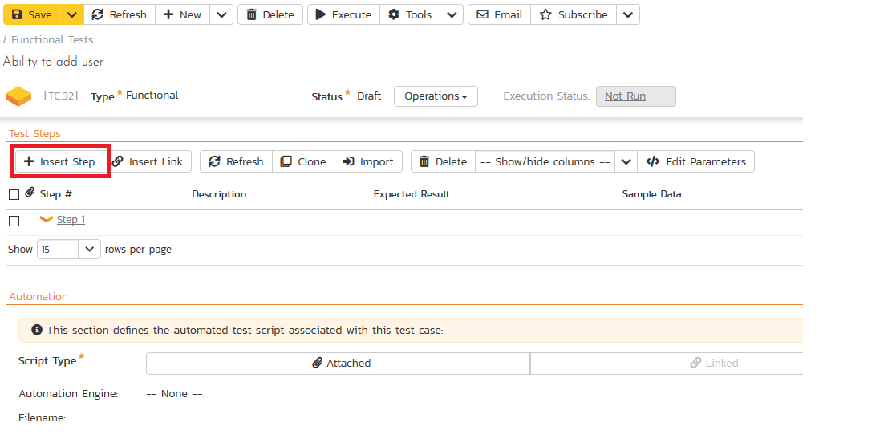
Test Steps
Notes:
You will note that as a result the system will automatically create a Step with the creation of the Test Case. You can then delete the default and add your own or edit the default step as you need. To insert a test step click the Insert Step button.

Slide 16
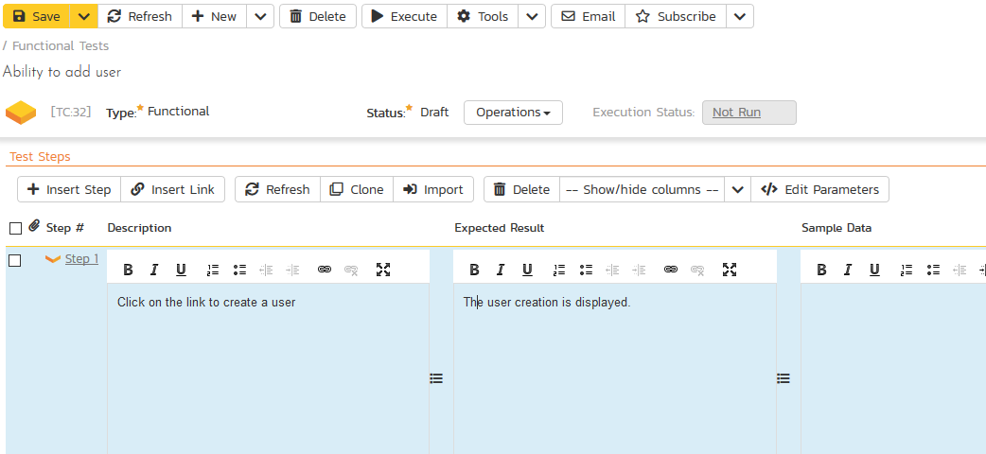
Test Steps
Notes:
This opens a text table with Three sections – Description, Expected Result and Sample Data. Here is where you include all the details testers will need to perform the test.

Slide 17
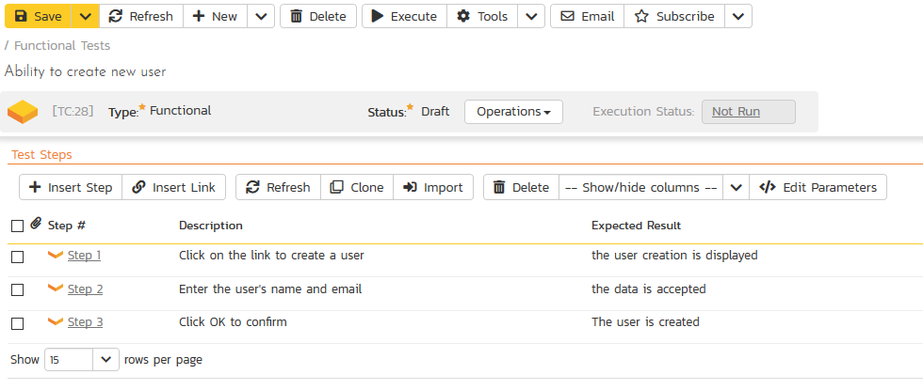
Test Steps
Notes:
Here we have added three test steps to our Test Case. However you will note that we didn’t include a login to application step. This a fairly generic step and we don’t want to write this step over and over again. So we can create a Common Test Case and insert a link.

Slide 18
Common Test Cases

Slide 19
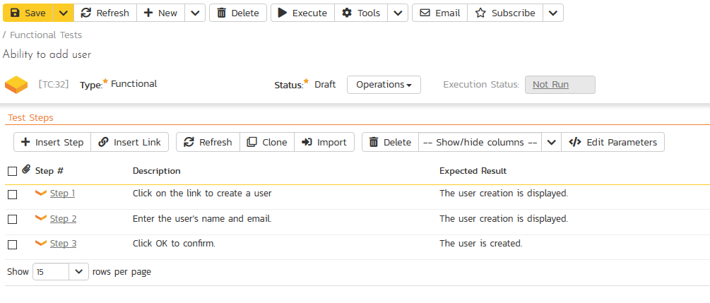
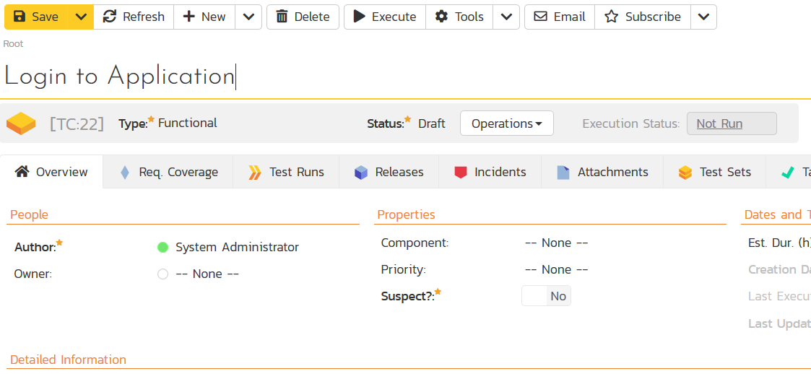
Create a Common Test
Notes:
First let’s quickly demonstrate how to create that login test case. We will repeat our actions as before – creating a new test case and then clicking to access the detail page you see here.

Slide 20
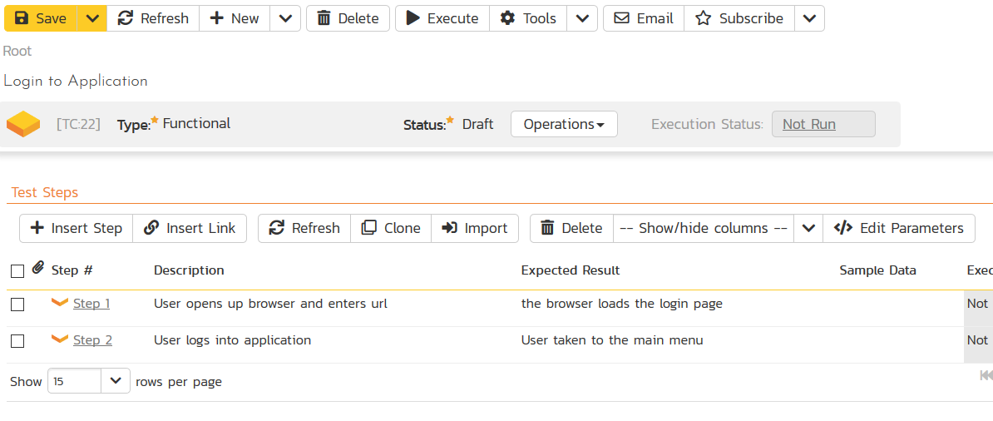
Create a Common Test
Notes:
We will enter two steps – Opening a browser and entering a url
Then entering a login and password.

Slide 21
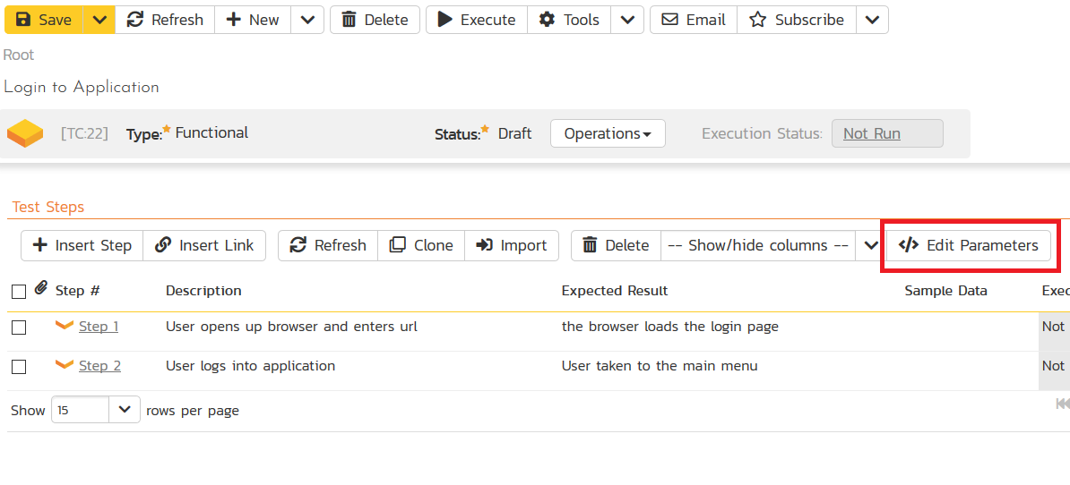
Create a Common Test
Notes:
We made it quite generic but when we use the Test case we will want to be able to specify the operating system, Browser, url, login and password so we will create parameters associated with the Test Case.

Slide 22
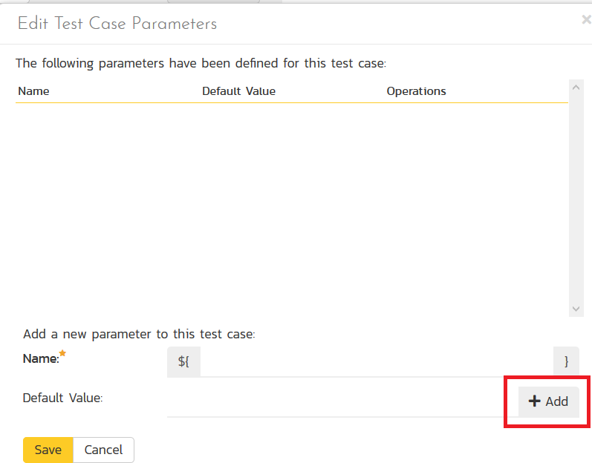
Create a Common Test
Notes:
We will enter those key parameters clicking Add after each one

Slide 23
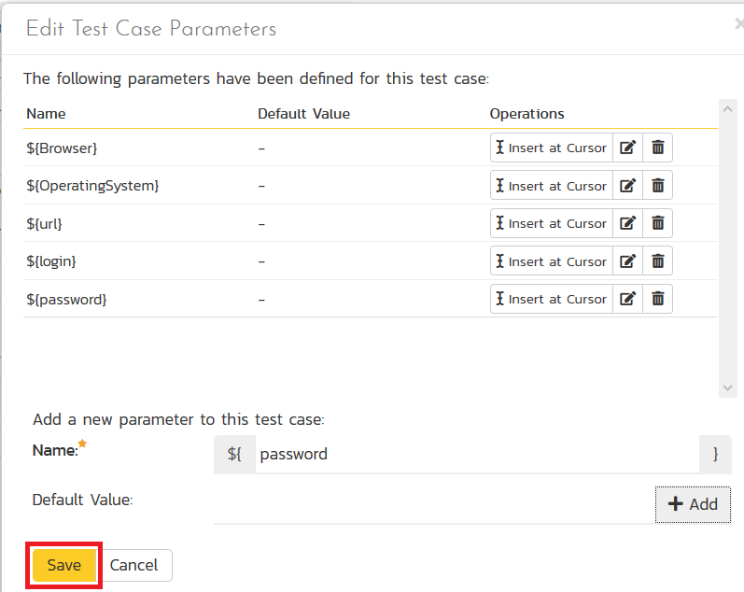
Create a Common Test
Notes:
Then hit save.

Slide 24
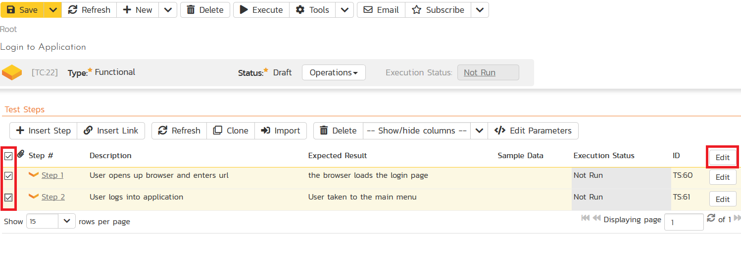
Create a Common Test
Notes:
Now we want to add the parameter values to our steps in the correct spots – we will click on the Steps to edit

Slide 25
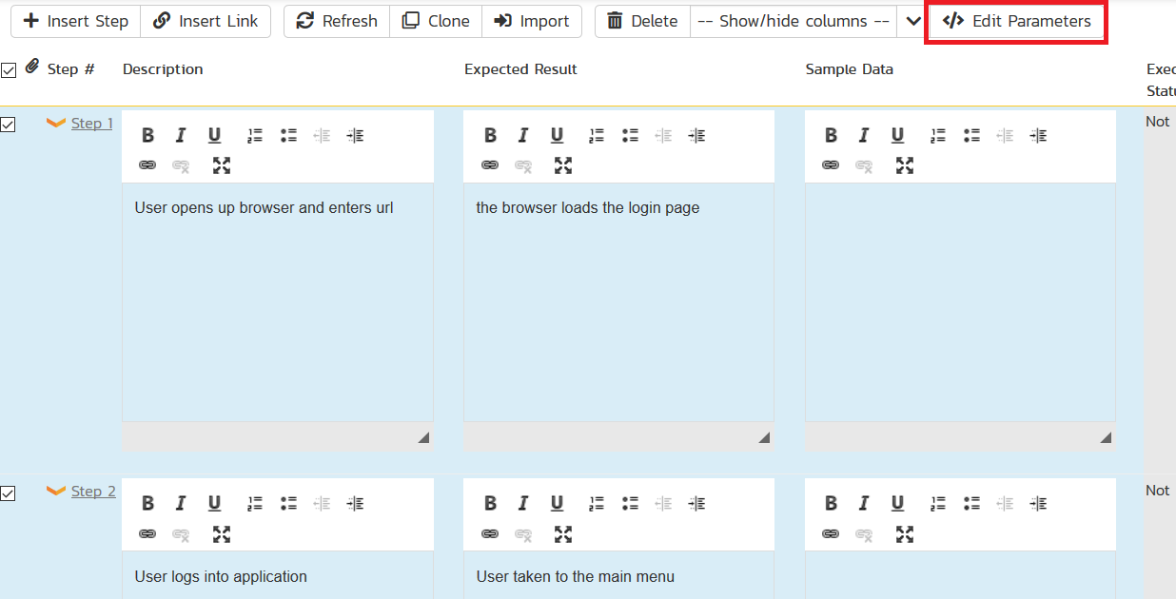
Specify Parameters
Notes:
Then click the Edit parameters button to open the parameter window.

Slide 26
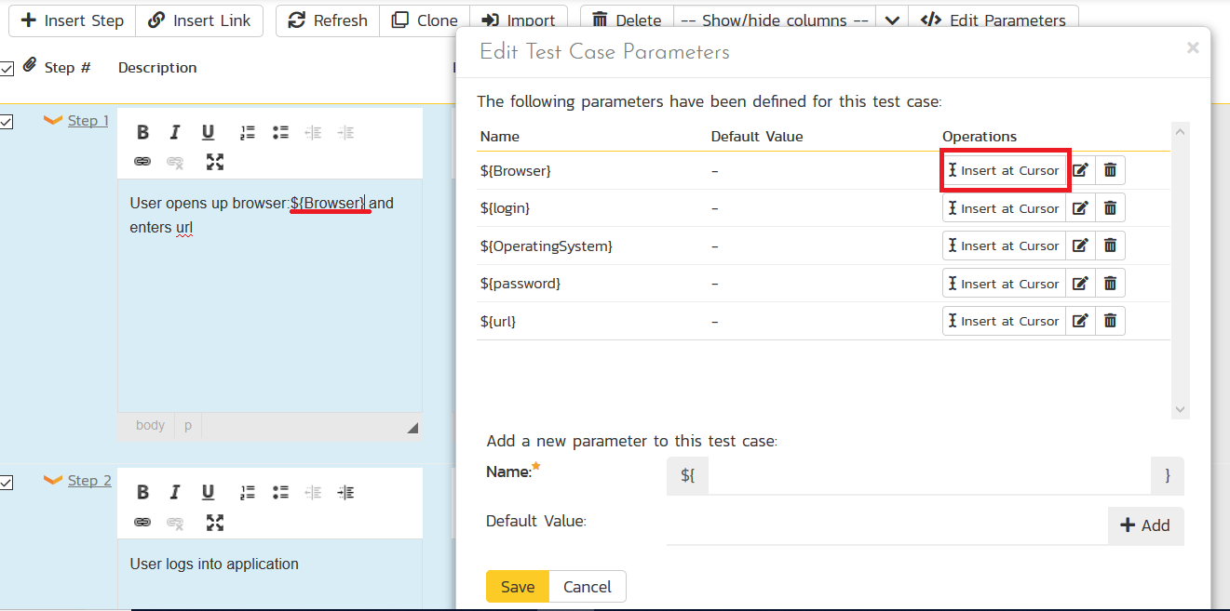
Specify Parameters
Notes:
Then you place the cursor in the Step description and select the Insert Cursor for the associated parameter.

Slide 27
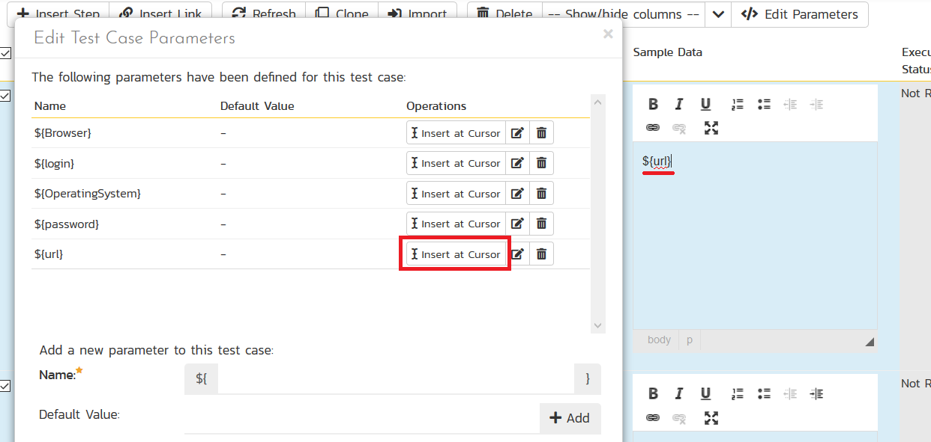
Specify Parameters

Slide 28
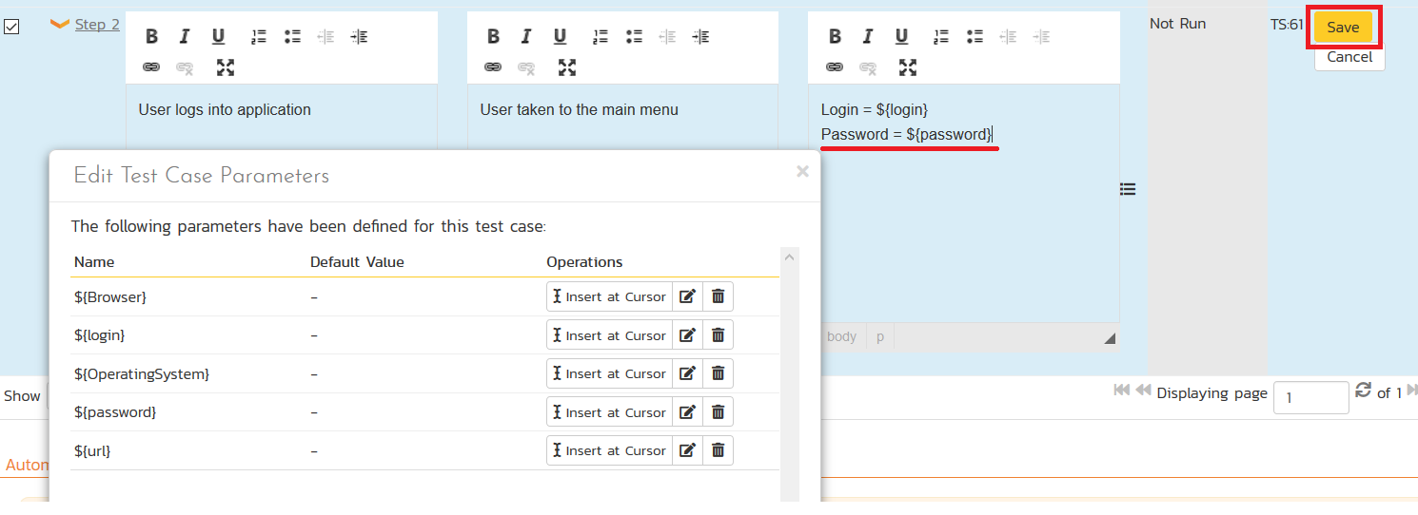
Specify Parameters
Notes:
Click save to secure these changes to the steps

Slide 29
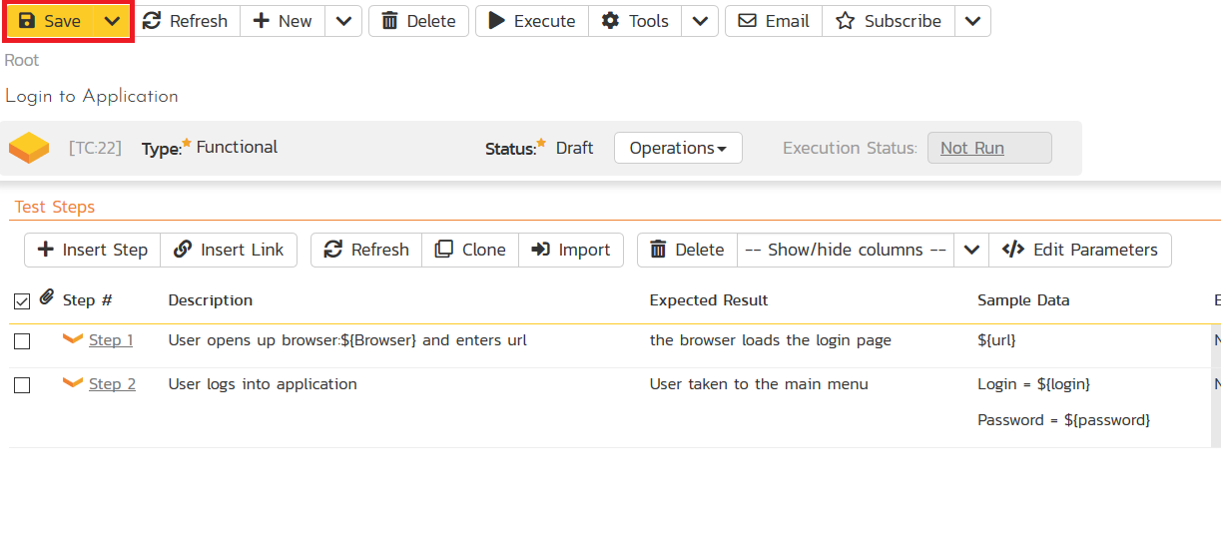
Save Common Test Case
Notes:
And save the Test Case at the top left

Slide 30
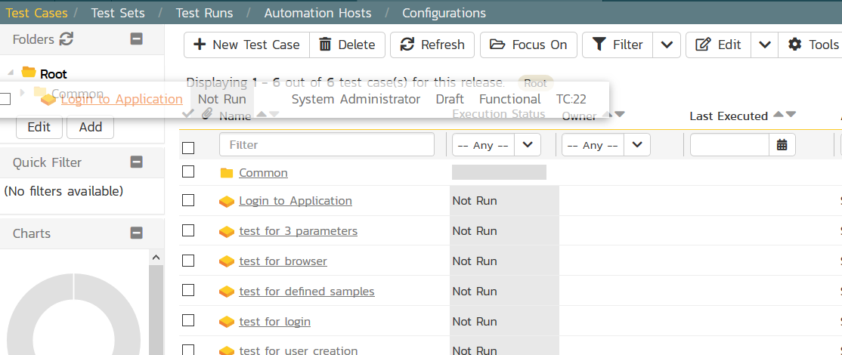
Add to Common Folder
Notes:
We can add the Test case to a folder – “Common” to be able to find it quickly.

Slide 31
Linked Test Cases

Slide 32
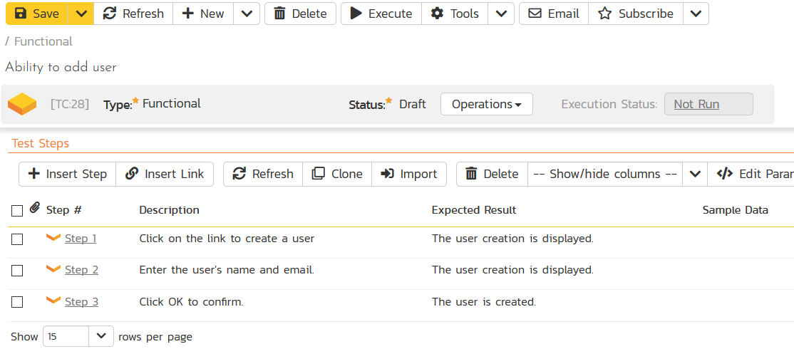
Link New Common Test
Notes:
So now if we return to our original Test Case – Ability to add user – and scroll to the Test Steps section we can click the insert Link button.

Slide 33
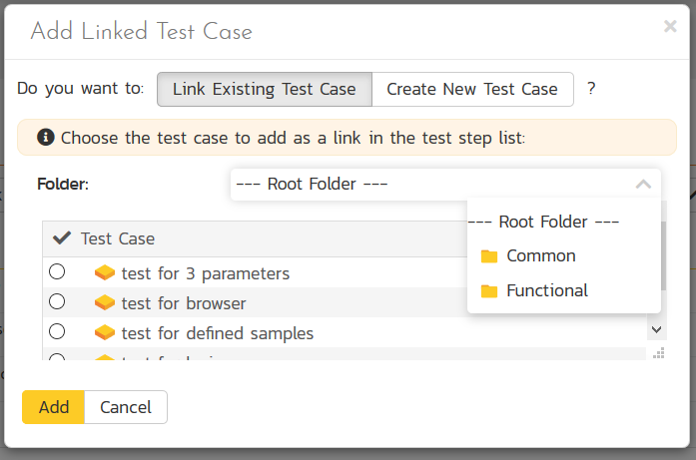
Link New Common Test
Notes:
Find our login test case from the common folder and click add

Slide 34
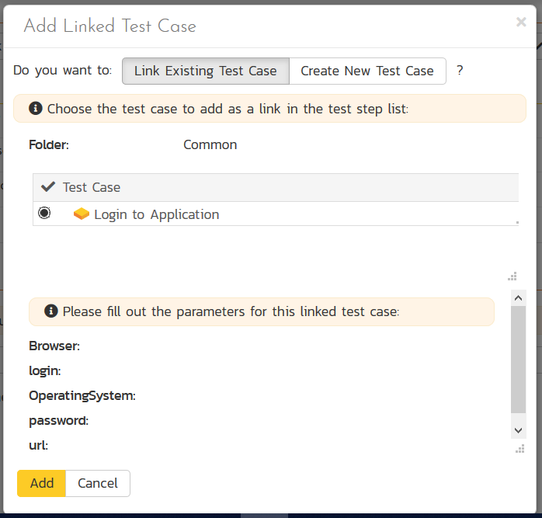
Link New Common Test
Notes:
The system will prompt you to define the parameters

Slide 35
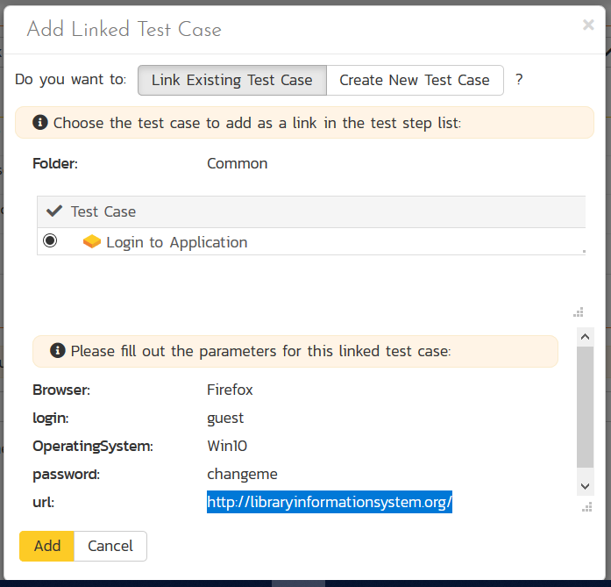
Link New Common Test
Notes:
Click add to save the definitions

Slide 36
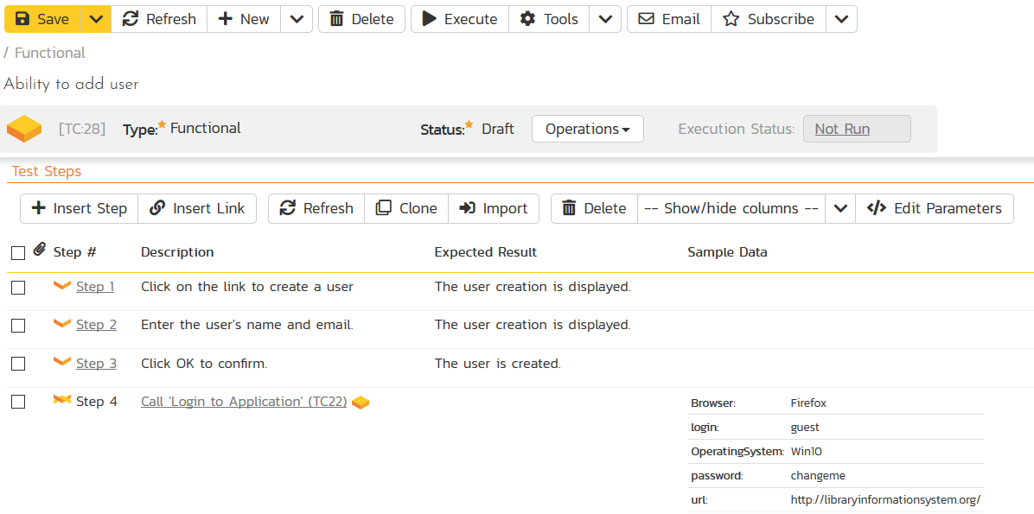
Link New Common Test
Tip: Drag and drop the to put the steps into the correct order.
Notes:
We need the login step to occur first so we simply drag and drop to the correct location

Slide 37
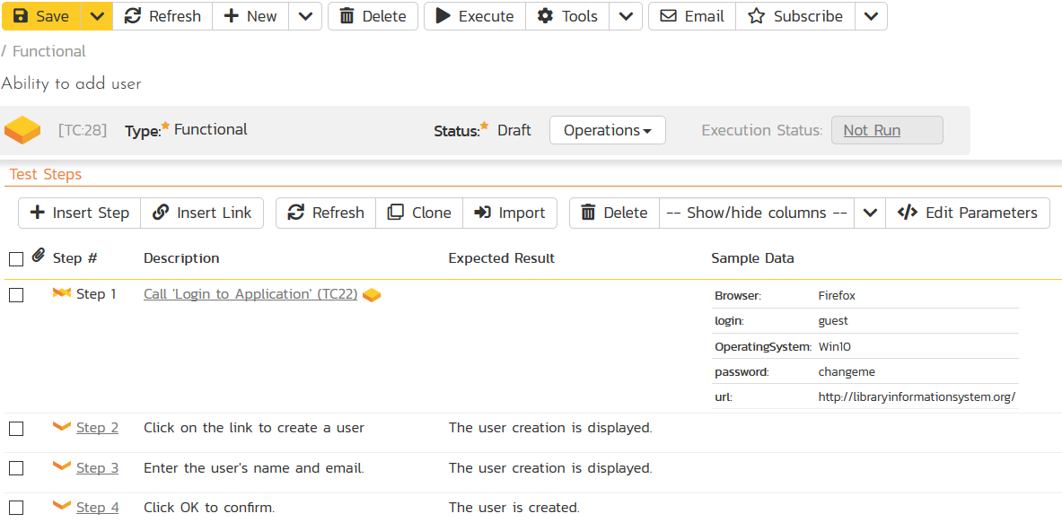
Link New Common Test
Notes:
You can execute this test case as is – just using the Execute button here.

Slide 38
Test Sets
Notes:
The system also allows the creation of Test Sets or groupings of Test Cases for execution.

Slide 39
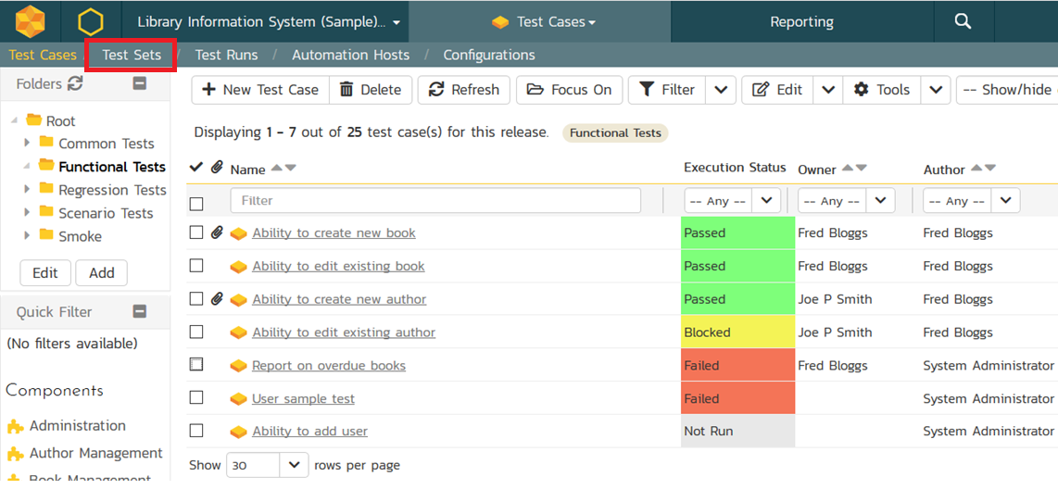
Create A Test Set

Slide 40
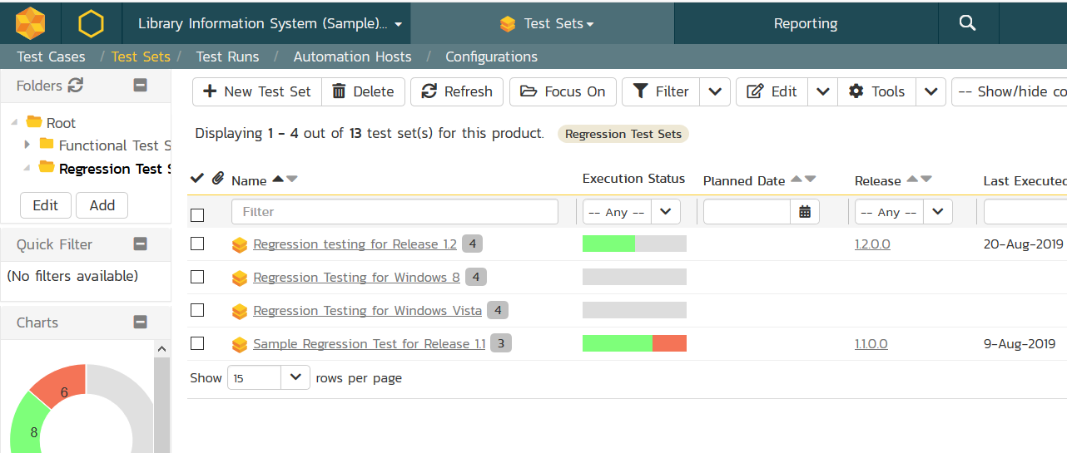
Create A Test Set
Notes:
You must move into the Test Set list page and select new test set

Slide 41
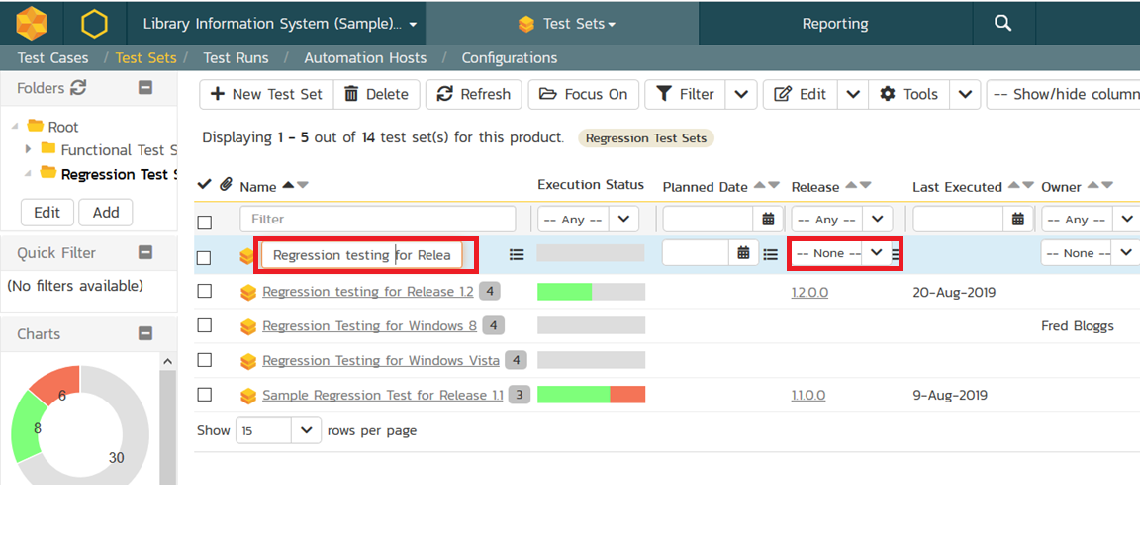
Create A Test Set
Notes:
Perhaps we are creating a list of test cases to run as regression testing. We can assign it to the associated Release.

Slide 42
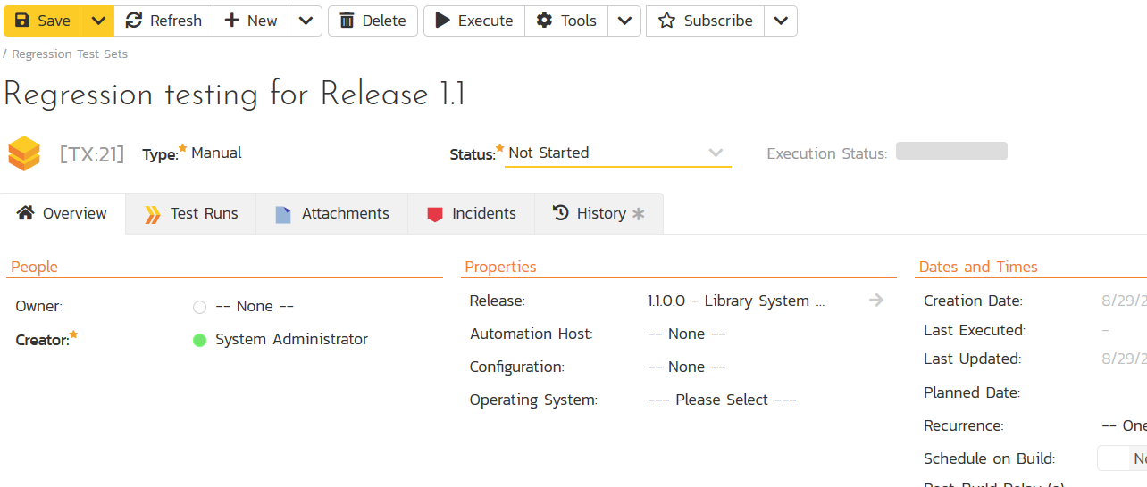
Create A Test Set
Notes:
Moving to the detail page

Slide 43
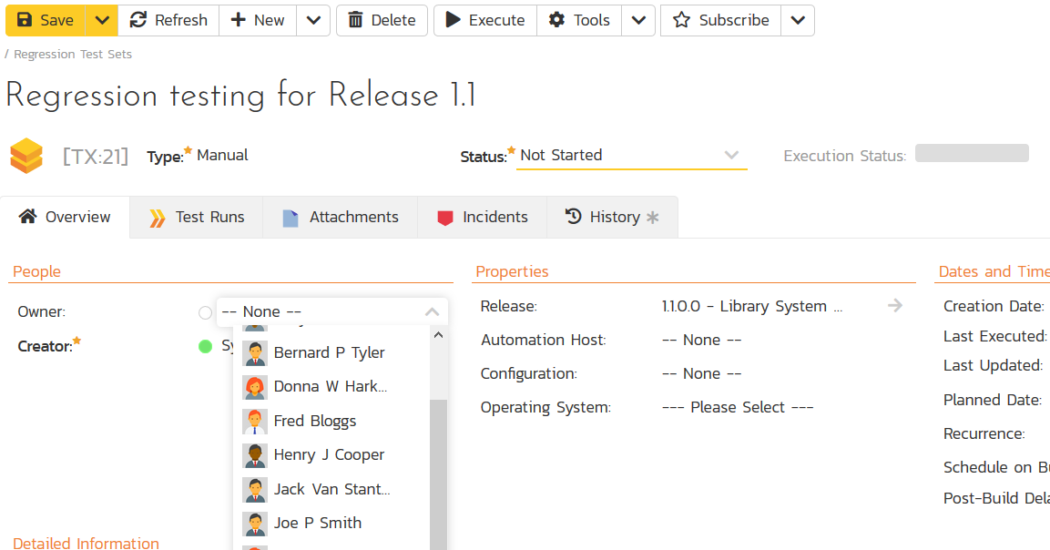
Create A Test Set
Notes:
we can Assign the Test Set to a tester

Slide 44
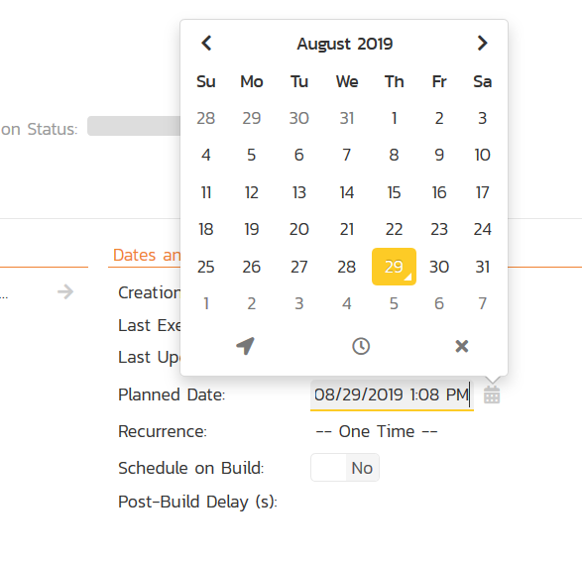
Create A Test Set
Notes:
Schedule it for a certain date

Slide 45
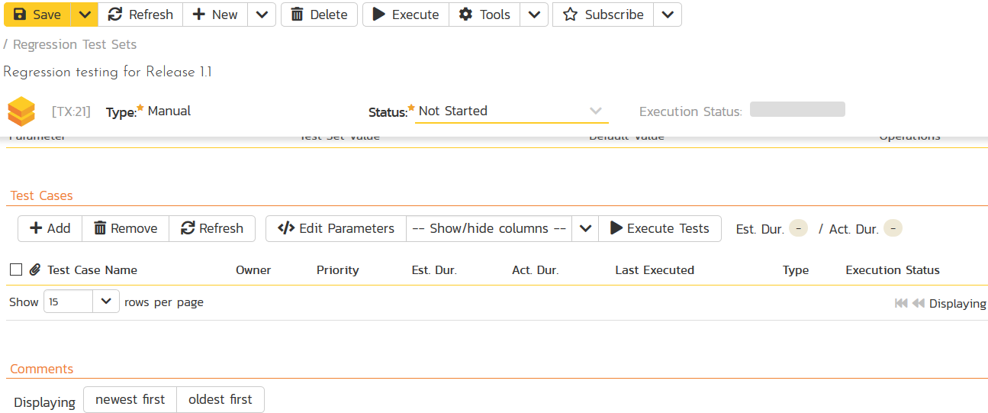
Create A Test Set
Notes:
Then Add Test Cases to the set

Slide 46
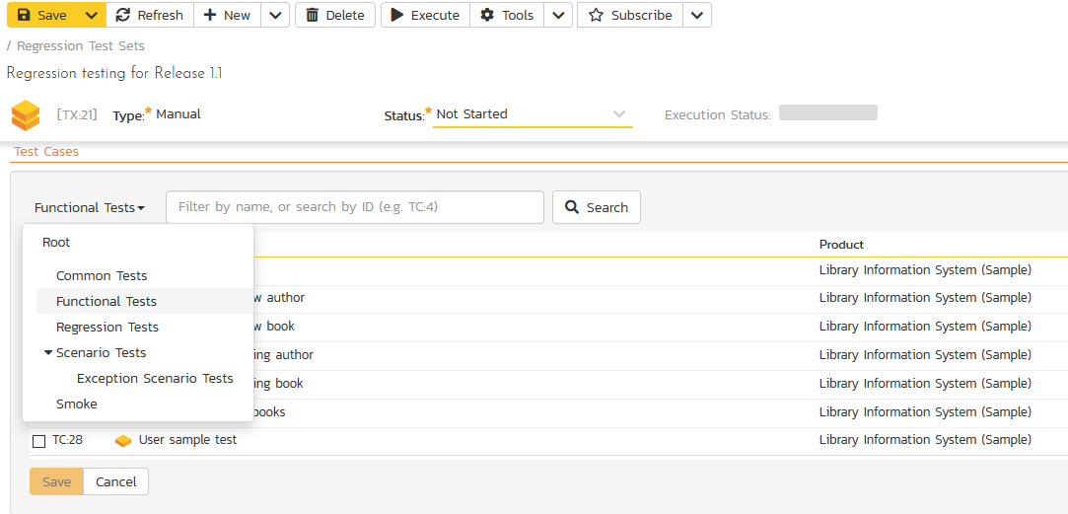
Create A Test Set
Notes:
Locating the Test Cases in their folders

Slide 47
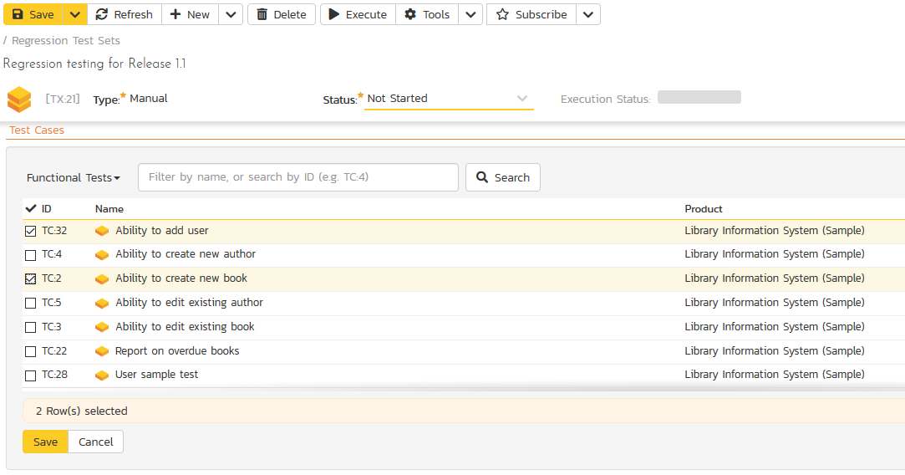
Create A Test Set
Notes:
Selecting the ones to add and Remembering to Save

Slide 48
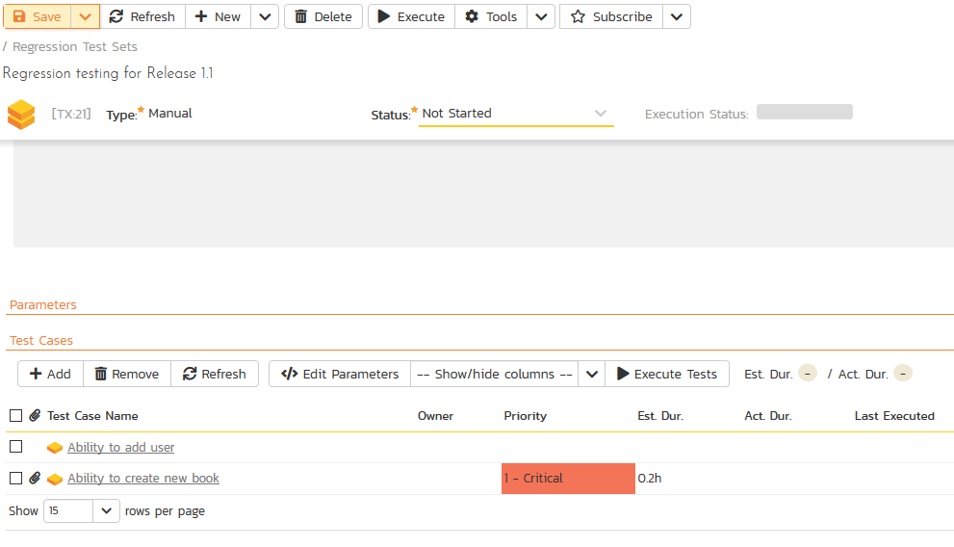
Create A Test Set
Tip: Can Execute Test Run from Test Set Screen.
Notes:
Saving the Test Set at the top left – it is now ready to Execute. Just as with Test Cases you can use the Execute button to execute from the detail page.

Slide 49
Test Runs

Slide 50
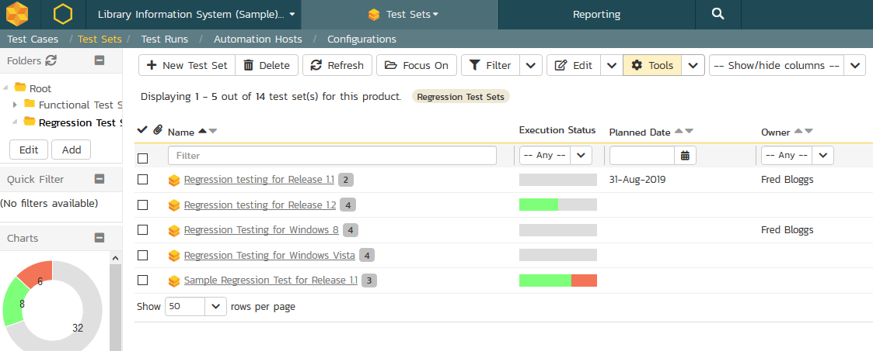
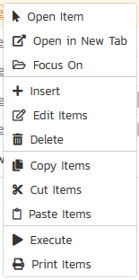
Executing a Test Set
Tip: Right Click for drop down to Execute.
Notes:
From the Test set list page you can execute with a right click or with the Tools menu at the top

Slide 51
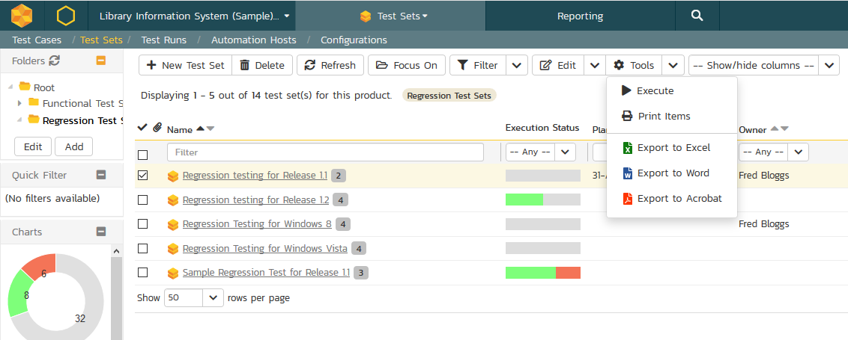
Executing a Test Set
Tip: Right Click for drop down to Execute.
Tip: Select Test Set and Tools/Execute.

Slide 52
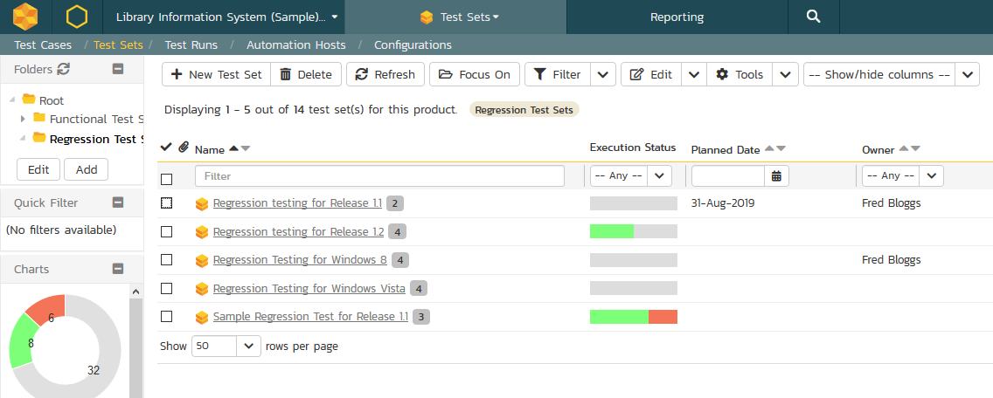
Executing a Test Set
Tip: Right Click for drop down to Execute.
Tip: Select Test Set and Tools/Execute.
Tip: Test Set Owner can Execute from My Page View
Notes:
The assigned tester can also find the test set on their My Page view

Slide 53
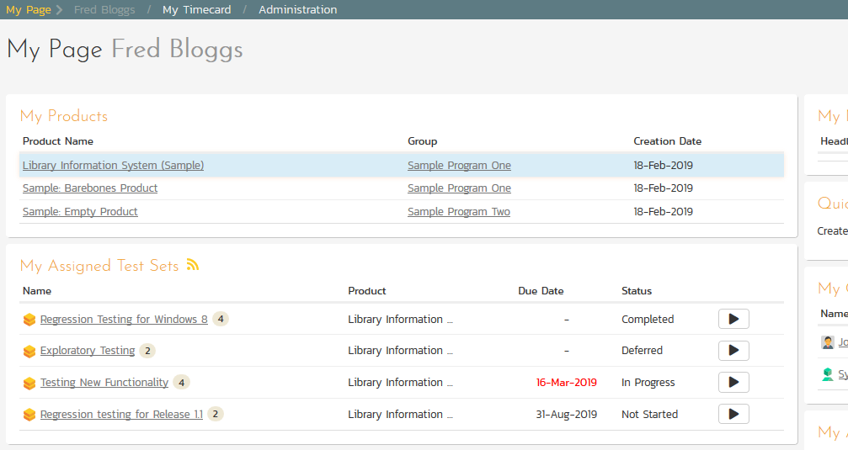
Executing a Test Set

Slide 54
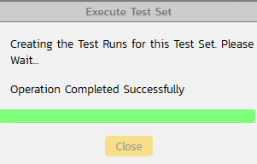

Executing a Test Set
Notes:
Clicking play here

Slide 55
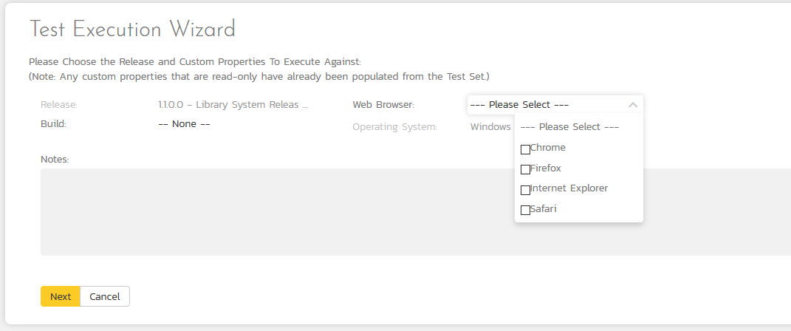
Executing a Test Set
Notes:
The test Execution wizard will ask for a field definition – depending on the workflow. – Click Next and you will see the Testing Execution Space

Slide 56
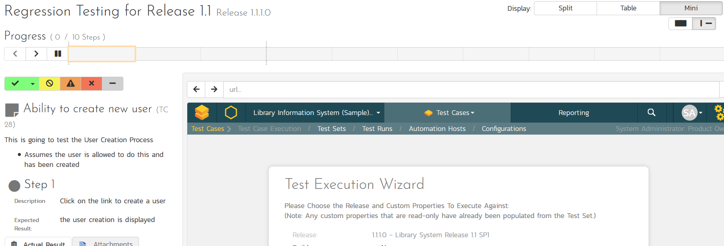



Executing a Test Set
Tip: Testers can select different Displays.
Tip: Begin Testing Steps.
Notes:
Some interesting features to note on this page:
The Testing Display has a few options, this split view, a table view (which looks more like Excel) or the mini view which allow testing via a smaller tablet screen or an I frame view which can imbed the a web-based application for testing and side by side logging of results.
The Tester can then work through the Test Steps for each Test Case in turn. Selecting the options for each Step

Slide 57

Executing a Test Set
Tip: To log a defect click Incidents tab.
Tip: Testers can record Actual Result. Including screen shot etc.
Notes:
Testers can include text for Actual result – as well as a screen shot. For this step we will find an error. We can then click on the Incidents tab and log a defect.

Slide 58

Executing a Test Set
Enter a defect name
Tip: Testers can record Actual Result. Including screen shot etc.
Notes:
Give it a name

Slide 59

Executing a Test Set
Tip: Fields with * are required. Workflows can change customize which are required fields.
Select defect type via drop down.
Notes:
Select the type of Incident and enter any other required fields. More about workflows and field customization in The following presentation

Slide 60


Executing a Test Set
Tip: Once you log information about the incident, Click Fail.
Notes:
Once the Incident information is recorded the Tester will select the Fail button

Slide 61




Executing a Test Set
Tip: Once all steps are completed – system provides a finish option.
Tip: Progress bar shows pass/fail. Able to pause timer.
Tip: Can choose to leave test and resume at a later time.
Notes:
A few other details about this Execution page.
The progress bar reflects the steps and records the time
you can pause the timer, you can leave and come back to resume testing later
Once all steps have been tested the system will provide a finish button.

Slide 62

Review Test Runs
Notes:
To review the test run – you select the test Runs artifact to see the list page
Click on the run for the details

Slide 63

Review Test Runs
Notes:
You now find all the information captured during that test run

Slide 64


Review Test Runs
Tip: You can see which steps were passed/failed or blocked.
Tip: You can quickly review the defect here.
Notes:
Scrolling down you can see which steps were passed falled or blocks and quickly view the logged incident details here.

Slide 65
Wrap Up

Slide 66
Key Take Aways
Organize Test Cases in Folder Structure.
Create Test Steps inside Test Case with Detailed Description, Expected result and sample data as necessary.
Link to Common Test Cases as steps with a parent test case.
Create Test Sets with groups of Test Cases then assign and schedule.
Easily Log Defects during Test Run for system capture of details.

Slide 67
Questions?

