Slide 1
Continuous Testing
Fact or fiction?
@Inflectra | #InflectraCon
Notes:
My journey to better understand continuous testing started about a year ago when I started hear the term more and more when talking to software professions and I decided it was time to figure out what it was all about. Sure, I’d heard other people’s views of what it was all about. These descriptions were usually given with bated breath and includes words like automation, continuous deployment

Slide 2


Jeffery Payne
CEO and founder of Coveros
Jeffery Payne is CEO and founder of Coveros, Inc., a company that helps organizations accelerate the delivery of secure, reliable software using agile methods. Prior to founding Coveros, he was the co-founder of application security company Cigital, where he served as Chairman of the Board and CEO for 16 years.
Jeffery is a recognized software expert and popular keynote speaker at both business and technology conferences on a variety of software quality, security, DevOps, and agile topics. He has testified in front of congress on issues such as digital rights management, software quality, and software research.
Jeffery is also the technical editor of the AgileConnection community (www.agileconnection.com)
jeff.payne@coveros.com
www.linkedin.com/in/jeffery-payne-21373
@jefferyepayne
@jefferyepayne

Slide 3
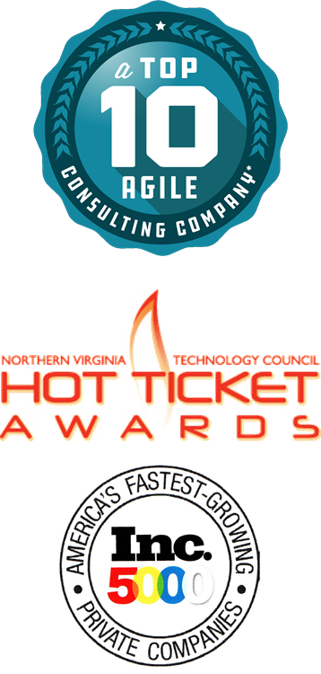
About Coveros
Founded in 2008, Coveros accelerates the delivery of secure, reliable software using agile methods
Services
DevOps implementations
DevSecOps integrations
Agile transformations & coaching
Agile software development
Agile testing & automation
Agile, DevOps, Testing, Security Training
Open source products
SecureCI – CI/CD stack
Selenified – Agile test framework

Slide 4


Continuous Testing
Continuous Testing was first coined by Gene Kim in a talk about DevOps in 2014
Notes:
We’ve all see hyped technology that has been a spectacular failure, right? And when I was looking around for whether anyone had written about the hype surrounding continuous testing, I started running into lots of technologies that got a lot of hype when they came out. I thought I’d share some of them and see if you all remember them.
Samsung Galaxy Note 7
Google Glass
Segue
Napster
Virtual Boy
Betamax

Slide 5
Continuous Testing
Continuous Testing was referenced in a 2018 DevOps report as a ‘key enabler’ for DevOps
Notes:
We’ve all see hyped technology that has been a spectacular failure, right? And when I was looking around for whether anyone had written about the hype surrounding continuous testing, I started running into lots of technologies that got a lot of hype when they came out. I thought I’d share some of them and see if you all remember them.
Samsung Galaxy Note 7
Google Glass
Segue
Napster
Virtual Boy
Betamax

Slide 6
Continuous Testing
Continuous Testing means we test more frequently than before but error on the side of speed over quality
Notes:
We’ve all see hyped technology that has been a spectacular failure, right? And when I was looking around for whether anyone had written about the hype surrounding continuous testing, I started running into lots of technologies that got a lot of hype when they came out. I thought I’d share some of them and see if you all remember them.
Samsung Galaxy Note 7
Google Glass
Segue
Napster
Virtual Boy
Betamax

Slide 7
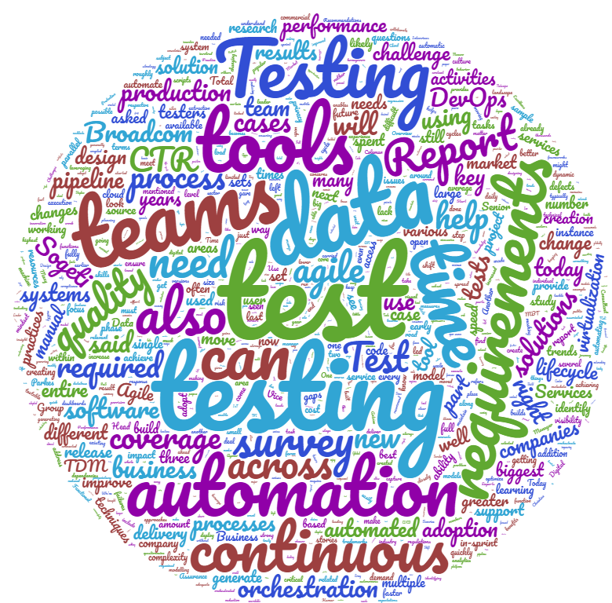
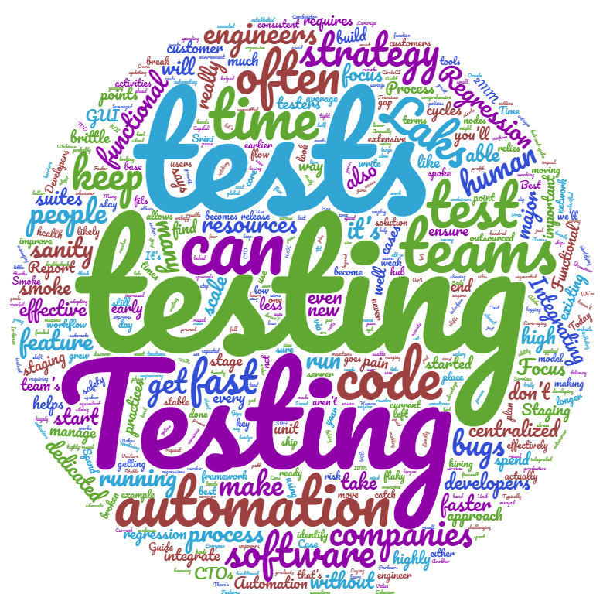
What IS Continuous Testing?
Notes:
Word maps

Slide 8
What IS Continuous Testing?
Continuous testing is the practice of testing across the software lifecycle to rapidly uncover and fix unexpected behaviors and provide the organization with information to make good business decisions
Notes:
Word maps

Slide 9

DevOps?
Dev
Ops

Slide 10

DevOps?
Testing
Performance
Security
Reliability
Dev
Availability
Ops
Think of Dev and Ops as the bookends

Slide 11
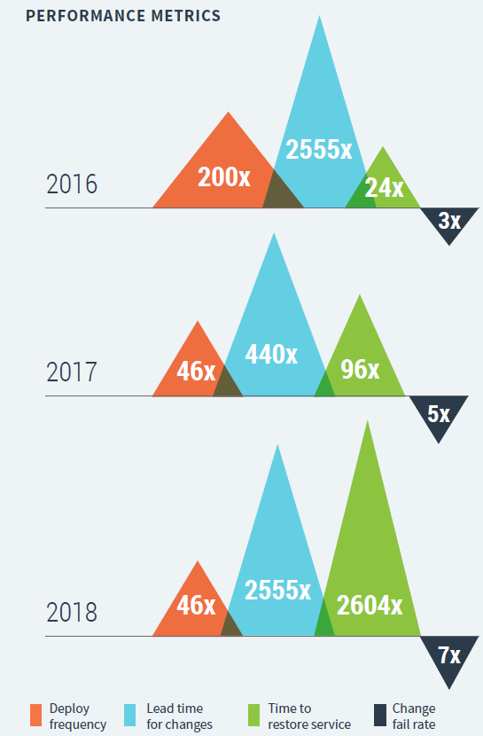
Accelerate: State of DevOps Report
The quality gap continues to grow between highest and lowest performers
Continuous testing mentioned as a key DevOps enabler for the first time in 2018!
Notes:
Continuous testing includes these practices, with some important additions:
Continuously reviewing and improving test suites to better find defects and keep complexity and cost under control
Allowing testers to work alongside developers throughout the software development and delivery process
Performing manual test activities such as exploratory testing, usability testing,and acceptance testing throughout the delivery process
Having developers practice test-driven development by writing unit tests before writing production code for all changes to the codebase
Being able to get feedback from automated tests in less than ten minutes both on local workstations and from a CI server

Slide 12
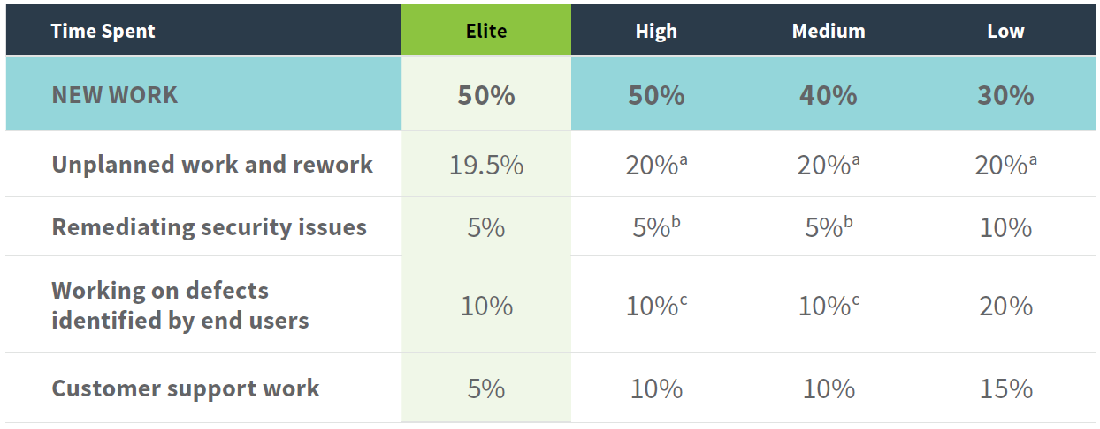
Accelerate: State of DevOps Report
Notes:
Continuous testing includes these practices, with some important additions:
Continuously reviewing and improving test suites to better find defects and keep complexity and cost under control
Allowing testers to work alongside developers throughout the software development and delivery process
Performing manual test activities such as exploratory testing, usability testing,and acceptance testing throughout the delivery process
Having developers practice test-driven development by writing unit tests before writing production code for all changes to the codebase
Being able to get feedback from automated tests in less than ten minutes both on local workstations and from a CI server

Slide 13
Continuous Testing: Reality #1
You will not realize significant benefits from DevOps without continuous testing

Slide 14
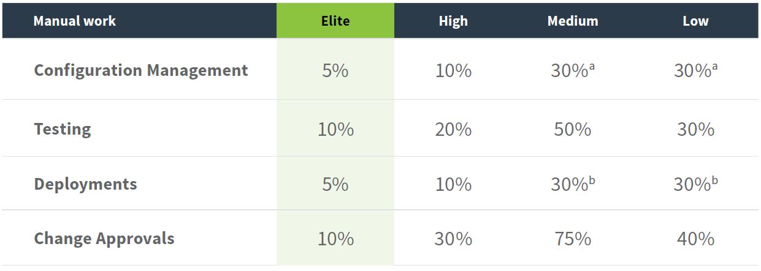
Accelerate: State of DevOps Report
Notes:
Continuous testing includes these practices, with some important additions:
Continuously reviewing and improving test suites to better find defects and keep complexity and cost under control
Allowing testers to work alongside developers throughout the software development and delivery process
Performing manual test activities such as exploratory testing, usability testing,and acceptance testing throughout the delivery process
Having developers practice test-driven development by writing unit tests before writing production code for all changes to the codebase
Being able to get feedback from automated tests in less than ten minutes both on local workstations and from a CI server

Slide 15
Continuous Testing: Reality #2
Continuous testing ≠ 100% test automation

Slide 16
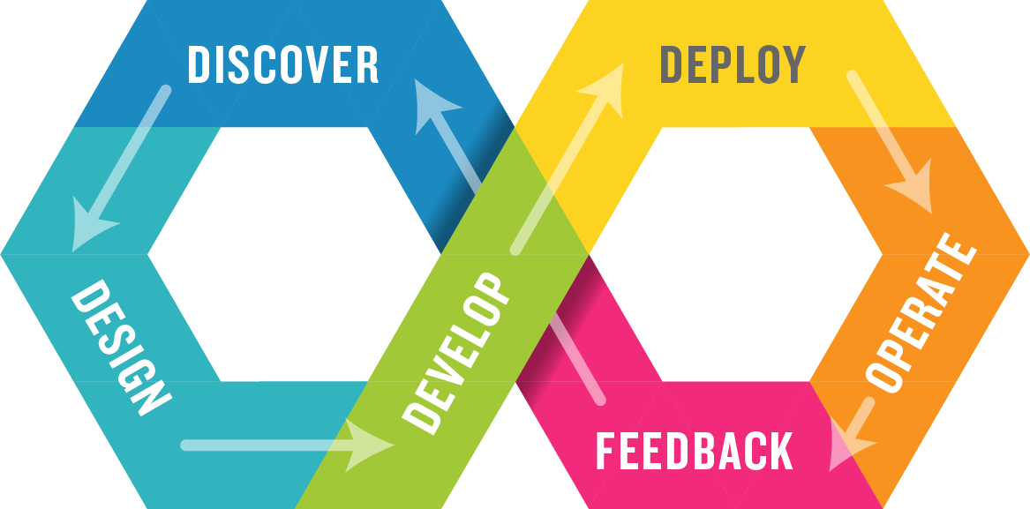
DevOps

Slide 17
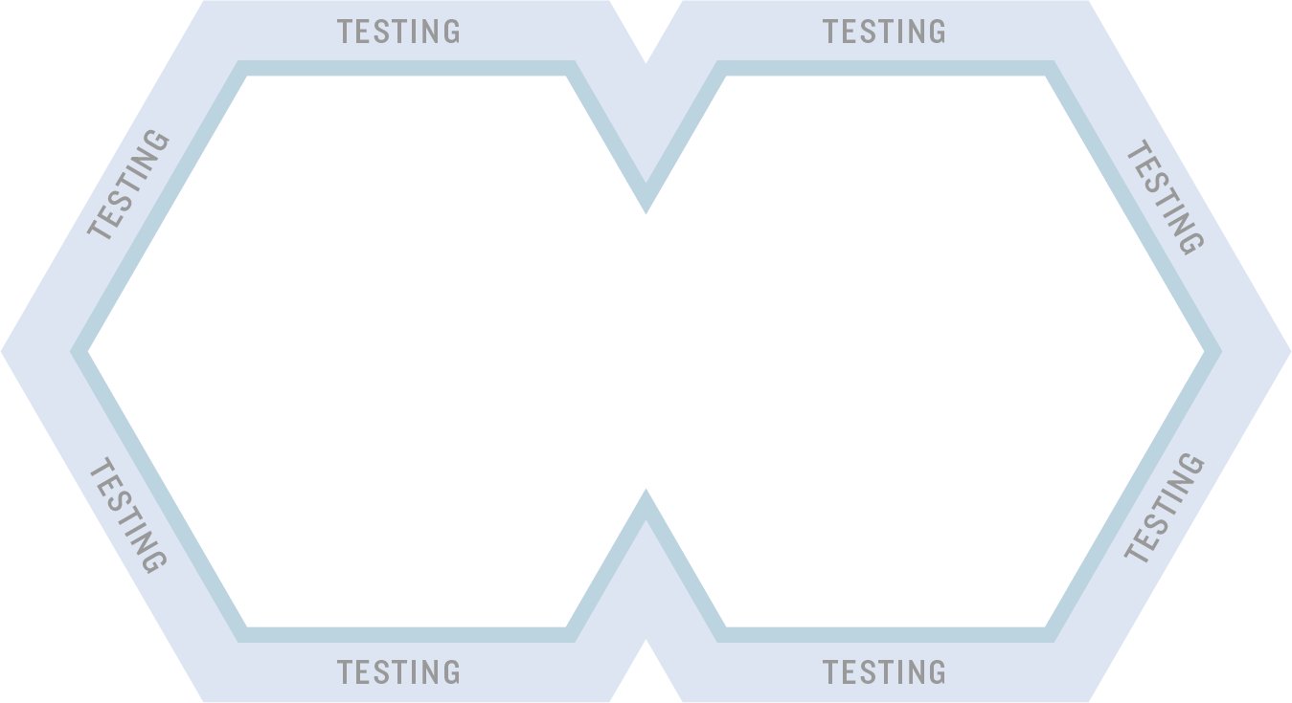
Being Continuous

Slide 18
Being Continuous
Continuous means testing is happening before, during, and after each software change is made
Enabling testing activities:
Collaborate on requirements (ex: BDD)
Validating change constantly (ex: regression testing)
Dev/Test Pairing (ex: exploratory testing, reviewing test cases)
Automated testing in CI (ex: unit testing, API testing, code analysis)
Continuous improvement of test approach, test suites, test scripts
Review of customer feedback and product ratings

Slide 19
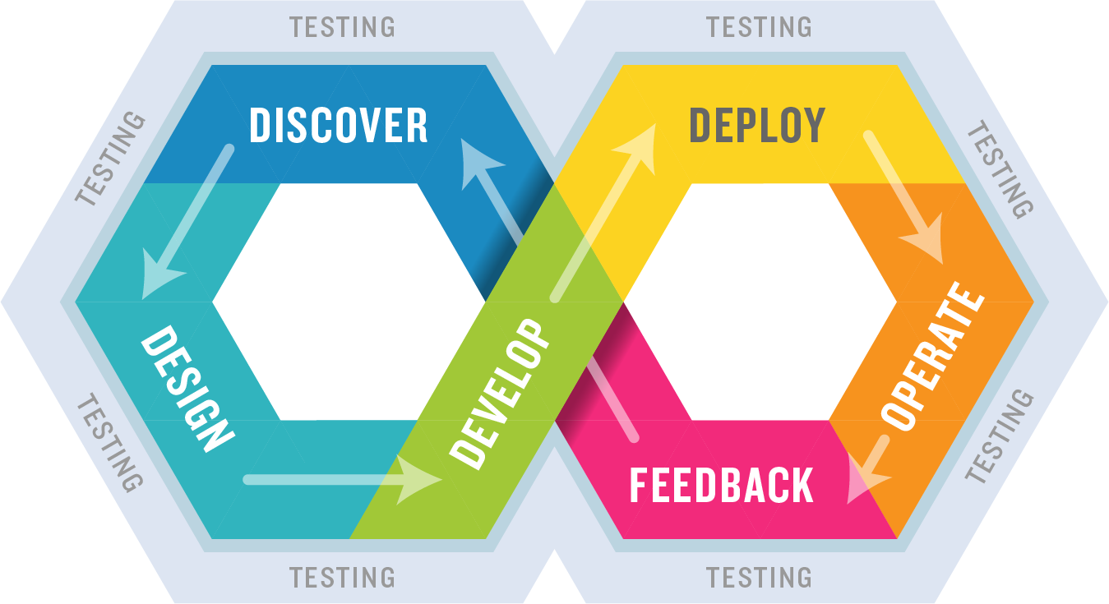
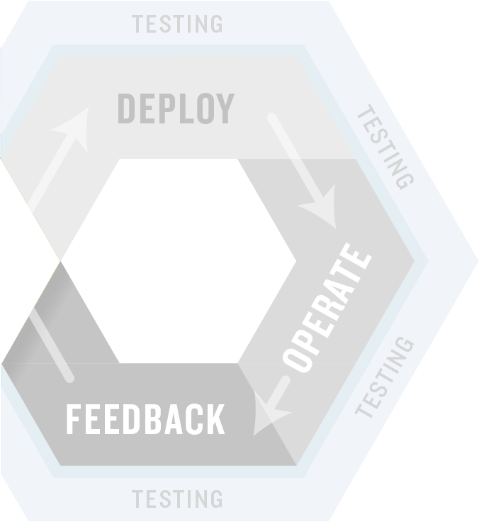

Shifting Left

Slide 20
Shifting Left
Shifting Left is about removing downstream blockers and finding and fixing defects closer to where they are introduced.
Enabling testing activities
Test driven development (ex: TDD and ATDD)
Identify security issues during dev (ex: code scanning, web security testing, secure unit testing, open source)
Profile performance of code (ex: performance testing)
Comprehensive testing in dev environments

Slide 21
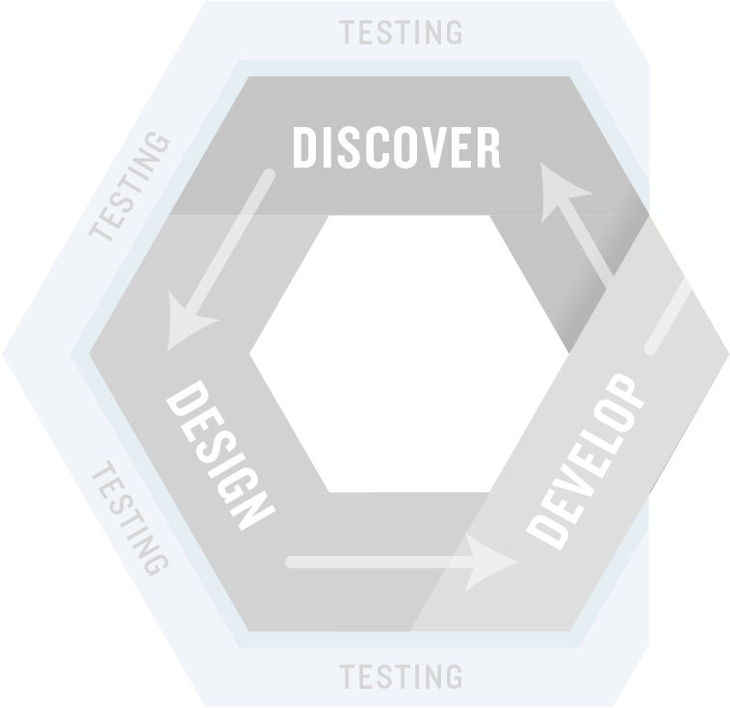

Shifting Right

Slide 22
Shifting Right
Shifting Right is about leveraging customers and access to production data to test effectively and support feedback loops
Enabling testing activities
Customer feedback on features (ex: A/B and Canary Testing)
Monitoring and healing production issues
Usability and experience (ex: usability testing, UI/UX)
Customer satisfaction (ex: NPS ratings, engagement, adoption)

Slide 23
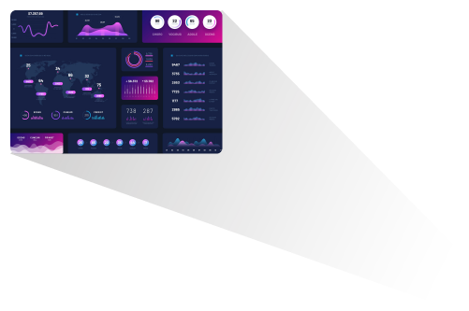
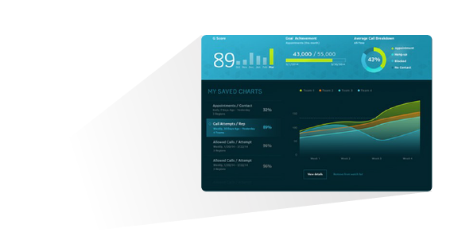
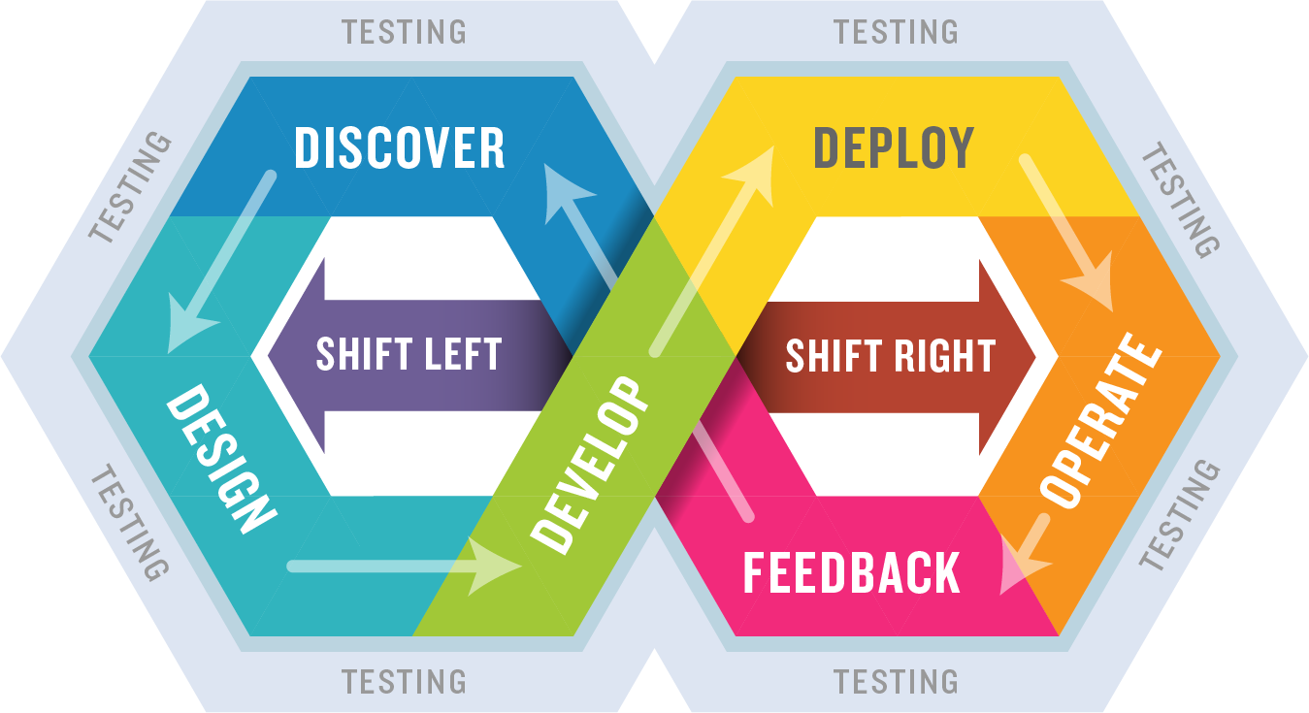

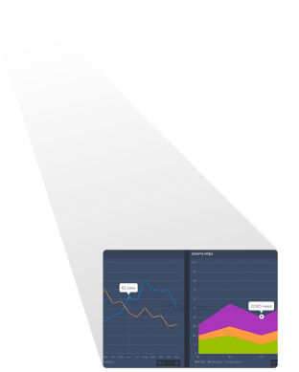
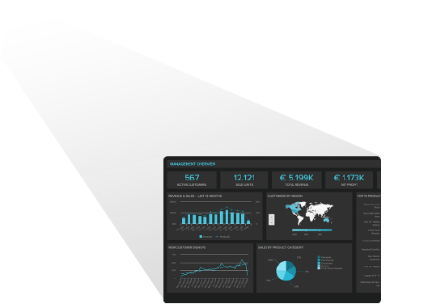
Adding Business Value

Slide 24
Adding Business Value
Adding business value focuses on presenting testing results in a business context to support business decisions
Enabling testing activities
Dashboards that align testing results with DevOps metrics
Dashboards that track the success of our testing in business terms
Techniques to align testing with business value / need
Testing focused on mitigating business risks

Slide 25
Continuous Testing: Reality #3
Siloed testing organizations will not be successful performing continuous testing

Slide 26
Seven Continuous Testing Enablers
Whole team quality
Production-like environments (cloud if possible!)
Build orchestration / Continuous integration
Automated testing below the UI
Service virtualization / emulation / simulation
Infrastructure as code and/or container orchestration
Test data management

Slide 27
Continuous Testing: Reality #4
Investment in enablers are essential to your continuous testing success

Slide 28
What Your Boss Needs to Know
You will not realize significant benefits from DevOps without continuous testing
DevOps without continuous testing results in continuous bugs
Continuous testing ≠ 100% test automation
Although significant automation is important
Siloed testing groups will not be successful
Outsourcing testing as a function will not be very effective either
Investment in enablers are essential to your continuous testing success
You cannot shift left or work continuously without them
Notes:
Low performing organizations are 3.9 times as likely to outsource functionality [DORA]
Low performing organizations are 3.2 times as likely to outsource QA/testing [DORA]
Highly evolved orgs are 44x more likely to reuse testing patterns [Puppet]
On average, orgs are spending as much as 47% of their time in building, managing, maintaining, and decommissioning test environments.
36% of respondents spend more than 50% of their testing time in searching, managing, maintaining, and generating test data

Slide 29
Thank You!
Contact Information:
Jeffery Payne
jeff.payne@coveros.com
@jefferyepayne
Notes:
Feel free to contact us any time. We love to hear from students and discuss topics.

