Slide 1


Spira Admin 1
Introduction to being a Spira admin
@Inflectra | #InflectraCon
Notes:
Welcome to Spira Admin 101

Slide 2

Simon Bor
Head of Products, Inflectra

Slide 3
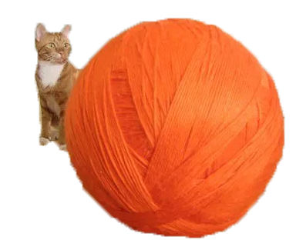
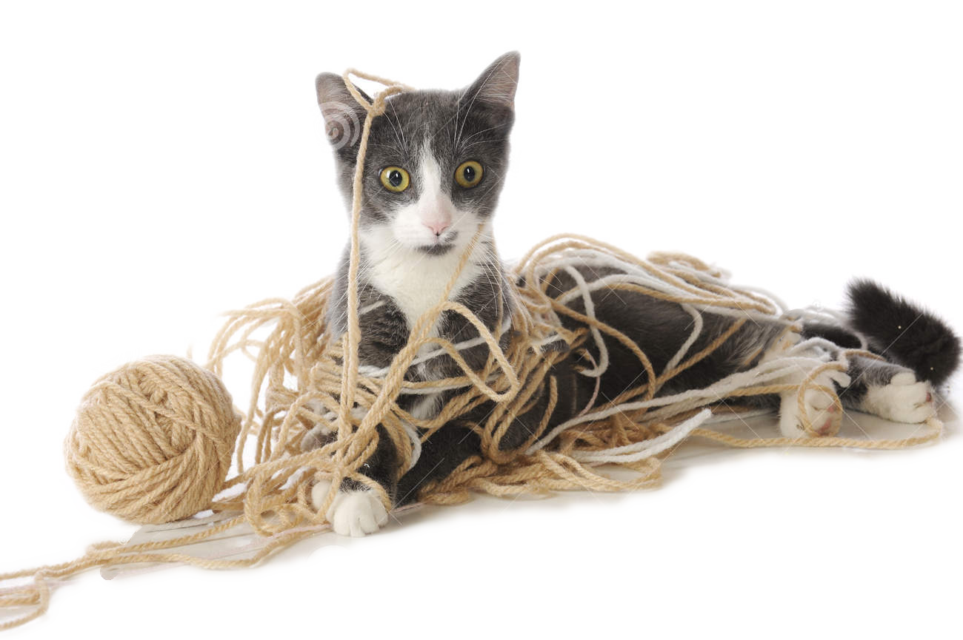

Session Aims
Notes:
Over the next 40 minutes we’re going to look under the hood at how Spira runs and the power we give you to get it running just the way you need.
My goal is to give you a roadmap for finding your way around Spira administration, and getting a better sense of what a Spira admin does.
You don’t need to be a Spira admin to get something out of this. Just knowing what options are available where has really helped me understand the tool better
I want this to be interactive, so there will be some space for questions throughout. And also prizes in the form of candy.
Can I have a show of hands - how many of you are Spira Admins? Of those who are, how many are new to being an admin?
OK next question: how many of you are cat owners? And of the cat owners, how many of you have cats who love yarn? And does anyone have a black cat?

Slide 4
… or if you want to get technical
Admin orientation
Building blocks
Users
Custom properties
Notes:
We are going to cover 4 things – starting with an abstract overview, and then walking through some basic tasks in the application itself.

Slide 5
Admin orientation
Notes:
OK first question: how many different parts are there in Spira administration – specifically SpiraPlan (it has more than the others). Just guess a number and whoever is closest gets some candy.

Slide 6
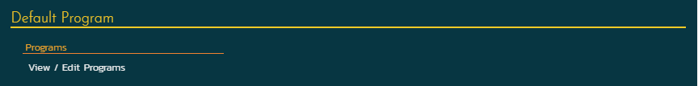
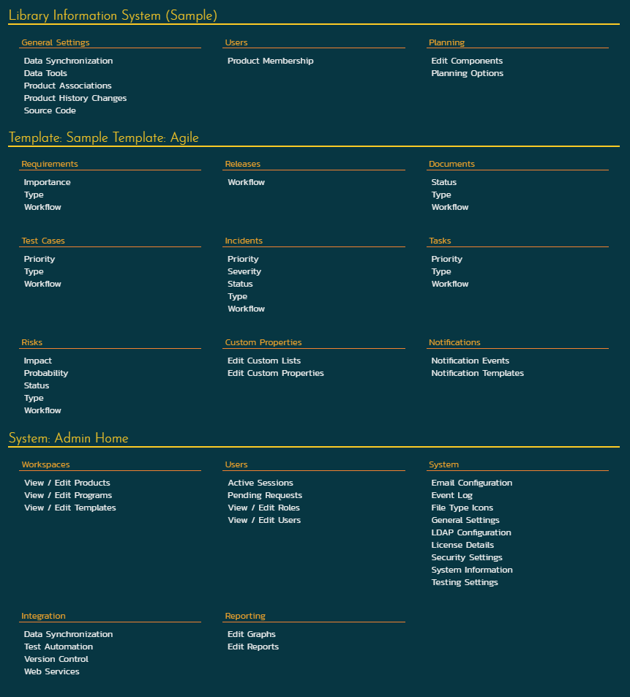
changing fields
reports & charts
workflows
statuses
membership
security
emails
Notes:
The answer is 58! That’s a lot. I’ve used or checked things on all of them, but there’s no way I could list them all. Together they help control and tailor who can use what, how each product is set up, and more.

Slide 7




The four sections of Spira admin
Product
Template
Program
System
Notes:
Let’s break it down into more manageable bits. 4 is a lot easy to talk about than 58.
As of 6.0 there are 4 parts to admin: administering products, editing the templates that control products, the programs that you group products in, and then the system

Slide 8
Product Membership
Components
Data syncs
Planning
History of changes
Product
Template
Program
System

Slide 9
Workflows
Field settings
Custom fields
Notifications
Product
Template
Program
System

Slide 10
Product
Template
Program
System

Slide 11
Users
Roles
Making products & programs
Integrations
Custom reports
Security
Product
Template
Program
System

Slide 12
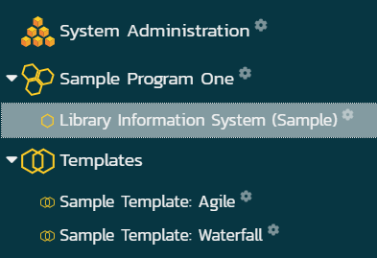
How to know if you are an admin
Notes:
The key is to look for the cogs

Slide 13
Building blocks

Slide 14
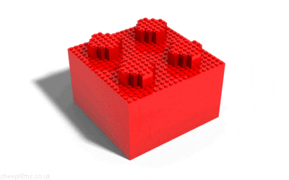
Notes:
Let’s walk through doing some basic stuff – a few steps that are pretty common for a system admin to do

Slide 15
… or if you want to get technical
1
Make a new product
2
Choose its template
3
Make a program
4
Add the product to the program
Notes:
OK this is a tough question: can anyone guess what this abstract diagram says we are going to do?

Slide 17

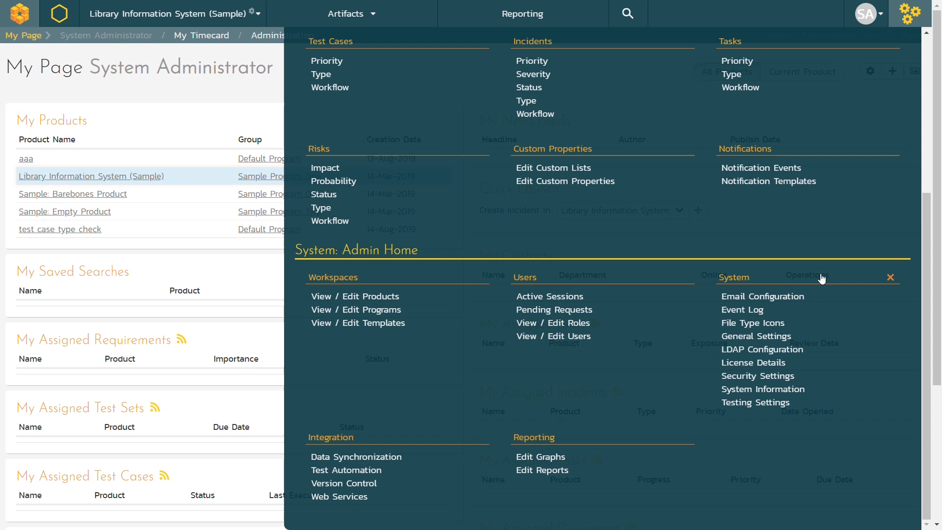


Notes:
If you are a system admin, whenever you open the admin menu, you will see the system admin menu options at the bottom.
In our first step we’re going to make a product.

Slide 18
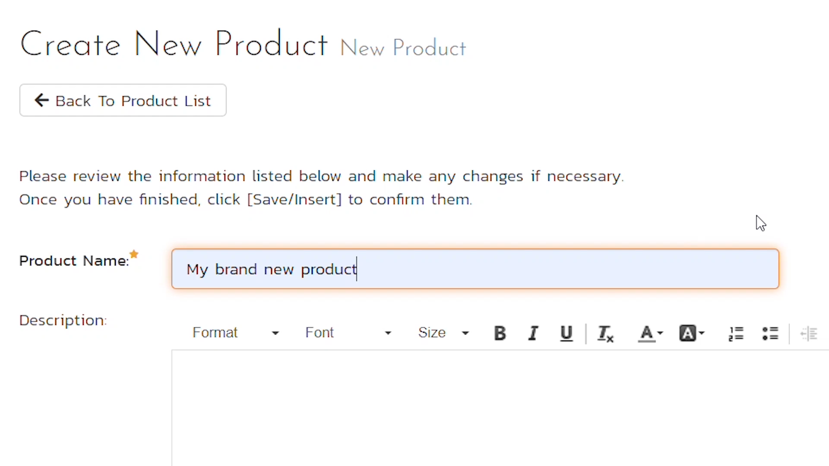

Slide 19
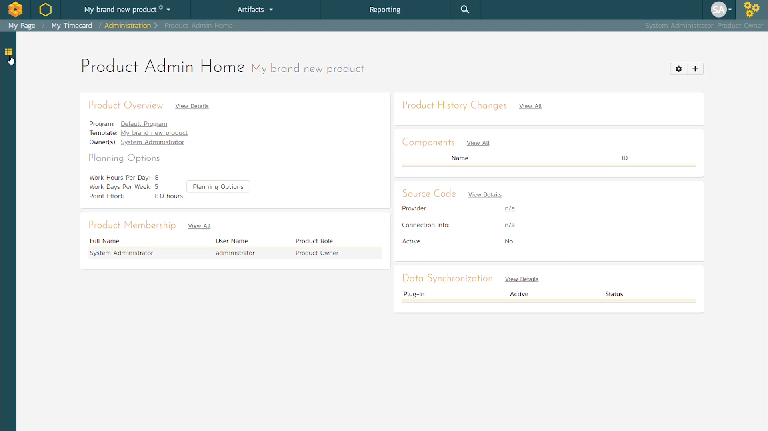

Slide 20
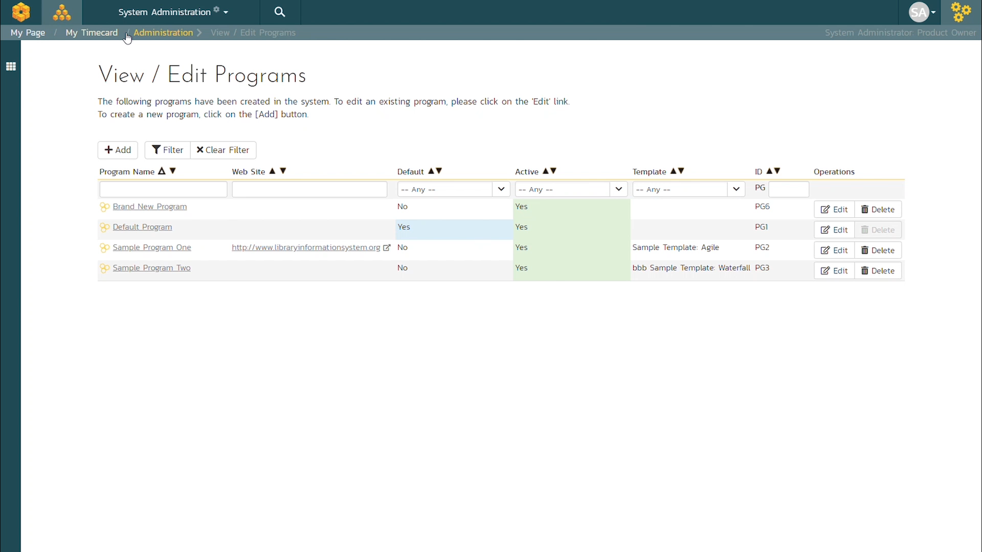

Slide 21
Users

Slide 23
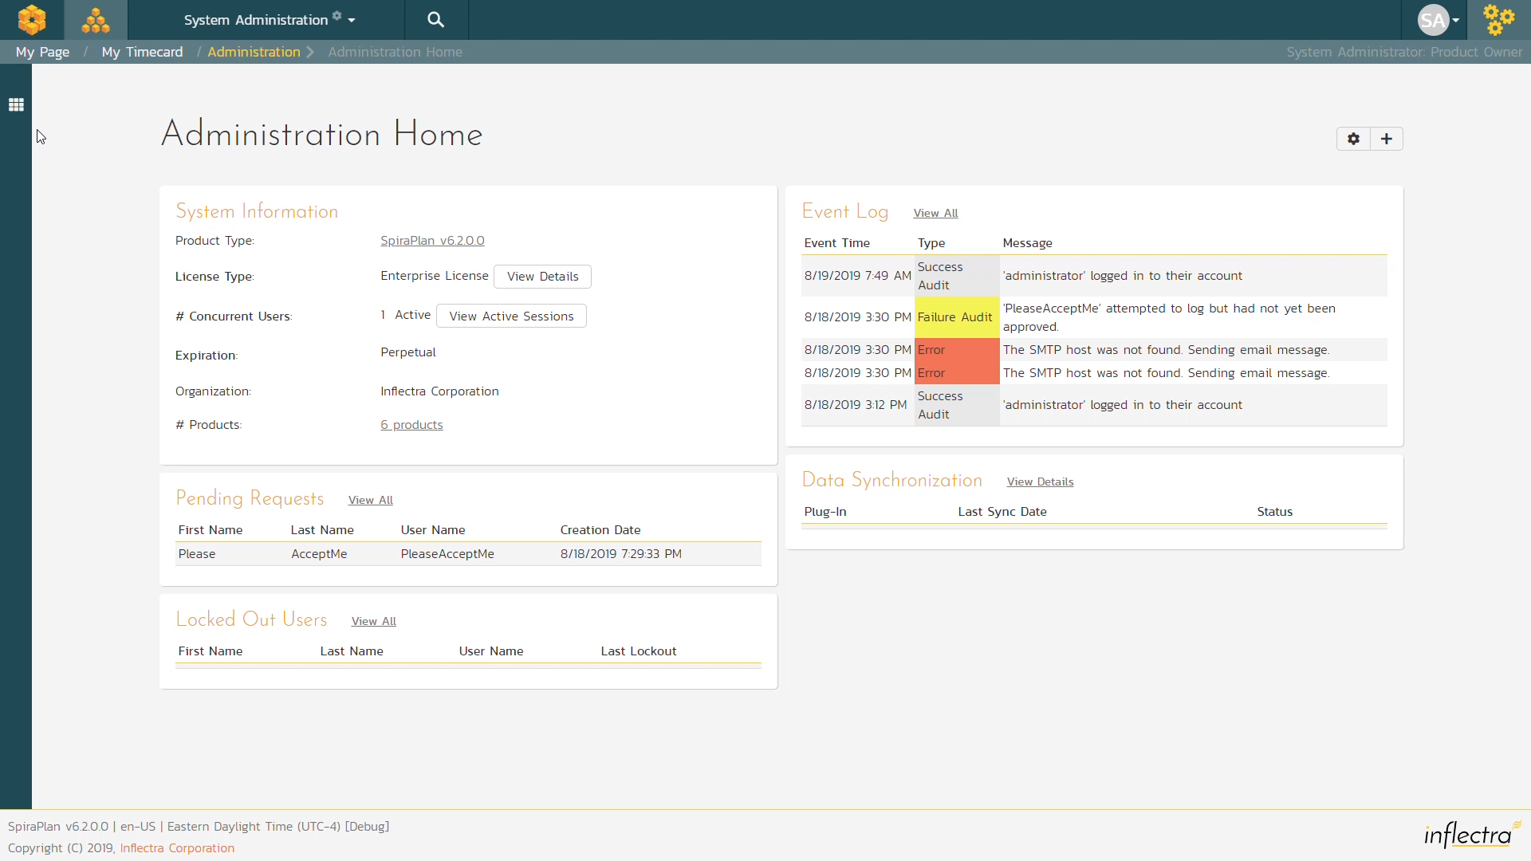
View users

Slide 24
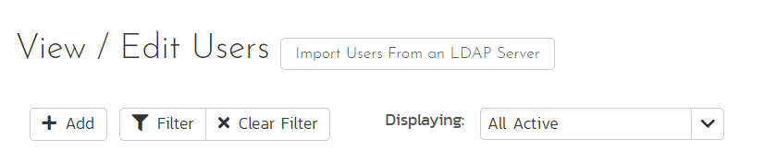
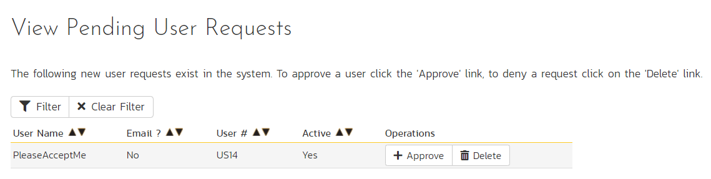
Add Users Two Ways

Slide 25

Who can do what: user roles
Product admin
Template admin
Limited view

Slide 26
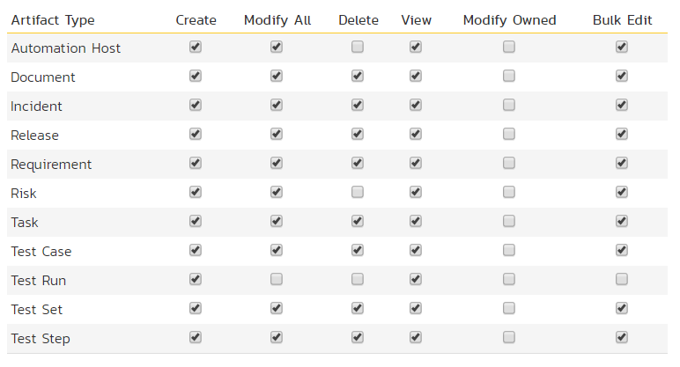
Role permissions

Slide 27
How many user roles are possible?
295,148,000,000,000,000,000
Notes:
For a quick bonus – can anyone actually ready out that number? I had to look it up btw

Slide 28
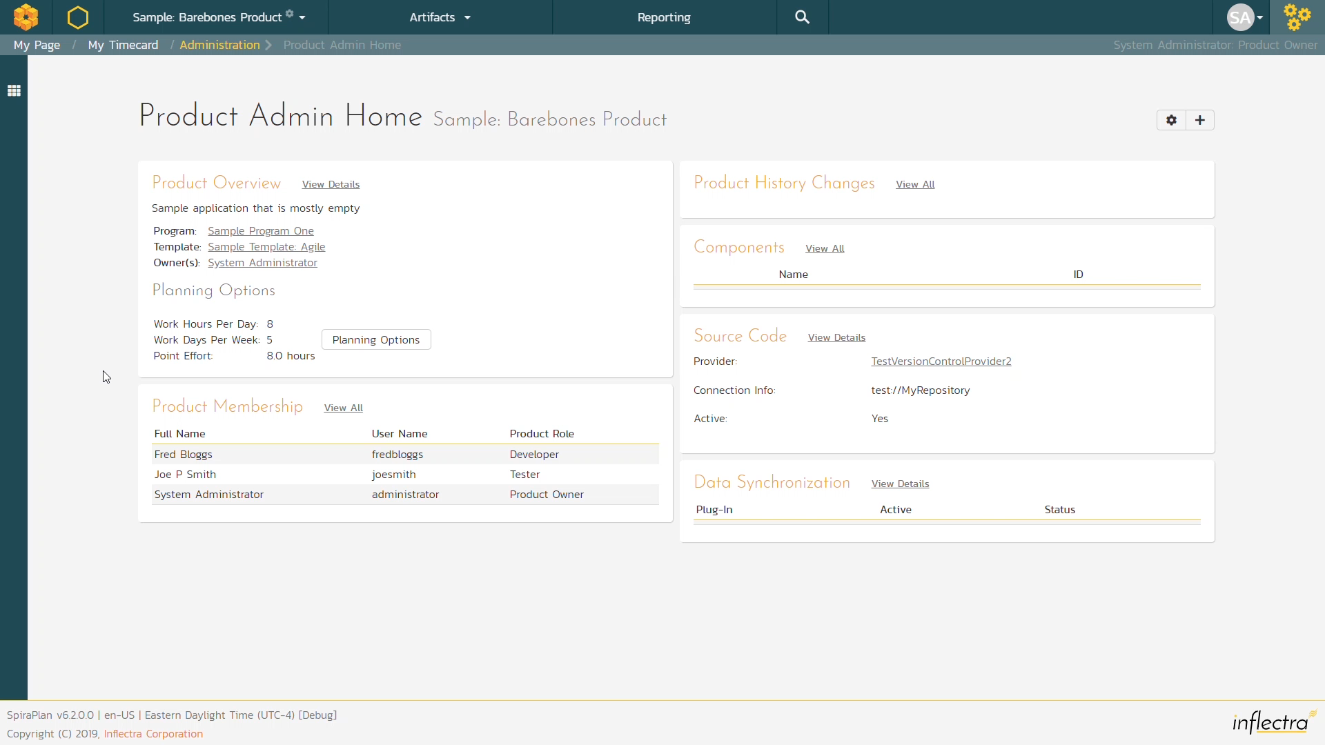
Adding Users to a Product

Slide 29
Custom Properties
Notes:
We’ve made products, looking into users, and now we’re in the home stretch. Custom properties are a way to add extra fields to many parts of the system

Slide 31
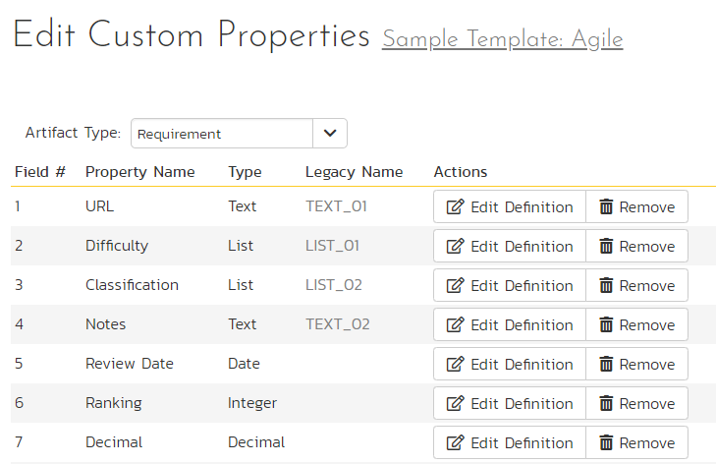
Finding custom properties
Notes:
Each artifact type, for each template can have up to 30 custom fields. That’s a lot. You access all of them from this one page – and select the artifact you want to add them to

Slide 32
Custom property types
text
numbers
true/false
date
list/multilist
user

Slide 33
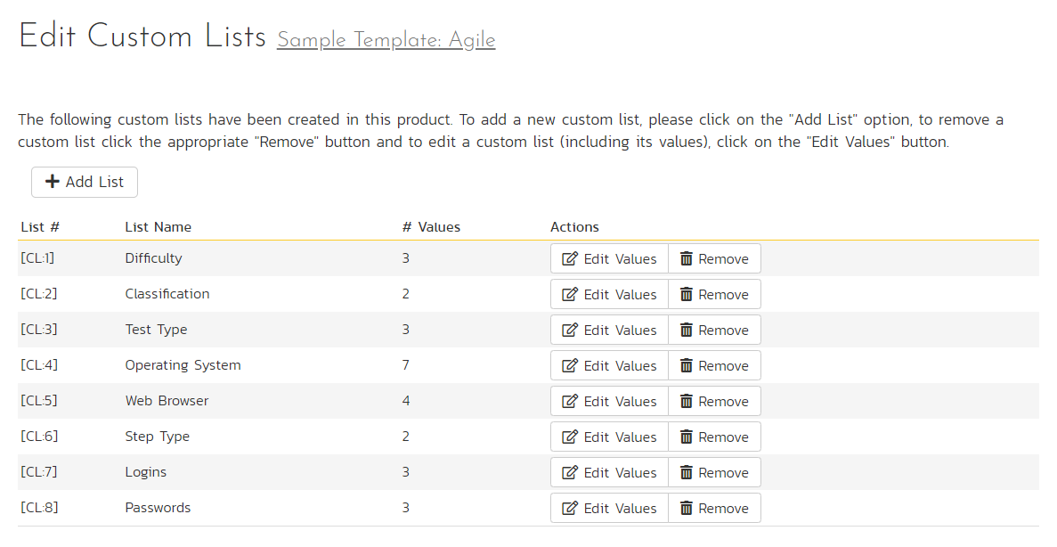
Custom lists
Notes:
The lists are special – you set them up separately from the custom properties. You can have as many custom lists as you want, and can use the same list across different custom properties and artifacts

Slide 34
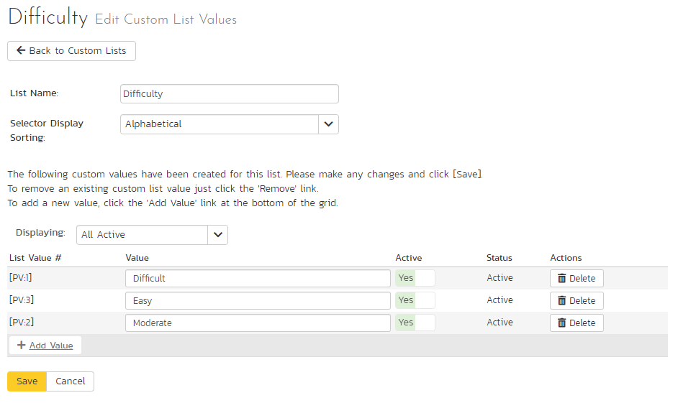
Custom lists
Notes:
The lists are special – you set them up separately from the custom properties. You can have as many custom lists as you want, and can use the same list across different custom properties and artifacts

Slide 35
Final tips

Slide 36
You can learn a lot from the admin menu / spiradoc.inflectra.com
System admins: make a dummy private product and template to play with
Admin 2 will be a deeper dive

Slide 37
Admin in 4 parts
products, templates, programs, system
Common admin actions
make a product, with a new template, add it to a program
Manage users
add, edit, approve, manage roles, add to products
Custom fields
30 per artifact per template, as many lists as you want

