Slide 1


Spira Admin 2
Advanced Tips
and Tricks
@Inflectra | #InflectraCon
Notes:
Welcome to Spira Admin 2

Slide 2

Simon Bor
Head of Products, Inflectra
Notes:
For those who weren’t here for admin 101 – I’m Simon

Slide 3



Session Aims
Notes:
Hopefully all of you here, can now say you know how to find things in Spira admin. Now we are going to take it to the next level. By the end of this session you should understand the majority of Spira’s administration. We only have 40 minutes so let’s get started.

Slide 4
… or if you want to get technical
Artifact fields
Workflows
Emails
Security
Notes:
With these four areas – and what we’ve already covered, you can easily bend Spira to your will. And if you get a chance to practice playing around with these in person and become experts you can solve probably 25%+ of the questions that our support team get – permissions and workflows are that important to how Spira works.

Slide 5

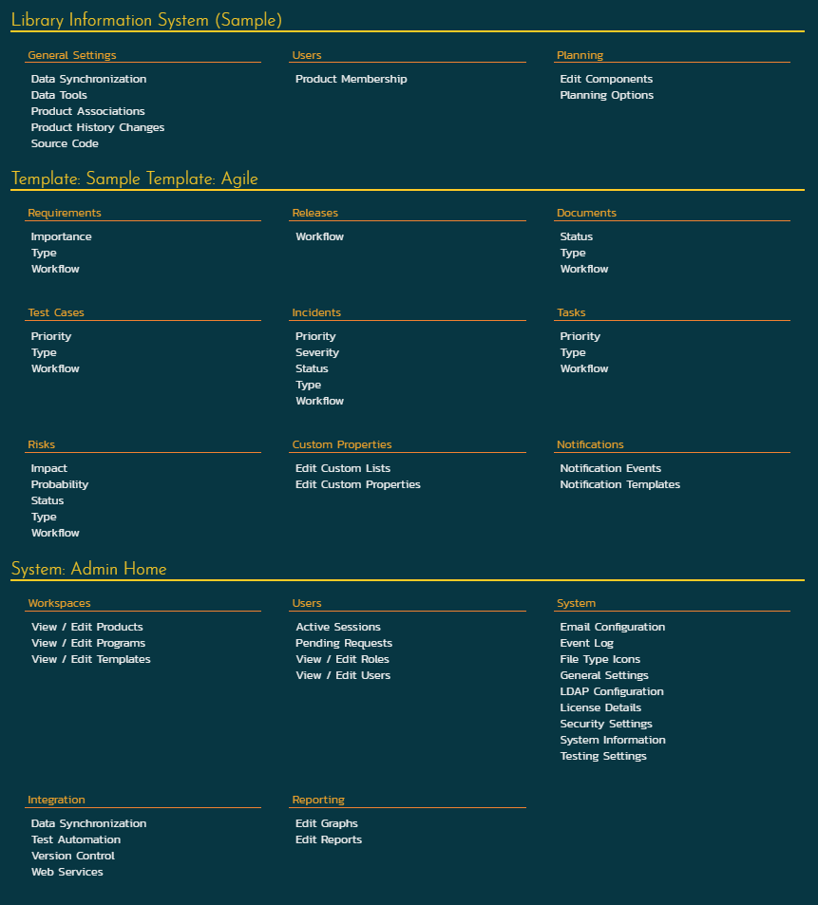

Slide 6
Artifact fields

Slide 7
Notes:
There are about a dozen different types of artifact in SpiraPlan, a few less in SpiraTest. Of these, about half have fields that you can manage at the template level – like we discussed before these are templates that can be shared across any number of products in the system

Slide 8



There are three types of field
Ranking
Statuses
Types
Notes:
Together these fields help do things in the application like:
Easily find the most important bugs that need to be fixed
Manage who can mark an enhancement as valid and worth considering for implementation
We will look at how each of these three types work individually, and then connect them to the workflow

Slide 9
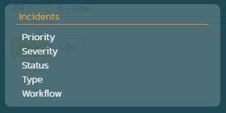
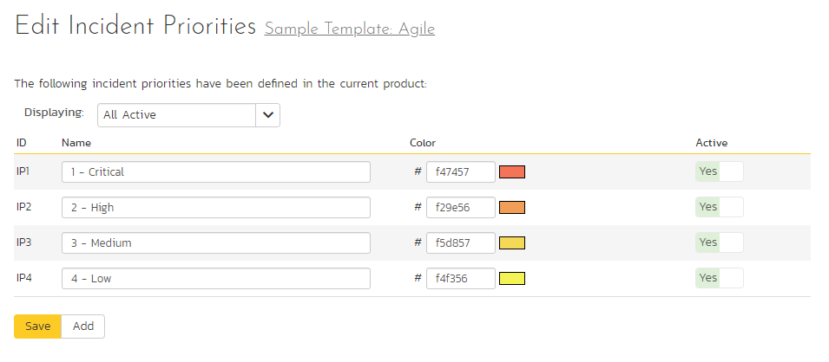
Incident ranking example
Notes:
These fields let you set importance, priority, things like that. They are mostly discreet scales, meaning you give a name but you can also set a score – to determine the relative positioning or ranking, as well as a color to help in identifying things in the UI.
If you make a change here it is immediately reflected everywhere for all users accessing products that use that template

Slide 10
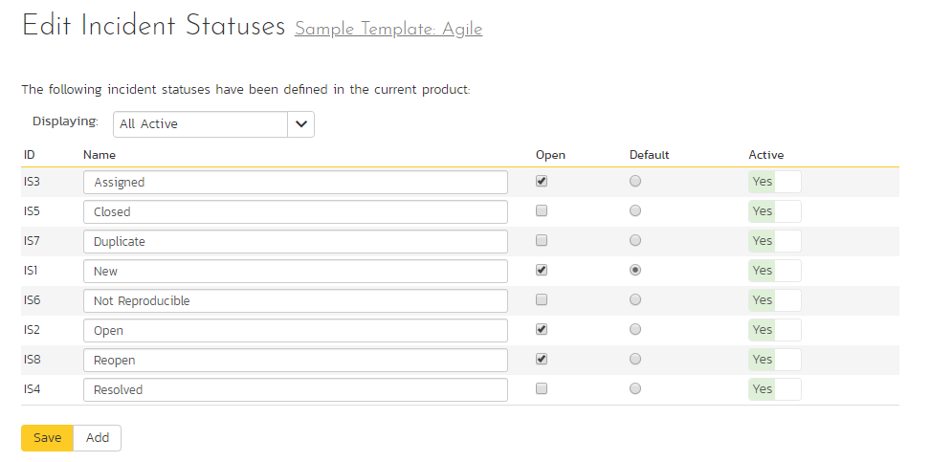
Incident status example
Notes:
Statuses tell you where an artifact is in the process. If types are the what, then statuses are the when/where
For a number of areas like incidents, you can define what statuses mean open (ie work that needs to be done) and closed (work that is done or does not need to be done)

Slide 11
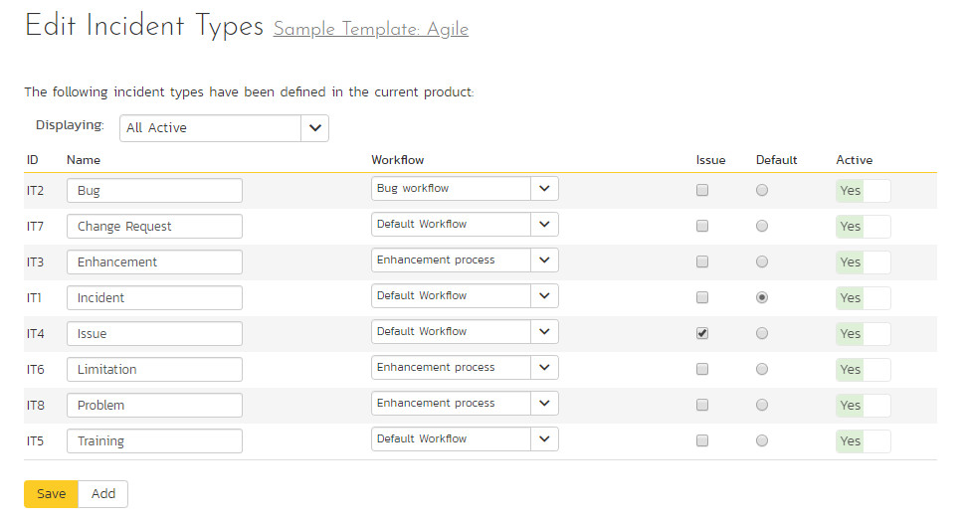
Incident type example
Notes:
Types give their items, eg incidents, more logical organization.
You of course can give each a name.
And importantly you use types to control the workflow. We will get to this later.
You can sometimes set special attributes to an artifact via its type: for instance, an issue has special significance to incidents, you can set which test case types set a test to be an exploratory test case in the system, or which requirement types should have steps – such as for a use case
Finally, because types have such significance to a workflow they have to be defined, so you need to set one to be the default

Slide 12
Workflows

Slide 13

Notes:
There are a handful of really powerful parts of administration – power to get things running smoothly with a little know how. Or the power to get really confused if you don’t have those way points.
I put product roles, workflows, notifications, and custom reports in this bucket. I gotta confess that workflows was the part of the system that took me the longest time to get my head around.

Slide 14
… workflows in 3 easy steps
1
Multiple workflows
2
Statuses / steps
3
Transitions
Notes:
OK this is a tough question: can anyone guess what this abstract diagram says we are going to do?

Slide 15
But what is a workflow? Example 1
Requested
Under Review
Accepted
Rejected
Notes:
This is a pretty simple start to a workflow that you can take a requirement through.

Slide 16
Requirement workflow 2
Requested
Accepted
Under Review
Planned
Rejected
Notes:
This is now a bit more of a complex flow. Here we are only showing 5 statuses. In reality, you have 17 requirement statuses to play with – some of these are suited for some workflows, others for different workflows. You do not need to use them all.
But you could build a workflow where you could move to any status from any status, or build one where there is but one path you can take

Slide 17
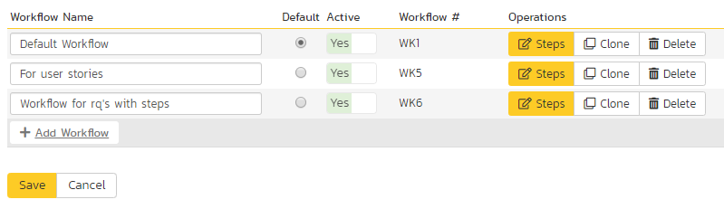
Requirement workflows overview
Use Cases
User Stories
Requirement Types, except…
Notes:
You can have multiple workflows, as we saw with the artifact types. You can have as many as you like.

Slide 18
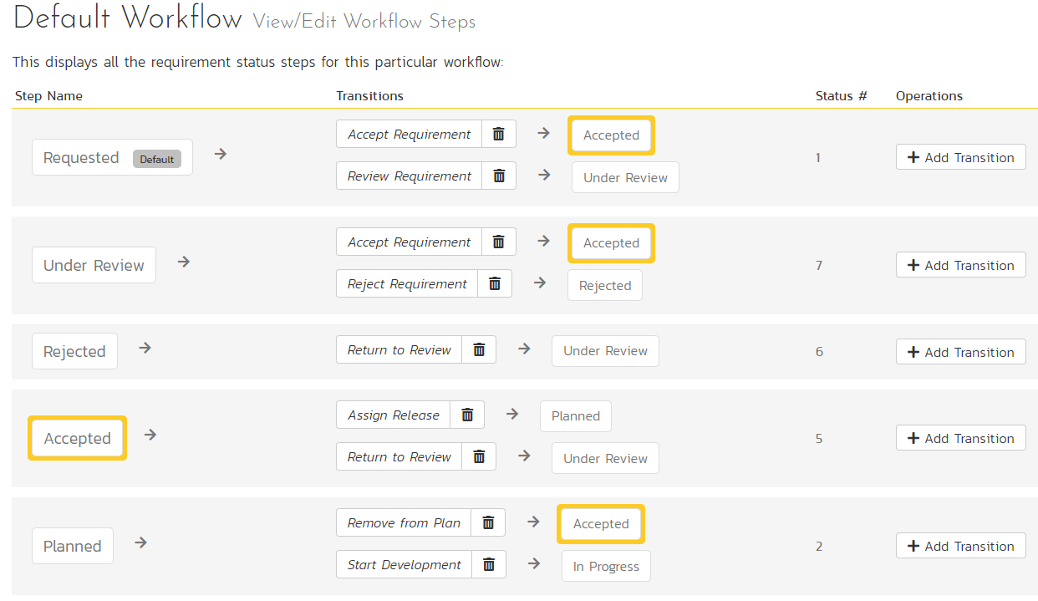
Requirement workflow in reality
Notes:
There are 3 main columns: the status you start on, the transitions you can take, and the status you end up on.
By adding transitions, you can pick new statuses to end on.

Slide 19
Requested
Under Review
Review Requirement
Accepted
Rejected
Notes:
Let’s explore just one part of this workflow to see how it works

Slide 20
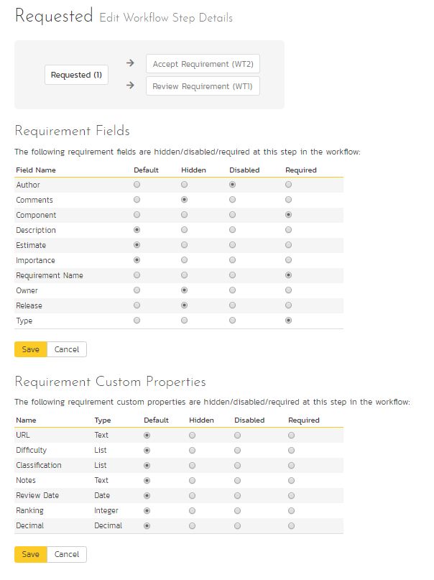
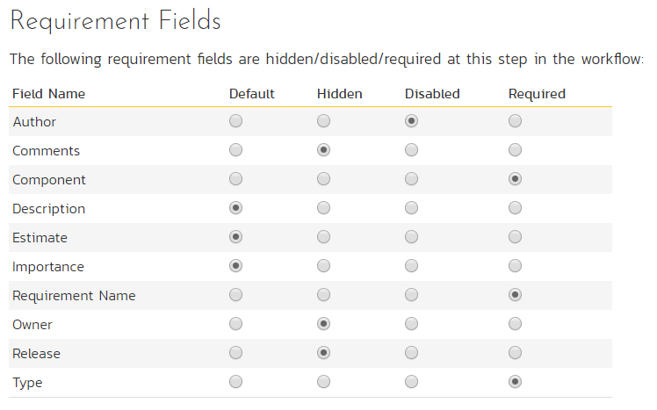
Status = requested
Requested
Review Requirement
Under Review

Slide 21
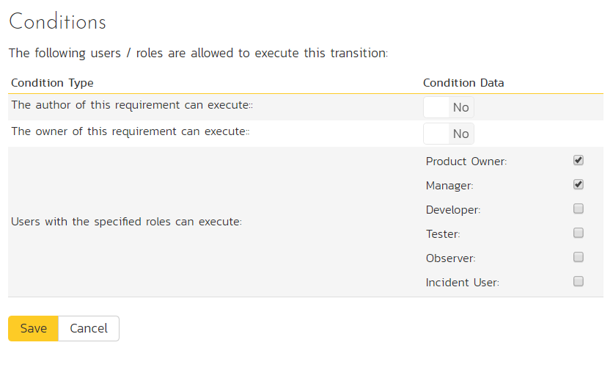
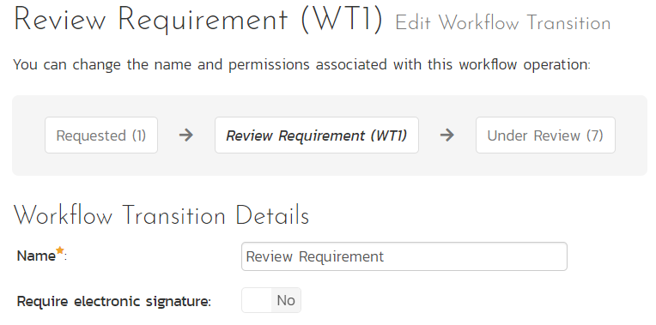
Transition = review requirement
Requested
Review Requirement
Under Review
Notes:
So the two key parts here are whether a digital signature is needed, and who can execute the transition.
For someone to be able to move from requested to under review, they need to have a role in this product and for this particular artifact that matches any of these conditions.
So a tester cannot use this transition – for them this will be invisible in the UI. But a manager can see it

Slide 22
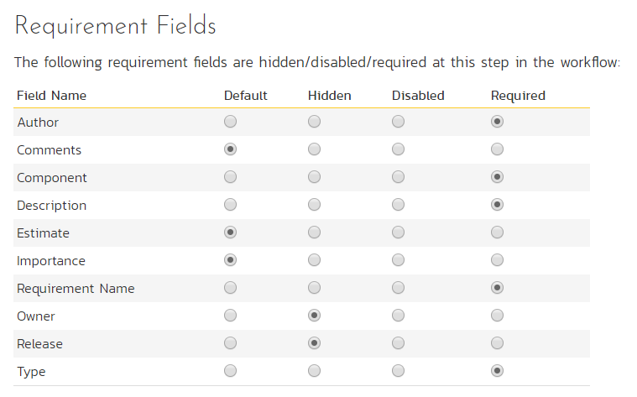
Status = under review
Requested
Review Requirement
Under Review
Notes:
Here we’ve changed the author to now be required and we let people add comments. Again, this is completely customizable, including for custom fields

Slide 23
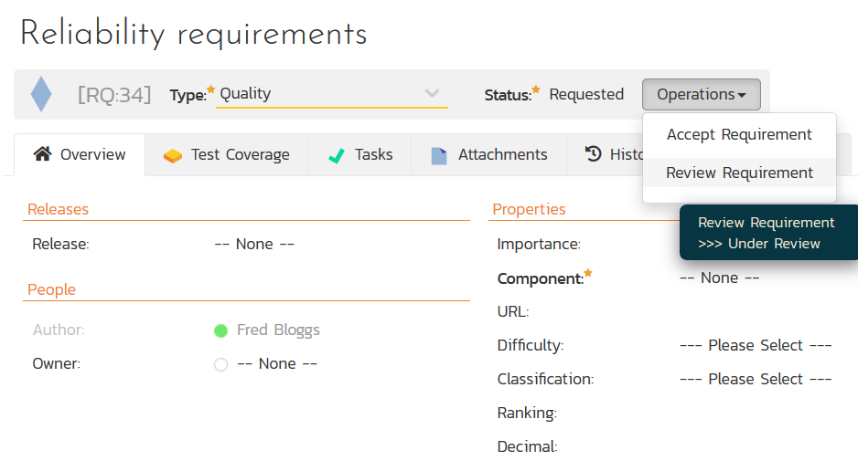
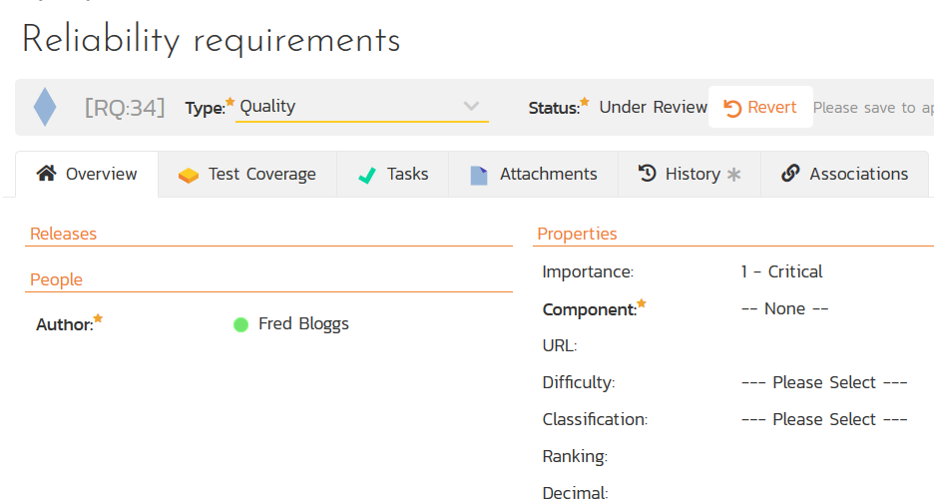
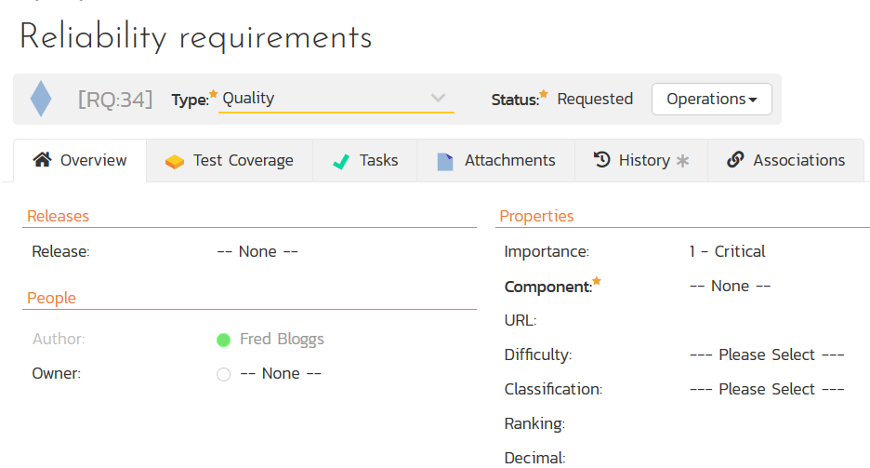
Let’s see this in action

Slide 24
Emails

Slide 25
Two parts: events and templates
Artifact changes
Event rule triggers
Email template sent

Slide 26
Email event options
Triggers on creation, on change to any field
Who gets it opener, owner, or based on role
Subject use most fields to customize
Notes:
Let’s break it down into more manageable bits. 4 is a lot easy to talk about than 58.
As of 6.0 there are 4 parts to admin: administering products, editing the templates that control products, the programs that you group products in, and then the system

Slide 27
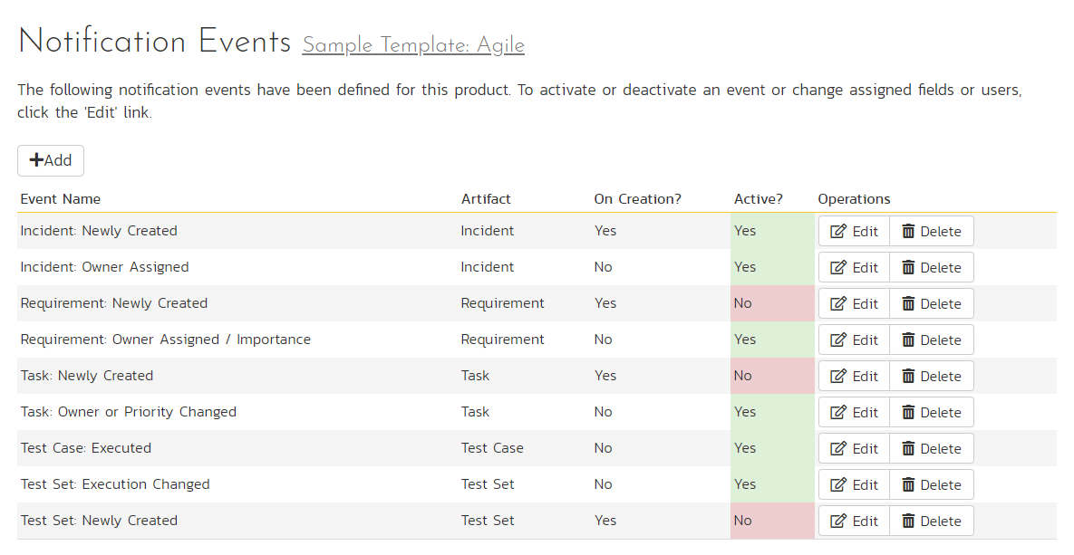

Slide 28
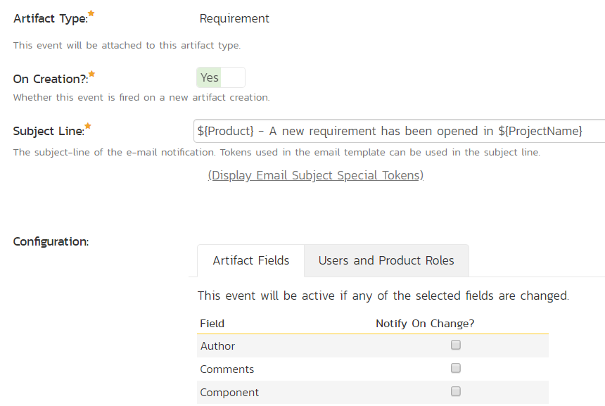

Slide 29
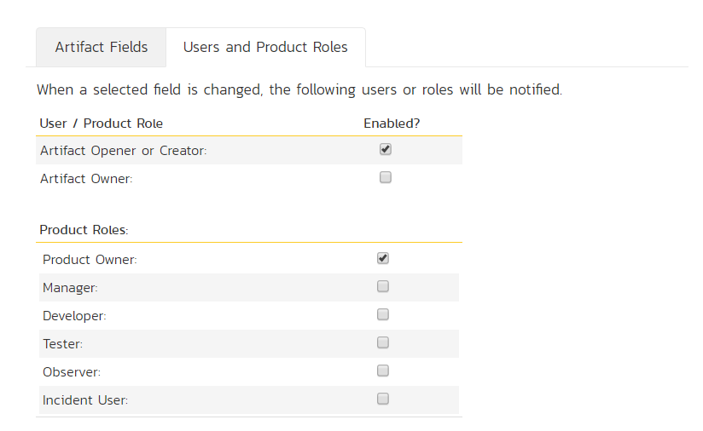

Slide 30
Email template
One per artifact
Customize with many fields
Style standard HTML – fully editable
Notes:
Let’s break it down into more manageable bits. 4 is a lot easy to talk about than 58.
As of 6.0 there are 4 parts to admin: administering products, editing the templates that control products, the programs that you group products in, and then the system

Slide 31
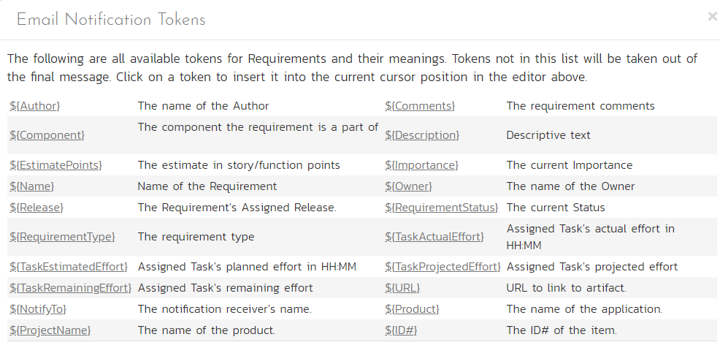

Slide 32
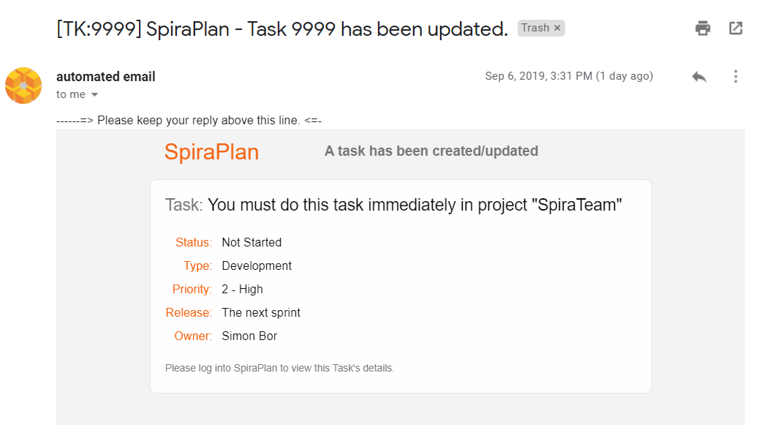

Slide 33
Security
Notes:
We’ve made products, looking into users, and now we’re in the home stretch. Custom properties are a way to add extra fields to many parts of the system

Slide 34
How to manage security
Users active, product membership, roles
Passwords format, force renewal
Logging in attempts, LDAP, OAuth
External access allowed domains

Slide 35
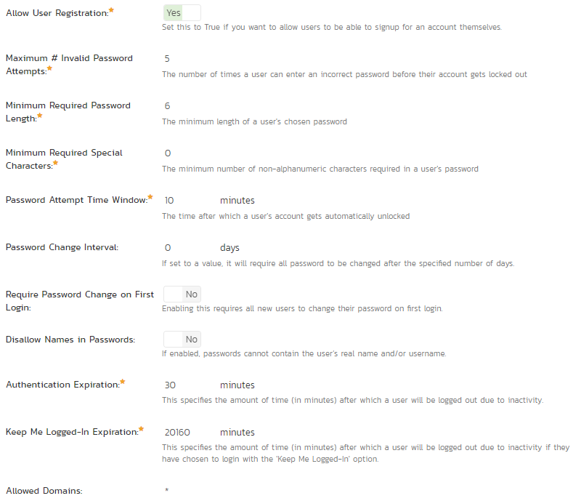

Slide 36
What to learn next?

Slide 37
Custom reporting (see session tomorrow)
Data syncing
Testing and planning settings
Source code / version control
Cross product associations
Auditing product history and undoing changes

Slide 38
Artifact fields
rank, status (workflow controlled), type (picks workflow)
Workflows
what fields you see, need, can change; who can move along the workflow
Emails
trigger on any field change you choose, email body per artifact
Security
control user access, passwords, network access

