Slide 1
Automation 1
Start Your Automation Journey With Rapise
@Inflectra | #InflectraCon

Slide 2
Denis Markovtsev
Principal Software Engineer, Inflectra
denis.markovtsev@inflectra.com
@dmarkovtsev

Slide 3
Agenda
Modern Web Applications
Rapise Demo
Creating a Test
Test Report Analysis
Maintenance of Tests

Slide 4
Modern Web Applications
Are
Hard to test?
Easy to test?

Slide 5
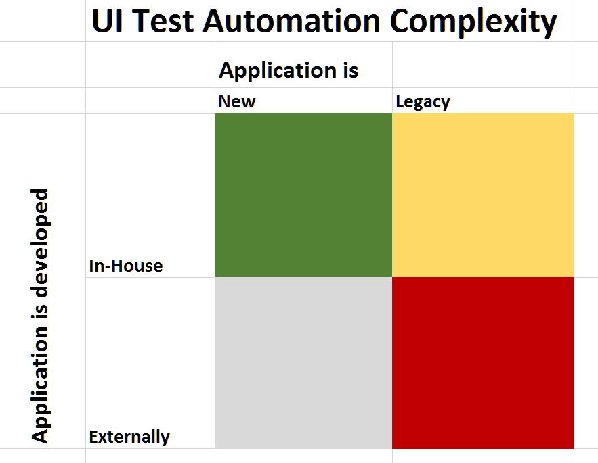

Slide 6
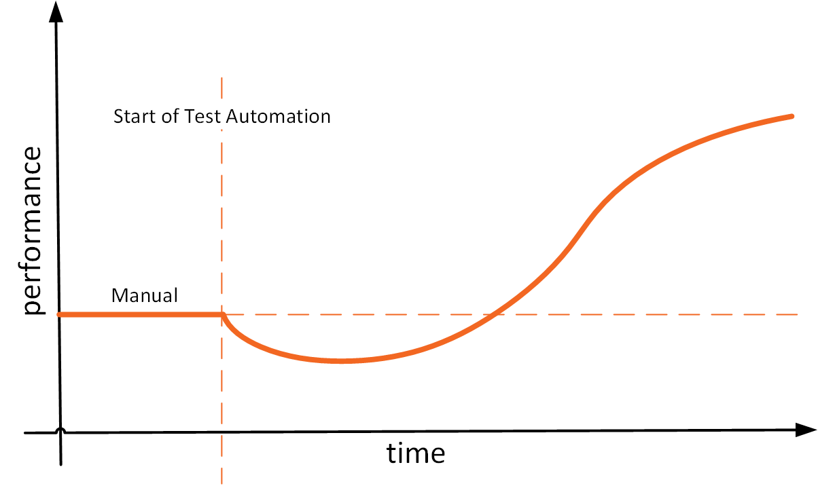
From Manual to Automated Testing

Slide 7
Automation Challenges
Identification of Elements
Input Simulation
Asynchronous Data Loading

Slide 8
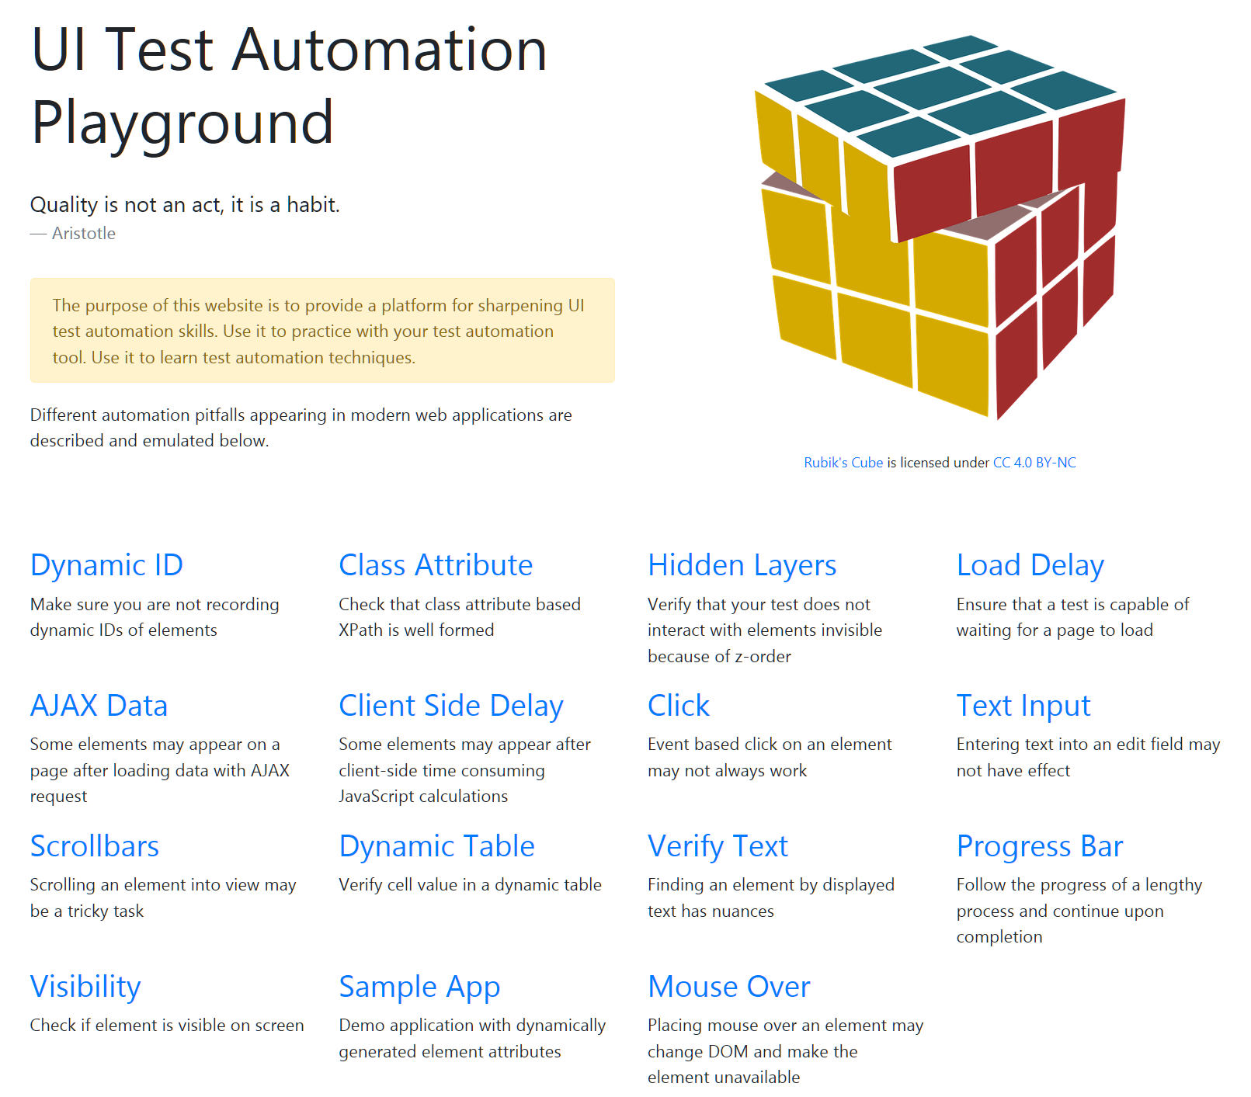
http://uitestingplayground.com/

Slide 9
Element Identification
Element locator
Is built automatically
Works after application reload
Works in data-driven scenarios
Works when application is modified

Slide 10
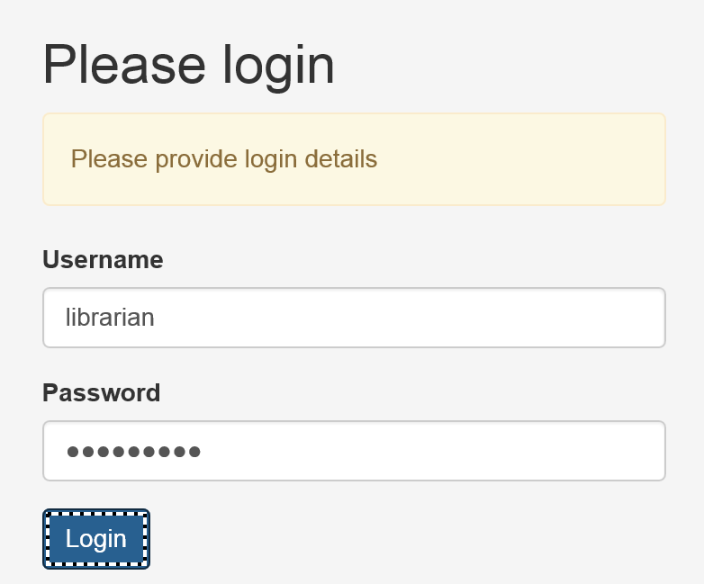
Input Simulation
DOM Events
Native Events

Slide 11
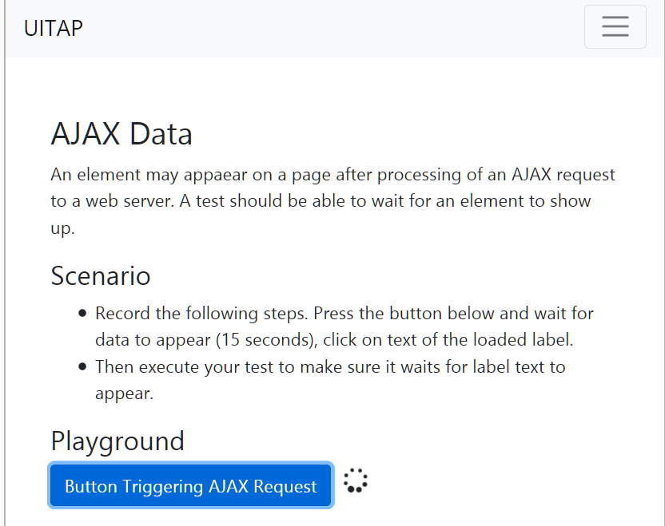
Asynchronous Data Loading

Slide 12
Don’t Panic: We Have a Solution
Rapise
Simplifies creation of a test
Reduces maintenance cost

Slide 13
Creating a Test
Recording
Modification
Playback

Slide 14
Demo: New Test

Slide 15
Demo: Test Recording

Slide 16
Demo: Test Playback

Slide 17
Demo: Test Modification

Slide 18
Test Report Analysis
Assertions
Screenshots

Slide 19
Demo: Test Failure

Slide 20
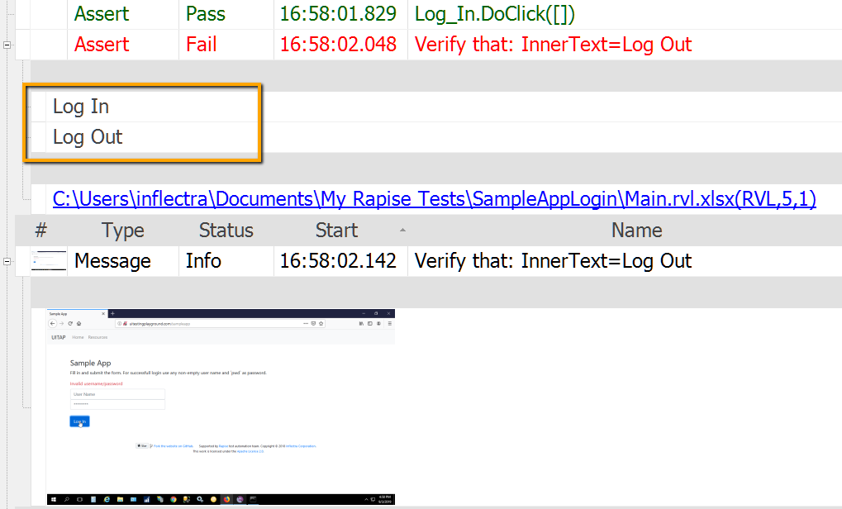
Failed Assertion

Slide 21
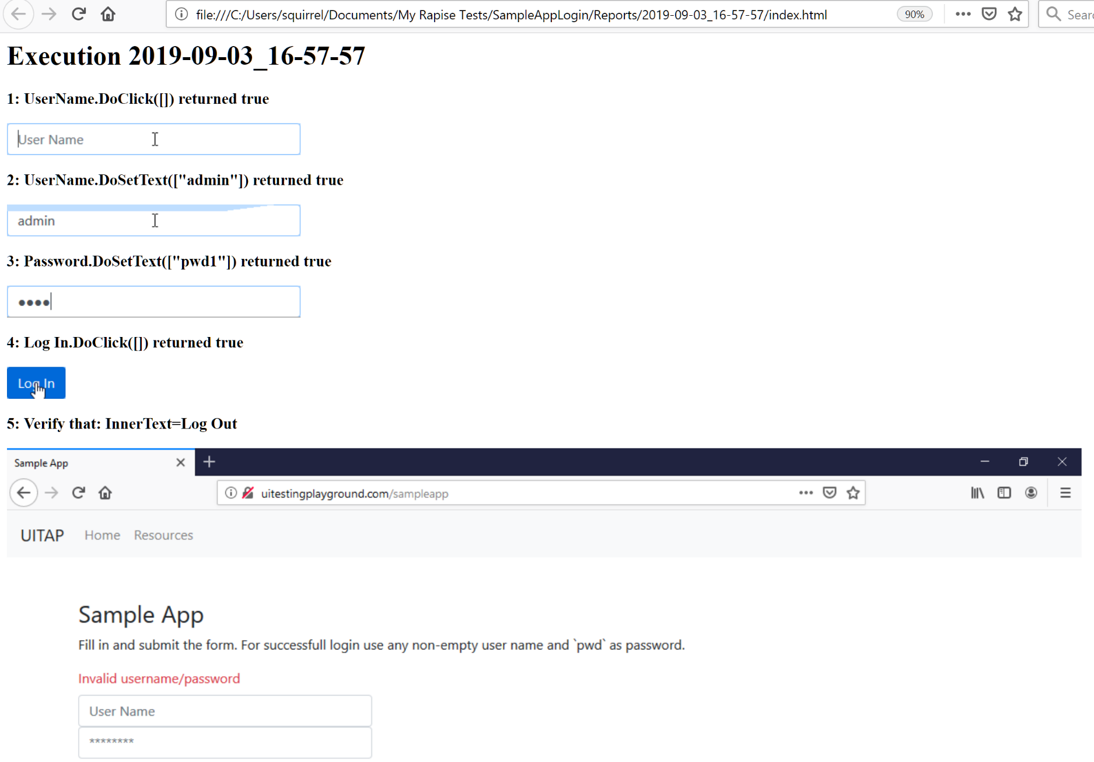
Screenshots

Slide 22
Maintenance of Tests
Flash
Re-learn
Web Application Profile
Self-Healing Locators

Slide 23
Demo: Object Not Found

Slide 24
Demo: Flash

Slide 25
Demo: Re-Learn

Slide 26
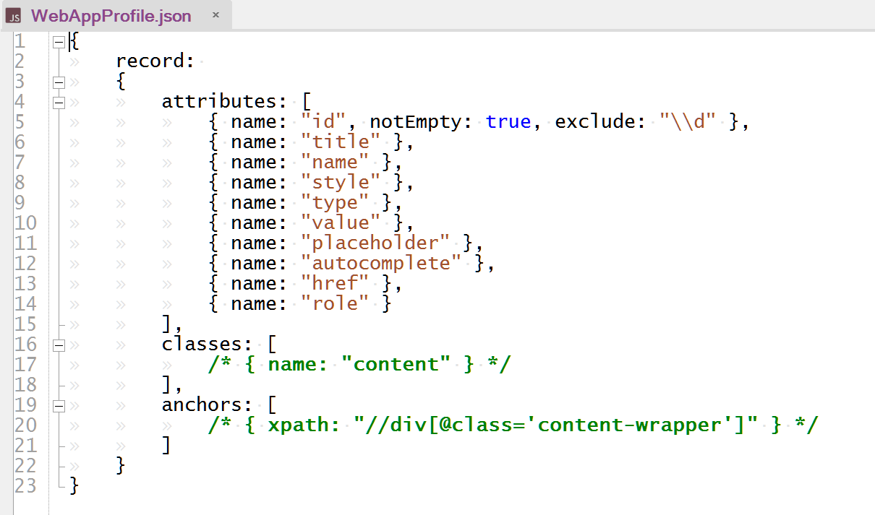
Web Application Profile

Slide 27
Demo: Web Application Profile

Slide 28
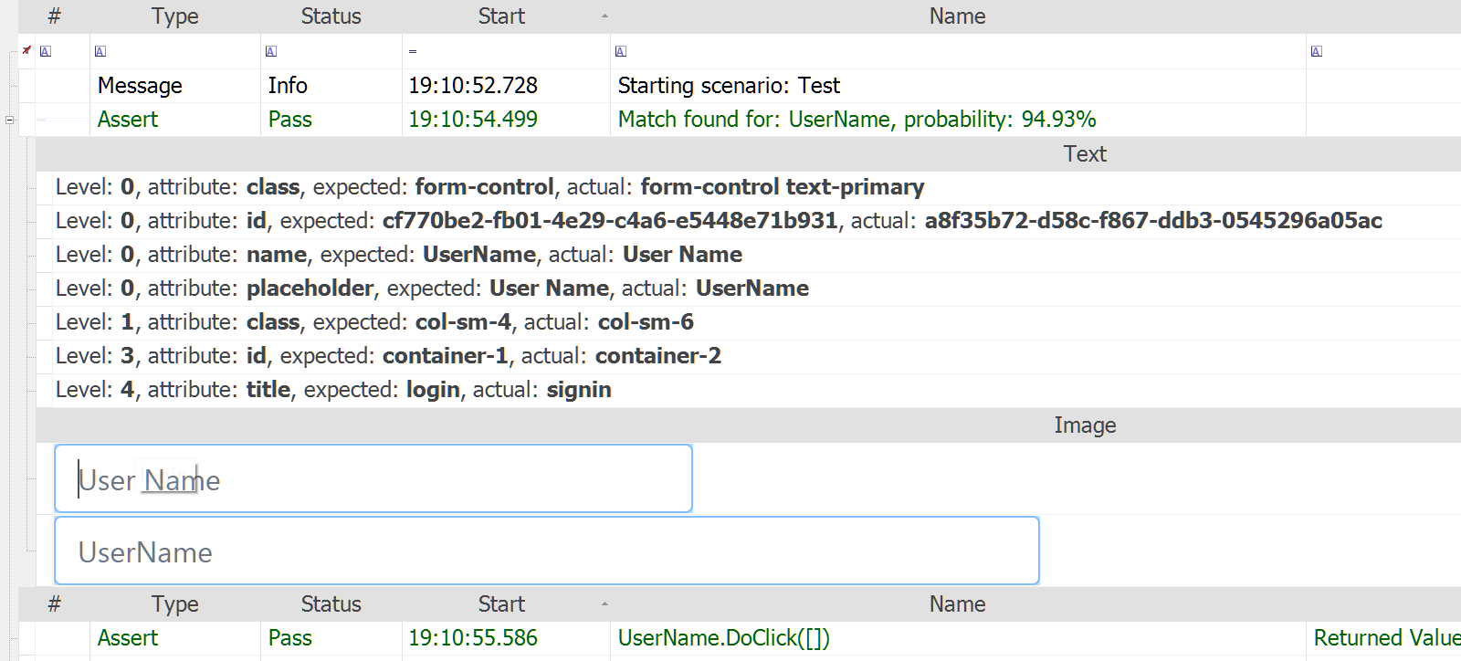
Self-Healing Web Locators

Slide 29
Demo: Self-Healing Web Locators

Slide 30
Q&A
Contact me:
@dmarkovtsev
denis.markovtsev@inflectra.com

