Slide 1
Program & Portfolio Management
@Inflectra | #InflectraCon
Notes:
Hear about the new program and portfolio features available in SpiraPlan. We will discuss how you can (and why you would want to) organize products into programs and programs into portfolios. We will cover the new dashboards and visualizations to help you plan and manage your releases and program milestones.

Slide 2
Simon Bor
Head of Products, Inflectra

Slide 3
Session Aims
Spira’s different workspaces
Our vision
Sneak peak
Feedback from you

Slide 4
Spira’s different workspaces

Slide 5
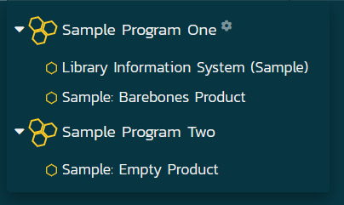
Workspaces in SpiraPlan 6.0
Product
Program
Notes:
Most of the features I’m talking about in this section have been around for a number of years. But in 6.0 we laid the foundation for radical improvements to how we can work with the different top level parts of the system.
The term we use for these are workspaces. Each workspace type has a definite relationship to each other type.
We have projects – now called products. They are controlled, as of 6.0 by templates – that manage the workflow, specific fields, notifications. Templates control the product workspace, but do not contain information themselves. The product contains the tests, releases, requirements etc.
And then we have programs, which are the next level up of organization. This workspace type sits above products - programs contain one or more product.

Slide 6
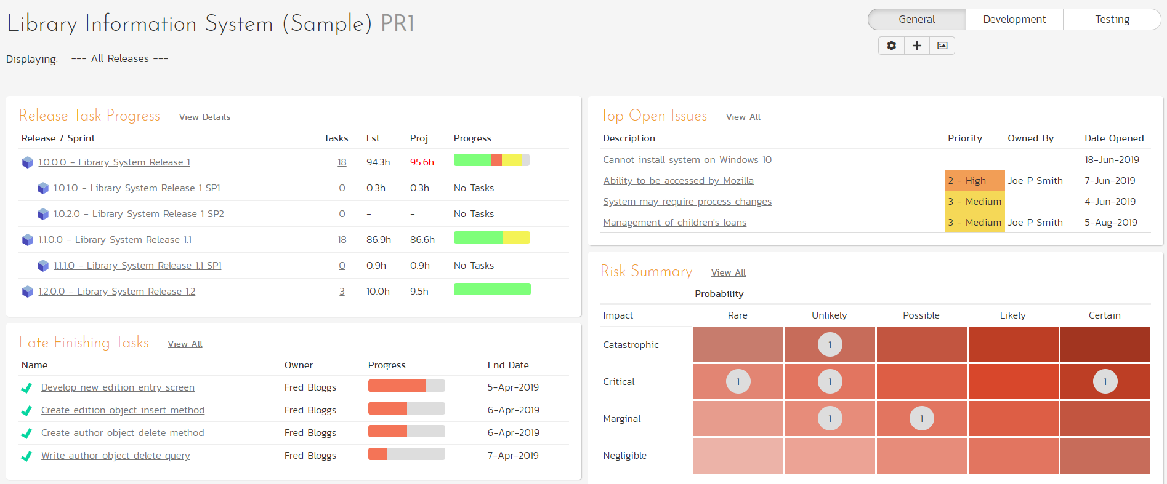
Notes:
We start at the product workspace where we can see what is going on across all releases, or for a particular release

Slide 7
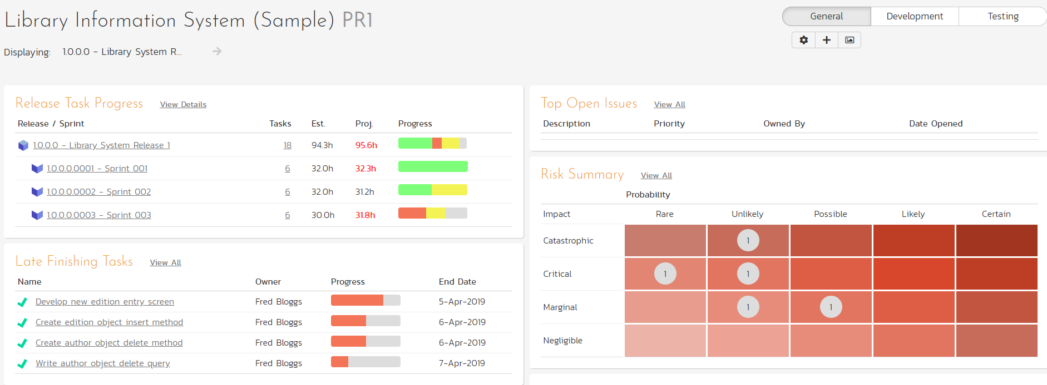
Notes:
Here’s that same product, but showing data only for one release

Slide 8
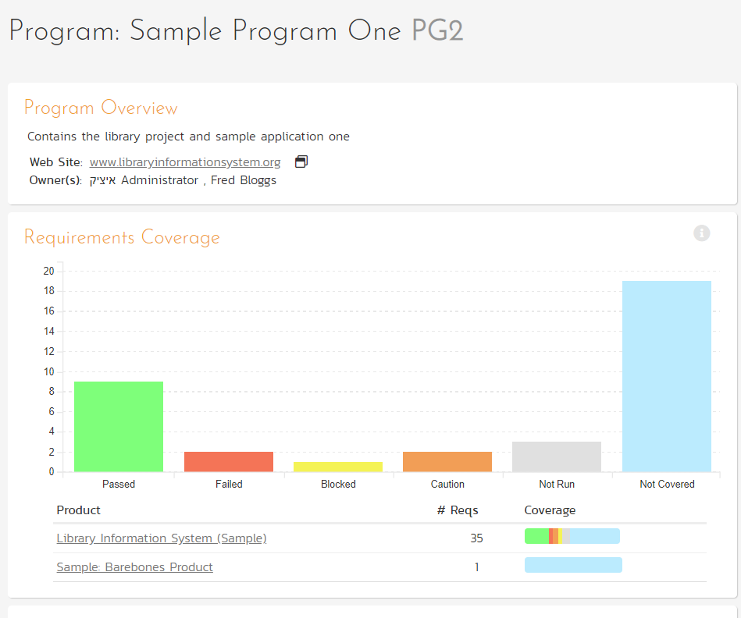
Notes:
We zoom up to the next workspace level – programs. Here we have a really simple program with two products in it. The data we can view here looks similar to that for the product, but it is aggregated in the top charts, with a mini view for each product shown beneath.
It is very straightforward to move a product into a program, or create a new program and move a number of existing products into it. Just bear in mind, that a product can only exist in one program
Programs are a great way to see across a similar set of products, or your work for a particular client. The product manager will focus on the product level, but the division manager will focus at this level.

Slide 10
Our vision
Notes:
Ok, that gets where we are out of the way, so we can get to the fun stuff. What we are going to share with you now has been a long time in the making.
We’ve had great feedback from select users from around the world on our very early thoughts.
Like I said before, v6 lays the foundation for some really big improvements. In other words, when we started the design process for 6.0 – probably close to 2 years ago, we had some of the goals we are going to talk to you about today in mind.

Slide 11
Workspaces in SpiraPlan 6.x
Product
Program
Portfolio
Enterprise
Notes:
PORTFOLIOS!
ENTERPRISE!
Will show the app itself shortly

Slide 12
What will this help you do?
Is a program of products running late?
How ‘done’ is a portfolio?
How are the big risks across an enterprise mitigated?
Notes:
Here are a few scenarios where we think this concept in SpiraPlan is going to really help you and your colleagues. Because of how we structure the application, to have test cases being distinct and logically different things to releases or requirements or bugs, we believe Spira is incredibly well placed to deliver something so useful and powerful you will wonder how you lived without it.

Slide 13
How: concept
Enterprise
Portfolio
Portfolio
Program
Program
Program
Program
Program
Product
Product
Product
Product
Product
Product
Product
Product
Product
Product
Product
Notes:
Here’s an example hierarchy that you will be able to make in SpiraPlan. Products in programs, programs in portfolios, and portfolios all in the enterprise / whole app view
Of course of each these workspace levels will have dashboards, and views of their own. Importantly they will also have a very clear way for data to flow up the tree. As we determine how complete each product is, that cascades and collects upwards to show how complete a program is, or its portfolio.
With this structure we want to show you in a simple way, the health of your delivery. So that the leaders in your organization can, at a glance, see if things are on track. And if they are off track, you can quickly see the blockages and drill down to the problems.

Slide 14
Sneak Peak

Slide 15
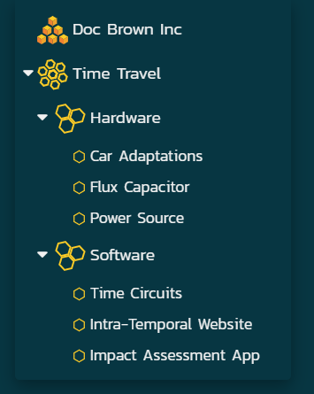
The new workspace dropdown

Slide 16
First phase
Requirements ‘complete’
Simple and transparent methodology
Make it scale up the hierarchy
Notes:
We roll this up from active releases to the product level, and then to each workspace level after that all the way to the enterprise level

Slide 17
Number*
Percent complete*
Start date
End date
* based on statuses

Slide 18
Standard views that roll up

Slide 20
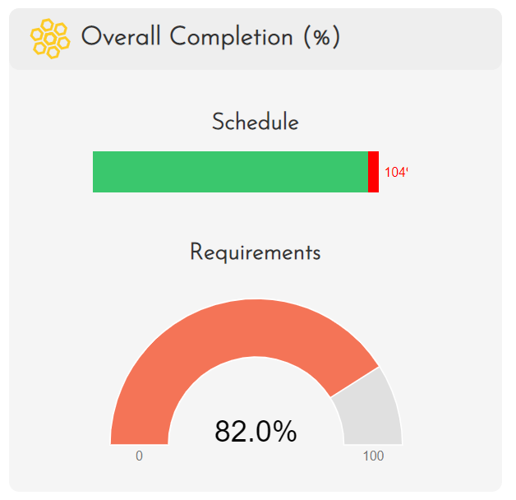

Slide 22
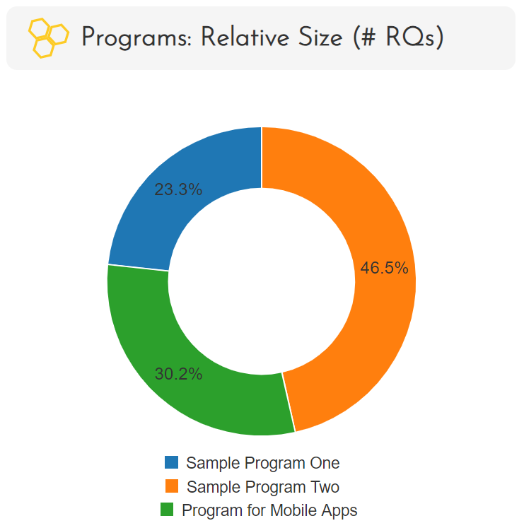

Slide 23
and...

Slide 24
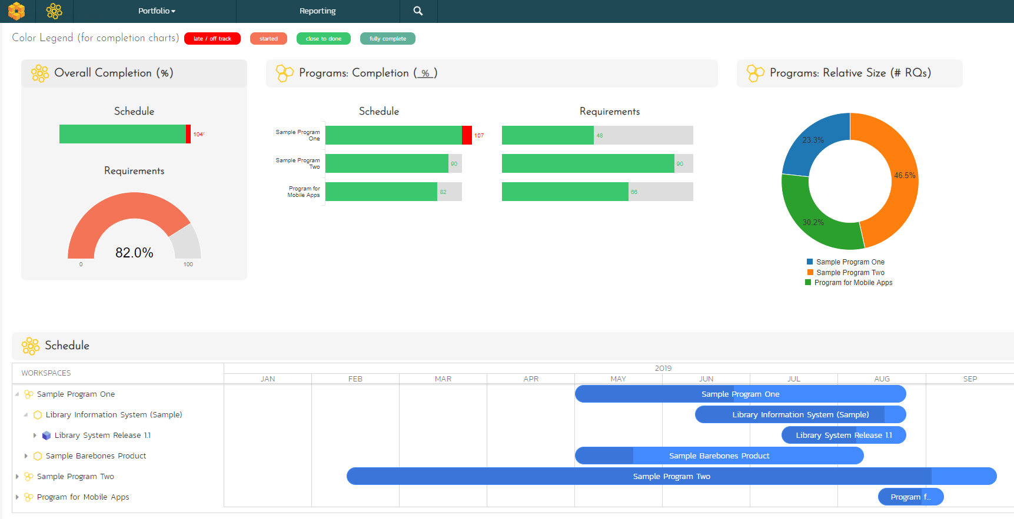
Notes:
We think these new features will really upgrade and expand the insights SpiraPlan can give you at all levels of your organizations and across your products and activites. We can’t wait to get this new version into your hands.

Slide 25
Feedback

Slide 26
Potential future phases
Risks
Quality and code metrics
Incidents
More complex metric of “complete” (eg story points, task effort or progress, test coverage)

Slide 27
Discussion topics
Most important metrics to measure
Key analysis leaders care about
What is essential for first version
Cool ideas for enhancements

