Slide 1


Goodbye to Old Tools
@Inflectra | #InflectraCon
Notes:
Building on ‘Spira admin 1’ you will learn more advanced administration topic including configuring artifact fields and workflows, modifying email notifications, changing the planning and testing settings, and the best practices for security and single-sign-on integration.

Slide 2


Peter Brackstone
Managing Director, Influence IT Consulting Pty Ltd
Sales Manager (ASPAC)
Inflectra Corporation
Brisbane. Australia
e peter.brackstone@Inflectra.com
e peter.brackstone@Influenceit.com.au
w www.influenceit.consulting
w www.inflectrasoftware.com.au

Slide 3
Objectives
Moving on from old tools such as Word, Excel, Micro Focus ALM, UFT, Bugzilla, etc. can be challenging for some users.
This module aims to demonstrate a roadmap for migration to the concepts within the Inflectra family of Quality Management & Testing Tools, specifically SpiraTest and Rapise.
We’ll also provide some handy tips and quick wins to keep your users happy and engaged during the transition.

Slide 4
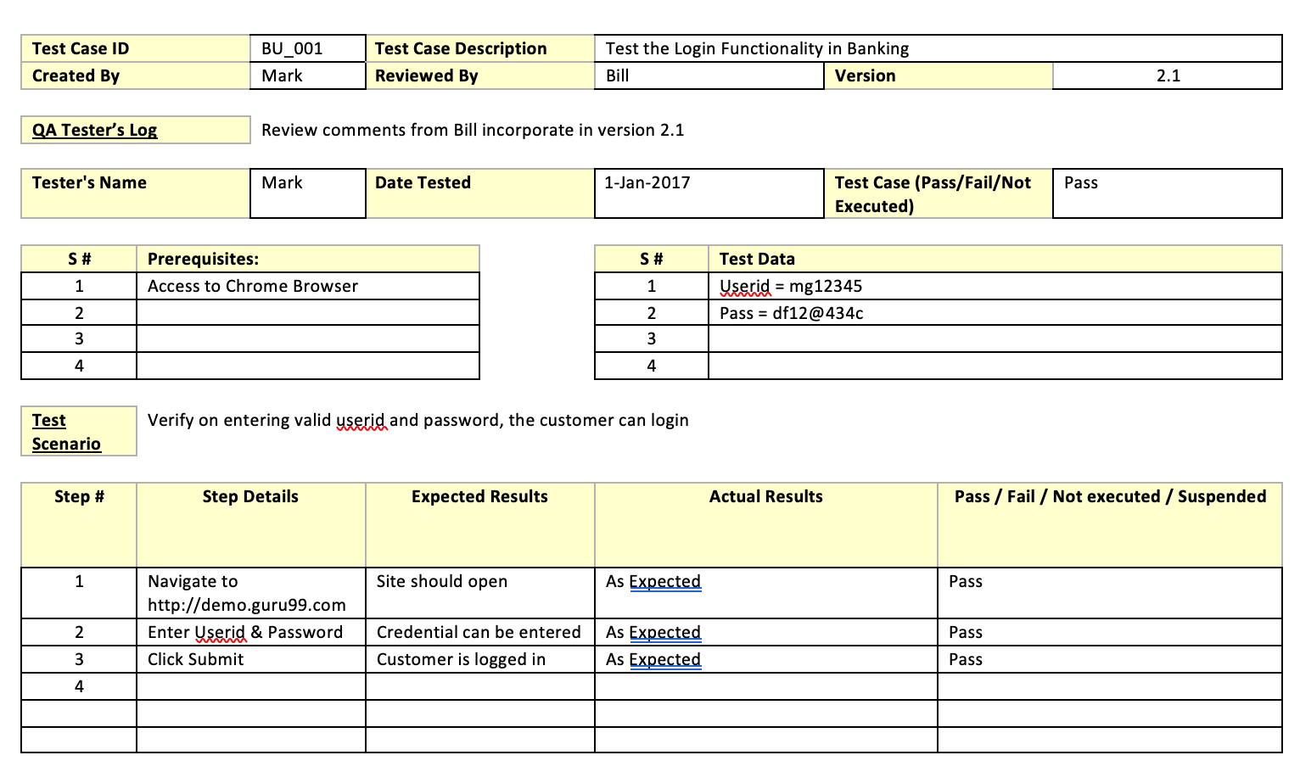
Old Approach
Word
Testing Documentation
Test Planning
Test Cases/Scripts
Results Recording
Excel
Test Cases/Scripts
Results Recording
Metrics for Reporting
Data Variables

Slide 5

Why?
Costly to produce
Costly to maintain
Inconsistent
Non-dynamic
Multiple sources
Version control?
Frustrating
Just not efficient!

Slide 6





Inflectra Tools
Quality & Test Management
SpiraPlan
SpiraTeam
SpiraTest
Testing Automation
Rapise
Remote Launch

Slide 7

Inflectra Products
Enable your teams to work in the right way, together
Assign tasks, bugs, tests or user stories to the best person
Quickly check on progress from anywhere
Help you lead your projects
Tracking of every part of the project
Meaningful, actionable data
Adapts to your methodology and processes
Help you manage your programmes
Keep things running smoothly
High-level overview of all projects
Manage releases, risks and issues from one place

Slide 8


Our Solution
Specifically designed Quality & Testing Management Tools
Single source of consistent, dynamic, controlled Testing Assets
Artefact associations
Supports most testing types
Integrations – 53 and counting!
Migration paths from legacy tools
Great support!

Slide 9

SpiraTest
Requirements Management
Test Management
Bug Tracking

Slide 10
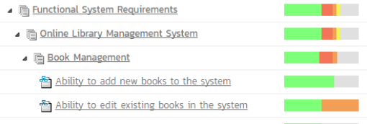
Requirements Managed
Manage requirements, features and use cases.
Map tests to requirements to track test coverage.
Drill down from requirements to tests and bugs.

Slide 11
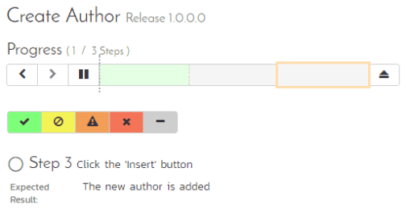
Tests Sorted
Create, edit and execute test cases with rich text editing
Test Management for exploratory, automated and manual tests with global scheduling
Support for templated and data-driven test cases

Slide 12
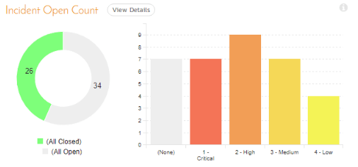
Bugs Tracked
Track bugs, enhancements, risks and issues
Link bugs to test steps during test execution for full -
Forward & backward traceability
Reporting

Slide 13
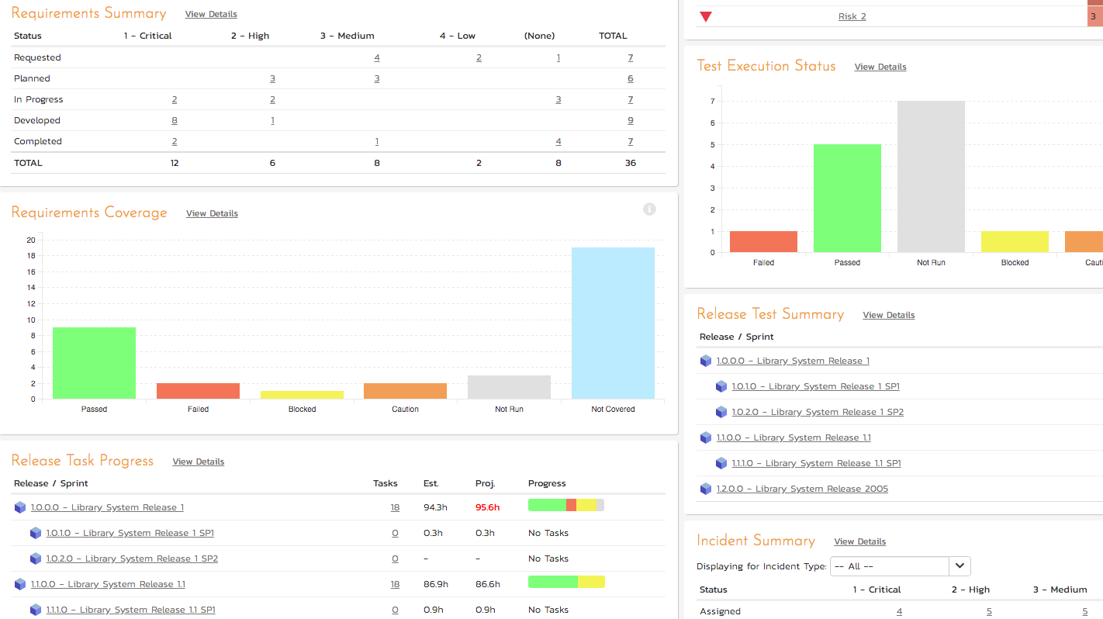
Everything Tracked
Personalised executive Dashboards
Real-time Charts
Customisable Reports
Fully customisable workflows to match your internal processes
Cloud or on-premise installation
All devices through browser

Slide 14
Automated Testing – Made Easy
Test web, mobile, desktop and APIs
Manage tests spanning multiple technologies simultaneously
Anyone can automate!
Record, edit (spreadsheet-based), execute
JavaScript-based engine for the more technical
MS Dynamics, AX, CRM, NAV and 365 support out of the box

Slide 15
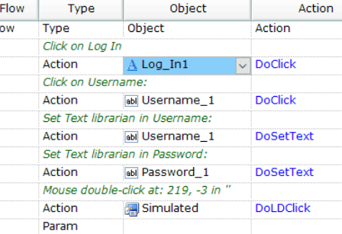
Scriptless Automation
Create automated tests – fast!
Record once, playback in any browser
Live validation during recording
Easy maintenance (readable by humans!)

Slide 16
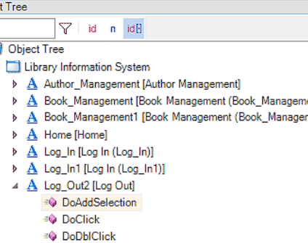
Robust Automation
Object-based approach
Create and refine tests using drag and drop
As the application updates, so will the objects: no fiddling required
Keyword and data-driven testing supported
One test across multiple technologies: no need for one per test per platform

Slide 17
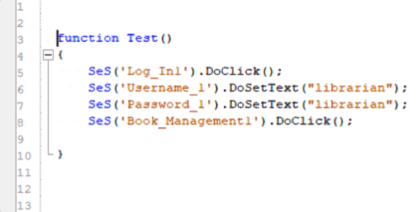
Flexible & Extensible
Supports Selenium and Appium
Hooks into top unit testing frameworks
Integrates with SpiraTest, Microsoft Team System (and others)
Extensible using JavaScript and third party libraries
Run tests at the right time, track to the right place, every time!

Slide 18
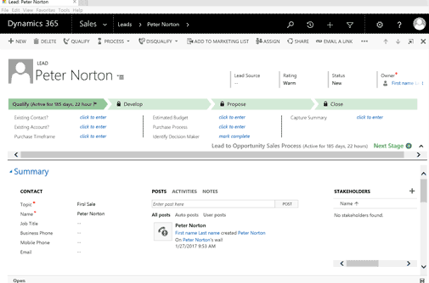
MS Dynamics & Salesforce
Out of the box testing support for:
MS Dynamics
Dynamix AX
CRM
NAV
365
Salesforce
Classic
Lightening

Slide 19


Method Agnostic
Inflectra tools are built to support multiple methodologies
Out of the box:
AGILE
AGILE Scrum
AGILE Kanban
Waterfall
Hybrid

Slide 20

Migration to Spira
Data Migration is a pain! Migrating to Spira is made easier with number of migration tools which your team will love!
Microsoft
Excel
Word
Project
Excel 365
GSuite
Google Sheets (Requirements)
Legacy tools:
HP ALM/Quality Centre
Microsoft Test Manager
TestRail
Test Link
Mercury Test Director
Full listing of tools/integrations:
https://www.inflectra.com/SpiraTest/Downloads.aspx#ImportTools

Slide 21
Happy Teams!
Re-use of existing artefacts
Easy to use migration tools
Standard office applications
Variety of platforms
Upload and Download
Functionality increasing
Chrome extensions/plug-ins
SpiraCapture

Slide 22
Questions?

