Slide 1

Developer 1:
Workflows and Code Management
@Inflectra | #InflectraCon

Slide 2


Adam Sandman
Director, Inflectra
Programmer from the age of 10
Working in the IT industry for over 20 years
Adam lives in Washington, DC, USA
@adammarksandman

Slide 3

About Me
Adam Sandman was a programmer from the age of 10 and has been working in the IT industry for the past 20 years.
Currently Adam is Director at Inflectra Corporation, where he is interested in technology, business and innovation.
Adam lives in Washington, DC, USA

Slide 4
Session Objectives
We will share recommendations and best practices for using Spira and TaraVault to manage your source code, with examples using both Git and Subversion.
We will discuss the recommended workflow for development tasks, linking tasks to code commits, and using our IDE plugins to improve efficiency.

Slide 5
Spira Code Management Integrations

Slide 6









Source Code Integration Options
Inflectra Hosted
Third-Party
&
VSS

Slide 7








IDE Integration Options
Visual Studio Code
Android Studio
Visual Studio

Slide 8
Spira Source Code Integration

Slide 9
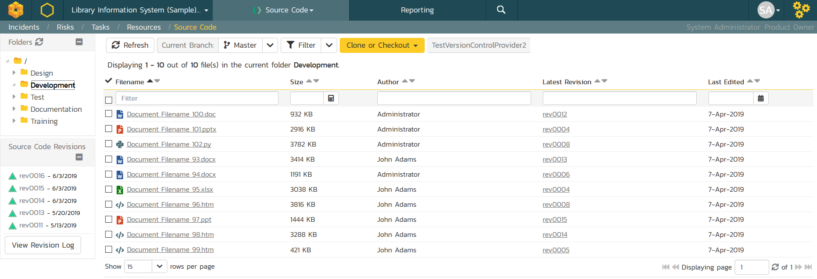
Browse Code Repositories

Slide 10
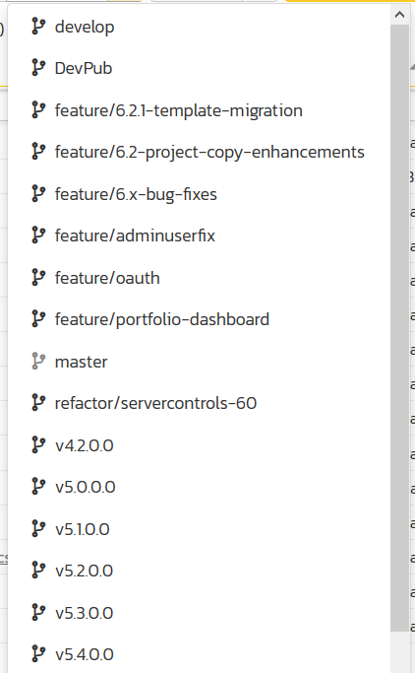
View/Manage Branches

Slide 11
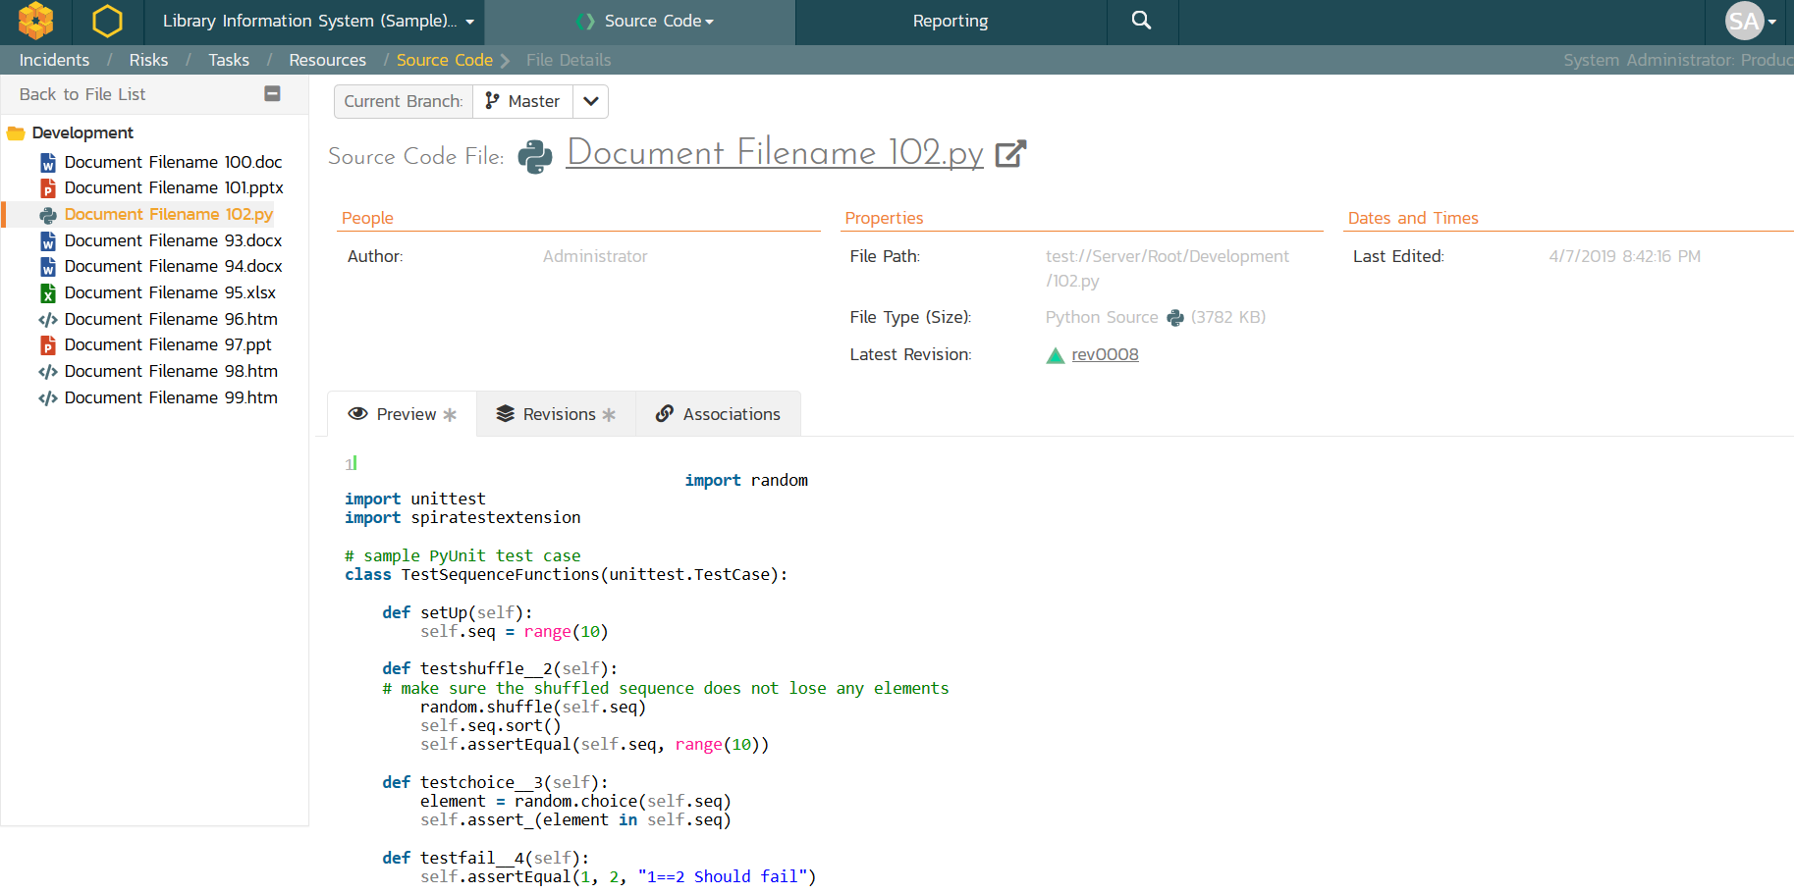
Preview Code Files

Slide 12
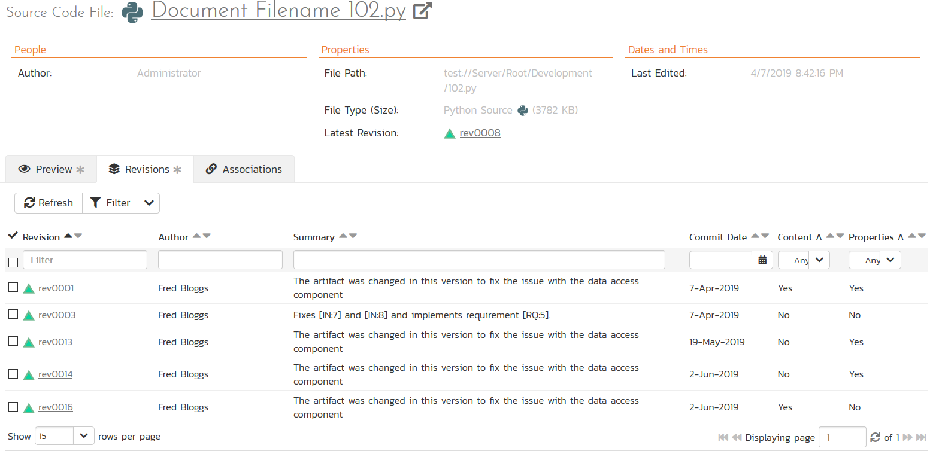
View Code Revisions

Slide 13
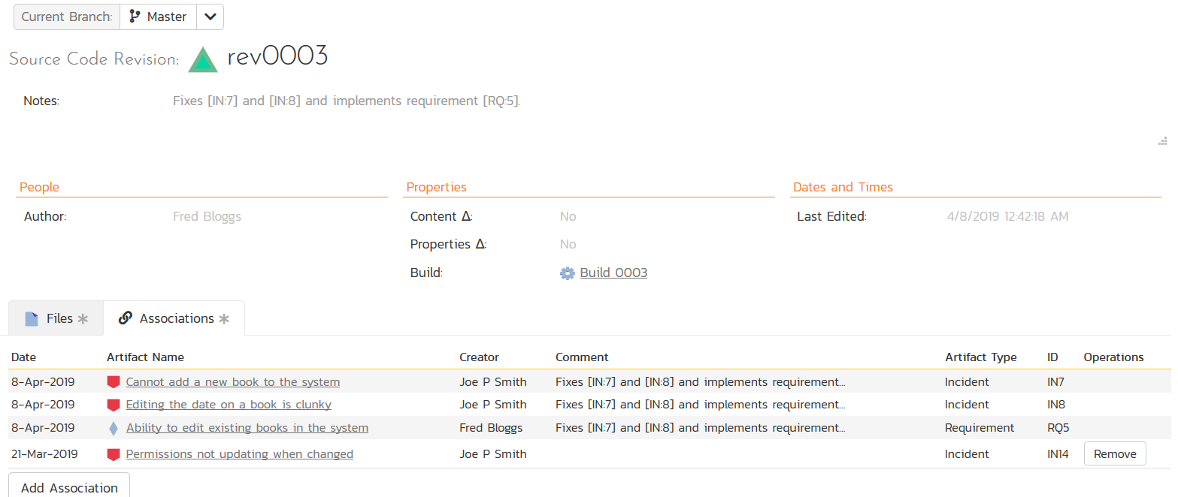
Artifact Assciations

Slide 14
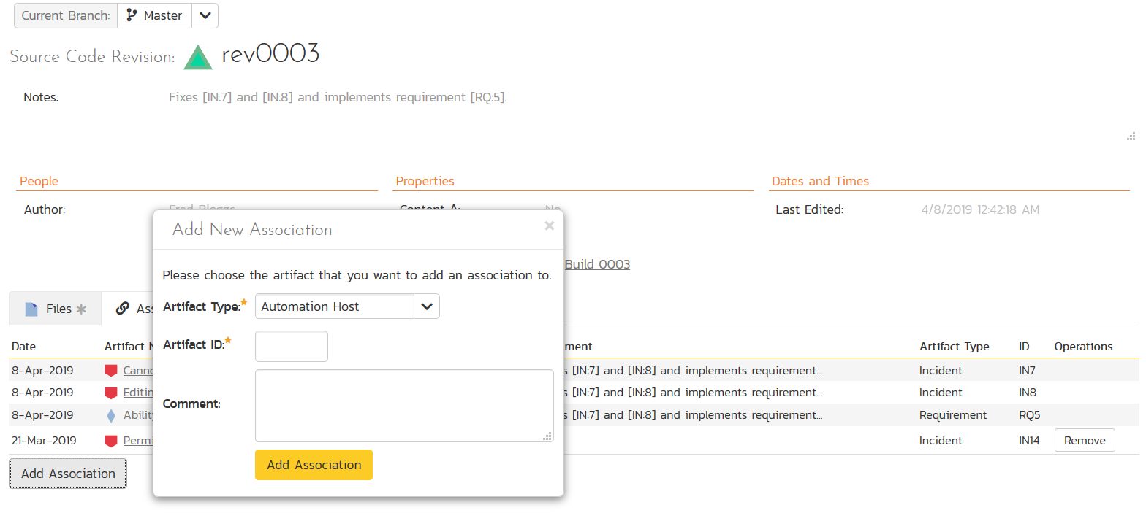
Artifact Assciations

Slide 15
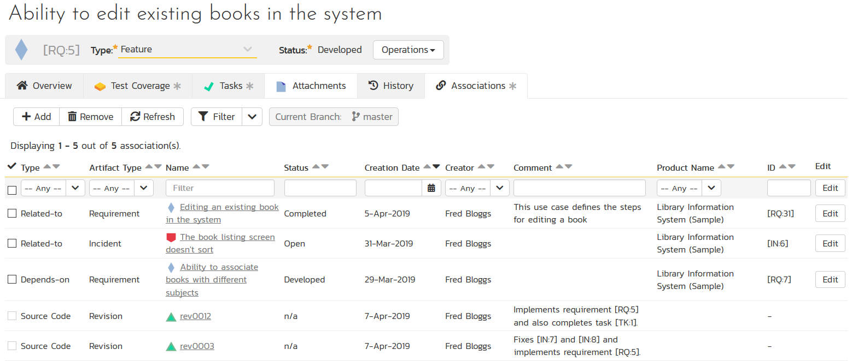
Artifact Associations

Slide 16
Source Code Workflows

Slide 17
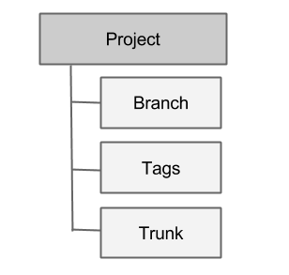
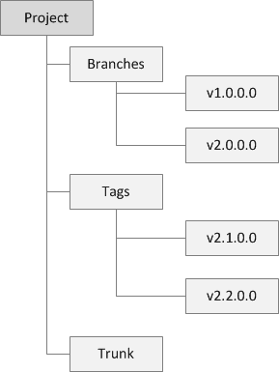
Subversion Workflow
Primary Development is done in Trunk
Commit into Trunk
Branches used for older versions being maintained
Commit into Branches
Tags used for milestones and mark releases
Cannot commit into tags

Slide 18
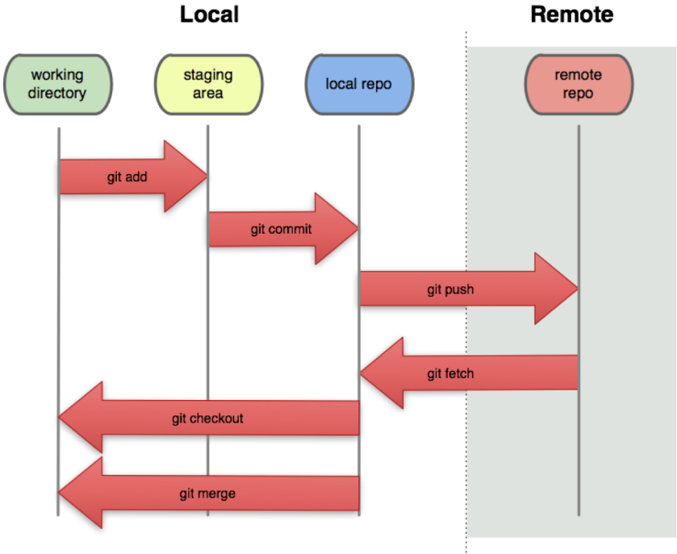
Git Architecture

Slide 19
Git Workflows
Several possible models:
Git Flow (recommended)
GitHub Flow
GitLab Flow
One Flow
Trunk-based development (like SVN)

Slide 20
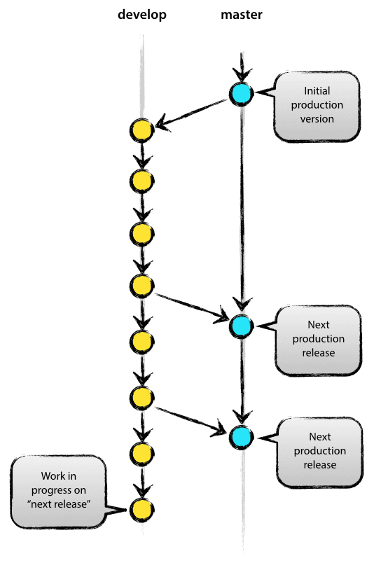
Git Flow Workflow
master — this branch contains production code. All development code is merged into master in sometime.
develop — this branch contains pre-production code. When the features are finished then they are merged into develop.
feature/* — feature branches are used to develop new features for the upcoming releases. May branch off from develop and must merge into develop.
hotfix/* — hotfix branches are necessary to act immediately upon an undesired status of master. May branch off from master and must merge into master and develop.

Slide 21
Workflow using Spira and Git

Slide 22
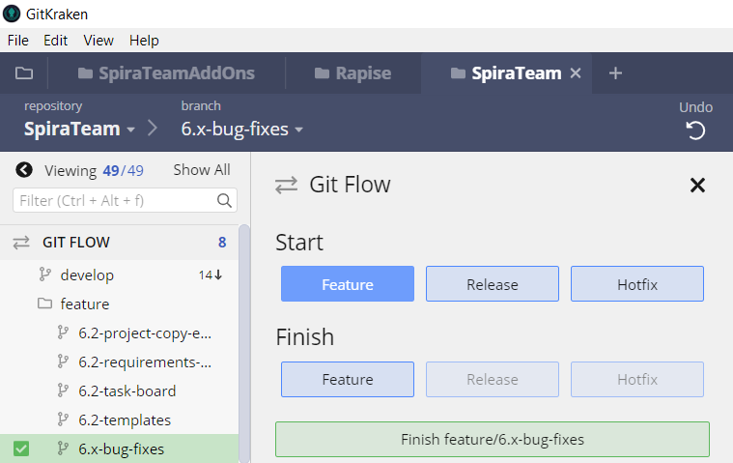
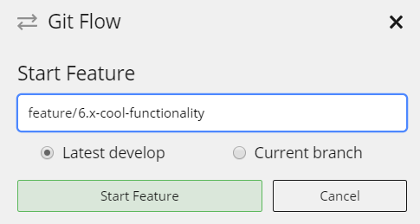
Create Feature Branch

Slide 23
Create Feature Branch

Slide 24
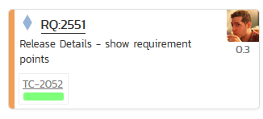
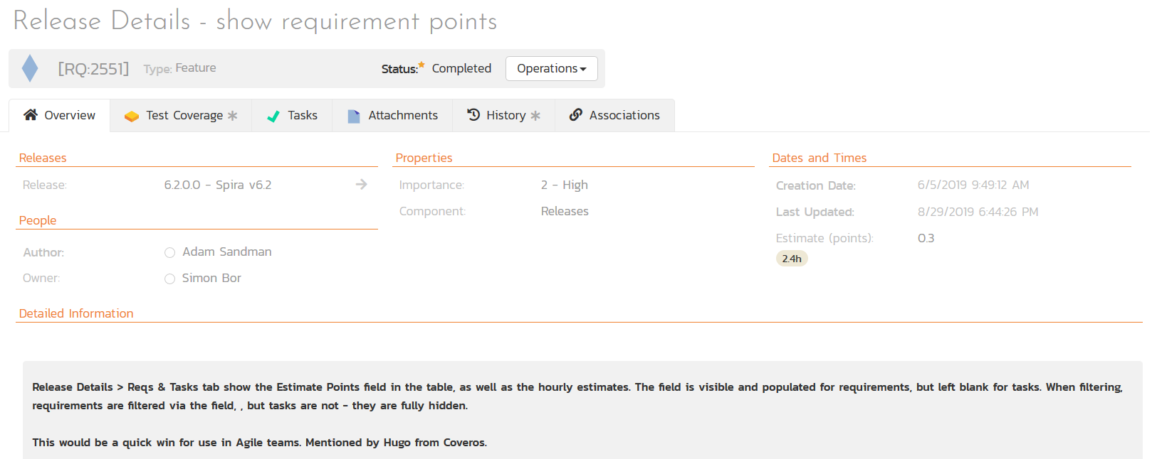
Write User Stories

Slide 25
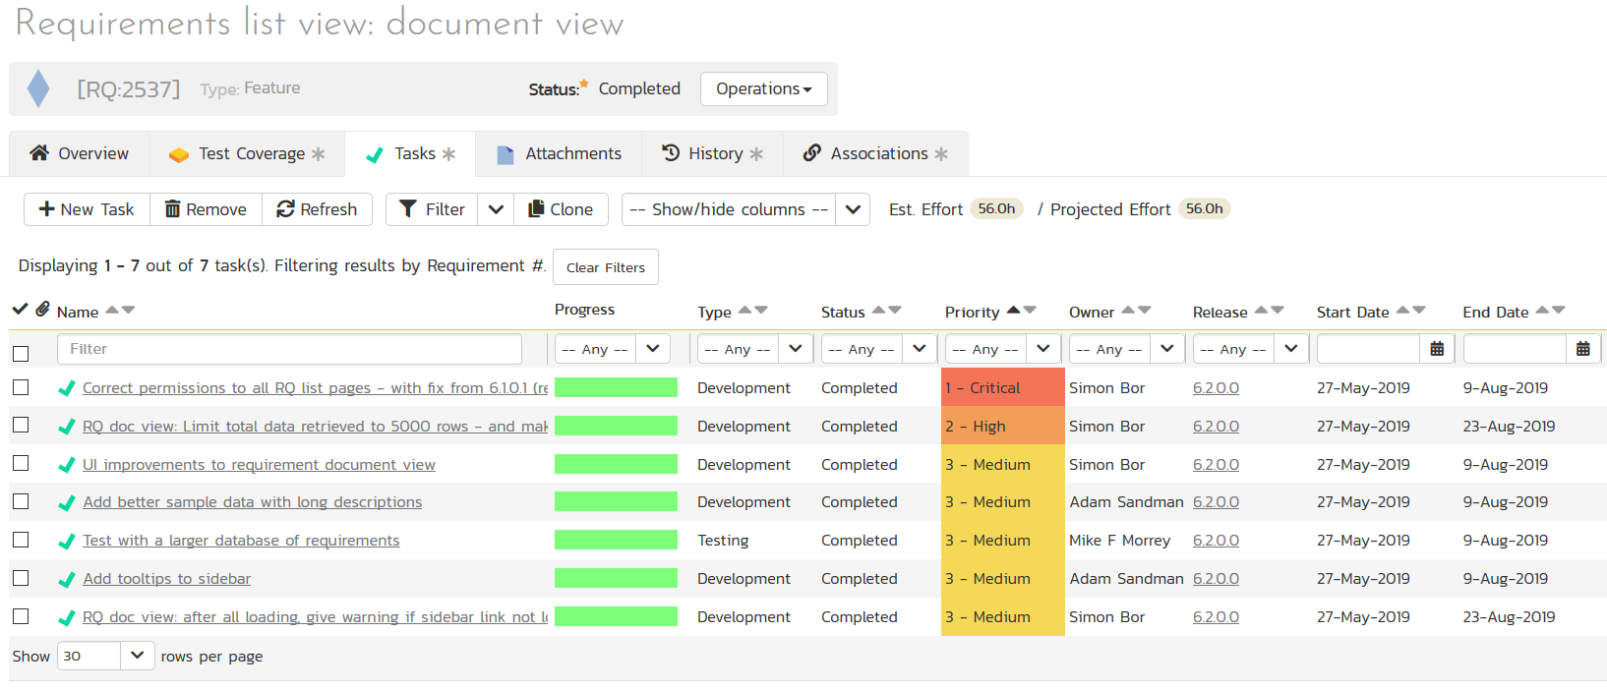
Create Tasks (if necessary)

Slide 26
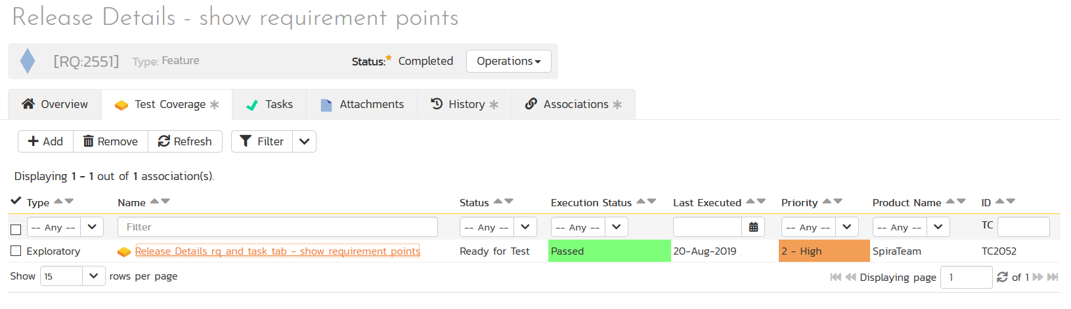
Create Test Cases (always)

Slide 27
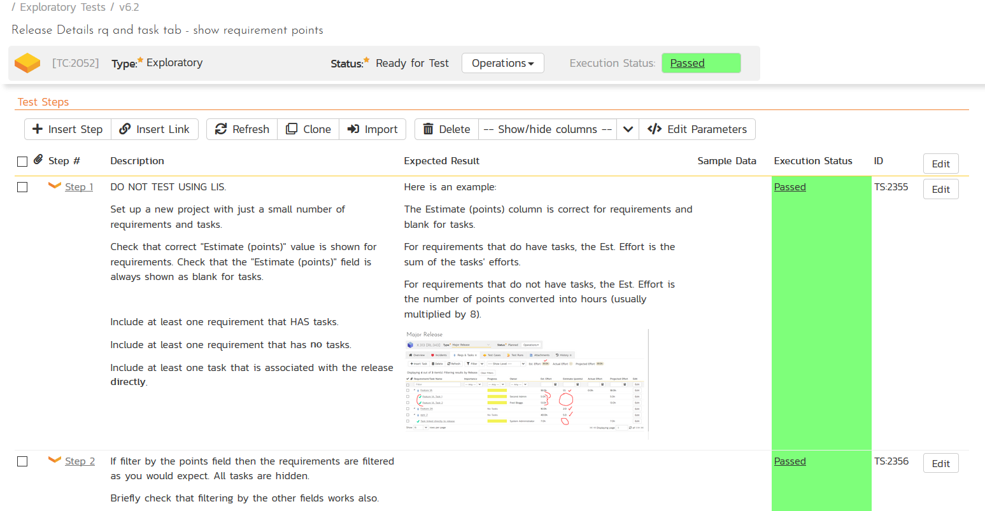
Create Test Cases (always)

Slide 28
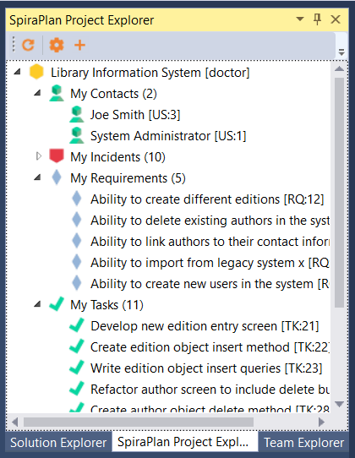
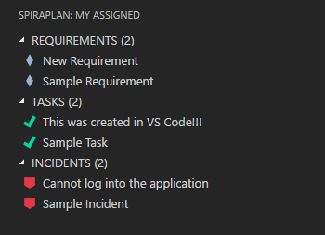
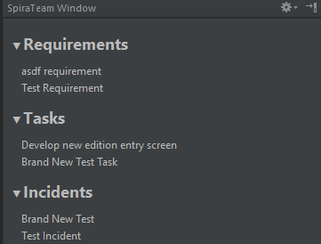
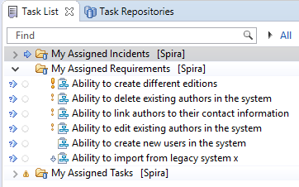
Write Code in IDE

Slide 29
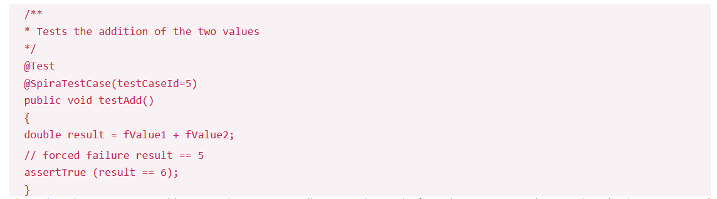








Write Unit Tests (!)
Plugins Available for:

Slide 30
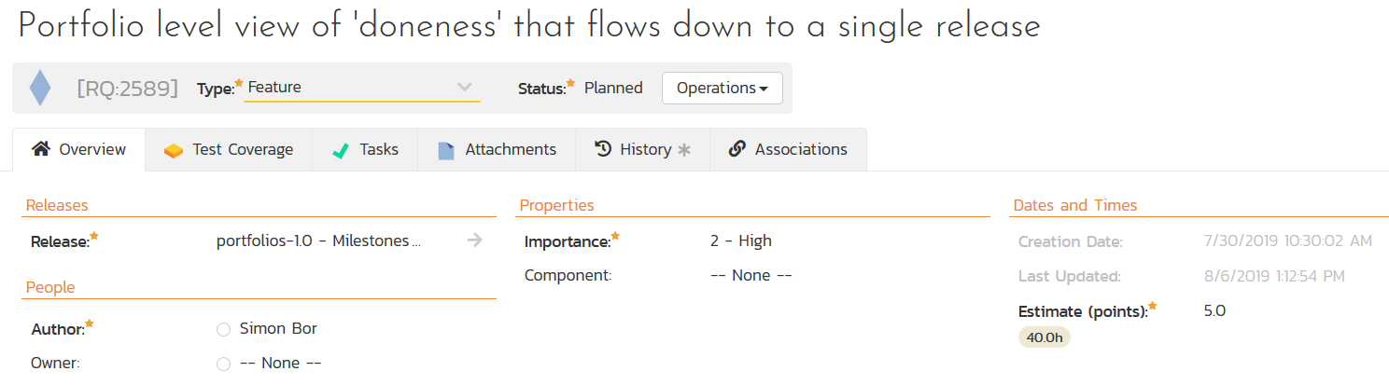
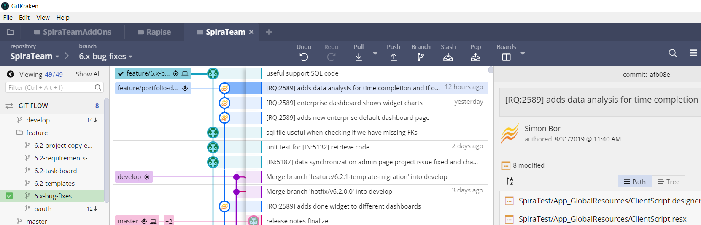
Commit and Push

Slide 31
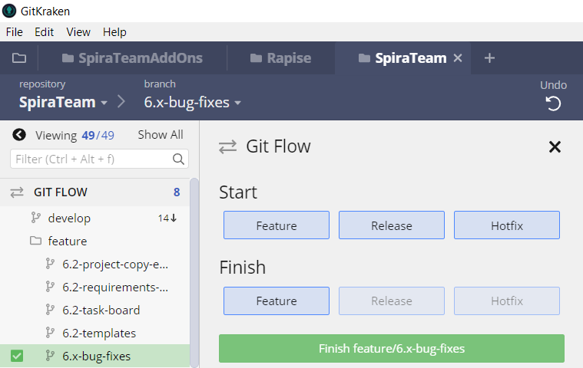
Merge / Pull Request

Slide 32
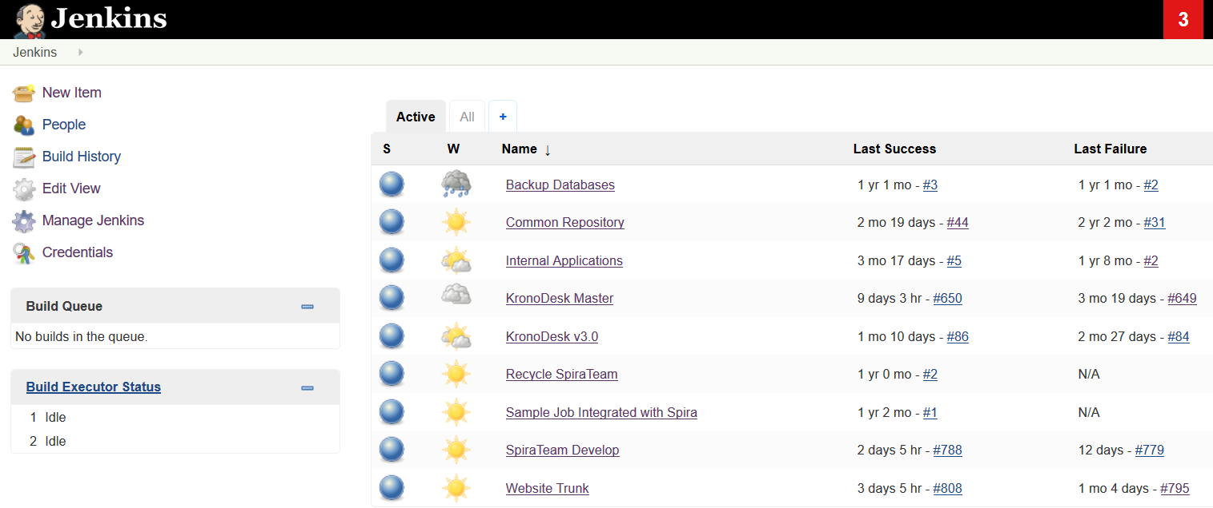
CI Builds ‘develop’ Branch

Slide 33
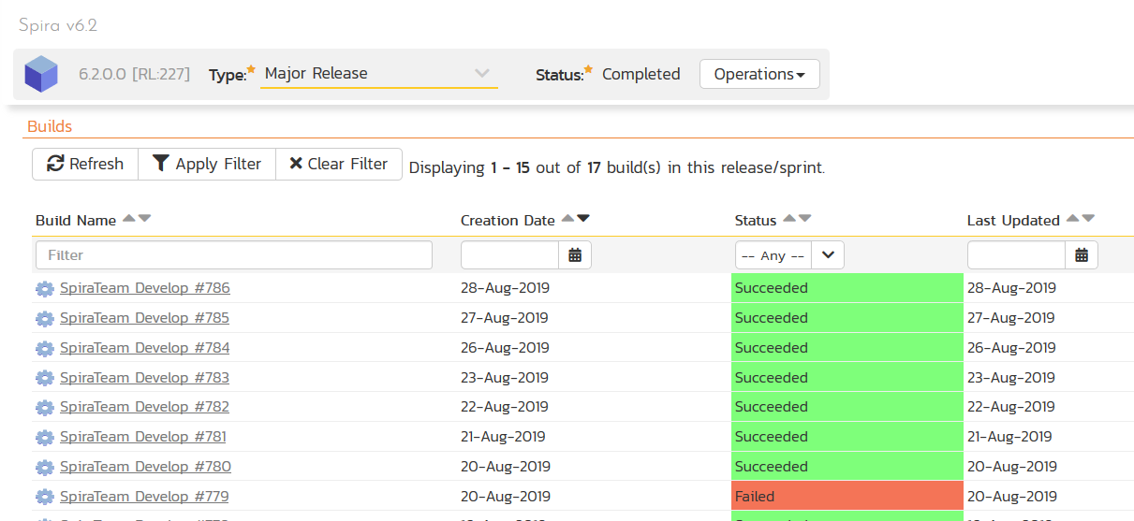
CI Builds ‘develop’ Branch

Slide 34
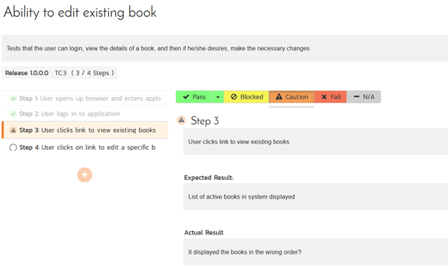
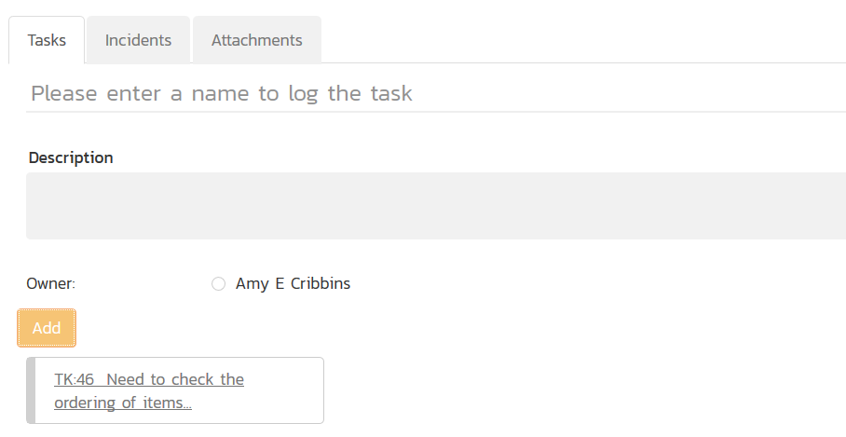
Exploratory & Manual Testing

Slide 35
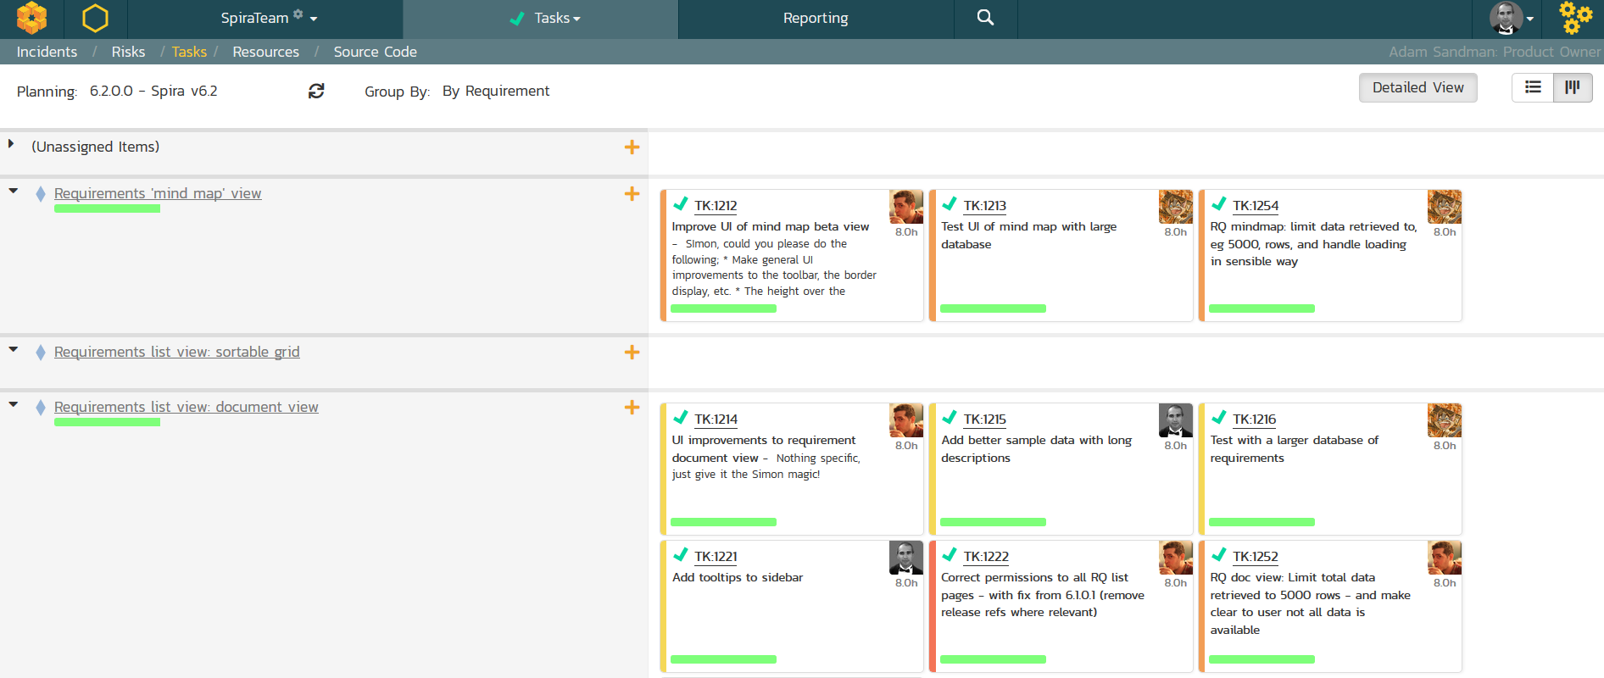
Track Progress

Slide 36
Wrap Up

Slide 37
Key Takeaways
Spira has many plugins and integrations to make developers’ lives easier
Define a code and task management workflow that works for you and your team
Make sure that testing is fully integrated into your workflow from day one

Slide 38
Questions?

Slide 39
Further Reading
Git Flow: https://nvie.com/posts/a-successful-git-branching-model/
GitHub Flow: http://scottchacon.com/2011/08/31/github-flow.html

