Slide 1

Testing 3:
Data-Driven Testing
@Inflectra | #InflectraCon

Slide 2

Remco Putker
Owner, Robust-IT
Program Manager, EY
@RPutker

Slide 3
Session Objectives
Building on the content of Testing 1 and 2, we will discuss more advanced techniques available in Spira for test management.
We will review the different ways to use test sets, automation hosts, test parameters and test configurations to promote data-driven testing, reliable automation, and DevOps integration with CI tools.

Slide 4
Test Case Parameters

Slide 5
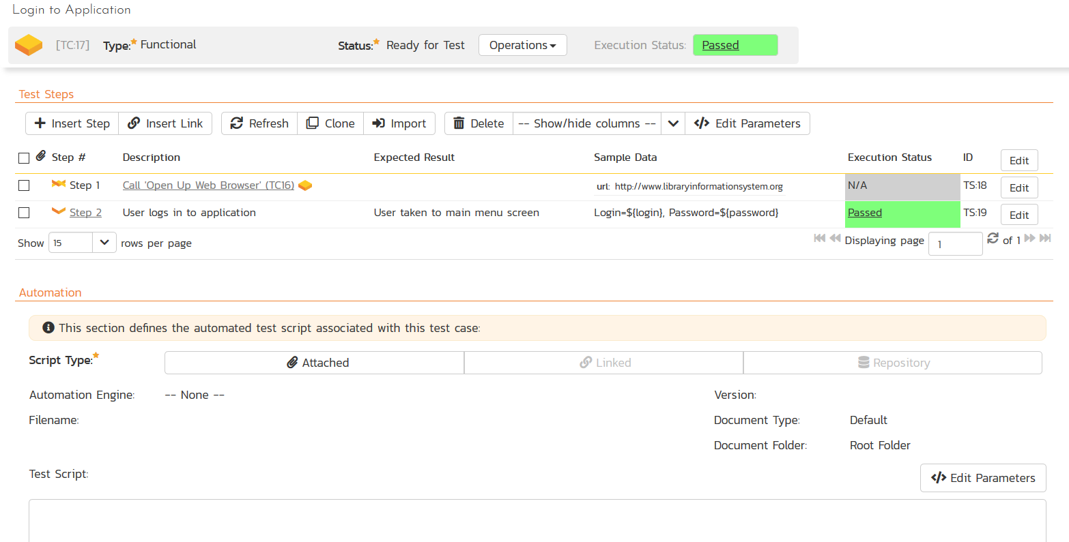
Define Test Case Parameters

Slide 6
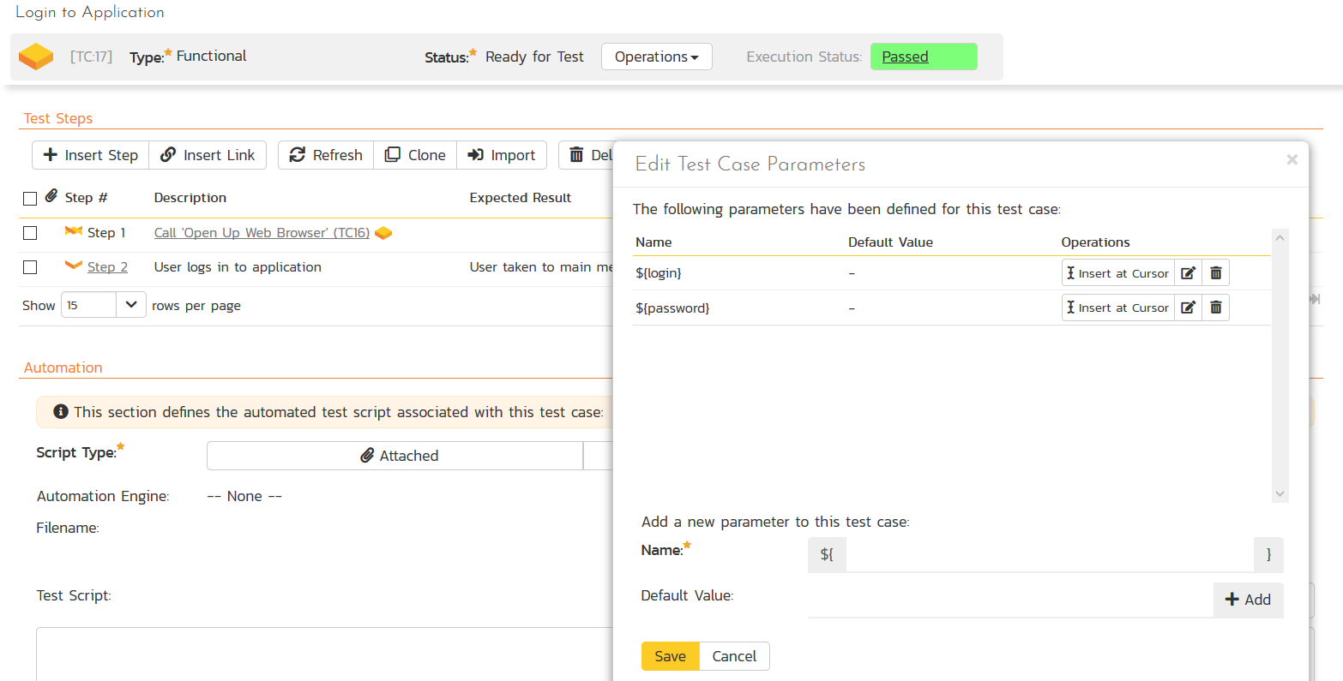
Define Test Case Parameters

Slide 7
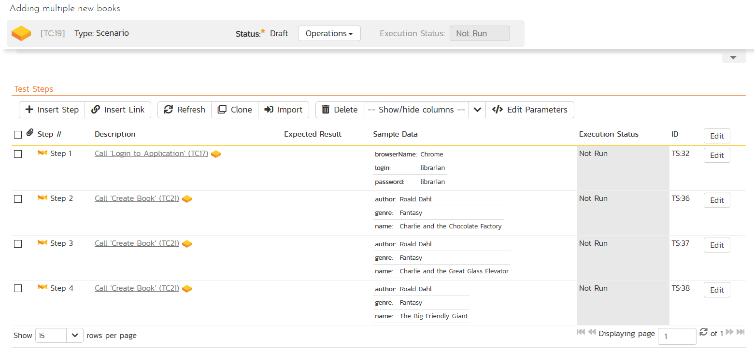
Multiple Parameter Levels

Slide 8
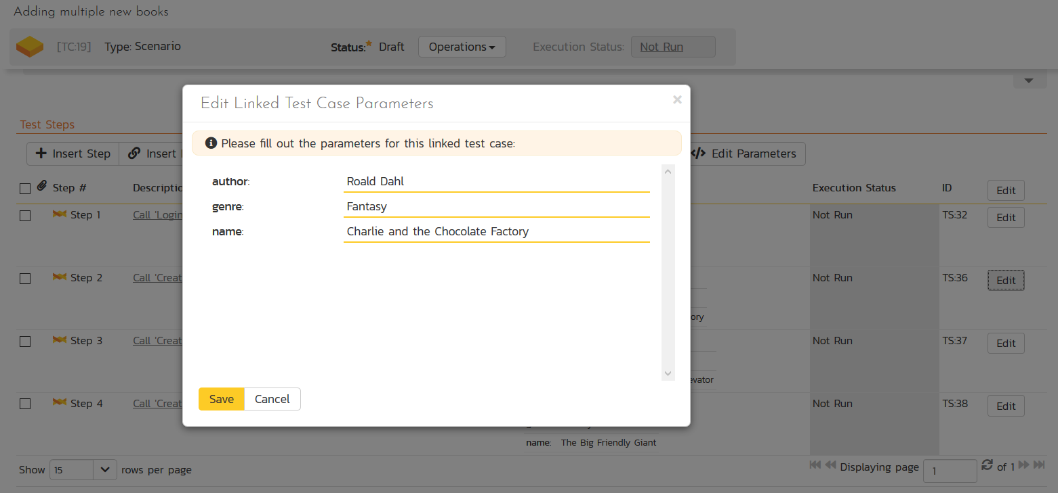
Multiple Parameter Levels

Slide 9
Test Sets & Parameters

Slide 10
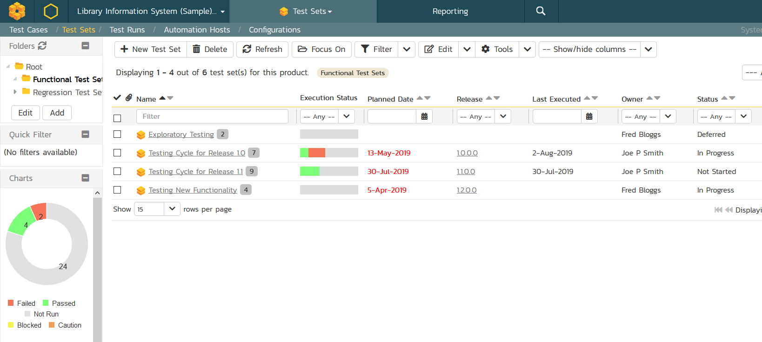
Test Sets Recap

Slide 11
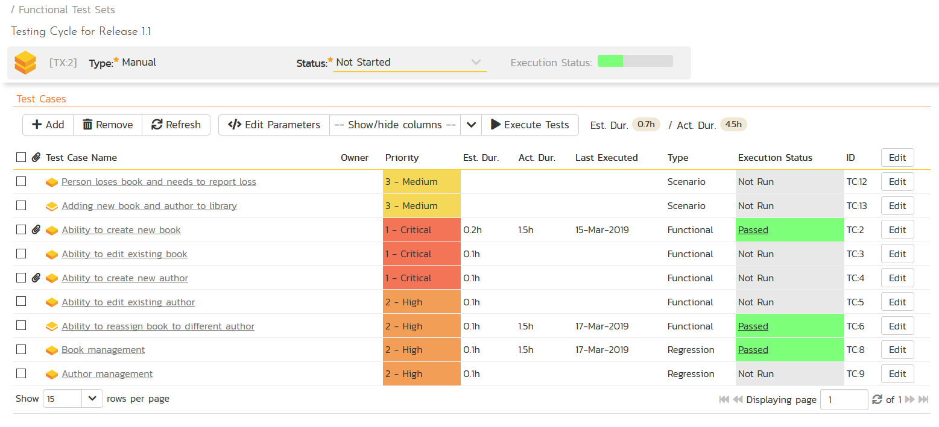
Test Sets Recap

Slide 12
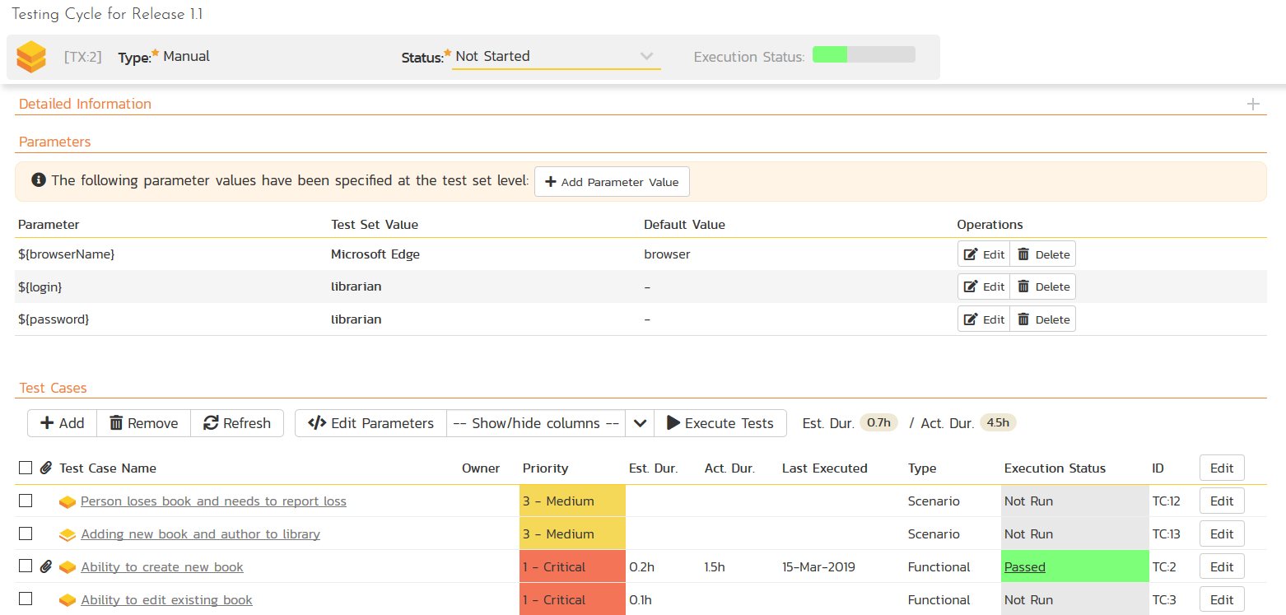
Parameters – Test Set Wide

Slide 13
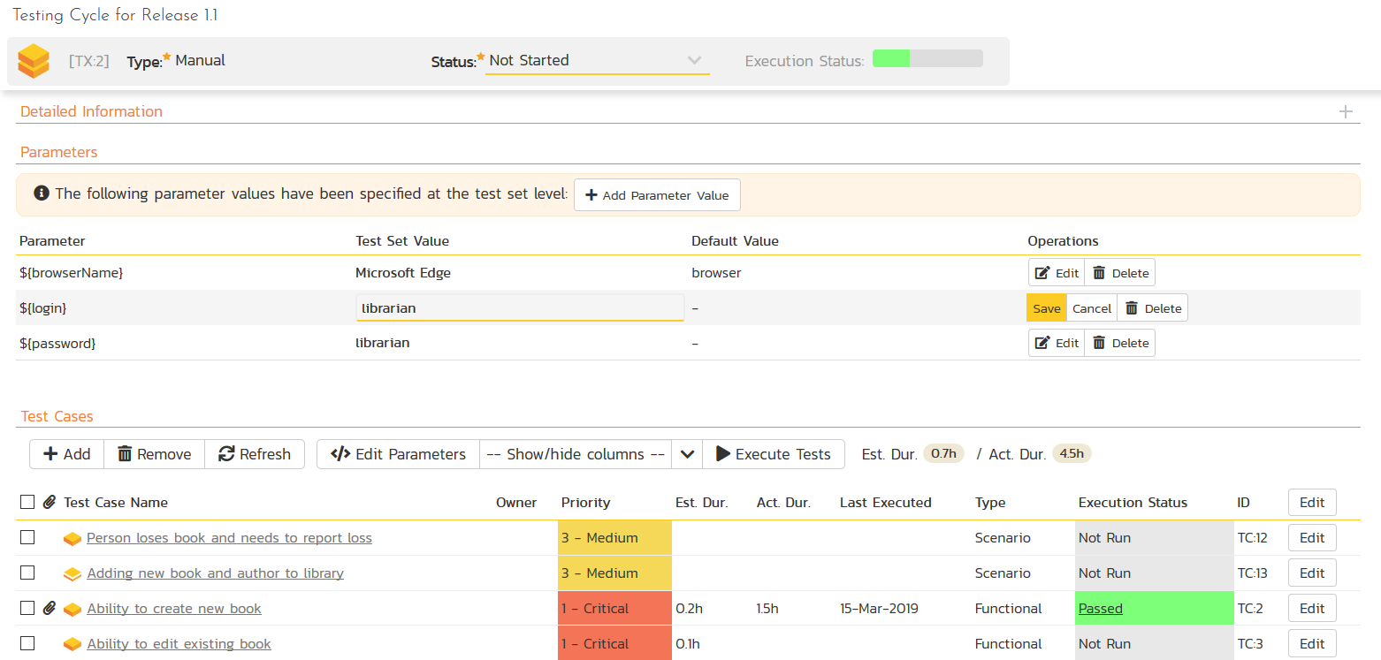
Parameters – Test Set Wide

Slide 14
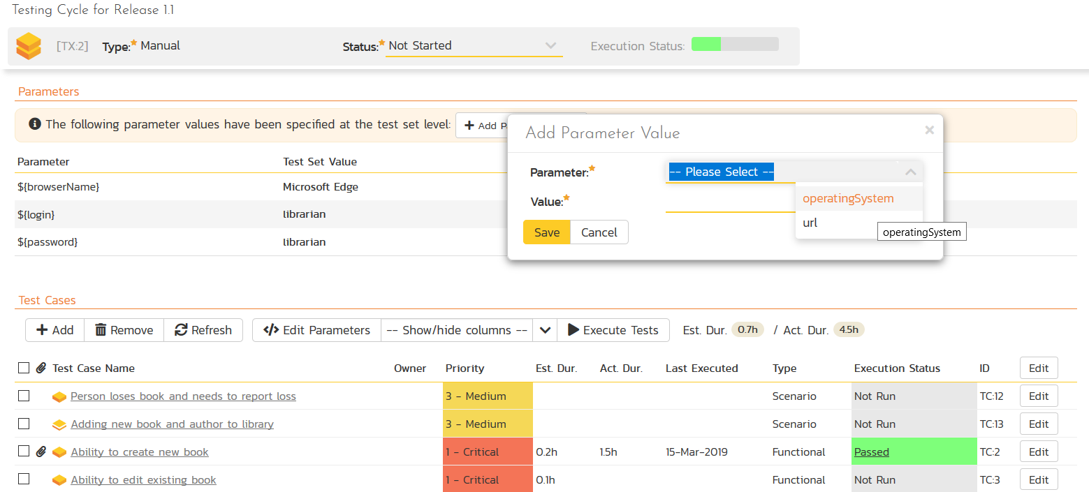
Parameters – Test Set Wide

Slide 15
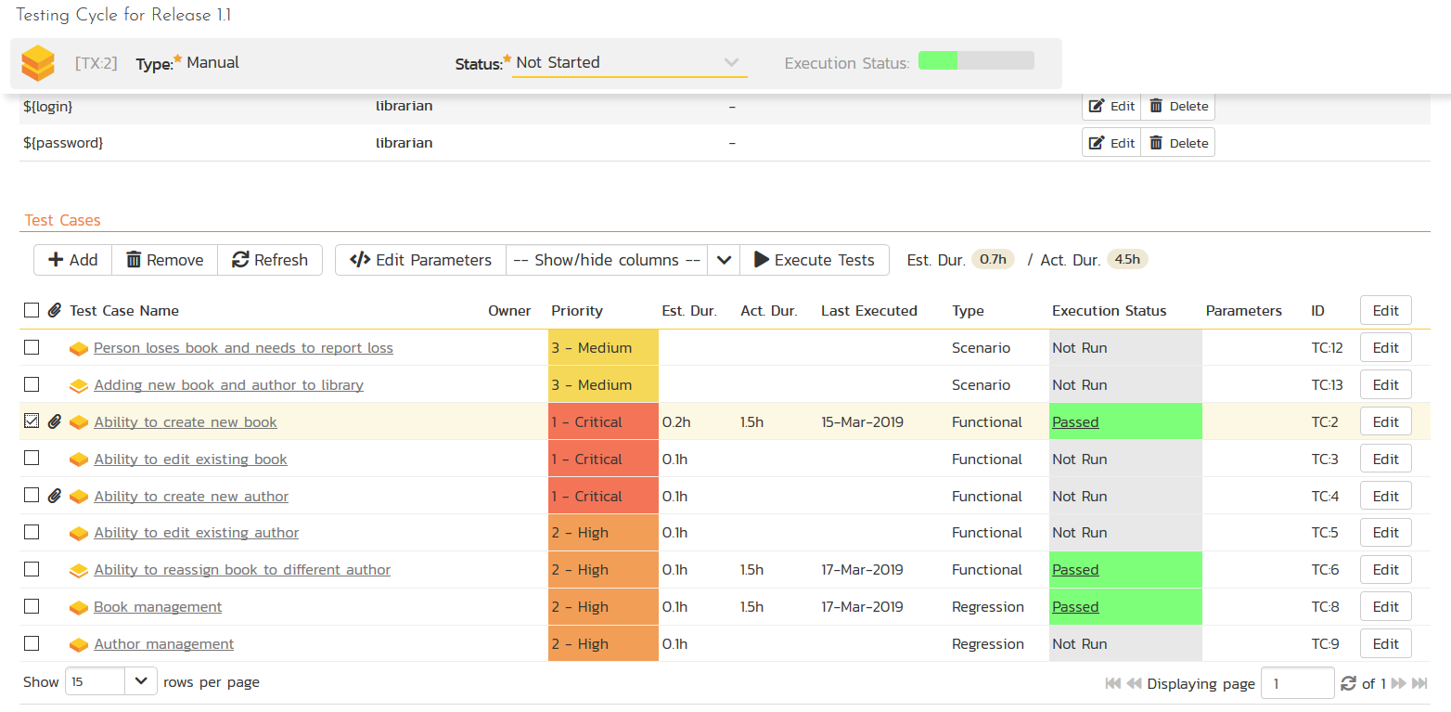
Parameters – Test Case Specific

Slide 16
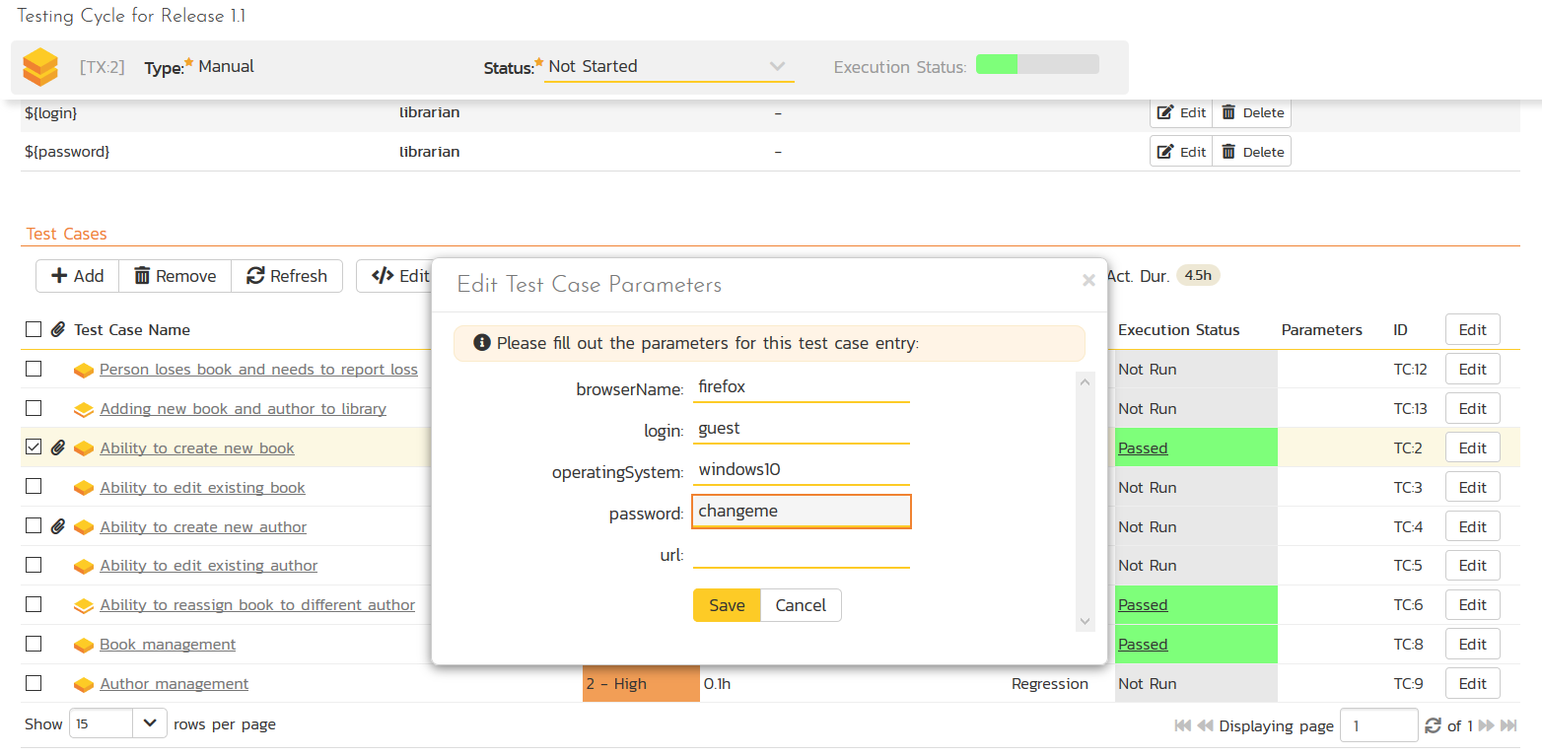
Parameters – Test Case Specific

Slide 17
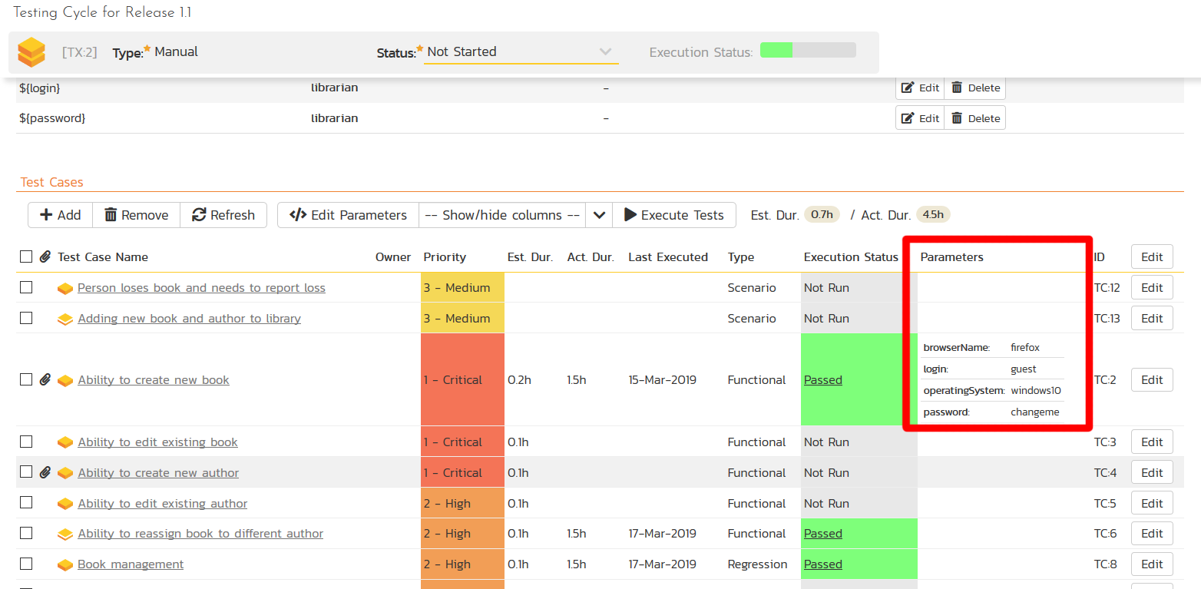
Parameters – Test Case Specific

Slide 18
Test Sets & Automation Hosts

Slide 19
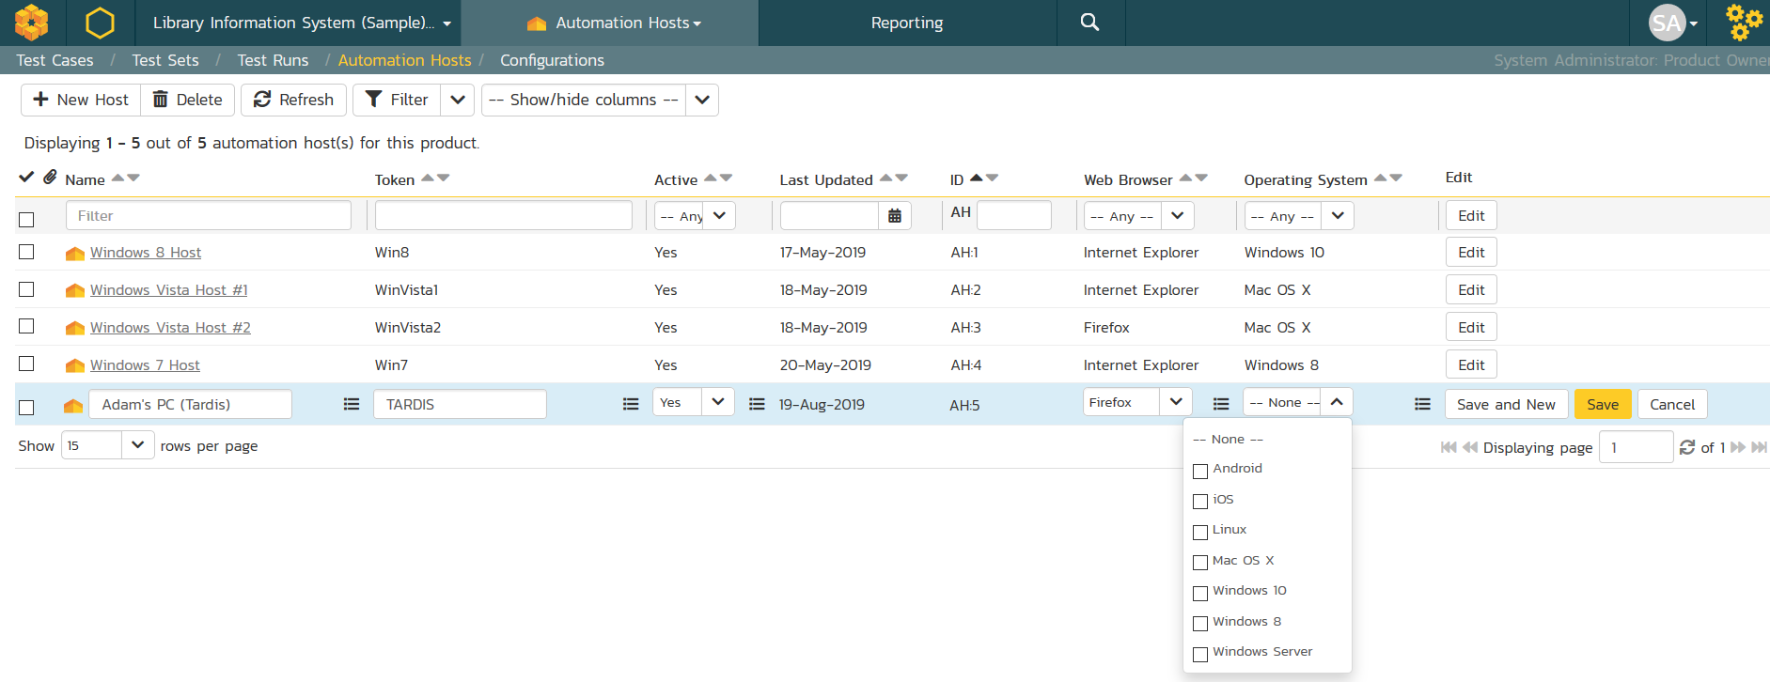
Automation Hosts

Slide 20
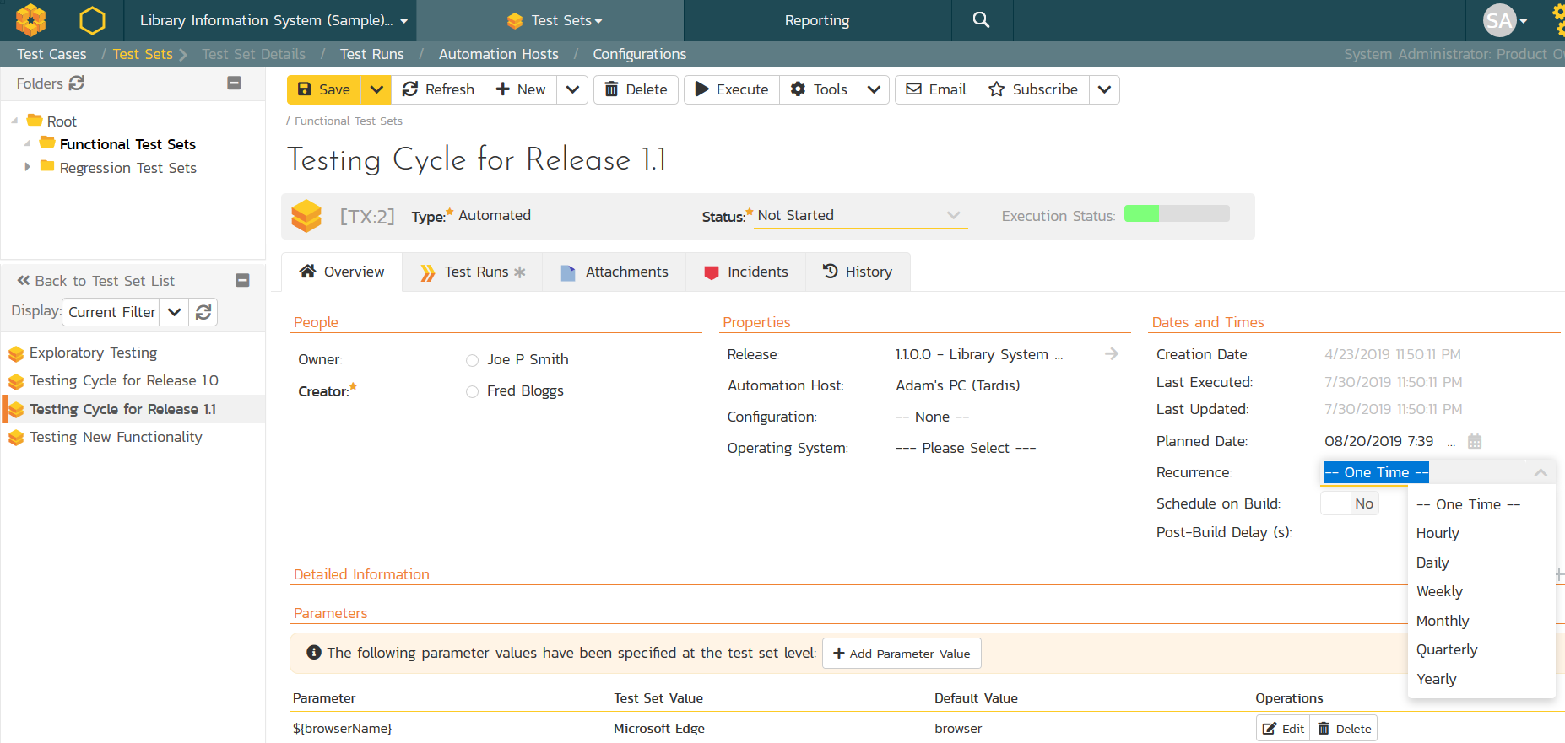
Test Sets for Automated Testing
Tip:
Schedule on Build to use CI triggers

Slide 21
Test Configurations

Slide 22
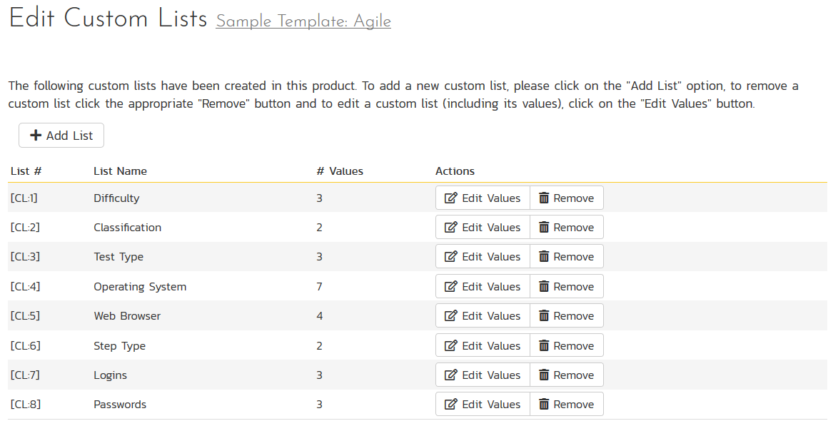
Define Custom Lists & Values

Slide 23
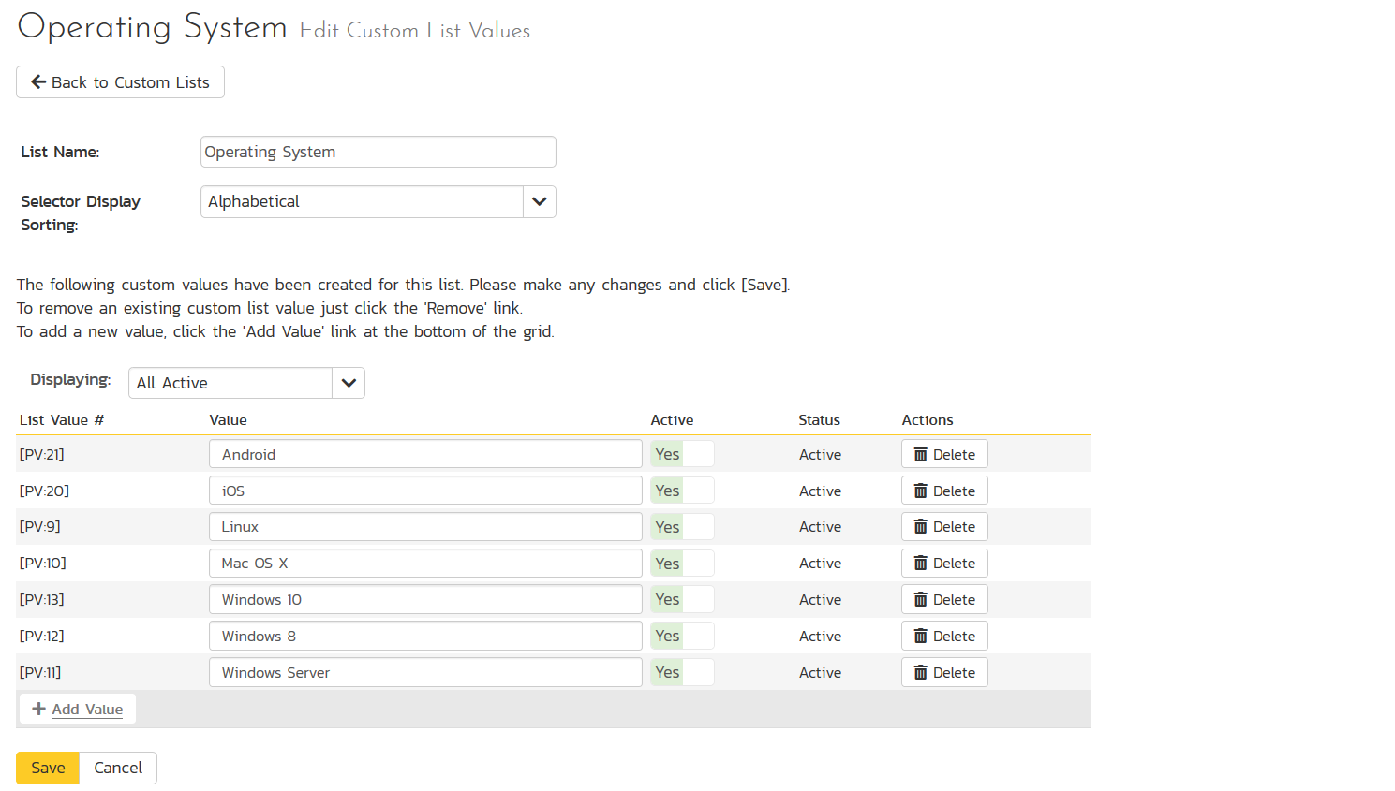
Define Custom Lists & Values
Tip:
Can import from MS-Excel using our Excel Add-In

Slide 24
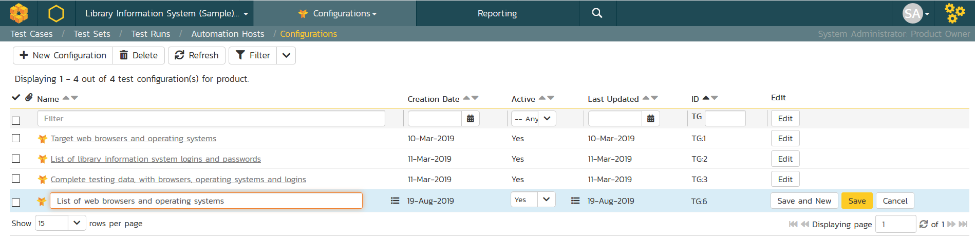
Test Configurations

Slide 25
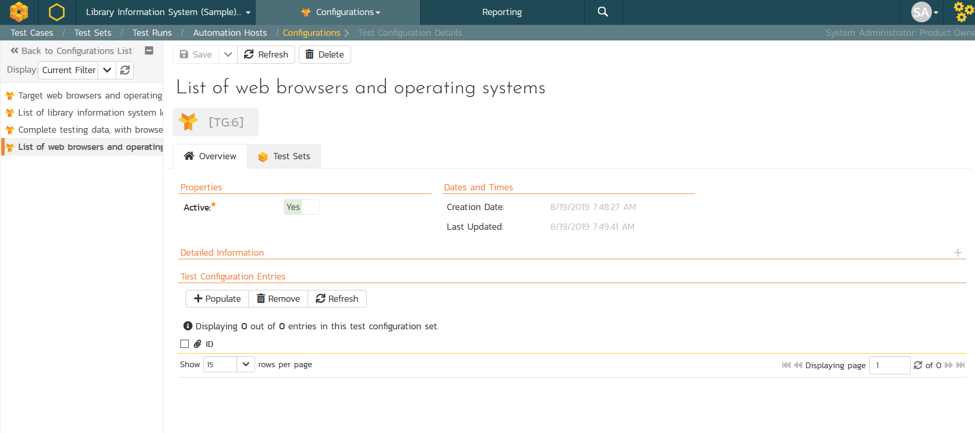
Populate Values

Slide 26
Populate Values

Slide 27
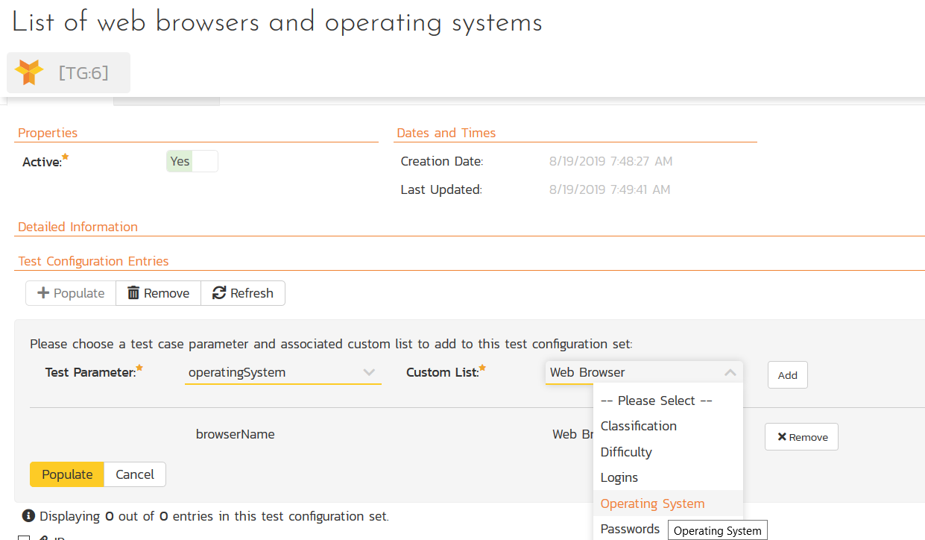
Populate Values

Slide 28
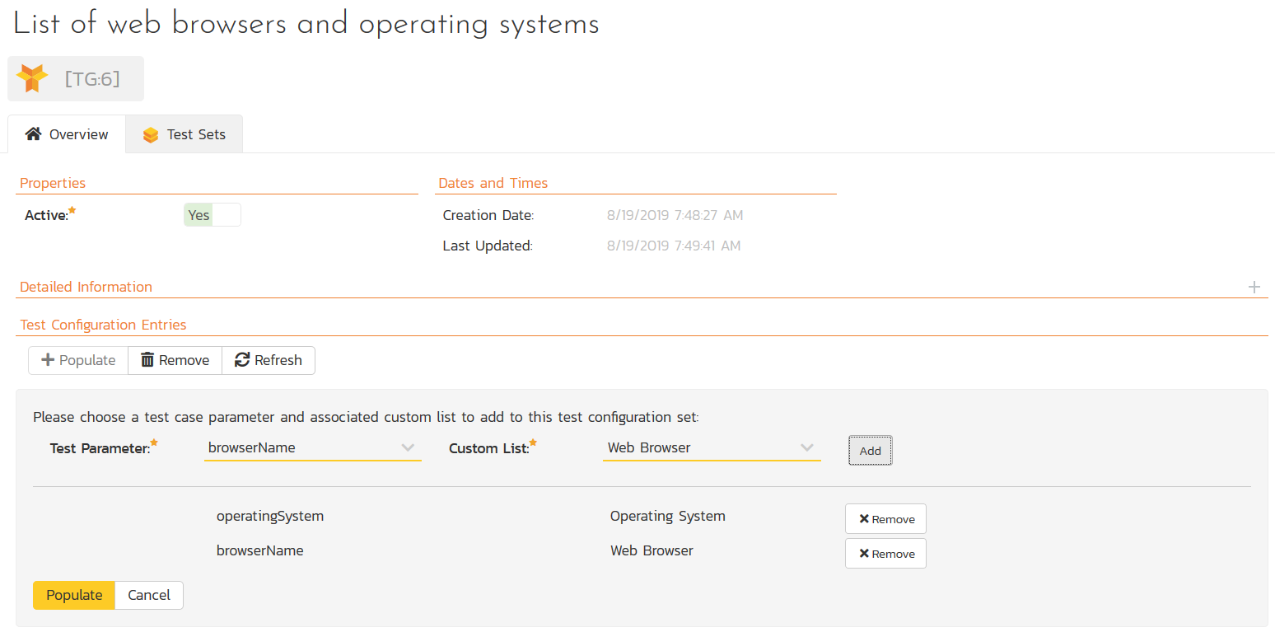
Populate Values

Slide 29
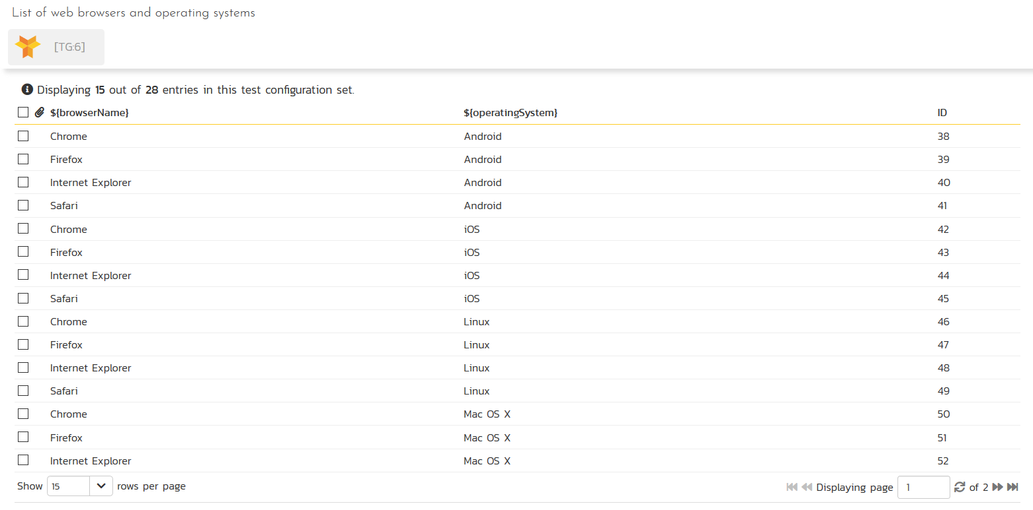
Populate Values
Tip:
You can remove any values that don’t make sense
(e.g. iOS and IE)

Slide 30
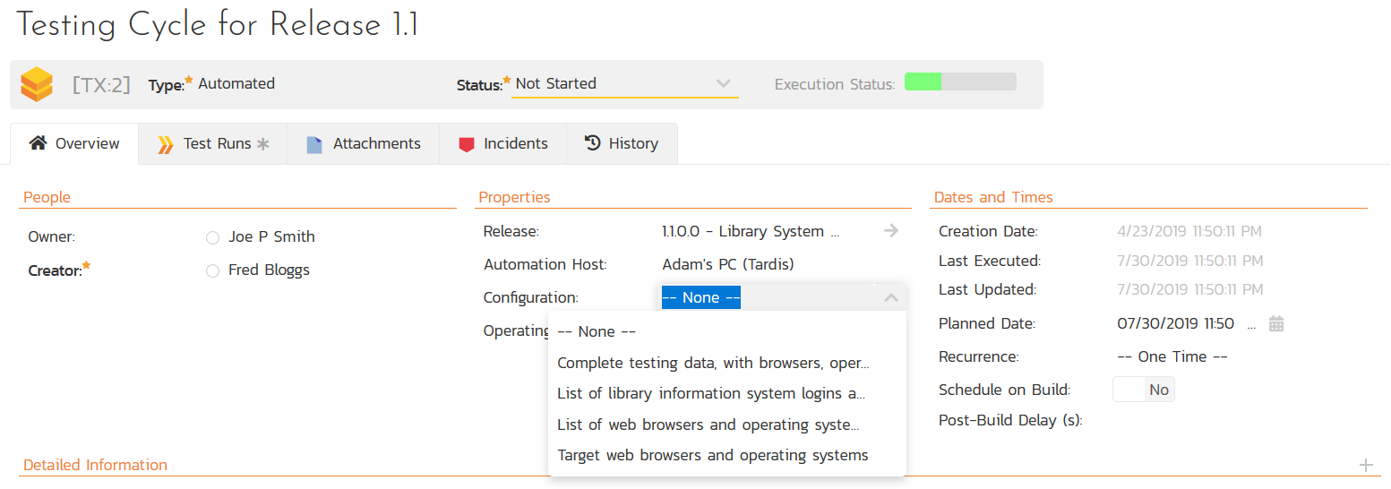
Associate with Test Set

Slide 31
Execute Tests
Manual
Automated
Test Run Created for Each Test Configuration Entry
  10 test cases
  4 web browsers
  3 operating systems
= 10 x 4 x 3
= 120 test runs
Tip: Focus on edge cases for manual tests
RemoteLaunch or RapiseLauncher downloads the test cases in the test set
  Test Configuration Data downloaded separately
  120 test runs executed automatically

Slide 32
Wrap Up

Slide 33
Key Takeaways
Test case parameters let you separate test data from test steps/scripts
Parameters can be used in multiple ways to execute test cases with different data
Test configurations and parameters can be used for both automated and manual testing

Slide 34
Questions?

