Slide 1
Spira API
What Can It Do For You?
@Inflectra | #InflectraCon
Notes:
One of the most important aspects of the Spira platform is its interoperability and openness. We will explain the different API options available, and discussthe relative merits of using REST or SOAP. We will outline our API versioning strategy and illustrate (with code examples) how you can accomplish various practical tasks using the API.

Slide 2
Simon Bor
Head of Products, Inflectra

Slide 3
Session Aims

Slide 4
More precisely…
SOAP vs REST
Version stability = awesome
Inspiration
Simple examples

Slide 5
SOAP vs REST

Slide 6
SOAP
REST
Self describing
Great with C#
Type safety
Autocomplete
Any other language
Minimal tooling/setup
Portable
If in doubt, use REST

Slide 7
Inflectra’s Approach to API

Slide 8
Standard API practice
New version
Logic changes
Old APIs deprecated
API code redos
Devs waste time

Slide 9
We flip things around
New version
Logic changes
We retrofit old APIs
API code keeps working
Devs don’t even notice

Slide 10
Examples
V5 reengineered test cases folders
…V4 test case API works
V6 switched to templates
…V5 API just works
…V4 test case API works
…V3 API still works

Slide 11
Inspiration

Slide 12
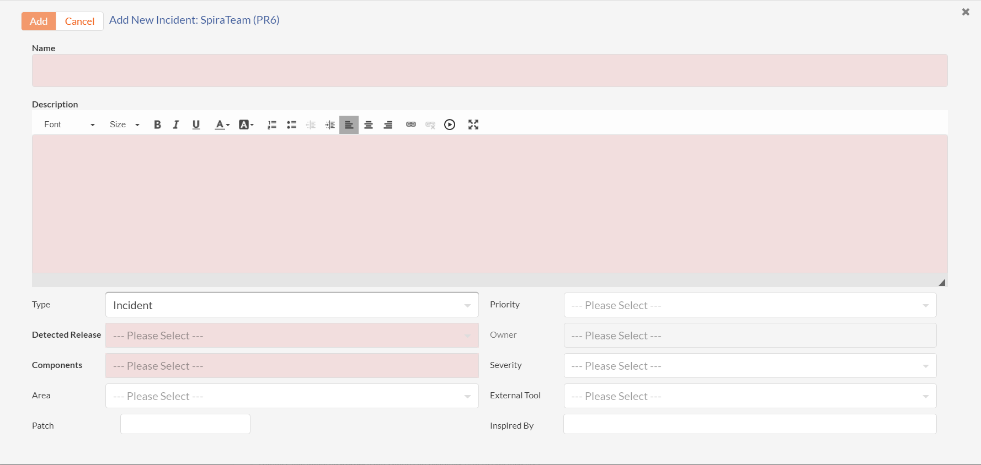
Making new incidents
Notes:
This is the add incident pane in our own tool KronoDesk. It gets all the information it needs about Spira using standard REST API calls.
Once you select a product, the code makes calls that help build out this form – specifically it gets the product specific information for things like incident type and priorities and releases. And it is fully compliant with Spira’s workflow – outside of Spira itself.

Slide 13
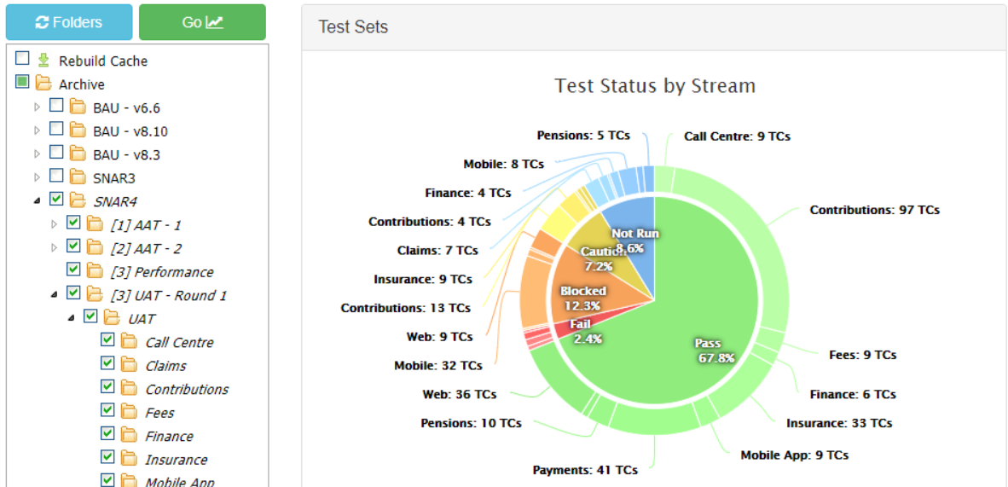
External dashboards
Notes:
This is something a customer shared with me just a few weeks ago. It shows a list of test set folders in a product on the left. The use can select any number of these folders and click Go. It then gets all sorts of information about the relevant test sets to generate loads of charts – test status by folder, by person, over time.

Slide 14
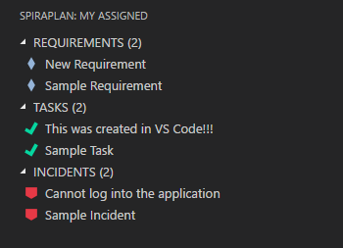
Our IDE plugins
Notes:
We make syncing engines to integrate Spira with other tools like Jira, MS Azure DevOps, legacy tools like HP QC. These all use the APIs of these other services and our SOAP APIs

Slide 15
Our integration plugins
Jira
Microsoft DevOps
Unit test plugins
Dozens more
Notes:
We make syncing engines to integrate Spira with other tools like Jira, MS Azure DevOps, legacy tools like HP QC. These all use the APIs of these other services and our SOAP APIs

Slide 16
How to get started

Slide 17
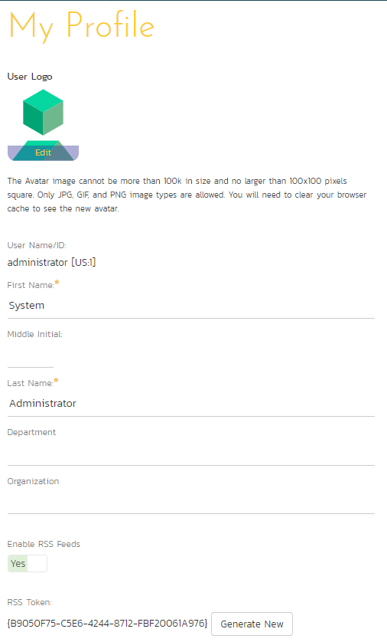
What you need
Access your docs: [spira-url]/Services/v6_0/RestService.aspx
Username: what you use to log in
Api-key: your RSS token

Slide 18
How to connect
base url
api access
api call
authentication
https://acme.spiraservice.net
/services/v6_0/RestService.svc/
projects
?username=administrator&api-key= {B9050F75-C5E6-4244-8712-FBF20061A976}
Notes:
There are a few different ways to connect to REST APIs – here is the most visual and simplest to get

Slide 19
Example walkthrough How to make a task

Slide 20
GET baseurl/projects
Pick your project ID from the array (eg 66)
POST baseurl/projects/66/tasks
BODY: {
“Name”: “My new task”,
“Description”: “I am making this using the API”,
“TaskStatusId”: 1
}

Slide 21
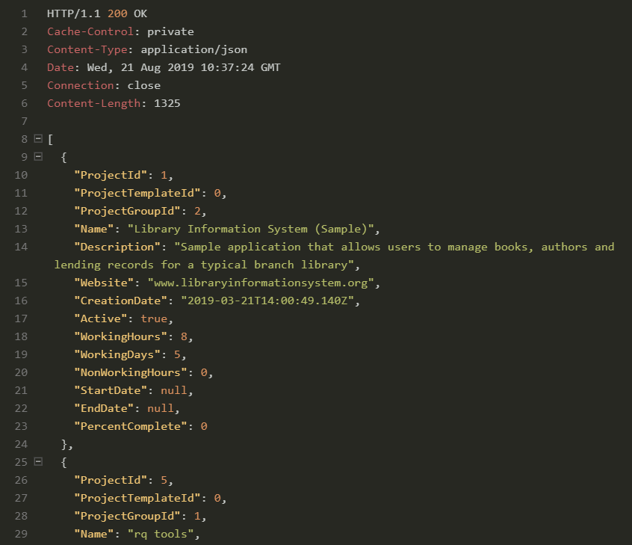

Slide 22
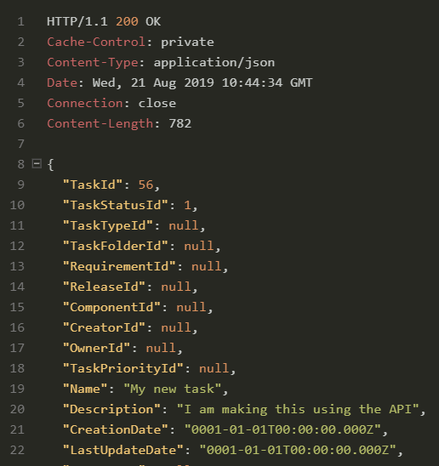

Slide 23
Some random ideas

Slide 24
Users add themselves to products
Decide who can do this: eg admins, members of a department, or on a special list
Create a web page that a user connects using their API credentials – and checks if they can do this

Slide 25
If they can add themselves…
Show list of products they are NOT members of
Let them select products
Maybe let them select their product role
Process their request to add them with a role to a product

Slide 26
Analyze if a release is fully tested
Get details about a release
If not all tests have passed, make a dashboard that shows text of all test step actual results from the most recent test run on that release for each test case

Slide 27
Incident Analysis
Get all P1 incidents created in a date range
Calculate how many are closed
Work out the average time from creation to closed
Automate this so it can be rerun anytime

Slide 28
Challenge: live brainstorming
Notes:
Does anyone have an idea for something – relatively simple – that we could try and make using the API?
Let’s spend a few minutes talking through together what data we would need and how we could pull the code together for it

Slide 29
Tips
api.inflectra.com for documentation
always start simple to check things work
when you get an error, read it, check logs
explore, play around, experiment

