Slide 1
What happened to all my testers?
Test Management in Agile
@Inflectra | #InflectraCon

Slide 2
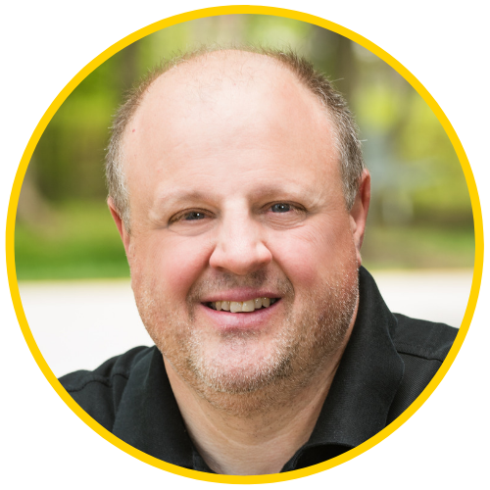
Jeffery Payne
CEO and founder of Coveros
Jeffery Payne is CEO and founder of Coveros, Inc., a company that helps organizations accelerate the delivery of secure, reliable software using agile methods. Prior to founding Coveros, he was the co-founder of application security company Cigital, where he served as Chairman of the Board and CEO for 16 years.
Jeffery is a recognized software expert and popular keynote speaker at both business and technology conferences on a variety of software quality, security, DevOps, and agile topics. He has testified in front of congress on issues such as digital rights management, software quality, and software research.
Jeffery is also the technical editor of the AgileConnection community (www.agileconnection.com)
jeff.payne@coveros.com
www.linkedin.com/in/jeffery-payne-21373
@jefferypayne

Slide 3
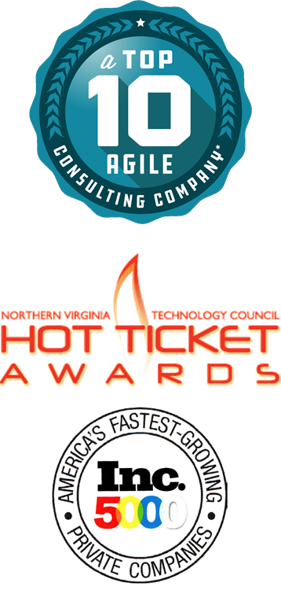
About Coveros
Founded in 2008, Coveros accelerates the delivery of secure, reliable software using agile methods
Services
DevOps implementations
DevSecOps integrations
Agile transformations & coaching
Agile software development
Agile testing & automation
Agile, DevOps, Testing, Security Training
Open source products
SecureCI – CI/CD stack
Selenified – Agile test framework

Slide 4
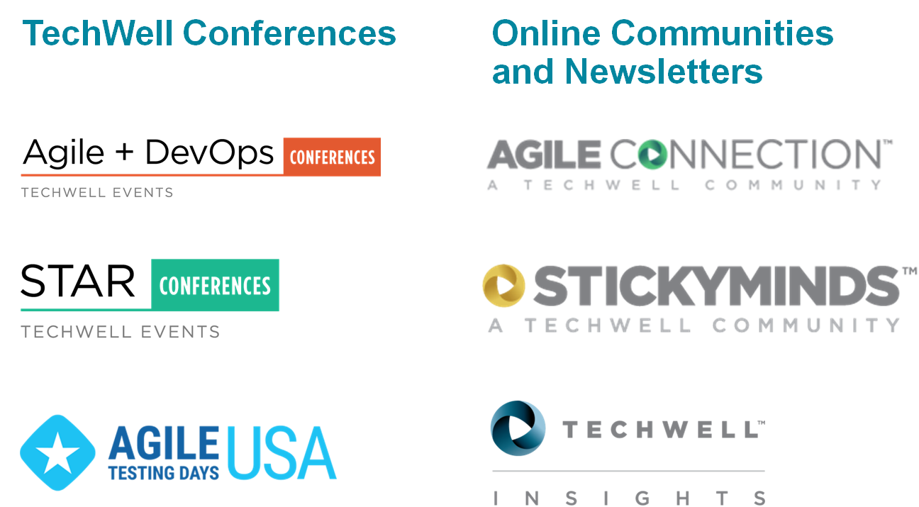
Additional Resources

Slide 5
Agenda
Activities involved in traditional test management
How test management changes with agile
Models for living in an agile world
Questions / wrap up

Slide 6
Traditional Testing Department
Test Manager
Test Lead
Test Lead
Automation Test Lead
Tester
Tester
Tester
Tester
Tester
Auto Tester
Auto Tester

Slide 7
Where are the managers?
?
Scrum Master
Product Owner
Scrum Master
Product Owner
Agile Team
Agile Team
Technical Lead
Technical Lead
Dev
Dev
Managers?
Dev
Dev
SDET
Tester
SDET
Tester

Slide 8
Traditional Test Manager Responsibilities
Capacity – hiring appropriate staff to support test needs
Project staffing – allocating testers to projects
Schedule – scheduling testing activities on projects
Strategy/planning – creation of approach, plans, estimates
Project oversight – oversee tester progress on tasks
Performance management – provide testers feedback on performance and perform appraisals / promotion recommendations
Budget – manage test budget and project test budgets
Enablers – purchase tools, bring in external training, approve conference participation, books/resources, days off

Slide 9
What Agile Teams often own
Staff assignments within project
Project task oversight
Planning, execution, delivery
Day-to-day feedback on performance
Scheduling of activities and durations during sprints
Tracking planned time off
Coaching/mentoring of skills as they pertain to the project
Tool selection (if organization allows this to occur)

Slide 10
What Agile Teams often ignore
Staff performance management
Career growth planning and rewards
Standardization of tooling and lightweight processes
Standardization of approaches / environments
Coaching and mentoring of specific skills
Budgets, hiring, firing

Slide 11
Agile Organizational Patterns
Approaches
Primary goal of Agile is to deliver value for customers so the structure you use will depend on your organization
Exact structure depends upon:
Product set – fewer products makes for easier collaboration and there being fewer natural silos to deal with
Strength and effectiveness of leadership and whether Dev and Ops have a shared goal
Whether IT Operations has the appetite to change from systems thinking to value stream and whether dev will take operational features seriously
Whether the org has the capacity and skills to lead Agile

Slide 12
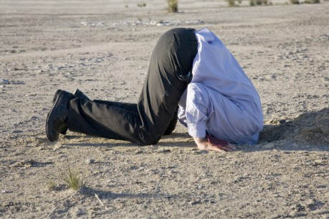
Ostrich model
Managers try to get involved in Sprint team management to keep control of their staff.
Often results in confusion when team members are pulled in different directions.
Managers feel frustrated and out of the loop.

Slide 13
Ostrich model structure
Dev Manager
Test Manager
BA Manager
Ops Manager
Scrum Master
Product Owner
Agile Team
Technical Lead
Dev
Dev
SDET
Tester

Slide 14
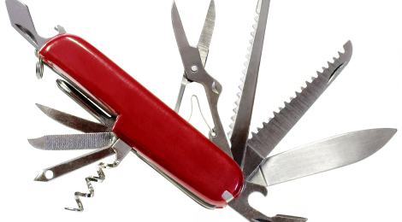
Generalized-specialist model
Once you get beyond a single agile team, coordination of activities and teams IS most definitely necessary.
Many orgs split management in this model between a Scrum of Scrums Master and staff manager
Also, consider shifting to other needed leadership positions: agile coach, Scum of Scrum Master, a Scrum Master

Slide 15
Generalized-specialist model structure
Scrum of Scrums
Agile Staff Mgr(s)
SoS Master
Scrum Master
Scrum Master
Scrum Master
Scrum Master
Agile Team
Agile Team
Agile Team
Agile Team

Slide 16
Center of Excellence model
Some line managers now lead up a role-based center of excellence responsible for:
Coach/mentoring skills
Evaluating and teaching teams about tools
Improving overall technical process / capabilities of teams
Provide training
Others become Scrum Masters and provide line management to entire Scrum team
Good things to coach testers on for agile:
testing more in less time,
how to focus on risk,
scripting skills
Balancing automation with exploratory testing
Driving development with tests

Slide 17
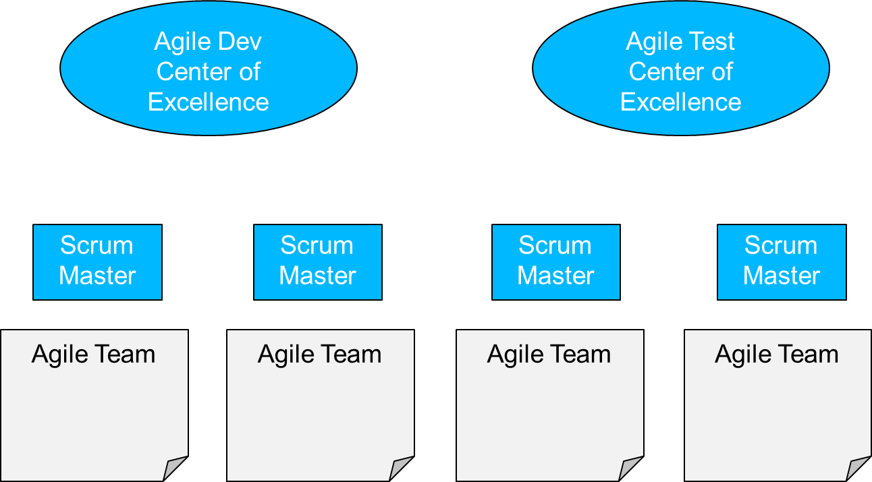
Center of Excellence model structure

Slide 18
Matrix model
Line managers focus on capacity, budgets, reporting, integration of agile teams, performance management
Center of Excellence focuses on coaching, training, tools use, better practices
Managers collaborate to drive success of projects and careers.
Or if a small organization, managers play roles in both staff management and staff growth

Slide 19
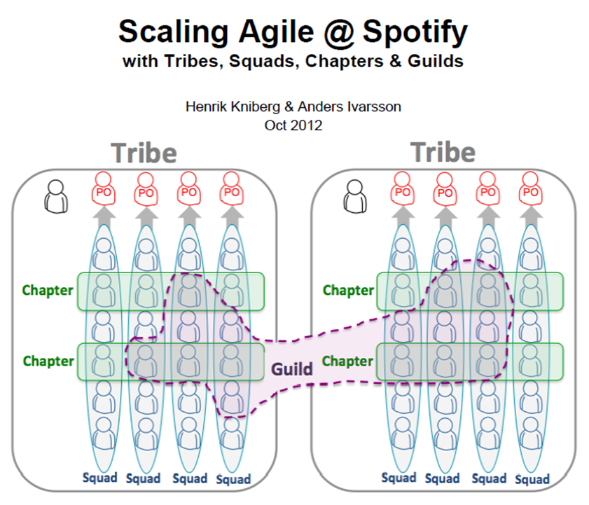
Spotify Example
Developed by Spotify for their own internal use
Shared at agile conferences where other organizations began using it

Slide 20
Spotify Model - Squads
A squad is a single agile team of 5-9 contributors
Squads are led by an agile coach
Squads work with a product owner

Slide 21
Spotify Model - Tribes
A tribe is a set of related squads
Often focused on a single product and/or value stream
Tribes have a dedicated leadership team for making sure squads integrate their work

Slide 22
Spotify Model - Chapters
A chapter is a particular functional area
Chapter leads are responsible for mentoring, growing, and often staffing a functional area
Chapter leads are senior staff and spend half their time in a squad or tribe

Slide 23
Spotify Model - Guilds
A guild is an area of interest within the organization
Guilds can be work related or social
Guilds meet occasionally to share knowledge

Slide 24
Questions?
Contact Information:
Jeffery Payne
jeff.payne@coveros.com
703.431.2920
Michael Sowers
Michael.Sowers@coveros.com
904-621-8235
Notes:
Feel free to contact us any time. We love to hear from students and discuss topics.

