Slide 1
Methodologies 3
Using Spira for Waterfall Projects
@Inflectra | #InflectraCon

Slide 2
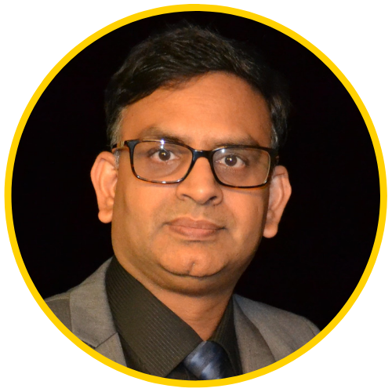
Dr. Sriram Rajagopalan
PhD, MBA, MS, BE
US, Canada, India, Vietnam, Ireland, Belgium, Greece, & Switzerland
Education
Work Experience
Training & Certification
Teaching & Training
PfMP, PgMP, PMP, SP, RMP, ACP, CSM, CSPO, ACC, CSD, SCT, CSOXP, SSBB, Instructional Designer, Speaker, Writer, and Author
Software Engineer, Team Leader, Business Analyst, Project Manager, Scrum Master, Agile Coach, Director, Vice President
@agilesriram

Slide 3
Our Time Today
SDLC Review
Review of Support in SpiraTeam® / SpiraPlan®
Summarize with Q & A

Slide 4
Dr. Royce’s SDLC to Waterfall
SDLC is not Waterfall
Planning
Analysis
Design
Implementation
Maintenance
Notes:
One of the most classic models for product development, in particular software, is waterfall model.
Who is familiar with this model?
Based on the response decide on the details of your presentation.
The waterfall model suggests that development is seen as flowing steadily downwards much like a waterfall through the phases.
The idea is that once you know what the requirements are, you move ahead one step at a time through design and implementation until the product is verified and ready for delivery.
What do you think of this model? Is it going to work?
Expect to hear that this model may have problems since once requirements are set, you need to move forward and implement them without being able to go back. The system is inflexible.
Interestingly the model was first presented by Royce, who suggested it as a failed model and moved on to offer a better model that did not have this limitation. However, his original waterfall model was noticed strongly and became popular.
How do you think we can improve on this model? What is missing?
Expect to hear that we need to have an iterative process so we can go back and forward between the requirements and implementations to make sure what we make is going to be valuable to the end user or the client.
Does anyone know such a system?
Suggest RUP and move on to the next slide to explain it.

Slide 5
Waterfall is a Mindset
Business Case
Extended Business Users
Release Testing
Requirements
Business Users
Acceptance Testing
System Specifications
Architect, Tester
System Testing
System Design
Tester
Integration Testing
Module Design
Engineer
Unit Testing
Development
Rajagopalan, S. (2014). Review of the myths on the original software development model. International Journal of Software Engineering, 5(6), 103-111.

Slide 6
Mindset in Waterfall & Agile
Waterfall
Agile
User Alienation
Big Upfront Design
Role clarity
Breakdown of Quad constraints
Value
Quality
Team
Constraints
Notes:
Waterfall Challenges
Alienates clients and business owners until deployment
Exhaustive documentation (BRD, FRD) resistant to change
Long planning & more time
Compartmentalized roles (PM, BA, Developer): Siloed thought & central dependency
Low visibility on projects: Schedule slip & budget overrun
Quality compromises

Slide 7
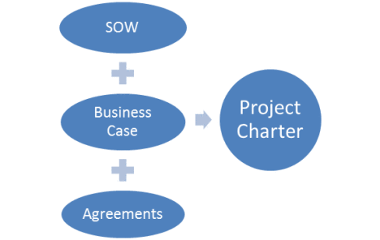
Getting to Scope from Value
Prescriptive
Hybrid
Adaptive
?

Slide 8
Systematic Evaluation
Start
Framework is dependent on how value is going to perceived and delivered
It goes through several checkpoints repeatedly
What works for one product or service in an organization may not always work for similar product or service in a different organization
What works for one business unit may not scale well in another business unit within the organization
What works at one snapshot in time for a framework in an organization may not be applicable for another snapshot in time
What > How
What is known more?
How > More
Predictive
Agile
Low Appetite
Cost of Change?
High Appetite
Predictive
Agile
Moderate
Availability of FACT feedback?
High
Predictive
Agile
Resistant
Adaptive Management Culture?
Enabling
Predictive
Agile
End

Slide 9
Plan Driven Approach
Scope
Schedule
Cost
Quality
Risk
Change
Communication
Resources
Stakeholders
Procurement

Slide 10
Agile Approach
Granularity
Dreams
Castles
Big House
Maintainable Home
2 BR, etc.
Idea
Epic 1
Theme C
Feature I
Need a
Epic 2
Theme D
Theme A
Theme B
Feature II
Need b
Need c
Transparency
Inspection
Adaptation
Time
T0
T10
T50

Slide 11
Requirements
When properly implemented and supported, the critical competency of developing and managing requirements enables the organization to meet stakeholder expectations, improve project performance, meet organizational benefits, and achieve tangible business outcomes.
(PMI, 2016, pg. 2)
When properly implemented and supported, the critical competency of developing and managing requirements enables the organization to meet stakeholder expectations, improve project performance, meet organizational benefits, and achieve tangible business outcomes.
(PMI, 2016, pg. 2)
Project Management Institute (2016). Requirements Management: A Practice Guide. Newtown Square, Pennsylvania.

Slide 12
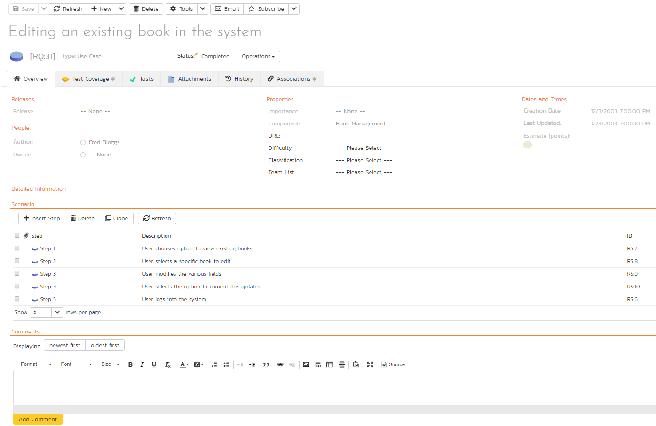
Engage with Stakeholders gathering & reviewing Requirements
Realizes DEEP property with more clarity
Helps with business value prioritization and alignment

Slide 13
Requirements Elicitation
What does the paying customer want?
What exciters can we add to keep the customer with us?
Customer Value Add
Business Value Add
Technical Value Add
Non-Value Add
Process Value Add
What types of documentation / training needed for users?
Are compliance documents needed to sustain business?
How to technology current to avoid risks from shelf-life?
How to avoid technical debt making platforms stable?
How to increase effectiveness by operational excellence?
How to enhance efficiency by continuous improvement?
What types of elements to retire that add no-value?
What types of process and procedure waste to eliminate?

Slide 14
Prioritize and Groom Requirements (incrementally and iteratively)
Project
Major Milestone
Current Iteration or
Minor Milestone
Forecasting what the team needs to work on for two upcoming iterations/milestones

Slide 15
Four Desirable Characteristics
Self-Organization
Time-Boxing
Incrementation
Iteration

Slide 16
Increase Transparency to Plan
Roadmap (Condensed WBS view) is no longer in MS Project or just with the PM.
The team is aware of the degree of requirements-test cases and thus quality of software.
Plan concurrent phases of project, program, or portfolio!

Slide 17
Wait! We have a Workflow Support too!
Customizable Workflow based on business needs
Supports agile principles of transparency, inspection, and adaptation.
Multiple workflows based on requirement types
Includes support for Digital Signature too!

Slide 18
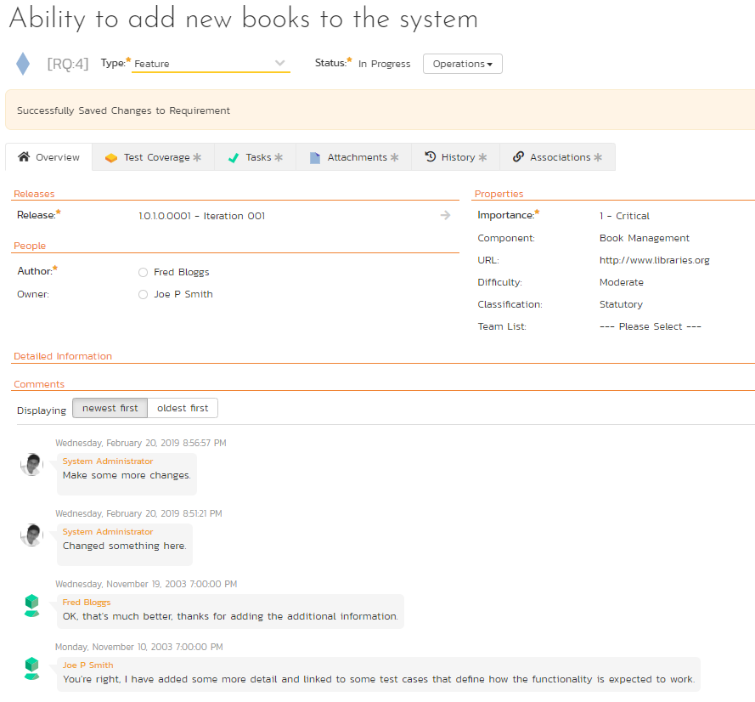
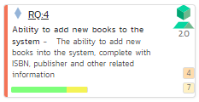
Transparency → Conversation → Better Team Estimates
Much of the collaboration is already happening without infringing on time commitments.
Planning sessions become more productive!
Auditable requirements making it easy for the team to commit story point estimates.
Facilitates remote, distributed, and virtual team collaboration.

Slide 19
Use Themes as Milestones
Aligns with the strategic product roadmap by mapping themes (components) in product backlog
Keep team engaged with releases and iterations

Slide 20
Plan for risk in Estimates by limiting hours/day
Life comes in the way! Whether it is company meetings or issues within the iteration, allowing for flex time mitigates risk.

Slide 21
Centralize task and testing transparency
Number of tasks (4) the team has identified to address this requirement
Visibility to fewer tasks and test cases mean trouble!
Number of test cases (4) the team has identified for acceptance testing.

Slide 22
One STOP to More Traceability

Slide 23
Pictures Speak Progress
View burndown, burnup, velocity, or coverage quickly!
Several widgets available
View coverage on more artifacts!
Export data grid or image for additional discussions

Slide 24
Triage defects without breaking iteration commitments
Not all defects identified need to be solved for project delivery.
Defects are uniquely identified so that these can be addressed during project team meetings.
Defects go through a separate customizable triage workflow as they are evaluated for the severity of impact.

Slide 25
Summary
Waterfall or agile is a framework with a set of philosophies
Focus on business needs by adopting practices
Focus on people, process, technology, and organizational needs

