Slide 1

Requirements Management
Best Practices
@Inflectra | #InflectraCon

Slide 2


Dr. Sriram Rajagopalan
PhD, MBA, MS, BE
US, Canada, India, Vietnam, Belgium, Ireland, Greece, & Switzerland
Education
Work Experience
Training & Certification
Teaching & Training
PfMP, PgMP, PMP, SP, RMP, ACP, CSM, CSPO, ACC, CSD, SCT, CSOXP, SSBB, Instructional Designer, Speaker, Writer, and Author
Software Engineer, Team Leader, Business Analyst, Project Manager, Scrum Master, Agile Coach, Director, Vice President
@agilesriram

Slide 3


Starting the Problem Half
Solved
Being Strategic (and Successful) About Requirements Gathering
Sriram Rajagopalan, PgMP Apr 25, 2019
Notes:
This cover page represents two connotations. The word “half” is illustrated by the two halves of the slide. The left title section is cut in half by the problem sketches on the right. Since we naturally read from left to right, this entire slides represents the progression (left to right) towards a solution. Hence we are looking at a half-solved problem.
Google Image: Heading > Problem Solving

Slide 4

DISCUSSION ROADMAP
Impact of Poor Requirements
Needs Assessment
Strategic Fit
Operational Excellence
Understanding the Importance and Value of Robust Project Requirements Gathering
Notes:
It is best if you can limit primary chapter breaks to 4.

Slide 5
Mostly Known Failure Causes
Poor Scheduling
Inaccurate Business Case
Inaccurate Business Case
Communication Issues
Unclear objectives to Team
Unclear objectives to Team
Quality Compromises
Vague Responsibility
Inefficient Resource Estimation
Stakeholder Challenges
Management Priorities
Management Priorities

Slide 6
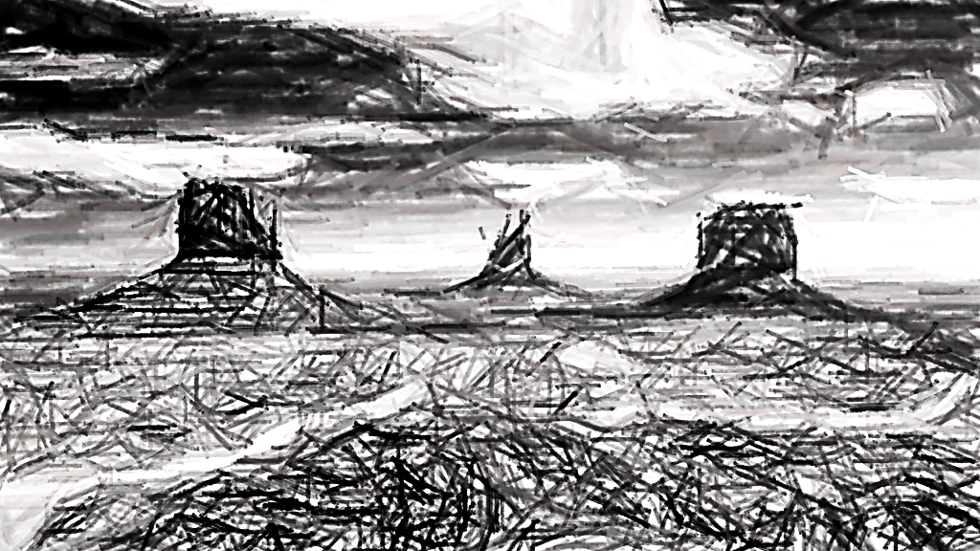


Requirements Communication
Notes:
Morrison Explanation
To be written

Slide 7

I wonder…
“Hmm…what if the Project Manager is the hidden contributing factor for starting the project right?”
Notes:
This slide is my alternative to your slide # 3 – man sitting on books thinking

Slide 8






Relate to the Essential Needs
More Awesome
Value
Awesome Value
Portfolio
Very Good
Value
Programs
Projects
Outcomes Generate Benefits
Realized Benefits Meets Strategic Objectives
Outputs
Produce Capabilities

Slide 9
Always start with a Strategic MVP
Granularity
Dreams
Castles
Big House
Maintainable Home
2 BR, etc.
Idea
Epic 1
Theme C
Feature I
Need a
Epic 2
Theme D
Theme A
Theme B
Feature II
Need b
Need c
Various types of Requirements to suit program or project needs
Support for scenario steps and workflow for every type of requirement
Requirements
Package
Component
Time
T0
T10
T50

Slide 10
Requirements have a Lifecycle
Needs Assessment
Requirements Management
Requirements Elicitation
Requirements Analysis
Requirements Monitoring
Solution Evaluation

Slide 11
Use Cases and User Stories
Use Cases
Prerequisite
Description
Actor
Basic Flow
Alternative Flow
Exception Flow
Post-Condition
User Stories
Card
Conversation
Confirmation
User Stories lack the context to a larger goal
User Stories lack completeness encompassing all aspects of a goal
User Stories do not forecast what work may be coming up

Slide 12












Use Case and User Stories Relationship
Need
Use Case
Features
Design Element
Quality
User Stories
Use Case A
Iteration Backlog
Use Case K
Roadmap
Product Backlog
Use Case M
Review
Use Case Z
Market Research

Slide 13

The Requirements - Competency Matrix
Goal Quadrant
High
Poor Customer Articulation
Good Team Evaluation
Good Customer Articulation
Good Team Evaluation
How Volatile Are Our Requirements?
Team’s Competency Level
[ Evaluation ]
Poor Customer Articulation
Poor Team Evaluation
Good Customer Articulation
Poor Team Evaluation
Low
Customer / Client’s Understanding of What They Want
High
[ Articulation ]
Notes:
This slide is an alternative to Technique # 4 – slide 12
This contains animation builds activated by clicks – some are automated.
Note: You will notice this slide doesn’t contain as much text in your original slide. The intent of this version is just to highlight the location and value of the quadrant. It is what you will say to each quadrant that is more important (which can be the verbiage from your original slide).
The “No” hashed circle and Checkmark icons are your slide two animations. They are used to emphasize danger and acceptance areas.

Slide 14
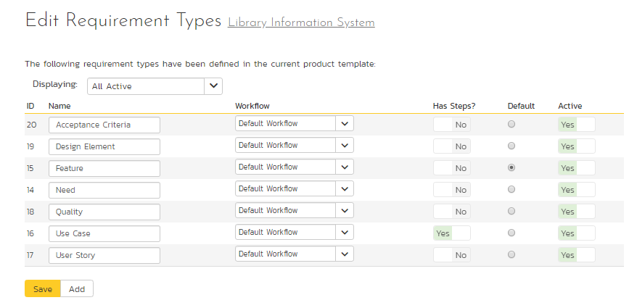
Think through the Requirement Categories
Some requirements one to think through the scenarios!
Not all requirements are the same! So, why not differentiate them?

Slide 15
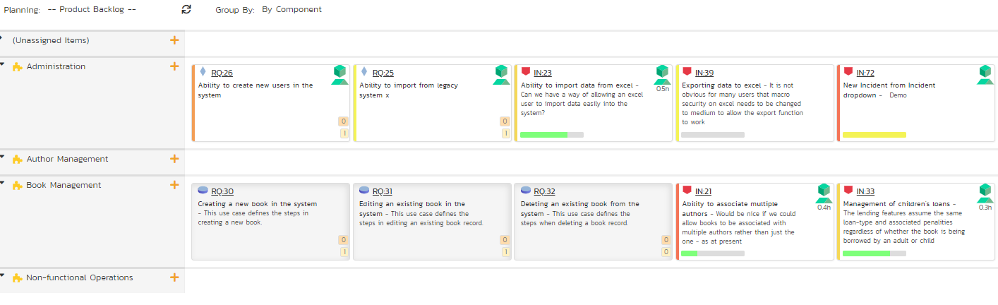
Use Themes as main goals
Aligns with the strategic product roadmap by mapping themes (components) in product backlog
Keep team engaged with releases and iterations

Slide 16

S
tated
P
erceived
SPACE
A
ctual
C
ultural
E
xploited
Notes:
Morrison Explanation
When I see the “word” space, I think of outer space. What better way to get your audience to remember this technique by visually getting them to understand what the term means. Visual association is one of the better techniques for memory retention.

Slide 17


THE NEED
Clearly specific needs are often explicitly expressed
STATED
Notes:
Morrison Explanation
Rather than have all the data in one chart, it is broken up to allow you to zero in on each one. The side is designed to have your audience focused on just the point that you are discussing and not wondering onto any of the other listed needs.

Slide 18
THE NEED
Values gained by choosing a product often as implicitly expected but not stated explicitly
PERCEIVED
Notes:
Morrison Explanation
Rather than have all the data in one chart, it is broken up to allow you to zero in on each one. The side is designed to have your audience focused on just the point that you are discussing and not wondering onto any of the other listed needs.

Slide 19
THE NEED
Satisfaction associated with the expected benefits met by unspoken and spoken needs
ACTUAL
Notes:
Morrison Explanation
Rather than have all the data in one chart, it is broken up to allow you to zero in on each one. The side is designed to have your audience focused on just the point that you are discussing and not wondering onto any of the other listed needs.

Slide 20
THE NEED
Needs other than direct features and benefits setting the decisions apart ahead of competition
CULTURAL
Notes:
Morrison Explanation
Rather than have all the data in one chart, it is broken up to allow you to zero in on each one. The side is designed to have your audience focused on just the point that you are discussing and not wondering onto any of the other listed needs.

Slide 21
THE NEED
Needs that have vulnerabilities from abuse and misuse preferring not to be exposed to and so to be avoided
EXPLOITED
Notes:
Morrison Explanation
Rather than have all the data in one chart, it is broken up to allow you to zero in on each one. The side is designed to have your audience focused on just the point that you are discussing and not wondering onto any of the other listed needs.

Slide 22
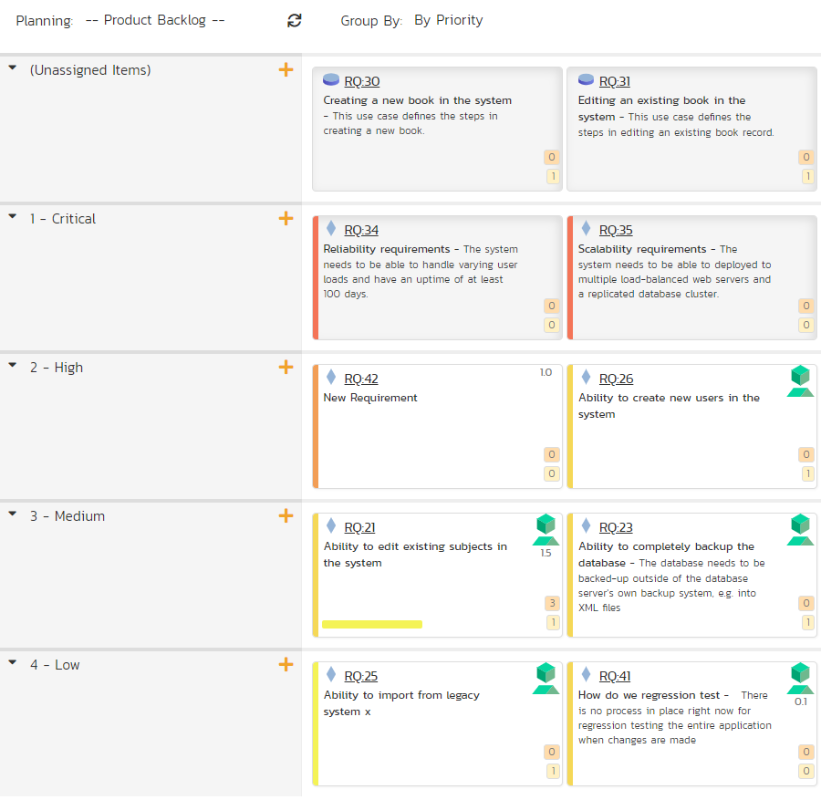
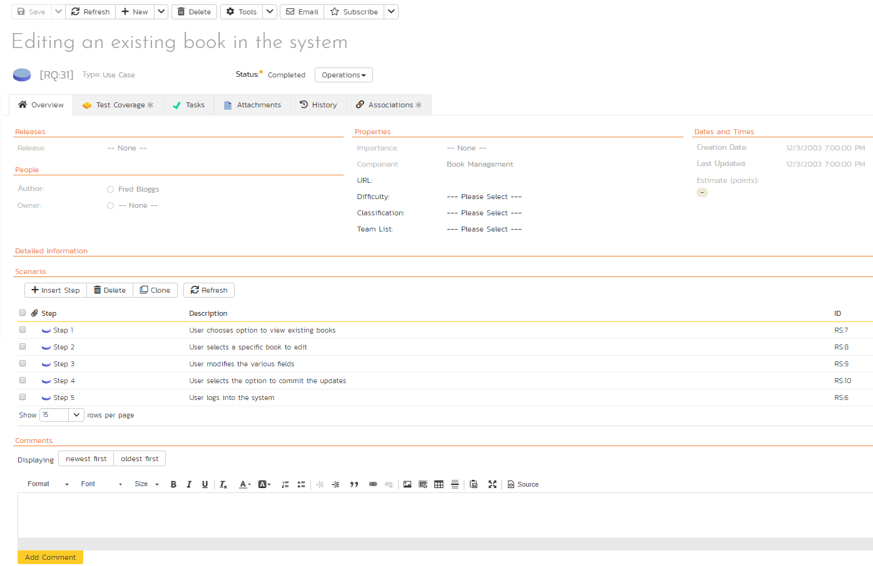
Engage with Stakeholders gathering & reviewing Requirements
Realizes DEEP property with more clarity
Helps with business value prioritization and alignment

Slide 23
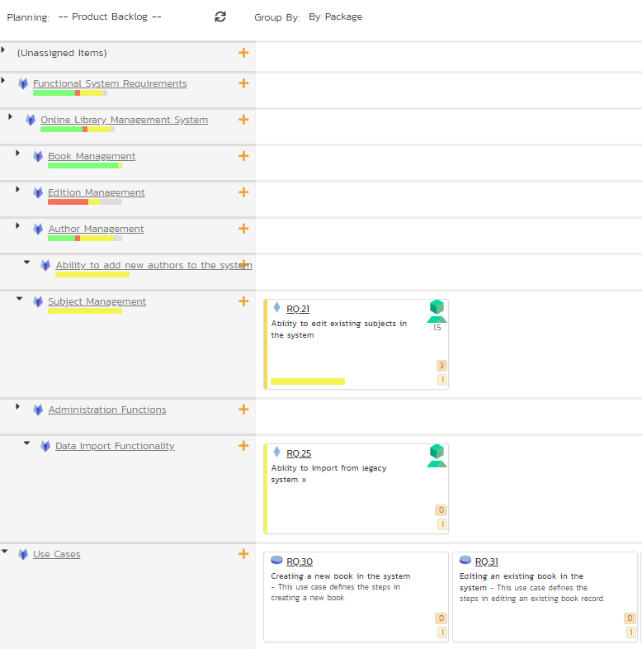
Align functionality based on Strategic Value Alignment
Categorizing requirements by value alignment

Slide 24
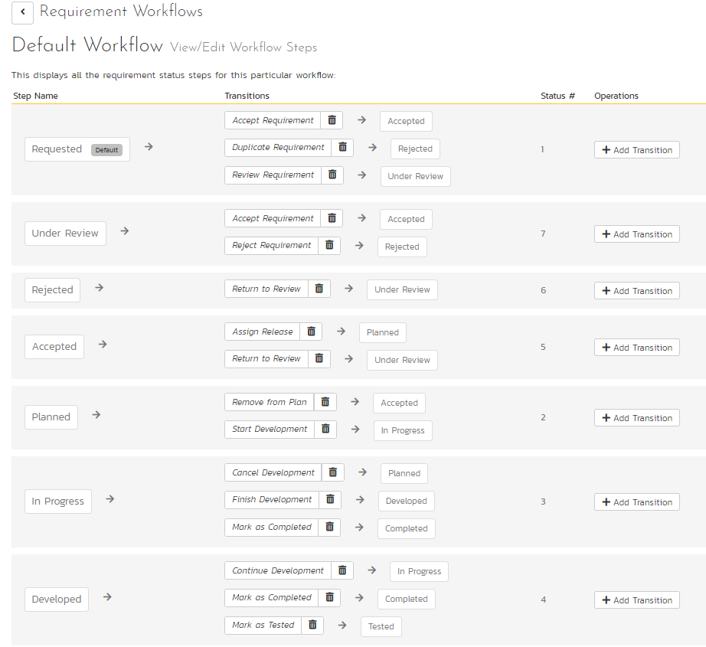
Wait! We have a Workflow Support too!
Customizable Workflow based on business needs
Supports agile principles of transparency, inspection, and adaptation.
Multiple workflows based on requirement types
Includes support for Digital Signature too!

Slide 25


SEE through Delivery
S
Success Criteria
Not just priority but also a pre-negotiated customer acceptance criteria
E
Entry Criteria
Well articulated criteria on when work will be accepted downstream within teams
E
Exit Criteria
Well understood criteria on when additional work or investment will not be made

Slide 26
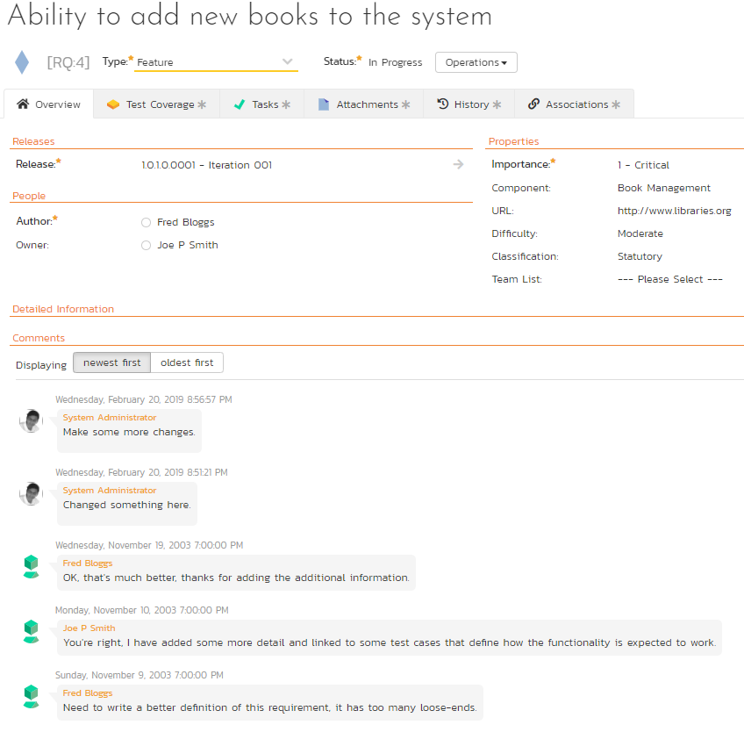
Incorporate workflow operation discipline to promote entry/exit criteria
Expand with traceability to other artifacts to track the quality of requirements!
Promote auditable dialog for requirements through its delivery, transition, and sustenance life cycle

Slide 27
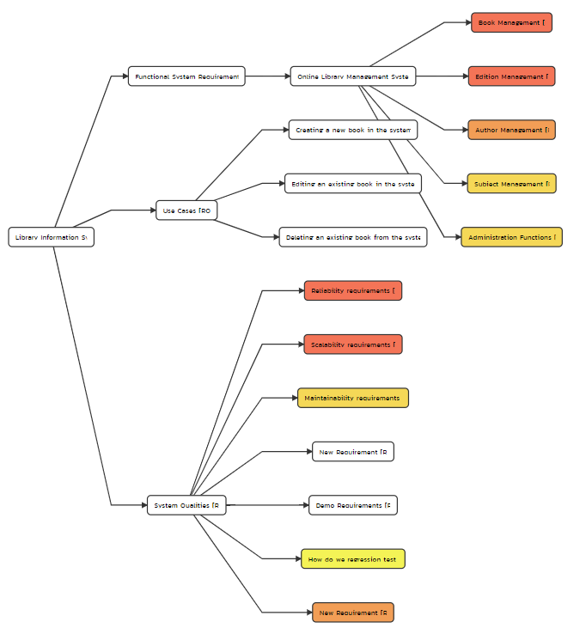
Requirements Mind Map View
Brand New functionality to create a mind map view

Slide 28



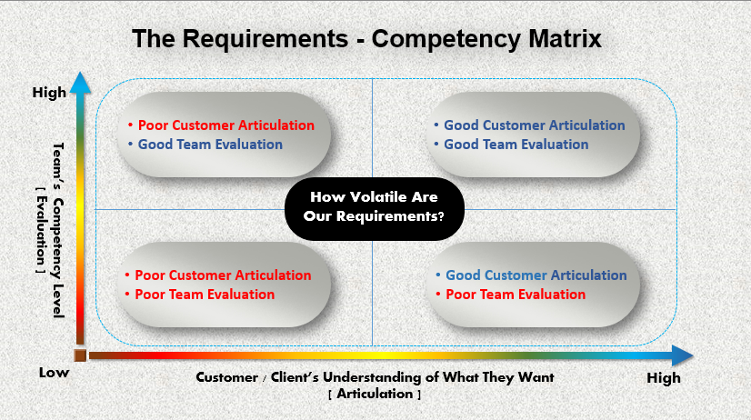
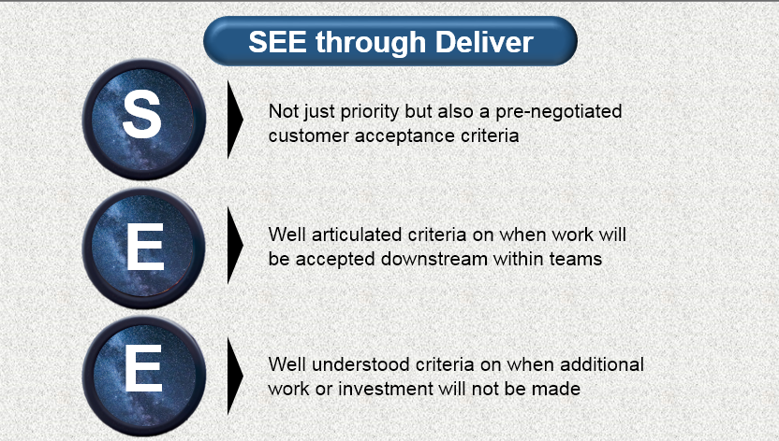
Conclusion
Needs
Assessment
Strategic
Fit
Operational Excellence
+
Notes:
This Conclusion Slide is a replacement for your same named slide # 18

Slide 29


