Slide 1

Rapid & Easy Automated Testing
+ Robotic Process Automation

Slide 2
Agile Software Development
Why You Need Automated Testing and When You Should Use It?

Slide 3
The Agile Manifesto Changed Development
The agile manifesto challenged the orthodoxy around software development, freeing it from the tyranny of process and rigidity, and embracing user feedback and change.
Traditional Waterfall Methodology
Requirements
Gathering
Business Design
Technical Design
Systems Development
Unit
Testing
Integration
Testing
Acceptance
Testing (UAT)
Release Complete
Agile Methodology
Limited Upfront Planning
Release #1
Release #2
Release #3
Release #4
It 1
It 2
It 3
It 4
It 5
It 6
It 7
It 8
It 9
It 10
It 11
It 12
Release Complete
Iteration N
Iteration Planning
Development, Continuous Integration, Unit Testing, Functional & Acceptance Testing

Slide 4
Agile – Led to Continuous Delivery
Organizations quickly realized how much more efficient they could be having integrated teams that collaboratively define the requirements, plan the releases and sprints, test the product during development and deploy the latest update in a seamless way
Release Plan
Iteration
Iteration
Scope
Iteration
Plan
Tested,
Integrated
Working
System

Slide 5
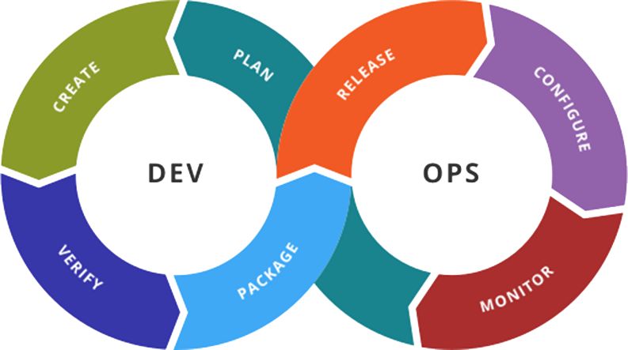
Agile & DevOps – Where is Testing?
Agile Testing is about integrating testing throughout DevOps
(By Devops.png: Rajiv.Pant derivative work: Wylve - derived from Devops.png: , Link, originally by Gary Stevens)

Slide 6
Continuous Testing in DevOps
TESTING
TESTING
TESTING
TESTING
TESTING
TESTING
TESTING
TESTING
Automated testing is the only way to align the speed of testing with development, integration and deployment

Slide 7
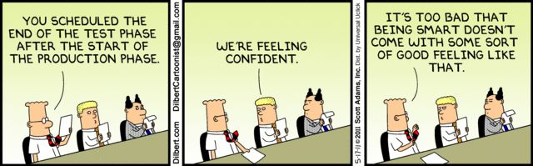
There Is Never Enough Time for Testing
You should not seek to automate 100% of all your tests, because manual testing and automated testing are more efficient at different things

Slide 8
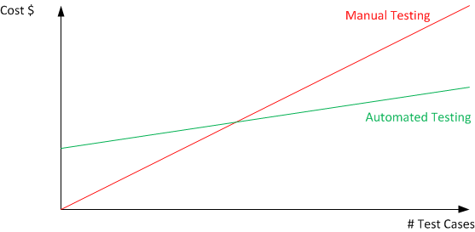
Manual Testing Does Not Scale

Slide 9
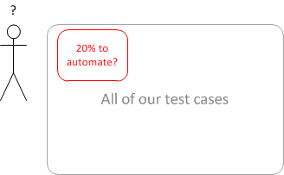
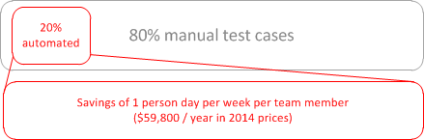
What Should We Automate?
You should base your decisions on the ROI:
Time to create and maintain the automated script VS
Time taken to execute the same script manual vs. automated

Slide 10
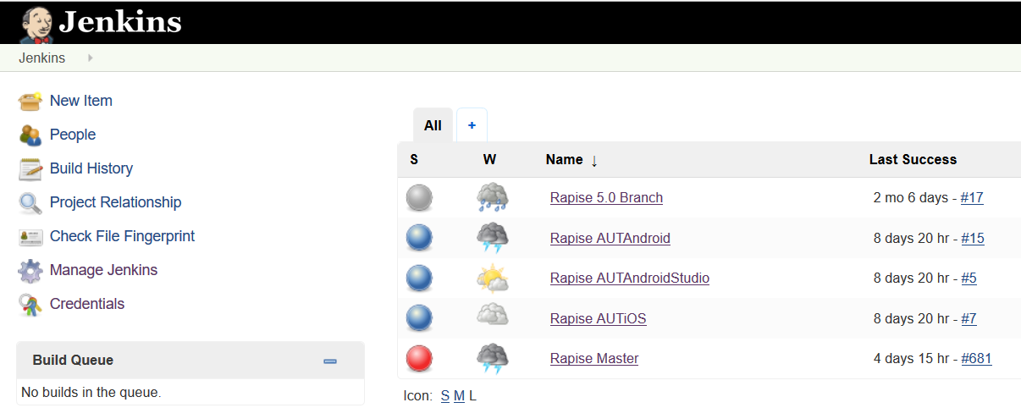
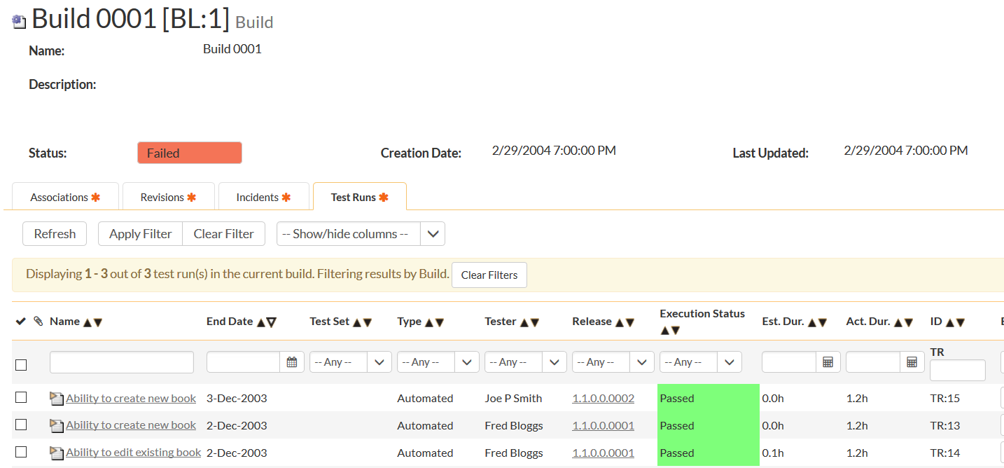
Continuous Integration (CI)
Ensure that you have a robust set of “smoke” tests that can run after every CI build
  Unit, API and Automated UI tests

Slide 11
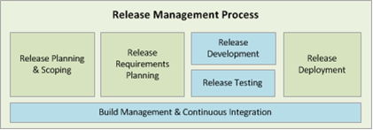
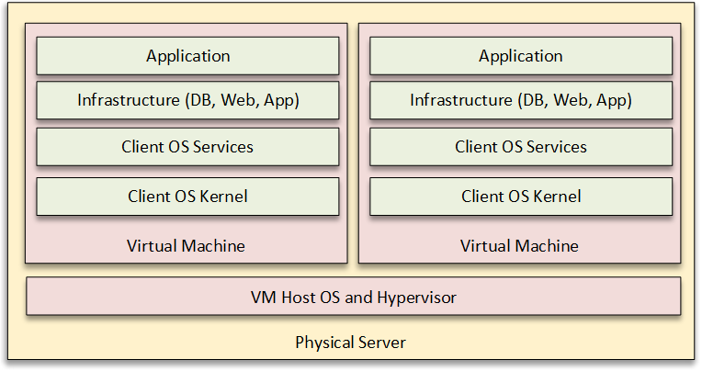
Continuous Deployment (CD)
Automating the process from release ready, tests passed, to production, post-release checks.

Slide 12
The Rapise Difference
How are we different and what our customers say

Slide 13







Introducing the Inflectra® Suite
KronoDesk®
IT Support & Help Desk
SpiraCapture™
Exploratory Testing
SpiraPlan®
Agile Program & Portfolio Management
SpiraTeam®
Application Lifecycle Management (ALM)
SpiraTest®
Requirements, Test Management
& Bug Tracking
TaraVault® - Source Code Management
Rapise®
Test & Process Automation (Web, GUI, Services)

Slide 14
Rapise – The Complete Automation Solution
KronoDesk®
IT Support & Help Desk Ticketing
SpiraTeam®
SpiraTest®
Requirements, Test &
Defect Management
Agile Project
Management
+
TaraVault® - Source Code Management & DevOps
Rapise®
Test & Process Automation Platform (Web, GUI, Services)

Slide 15
harmony
Notes:
Make great products
Help you work together
Help you deliver your products faster, more easily, with less pain, and less stress
At a grand scale – we’re passionate about making products that you will find transformative to how you work.
We both want to use our tools every day to help you do a whole number of complex things, and at the same time get out of your way so you don’t need to worry about SpiraTeam and can instead focus on helping your own customers

Slide 16
How Do We Foster Harmony?
Across Disciplines
Through Simplicity
Across Ecosystems

Slide 17



Harmony Across the Disciplines
Testers
Developers
Managers
We consider each of these three stakeholders groups when designing features for Rapise, so that everyone in teams can get the most out of the system working together.

Slide 18


Simplicity = Productivity from Day One
Less Time Doing:
More Time Doing:
No plugins, customization or configuration needed day one

Slide 19
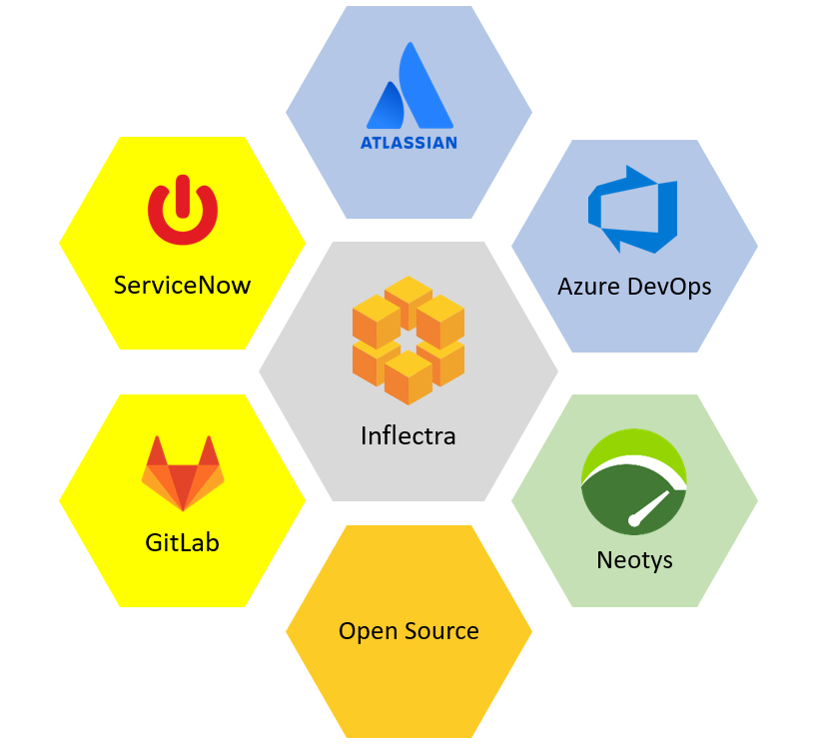
Harmony Across Ecosystems
We recognize that you need to integrate
Rapise with other tools and systems
We make this easy and straightforward so you can get working faster & easier

Slide 20































Representative Customers by Industry
We have ~ 80,000 users in 5,000+ companies worldwide:
Energy & Industrial
Financial & Business Services
Government & Defense
Information Technology
Healthcare & Bio-Technology
Telecommunications
Retail & Consumer Goods
Transportation & Hospitality

Slide 21

























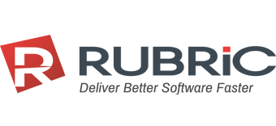
Global Partner Network
North America
South America & Mexico
Asia
Europe
Australia
Middle East & Africa

Slide 22
Customer Testimonials
“
We have been using the Rapise automation tool for a few years now. I have been very impressed with just how simple the tool is to setup and record your automation scripts. As we have learned more about the tool we have found it to have all the functionality we need without all the complexity of many other tools out there… We can rely on the trusted Inflectra customer support team that has always been awesome.
- Daniel Hauser, Sr. QA Analyst RegEd
“
It was very easy to learn and get started using the tool to automate our manual test cases. The Inflectra support has been great in working with us to identify and add features as needed. We are currently using Rapise to automate our regression test bed for Microsoft Dynamics AX ERP System. The customer support has been great in helping us to get started. The tool integrates well with SpiraTeam, so we can launch our tests and record results. Rapise has been easy to learn and quick to make progress on automating our regression test bed. We are very happy with the tool and the support that we have received from Inflectra. It is a high quality product at a great price..
- Kevin D., Kent Corporation
“

Slide 23
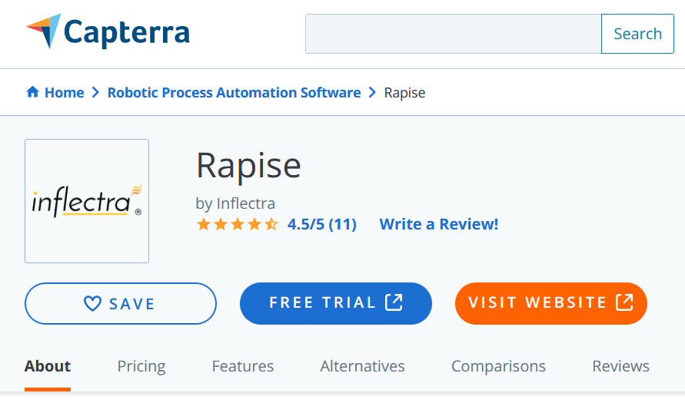
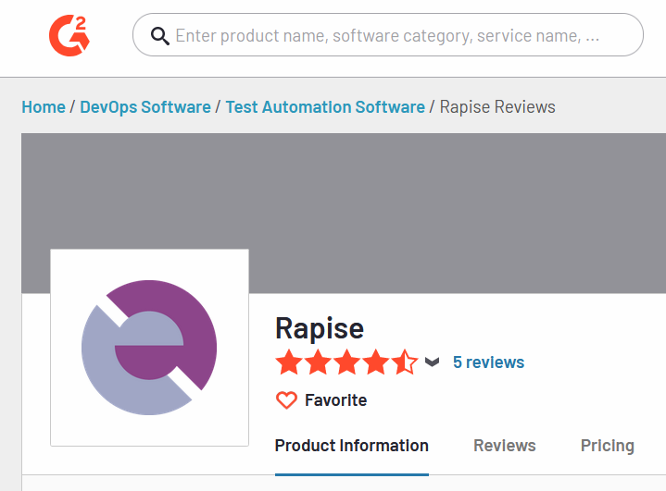
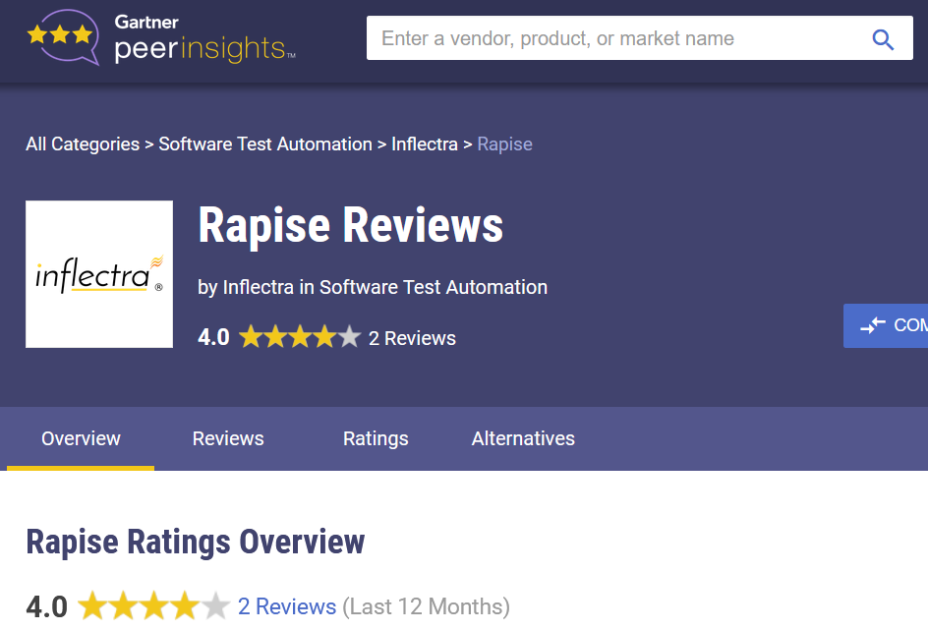
Awards and Recognition*
*Gartner, G2 Crowd, Capterra

Slide 24
Inflectra Core Values
Great Products: Build for Our Users Not Investors
  Building great software for customers, not chasing the latest fad.
Great Team: We Just Get it Done
  Treat customers well, solve their problems, no drama or red tape.
Great Workplace: Family and Life Flexibility
  Unlimited vacation, amazing benefits, flex/part time welcomed.
Great Community: Enabling Second Acts
  Expanding opportunities for new/second careers in technology.

Slide 25
Feature Overview
The Top 10 Reasons You Should Use Rapise

Slide 26
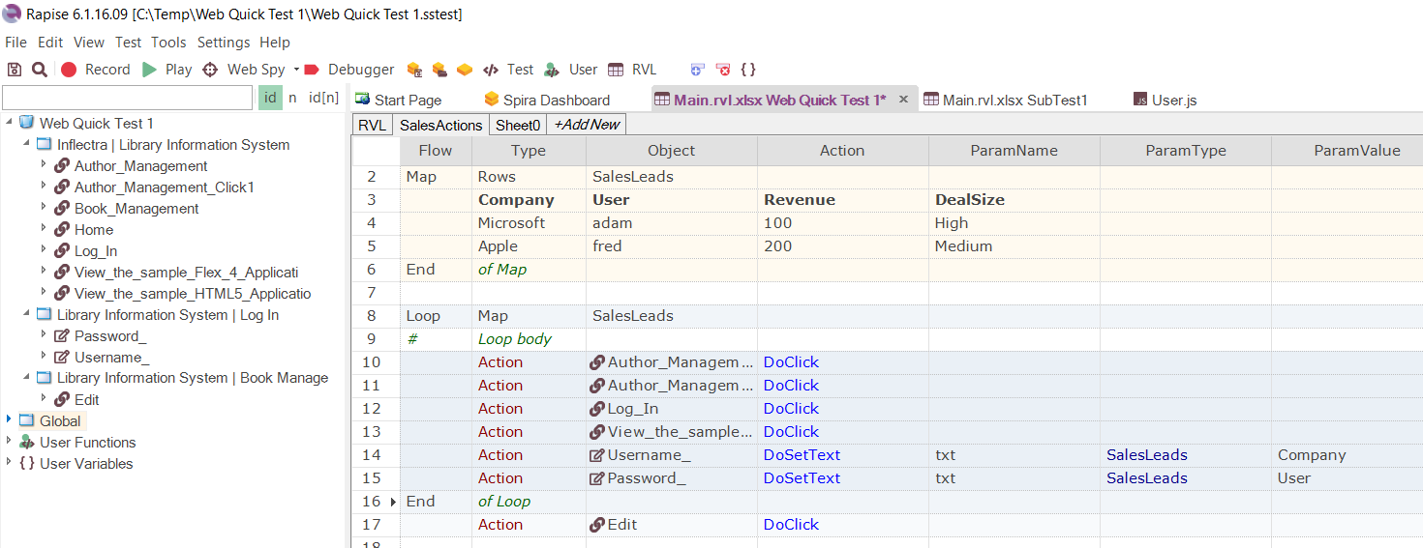
1. Codeless Automation vs. Custom Framework
Maintenance of automated tests is the biggest issue
Custom frameworks = Job Security
v.s. Self-Healing Tests with AI-Based Locators

Slide 27



















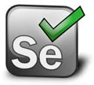

2. Coverage of Your Applications
Web Applications
Mobile Applications
Cross-Platform Technologies
Windows Applications
Enterprise Applications
Third-Party Component Libraries
Unit Test Frameworks
Integrations

Slide 28
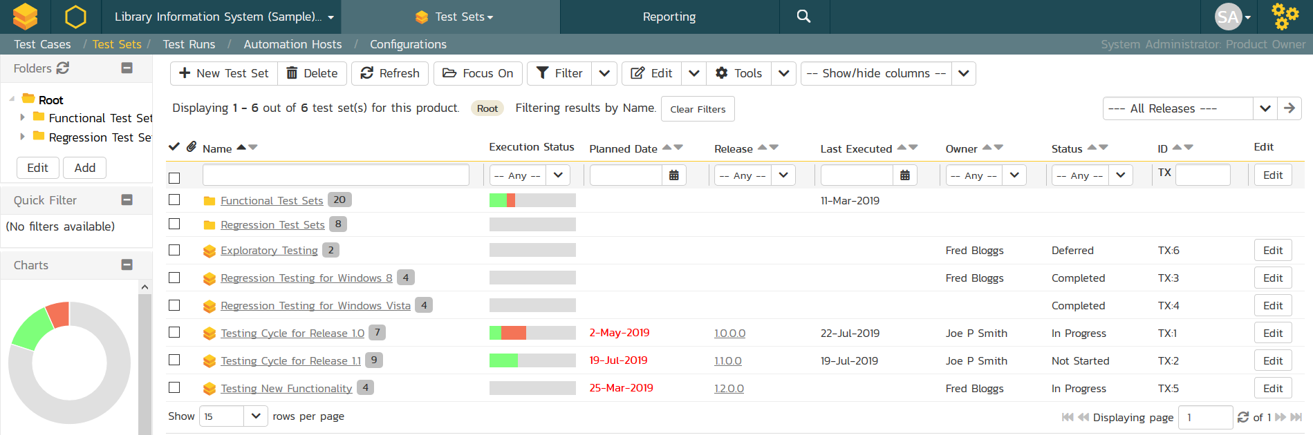
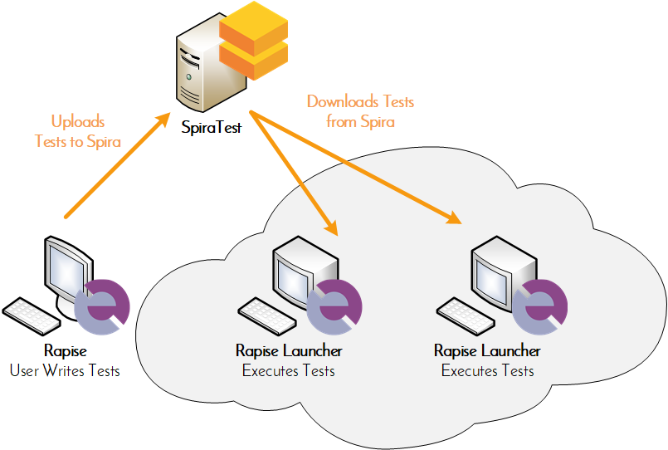
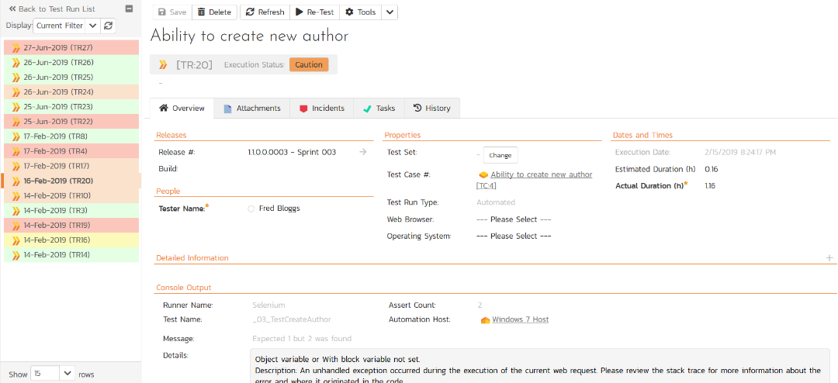
3. Distributed Testing
Orchestrate your automated Rapise tests from SpiraTest, with integrated test lab management and data-driven testing

Slide 29
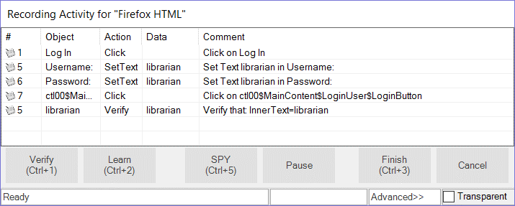
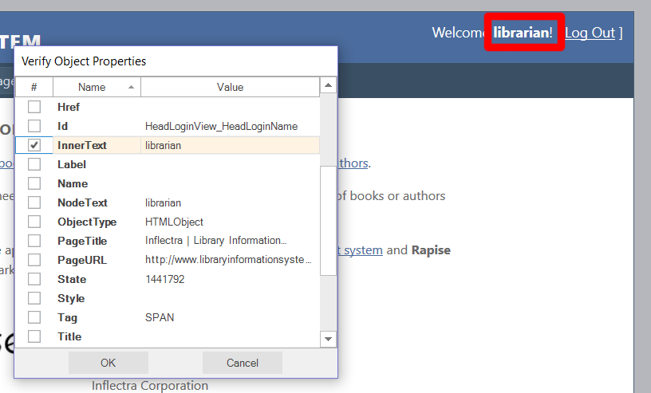
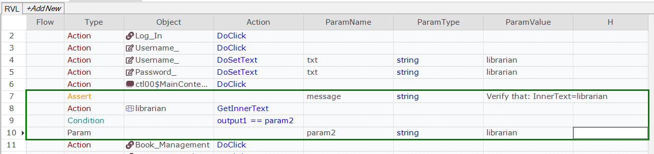
4. Automated Recording & Verification

Slide 30
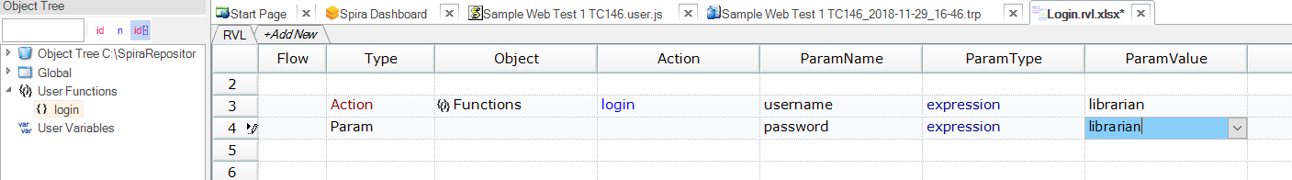
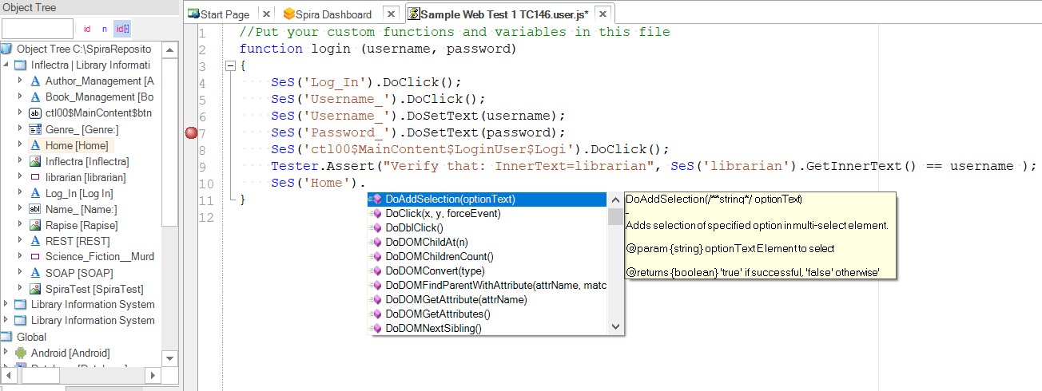
5. Extensible with Code (when needed!)

Slide 31
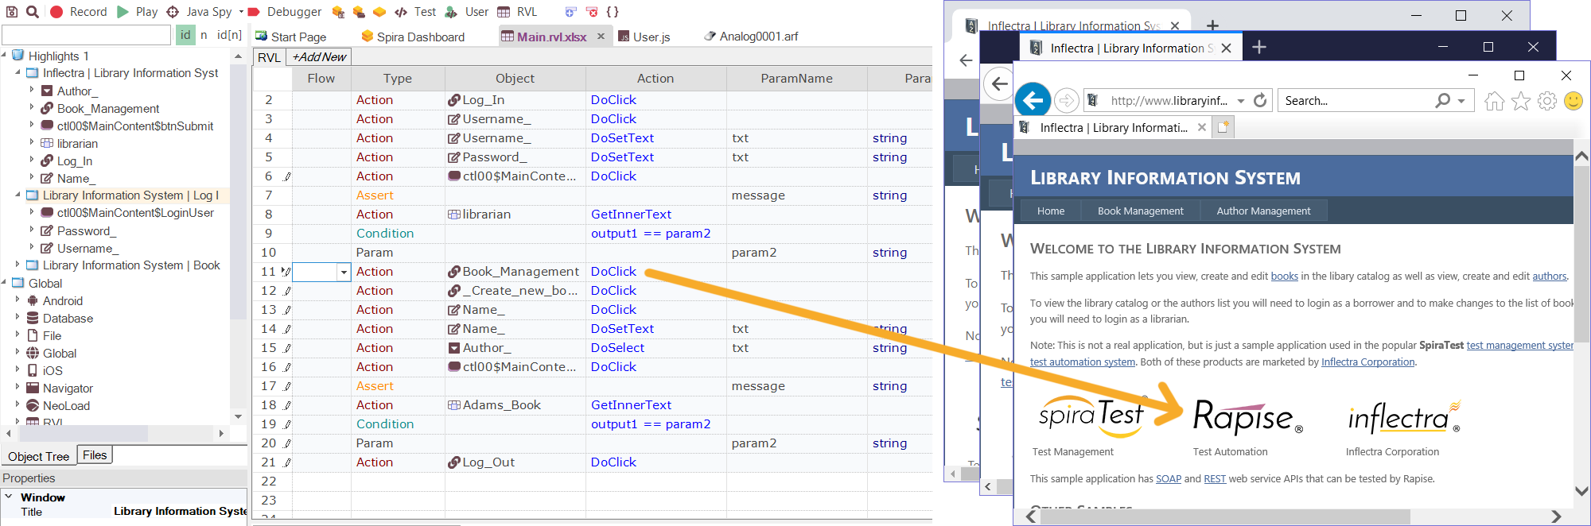

6. Cross-Browser & Device Support

Slide 32
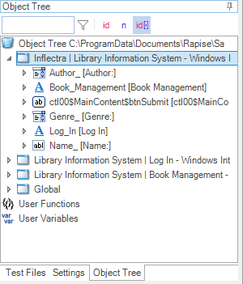
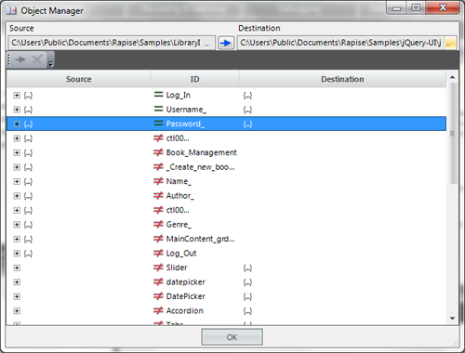
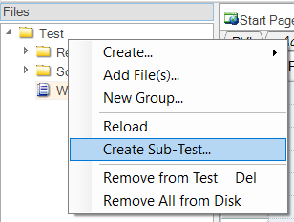
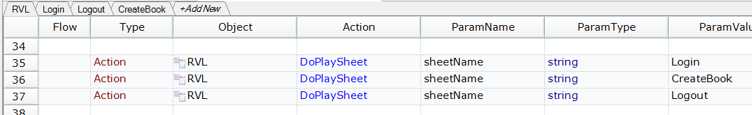
7. Reusable Steps and Objects

Slide 33
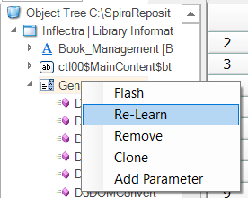
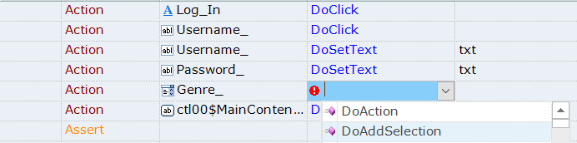
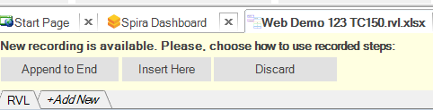
8. Easy Modification / Update

Slide 34
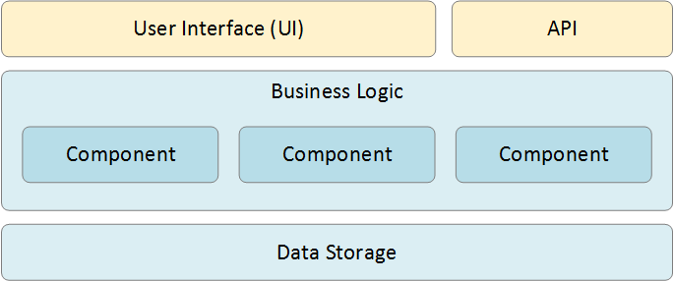
9. Support for UI and API Testing

Slide 35
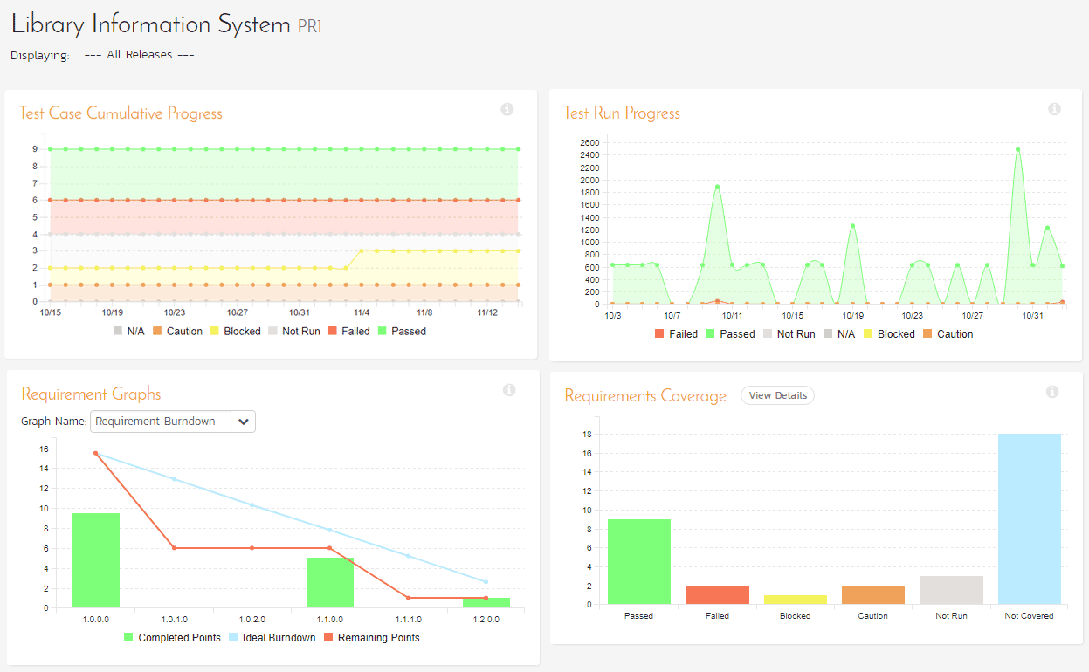
10. Powerful Reporting with SpiraTest

Slide 36
Platforms Supported
Rapise is your best choice for web, mobile, desktop and APIs

Slide 37
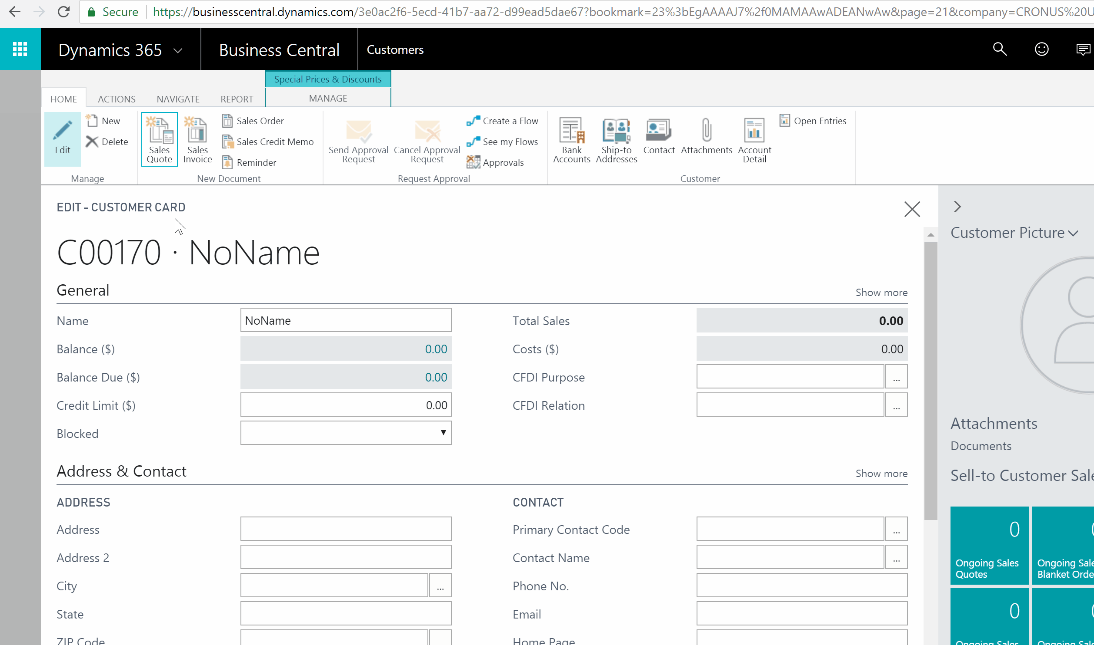
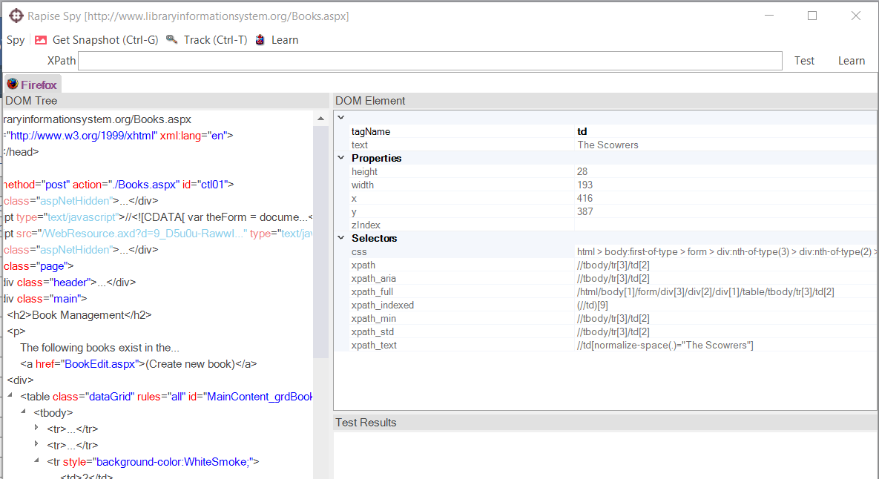
Web Applications
Rapise supports multiple versions of IE, Edge, Firefox Chrome, Safari and Opera. You can record in one browser and playback in all.

Slide 38
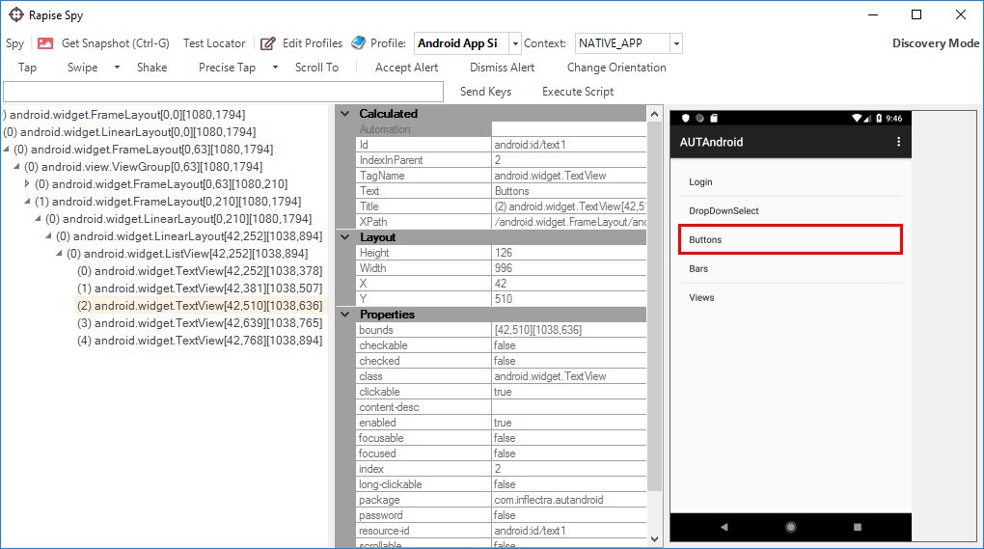
Mobile Apps
Automate Mobile Apps (native, web, iOS, Android)
Works with physical, simulated and cloud devices

Slide 39
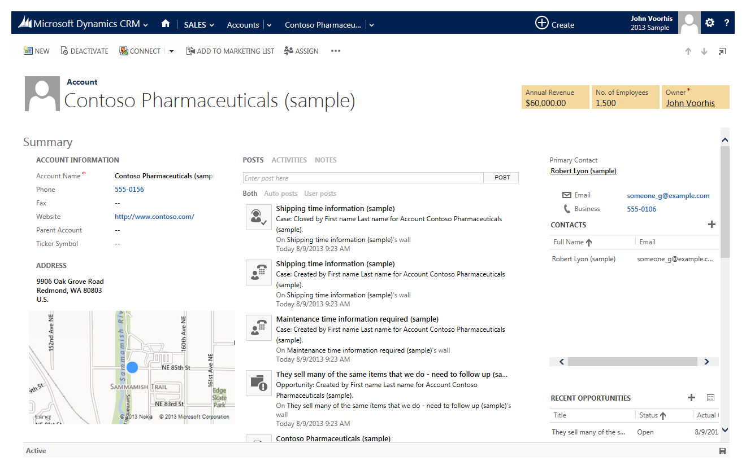
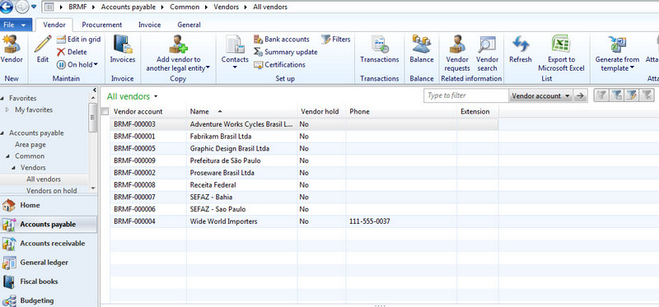
Desktop Applications
Rapise can automate most desktop applications
Support for Windows, Java, Qt, .NET Applications
Libraries for common third party components and controls

Slide 40
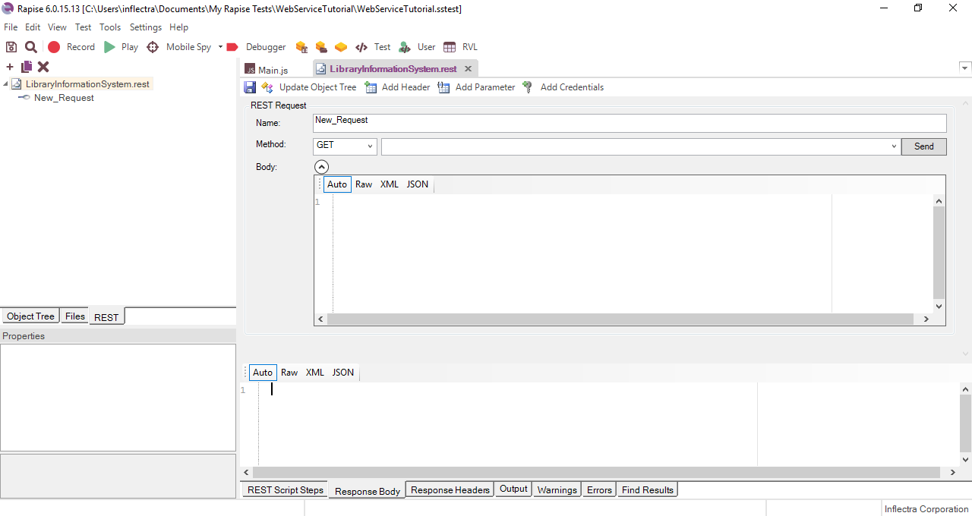
Web Services & APIs
Automates REST and SOAP web service APIs

Slide 41
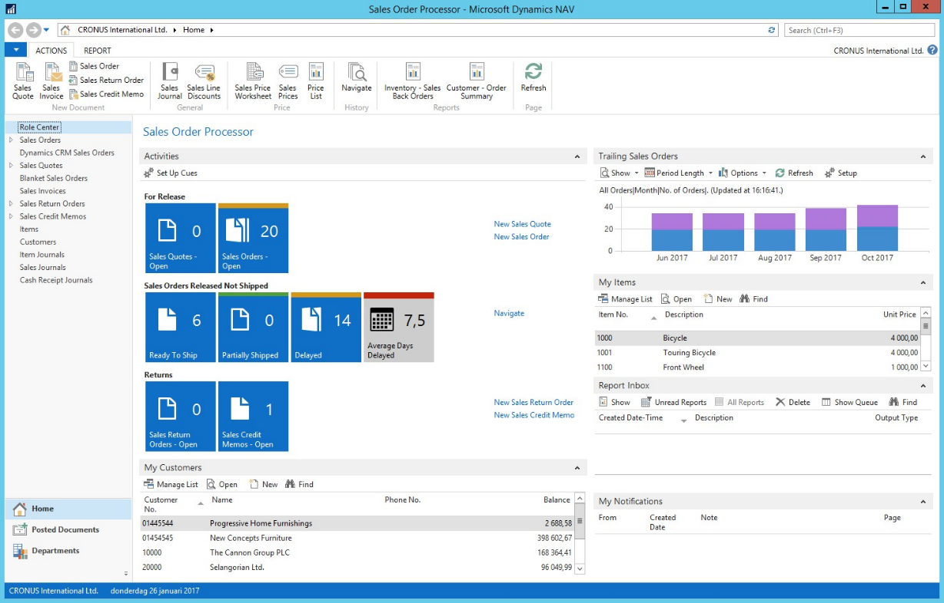
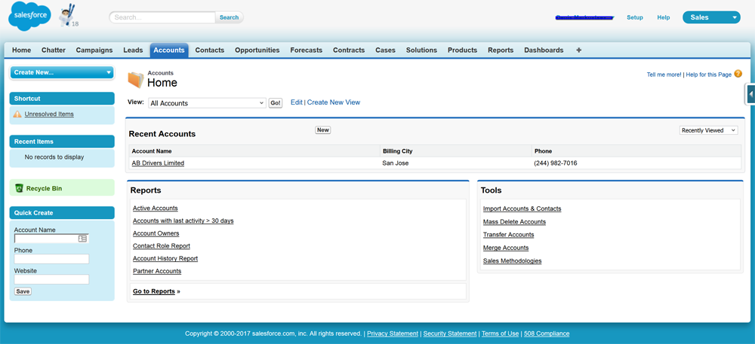
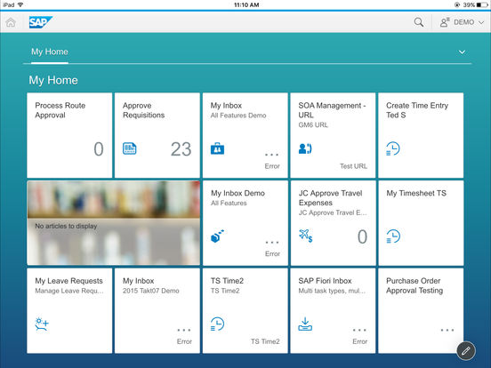
Enterprise Applications
Special support for CRM tools such as Salesforce and Dynamics 365
Support for ERP platforms: SAP and Dynamics AX & NAV

Slide 42
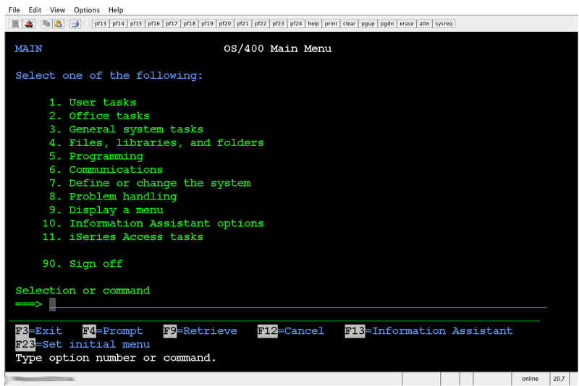
Terminal (Mainframe) Applications
Rapise has support for “green screen” mainframe applications running on VT100 or AS400 style terminals.
Rapise can connect to a variety of terminal emulators, both Java Swing or Windows native, to automate text-based terminal applications

Slide 43
What About RPA?
Rapise is a powerful Robotic Process Automation (RPA) Tool

Slide 44
Robotic Process Automation - RPA
RPA – is a software for automatic manipulation of PC’s user interface.
RPA software can do what a real user can do and more.

Slide 45
What RPA Can Do
Save time
Repetitive
tasks
24/7
Save budget
Work autonomously
Analyze
Process
Integrate legacy systems
large volumes of data
for employees

Slide 46
RPA Benefits
Fast & Cheap Implementation
Easy to Support
Local & Remote Scheduled & On Demand Execution
Data Access Control at UI Level
Uses Existing IT Systems

Slide 47
Rapise RPA Capabilities
Automation for Desktop, Mobile and Web applications
  Independent of screen resolution and coordinates
REST and SOAP calls to third-party systems
Database connection
Email processing
File & Command Line operations
Text manipulation
Full support for Excel spreadsheets
Flexible reporting

Slide 48
Common RPA Scenarios & Tasks
Fill a form based on data in external file
Create a record from incoming email
Import data from a spreadsheet or third-party system
Web scraping
Screen scraping
Terminal automation

Slide 49
Questions?

