Slide 1
Real Testing Scenario Strategy:
Bringing this all together – Success!
Presented by
Adam Sandman
Inflectra Corporation
QA Geek Week | Hertzliya, Israel, 2018

Slide 2

About Me
Adam Sandman was a programmer from the age of 10 and has been working in the IT industry for the past 20 years.
Currently Adam is a Director of Technology at Inflectra Corporation, where he is interested in technology, business and innovation.
Adam lives in Washington, DC, USA

Slide 3
Agenda
Requirements Discovery and management, linked to:
  Manual testing
  Unit testing (e.g. NUnit, MS-Test, jUnit)
  UI testing
  Load testing
  API Testing
Connecting to CI server such as Jenkins.
Data-driven testing example
Monitoring, with dashboards and reporting

Slide 4
Takeaways
Learn about the different tiers of testing
Understand how tools can address the challenges of testing each tier
See a sample architecture for a typical web-based multi-tier application
How you can bring it all together for your applications

Slide 5
Creating the Test Plan

Slide 6
Testing = Manage Technical Risk

Slide 7
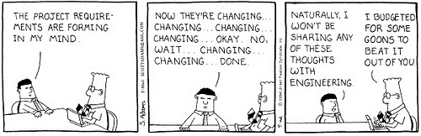
So What Do We Need to Do First?
Define Our Requirements
Develop Our Test Strategy

Slide 8
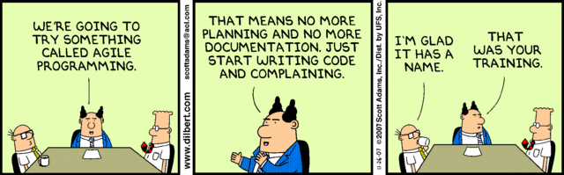
What Are The Requirements?
We need a set of “requirements” to write our tests, regardless of whether we’re using an Agile or Waterfall methodology.

Slide 9
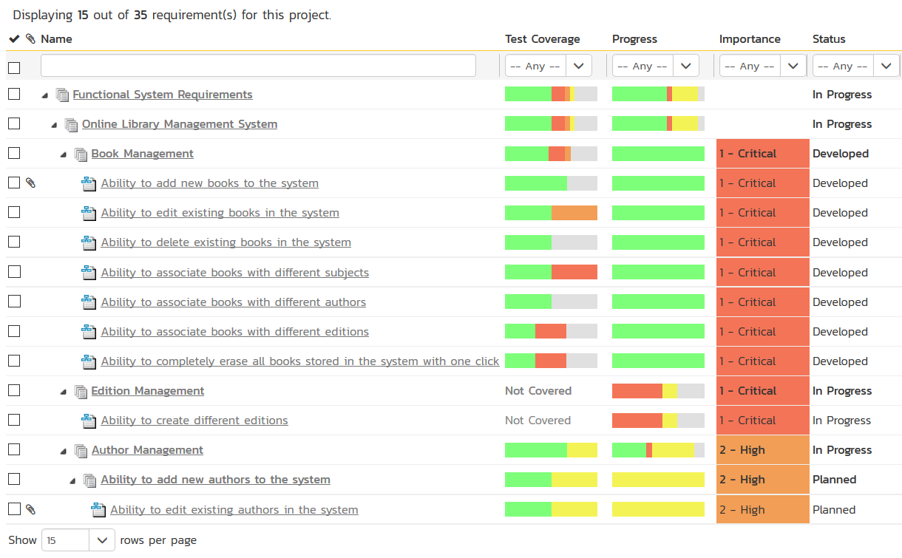
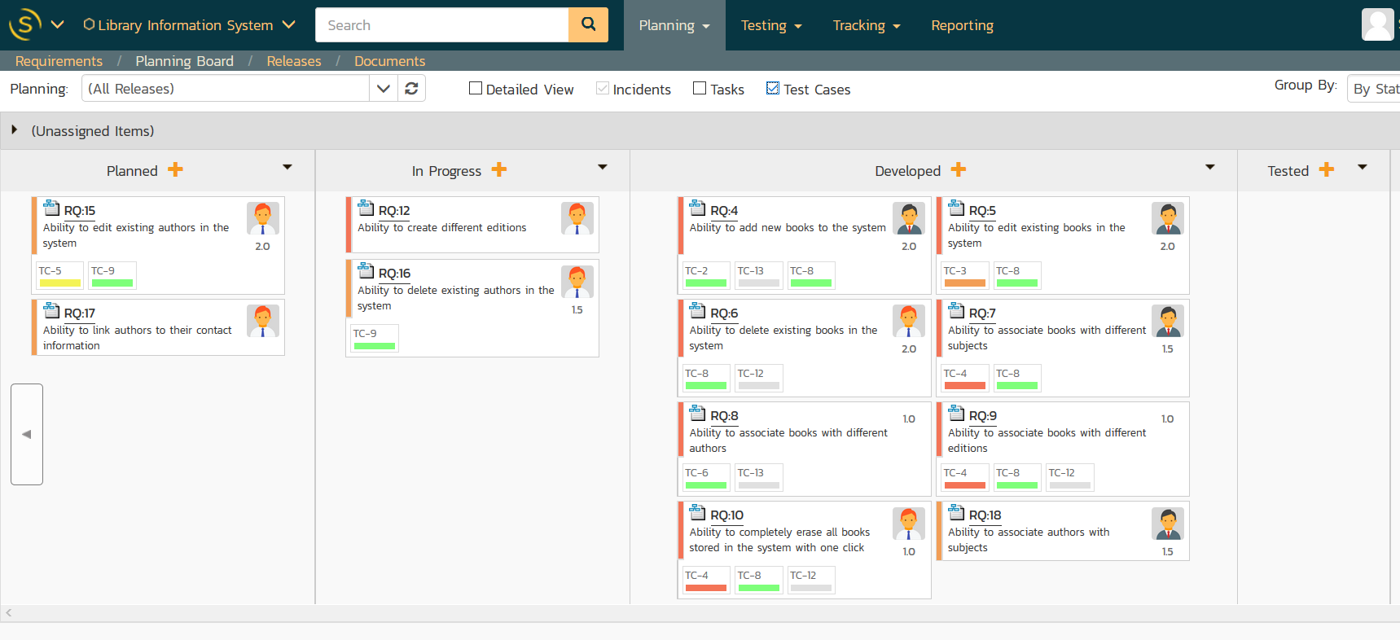
What Our Our Requirements?
Traditional Requirements Matrix
Agile User Stories

Slide 10
Now What’s Our Test & Dev. Strategy
Requirements, User Stories, etc.
Acceptance
Tests
Exploratory
Testing
Source Code Mgt.
Automated
Tests (Checks)
Test Environments
Subversion
Git
Continuous Integration
(Jenkins)
Installation
Process

Slide 11
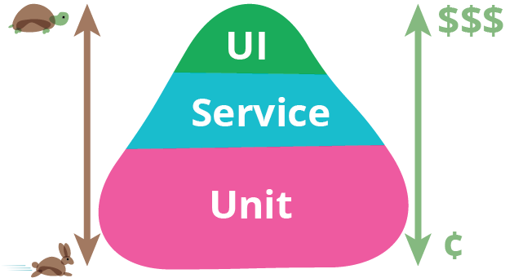
What Tests Should We Automate?

Slide 12
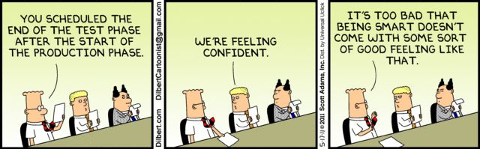
There Is Never Enough Time for Testing
You should not seek to automate 100% of all your tests, because manual testing and automated testing are more efficient at different things

Slide 13
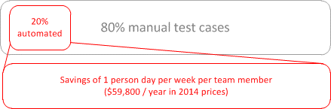
What Tests Should We Automate?
Automate the repetitive, stable, unchanging, boring things that are ideal for automated testing
Let manual testing find the lurking items that you don’t even know exist (yet!) and cannot automate.

Slide 14
What About CI/CD and DevOps?

Slide 15
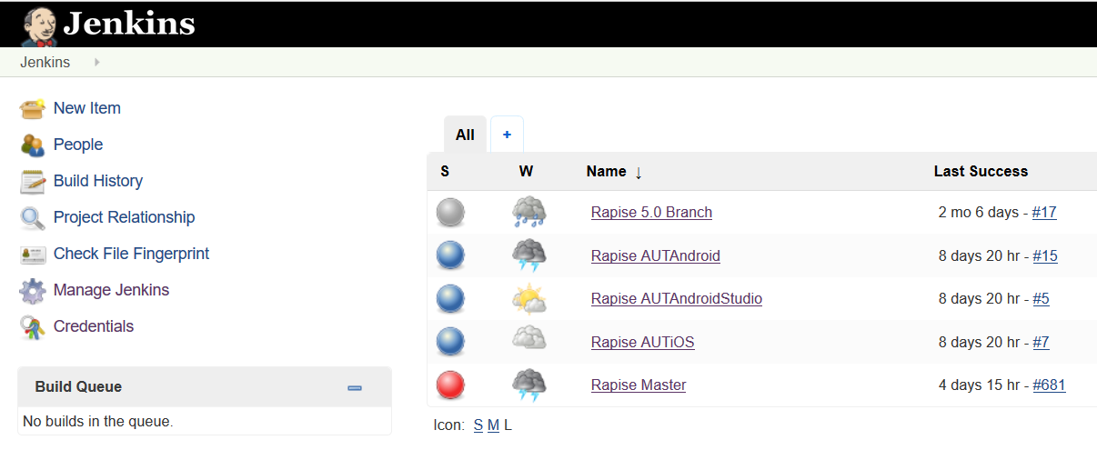
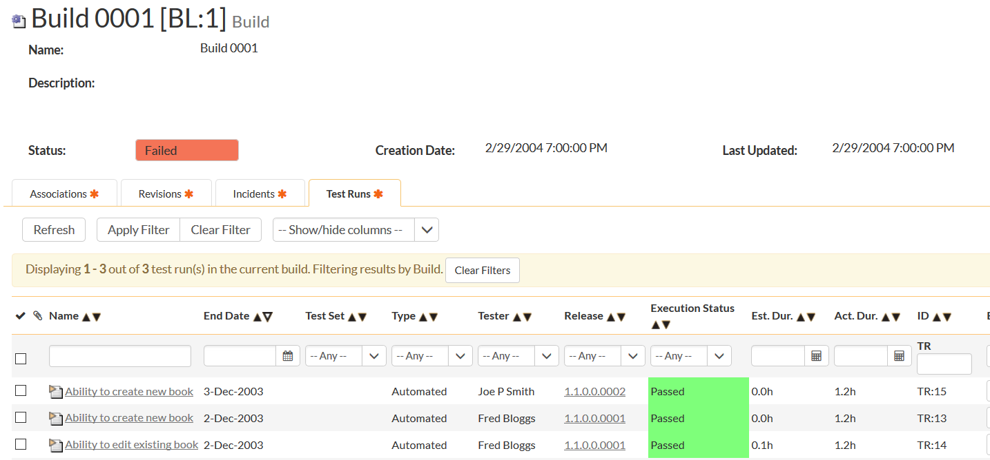
Continuous Integration (CI)
Ensure that you have a robust set of “smoke” tests that can run after every CI build
  Unit, API and Automated UI tests

Slide 16
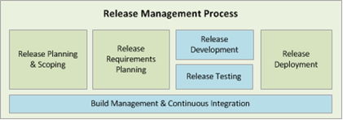
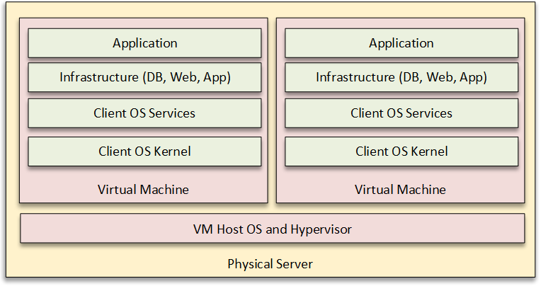
Continuous Deployment (CD)
Automating the process from release ready, tests passed, to production, post-release checks.

Slide 17
Automated Testing
What types of automation should we consider?

Slide 18
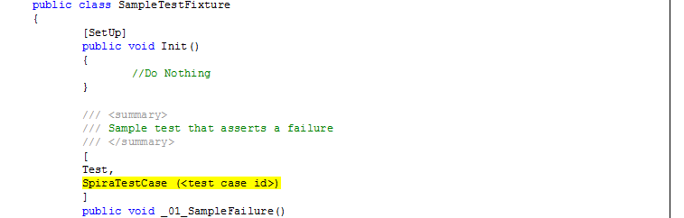
Unit Testing
Unit test frameworks are chosen for each technology you use:
  Java Development – jUnit or TestNG
  .NET Development – NUnit or MS-Test
  Similar frameworks for Ruby, Perl, Python, JS, C
Tie them into your test management platform if possible

Slide 19
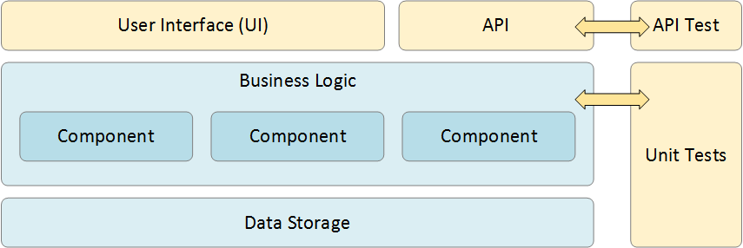
API / Service Testing
APIs are now more important than the applications
Business Models such as UBER or AWS Rely on APIs
You need to regression every version of the API you support

Slide 20
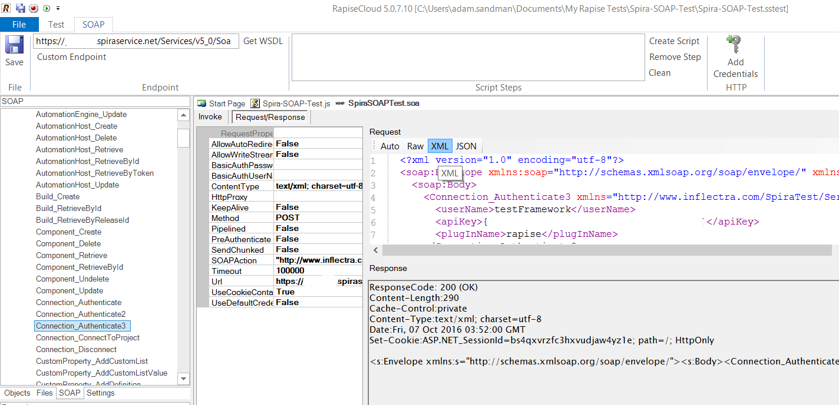
API / Service Testing
Tools such as SOAP-UI, Rapise, POSTman can test different APIs
Some are limited to SOAP, REST, etc. others cover multiple types
Make sure you tie them back into your test management system

Slide 21
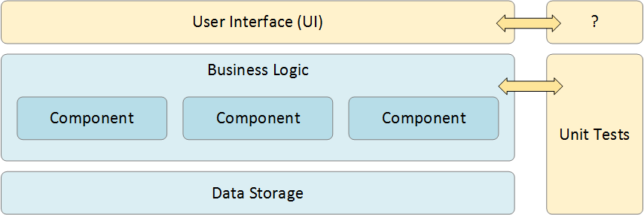
Automated User Interface (UI) Testing
A lot of business rules, functionality still in the UI layer
Automate the parts that are stable and time consuming to manually test. Beware the negative ROI of testing 100% of a highly changing UI. Humans deal with change better*
(*until AI solves it!)

Slide 22
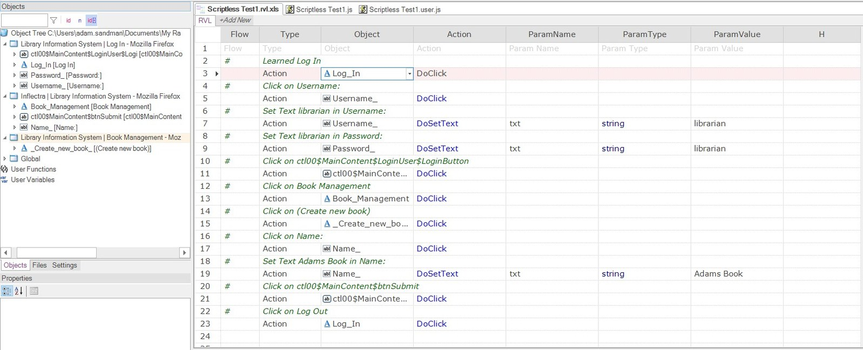
Automated User Interface (UI) Testing
There are various UI testing tools available:
  Free tools such as Selenium, Appium, etc. require you to be a programmer
  Commercial tools such as Rapise, Ranorex, UFT, TestComplete make it easier for the non-programmer
  Choose the tool(s) that work with your application and your testing team’s skill level

Slide 23
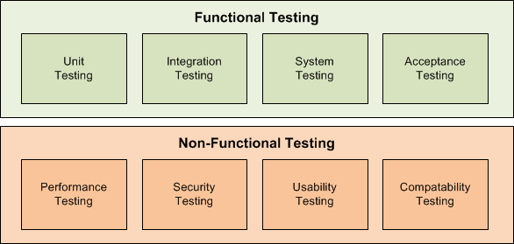
Non-Functional Testing
Don’t leave Performance Testing Until the End (*Big Mistake*)
There are many tools to choose from (JMeter, NeoLoad, LoadRunner, etc.)
Make sure you tie it into your test management platform

Slide 24
Manual Testing
Automated checks aren’t everything

Slide 25
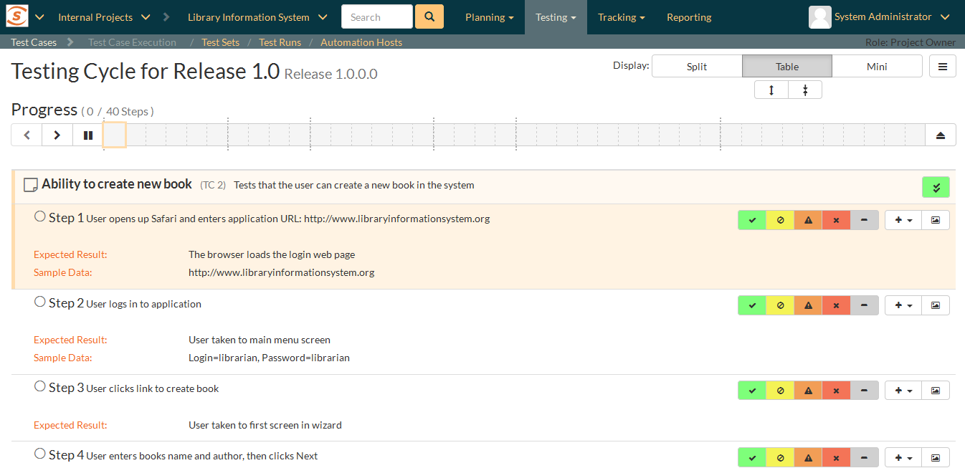
Manual Testing / User Testing
There are many good test management tools to choose from. Don’t default to using Excel, Google Sheets
Understand UAT manual testing vs. Exploratory Testing
  They are different and should be used appropriately

Slide 26
Data-Driven Testing

Slide 27
Manual Testing / User Testing
There are many good test management tools to choose from. Don’t default to using Excel, Google Sheets
Understand UAT, manual testing vs. Exploratory Testing
  They are different and should be used appropriately

Slide 28
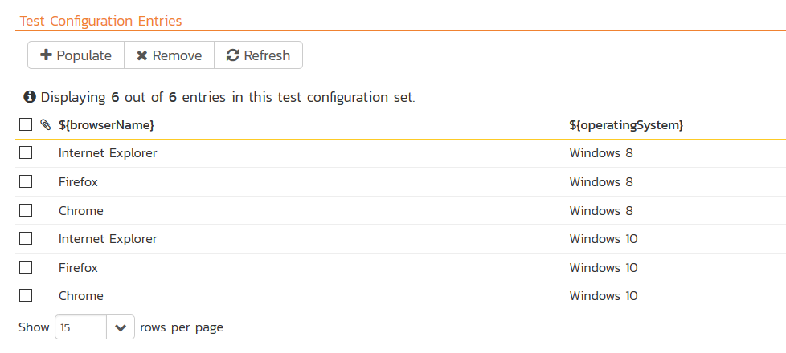
Data-Driven Automated Testing
Create automated tests so that they are reusable across different combinations of test data

Slide 29
Monitoring Testing

Slide 30
Monitoring Test Activities
In the next sections we will discuss the different types of testing.
It is important to be able to monitor all testing activities and track key metrics
  Requirements test coverage
  Code test coverage
  Regression coverage of at-risk areas

Slide 31
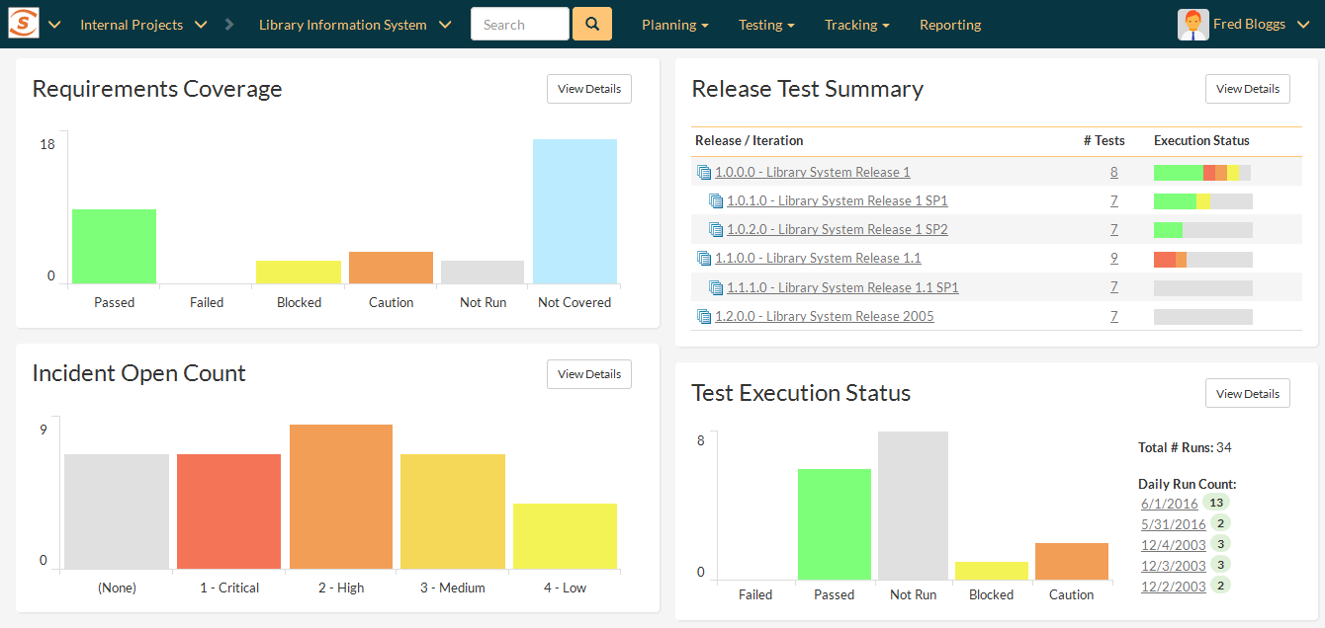
Monitoring Test Activities
Modern test management tools include powerful dashboards and reports.

Slide 32
Wrap Up
Testing Reduces Business Risk
Let Your Requirements Drive Your Test Strategy
Your “TestOps” Environment depends on your DevOps
Your Test Plan Should Include Various Types of Testing to Meet Your Objectives and Business Goals

Slide 33
See It In Action…
An example using SpiraTest

Slide 34
Questions?

Slide 35
Thank you for attending.
See you next year :-)

