Slide 1
Real Testing Scenario Strategy:
The Role of Exploratory Testing
Presented by
Adam Sandman
Inflectra Corporation
QA Geek Week | Hertzliya, Israel, 2018

Slide 2

About Me
Adam Sandman was a programmer from the age of 10 and has been working in the IT industry for the past 20 years.
Currently Adam is a Director of Technology at Inflectra Corporation, where he is interested in technology, business and innovation.
Adam lives in Washington, DC, USA

Slide 3
Takeaways
Why and where to use exploratory testing
Tools you can use for exploratory testing
How to fit exploratory testing into your sprints

Slide 4
Why Use Exploratory Testing?

Slide 5
Testing = Manage Technical Risk

Slide 6
All The Automated Tests Pass
Should We Ship?

Slide 7
Exploratory Testing: Navigating Edges
User Stories
Requirements
Automated Testing

Slide 8
Exploratory Testing: Navigating Edges
The Actual System

Slide 9
Exploratory Testing: Navigating Edges
The Actual System
Edge Cases

Slide 10
Exploratory Testing: Where & Why
Good testers find issues that no one knows about
Exploratory testing finds those edge cases
It’s the unknown ‘unknowns’ that trip you up
It’s particularly useful when the functionality is still being formed in early sprints

Slide 11
Tools That Can Help

Slide 12
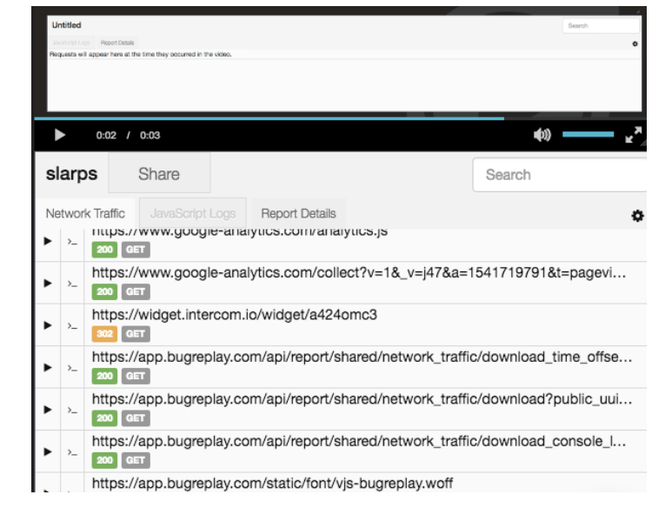
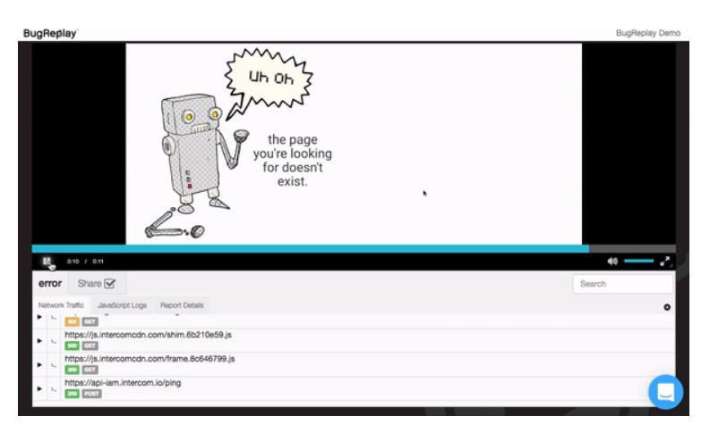
Real-Time Capture Tools
Tools like BugReplay let you easily capture video, screenshots, logs, network traffic, etc.

Slide 13
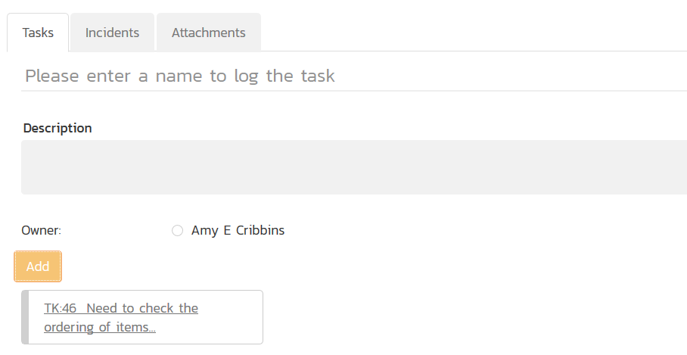
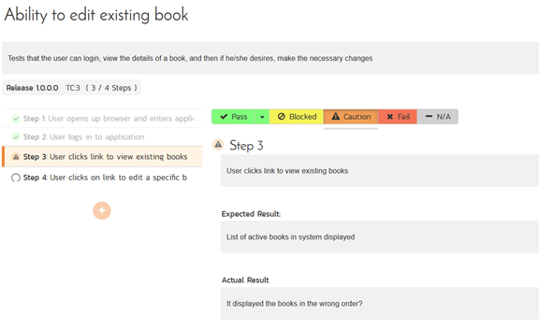
Exploratory Test Management Tools
Tools that let you document your testing, capture “Tasks” that are not defects

Slide 14
How to Incorporate into Sprints

Slide 15
Session-Based Testing
Applies some basic structure to exploratory testing
Time-boxed session where you focus on a specific objective or set of user stories
Test Cases are basically just a description of the objective or area being tested
  You can link it to the requirements and user stories
  Measuring functionality coverage is a good thing!
Executing a test case means following an unstructured path that tests the objective, recording all observations, not just problems.
  Even if functionality is not finished, the observations are useful to the developer

Slide 16
Challenges of Exploratory Testing
Sometimes it’s hard to know if it’s broken or ‘just not done yet’
  Observations may not be actual issues
  The Units Tests all Pass, Why is it Broken?
We can both read the test run report and get completely different information!
Test Runs end up being a lot of unrelated issues that can be hard to trace – Solution use Tasks!
When to transition from recording test runs and tasks to logging defects?

Slide 17
Questions?

Slide 18
Thank you for attending.
See you next year :-)

