Slide 1

Automated Testing, Integrated

Slide 2
Agile Software Development
How the Agile Manifesto Changed Everything

Slide 3
The Agile Manifesto Changed Development
The agile manifesto challenged the orthodoxy around software development, freeing it from the tyranny of process and rigidity, and embracing user feedback and change.
Traditional Waterfall Methodology
Requirements
Gathering
Business Design
Technical Design
Systems Development
Unit
Testing
Integration
Testing
Acceptance
Testing (UAT)
Release Complete
Agile Methodology
Limited Upfront Planning
Release #1
Release #2
Release #3
Release #4
It 1
It 2
It 3
It 4
It 5
It 6
It 7
It 8
It 9
It 10
It 11
It 12
Release Complete
Iteration N
Iteration Planning
Development, Continuous Integration, Unit Testing, Functional & Acceptance Testing

Slide 4
Agile – Led to Continuous Delivery
Organizations quickly realized how much more efficient they could be having integrated teams that collaboratively define the requirements, plan the releases and sprints, test the product during development and deploy the latest update in a seamless way
Release Plan
Iteration
Iteration
Scope
Iteration
Plan
Tested,
Integrated
Working
System

Slide 5
Agile Test Management
When you have continuous development, you need continuous testing

Slide 6


Continuous Testing in DevOps
Automated testing is the only way to align the speed of testing with development, integration and deployment

Slide 7
Testing Throughout the DevOps Toolchain
Requirements, User Stories, etc.
Acceptance
Tests
Exploratory
Testing
Source Code Mgt.
Automated
Tests (Checks)
Test Environments
Subversion
Git
Continuous Integration
(Jenkins)
Installation
& Deployment
Automated Continuous Testing

Slide 8
Introducing RemoteLaunch
SpiraTest and RemoteLaunch allow seamless automated testing

Slide 9







The Inflectra® Suite
KronoDesk®
IT Support & Help Desk
SpiraCapture™
Exploratory Testing
SpiraPlan®
Agile Program & Portfolio Management
SpiraTeam®
Application Lifecycle Management (ALM)
SpiraTest®
Requirements, Test Management
& Bug Tracking
TaraVault® - Source Code Management
Rapise®
Test Automation (Web, GUI, Services)

Slide 10
SpiraTest – The Integrated QA Solution
KronoDesk®
IT Support & Help Desk Ticketing
SpiraTeam®
SpiraTest®
Requirements, Test &
Defect Management
Agile Project
Management
+
TaraVault® - Source Code Management & DevOps
Rapise®
Test Automation Platform (Web, GUI, Services)
See Spira Comparison Matrix to compare SpiraTest vs. Other Editions

Slide 11

RemoteLaunch® - Automation Integration
Host #1
Windows 2008
IE 8.0
Manual
Tester #1
RemoteLaunch®
Host #2
Windows Vista
Mozilla Firefox
SpiraTest®
Repository
Manual
Tester #2
RemoteLaunch®
Host #3
Ubuntu Linux
Google Chrome
Manual
Tester #3
RemoteLaunchX®
RemoteLaunch lets you integrate other automated testing tools with SpiraTest in addition to our own Rapise product

Slide 12
harmony
Notes:
Make great products
Help you work together
Help you deliver your products faster, more easily, with less pain, and less stress
At a grand scale – we’re passionate about making products that you will find transformative to how you work.
We both want to use our tools every day to help you do a whole number of complex things, and at the same time get out of your way so you don’t need to worry about SpiraTeam and can instead focus on helping your own customers

Slide 13
How Do We Foster Harmony?
Across Disciplines
Through Simplicity
Across Ecosystems

Slide 14



Harmony Across the Disciplines
Testers
Developers
Managers
We consider each of these three groups when designing features for SpiraTest and RemoteLaunch, so that everyone in teams can get the most out of the system working together.

Slide 15


Simplicity = Productivity from Day One
Less Time Doing:
More Time Doing:
No plugins, customization or configuration needed day one

Slide 16
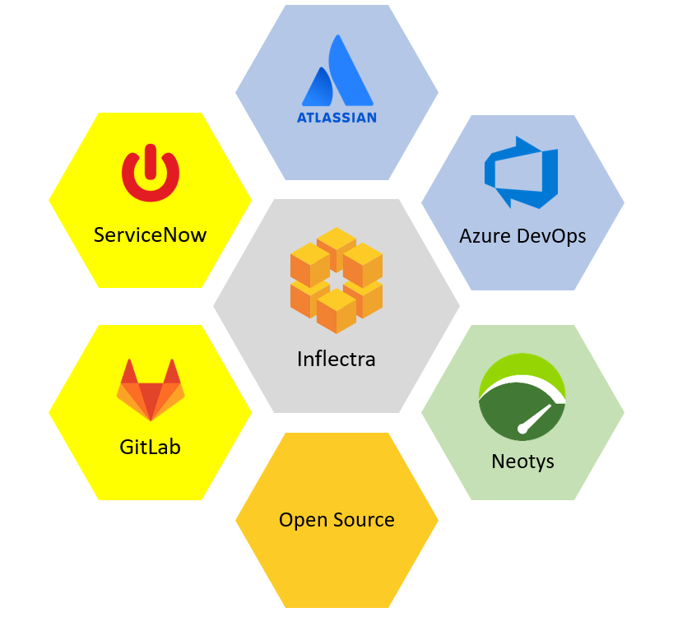
Harmony Across Ecosystems
We recognize that you need to integrate
SpiraTest with other tools.
RemoteLaunch lets you connect other automated testing tools to SpiraTest as easy as our own products.

Slide 17






























Representative Customers by Industry
We have ~ 80,000 users in 5,000+ companies worldwide:
Energy & Industrial
Financial & Business Services
Government & Defense
Information Technology
Healthcare & Bio-Technology
Telecommunications
Retail & Consumer Goods
Transportation & Hospitality

Slide 18
Regulated Industries - Automating Compliance
End-to-end traceability out
of the box
Data Privacy, Security
baked in
Generate Documentation from data
Workflows & Electronic Signatures
Integration across the software value chain

Slide 19






















Global Partner Network
North America
South America & Mexico
Asia
Europe
Australia
Middle East & Africa

Slide 20
Customer Testimonials
“
When we started out using SpiraTest, we didn't have a structured process for mapping Requirements to Test Case coverage, or indeed test results. We started out from scratch, and have since expanded the use of the tool inside our organization to our remote location also. SpiraTest has enabled us to gain clear tracability and easy test case management, that makes regression test planning easy.
- Claus Trohl, Interacoustics AS
“
It blew the doors off what we can do. What used to take three months manually now takes only three hours! - Software Development Lead, Major US Defense Contractor
“
Great tool to help organize software testing needs like project requirements, building a test plan, writing the tests, planning the test activities and capturing the results also like bug tracking in the automation testing as well manual testing.
- Vasu Nelluru, Sharp
“

Slide 21
Product Walkthrough
Lets walk through the setup and configuration one step at a time

Slide 22
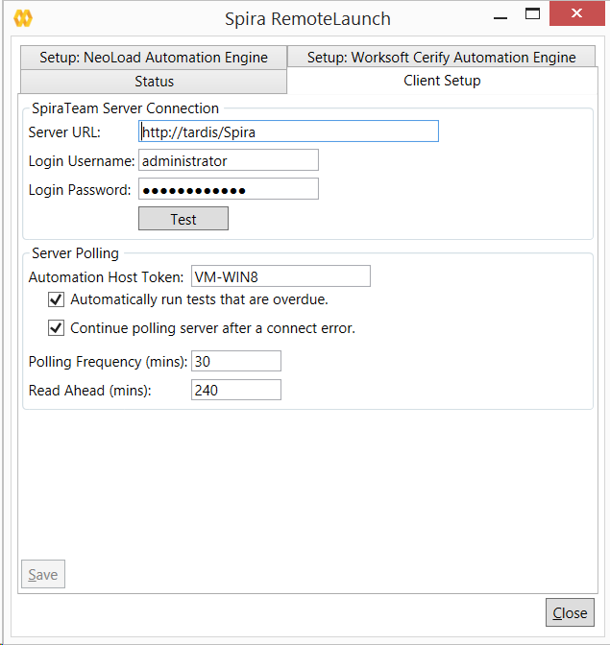
Installation and Configuration
Install RemoteLaunch on each of the automation hosts
Specify the SpiraTest server to connect to
Configure the polling interval and other execution parameters

Slide 23
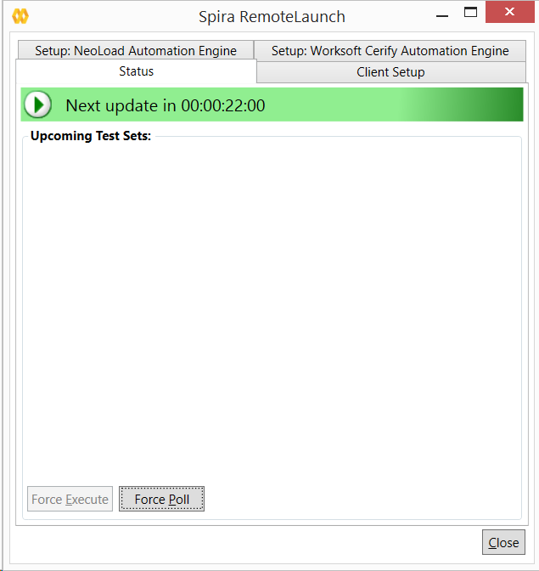
Status Display
The Status tab will display the current status of Remote Launch:
  Idle
  Executing a test
  Paused
You can force RemoteLaunch to immediately launch a test set in its queue before the planned date/time

Slide 24
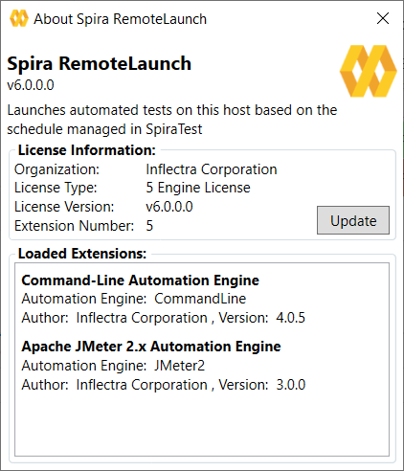
Test Execution Engines
The plug-ins for the different test automation engines should be copied into the “extensions” folder
The plug-ins will be displayed in the “About Spira RemoteLaunch” dialog box
You can configure plug-in specific parameters inside RemoteLaunch

Slide 25

RemoteLaunchX – Cross-Platform Automation
In addition to RemoteLaunch® that runs on Microsoft Windows, there is RemoteLaunchX that is written in 100% Java and can be used on:
  Linux (Ubuntu, Redhat, etc.)
  Mac OS X
  Any platform that can run Java 1.7+
#This file contains the configuration data used by the RemoteLaunch-X
#Spira connection information
server-url = http://vm-win2012r2/SpiraTeam
server-login = fredbloggs
server-password = PleaseChange
#The automation host token
host-token = MyHost1
#The regular expressions for each of the possible execution statuses
pass-regex = .*
fail-regex = .*(Error|Fail|Fatal).*
caution-regex = .*(Warning|Caution).*
blocked-regex = .*(Blocked).*

Slide 26
Setting up SpiraTest
Using SpiraTest with RemoteLaunch to schedule automated tests

Slide 27
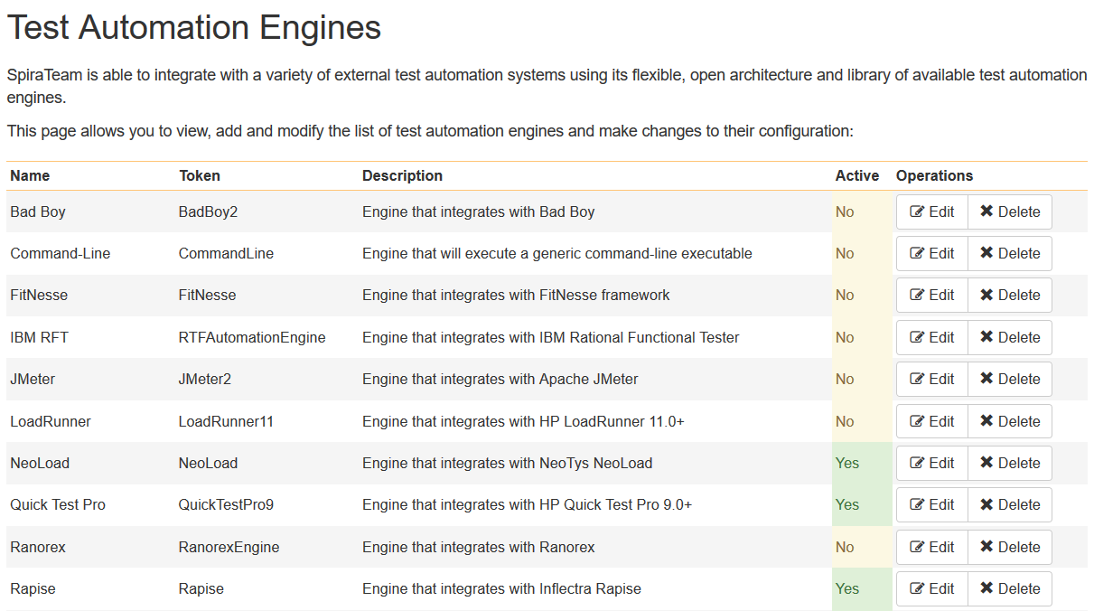
Test Automation Engines - Configuration
The various automated test engines that will be used in SpiraTest need to be configured to match the plug-ins installed in RemoteLaunch.

Slide 28
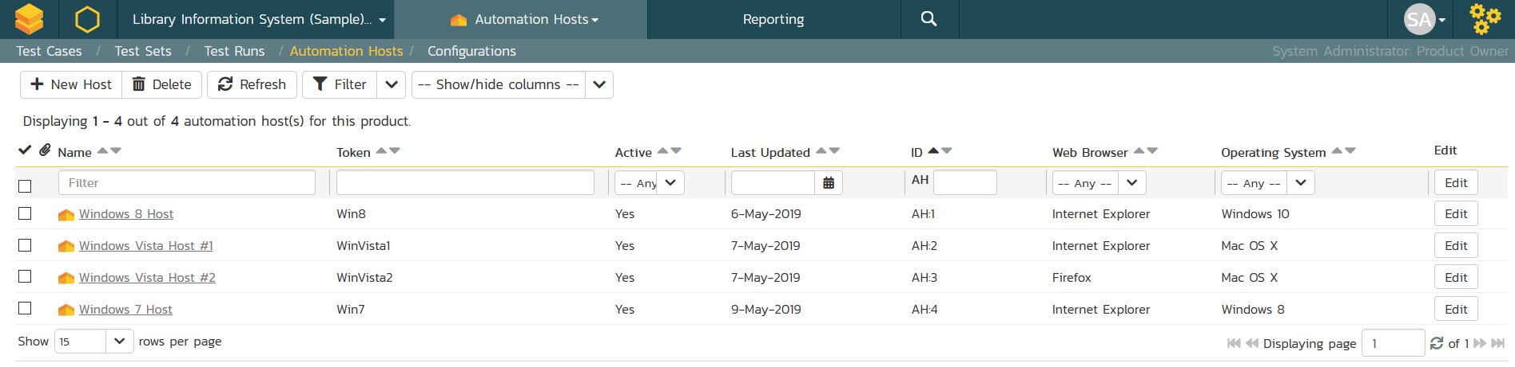
Test Automation Hosts - Configuration
The automated test scripts managed in SpiraTest / SpiraTeam can be either executed on the local machine or scheduled for execution on a series of remote hosts.
The local machine and/or remote hosts must all be running an instance of RemoteLaunch ® that is pointing o the central SpiraTest / SpiraTeam server.

Slide 29
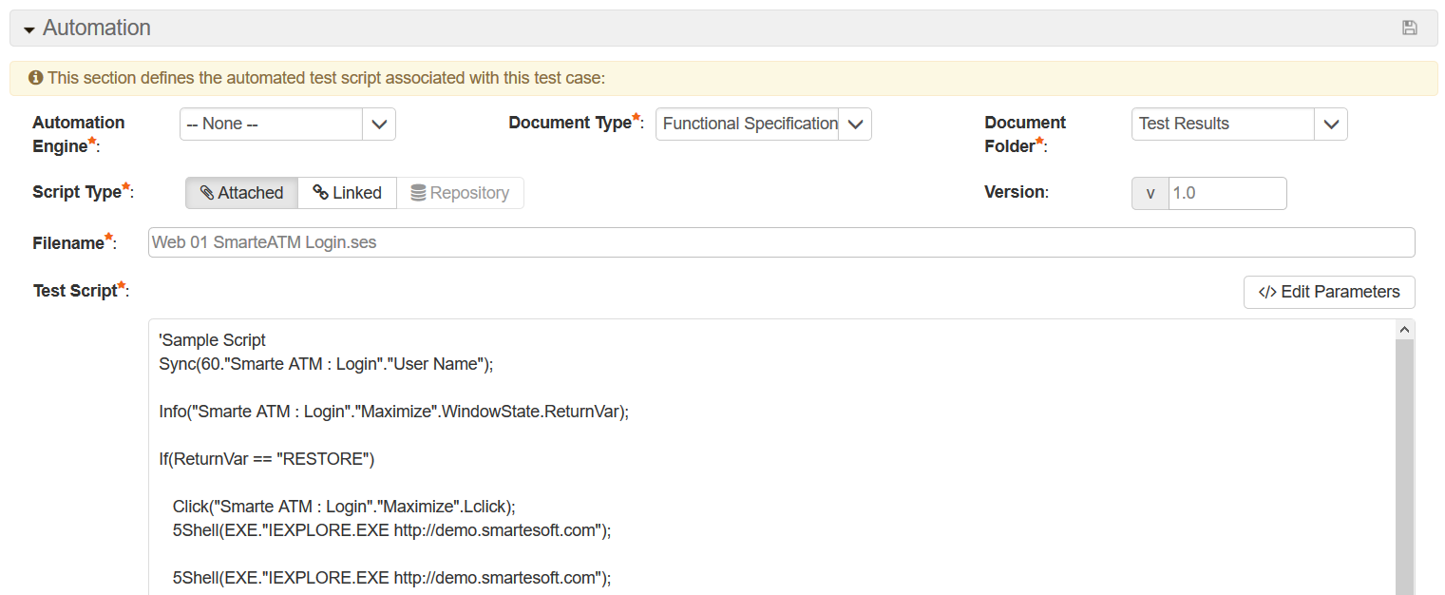
Test Cases – Attaching Scripts
You attach test automation scripts to existing test cases in SpiraTest / SpiraTeam. The results of the test execution will be reported back as automated Test Runs in SpiraTest / SpiraTeam.

Slide 30
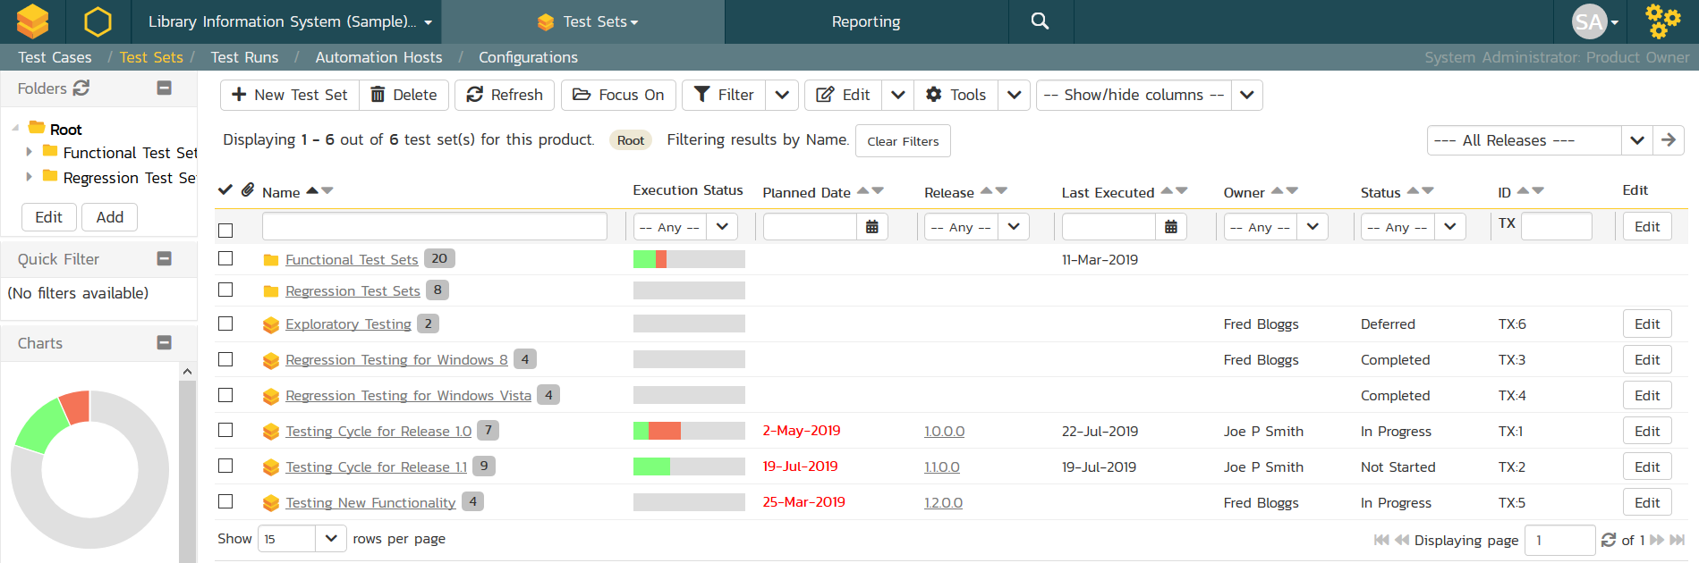
Test Sets – Scheduling for Automation
You can organize the test cases into test sets, which are assigned to specific automation hosts for execution. You can either assign unique host names to each computer or use the same host name, in which case SpiraTest will simply use the first available machine.

Slide 31
Available Plugins
Here’s some of the tools you can use RemoteLaunch with

Slide 32













Plugins Available
RemoteLaunch can connect to a variety of commercial and open source tools:
Functional Testing Tools
User Interface testing Tools
Load and Performance Testing
API Testing Tools

Slide 33
Questions?

