Slide 1
WEBINAR:
Software Development & Testing Challenges in the Financial Services Industry
We will be starting the webinar shortly, please stand by…
All phones will be automatically on mute until the Q&A.
May 24th, 2018 – Adam Sandman

Slide 2
WEBINAR:
Software Development & Testing Challenges in the Financial Services Industry
May 24th, 2018 – Adam Sandman

Slide 3
Agenda
Challenges in Banking & Finance
Horror Stories
Testing and Compliance Tools to Reduce Risk
  Managing Testing & Compliance with SpiraTeam
  Automating Test Cases with Rapise
Q&A

Slide 4

Challenges in
Banking & Finance

Slide 5
What are some of the top challenges?
Compliance with regulations
  Sarbanes-Oxley (SarBox)
  Dodd-Frank
  FATCA
New Technology & Innovation
  Cryptocurrencies and blockchain
  Artificial Intelligence and high-frequency trading

Slide 6
What are some of the top challenges?
Upgrade of legacy systems, M&A
  Clean-up of glued together systems from 2007 crisis
  Data migration to newer platforms
Cybersecurity and data-breaches
  General Data Protection Regulation (GDPR)
Customer Expectations
  Mobile banking
  Mobile payments
  Banking ‘anywhere’ and ‘everywhere’

Slide 7
Horror Stories
aka Case Studies

Slide 8

RBS IT Upgrade Failure
Upgrade of core payments system (CA-7 software) failed, resulting in disruption of bank payments for ~ 2 week
  Affected RBS, NatWest and Ulster Bank payments
  Inability to make payments, access cash from ATMs
  Double entry of payments, corrupted transactions
Business Impact
  RBS Fined £56m by Bank of England and FCA
  Loss of customers and reputational impact
Two years later, the same thing happened again, 600,000 customer payments went “missing”

Slide 9
Why Did It Happen?
The bank’s archaic technology systems struggled with the growing weight of customer transactions spurred by digital banking.
The regulator told banks to make sure their computers are able to support millions of their customers’ accounts after RBS’s earlier failure highlighted the antiquated state of many of their systems.
  (https://www.theguardian.com/business/2015/jun/17/rbs-fails-to-make-600000-payments-customers-it-technology-failure-bank)

Slide 10

TSB Data Migration Failure
Customer accounts were migrated from existing platform managed by Lloyds Banking Group to new Proteo platform
Capacity Issues
  Web, mobile, branch banking not available
Data Integrity Issues
  Customers could see each other accounts
Business Implications
  Instead of saving £ 100m/year, it will cost ~ £30m in incentives to retain people, plus fines of > £ 70m
  Would have been worse if GDPR was already in force

Slide 11
Why Did It Happen?
“The conversion of the systems – the data and the interface accessing the data, which links up to the banking system – clearly has not been well-tested before it went online,”
  Shujun Li, a professor of cybersecurity at the University of Kent’s School of Computing.
"The scale of the problem we saw is incredible. It’s impossible if they had done systematic testing of the system. For me, it’s clearly a case of management, rather than purely a technical problem.”
  (http://www.wired.co.uk/article/tsb-crisis-it-issues-online-banking-problems-ibm-paul-pester-compensation)

Slide 12
Testing and Compliance Tools to Reduce Risk
The Inflectra Solution

Slide 13
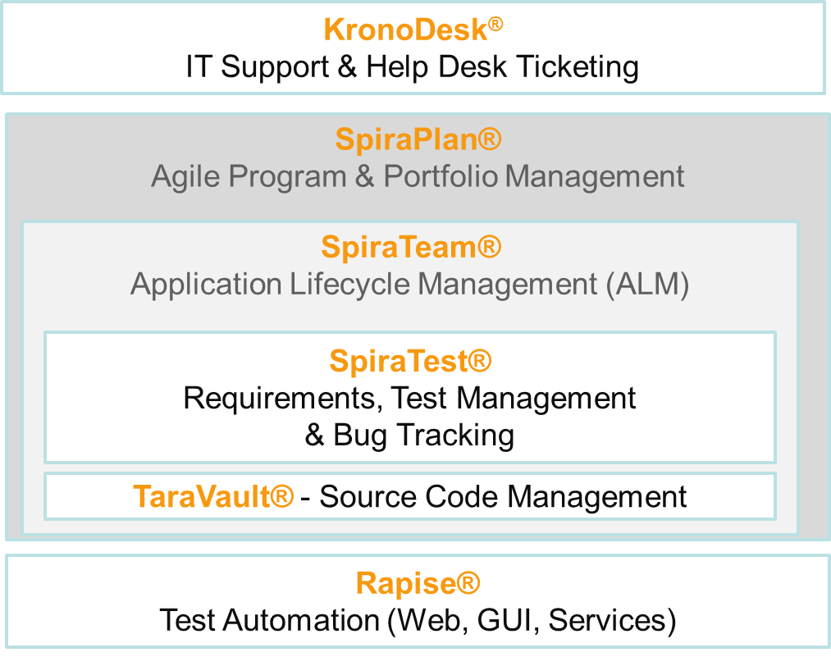
Inflectra Product Suite
Requirements and Test Validation Platform
Test & Process Automation

Slide 14
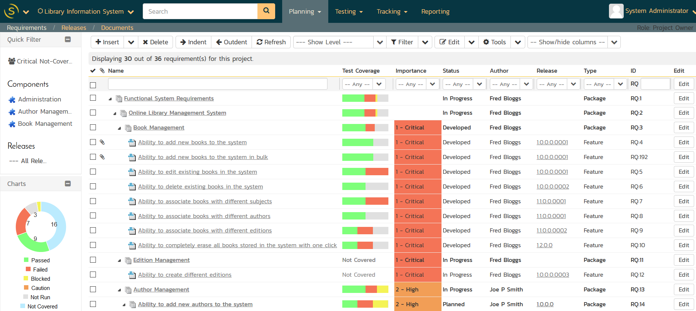
Requirements & Test Validation

Slide 15
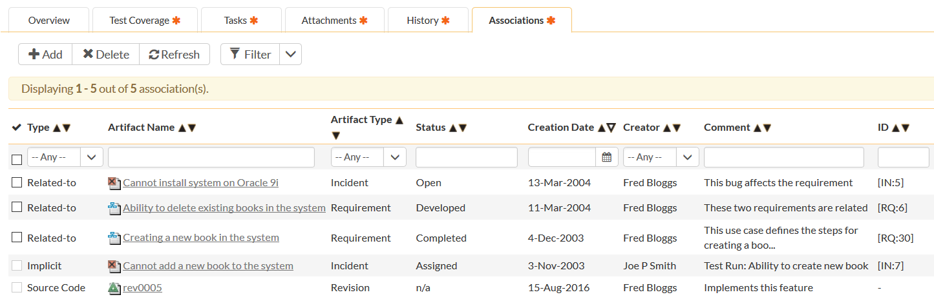
Requirements Traceability

Slide 16
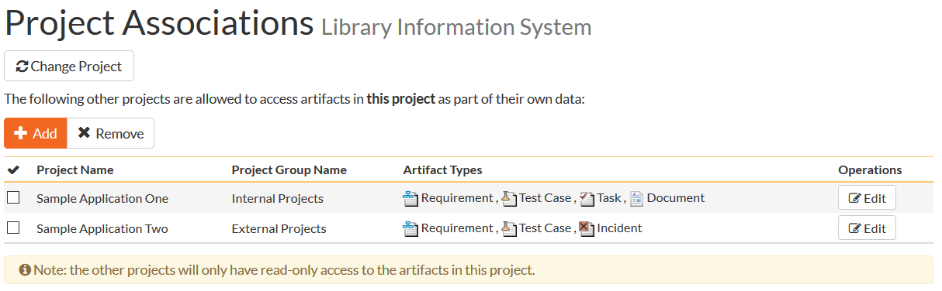
Shared Requirements
Ability to define core mandated requirements that are shared between projects as well as project-specific features, use cases, and user stories.

Slide 17
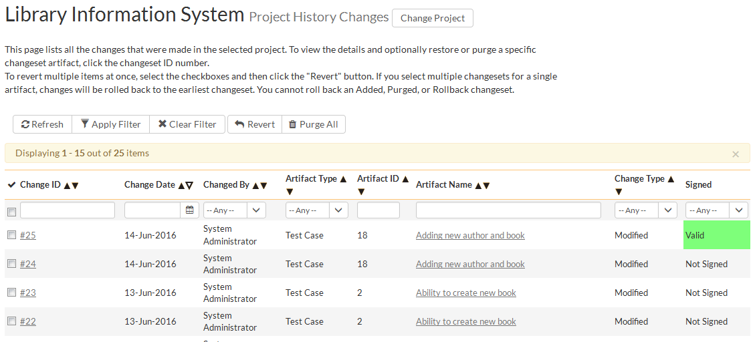
Audit Logging & Trail

Slide 18
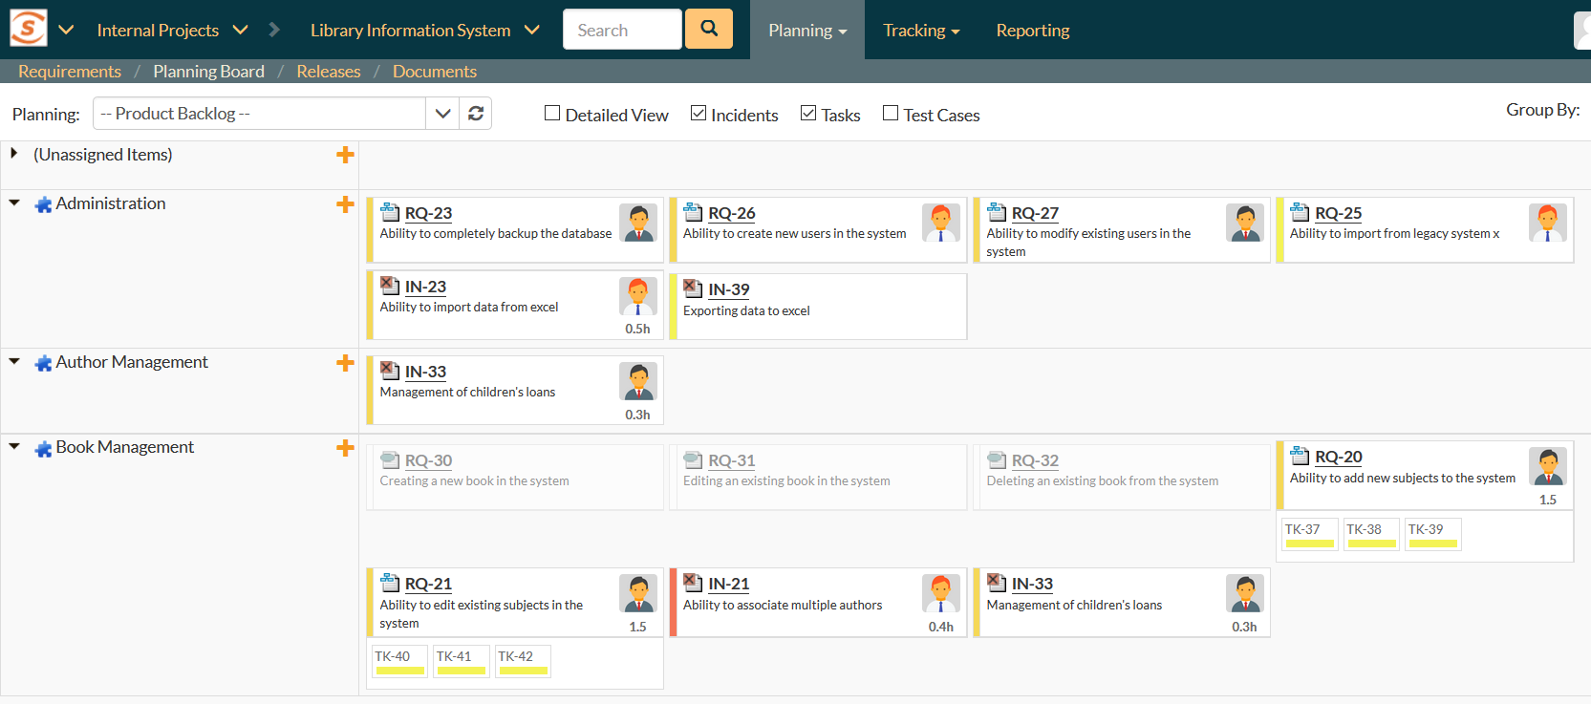
Speed and Agility with Compliance

Slide 19
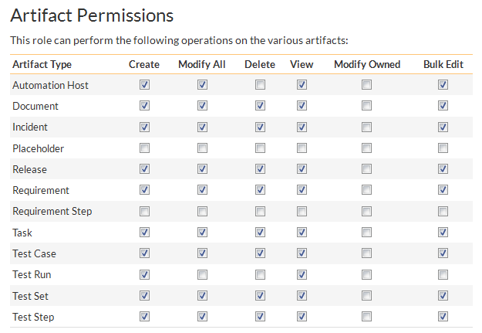
Controlled / Secure Access

Slide 20
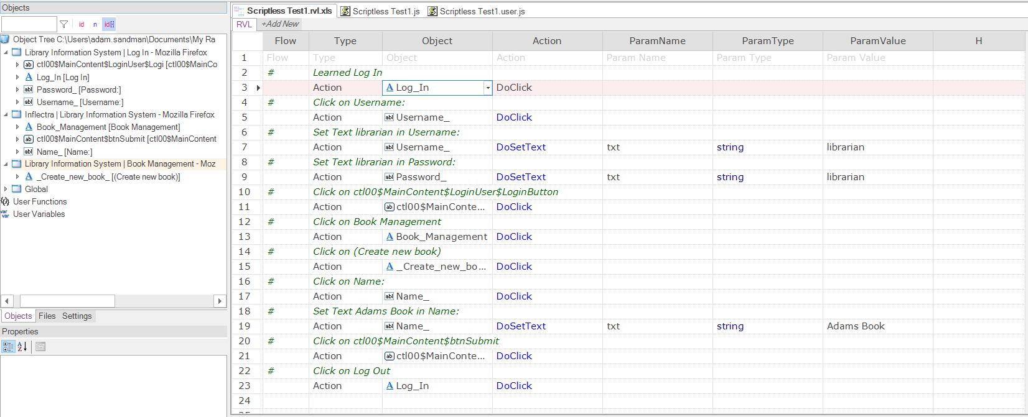
Automated Testing

Slide 21
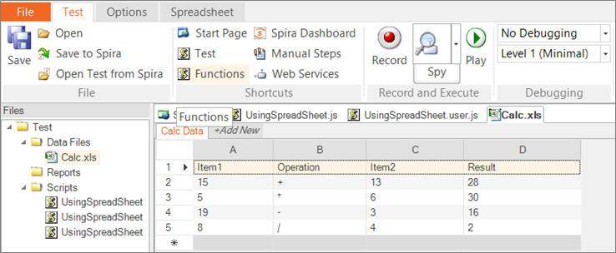
Data-Driven Algorithmic Testing

Slide 22
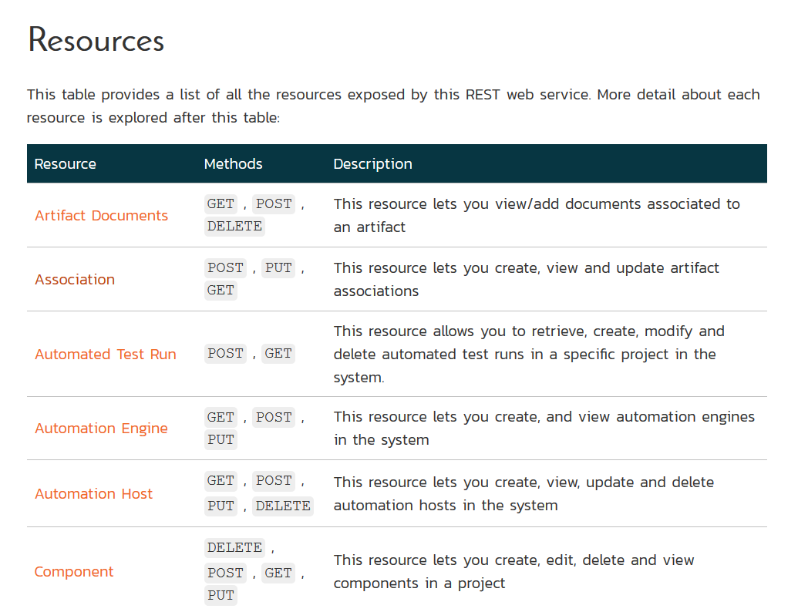

Data Interoperability

Slide 23
Application Demos

Slide 24
Questions?
Please feel free to unmute your line, raise your hand, or simply write your question in the Chat window.

Slide 25

Thanks for Watching
Subscribe to Our Channel for More Videos on Software Testing
http://www.youtube.com/inflectracorporation

