Slide 1

Enterprise Agile Planning
®

Slide 2
Solving Your Agile Challenges
The challenges in scaling agile methodologies

Slide 3
Factors Driving Change
Faster Cycles, Continuous Delivery
Increased Regulation, Data Privacy, Security
Global Supply Chains of H/W and S/W
Artificial Intelligence & Machine Learning
Data Federation Across Vendors & Suppliers

Slide 4
The Evolution of Agile – Individual Teams
Dev
Dev
Customer
Product Owner
Scrum Master
UI
DBA
Test
Test

Slide 5
Scaling to Team of Teams
Product A
Team 2
Team 1
Team 3
Program Manager

Slide 6
Scaling to Products & Portfolios
Product A
Product B
Product C
Product D

Slide 7
Enterprise Planning & Roadmaps
Company Strategy & Objectives
Product A
Product B
Customer Support & Service Delivery
Product C
Product D
Infrastructure, DevOps, Culture, Values

Slide 8
What Comes Next?
The supply of value from idea creation to product delivery is no longer restricted to the organization
One company is a supplier of products used as a component in the product of is customer
Outsourcing companies deliver components for multiple competing companies at the same time
Who’s “enterprise” are we considering when we look at program and portfolio management views?
We need to instead think of networked “supply chain”

Slide 9
The Integrated Agile Supply Chain
Company 1
Company 2
Company Strategy & Objectives
Company Strategy & Objectives
Product A
Product B
Product A
Product B
Customer Support & Service Delivery
Customer Support & Service Delivery
Product C
Product D
Product C
Product D
Infrastructure, DevOps, Culture, Values
Infrastructure, DevOps, Culture, Values
Outsourced Supplier
Industry Regulators
Other Suppliers
Company Strategy & Objectives
Product A
Product B
Customer Support & Service Delivery
Data Privacy Authorities
Product C
Product D
Service & Solution Partners
Infrastructure, DevOps, Culture, Values

Slide 10
The Integrated Agile Supply Chain
Team
Teams
Departments
Org Units
Product owners
Regulators
Suppliers
Services
Outsourcing
Company Boundary
Org Units
Departments
Teams
Team

Slide 11
The SpiraPlan Difference
How are we different and what our customers say

Slide 12







Introducing the Inflectra® Suite
KronoDesk®
IT Support & Help Desk
SpiraCapture™
Exploratory Testing
SpiraPlan®
Agile Program & Portfolio Management
SpiraTeam®
Application Lifecycle Management (ALM)
SpiraTest®
Requirements, Test Management
& Bug Tracking
TaraVault® - Source Code Management
Rapise®
Test Automation (Web, GUI, Services)

Slide 13
SpiraPlan – Enterprise Program Management
SpiraPlan®
Agile Program & Portfolio Management
Enterprise
SpiraTeam®
Application Lifecycle Management (ALM)
Project
SpiraTest®
Requirements, Test Management
& Bug Tracking
Team
TaraVault® - SCM Using Git or Subversion
See Spira Comparison Matrix for a comparison on the different editions

Slide 14
harmony
Notes:
Make great products
Help you work together
Help you deliver your products faster, more easily, with less pain, and less stress
At a grand scale – we’re passionate about making products that you will find transformative to how you work.
We both want to use our tools every day to help you do a whole number of complex things, and at the same time get out of your way so you don’t need to worry about SpiraPlan and can instead focus on helping your own customers

Slide 15
How Do We Foster Harmony?
Across Disciplines
Through Simplicity
Across Ecosystems

Slide 16



Harmony Across the Disciplines
Testers
Developers
Managers
We consider each of these three stakeholders groups when designing features for SpiraPlan, so that everyone in teams can get the most out of the system working together.

Slide 17


Simplicity = Productivity from Day One
Less Time Doing:
More Time Doing:
No plugins, customization or configuration needed day one

Slide 18
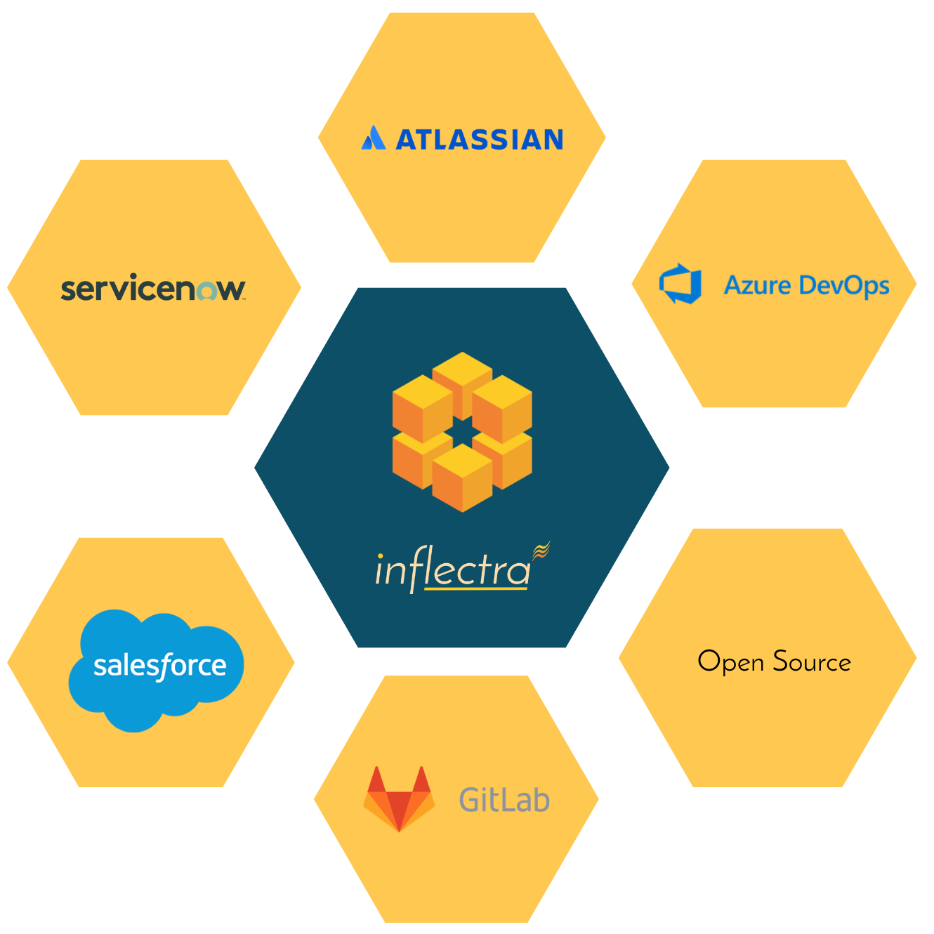
Harmony Across Ecosystems
We recognize that you need to integrate SpiraPlan with other tools and systems
We make this easy and straightforward so you can get working faster & easier

Slide 19
Inflectra Core Values
Great Products: Build for Our Users Not Investors
  Building great software for customers, not chasing the latest fad.
Great Team: We Just Get it Done
  Treat customers well, solve their problems, no drama or red tape.
Great Workplace: Family and Life Flexibility
  Unlimited vacation, amazing benefits, flex/part time welcomed.
Great Community: Enabling Second Acts
  Expanding opportunities for new/second careers in technology.

Slide 20
How SpiraPlan Works For You
Features for different industries and methodologies

Slide 21

Bridging Between Agile and Compliance
Support for Regulated Processes
Modern, Agile Processes
Baselining
Risk Management
Electronic Signatures
Data Privacy
Compliance
Workflow
Requirements Mgt
On-Premise
CI / CD
Scrum
Kanban
Scaled Agile
DevOps
Distributed Teams
Remote Working
Cloud-Based

Slide 22

Healthcare & Life Sciences
Electronic signatures for FDA 21 Part 11 compliance
Secure hosting with support for HIPAA BAA agreements
End to end traceability of requirements, tests, and code
Validated platform where you control update cadence

Slide 23

Financial Services & Insurance
Secure cloud platform (SOC2) or on-premise deployment
Integrated enterprise risk management
Integration with automated testing and compliance tools
End-to-end traceability and auditability of testing

Slide 24

Energy, Industrial, & Automotive
Testing for public safety with world class test management
Define requirements and test for compliance
Integrate standards and regulations into your test plans
Understand and manage risk of critical systems

Slide 25

Defense, Government & Aerospace
Manage programs and portfolios across platforms
Test step level traceability for mission systems
Automate testing and compliance with RemoteLaunch
Security and privacy with on-premise and AWS GovCloud

Slide 26































Representative Customers by Industry
We have ~ 80,000 users in 5,000+ companies worldwide:
Energy & Industrial
Financial & Business Services
Government & Defense
Information Technology
Healthcare & Bio-Technology
Telecommunications
Retail & Consumer Goods
Transportation & Hospitality

Slide 27
Regulated Industries - Automating Compliance
End-to-end traceability out
of the box
Data Privacy, Security
baked in
Generate Documentation from data
Workflows & Electronic Signatures
Integration across the software value chain

Slide 28











Compliance with International Standards
EudraLex
Volume 4
Part I & II
Guidance on Data Integrity

Slide 29


























Global Partner Network
North America
South America & Mexico
Asia
Europe
Australia
Middle East & Africa

Slide 30
Customer Testimonials
“
Easy to set up (meaning the project templates, users, customizable fields, etc.) * Very good integration possibilities with other tools * Attractive GUI * Great customization possibilities for reports * REST API available and well documented. We used a maintenance release for one of our medical devices as a trial. Spira allowed very easy control of Requirements and Test artifacts and especially traceability and traceability reporting, which is vital for e.g. the FDA submissions.
- Dennis Lardenoye, Pie Medical Imaging
“
Modern Tool, Properly Designed! I really am enjoying working with SpiraPlan. I managed various other ALM environments for about a decade and it's quite refreshing to be working with a modern tool that was properly designed from the ground up!
- Tim Hartman, TX3 Life Sciences
“

Slide 31
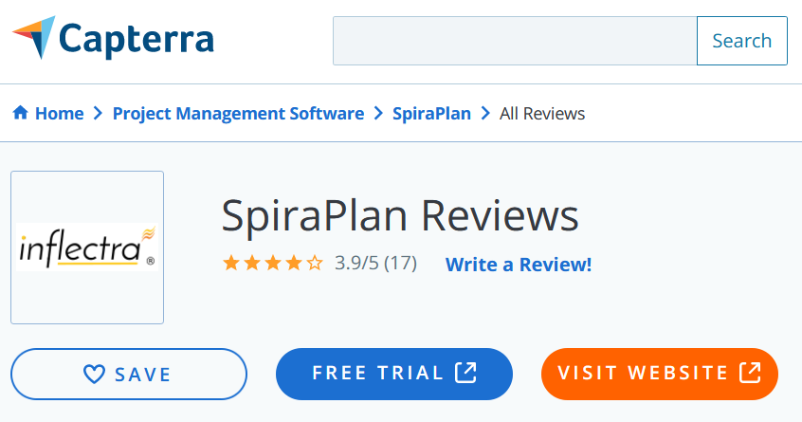
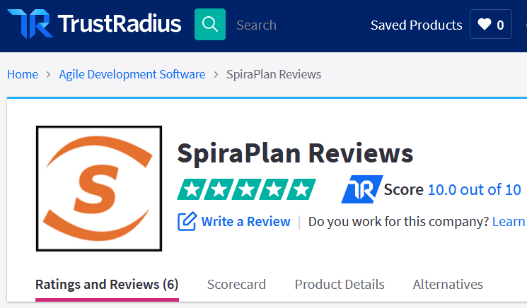
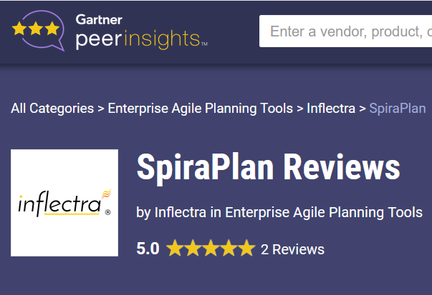
Awards and Recognition*
*Gartner, TrustRadius, Capterra

Slide 32
Feature Overview
Lets Look at the Key Features in SpiraPlan

Slide 33
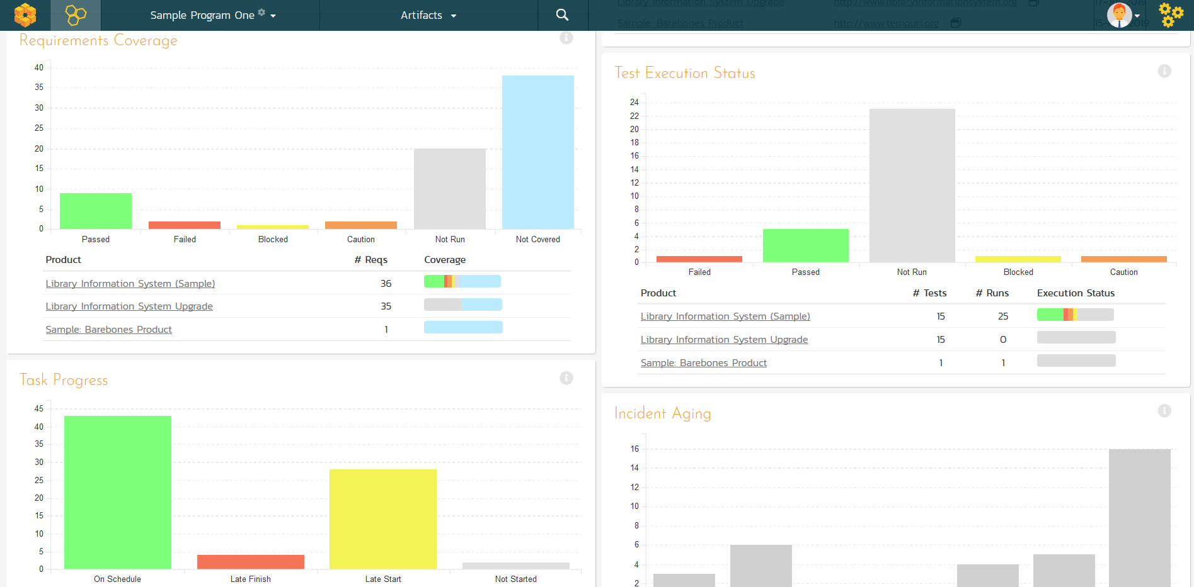
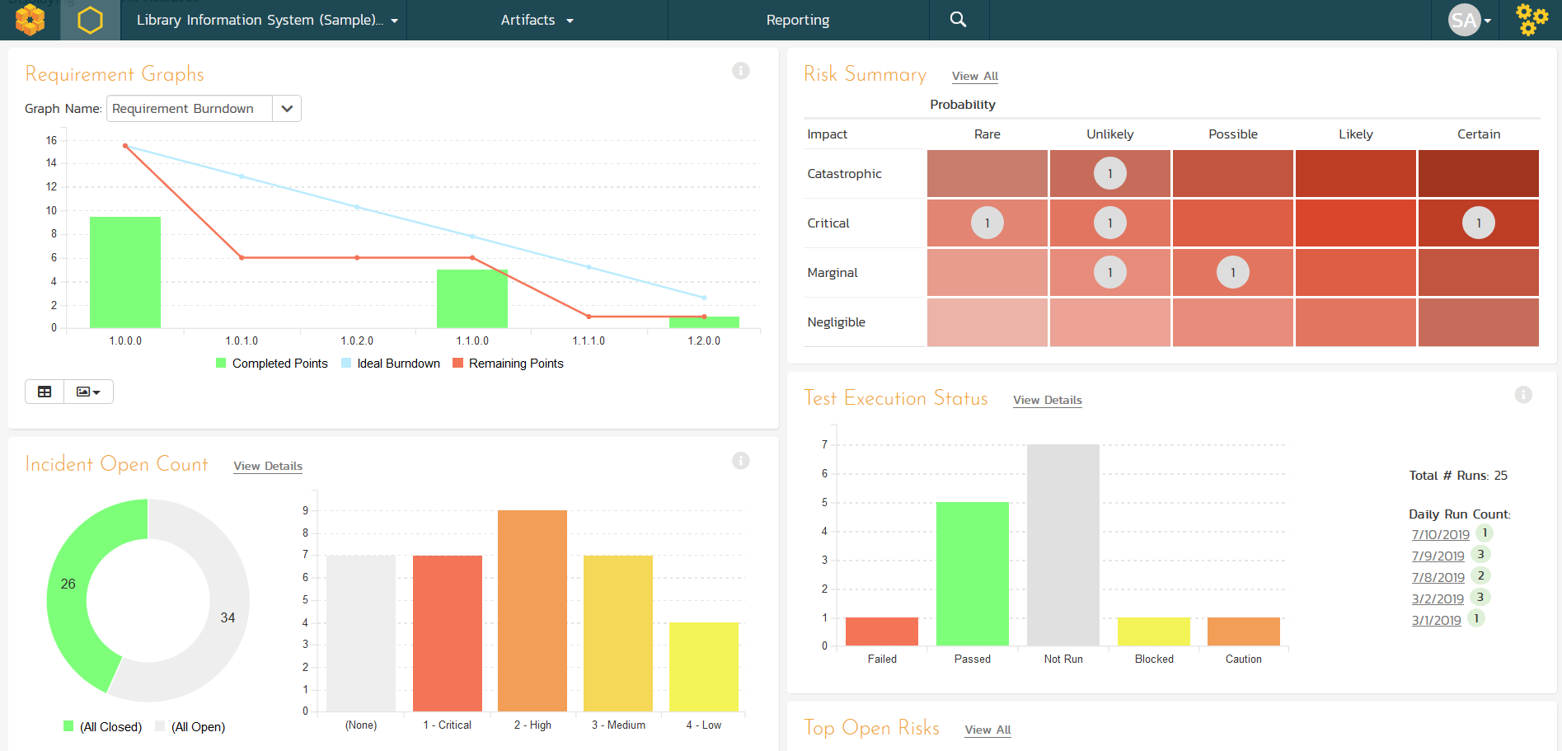
Program & Project Dashboards
Customizable reporting dashboards at the program, product, project, release and sprint levels

Slide 34
Managers
Notes:
Managers, our third pillar, could always take advantage of our reporting, dashboards, and traceability features. But we knew we could do a lot more to help managers – both senior leaders and those in other roles like BI

Slide 35
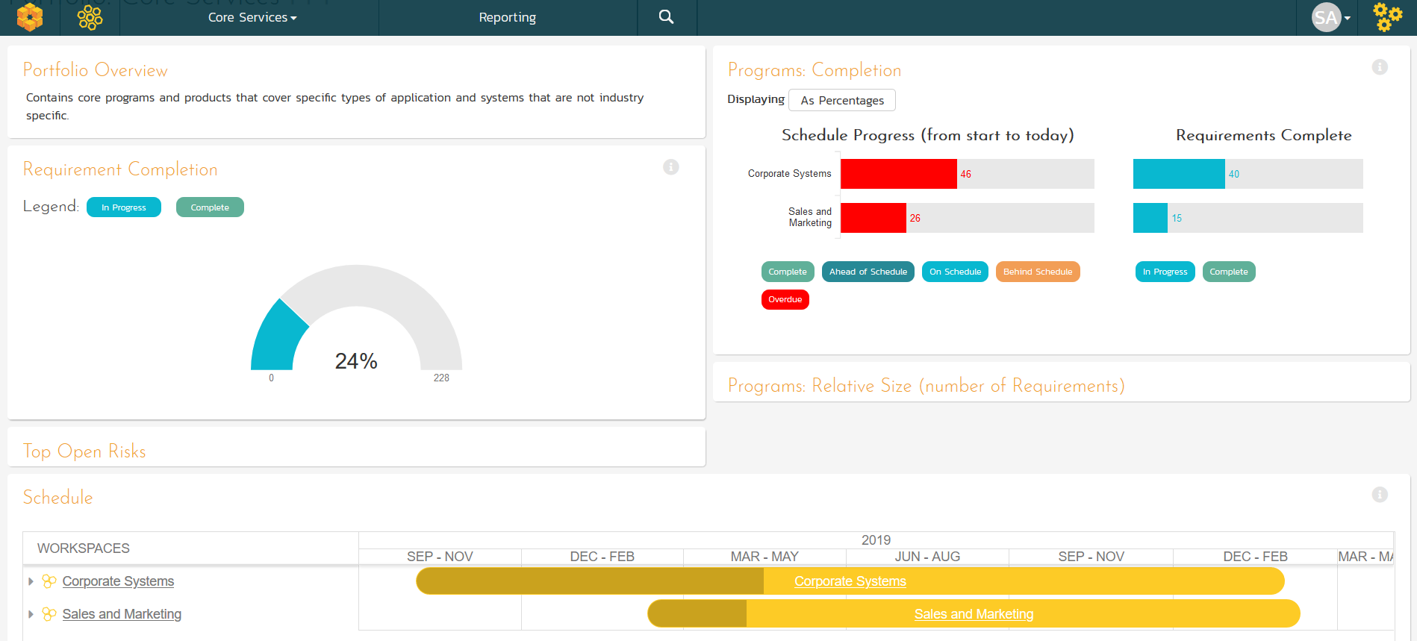
Portfolio Management & Roadmapping
Project Portfolio Management (PPM) dashboards

Slide 36
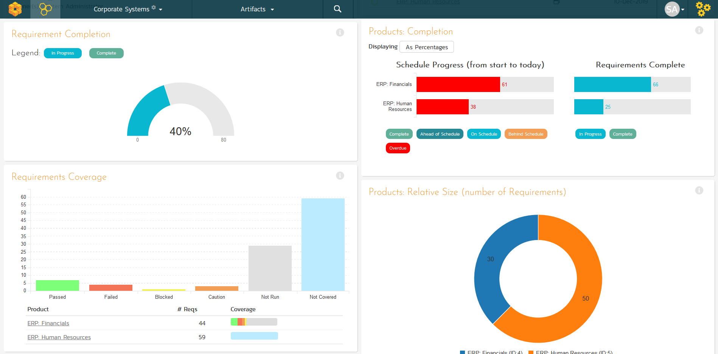
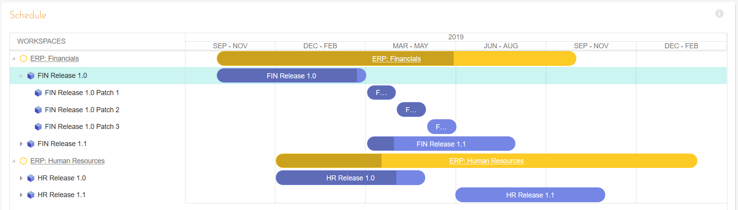
Program Management
Program planning and program management with integrated dashboards and program roadmaps.

Slide 37
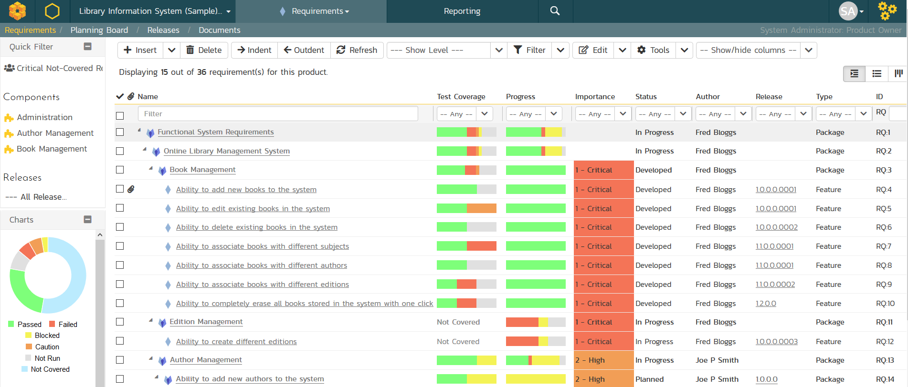
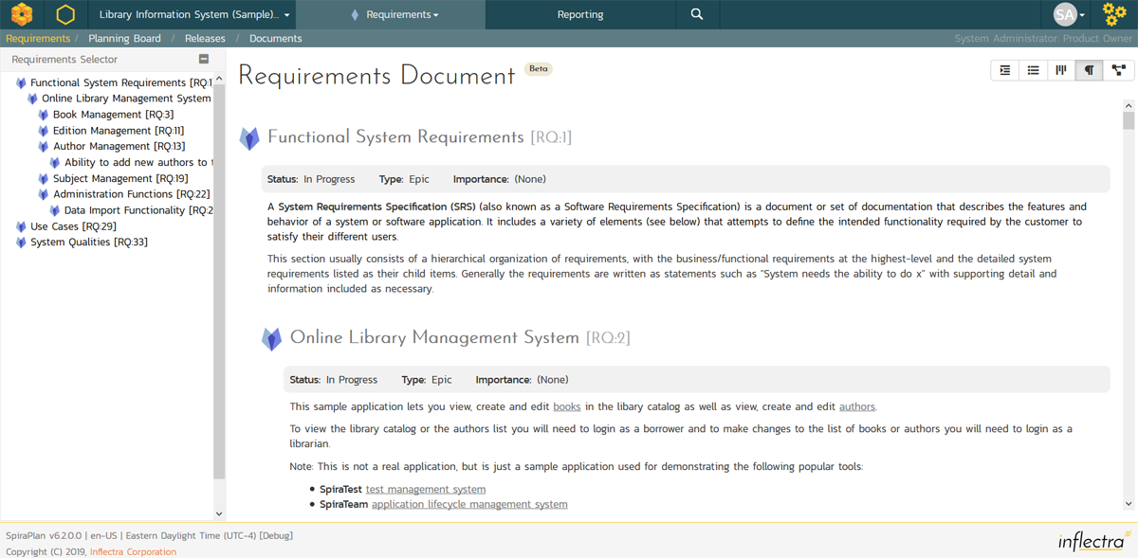
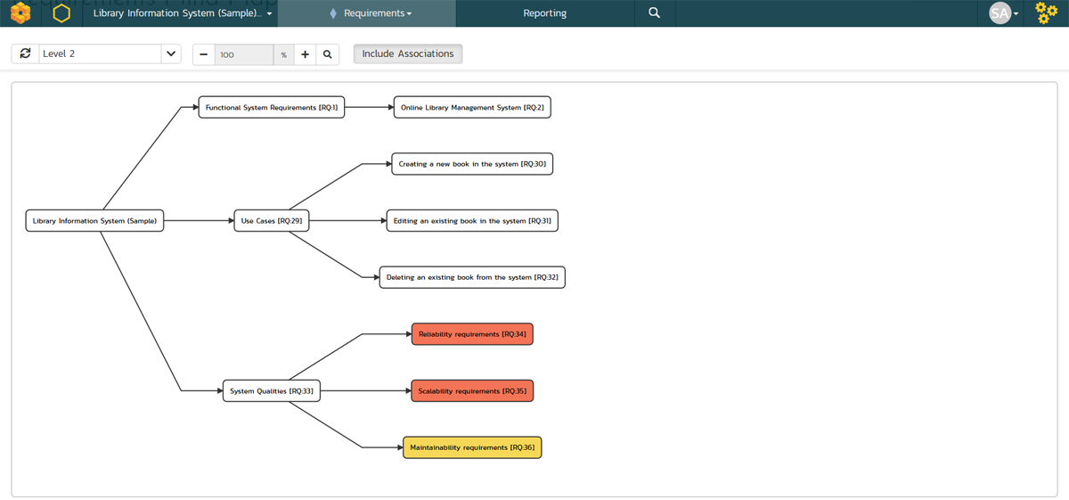
Requirements Management
Requirements management with end-to-end traceability

Slide 38
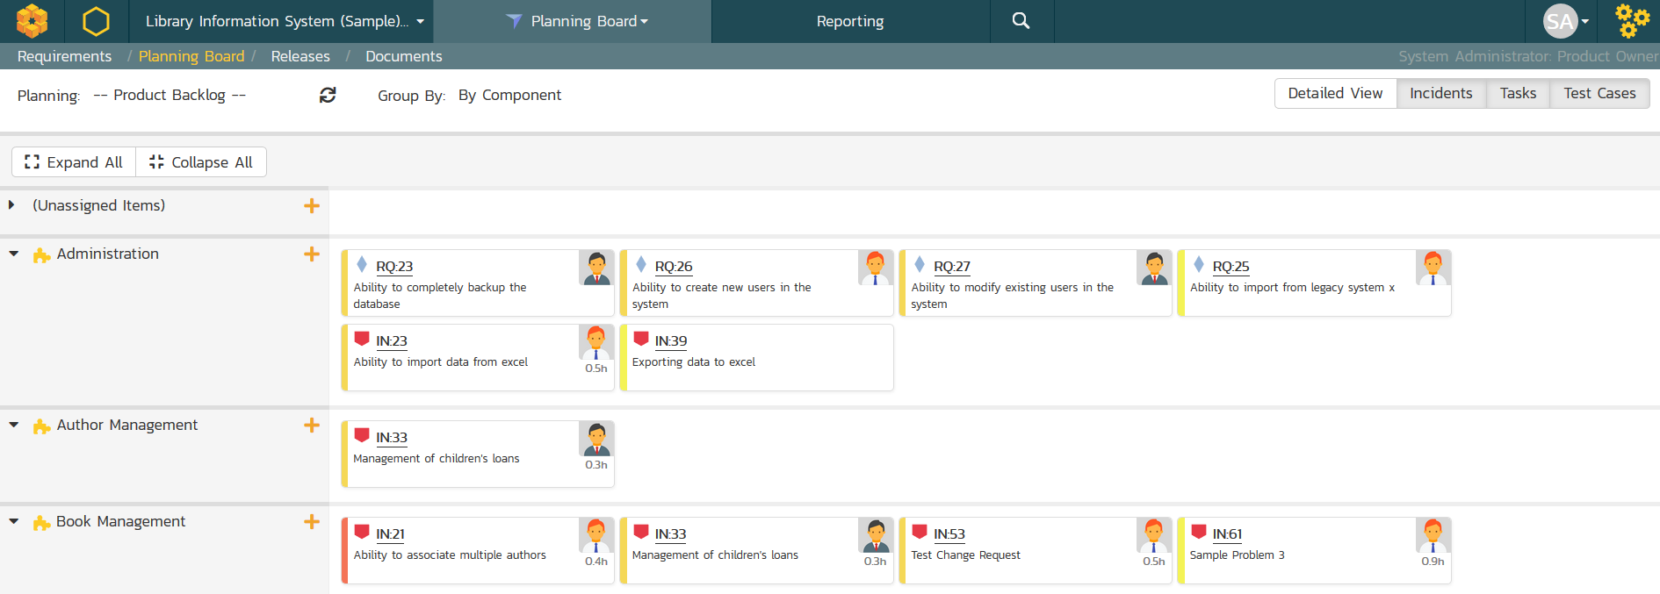
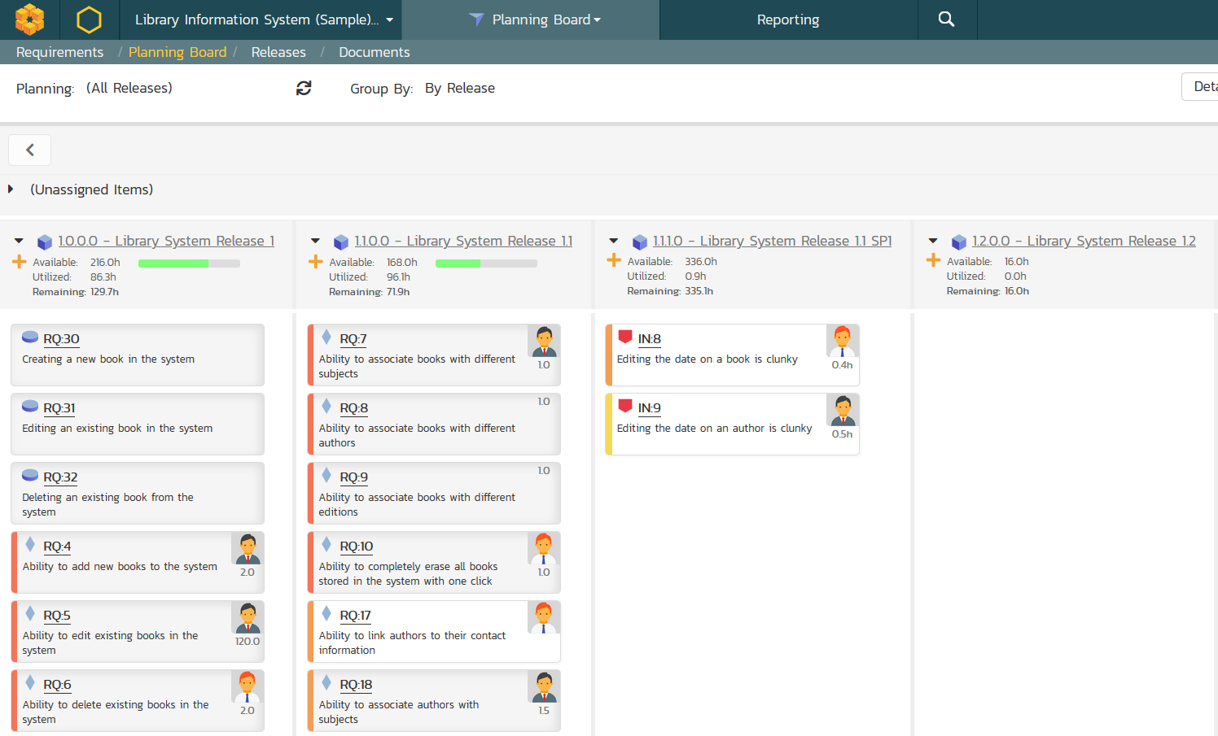
Agile Project Planning
Agile planning boards with test and task traceability that support multiple methodologies including Scrum and Kanban.

Slide 39
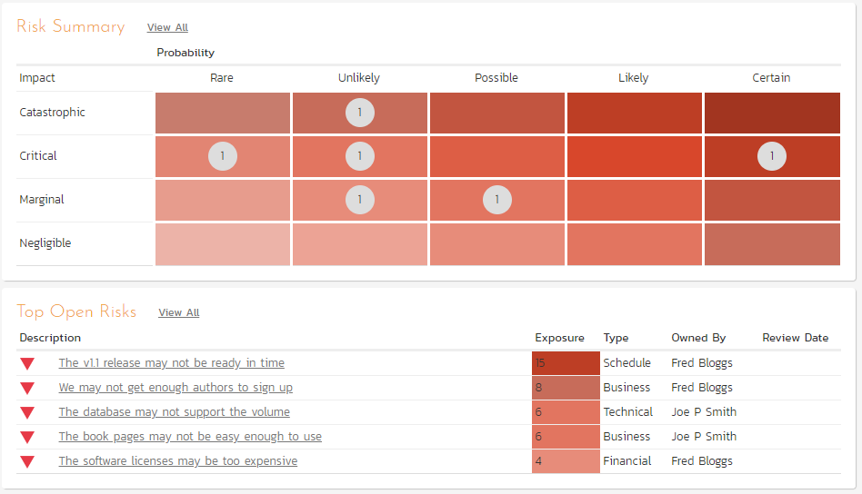
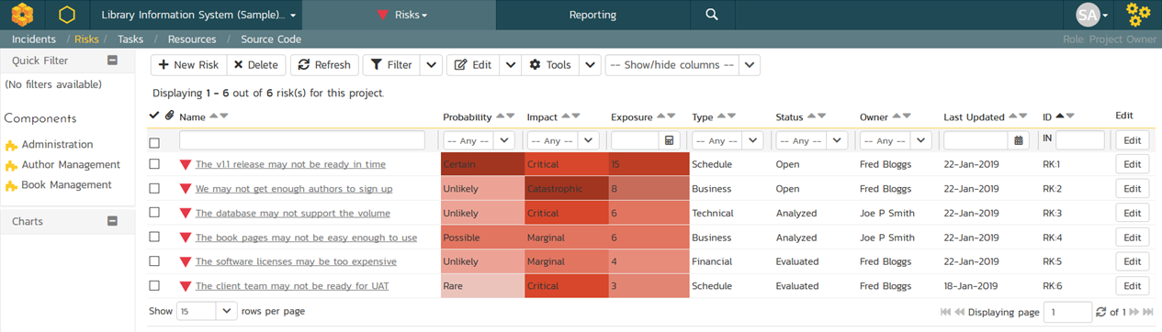
Risk Management
Manage your product and program risks, track mitigations and action items. Automated exposure calculations out of the box.

Slide 40
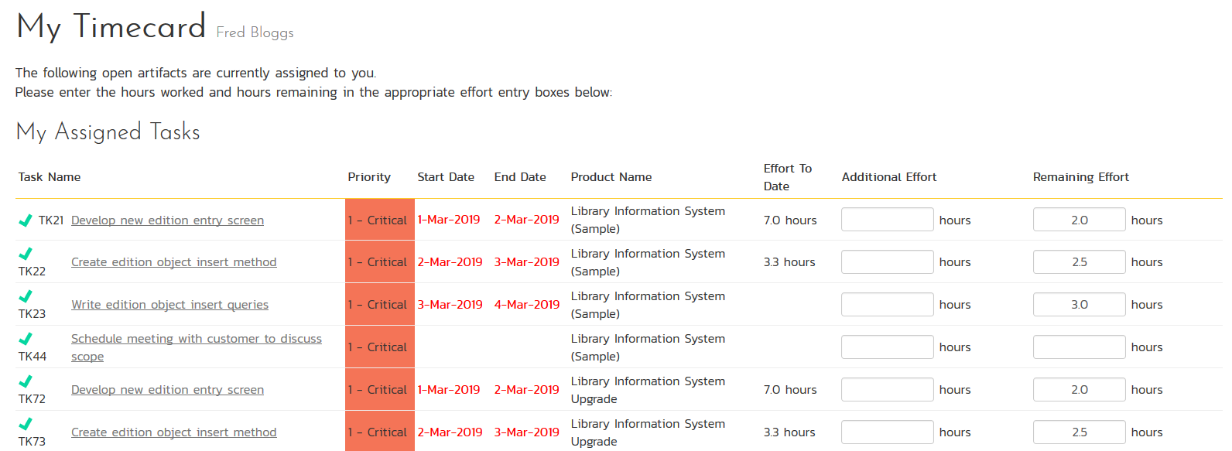
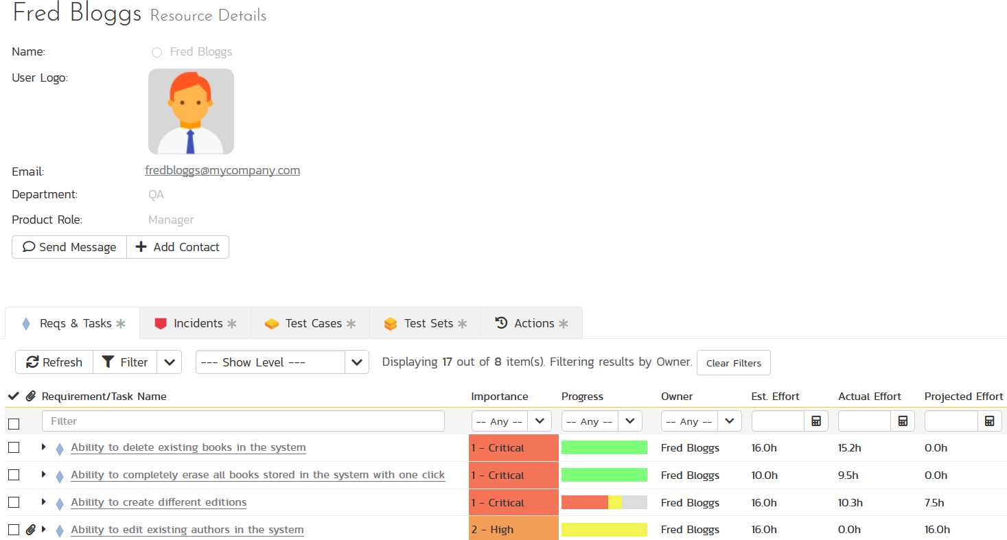
Resource Management
Manage the people and teams on your projects with centralized timecard submission and resource planning.

Slide 41
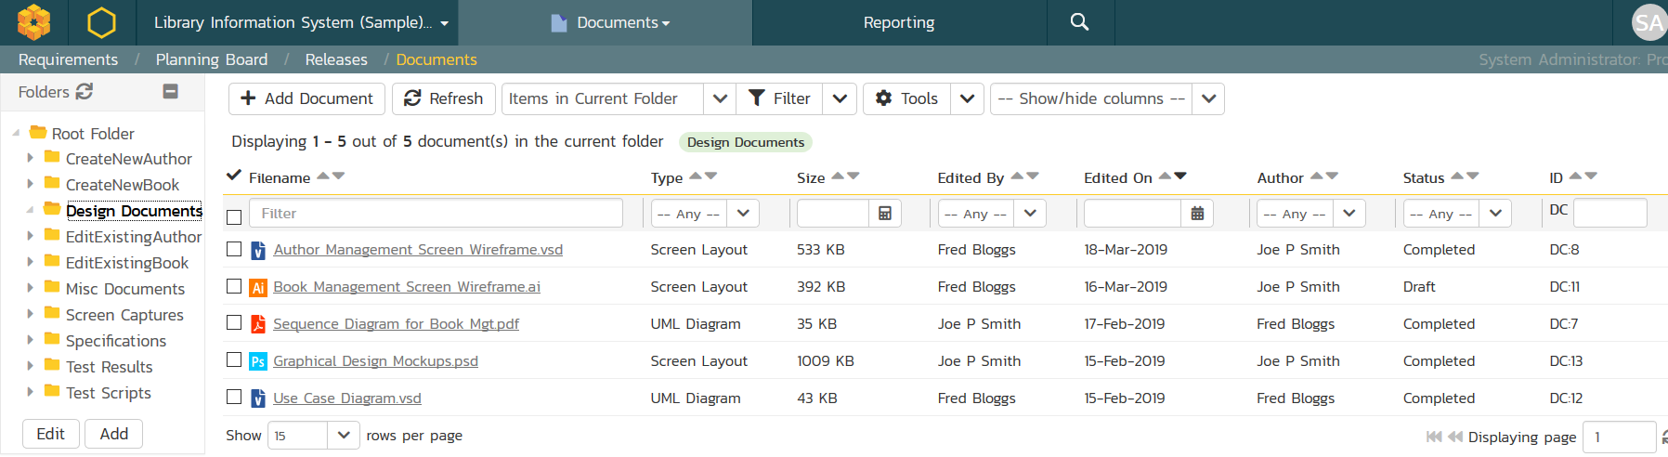
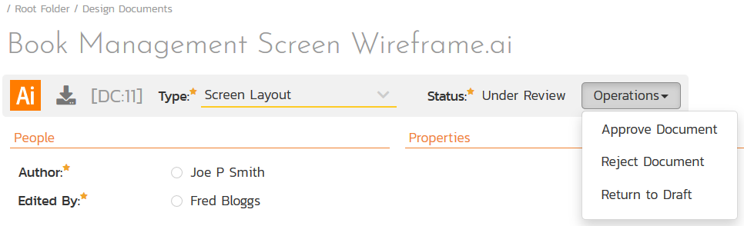
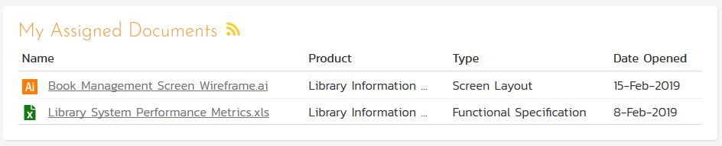
Document Management
Complete integrated document management system with versioning, check-in/out and approval workflows.

Slide 42
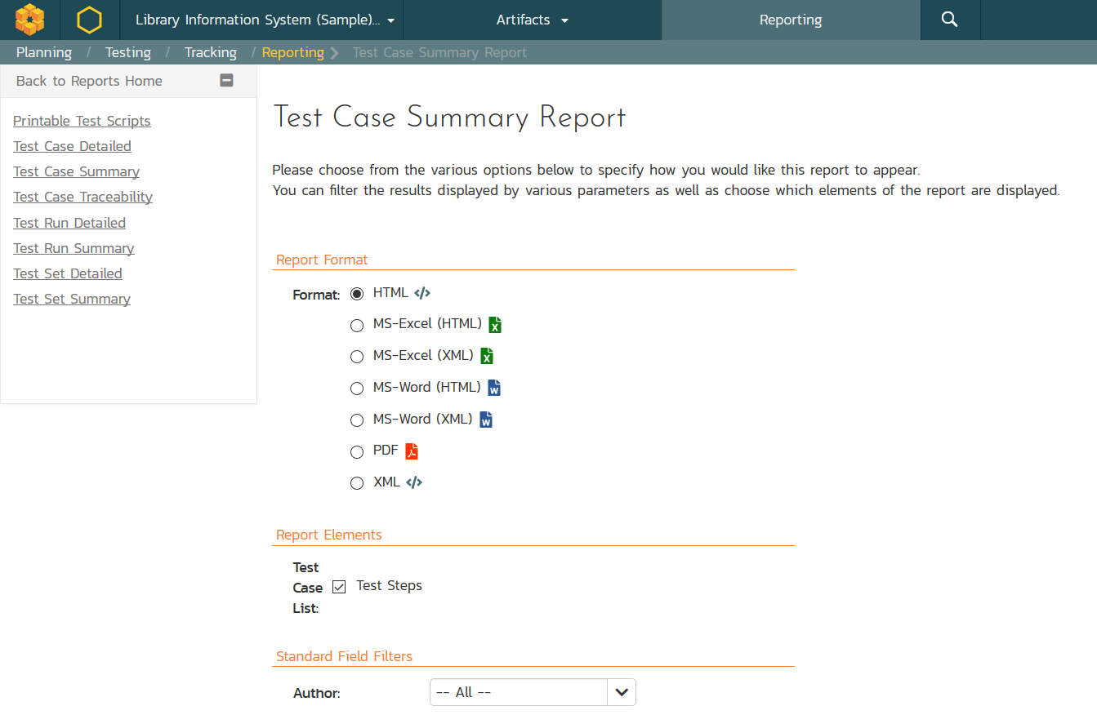
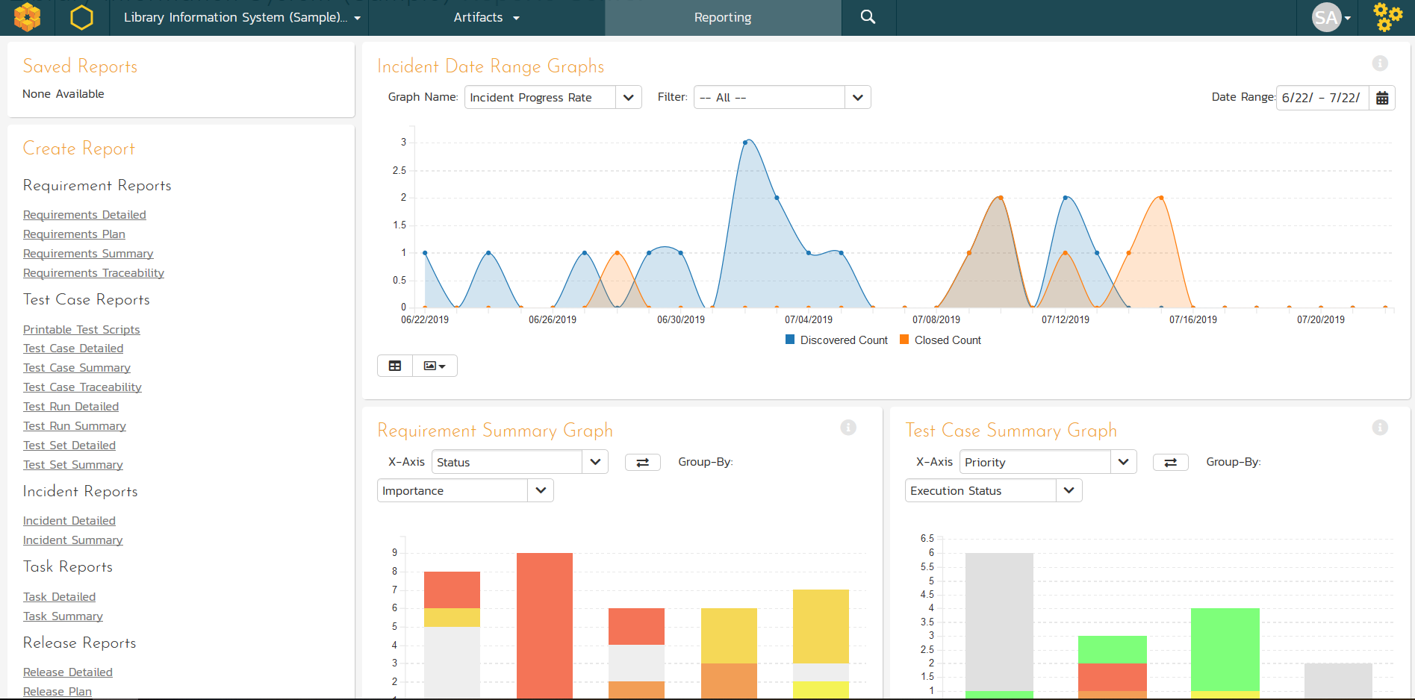
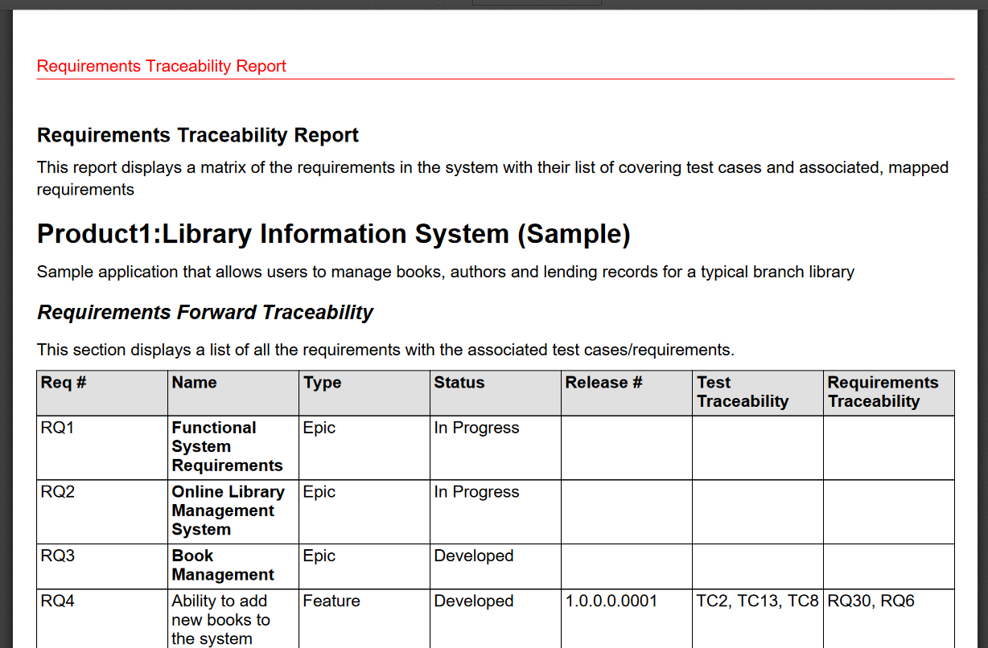
Customizable Reporting
Library of standard and custom reports, export in various formats including Word, PDF, Excel and PDF

Slide 43
Testers
Notes:
That’s the very high level, but what does this mean in detail for you? What have we or are we about to release that can help you? Let’s talk testers first

Slide 44
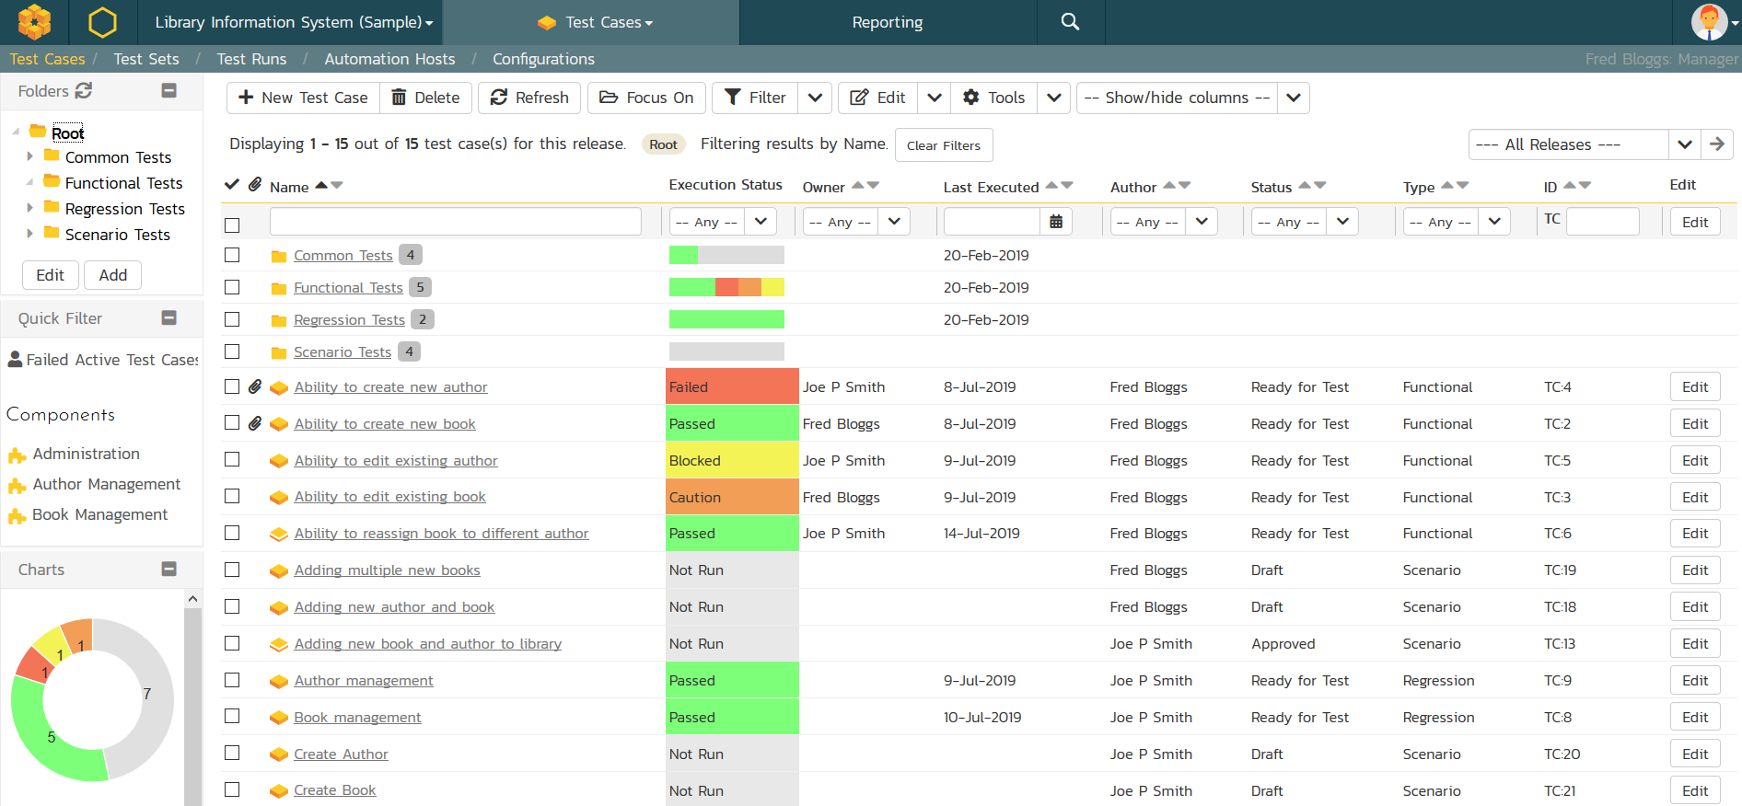
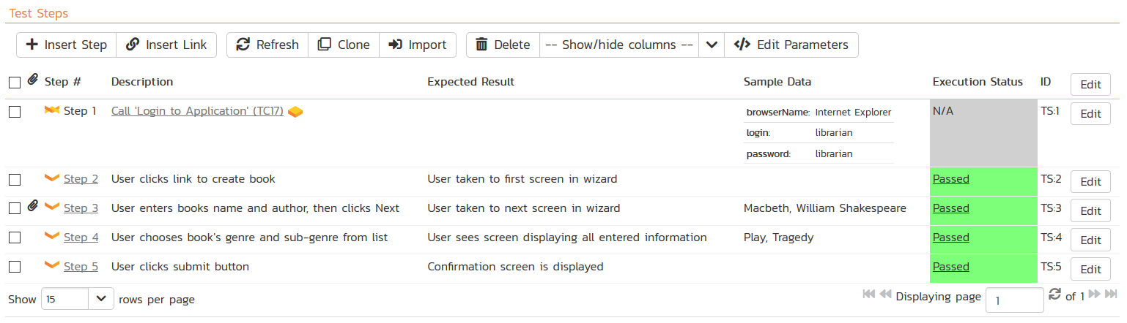
Test Management & QA
Manage your automated and manual test cases, test suites and testing artifacts in a central repository.

Slide 45
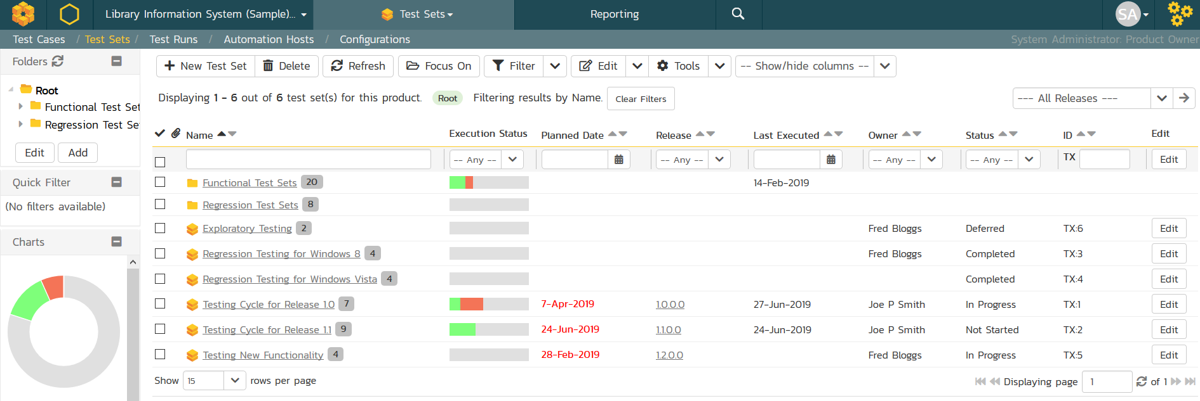
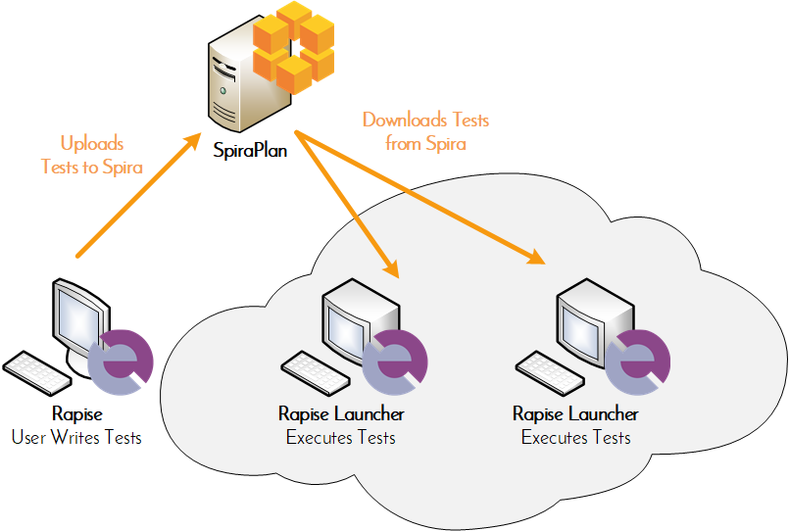
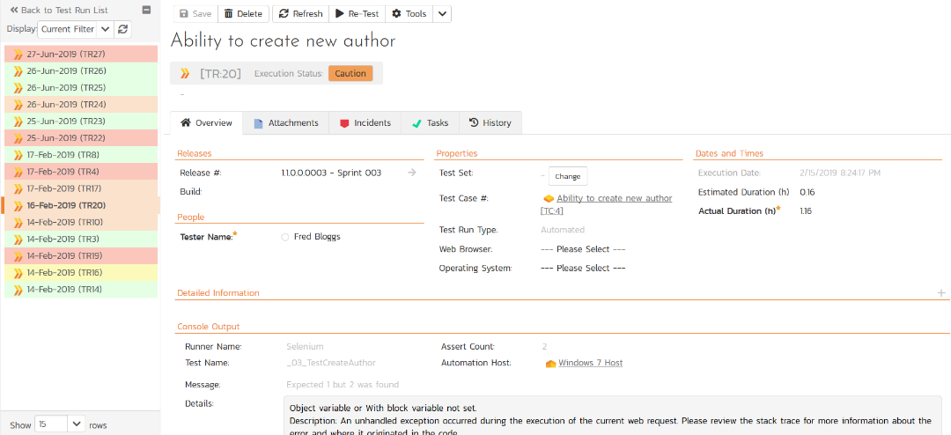
Automated Testing
Orchestrate your automated tests from SpiraPlan, with integrated test lab management and data-driven testing

Slide 46
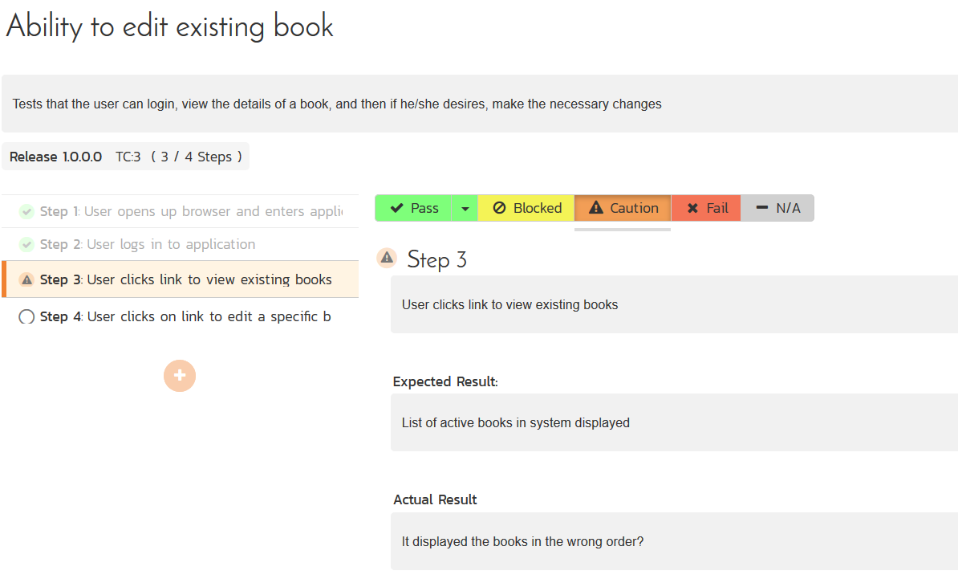
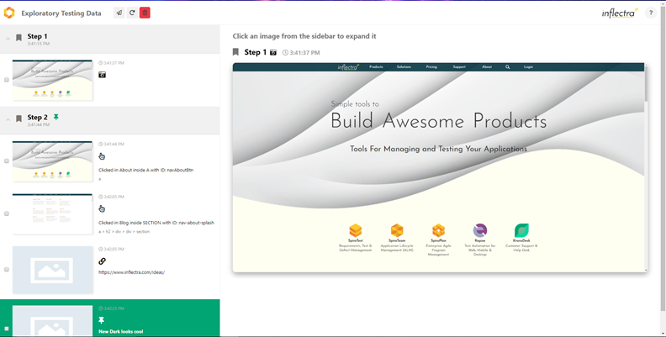
Manual & Exploratory Testing
SpiraPlan provides an easy to use testing wizard for manual and exploratory tests, including SpiraCapture™ for session capture.

Slide 47
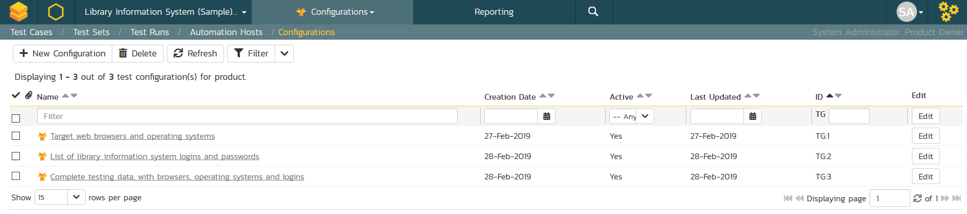
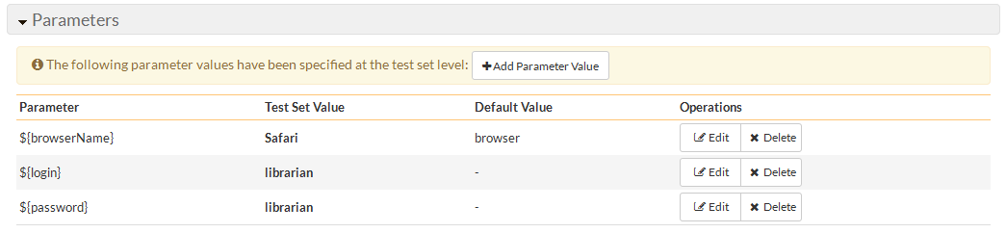
Data-Driven Testing
SpiraPlan lets you parameterize your test cases and execute them using different data combinations for full coverage.

Slide 48
Developers
Notes:
Let’s talk next about developers

Slide 49
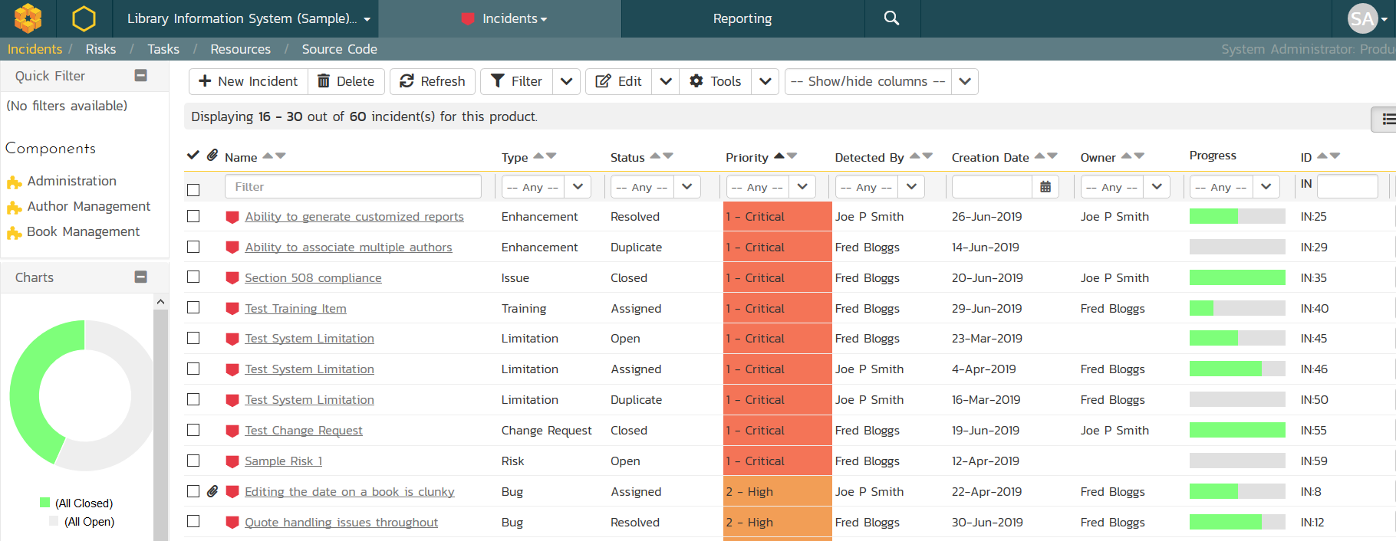
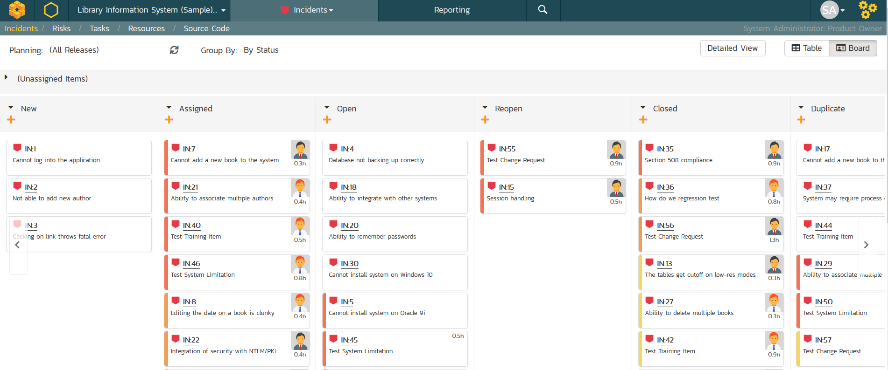
Issue & Defect Tracking
SpiraPlan includes a flexible bug and issue tracker with list and agile board views, and integrated workflow engine.

Slide 50
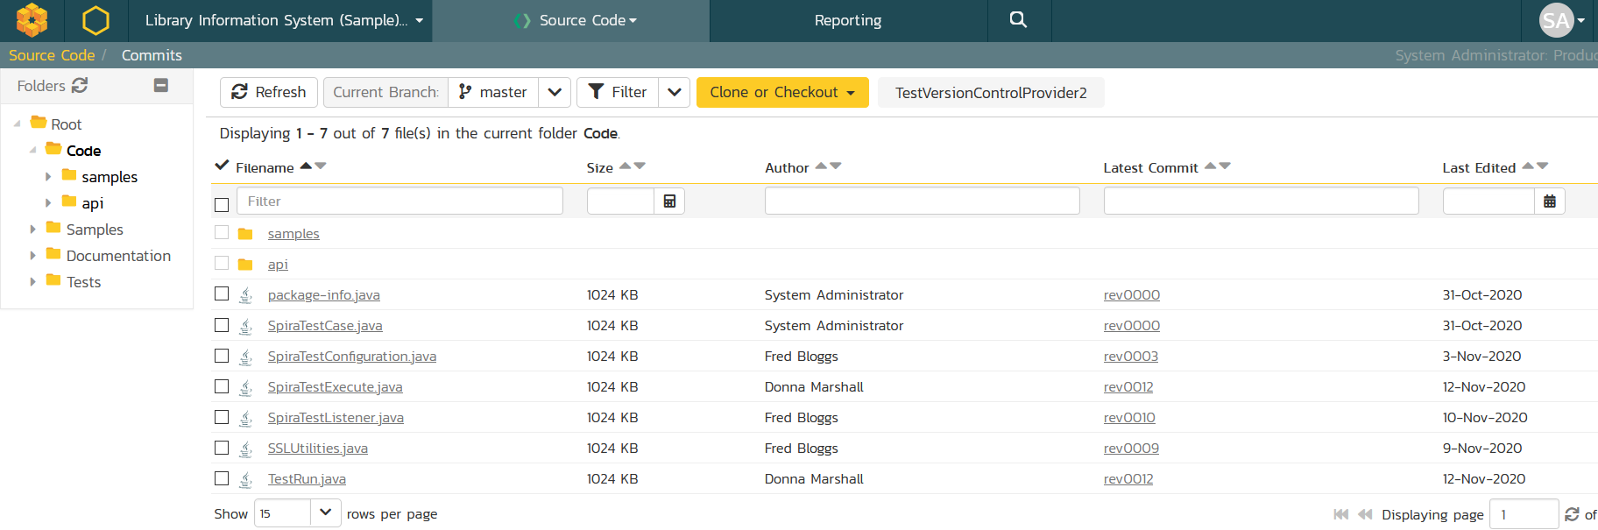

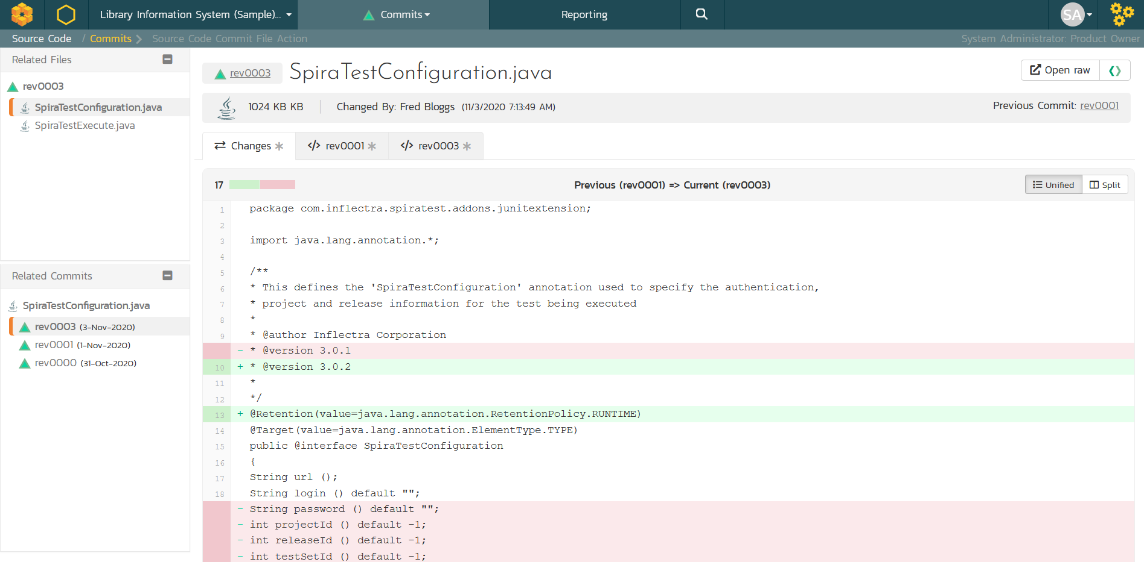


Source Code Management
&
Integrated source code management using Git or Subversion hosted in TaraVault or external. Allows code-level traceability.

Slide 51
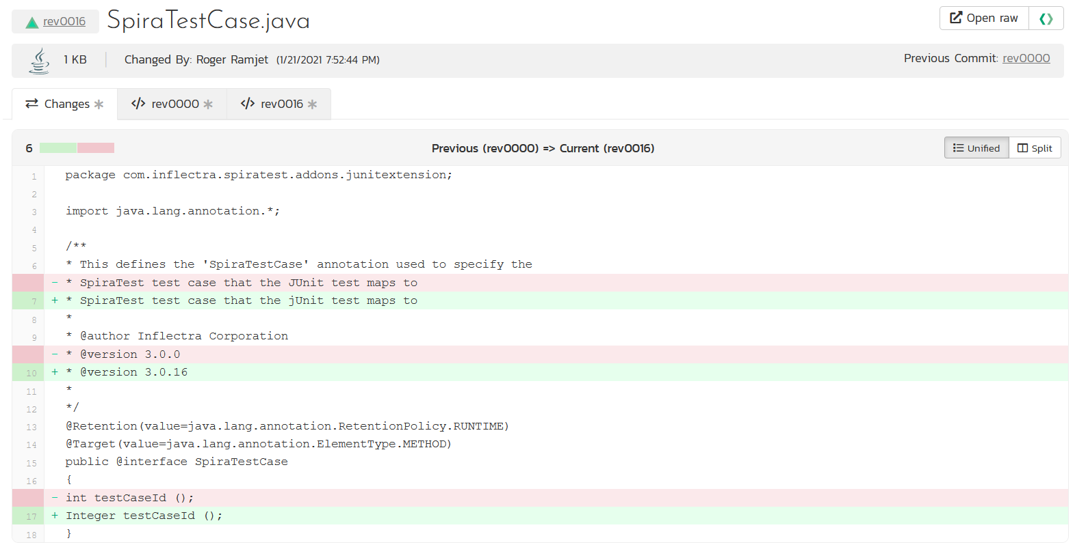
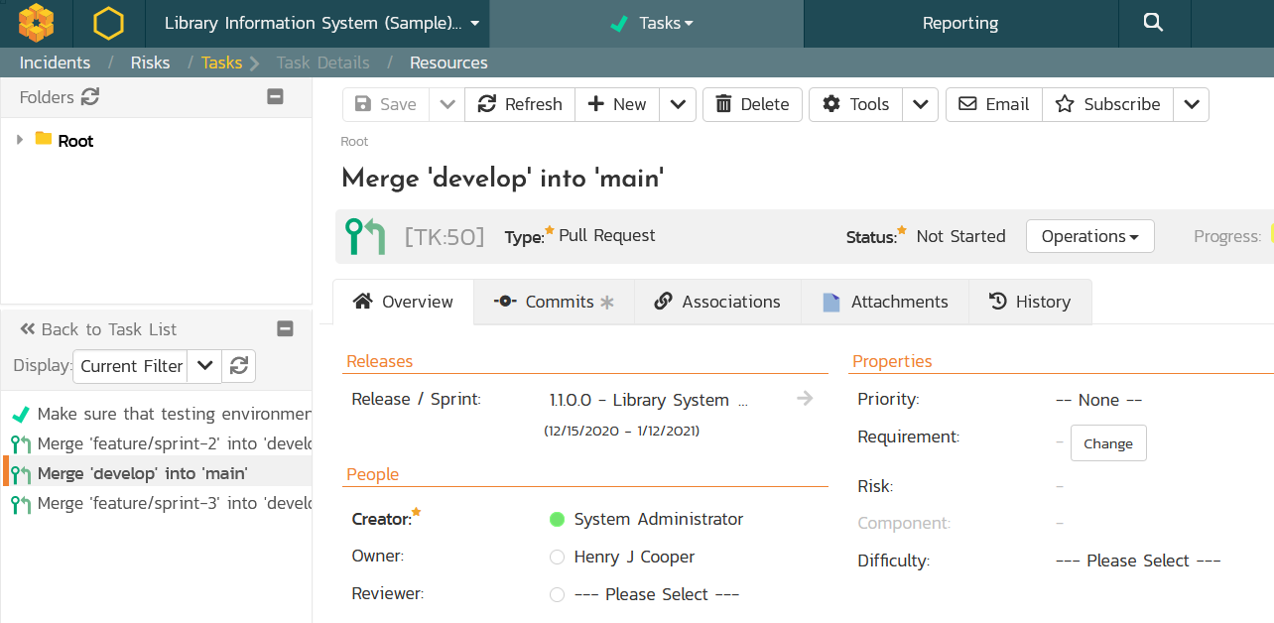
Code Reviews & Pull Requests
Manage your development workflows including merge/pull requests and code reviews with full traceability.

Slide 52
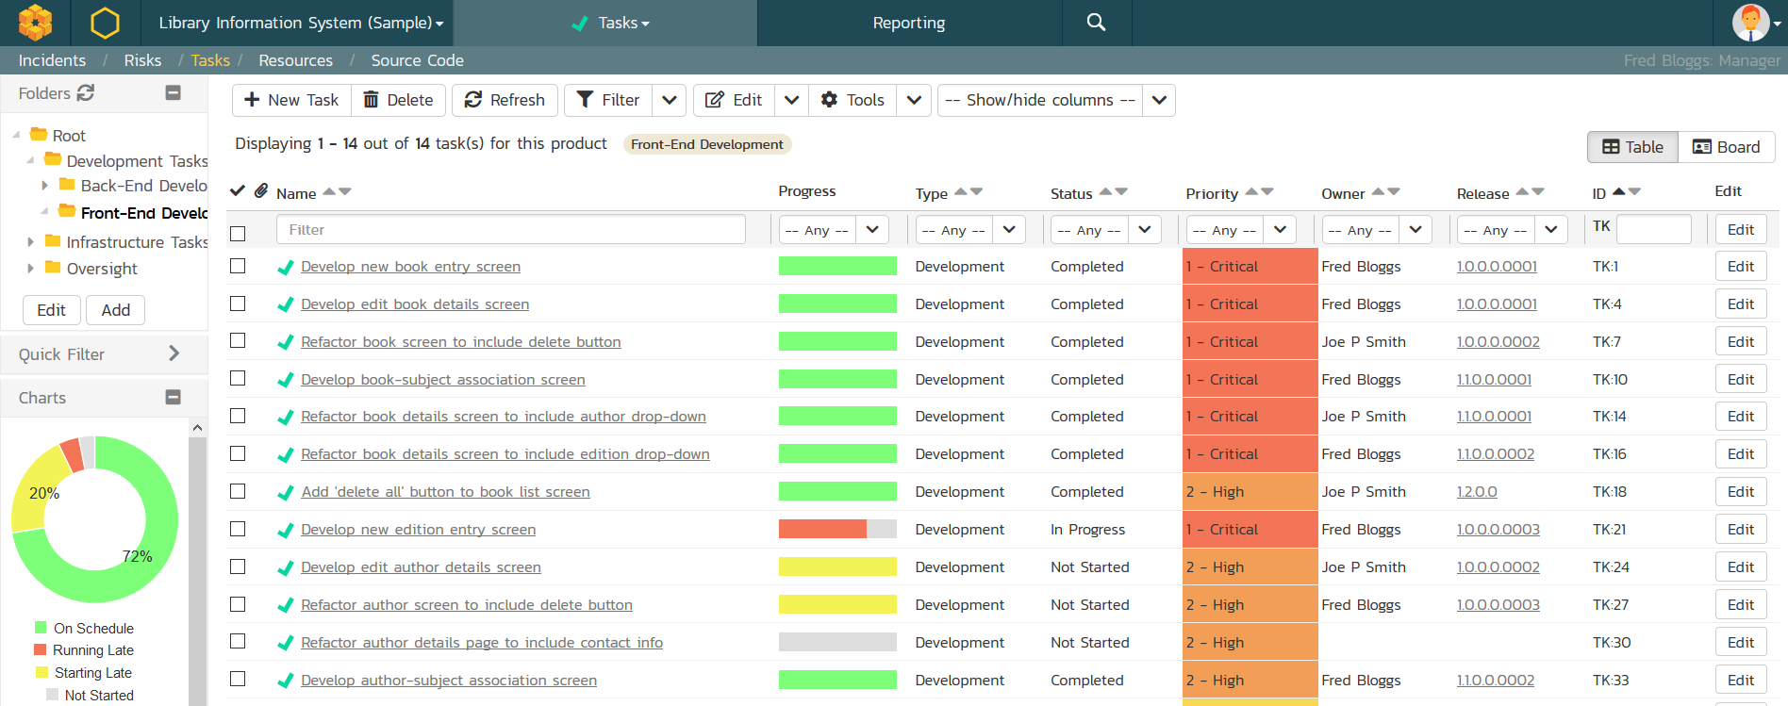
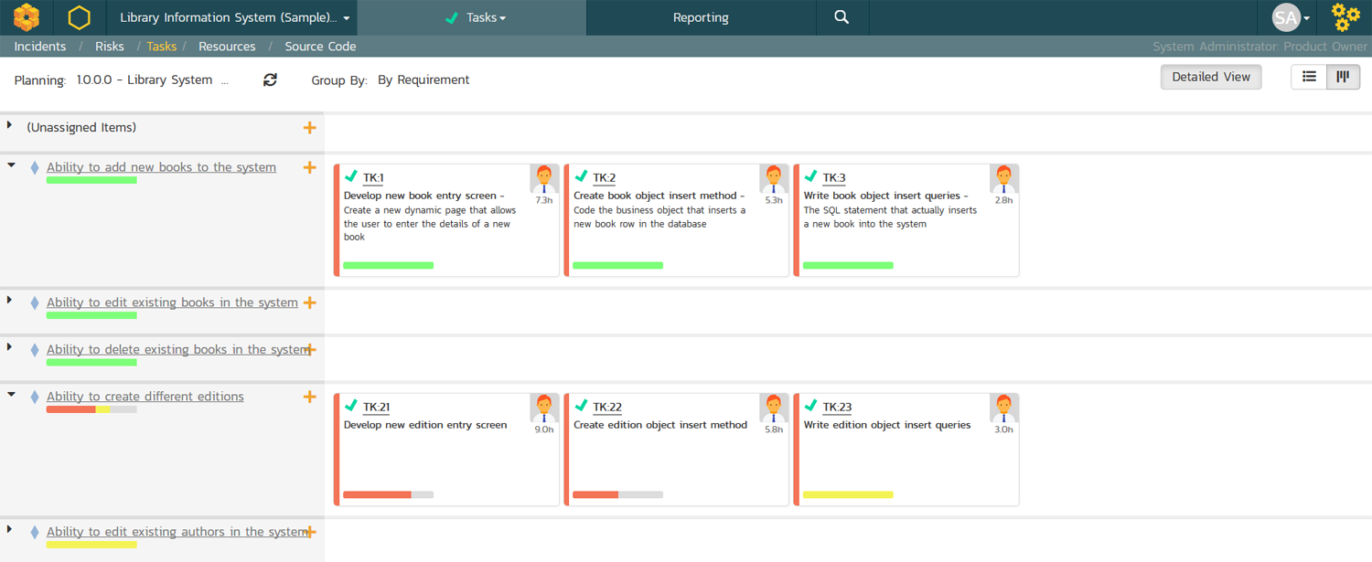
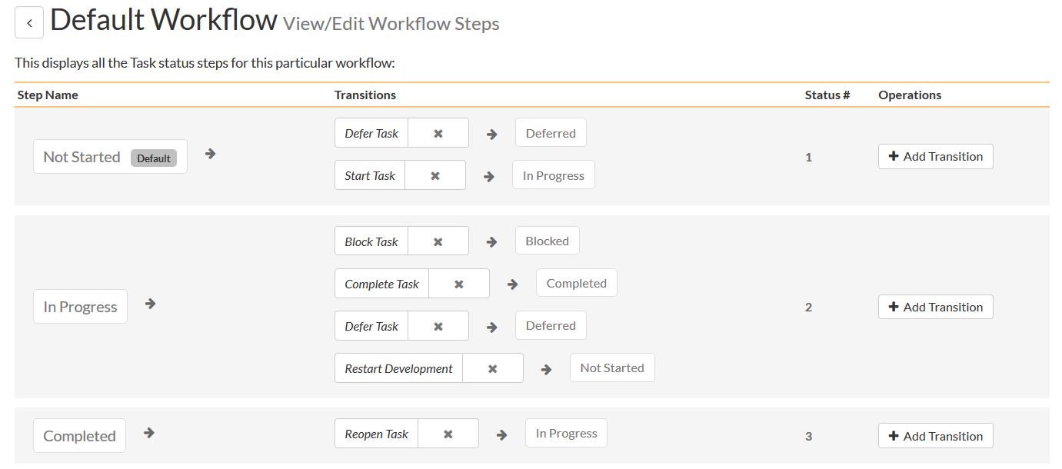
Task Tracking
Track project tasks with customizable workflows.
Measure progress against the requirements and user stories

Slide 53
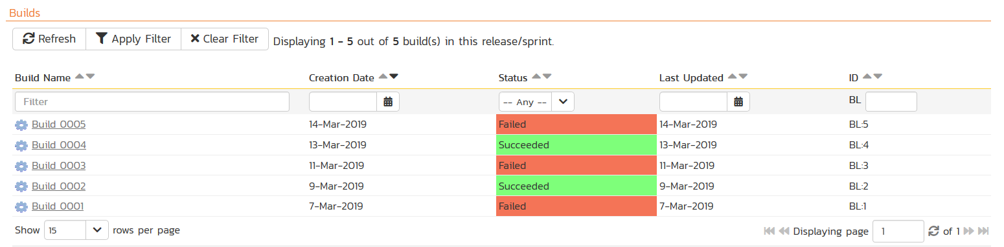
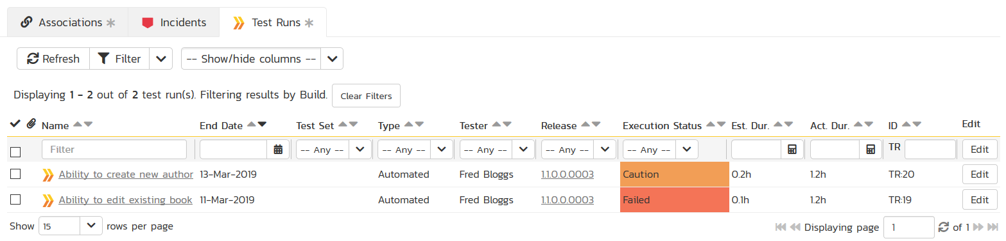
Build Integrated with CI / CD Tools
Build Management in SpiraPlan lets you integrate with continuous integration build servers with full traceability for each build

Slide 54
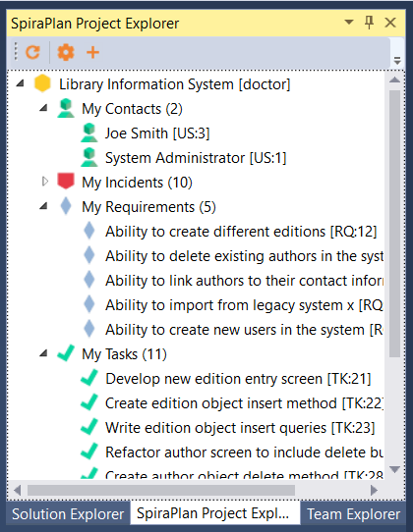
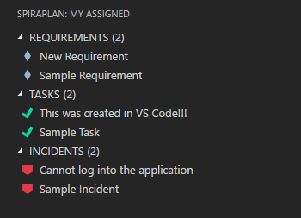
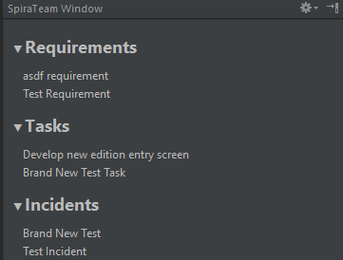



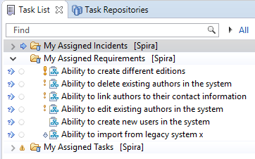

Integration with your Favorite IDEs

Slide 55
Everyone
Notes:
Managers, our third pillar, could always take advantage of our reporting, dashboards, and traceability features. But we knew we could do a lot more to help managers – both senior leaders and those in other roles like BI

Slide 56
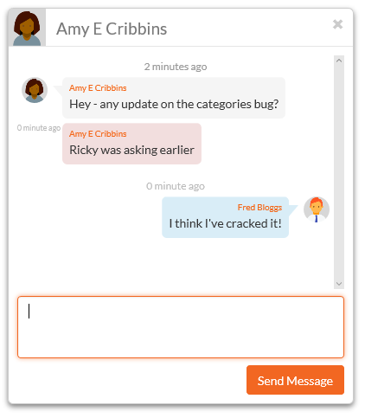
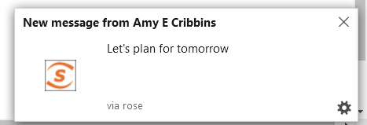

Collaboration and Instant Messaging
Real-time collaboration and communication with SpiraPlan instant messenger, artifact following, RSS Feeds and Email

Slide 57
Integration Options
SpiraPlan Fits into Your Ecosystem Seamlessly

Slide 58
Recap: Harmony Across Ecosystems
We recognize that you need to integrate SpiraPlan with other tools and systems
We make this easy and straightforward so you can get working faster & easier

Slide 59









































































Open Ecosystem – Over 70 Integrations
IDE
CI/CD
Automation
Unit Testing
Bug-Tracking
Detailed Integration List
Import / Conversion
Load Testing

Slide 60
Questions?

