Slide 1

Enterprise Agile Planning
®

Slide 2
Why Inflectra?
WE BELIEVE QUALITY SHOULD BE AT THE CORE, DO YOU?

Slide 3
When A Single Point Of Failure Is Not An Option
INFLECTRA HELPS YOU DELIVER QUALITY SOFTWARE, FASTER AND WITH LOWER RISK

Slide 4



With Inflectra, Deliver Measurable Quality Fast! Only 16% of software development projects are completed on time and within budget.
PRODUCT MANAGERS
QUALITY ASSURANCE
SOFTWARE TESTING
52%
of time spent on unplanned “fire-fighting” activities
40%
of software budget spent on Quality Assurance
5%
of companies carry out fully automated testing internally
60%
of businesses lack a plan to enhance their PM process
39%
of software projects fail due to poor requirements gathering
24%
of companies saw ROI uplift from automated testing
39%
of managers that worry about missing launch date
67%
of customers cite “bad experience” with products as their churn reason
35%
of companies use non-testers for software testing
Sources: “Software Survival in 2024”, Beta Breakers; “10 QA Statistics”, Testlio; “Product Management Statistics”, UXCam; “Software Testing Statistics – 2024”, TrueList

Slide 5









The Inflectra® Platform
SpiraPlan® - Agile Program & Portfolio Management for the Enterprise
SpiraTeam® - Agile Lifecycle Management for Teams
SpiraTest® - Test Management for Teams
DataSync™ - Seamless Data Synchronization
SpiraApps™ - Spira
Extensibility Framework
SpiraCapture™- Free
Exploratory Testing
Rapise® - AI-Powered Test Automation
KronoDesk®- Customer Service Desk
RemoteLaunch® - Test Orchestration

Slide 6




Spira Platform Snapshot
Capabilities
SpiraTest
SpiraTeam
SpiraPlan
Requirements Management
Test Management & Traceability
Defect & Issue Tracking
Agile Planning Tools
Program & Portfolio Planning

Slide 7
Why SpiraPlan?
Program Management & ALM For Scaling Agile & Enterprises

Slide 8











SpiraPlan® - Program Management for Scaling Agile
KEY FEATURES & BENEFITS
DIFFERENTIATORS
Enterprise-grade agile planning & execution capabilities enable the user to have a 360-degree view of all projects and programs
1
Truly holistic solution that allows full planning, development, and testing in one solution, eliminating the need to purchase multiple products
2
Focus on “built-in”; with integrations, capabilities, artifacts, and more all included to minimize limitations
Fine-tuned capabilities such as baseline management, configuration management, and version control that are tailored to the complex compliance & quality standards of regulated industries
3
Tailored for highly regulated industries, enabling customers to deliver high quality, mission-critical software without sacrificing speed for compliance
4
OData API for dashboard / report creation with customized queries from common reporting tools (e.g., Excel, PowerBI)
Fully ecosystem-agnostic integrations and various deployment options, designed to fit the needs of any enterprise
5
Operate in both cloud and on-premise hosting environments
Enhanced automation through generative AI, driving efficiencies in creation of project artifacts from requirements and generation of test cases
POPULAR INTEGRATIONS
END USER(S)
Program & Project Managers
Risk Management Professionals
Portfolio Managers
Chief Information Officer (CIO)
30%
40%
30%
faster
delivery
fewer
defects
reduced
risk

Slide 9

SpiraPlan®: Personas
PROJECT MANAGER
HEAD OF IT
PORTFOLIO MANAGER
RISK/COMPLIANCE MANAGER
Demographics:
Age: 35-50
Experience: 10+ years
Goals:
Execute large-scale software programs, ensuring alignment with organizational objectives.
Manage dependencies, timelines, & resource allocation across teams
Deliver high-quality software solutions on schedule and within budget.
Pain Points:
Managing interdependencies across multiple software development teams and external vendors.
Limited tools to visualize program-level KPIs, milestones, and risks in real time.
Inefficient communication channels causing delays and misaligned priorities.
Demographics:
Age: 35-55
Experience: 10+ years
Goals:
Ensure all tools are fully integrated & interoperable.
Maintain strict compliance with security protocols and regulatory requirements.
Scale IT infrastructure to support growth & efficiency.
Pain Points:
Complexity in maintaining interoperability across systems and tools.
Difficulty meeting compliance requirements without impacting usability or flexibility.
Lack of a centralized system to monitor and maintain operational performance across tools.
Demographics:
Age: 30-50
Experience: 8+ years
Goals:
Align project portfolios with strategic objectives to maximize ROI and value delivery.
Monitor resource utilization and performance metrics across the entire portfolio.
Balance competing priorities and dependencies to ensure smooth execution.
Pain Points:
Lack of centralized insights into portfolio health and interdependencies across projects.
Inefficient resource allocation leading to delays.
Challenges in generating real-time, data-driven reports for stakeholders and leadership.
Demographics:
Age: 45-55
Experience: 12+ years
Goals:
Centralize risk identification, tracking, and mitigation within a single system.
Ensure alignment with regulatory frameworks (ISO 27001, GDPR, SOX).
Deliver real-time, actionable insights to stakeholders.
Pain Points:
Disconnected risk and compliance data across multiple tools.
Limited automation for risk triggers and compliance escalations.
Inefficient compliance reporting and audit preparation.

Slide 10
SpiraPlan®: User Benefits
STRATEGIC ALIGNMENT
FASTER TIME-TO-MARKET
STREAMLINED COMPLIANCE AND GOVERNANCE
PROACTIVE RISK MANAGEMENT
Ensures all projects and programs align with organizational goals through integrated performance tracking and reporting.
Reduces project delays and inefficiencies with automation and streamlined processes, driving innovation and competitiveness.
Ensures adherence to industry standards and regulatory requirements with integrated governance tools.
Identifies, assesses, and mitigates risks organization-wide, ensuring stability and resilience in operations.
ENTERPRISE MANAGEMENT
PORTFOLIO MANAGEMENT
ENTERPRISE-GRADE SCALABILITY
REAL-TIME REPORTING ACROSS LEVELS
SpiraPlan centralizes project, program, and portfolio management into a single, scalable platform for large organizations
Provides real-time visibility into portfolio performance, enabling strategic alignment with business objectives and resource allocation.
Handles large-scale, multi-team configurations with support for global collaboration and complex reporting needs.
Offers portfolio-wide insights and program-specific analytics with drill-down capabilities for actionable decision-making.

Slide 11



Add-On Products
Extends Spira® Platform (SpiraTest, SpiraTeam, SpiraPlan) with customizable features to meet specific industry needs and compliance requirements.
Offers modular SpiraApps to dynamically adapt workflows, optimize SDLC processes, and maximize ROI.
Integrates with AI solutions like ChatGPT, Azure OpenAI, and AWS Bedrock for automated test generation, risk analysis, and streamlined project management.
Quick installation with support for integrations like GitHub, GitLab, AWS Bedrock, and CircleCI for a unified workflow experience.
Supports third-party development and monetization of SpiraApps, expanding functionality and fostering innovation.
DataSync is a data synchronization tool designed to automate and streamline integrations between Spira and external platforms, ensuring real-time updates and consistent data across systems.
Automatically reflects changes across all connected tools, reducing
manual work and ensuring teams stay aligned.
Adapts to any operational need with cloud, on-premise, and hybrid deployment models, making it ideal for businesses of all sizes and industries.
Comprehensive and developer-friendly, DataSync offers advanced data mapping, multi-instance support, and a centralized dashboard for easy management and troubleshooting.
Ensures data integrity with robust security features and scales effortlessly to handle growing business requirements, including complex hybrid environments.

Slide 12




Add-On Products
Browser-based testing capture tool that enables secure recording of exploratory testing sessions
Automated tracking of clicks & keystrokes on each tab being recorded
Logging of steps for each testing session and notes for specific issues encountered
Delivered as “freemium” product; viewed as additional lever of future product-led growth for the Spira suite
B2B service desk solution for cloud & on-premise installations that integrates tightly with all Spira products to keep product teams informed
Built-in knowledge base, help desk, and forums capabilities with a powerful ticketing system that facilitates communication with the end customer and enables prioritization
Centralization of all customer communications enables a streamlined approach to customer support
Complete configurability allows for adaptability to any customer support workflow
Quick set-up and easy-to-use ticket creation & management, with an existing email integration
Robust and customizable reports for effective visualization of the entire customer support engine with easy KPI tracking (e.g., ticket volume, resolution times, customer satisfaction, etc.)

Slide 13


Add-On Products
Accelerators
Extension of the Spira suite that enables orchestration of automated regression testing (manual & automated)
Open architecture to allow for use in tandem with SpiraTest or other test automation tools, whether commercial (HP Unified Functional Testing, TestComplete) or open source (Selenium, Playright)
Facilitates scheduling, execution, and management of automated test scripts, allowing for full oversight of distributed test labs from a central SpiraTest server
Flexible deployment (cloud, on-premise, hybrid) to suit the needs of all end users
Real-time and detailed reporting delivers a holistic view of manual & automated testing with screenshots, log files, and QA metrics
Primary target users are automation engineers, but also test managers and QA managers
Pre-defined packages of professional services for specific customer objectives
Each package is associated with specific outcomes & deliverables, offered at a fixed price vs. hourly
Provides smaller organizations & teams access to the expertise of Inflectra’s global solution partner network
Offerings are incremental to Inflectra’s existing customer support and other services

Slide 14





Customer Onboarding & Self-Guided Enablement
1
2
3
4
5
Getting Started Videos
Introduces our products and walks you through your first 10 days.
Inflectra Campus
Online Training
Includes free introductory courses followed by paid advanced modules and certificates
Live Webinars
& Q&A
Regular webinars on key product releases, customer roundtables, and other interactive sessions
YouTube
Channel
Recordings of our webinars, advanced product insights and other key Inflectra information
InflectraCon360
Thought leadership content from industry leaders, Inflectra customers and partners
Learn more
Learn more
Learn more
Learn more
Learn more

Slide 15





Technical Support & Customer Success
1
2
3
4
Live Tech Support
Legendary technical support via email, phone, forums. Free standard support with every purchase.
Knowledge Base
A repository of expert-written articles covering product troubleshooting, best practices, and tips & tricks.
Documentation
Quick-start guides, in-depth manuals, and integration instructions for smooth deployment & optimal performance.
Account Managers
Experienced account executives providing strategic guidance from pre-sales consultations through the entire lifecycle.
Premium Support
Combined advanced customer success and tailored technical support delivered by highly skilled professionals.

Slide 16
How SpiraPlan Works For You
Features for different industries and methodologies

Slide 17

Bridging Between Agile and Compliance
Support for Regulated Industries
Modern, Agile Processes
Baselining
Risk Management
Electronic Signatures
Data Privacy
Compliance
Workflow
Requirements Mgt
On-Premise
CI / CD
Scrum
Kanban
Scaled Agile
DevOps
Distributed Teams
Remote Working
Cloud-Based

Slide 18


Healthcare, Life Sciences & Bio-Tech
Electronic signatures for FDA 21 Part 11 compliance
Secure hosting with support for HIPAA BAA agreements
End to end traceability of requirements, tests, and code
Validated platform where you control update cadence
Learn more

Slide 19

Financial Services & Insurance
Secure cloud platform (SOC2) or on-premise deployment
Integrated enterprise risk management
Integration with automated testing and compliance tools
End-to-end traceability and auditability of testing
Helps You Manage Compliance: DORA, SOX, BASEL III
Learn more

Slide 20

Energy, Industrial & Automotive
Testing for public safety with world class test management
Define requirements and test for compliance
Integrate standards and regulations into your test plans
Understand and manage risk of critical systems
Support for Failure Mode & Effects Analysis (FMEA)
Learn more

Slide 21

Defense, Government & Aerospace
Manage programs and portfolios across platforms
Test step level traceability for mission systems
Automate testing and compliance with RemoteLaunch
Orchestrate System of Systems (SoS) development
Security and privacy with on-premise and AWS GovCloud
Learn more

Slide 22
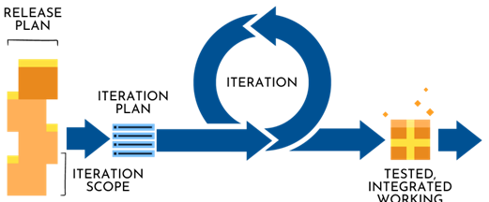
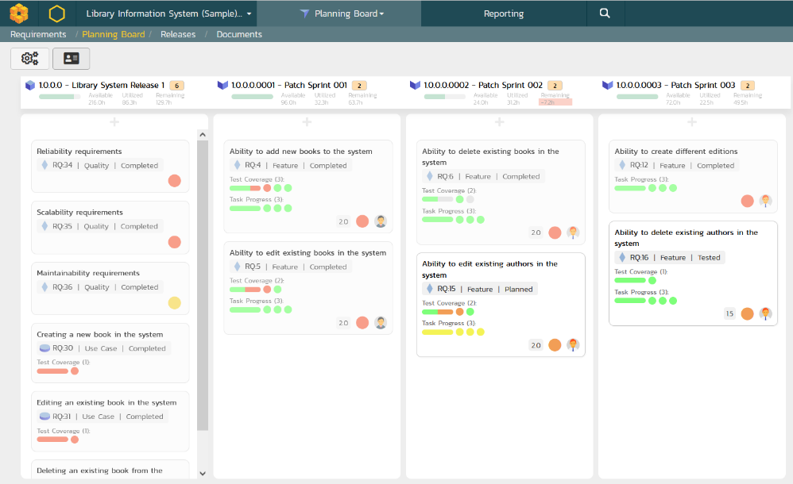
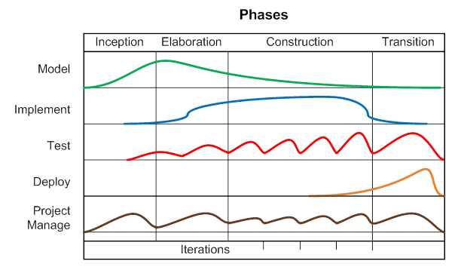
Support for Agile Methodologies
SpiraPlan has been specifically designed to handle all the most popular agile methodologies including Scrum, Kanban, AUP and DAD.

Slide 23
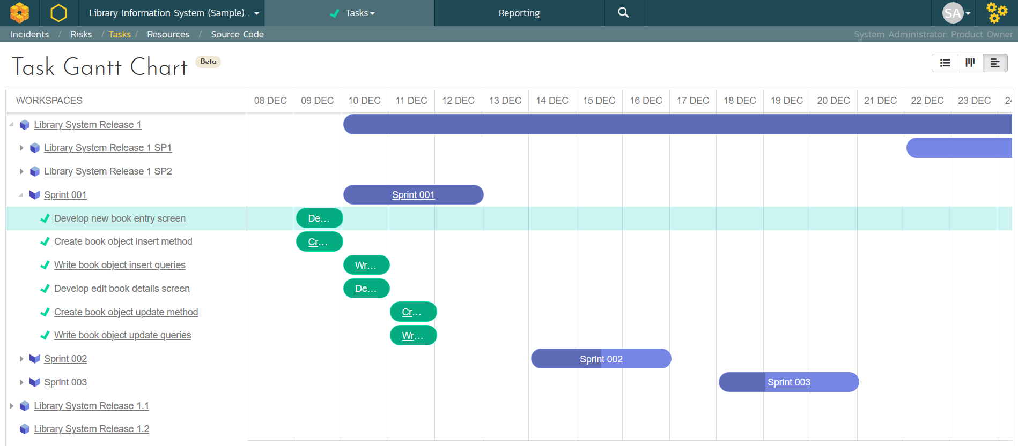
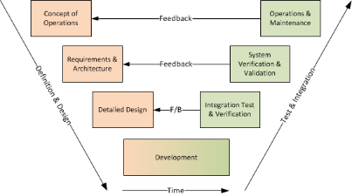
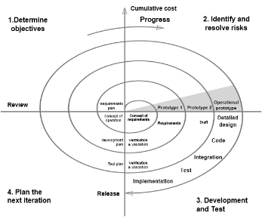
Support for Predictive Methodologies
SpiraPlan has been specifically designed to handle all the most popular predictive methodologies such as waterfall, hybrid and V-model.

Slide 24
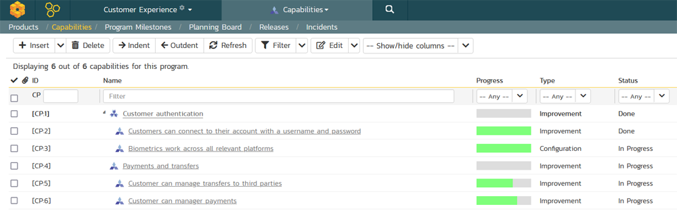
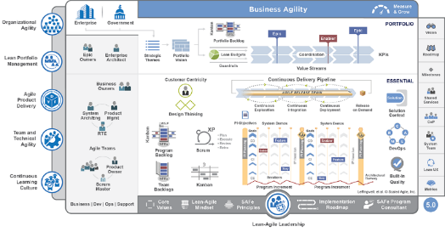
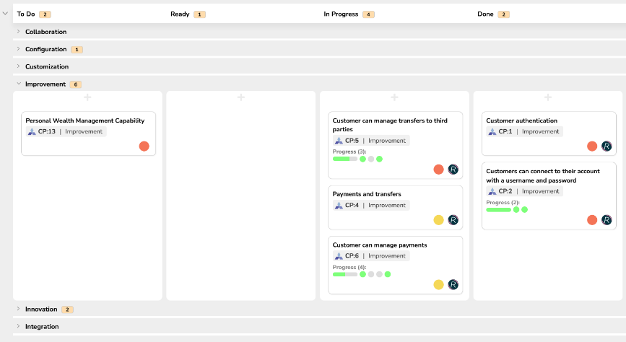
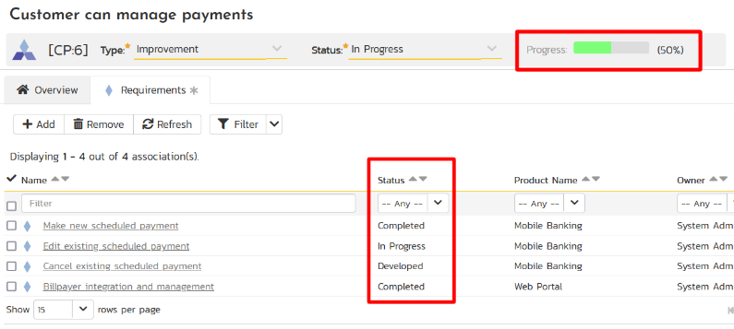
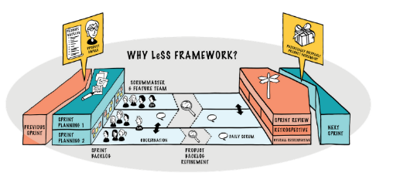
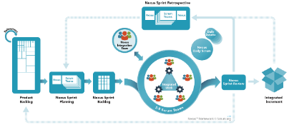
Support for Scaled Agile & SAFe®
SpiraPlan has built-in support for program and portfolio backlogs, aligned with SAFe and other Scaled Agile methods

Slide 25
Features for Regulated Industries
Auditability and end-to-end traceability
Data Privacy, Security baked in
Generation of Compliance Documentation
Workflows & Electronic Signatures
Integrated Risk Analysis and Management

Slide 26


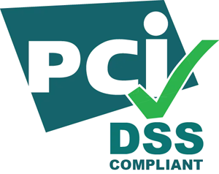
Security & Compliance
Our cloud platform is SOC2 Type II certified
Our website and payment systems are PCI-DSS certified
Data encrypted in transit and at rest using strong ciphers
Multi-factor authentication (MFA) and Single Sign On (SSO)
Physical infrastructure provided by Amazon Web Services.
Learn more

Slide 27














Compliance with International Standards
Guidance on Data Integrity
EudraLex Volume 4 Part I & II

Slide 28
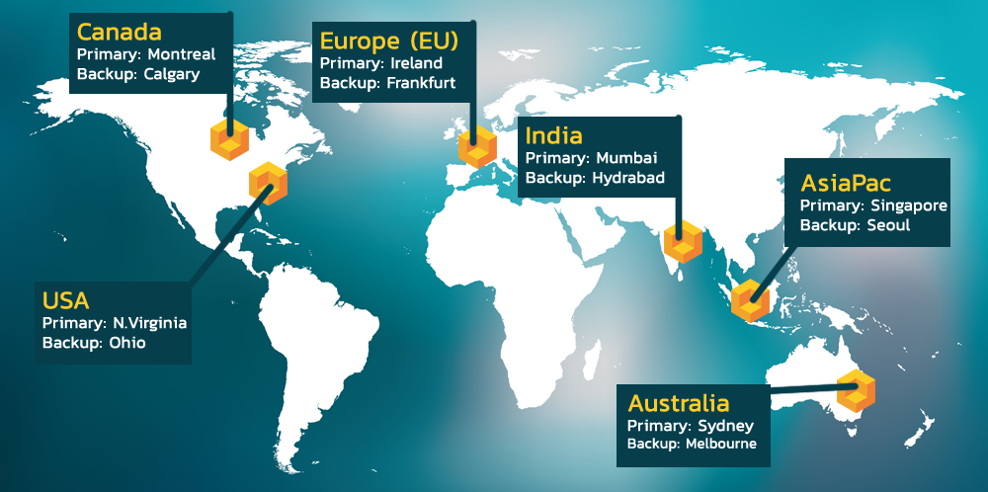
Hosting: Data Privacy and Sovereignty Built In

Slide 29































Representative Customers
Energy, Industrial & Transport
Financial & Business Services
Media & Telecom
Government & Defense
Healthcare & Bio-Technology

Slide 30


























Global Partnership Ecosystem
SOLUTION PARTNERS
TECHNOLOGY PARTNERS
TIERS
# PARTNERS
AREAS OF FOCUS:
Artificial Intelligence (AI)
DevOps & CI/CD
Test Automation
Device Management
Modeling Tools
Platinum
9
Modernization
Agile Transformation
Implementation Services
Training
Load Testing
Gold
10
Silver
31
Blue
69

Slide 31
Customer Testimonials
“
Easy to set up (meaning the project templates, users, customizable fields, etc.) * Very good integration possibilities with other tools * Attractive GUI * Great customization possibilities for reports * REST API available and well documented. We used a maintenance release for one of our medical devices as a trial. Spira allowed very easy control of Requirements and Test artifacts and especially traceability and traceability reporting, which is vital for e.g. the FDA submissions.
- Dennis Lardenoye, Pie Medical Imaging
“
Modern Tool, Properly Designed! I really am enjoying working with SpiraPlan. I managed various other ALM environments for about a decade and it's quite refreshing to be working with a modern tool that was properly designed from the ground up!
- Tim Hartman, TX3 Life Sciences
“

Slide 32
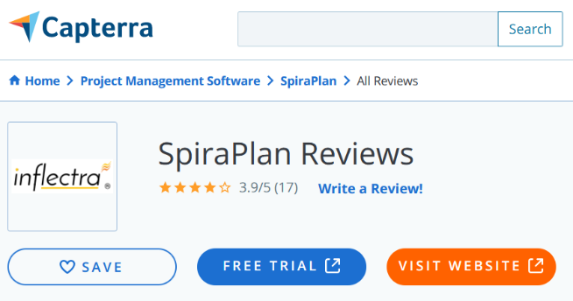
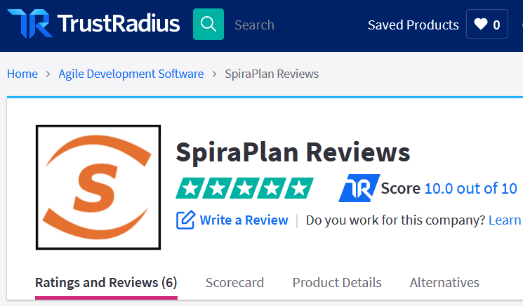
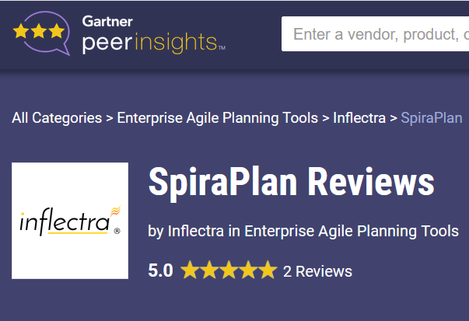
Awards and Recognition*
*Gartner, TrustRadius, Capterra

Slide 33
Feature Overview
Let’s Look at the Key Features in SpiraPlan

Slide 34
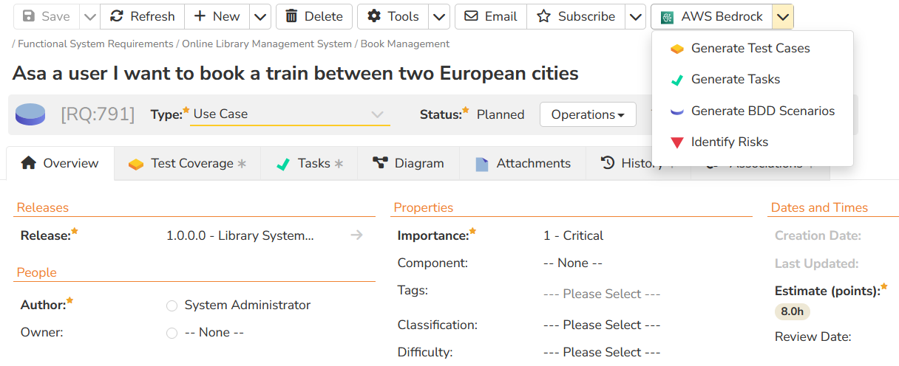
AI Supercharged Lifecycle Management
SpiraPlan's artificial intelligence functionality lets you generate project artifacts such as requirements, test cases, tasks, code, risks and deliverables. The AI functionality increases productivity by 40%.

Slide 35
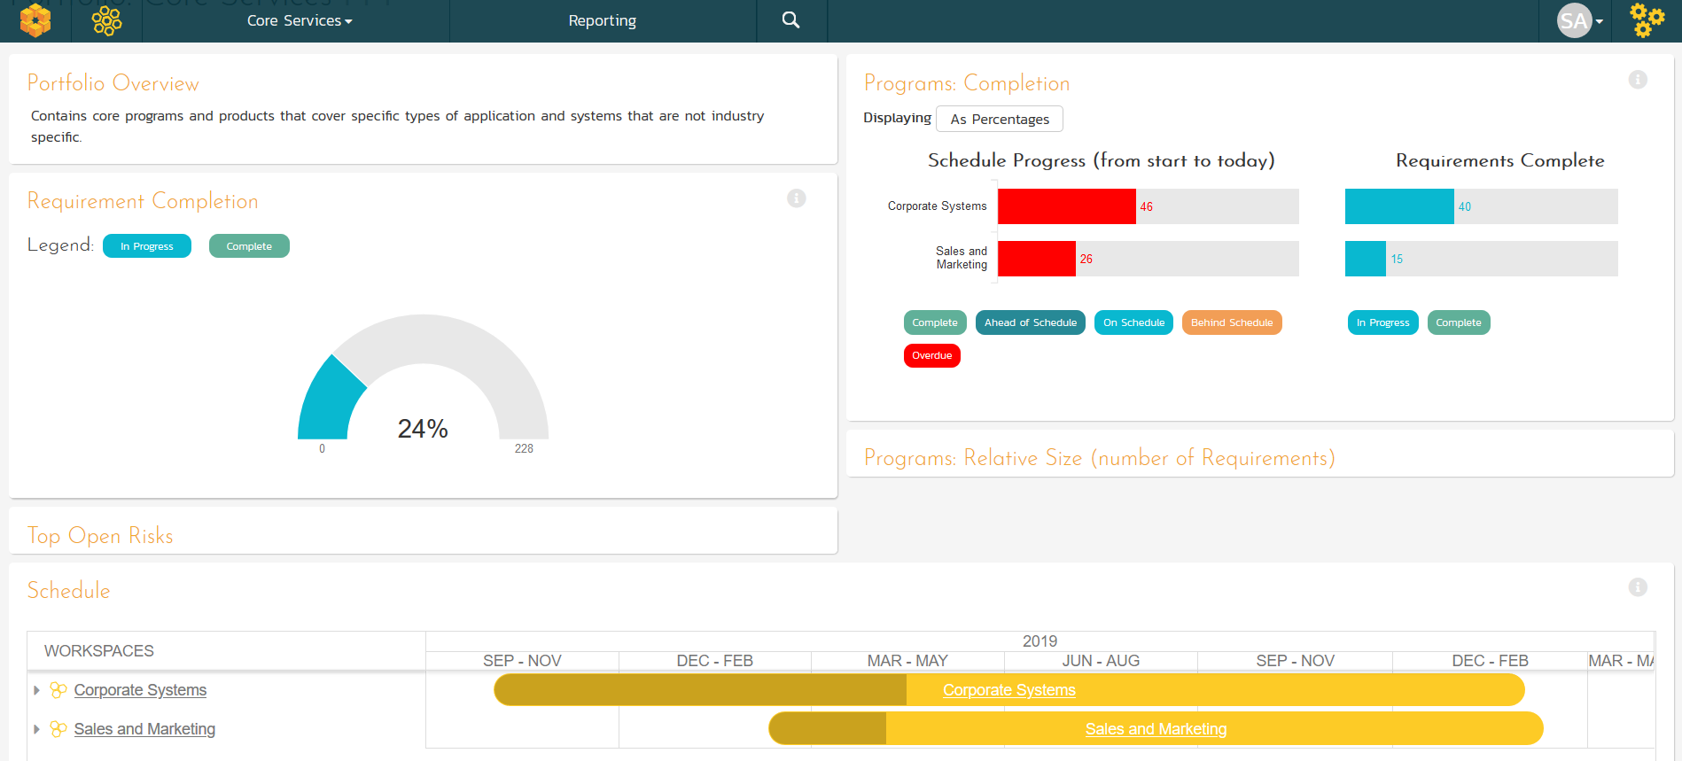
Portfolio Management & Roadmapping
Project Portfolio Management (PPM) dashboards

Slide 36
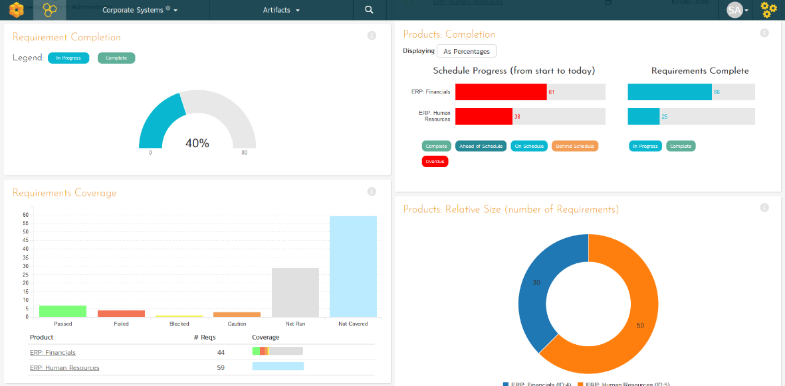
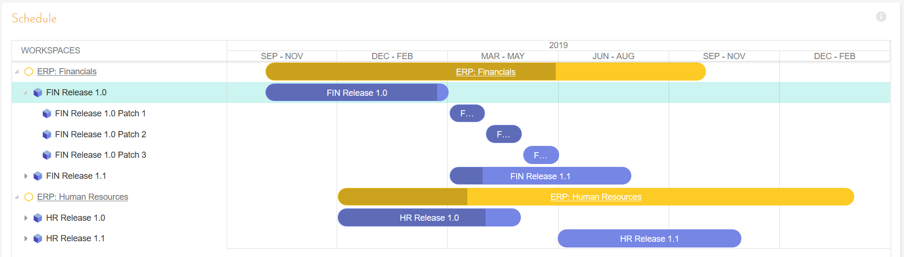
Program Management
Program planning and program management with integrated dashboards and program roadmaps.

Slide 37
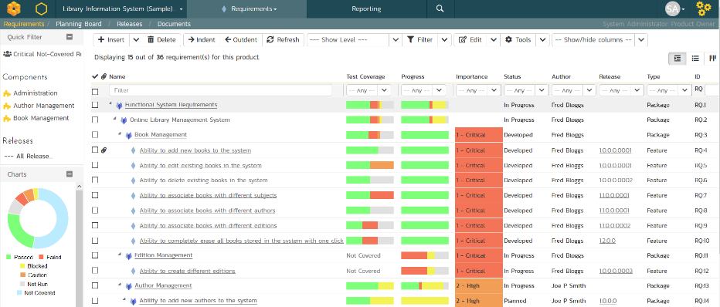
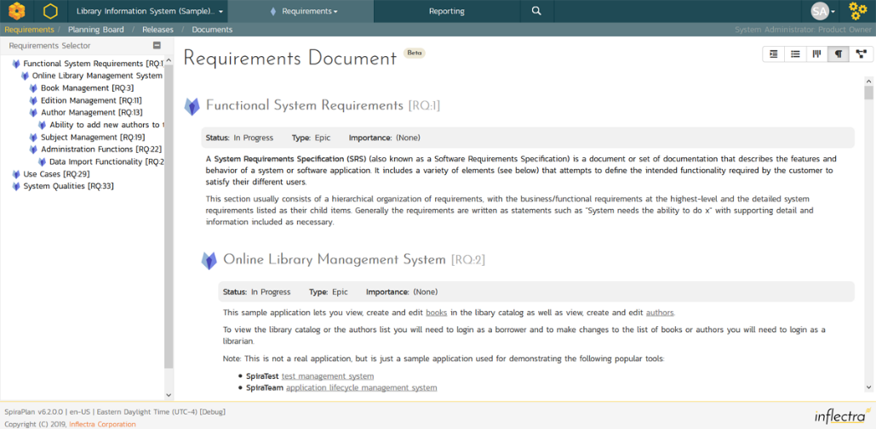
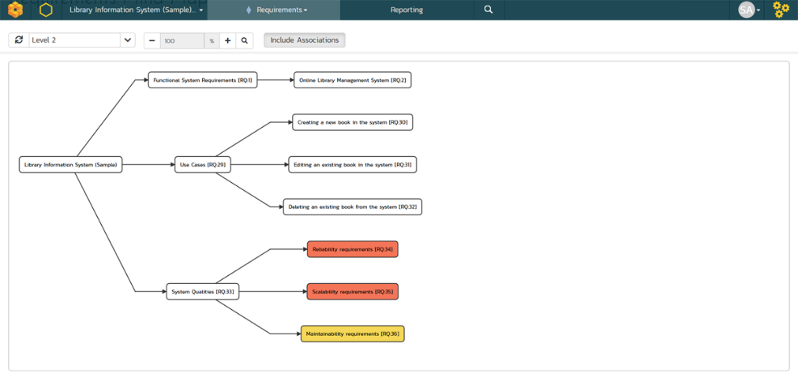
Requirements Management
Requirements management with end-to-end traceability, multiple views and powerful change tracking.

Slide 38
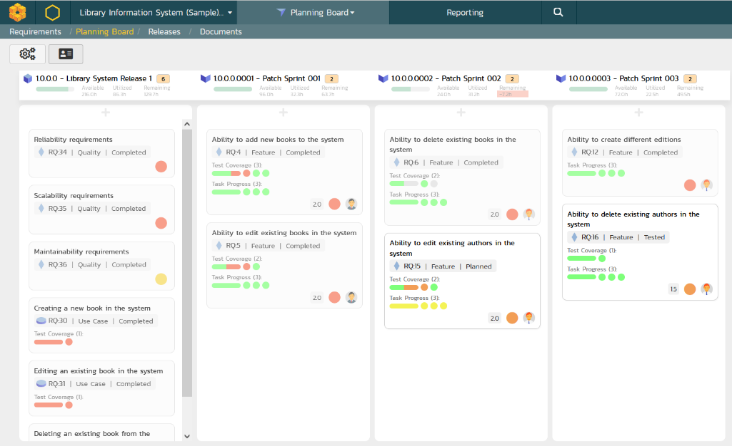
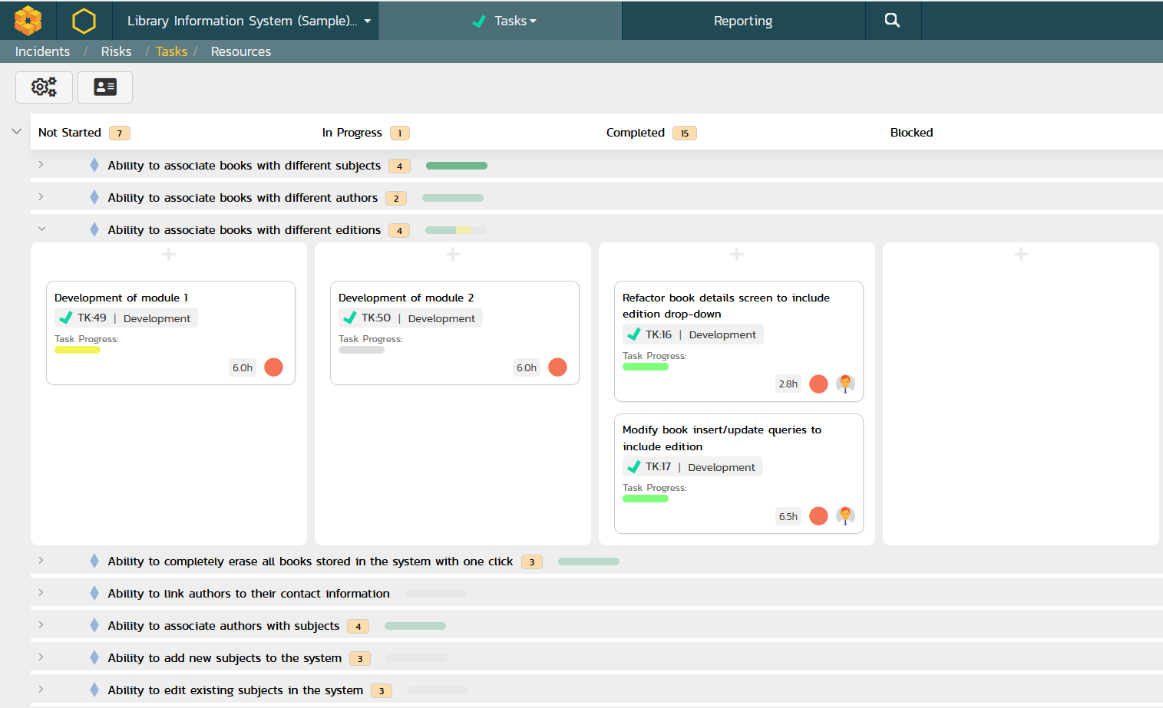
Agile Project Planning
Agile planning boards with test and task traceability that support multiple methodologies including Scrum and Kanban.

Slide 39
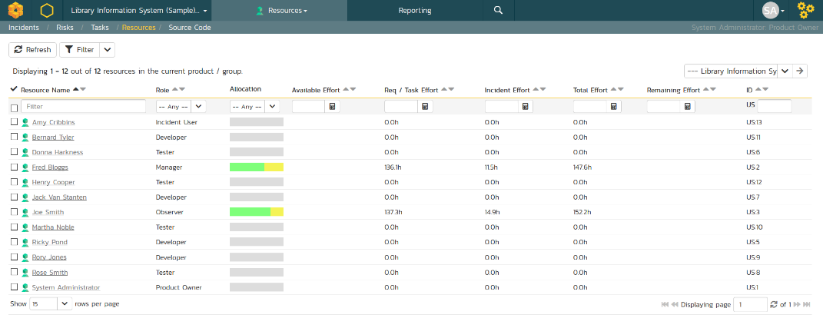
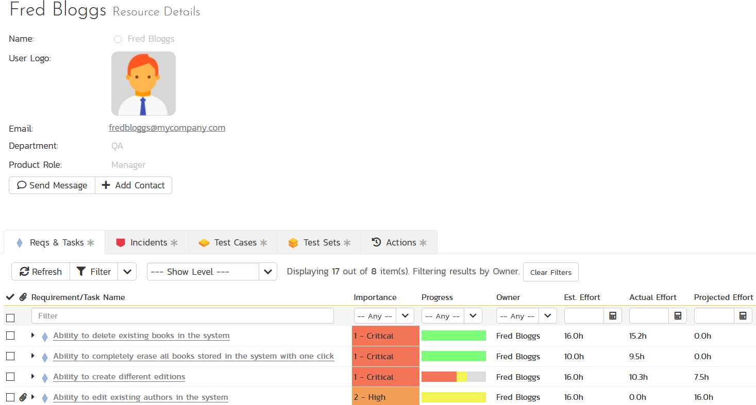
Resource & Team Management
Manage the people and teams on your projects with the ability to rollup the data to a program level.

Slide 40
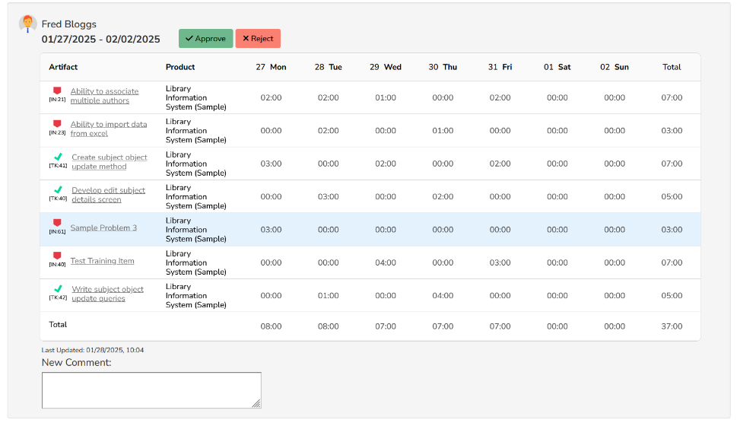
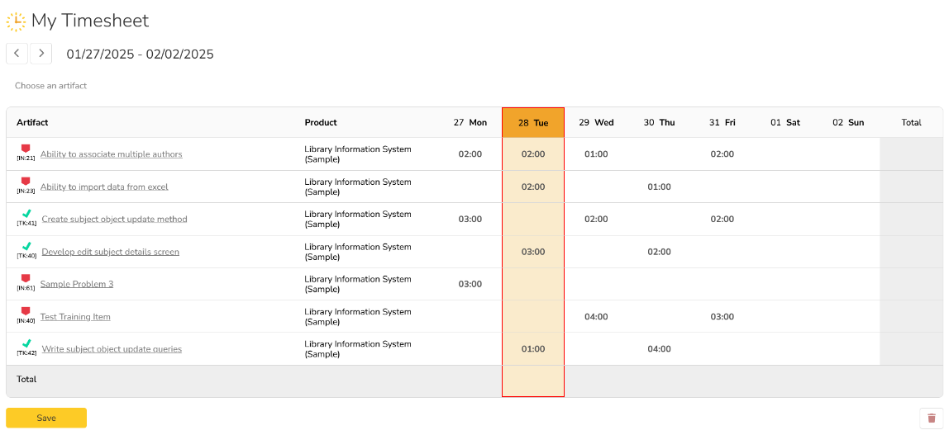
Time Tracking & Approvals
SpiraPlan includes a powerful time tracking system that lets users submit their time spent against assigned tasks and incidents, with timesheet managers able to review and approve timesheets.

Slide 41
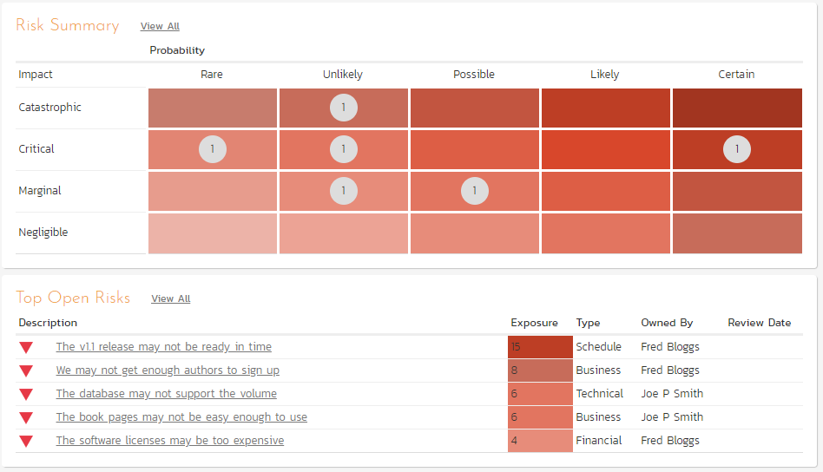
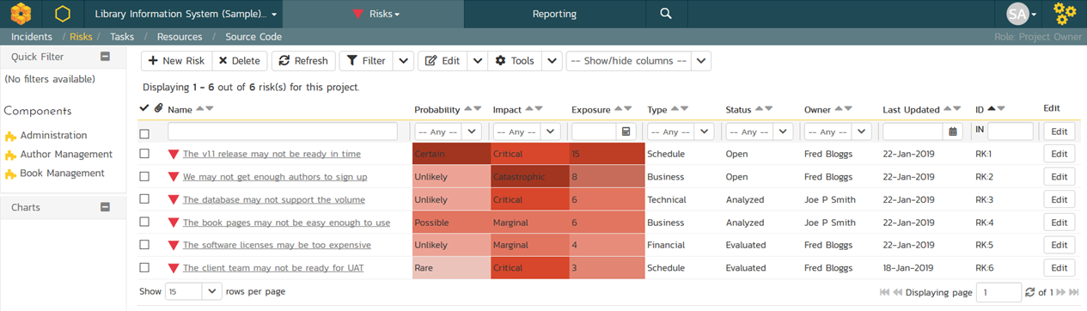
Risk Management
Manage your product and program risks, track mitigations and action items. Automated exposure calculations out of the box.

Slide 42
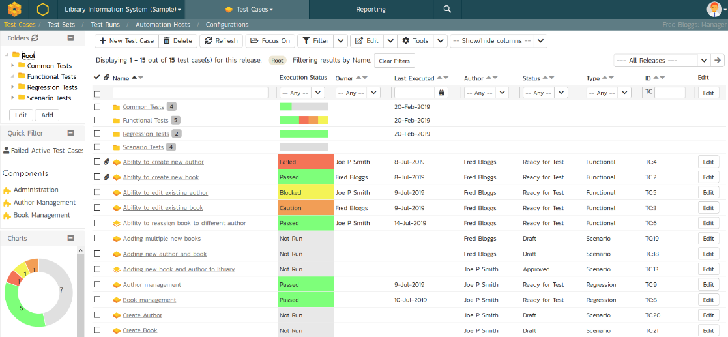
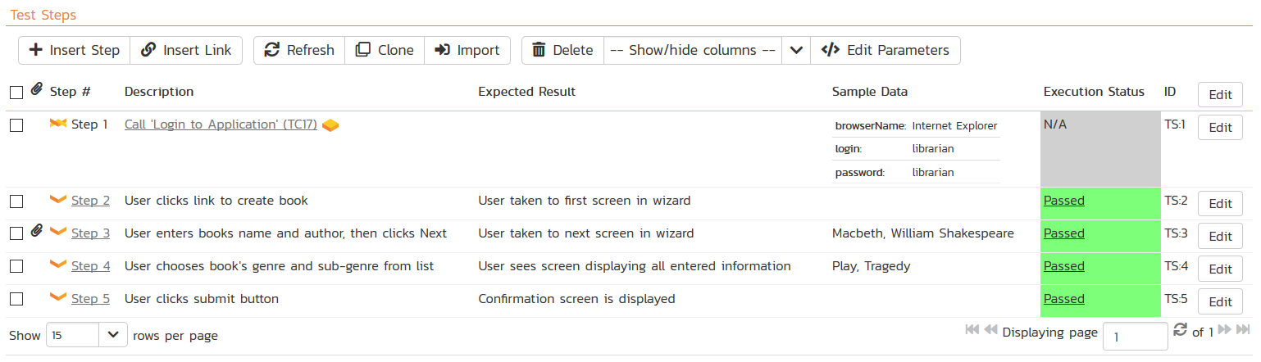
Test Management & QA
Manage your automated and manual test cases, test suites and testing artifacts in a central repository.

Slide 43
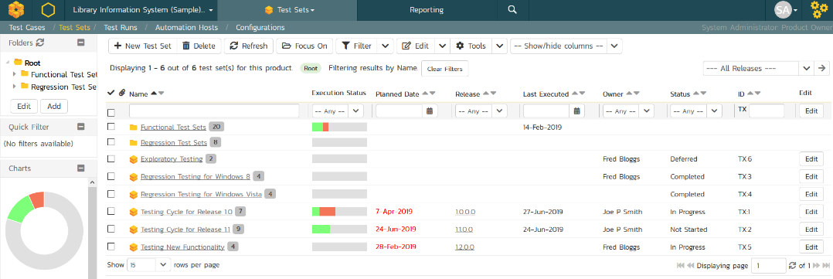
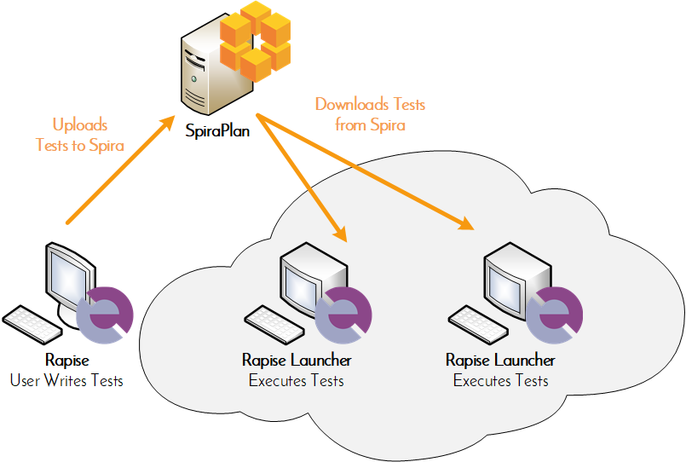
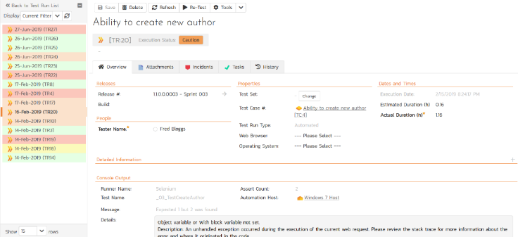
Automated Testing
Orchestrate your automated tests by linking Rapise® from Inflectra with SpiraPlan, with integrated test lab management.

Slide 44
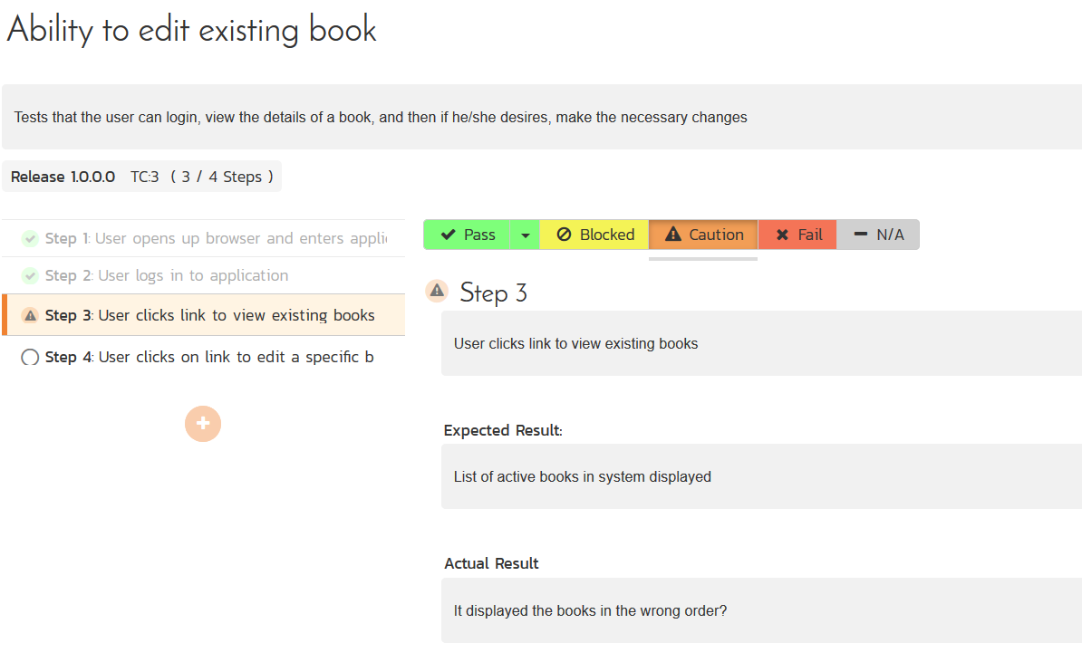
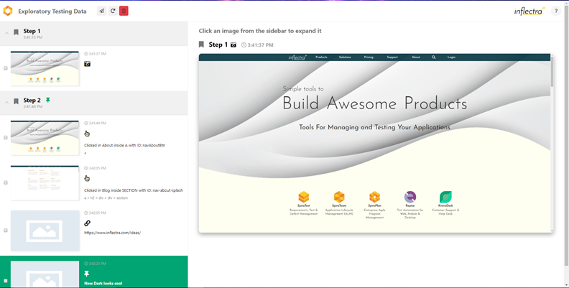
Manual & Exploratory Testing
SpiraPlan provides an easy to use testing wizard for manual and exploratory tests, including SpiraCapture™ for session capture.

Slide 45
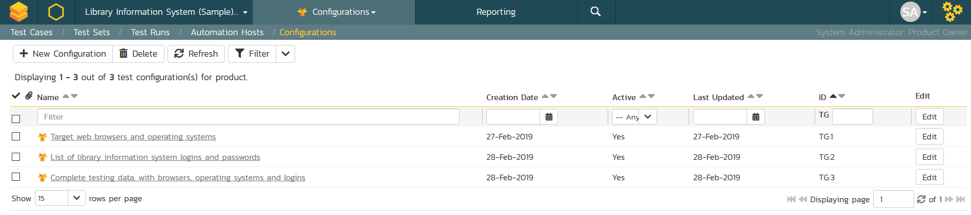
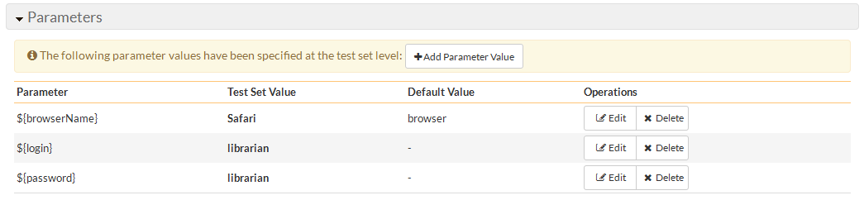
Data-Driven Testing
SpiraPlan lets you parameterize your test cases and execute them using different data combinations for full coverage.

Slide 46
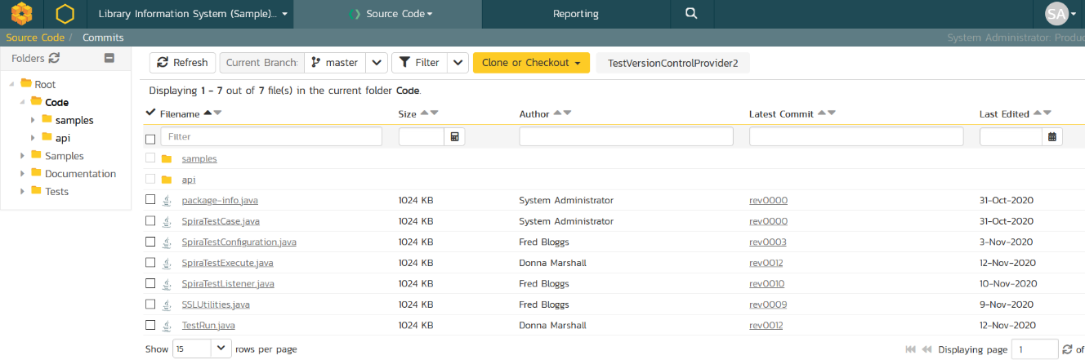
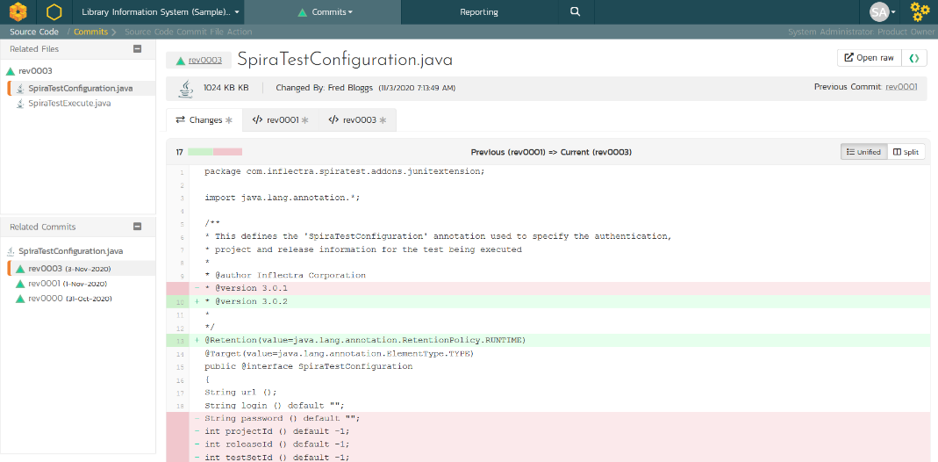


Source Code Management
&
Integrated source code management using Git or Subversion. Plugins for GitHub and GitLab. Allows code-level traceability.

Slide 47
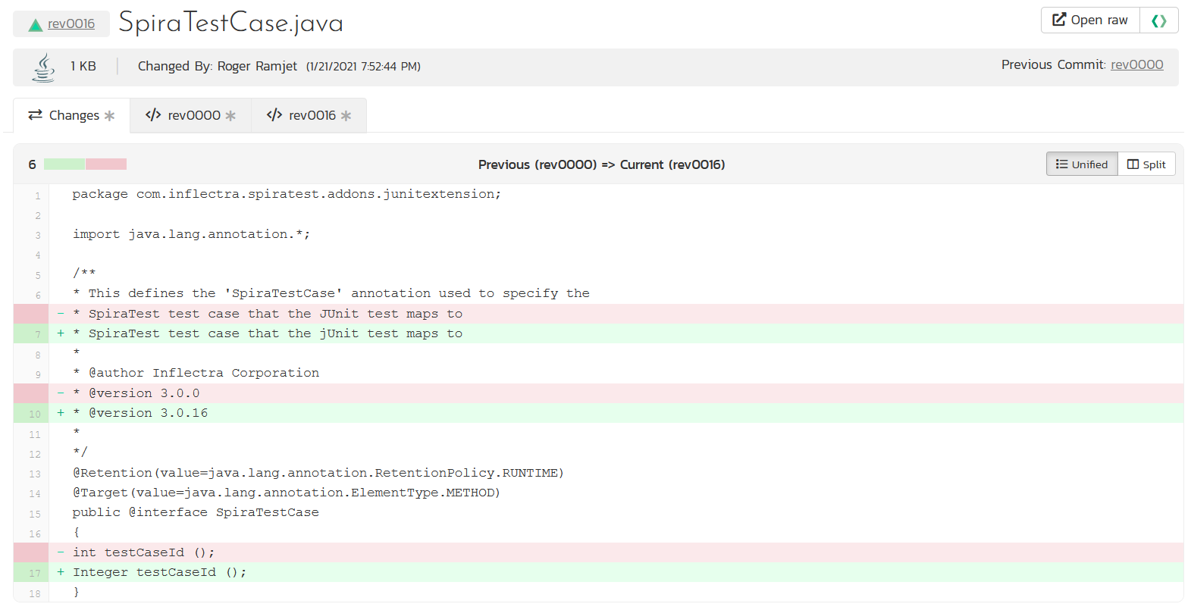
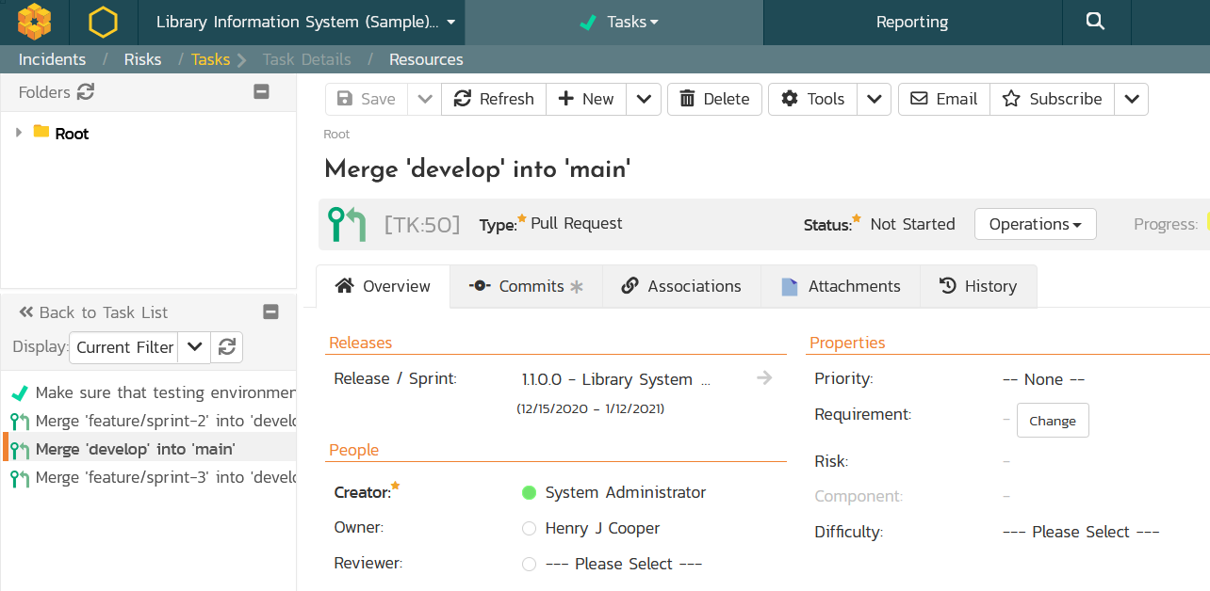
Code Reviews & Pull Requests
Manage your development workflows including merge/pull requests and code reviews with full traceability.

Slide 48
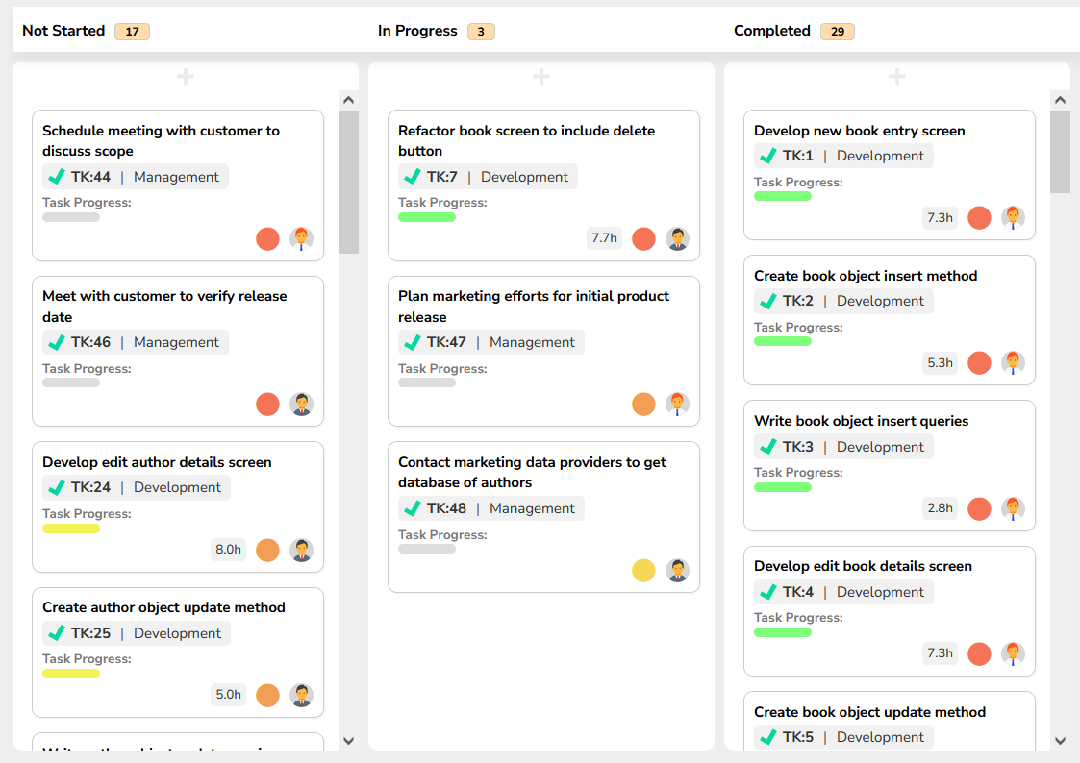
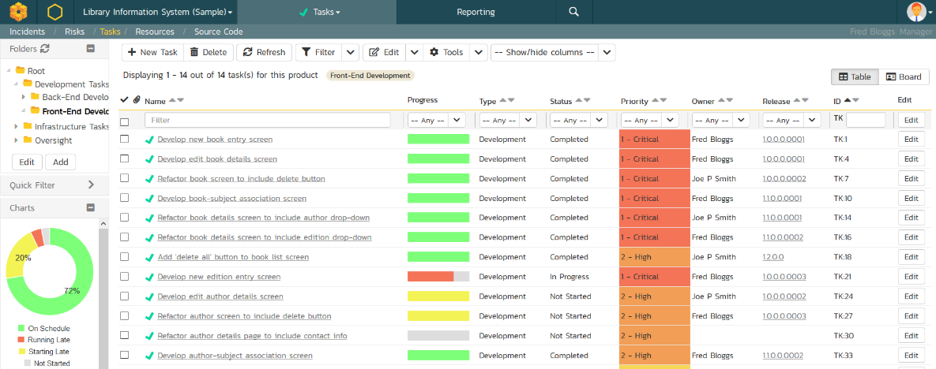
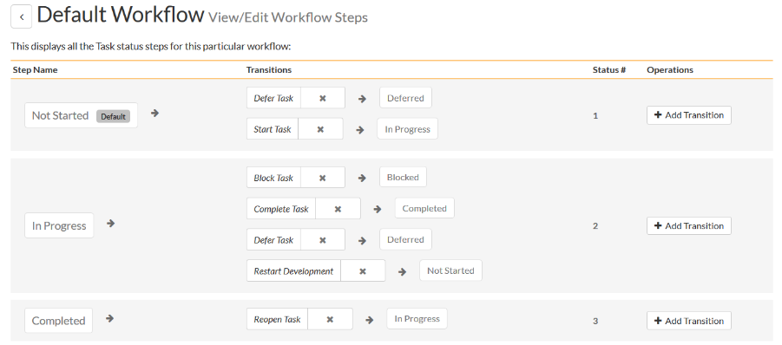
Task Tracking
Track project tasks with customizable workflows. Measure progress against the requirements and user stories

Slide 49
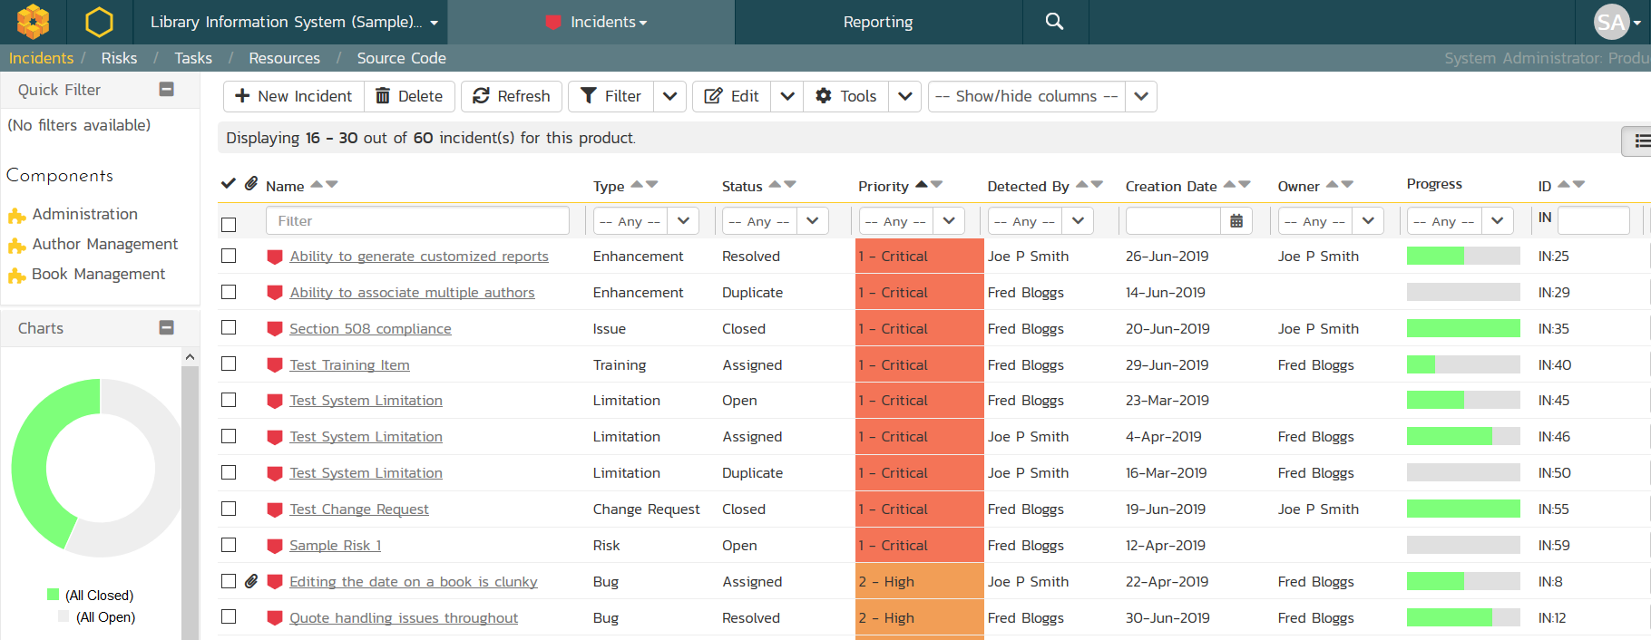
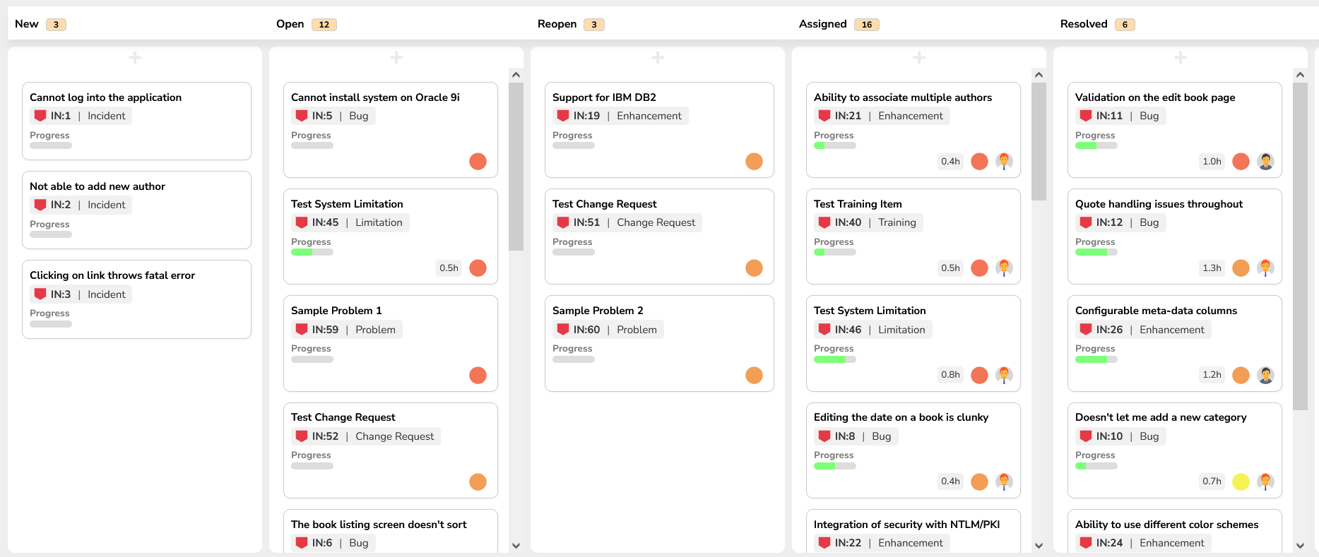
Issue & Defect Tracking
SpiraPlan includes a flexible bug and issue tracker with list and agile board views, and integrated workflow engine.

Slide 50



Collaboration and Instant Messaging
Real-time collaboration and communication with SpiraPlan instant messenger, artifact following, RSS Feeds and Email

Slide 51



Document Management
Complete integrated document management system with versioning, check-in/out and approval workflows.

Slide 52



Customizable Reporting
Library of standard and custom reports, export in various formats including Word, PDF, Excel and PDF

Slide 53


Extensibility with SpiraApps™
SpiraApps are powerful add-ons that unlock the full potential of SpiraPlan by extending its core functionality to precisely match your specific requirements.
They empower allow you to optimize SpiraPlan to support your software development lifecycle and quality engineering practices.

Slide 54
Integration Options
SpiraPlan Fits into Your Ecosystem Seamlessly

Slide 55

























Extensive Integrations & Migrations
80+ INTEGRATIONS
35+ BUILT-IN MIGRATIONS

Slide 56








Integration with your Favorite IDEs

Slide 57


RemoteLaunch® - Automation Integration
Host #1
Windows 2008
IE 8.0
Manual
Tester #1
RemoteLaunch®
Host #2
Windows Vista
Mozilla Firefox
SpiraPlan®
Repository
Manual
Tester #2
RemoteLaunch®
Host #3
Ubuntu Linux
Google Chrome
Manual
Tester #3
RemoteLaunchX®
RemoteLaunch® lets you integrate other automated testing tools with SpiraPlan in addition to using Rapise®

Slide 58


Build Integrated with CI / CD Tools
Build Management in SpiraPlan lets you integrate with continuous integration build servers with full traceability for each build

Slide 59








































































Open Ecosystem – Over 80 Integrations
IDE
CI/CD
Automation
Unit Testing
Bug-Tracking
Detailed Integration List
Import / Conversion
Load Testing

Slide 60
Questions?

