Slide 1



+ Quality Management
+
How SpiraTest adds Testing Capabilities to Jira

Slide 2
Why Customers use SpiraTest + Jira?
Their developers use Jira to manage issues
They use Jira Agile to manage user stories
In Agile, testing and quality is integral
Adding SpiraTest gives you integrated test management for Jira
Licensing is affordable and easy to deploy and integrate
  No need to license all Jira users in SpiraTest, and vice-versa

Slide 3
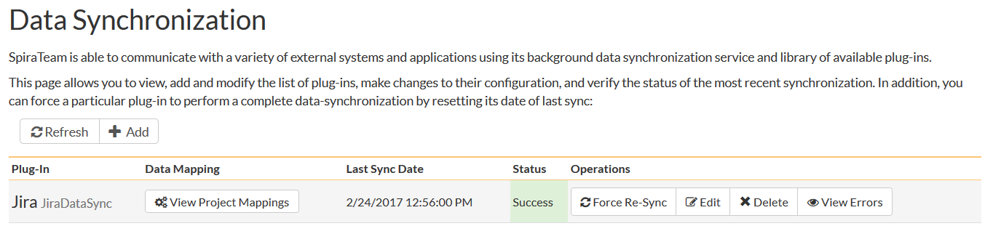
Bi-directional Data-Synchronization

Slide 4
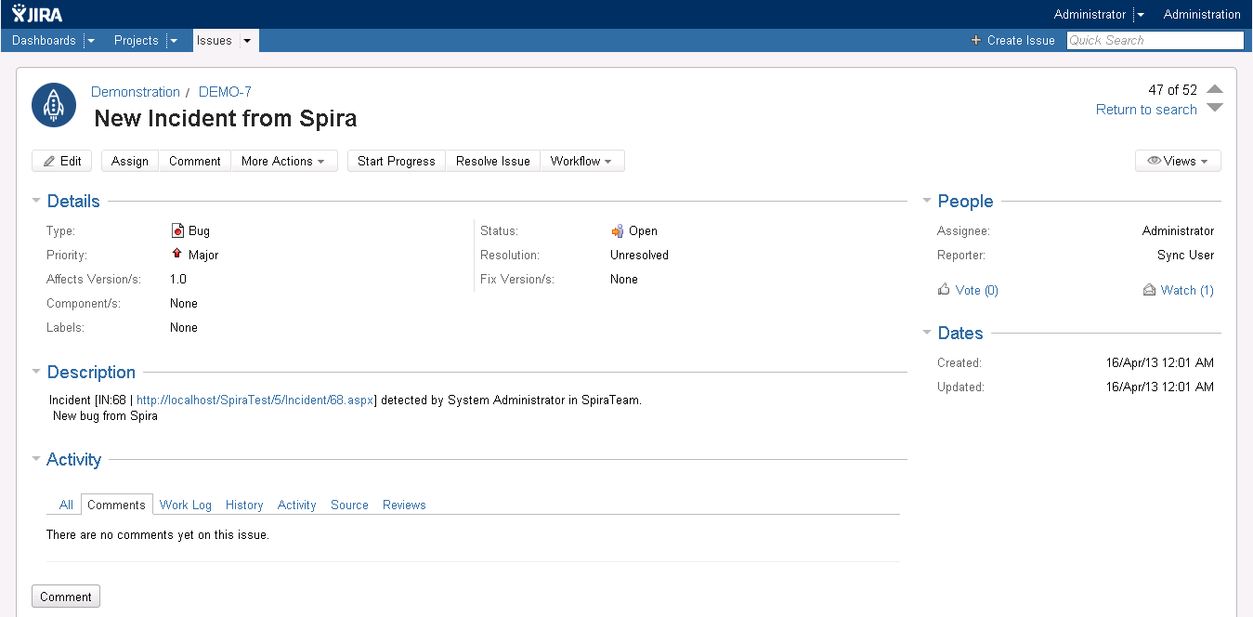
Issues and User Stories Synchronized

Slide 5
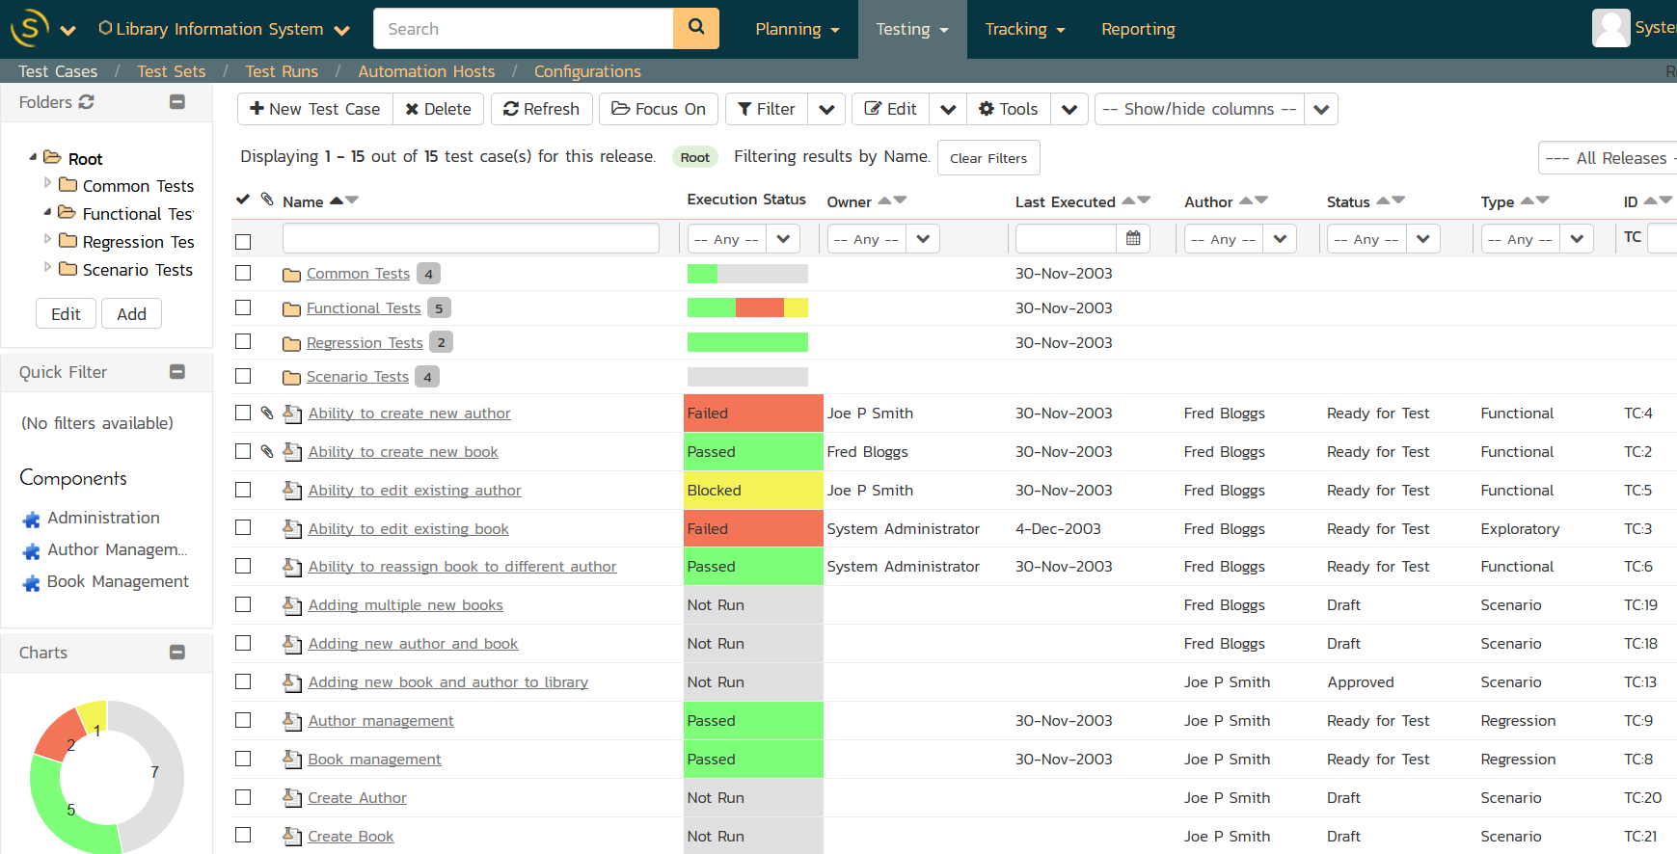
Quality Management Integrated

Slide 6
SpiraTest Marketplace Add-On for Jira

Slide 7
Questions?

