Slide 1


WEBINAR: Integrating SpiraTest with JIRA
+
We will be starting the webinar shortly, please stand by…
All phones will be automatically on mute until the Q&A.
February 15th, 2018 – Adam Sandman

Slide 2
Agenda
Overview of Integration
  Typical Use Cases
Architecture Options
  Cloud vs. On-Premise
Future Plans
  New Project Auto-Configuration
  Plugin to display data inside Jira (marketplace)
Configuring the Connection
Setting up the Project Mapping
  Incidents
  Users
  Requirements
Q&A?

Slide 3
Integration with JIRA – Use Case #1 - Incidents
Your testing team is working in SpiraTest, and is running tests and logging defects.
  You want the new defects logged to get added to JIRA
  Once in JIRA, your developers work on reproducing the issue and fixing the defect
  Your testers want to see the status of the defects in SpiraTest, and your managers want to have integrated requirements, test and defect metrics
The synchronization service will:
  Add new incidents from SpiraTest > JIRA
  Add new issues from JIRA > SpiraTest
  Update issues in SpiraTest from changes made in JIRA (inc. comments)

Slide 4
Integration with JIRA – Use Case #2 – User Stories
Your testing team is working in SpiraTest, and is running tests
Your development team is creating user stories in JIRA
  You want to have the user stories in JIRA create new requirements in SpiraTest
  You want to be able to link test cases to these user stories/requirements
  Your managers want to be able to report of requirements test coverage
The synchronization service will:
  Add new user stories from JIRA > SpiraTest as requirements
  Update requirements in SpiraTest from changes made in JIRA to the user stories

Slide 5
Benefits of the Synchronization Approach
We chose this approach over two other options:
  Write completely standalone plugin for JIRA
  Have JIRA do all the issue tracking for SpiraTest
The benefits this gives you are:
  Customers tell us that the pure plugin approach doesn’t really give the testers and QA managers a real test management solution
  A completely integrated view of requirements, test cases and defects
  Developers work in JIRA, testers work in SpiraTest
  You can have multiple JIRA installations connect to SpiraTest, giving you an enterprise view of all the separate JIRA instances

Slide 6
Architecture Options

Slide 7
Possible Deployment Options
There are three possible deployment options for the SpiraTest-JIRA data synchronization:
  You have both SpiraTest and JIRA cloud-hosted
  You have SpiraTest installed on-premise (JIRA can be either)
  You have SpiraTest cloud-hosted, but JIRA installed on-premise
We shall discuss each of these in turn:

Slide 8
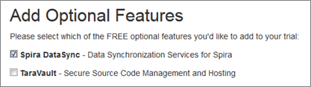
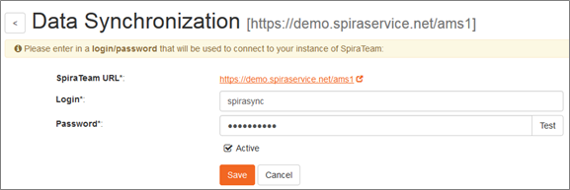

SpiraTest and JIRA Cloud-Hosted
The Inflectra cloud data-sync service is an add-on to your subscription that manages the integration entirely cloud-based
  Nothing needs to be installed locally
  We take care of running the integration

Slide 9
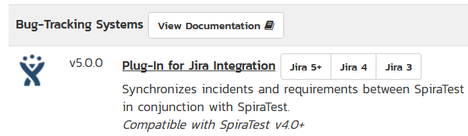
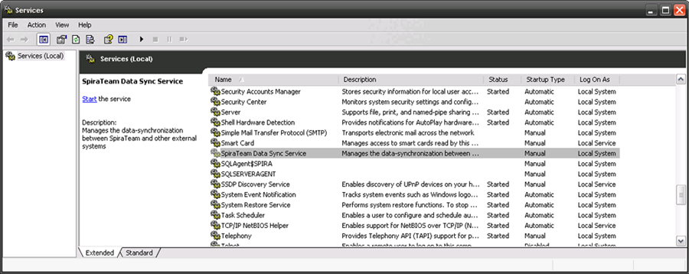
SpiraTest On-Premise (JIRA Either)
The installed version of SpiraTest comes with a built-in Synchronization Windows Service
  It takes care of the synchronization, it just needs to be started
  There is a JIRA plugin you need to download from our website, and put into the appropriate folder in your SpiraTest installation

Slide 10
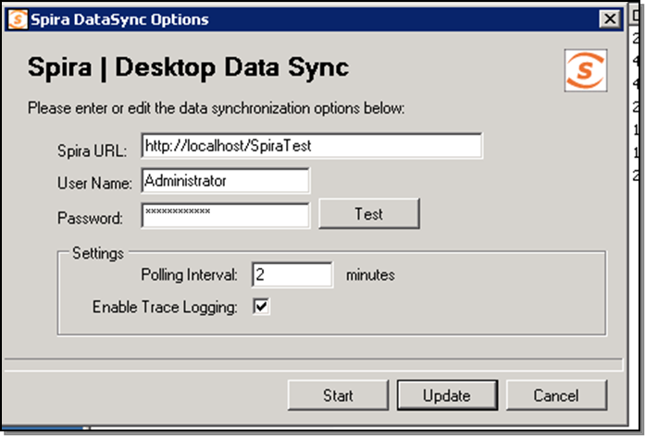
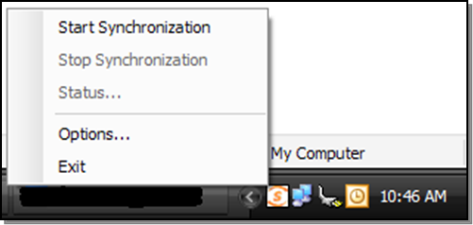
SpiraTest Cloud-Hosted, JIRA On-Premise
This is a less typical case, where you have a locally installed version of JIRA, but SpiraTest is cloud-hosted by Inflectra
We have a special DesktopDataSync tool that sits inside your firewall, and connects to SpiraTest and JIRA

Slide 11
Configuration Best Practices
Work with your JIRA team to understand how they have it configured
What issue types do you want to synchronize?
Determine what fields you really need to synchronize
  At least all of the required fields in both systems
  You don’t want to make the configuration unnecessarily complicated or need unnecessary updates because you changed things in JIRA/SpiraTest
Understand your business use cases before you configure the system.
  Let that drive how you setup the integration

Slide 12
Future Plans

Slide 13
JIRA Data-Synchronization Enhancements
We have some planned enhancements for the JIRA plugin:
  Ability to sync comments from SpiraTest > JIRA as well as the reverse
  Ability to sync attachments from JIRA > SpiraTest on updates as well as initial creation/sync
  Please let us know if you have other ideas?

Slide 14
Project Auto-Configuration Tool
We are going to have a page in SpiraTest v5.4.x.x that will show you all of the JIRA information in one easy to see page.
We are also in the process of adding a feature to SpiraTest to allow it to create a new project directly from JIRA:
  You would choose the project in JIRA
  It would create all the project mappings automatically ☺
  It would give you the option to map users, map requirements, as well as incidents and releases
It would be only available for new project creation, so updates to existing project mappings would need to be done the same was as at present.

Slide 15
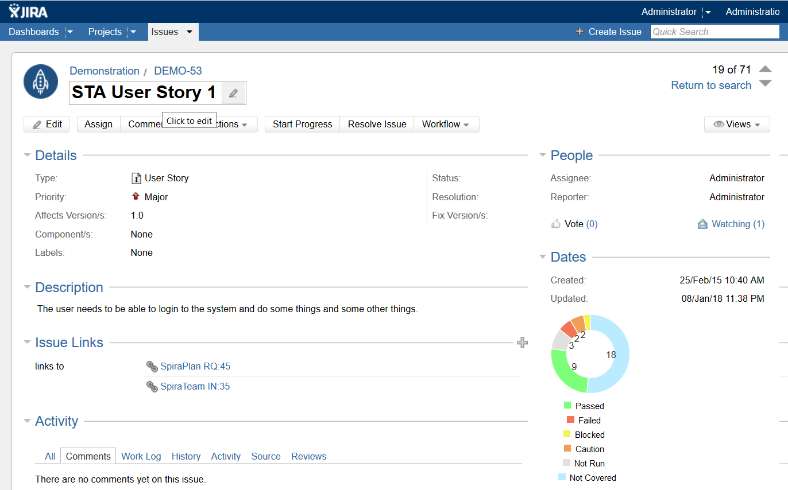
Add-On for JIRA in the Atlassian Marketplace
We are in the process of developing an add-on for JIRA that will display key SpiraTest metrics
inside JIRA:
  Requirements Test Coverage
  in the User Stories page
  Test Run information
  in the Issue Details page

Slide 16
Configuring the Integration

