Slide 1

Requirements, Test & Defect Management

Slide 2
Agile Software Development
How the Agile Manifesto Changed Everything

Slide 3
The Agile Manifesto Changed Development
The agile manifesto challenged the orthodoxy around software development, freeing it from the tyranny of process and rigidity, and embracing user feedback and change.
Traditional Waterfall Methodology
Requirements
Gathering
Business Design
Technical Design
Systems Development
Unit
Testing
Integration
Testing
Acceptance
Testing (UAT)
Release Complete
Agile Methodology
Limited Upfront Planning
Release #1
Release #2
Release #3
Release #4
It 1
It 2
It 3
It 4
It 5
It 6
It 7
It 8
It 9
It 10
It 11
It 12
Release Complete
Iteration N
Iteration Planning
Development, Continuous Integration, Unit Testing, Functional & Acceptance Testing

Slide 4
Agile – Led to Continuous Delivery
Organizations quickly realized how much more efficient they could be having integrated teams that collaboratively define the requirements, plan the releases and sprints, test the product during development and deploy the latest update in a seamless way
Release Plan
Iteration
Iteration
Scope
Iteration
Plan
Tested,
Integrated
Working
System

Slide 5
Agile Test Management
When you have continuous development, you need continuous testing

Slide 6
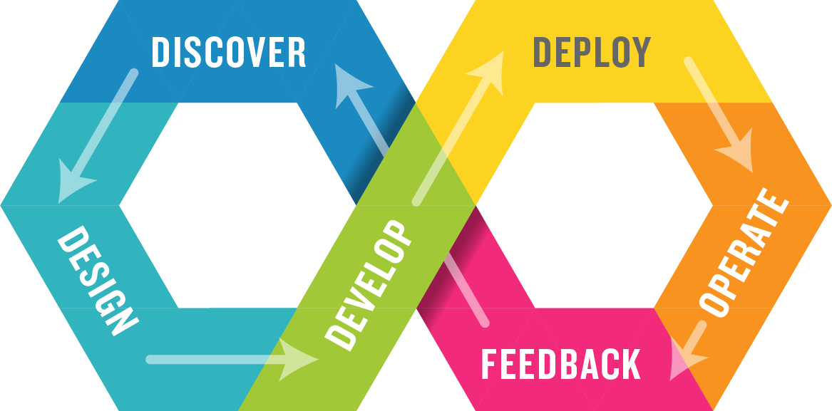
Development & Operations (DevOps)
DevOps integrates Dev, Test & Ops in a single process.

Slide 7
But Where Is Testing on the DevOps Diagram?
Is it on the left hand-side or the right hand side?

Slide 8
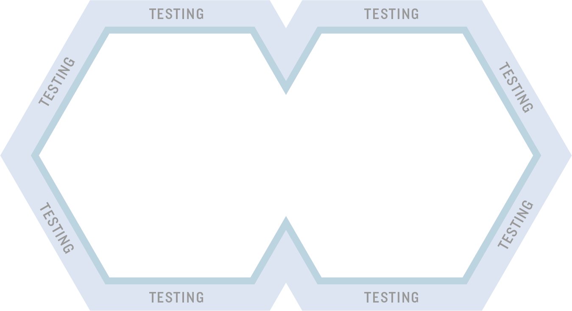
Both – It is Throughout the Process
This is what is meant by Continuous Testing in DevOps

Slide 9
Testing Throughout the DevOps Toolchain
Requirements, User Stories, etc.
Acceptance
Tests
Exploratory
Testing
Source Code Mgt.
Automated
Tests (Checks)
Test Environments
Subversion
Git
Continuous Integration
(Jenkins)
Installation
& Deployment

Slide 10
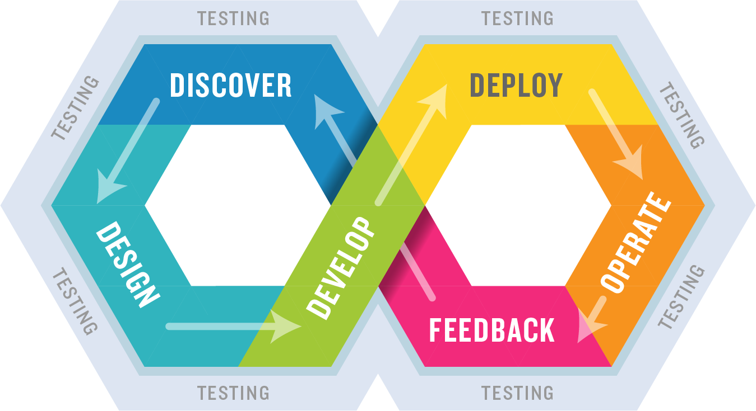
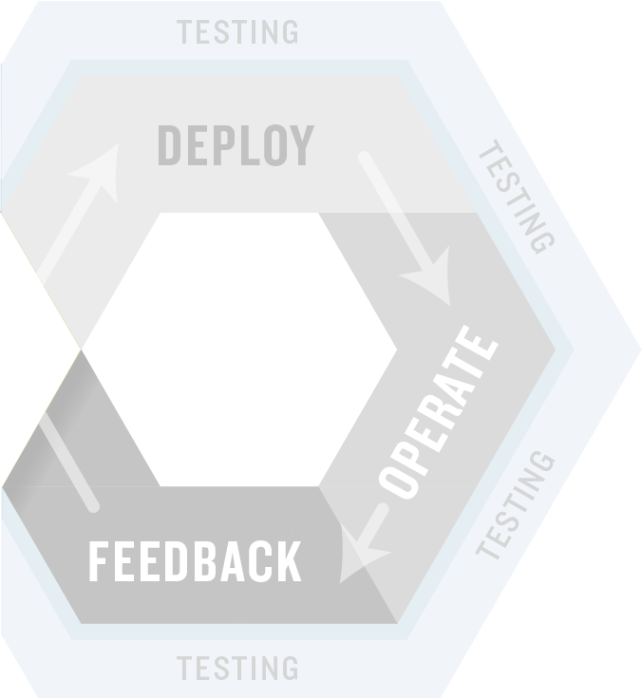

Shifting Left – Testing Earlier in the Process
Integrate automated unit, functional, API, performance, and security testing into your CI process.
Exploratory testing before the code is finished.

Slide 11
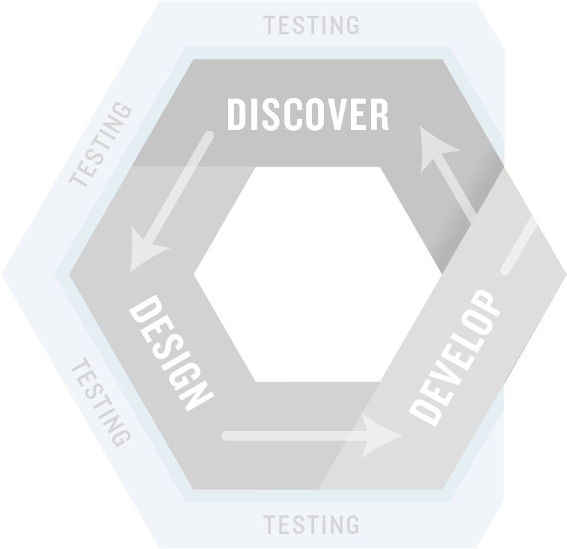

Shifting Right – Testing in Production
Integrate monitoring of the live application into your testing process.
Include system monitoring and metrics as well as input from customer support and the business.

Slide 12
The SpiraTest Difference
How are we different and what our customers say

Slide 13







Introducing the Inflectra® Suite
KronoDesk®
IT Support & Help Desk
SpiraCapture™
Exploratory Testing
SpiraPlan®
Agile Program & Portfolio Management
SpiraTeam®
Application Lifecycle Management (ALM)
SpiraTest®
Requirements, Test Management
& Bug Tracking
TaraVault® - Source Code Management
Rapise®
Test Automation (Web, GUI, Services)

Slide 14
SpiraTest – The Integrated QA Solution
KronoDesk®
IT Support & Help Desk Ticketing
SpiraTeam®
SpiraTest®
Requirements, Test & Defect Management
Agile Project Management
+
TaraVault® - Source Code Management & DevOps
Rapise®
Test Automation Platform (Web, GUI, Services)
See Spira Comparison Matrix to compare SpiraTest vs. Other Editions

Slide 15
Why Choose SpiraTest?
SpiraTest provides requirements, test case and defect management in a single package with end-to-end traceability:
Web-based User Interface
Robust APIs
Quality Assurance Management
Requirements
Test Cases
Defects
Project and User Management Core Functionality

Slide 16
harmony
Notes:
Make great products
Help you work together
Help you deliver your products faster, more easily, with less pain, and less stress
At a grand scale – we’re passionate about making products that you will find transformative to how you work.
We both want to use our tools every day to help you do a whole number of complex things, and at the same time get out of your way so you don’t need to worry about SpiraTeam and can instead focus on helping your own customers

Slide 17
How Do We Foster Harmony?
Across Disciplines
Through Simplicity
Across Ecosystems

Slide 18



Harmony Across the Disciplines
Testers
Developers
Managers
We consider each of these three stakeholders groups when designing features for SpiraTest, so that everyone in teams can get the most out of the system working together.

Slide 19


Simplicity = Productivity from Day One
Less Time Doing:
More Time Doing:
No plugins, customization or configuration needed day one

Slide 20
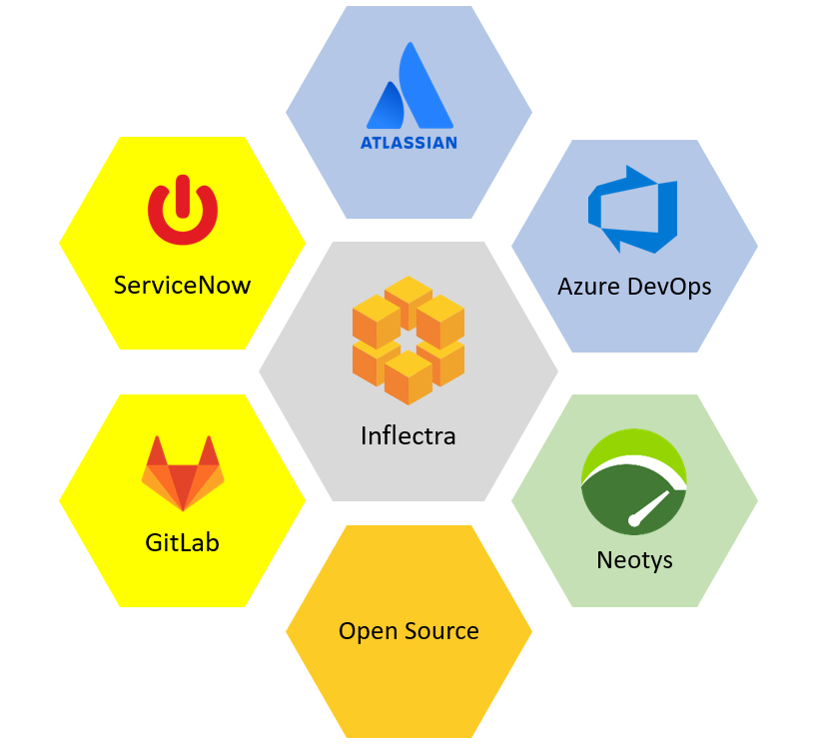
Harmony Across Ecosystems
We recognize that you need to integrate SpiraTest with other tools and systems
We make this easy and straightforward so you can get working faster & easier

Slide 21
How SpiraTest Works For You
Features for different industries and methodologies

Slide 22

Healthcare & Life Sciences
Electronic signatures for FDA 21 Part 11 compliance
Secure hosting with support for HIPAA BAA agreements
End to end traceability of requirements, tests, and defects
Validated platform where you control update cadence

Slide 23

Financial Services & Insurance
Secure cloud platform (SOC2) or on-premise deployment
Generate financial compliance documentation automatically
Integration with automated testing and verification tools
End-to-end traceability and auditability of testing

Slide 24

Energy, Industrial, & Automotive
Testing for public safety with world class test management
Define requirements and test for compliance
Integrate standards and regulations into your test plans
Understand and manage risk of critical systems

Slide 25

Defense, Government & Aerospace
Requirements management with secure workflows
Test step level traceability for mission systems
Automate testing and compliance with RemoteLaunch
Security and privacy with on-premise and AWS GovCloud

Slide 26






























Representative Customers by Industry
We have ~ 80,000 users in 5,000+ companies worldwide:
Energy & Industrial
Financial & Business Services
Government & Defense
Information Technology
Healthcare & Bio-Technology
Telecommunications
Retail & Consumer Goods
Transportation & Hospitality

Slide 27
Regulated Industries - Automating Compliance
End-to-end traceability out of the box
Data Privacy, Security baked in
Generate Documentation from data
Workflows & Electronic Signatures
Integration across the software value chain

Slide 28






















Global Partner Network
North America
South America & Mexico
Asia
Europe
Australia
Middle East & Africa

Slide 29
Customer Testimonials
“
Working with enterprise software in the Finance/Accounting area, I open many support tickets for issues. This time, it's different. I just had to let your team know what a great product SpiraTest is. We mostly need to perform manual tests of key system controls during the SaaS provider's upgrades throughout the year. I'm still learning the product. But, *every single time* I've thought "gee, I bet it doesn't do [fill in blank]," I'm proven wrong. Not only have I not experienced any pain points, but it's almost fun to use such a well-designed product that lets me get to work and get my job done efficiently. So, thank you.
- Michael Aust, Plenty Unlimited Inc.
“
I looked at more than a dozen products and the bottom line is that SpiraTest is hugely superior in value over everything I evaluated. The staff was a tremendous help and a big part of our decision. We are able to train quickly and let people take over as their own project owners in many cases and just stay in touch and help them along the way.
- Chris Deaton, Arizona State University
“

Slide 30
Feature Overview
Lets Look at the Key Features in SpiraTest

Slide 31
Managers
Notes:
Managers, our third pillar, could always take advantage of our reporting, dashboards, and traceability features. But we knew we could do a lot more to help managers – both senior leaders and those in other roles like BI

Slide 32
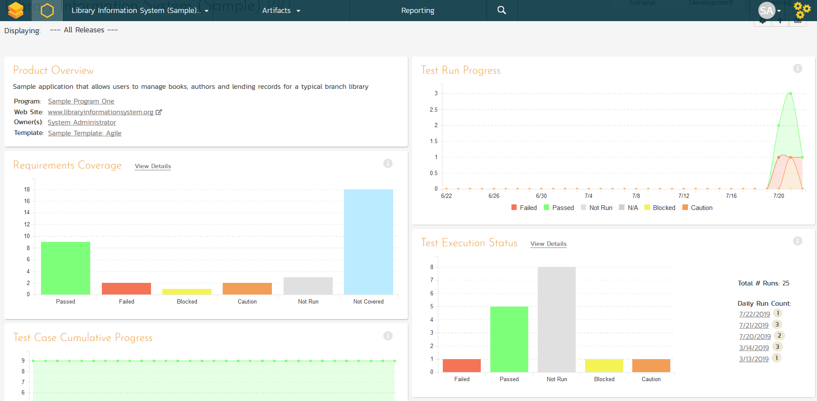
Personalized Reporting Dashboards
Customizable reporting dashboards at the product, project, release and sprint levels.

Slide 33
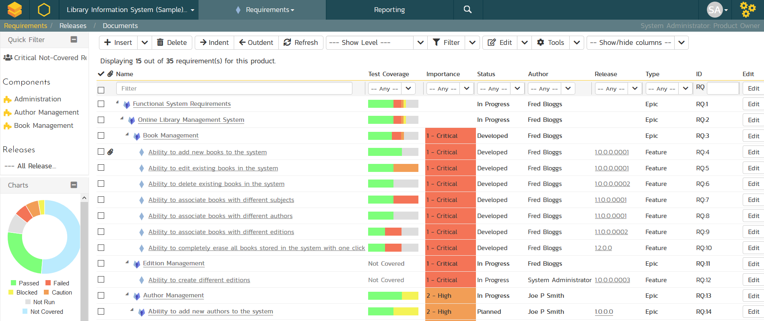
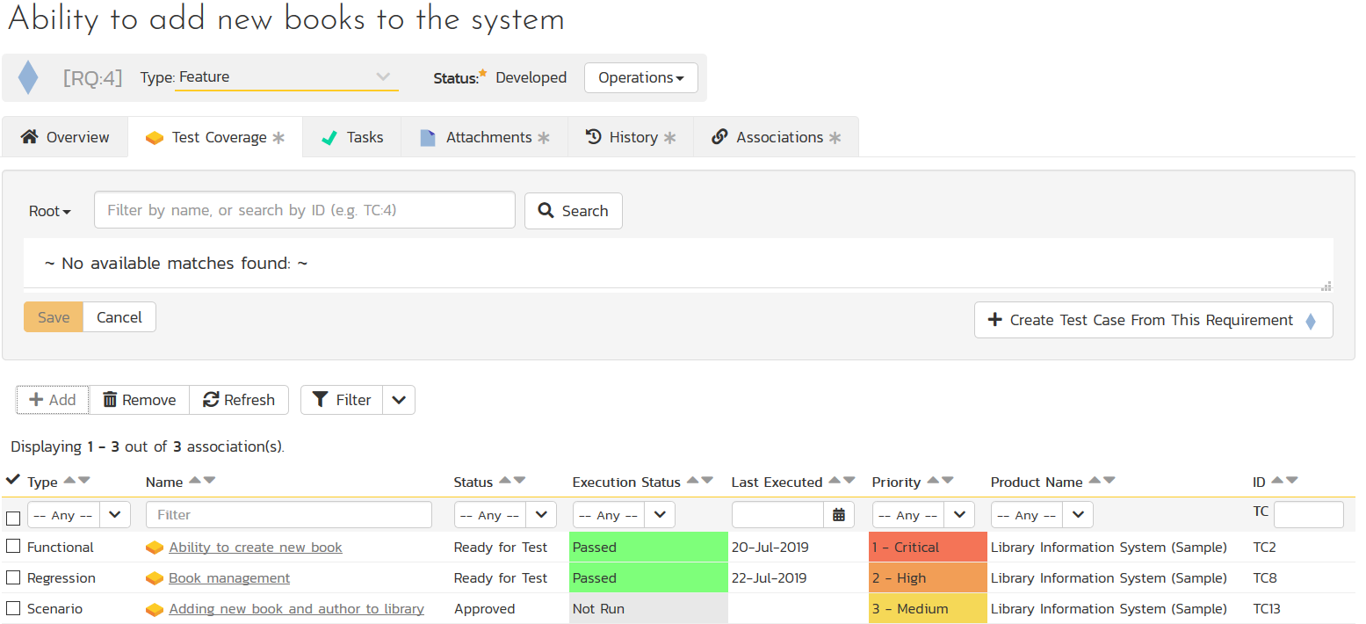
Requirements Management
Requirements management with test & defect traceability

Slide 34
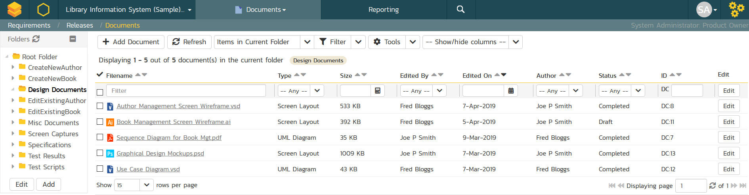
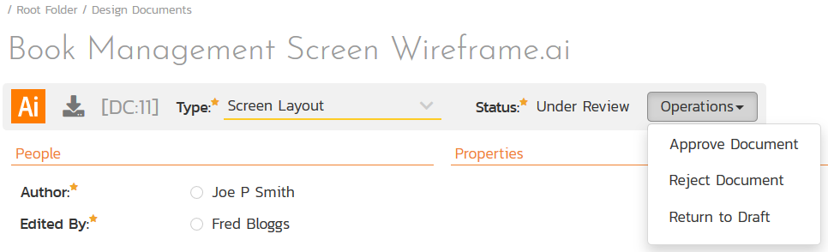
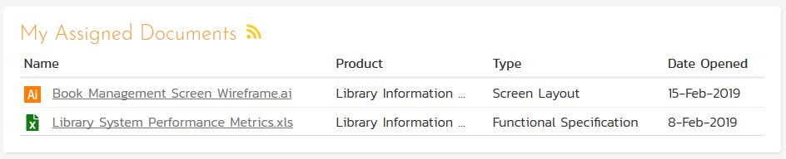
Document Management
Complete integrated document management system with versioning, check-in/out and approval workflows.

Slide 35
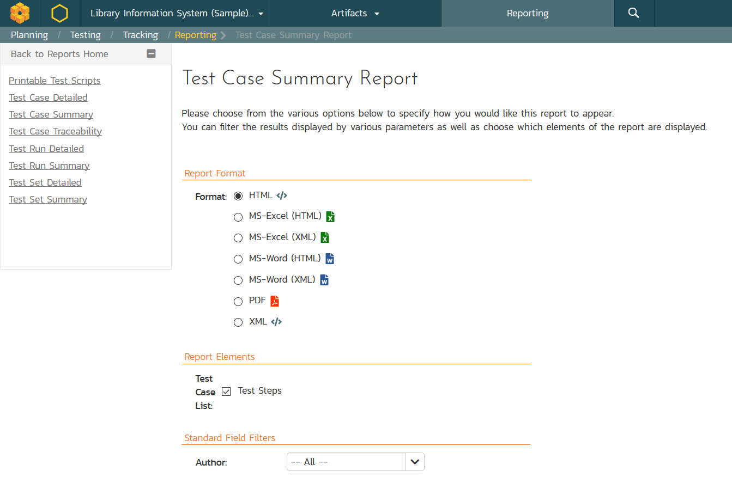
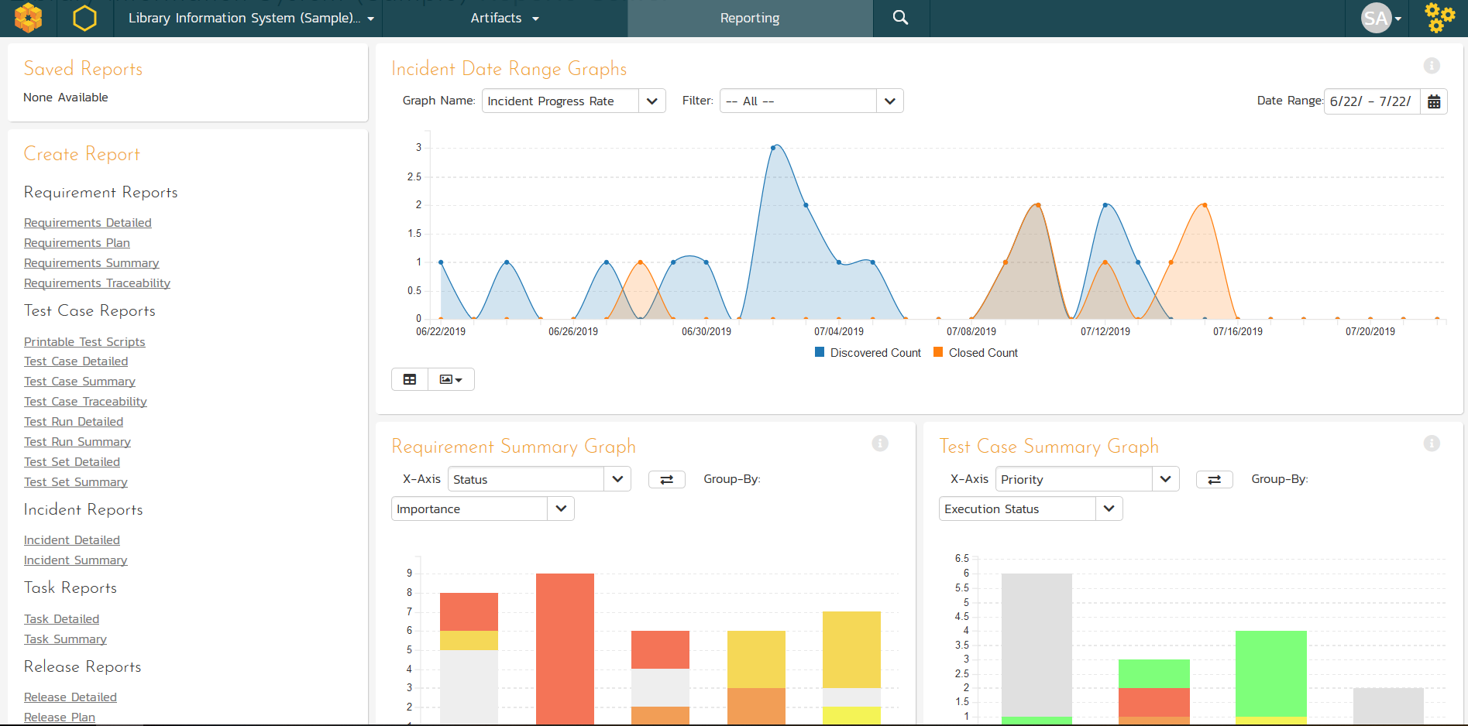
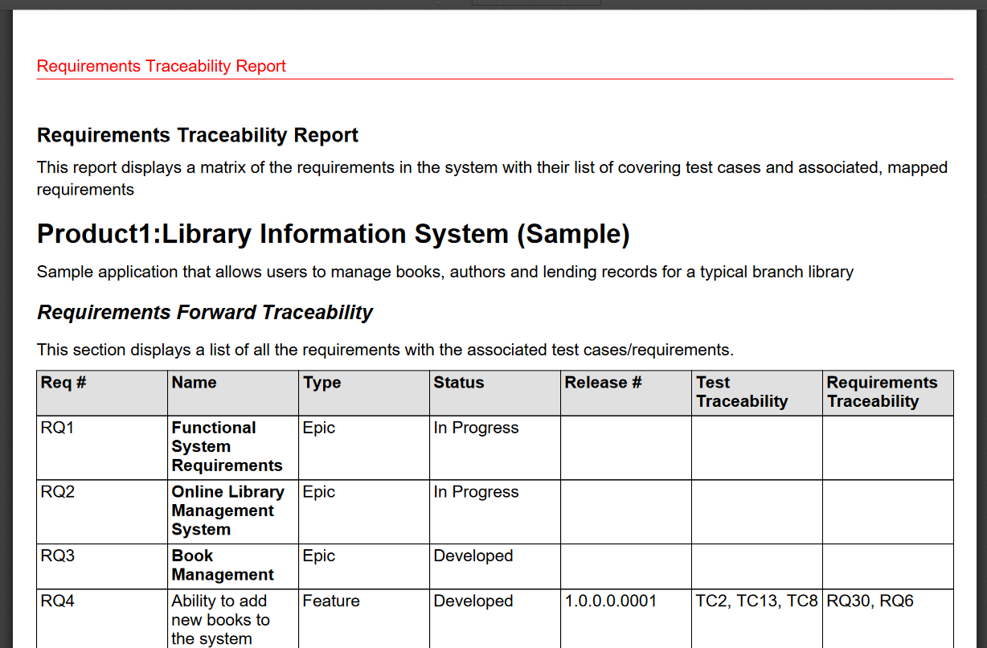
Customizable Reporting
Library of standard and custom reports, export in various formats including Word, PDF, Excel and PDF

Slide 36
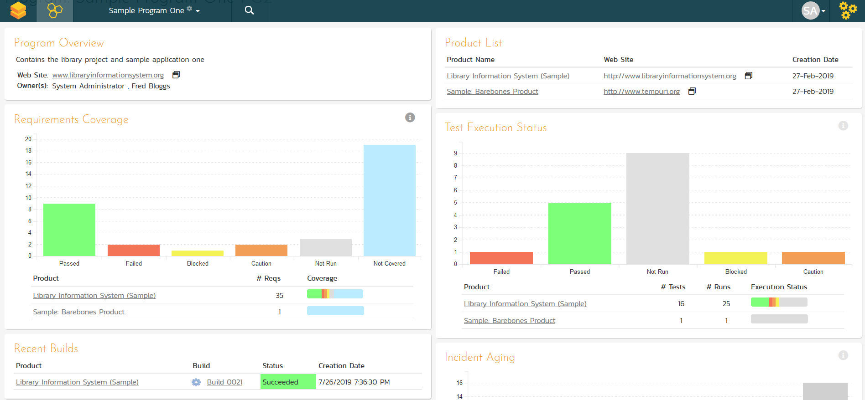
Cross Project Reporting
Dashboards and reports let you see the health of your different projects, grouped by program.

Slide 37
Testers
Notes:
That’s the very high level, but what does this mean in detail for you? What have we or are we about to release that can help you? Let’s talk testers first

Slide 38
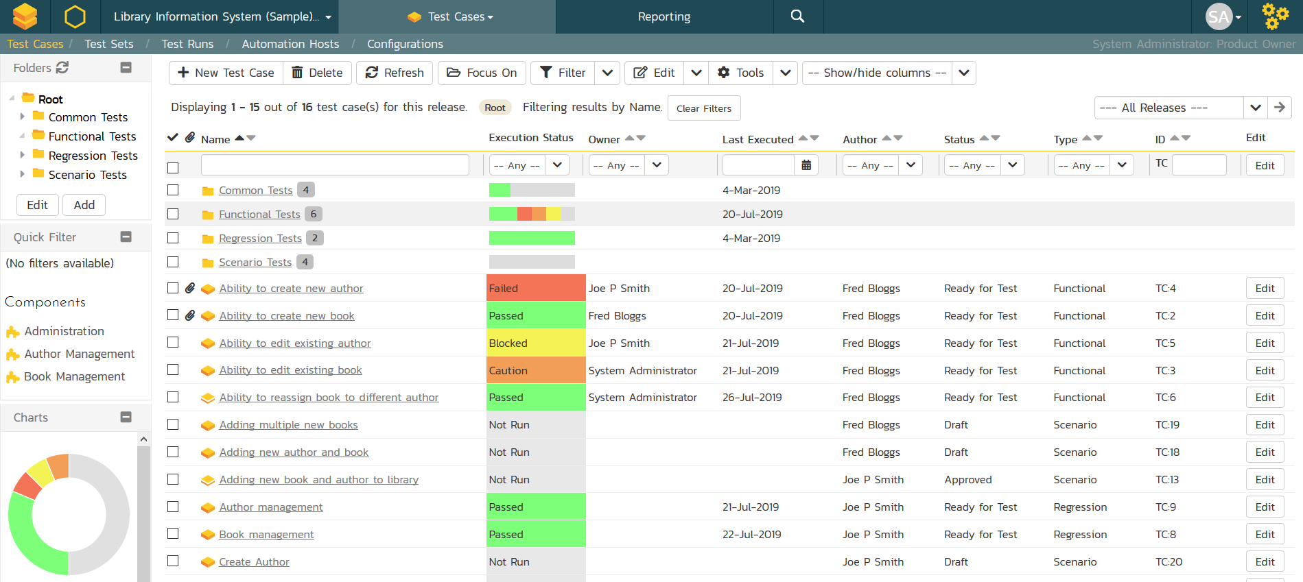
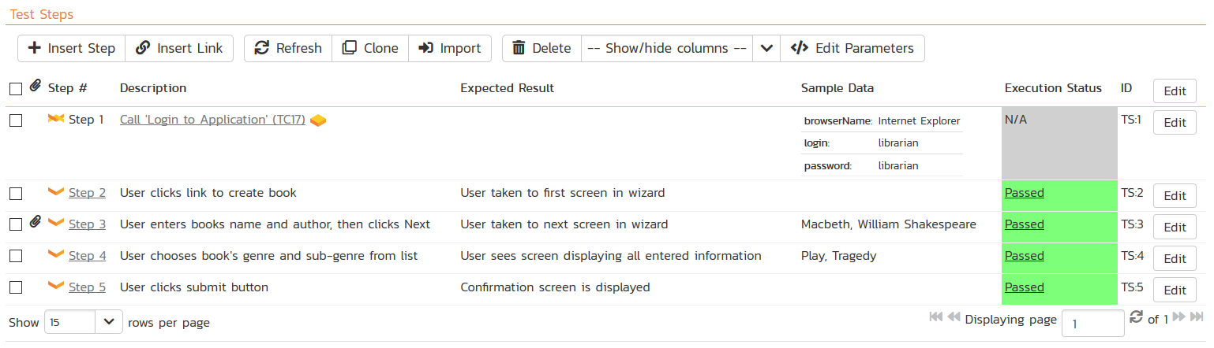
Test Management & QA
Manage your automated and manual test cases, test suites and testing artifacts in a central repository.

Slide 39
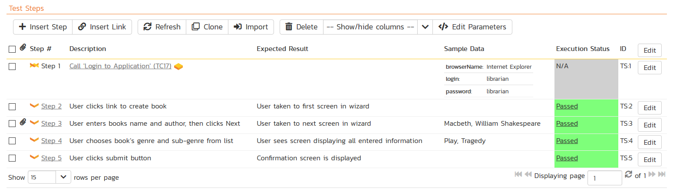
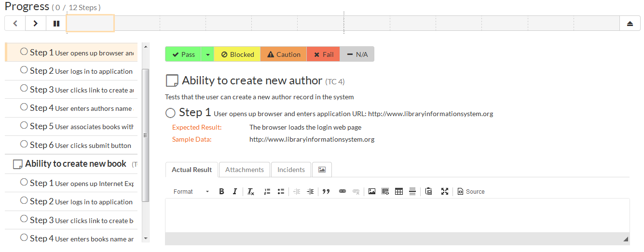
Manual Testing
SpiraTest lets you easily author test cases and test steps with a built in test execution wizard that makes running tests easy.

Slide 40
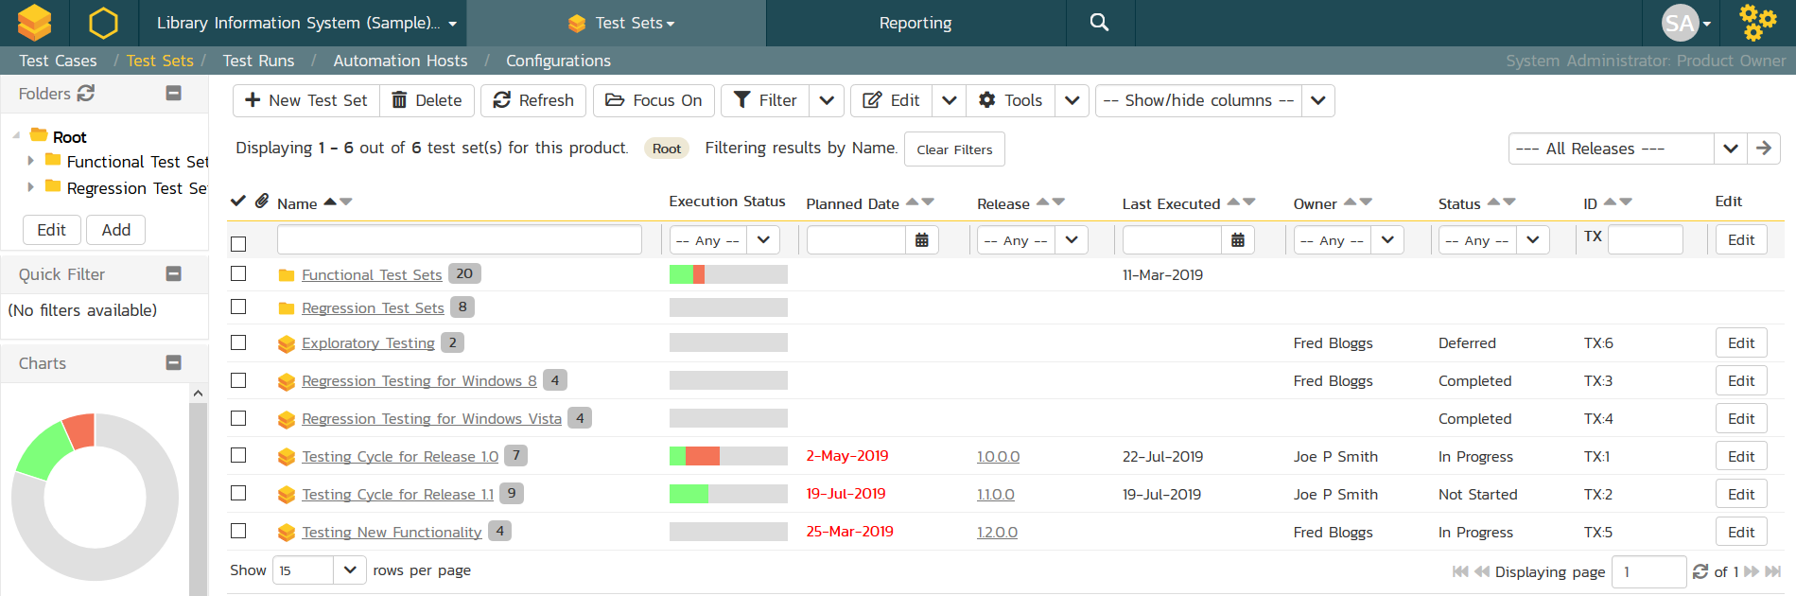
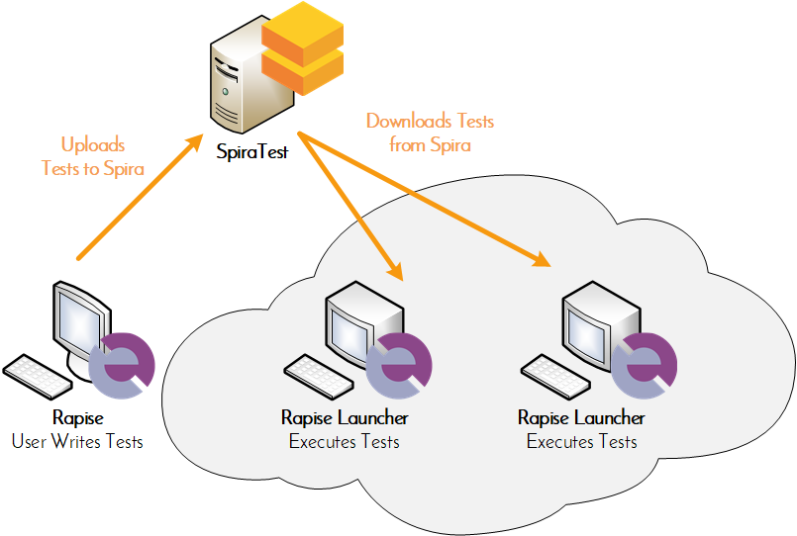
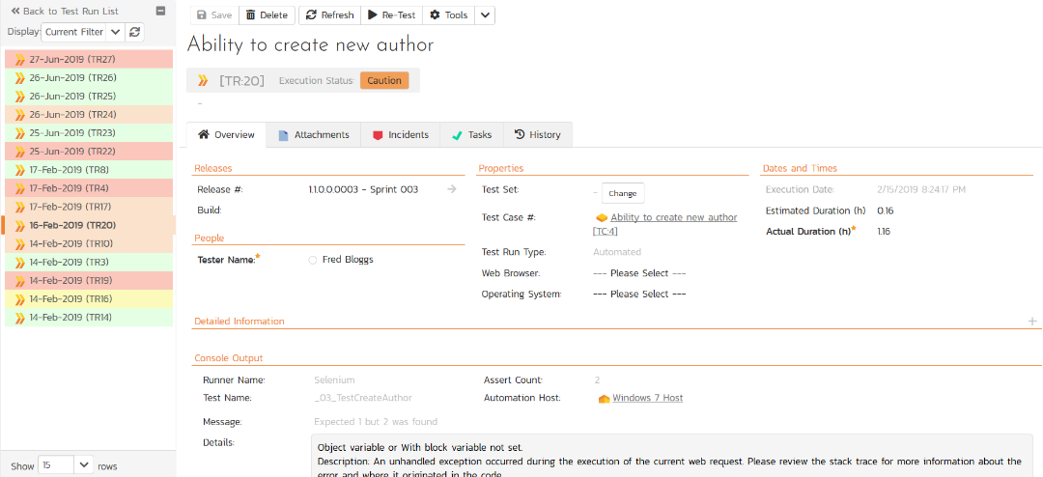
Automated Testing
Orchestrate your automated tests from SpiraTest, with integrated test lab management and data-driven testing

Slide 41
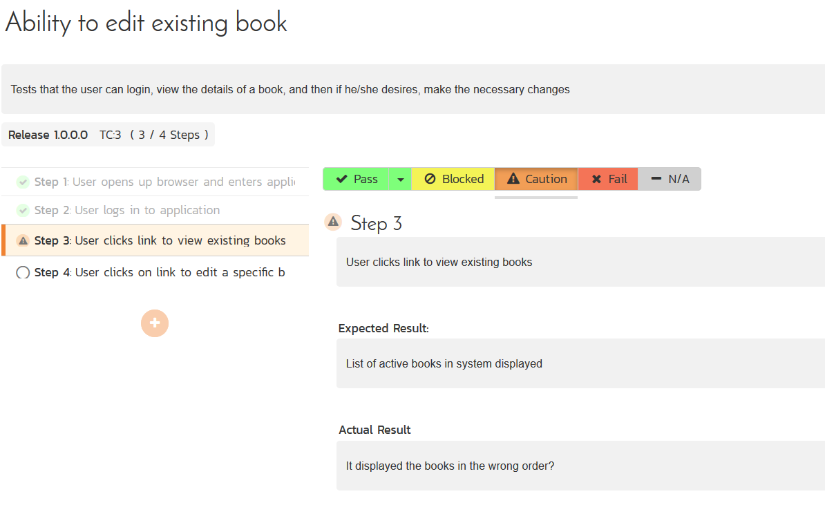
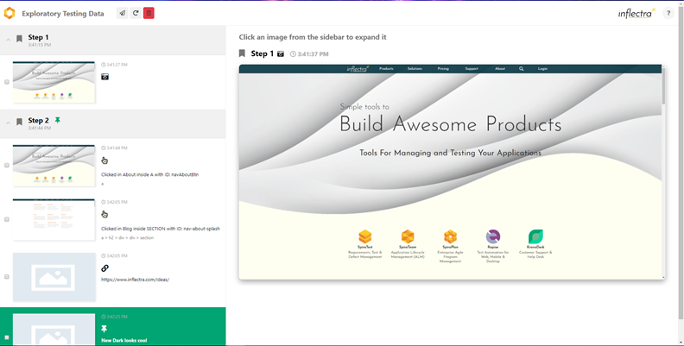
Exploratory & Session-Based Testing
SpiraTest provides an easy to use testing wizard for session and exploratory tests, with SpiraCapture™ for automated capture.

Slide 42

RemoteLaunch® - Automation Integration
Host #1
Windows 2008
IE 8.0
Manual
Tester #1
RemoteLaunch®
Host #2
Windows Vista
Mozilla Firefox
SpiraTest®
Repository
Manual
Tester #2
RemoteLaunch®
Host #3
Ubuntu Linux
Google Chrome
Manual
Tester #3
RemoteLaunchX®
RemoteLaunch lets you integrate other automated testing tools with SpiraTest in addition to Rapise

Slide 43
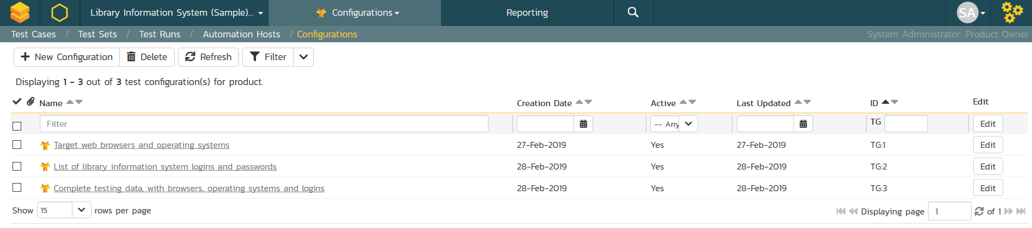
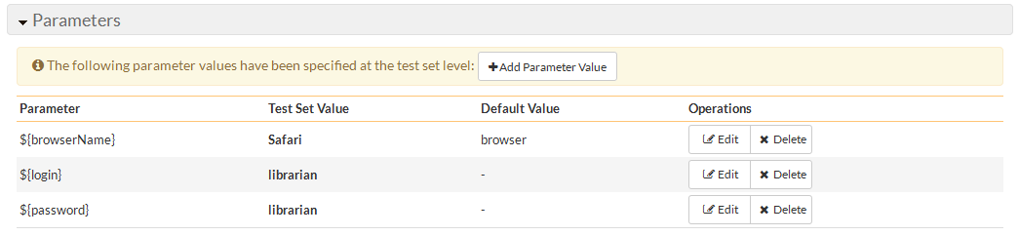
Data-Driven Testing
SpiraTest lets you parameterize your test cases and execute them using different data combinations for full coverage.

Slide 44
Developers
Notes:
Let’s talk next about developers

Slide 45
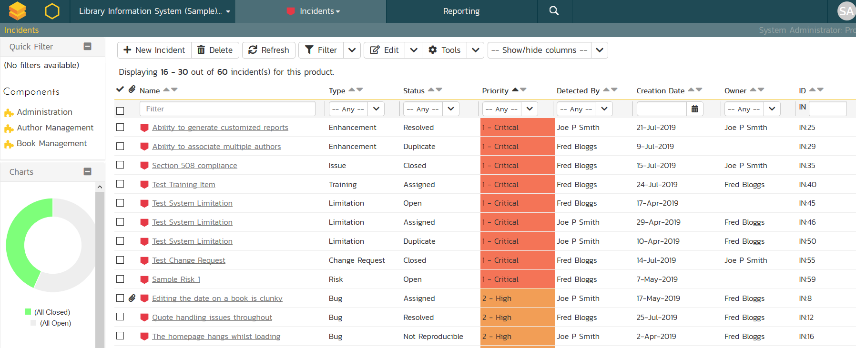
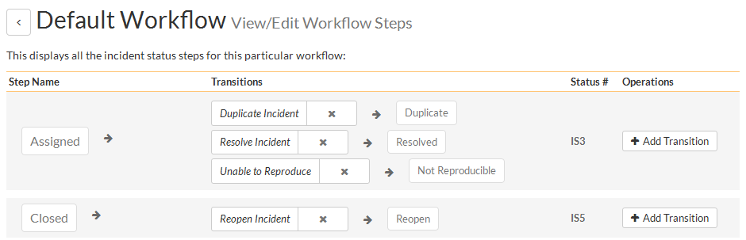
Issue & Defect Tracking
SpiraTest includes a flexible bug and issue tracker with requirements traceability, and integrated workflow engine.

Slide 46
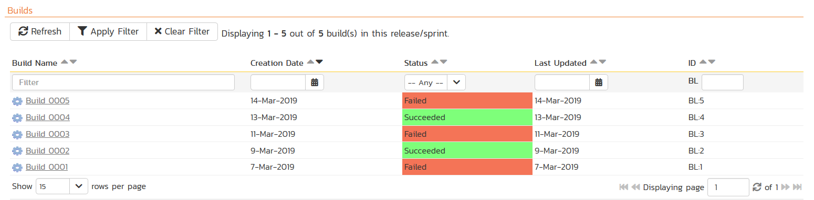
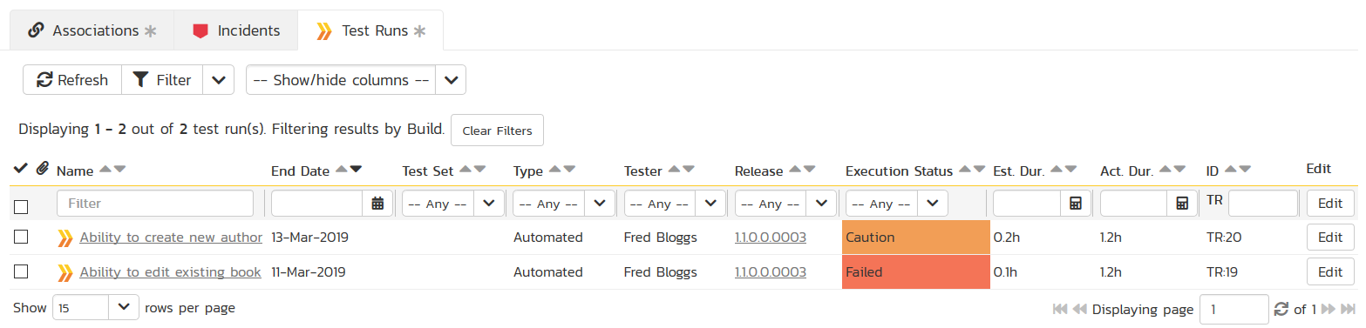
Build Integrated with CI / CD Tools
Build Management in SpiraTest lets you integrate with continuous integration build servers with full traceability for each build

Slide 47
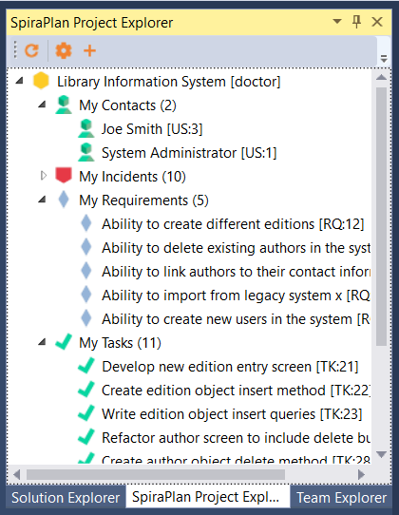
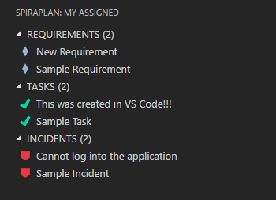
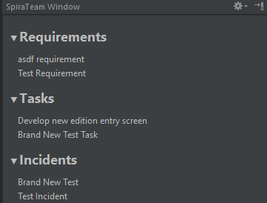



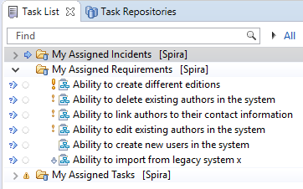

Integration with your Favorite IDEs

Slide 48
Integration Options
SpiraTest Fits into Your Ecosystem Seamlessly

Slide 49
Recap: Harmony Across Ecosystems
We recognize that you need to integrate SpiraTest with other tools and systems
We make this easy and straightforward so you can get working faster & easier

Slide 50




















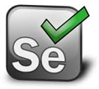










Integration Options
Over 60 integrations and connectors, here’s some of the more popular ones:
Developer IDEs
Unit Test Frameworks
CI / Build Servers
Bug-Tracking Tools
Modelling Tools
Functional Testing Tools
Legacy ALM Tools
Performance Testing Tools

Slide 51
Questions?

