Slide 1
Source Code Management

Slide 2
The Inflectra® Suite
KronoDesk®
IT Support & Help Desk
SpiraCapture™
Exploratory Testing
SpiraPlan®
Agile Program & Portfolio Management
SpiraTeam®
Application Lifecycle Management (ALM)
SpiraTest®
Requirements, Test Management
& Bug Tracking
TaraVault® - Source Code Management
Rapise®
Test Automation (Web, GUI, Services)

Slide 3
TaraVault – Source Code Mgt for Spira
KronoDesk®
IT Support & Help Desk Ticketing
SpiraTeam®
SpiraTest®
Requirements, Test & Defect Management
Agile Project Management
+
TaraVault® - Source Code Management & DevOps
Rapise®
Test Automation Platform (Web, GUI, Services)

Slide 4
harmony
Notes:
Make great products
Help you work together
Help you deliver your products faster, more easily, with less pain, and less stress
At a grand scale – we’re passionate about making products that you will find transformative to how you work.
We both want to use our tools every day to help you do a whole number of complex things, and at the same time get out of your way so you don’t need to worry about SpiraTeam and can instead focus on helping your own customers

Slide 5
How Do We Foster Harmony?
Across Disciplines
Through Simplicity
Across Ecosystems

Slide 6
Harmony Across the Disciplines
Testers
Developers
Managers
We consider each of these three groups when designing features for the Spira ecosystem, so that everyone in teams can get the most out of the system working together.

Slide 7
Simplicity = Productivity from Day One
Less Time Doing:
More Time Doing:
No plugins, customization or configuration needed day one

Slide 8
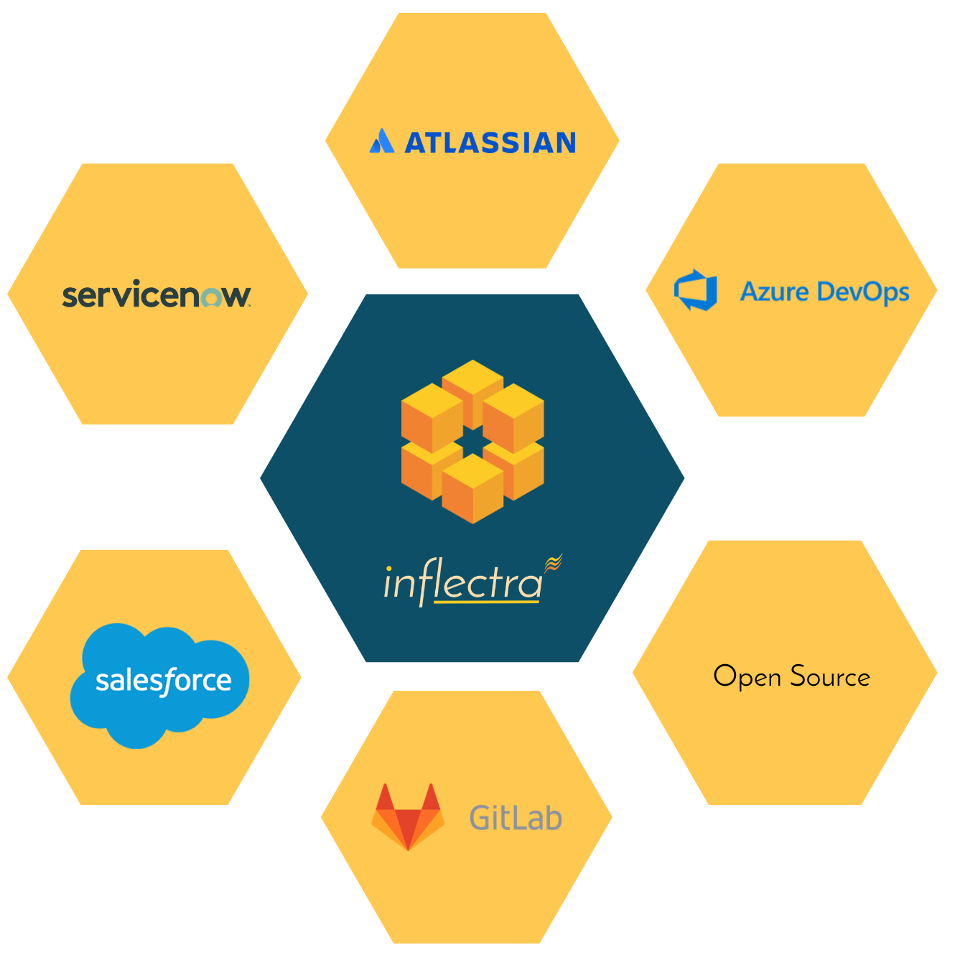
Harmony Across Ecosystems
We recognize that you need to integrate Spira with other tools.
Spira comes with its own integrated source code management system, or you can use your own.

Slide 9
Representative Customers by Industry
We have ~ 80,000 users in 5,000+ companies worldwide:
Energy & Industrial
Financial & Business Services
Government & Defense
Information Technology
Healthcare & Bio-Technology
Telecommunications
Retail & Consumer Goods
Transportation & Hospitality

Slide 10
Regulated Industries - Automating Compliance
End-to-end traceability out of the box
Data Privacy, Security baked in
Generate Documentation from data
Workflows & Electronic Signatures
Integration across the software value chain

Slide 11
Global Partner Network
North America
South America & Mexico
Asia
Europe
Australia
Middle East & Africa

Slide 12
TaraVault Features
Why you should choose TaraVault for your source code management

Slide 13
Key TaraVault Features
Enterprise-grade source code repository hosting.
Integrates with SpiraPlan and SpiraTeam systems for source code browsing, including inline code DIFF viewing.
Your choice of Git or Subversion Hosting for each project.
Requirements, tasks, defects and issues can be linked to source code files and revisions for maximum traceability.
Support for Git branching and merging workflows with integrated pull / merge request functionality.

Slide 14
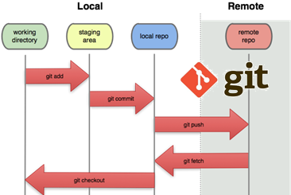
Enterprise Git Hosting
TaraVault includes enterprise-grade Git repository hosting. Each TaraVault project comes with its own private Git source code repository.
When you need distributed version control that is lightning fast, with powerful branching and merging out of the box, support for disconnected teams and users, TaraVault Git is your best choice.

Slide 15
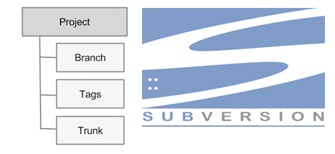
Enterprise Subversion Hosting
TaraVault provides enterprise-grade Subversion repository hosting. Each TaraVault project comes with its own private Subversion source code repository with fine-grained security.

Slide 16
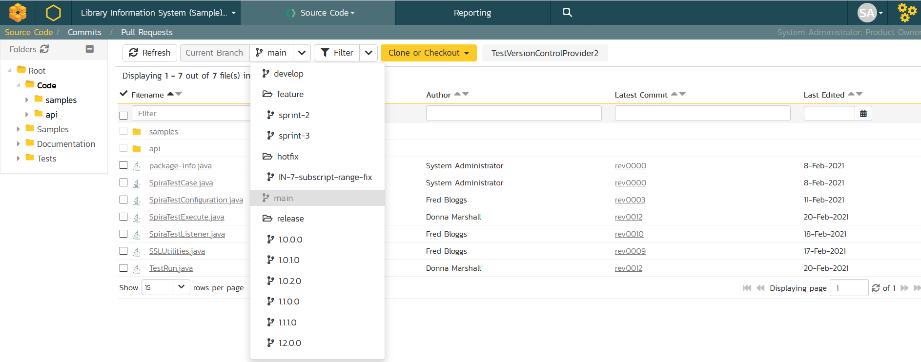
Code Viewing with Spira
TaraVault and Spira lets you view branches, files and folders from the convenient web interface.

Slide 17
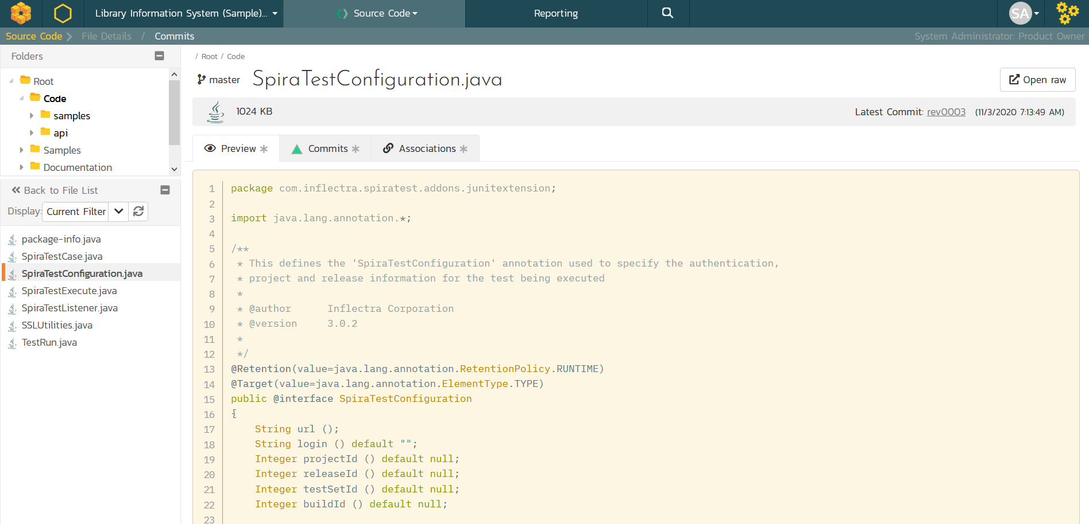
Preview Code Files with Syntax Highlighting

Slide 18
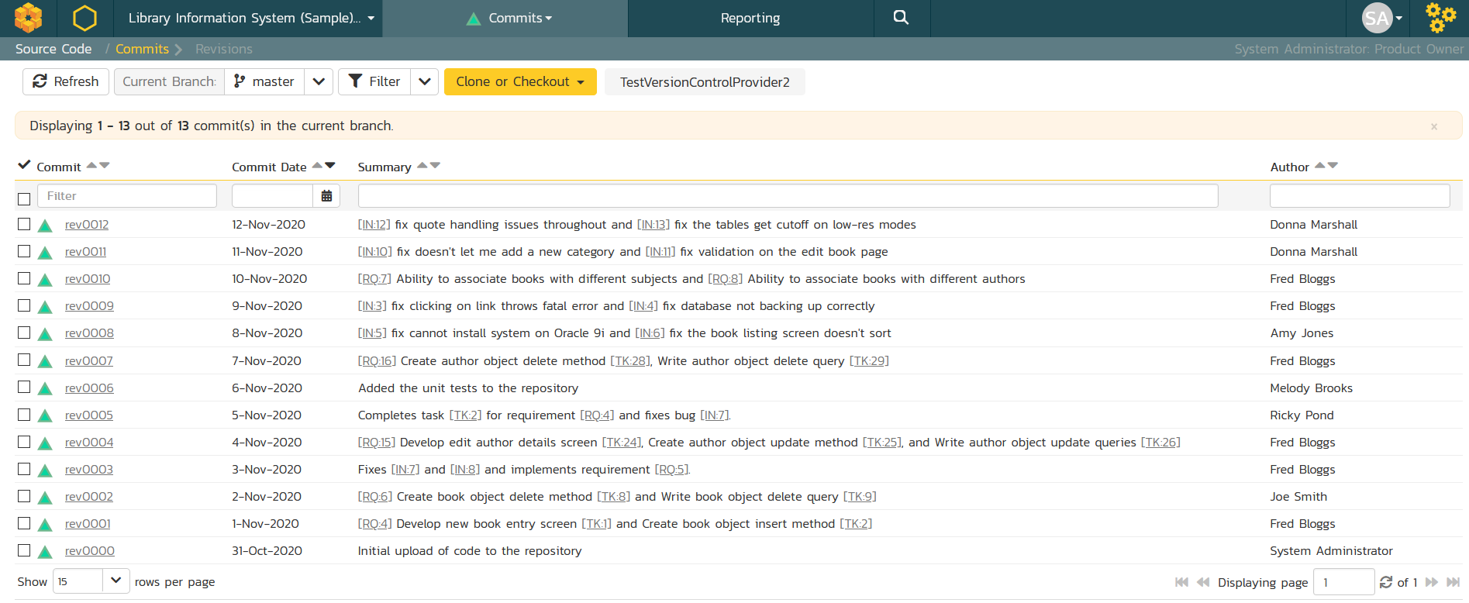
View Code Commits

Slide 19
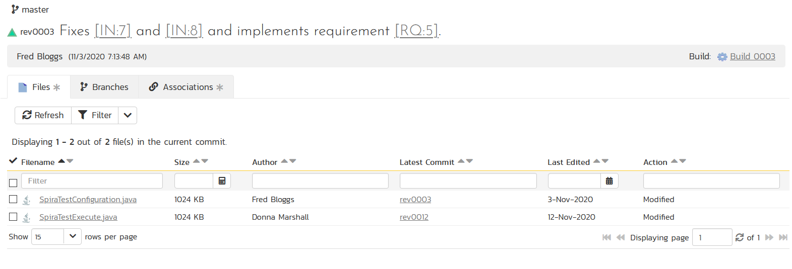
View File Changes in Commits
View the individual code files changed in each atomic commit.

Slide 20
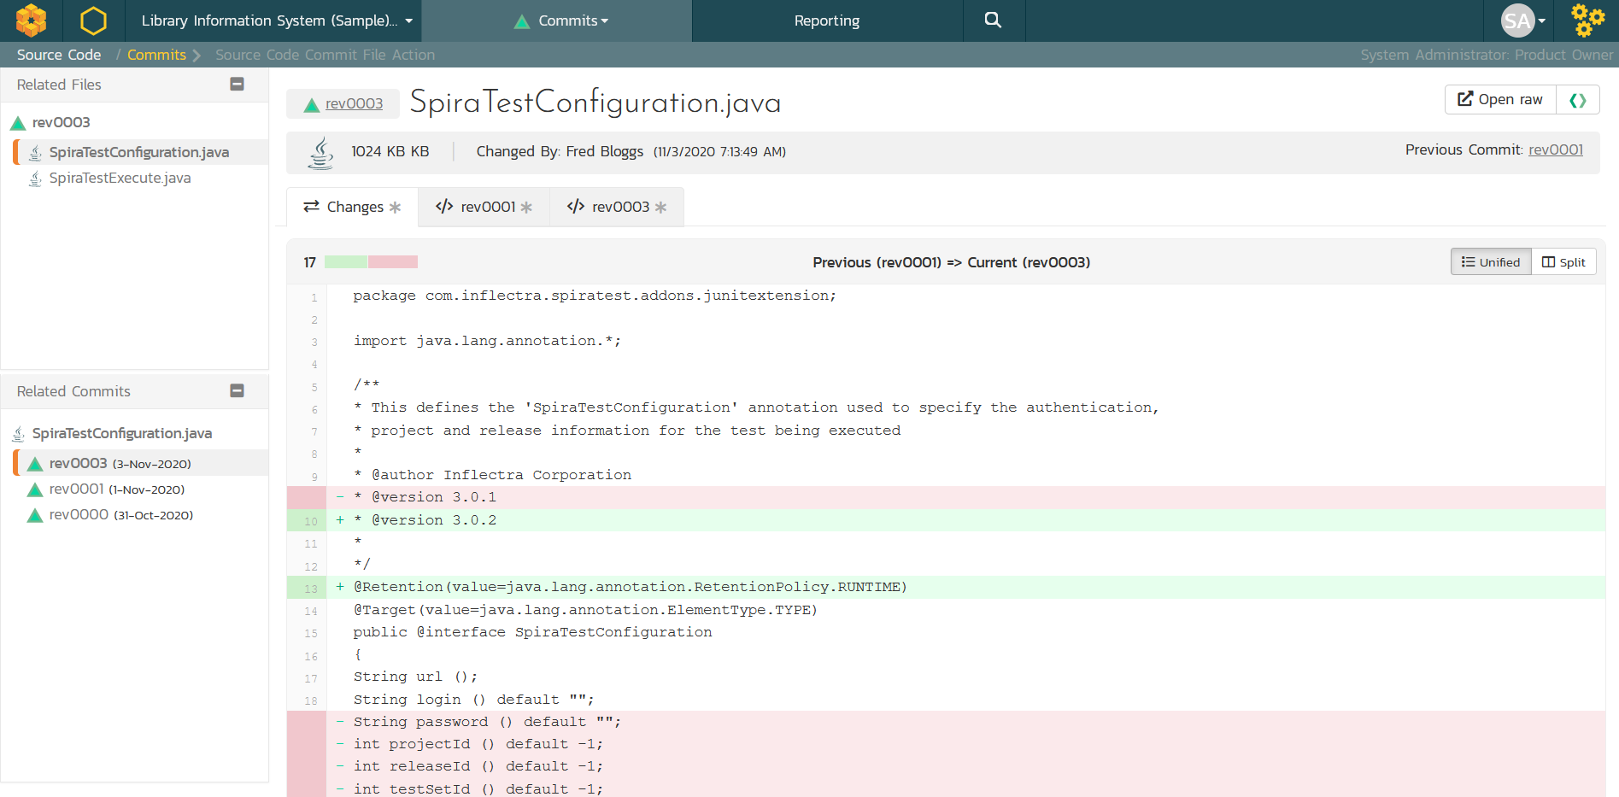
Show Code Changes in Difference Views
Drill-down to show the lines of code changed. TaraVault has unified and side-by-side views available of code changes.

Slide 21
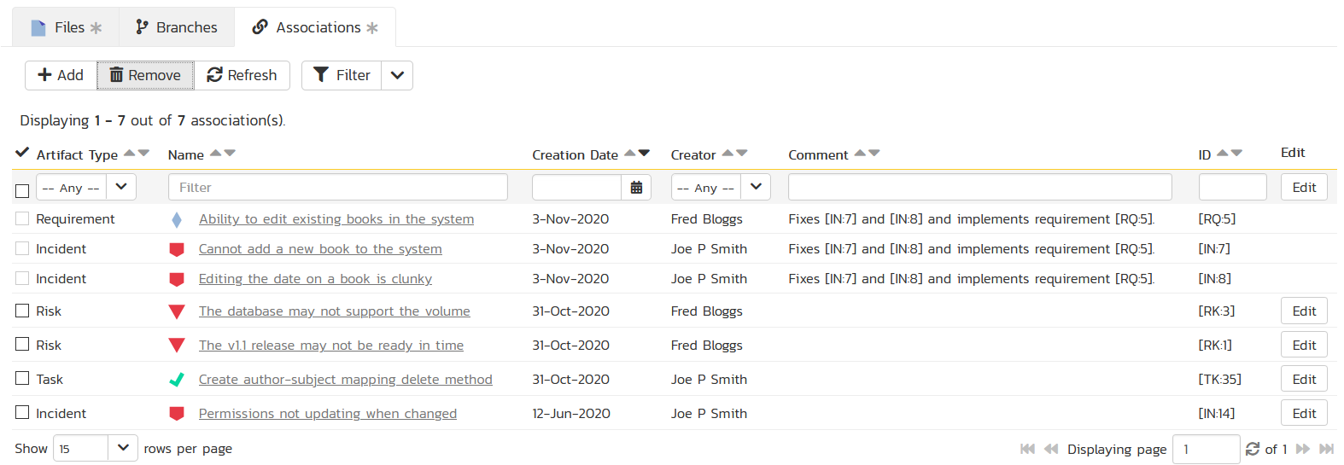
Artifact Associations & Traceability
View the artifacts affected by code changes. Can be linked inside Git using artifact tokens or afterwards in Spira user interface.

Slide 22
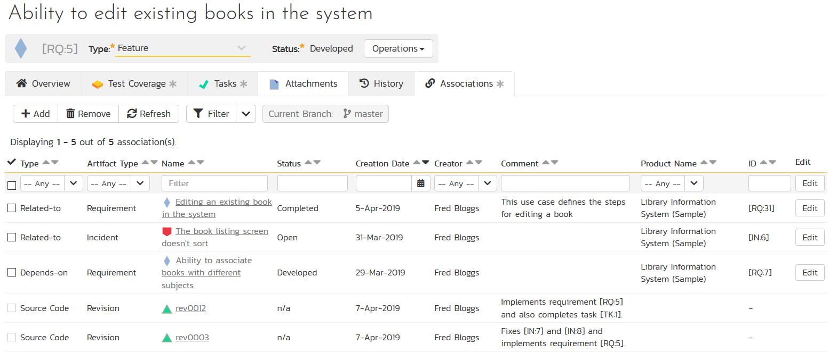
End to End Traceability

Slide 23
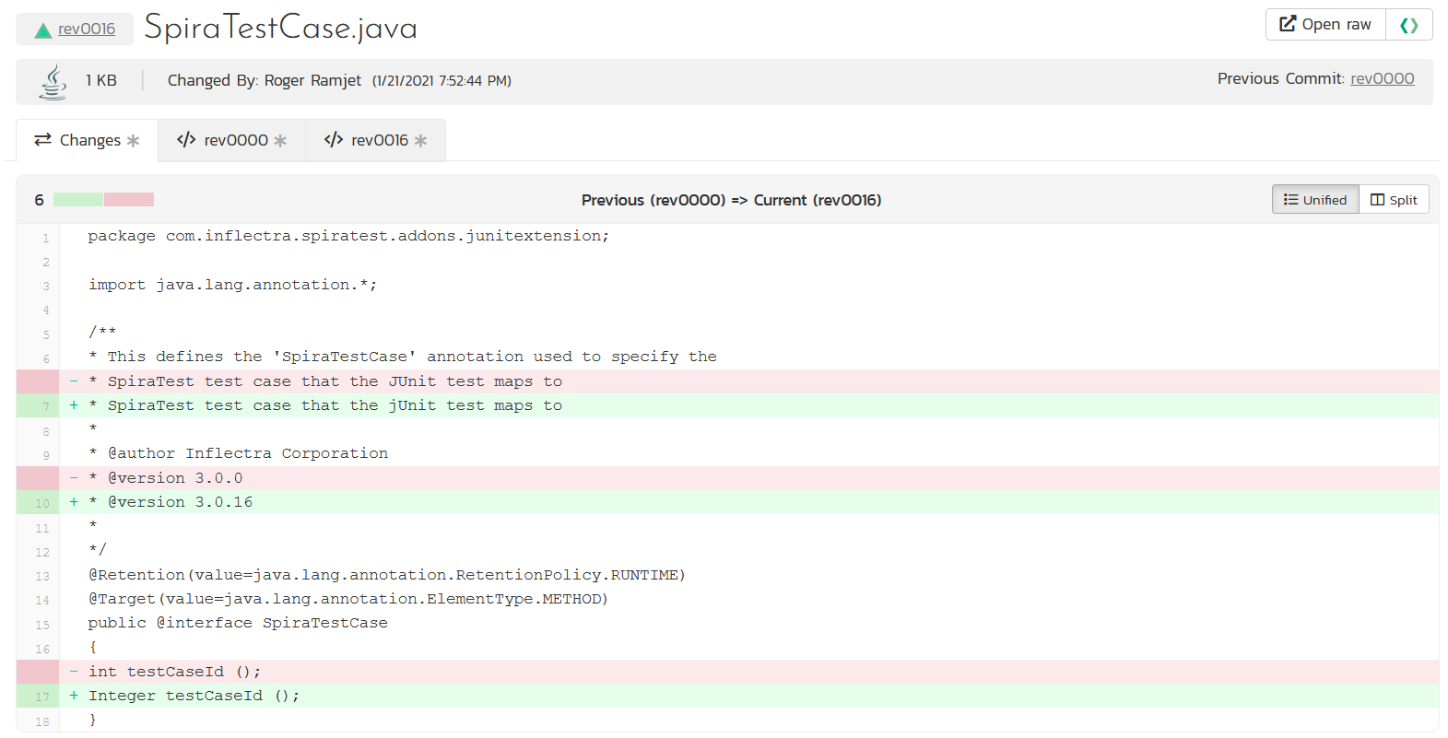
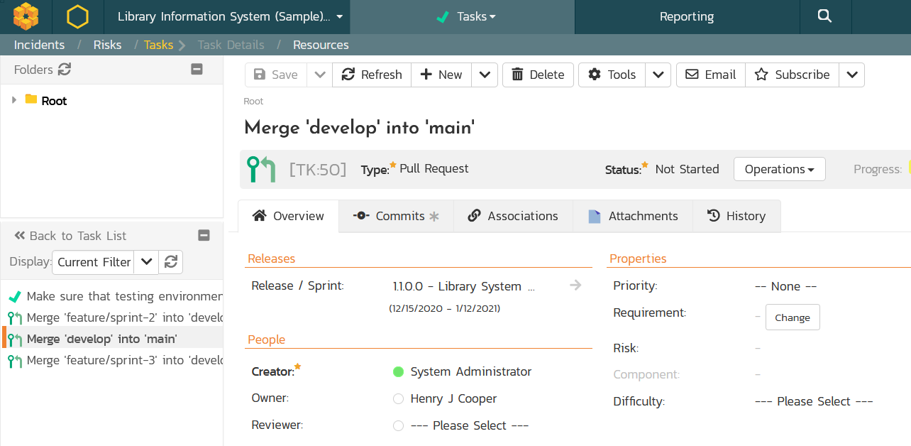
Code Reviews & Pull Requests
Manage your development workflows including merge/pull requests and code reviews with full traceability.

Slide 24
Source Code Workflows

Slide 25
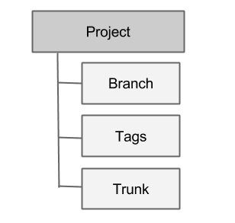
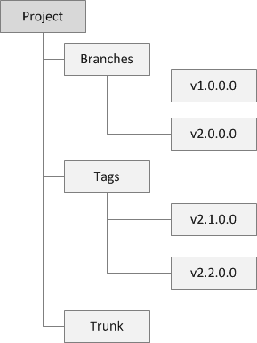
Subversion Workflow
Primary Development is done in Trunk
Commit into Trunk
Branches used for older versions being maintained
Commit into Branches
Tags used for milestones and mark releases
Cannot commit into tags

Slide 26
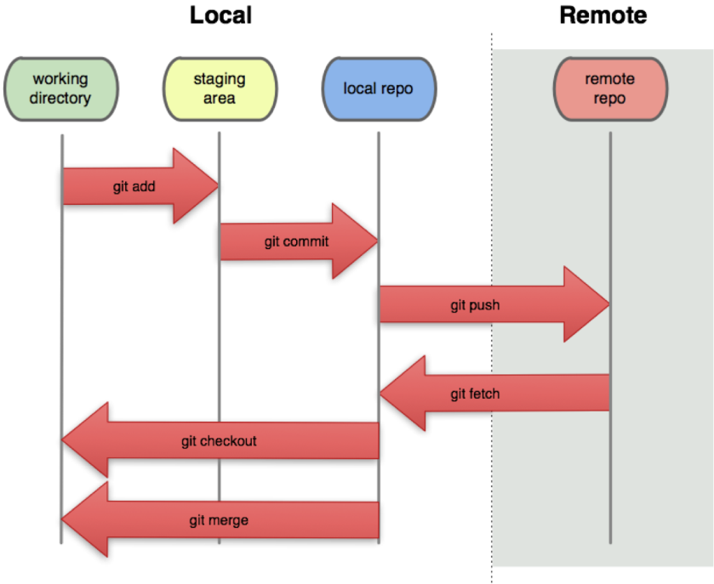
Git Architecture

Slide 27
Git Workflows
Several possible models:
Git Flow (recommended)
GitHub Flow
GitLab Flow
One Flow
Trunk-based development (like SVN)

Slide 28
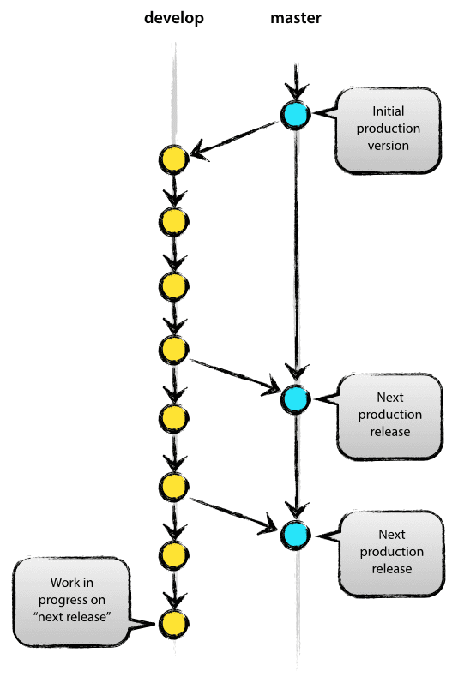
Git Flow Workflow
master — this branch contains production code. All development code is merged into master in sometime.
develop — this branch contains pre-production code. When the features are finished then they are merged into develop.
feature/* — feature branches are used to develop new features for the upcoming releases. May branch off from develop and must merge into develop.
hotfix/* — hotfix branches are necessary to act immediately upon an undesired status of master. May branch off from master and must merge into master and develop.

Slide 29
Workflow using Spira and Git

Slide 30
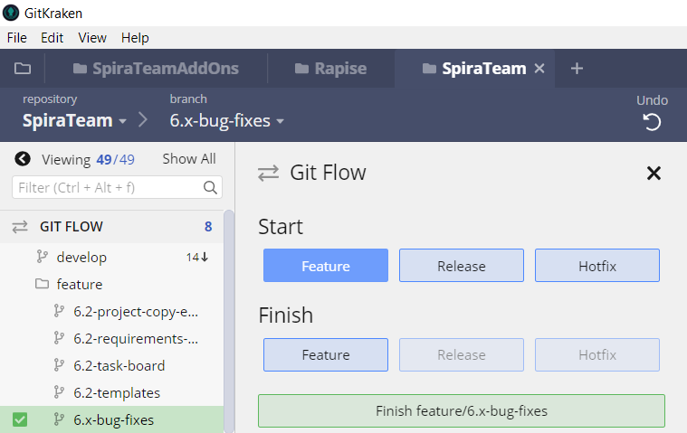
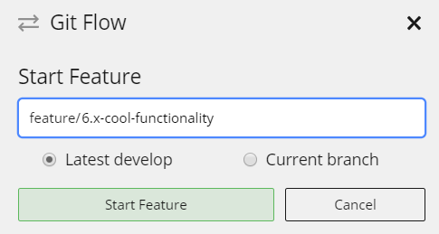
Create Feature Branch

Slide 31
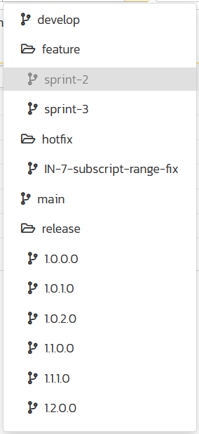
Create Feature Branch

Slide 32
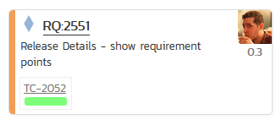
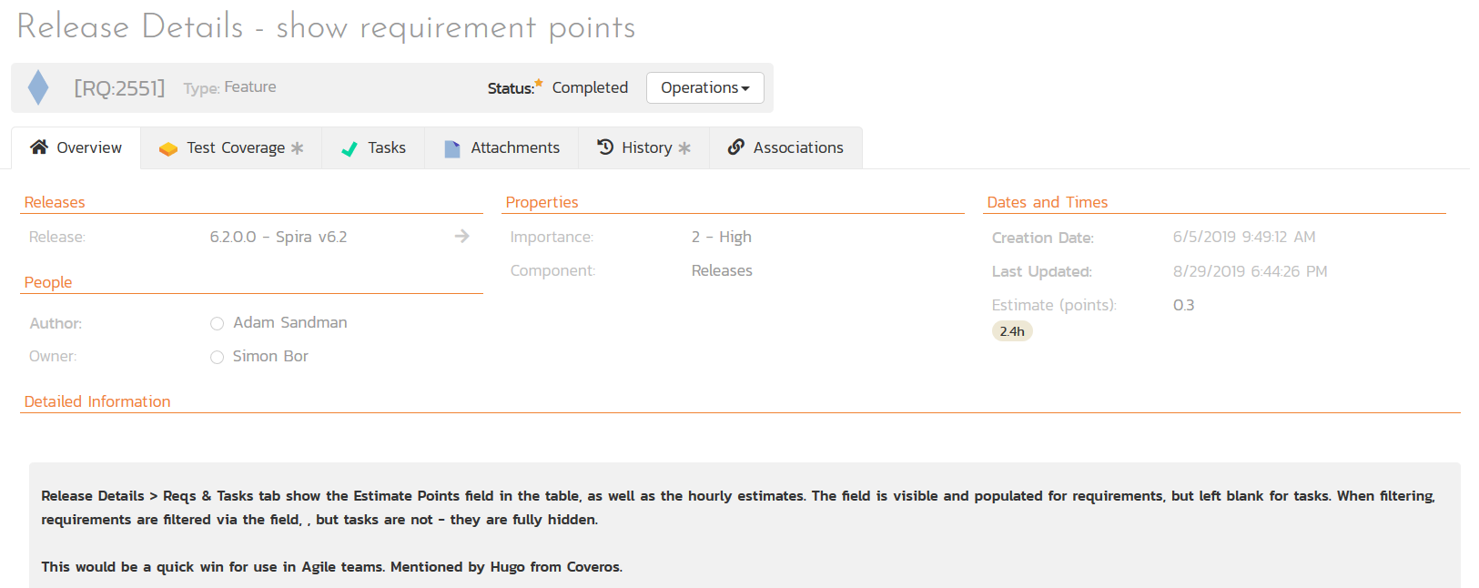
Write User Stories

Slide 33
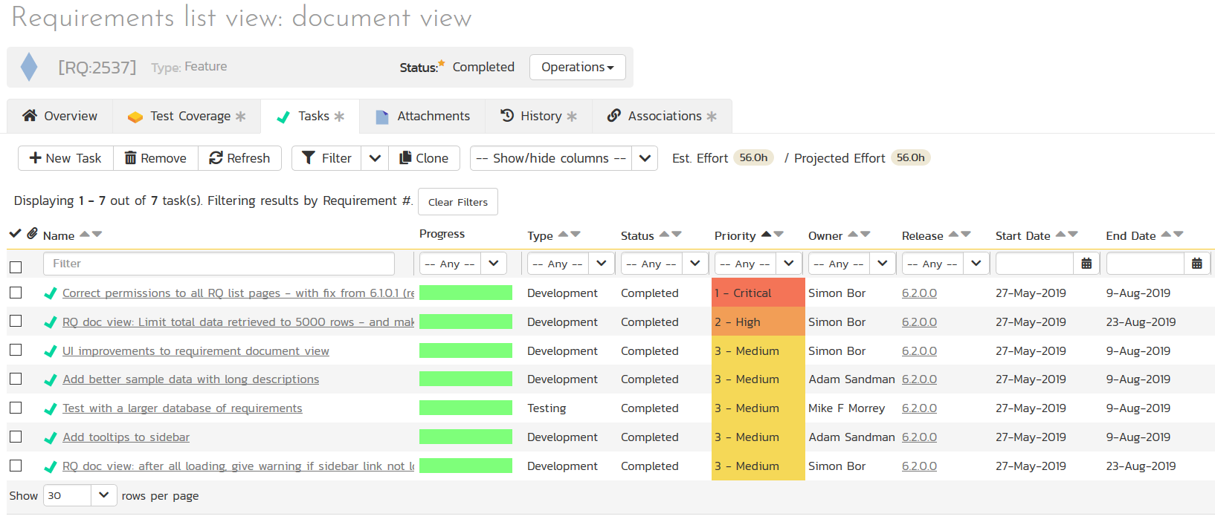
Create Tasks (if necessary)

Slide 34
Create Test Cases (always)

Slide 35
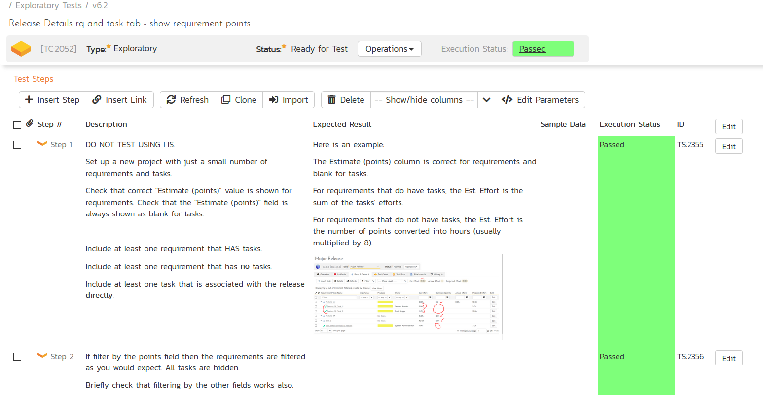
Create Test Cases (always)

Slide 36
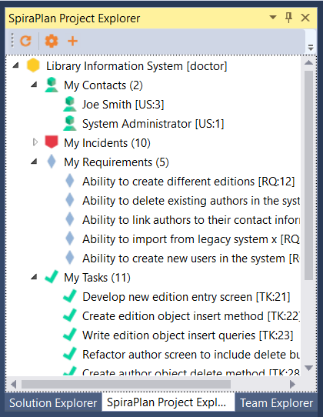
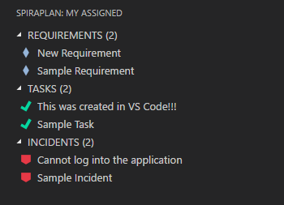
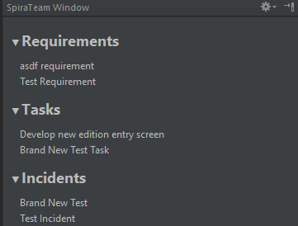
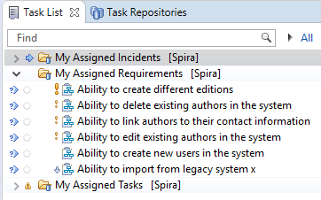
Write Code in IDE

Slide 37
Commit and Push

Slide 38
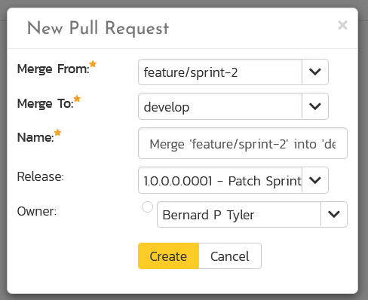
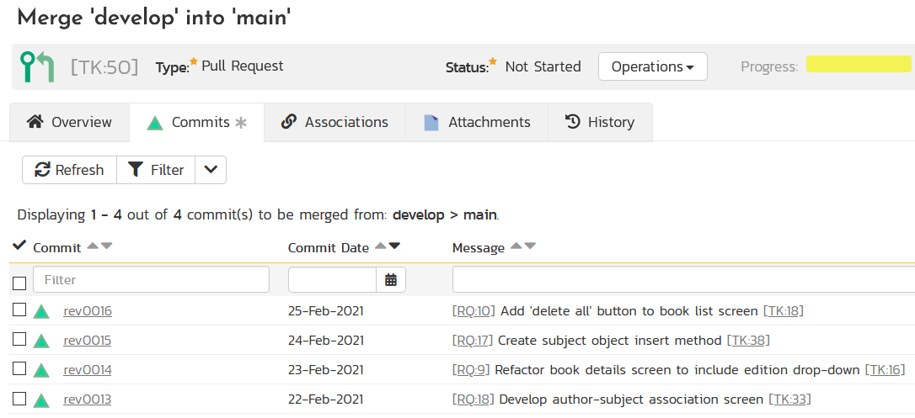
Create Merge / Pull Request

Slide 39
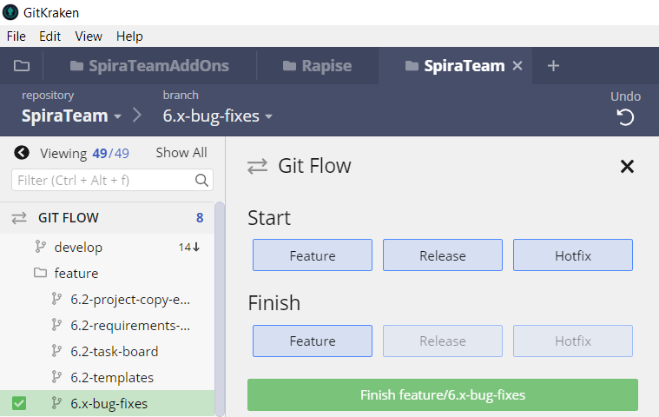
Complete Merge / Pull Request

Slide 40
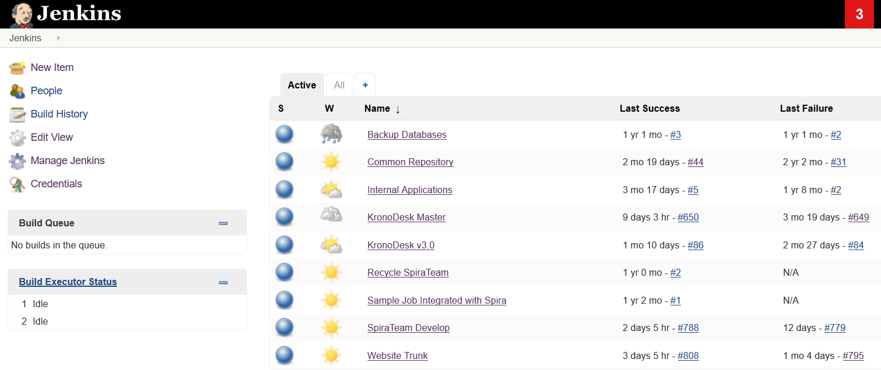
CI Builds ‘develop’ Branch

Slide 41
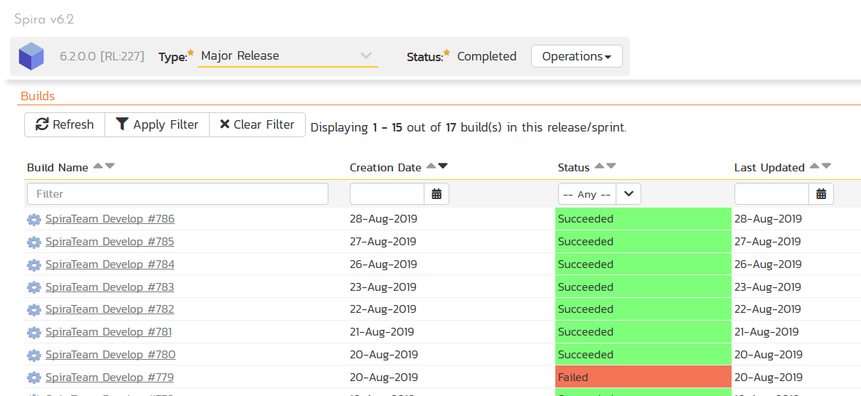
CI Builds ‘develop’ Branch

Slide 42
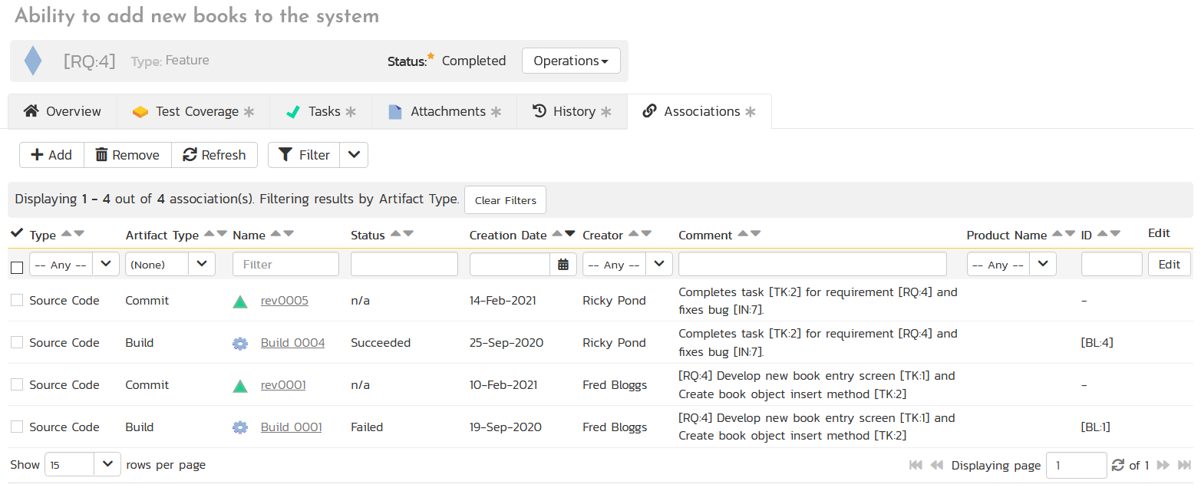
Requirements Show Associated CI Builds

Slide 43
Questions?

