Slide 1
WEBINAR: Robotic Process Automation (RPA) of Dynamics NAV with Rapise
October 4th, 2018 – Denis Markovtsev, @dmarkovtsev
Introduced by Adam Sandman, @adammarksandman

Slide 2
Agenda
Overview of Rapise capabilities
RPA & Test scenarios you can do with Rapise
Demo scenario
Necessary skills
Our offering
Q&A

Slide 3
Rapise Capabilities

Slide 4
Rapise Capabilities
Automation for Desktop, Mobile and Web applications
Independent of screen resolution and coordinates
REST and SOAP calls to third-party systems
Database connection
Email processing
File & Command Line operations
Text manipulation
Full support for Excel spreadsheets
Flexible reporting

Slide 5
Supports Multiple Platforms & Technologies
Web Applications
Mobile Applications
Cross-Platform Technologies
Windows Applications
Desktop Applications
Web Applications
Unit Test Frameworks
Integrations

Slide 6
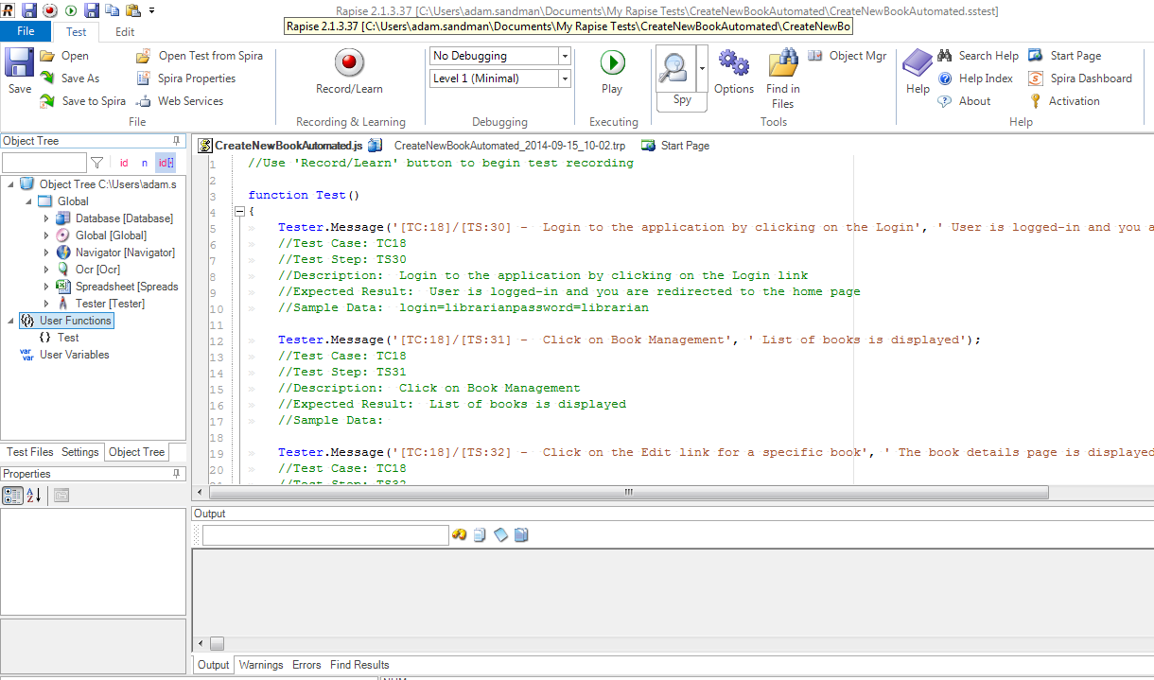
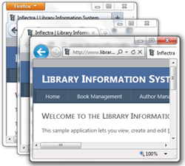
Web Applications
Rapise supports multiple versions of IE, Edge, Firefox Chrome, Safari and Opera.

Slide 7
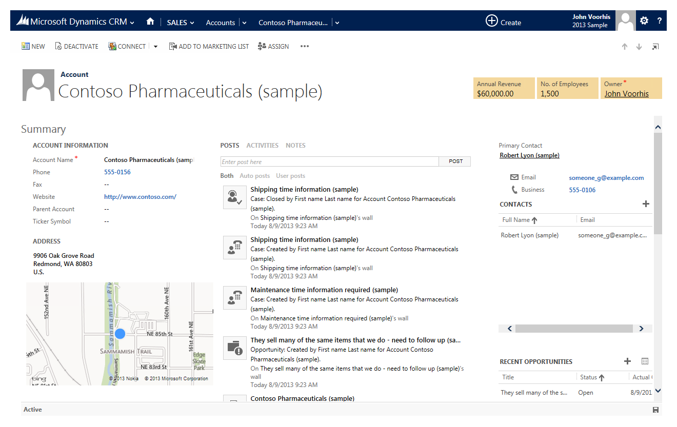
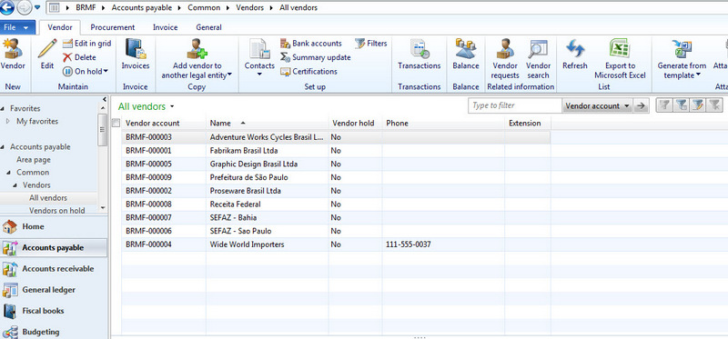
Desktop Applications
Rapise can automate most desktop applications

Slide 8
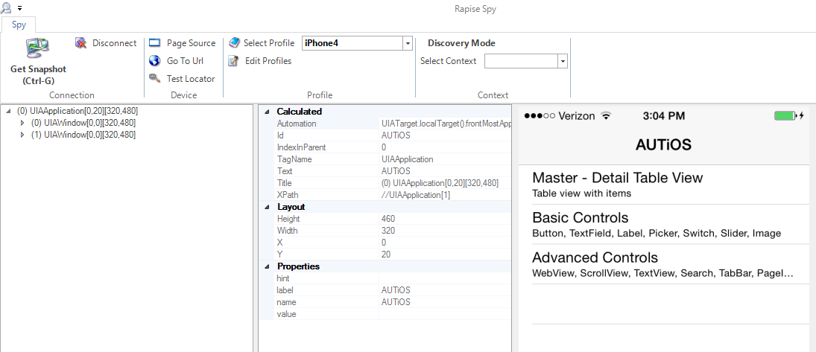
Mobile Apps
Automate Mobile Apps (native, web, iOS, Android)

Slide 9
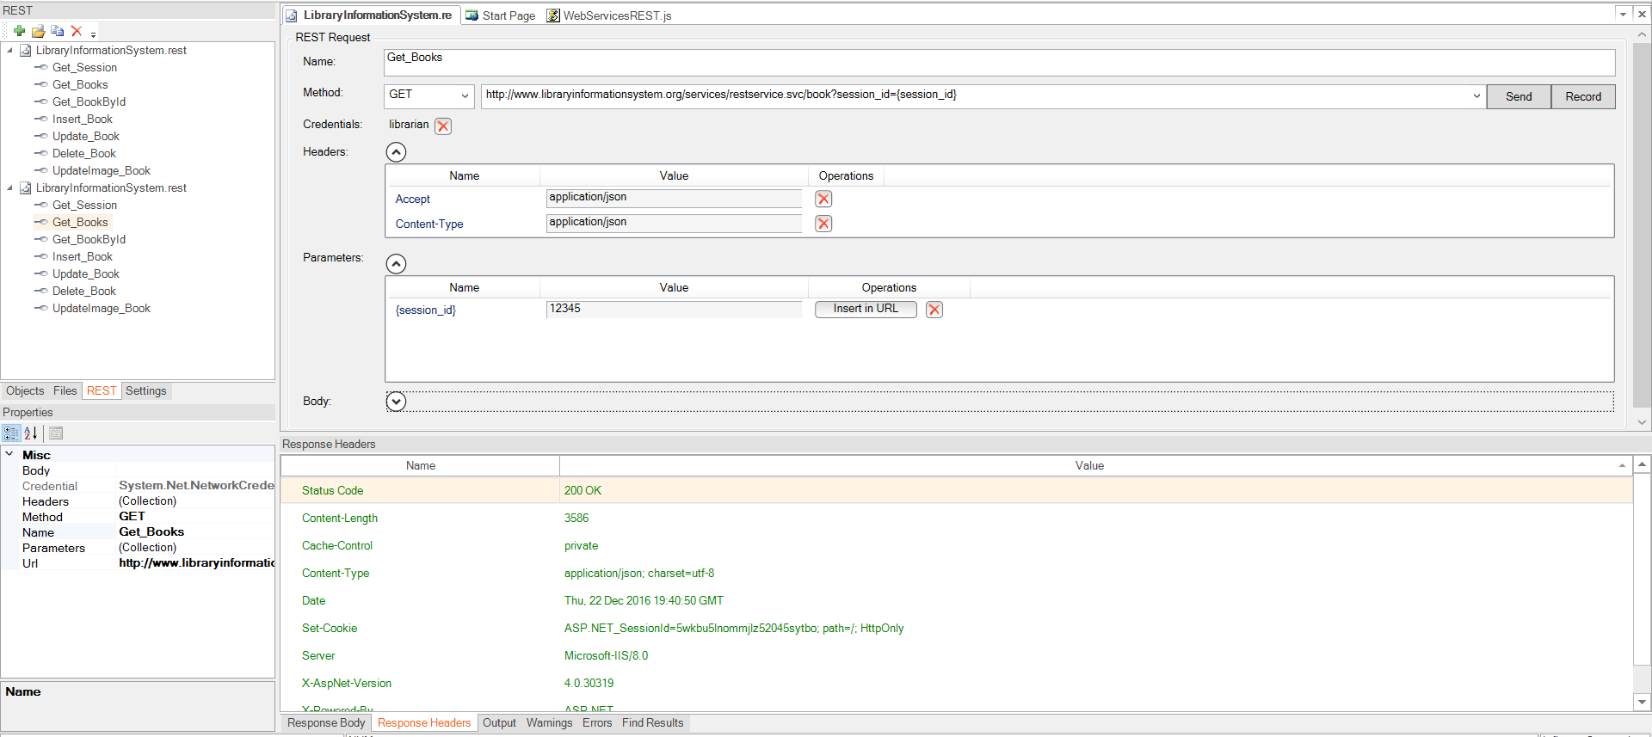
Web Services & APIs
Automate REST and SOAP APIs

Slide 10
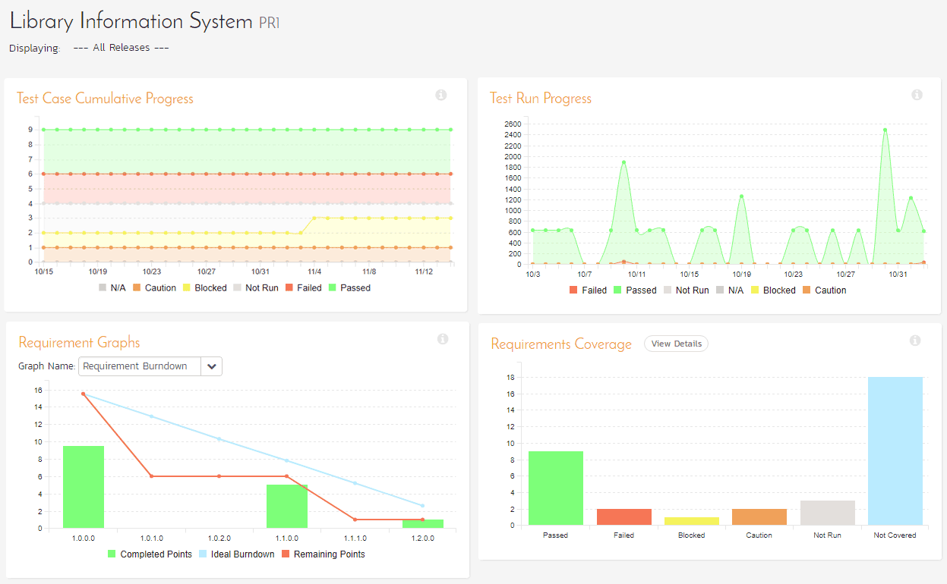
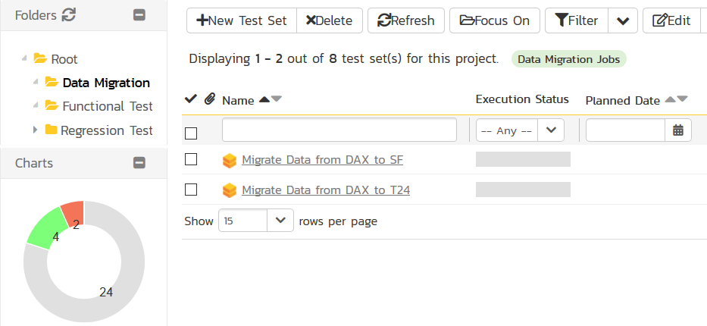
Process Orchestration with SpiraTeam

Slide 11
RPA Scenarios & Tasks
Fill a form based on data in external file
Create a record from incoming email
Import data from a spreadsheet or third-party system
Web scraping
Screen scraping
Terminal automation

Slide 12
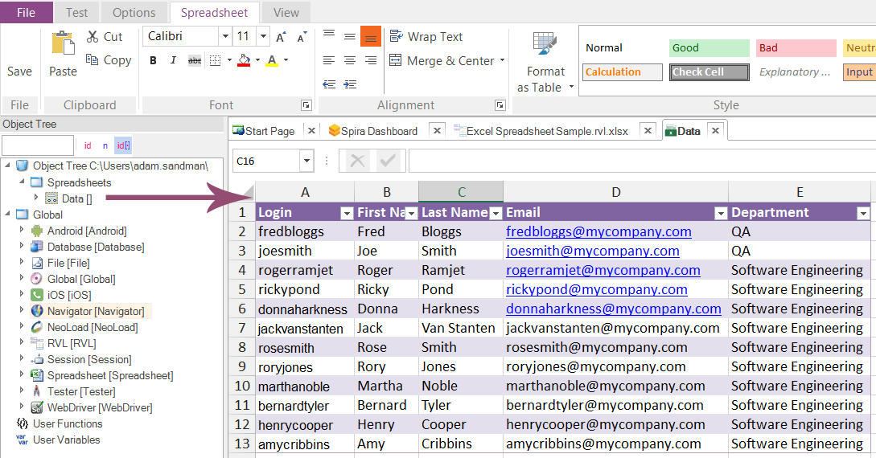
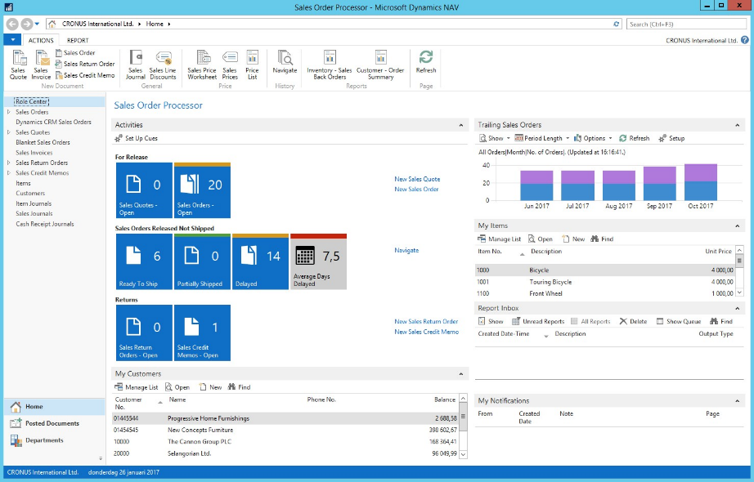
Demo
Importing categories, vendors and items from Excel spreadsheet
Do not create a new record if data already exists
Output important information into the same spreadsheet

Slide 13
Live Demo

Slide 14
Necessary Skills
Knowledge of a programming language is not required for most scenarios
Rapise Visual Language
For advanced scenarios
basic knowledge of JavaScript

Slide 15
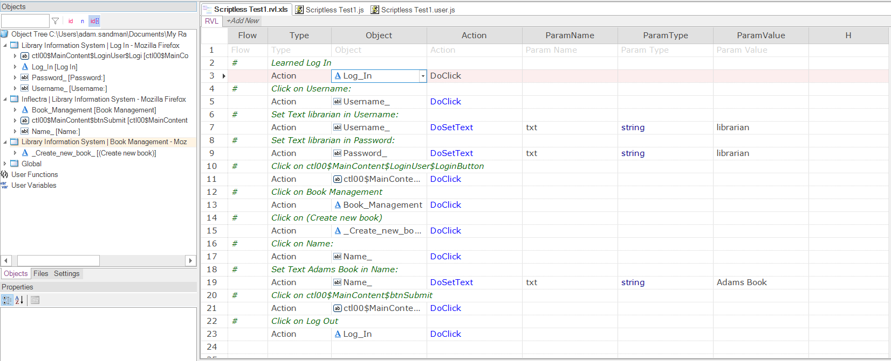
Rapise Visual Language (RVL)
Easier to use, Easier to maintain.

Slide 16
Our Offering
Rapise RPA tool
Training services
Implementation services

Slide 17
Recap – Rapise Capabilities
Automation for Desktop and Web applications
Independent of screen resolution and coordinates
REST and SOAP calls to third-party systems
Database connection
Email processing
File & Command Line operations
Text manipulation
Full support for Excel spreadsheets
Flexible reporting

Slide 18
Next Steps
If you like what you saw today:
Sign Up to Our Partner Program
Reseller and/or
Affiliate
Purchase a heavily discounted partner license
Discounts of 75% if you sign up to be a partner
We are offering free training for a limited time
If you become a partner and purchase partner license,
Certified Partner Program

Slide 19
Questions?
Please Use the Chat Window or Unmute Your Line

